Slide 1
PROJECT EA DEEP LEARNING Sequence to sequence learning
Quang Anh Nguyen

Slide 2
sub-projects
Sketch Generation
Neural Machine Translation
Handwriting Synthesis

Slide 3
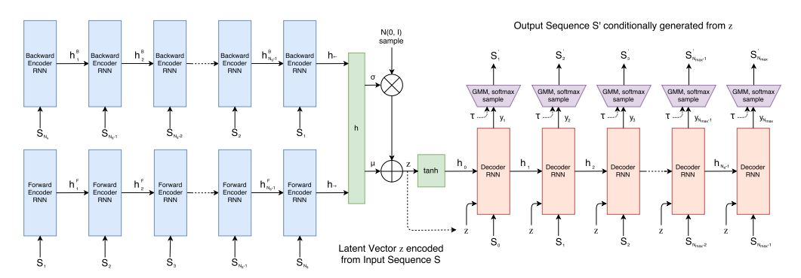



Sketch generation model
GMM
soft p
dx
dy
p1
p2
p3
$$Π$$
$$μ$$
$$σ$$
q1
q2
q3

Slide 4
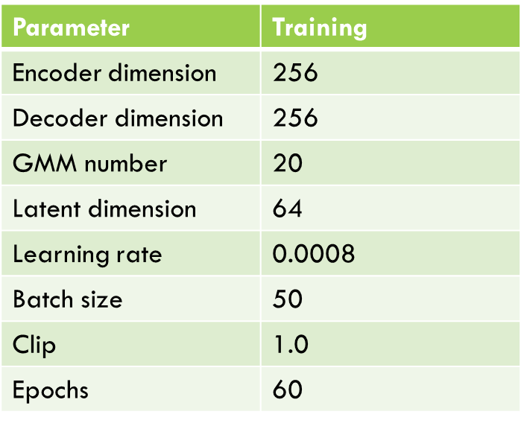
Sketch generation training
Parameter | Training
Encoder dimension | 256
Decoder dimension | 256
GMM number | 20
Latent dimension | 64
Learning rate | 0.0008
Batch size | 50
Clip | 1.0
Epochs | 60

Slide 5
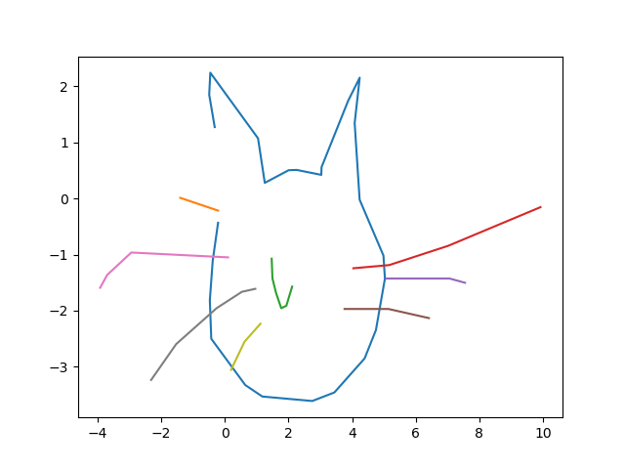
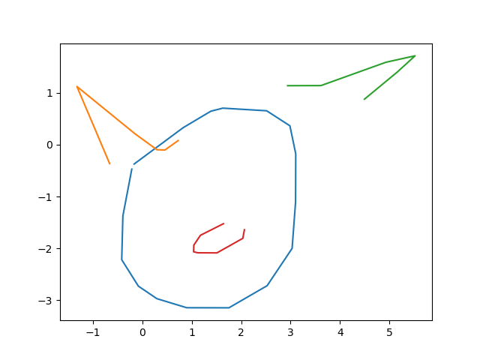
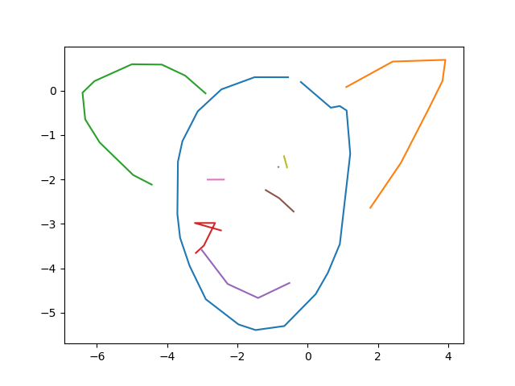
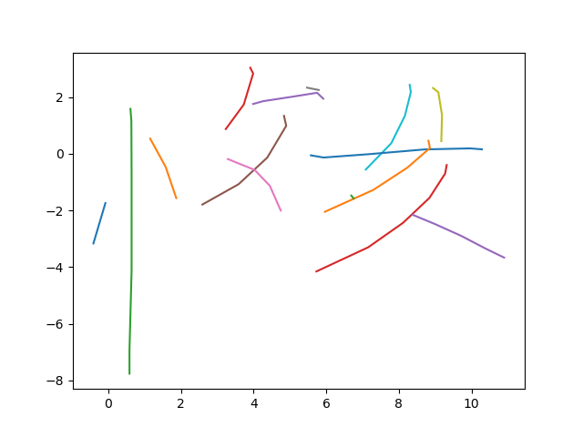
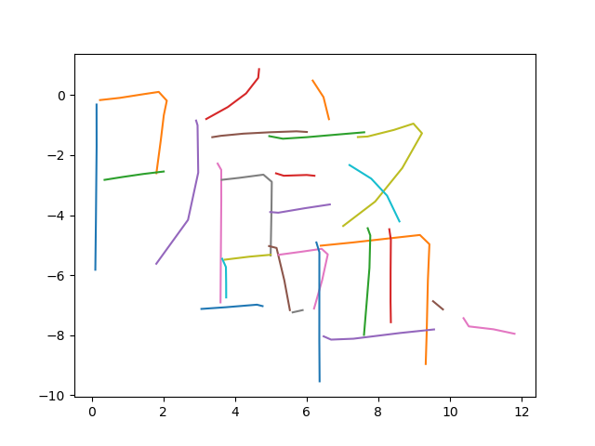
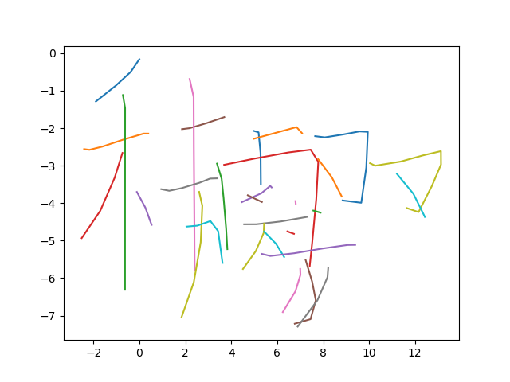
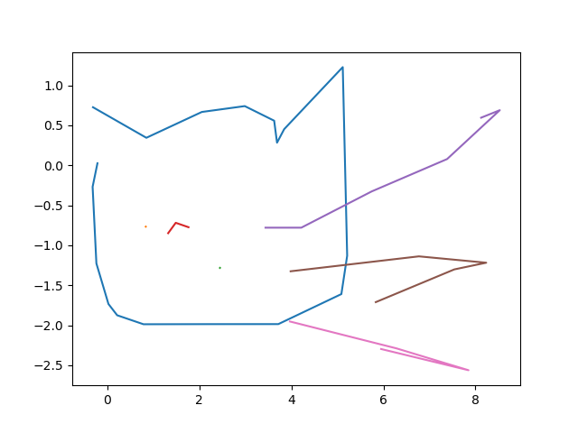
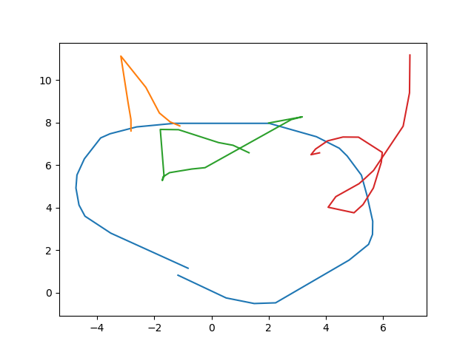
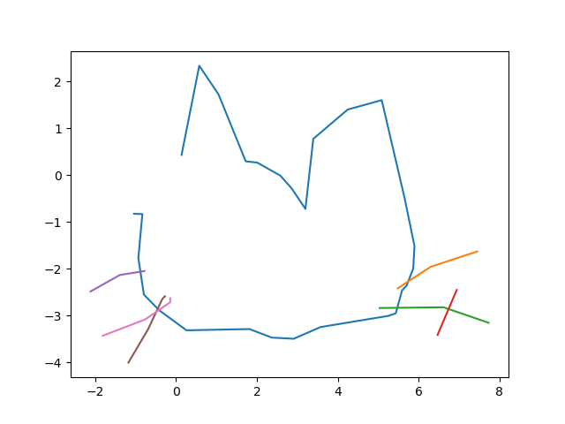
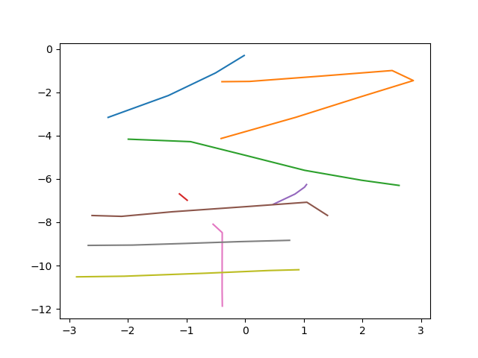
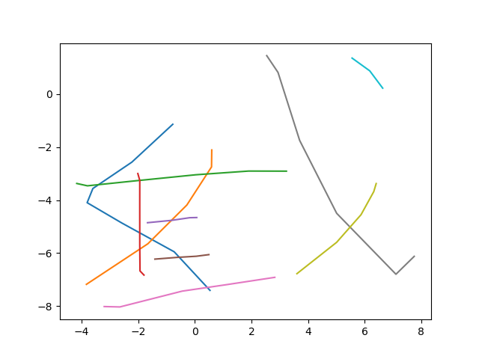
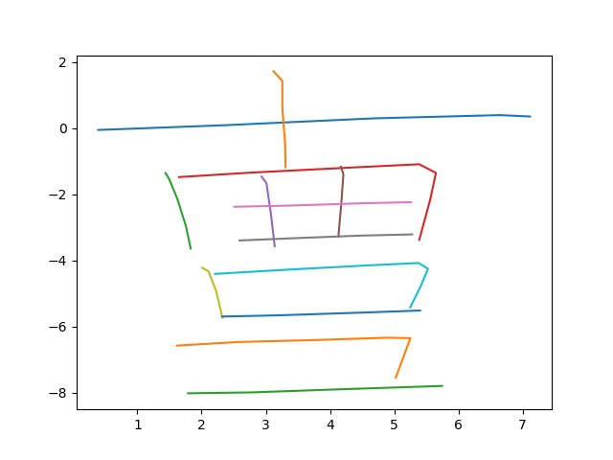
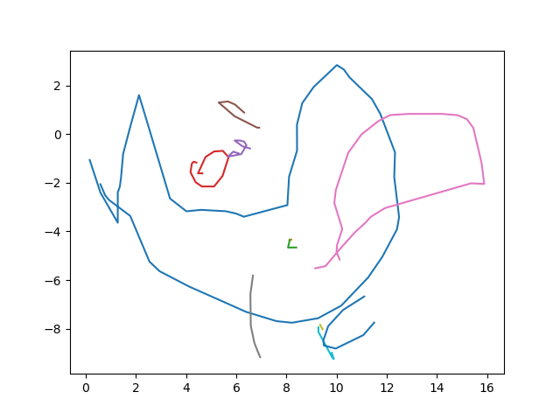
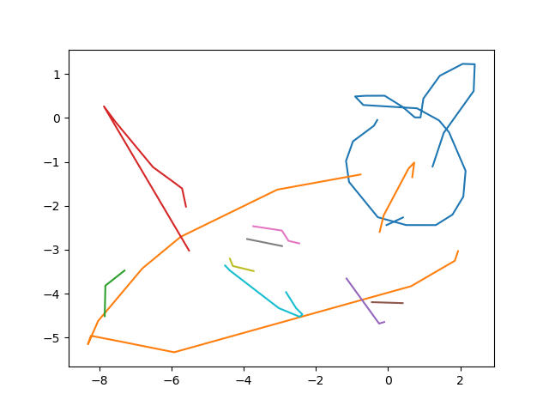
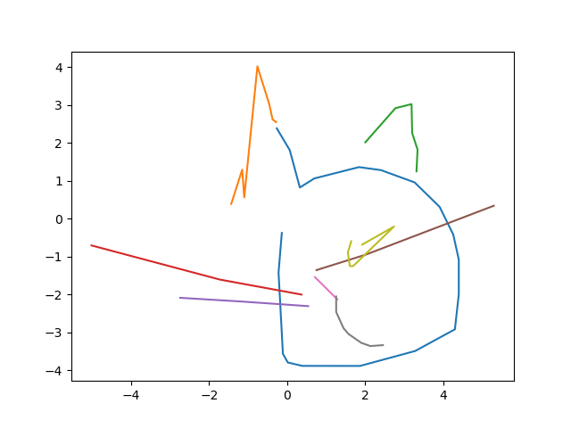
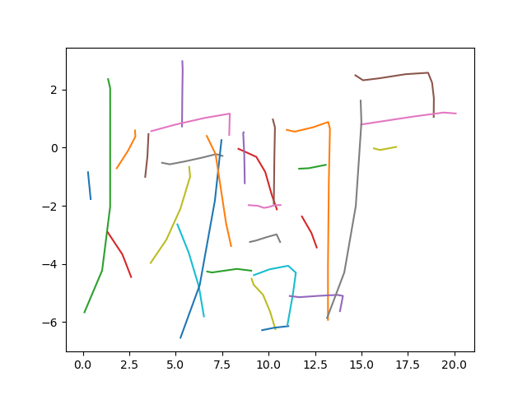
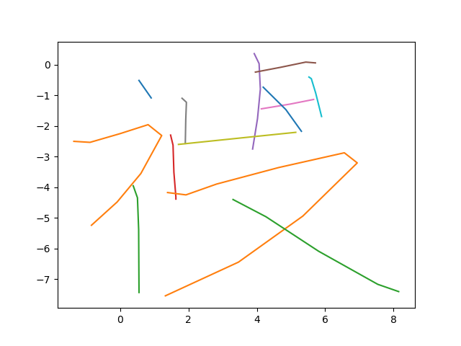
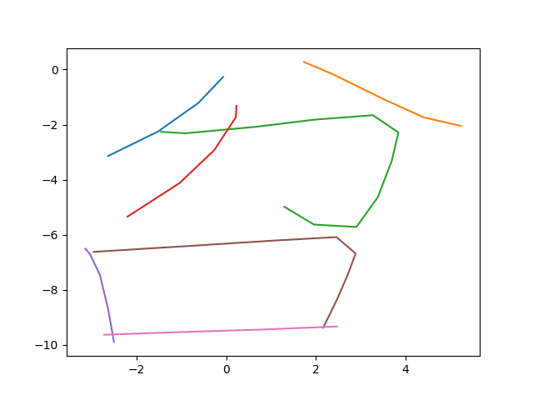
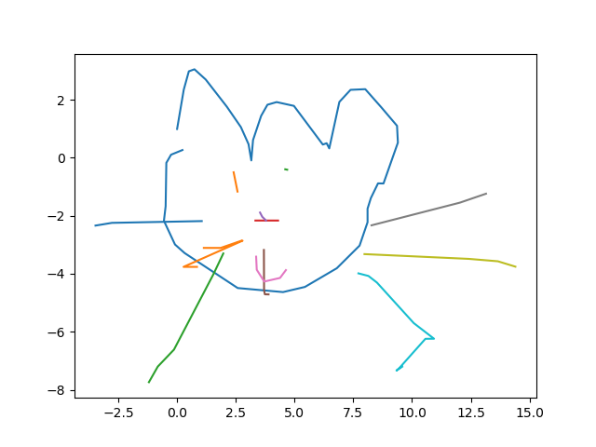
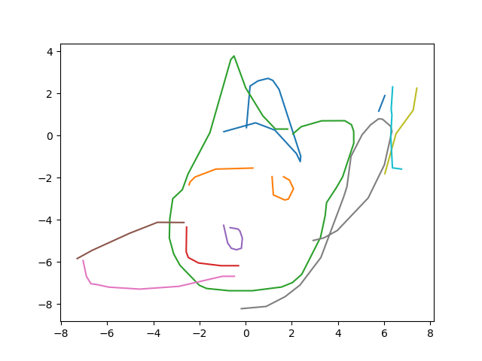
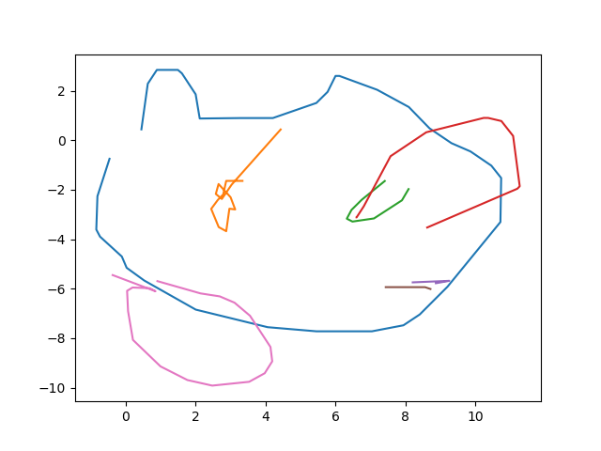
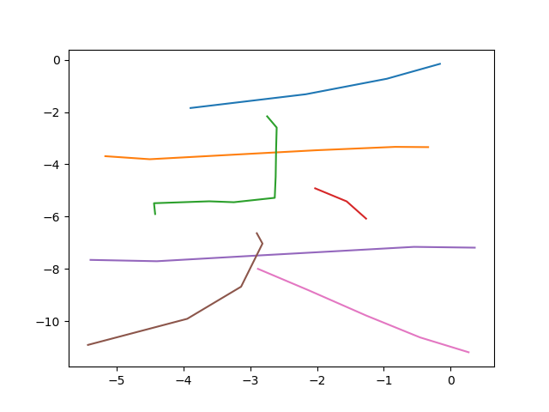
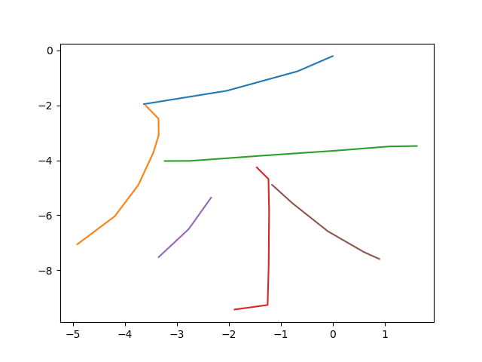
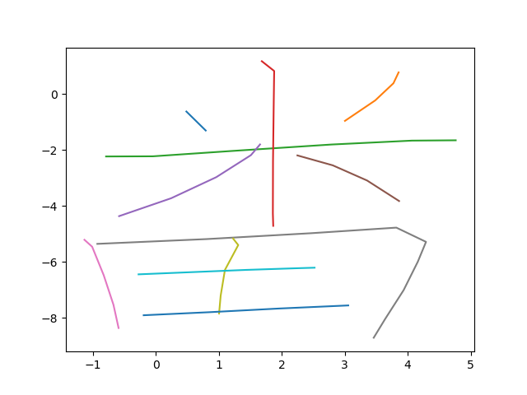
sketch generation results

Slide 6
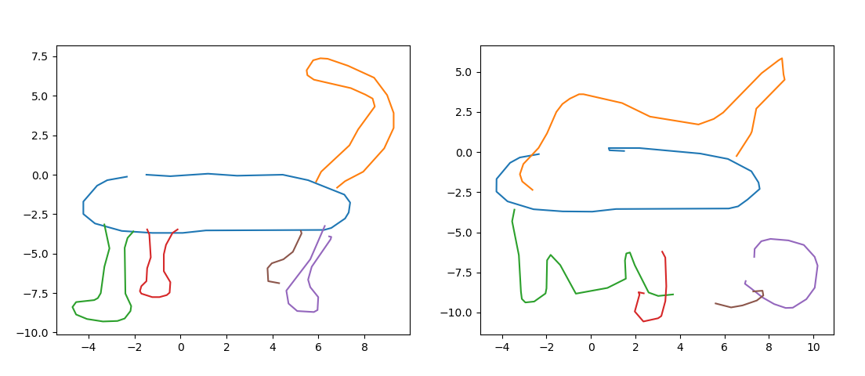
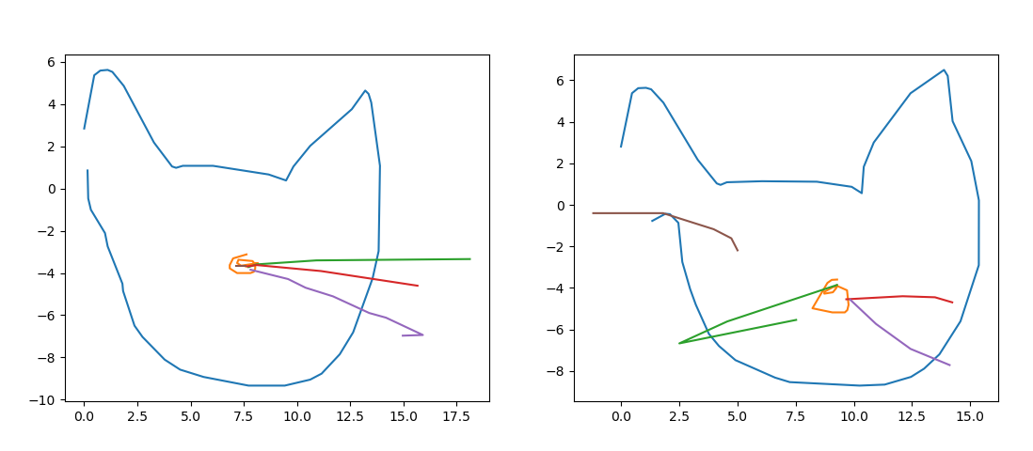
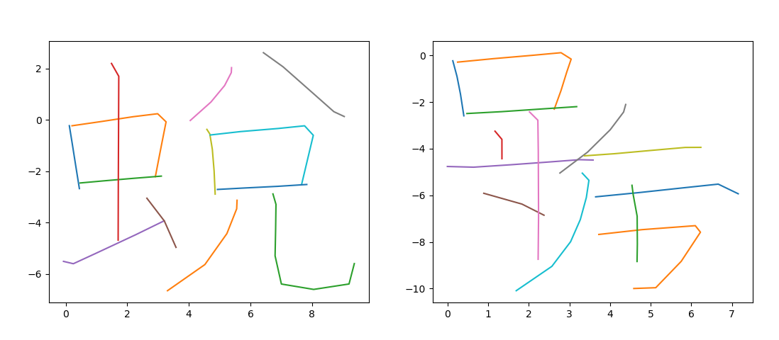
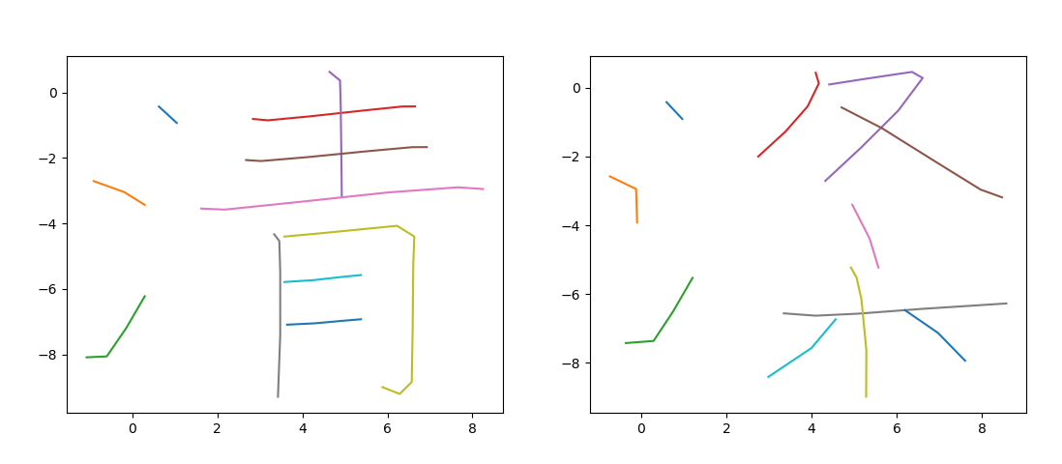
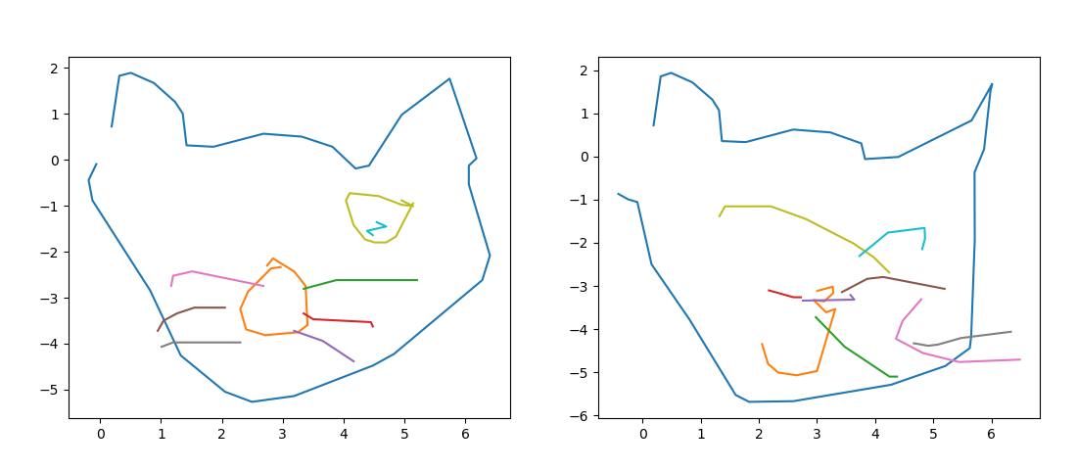
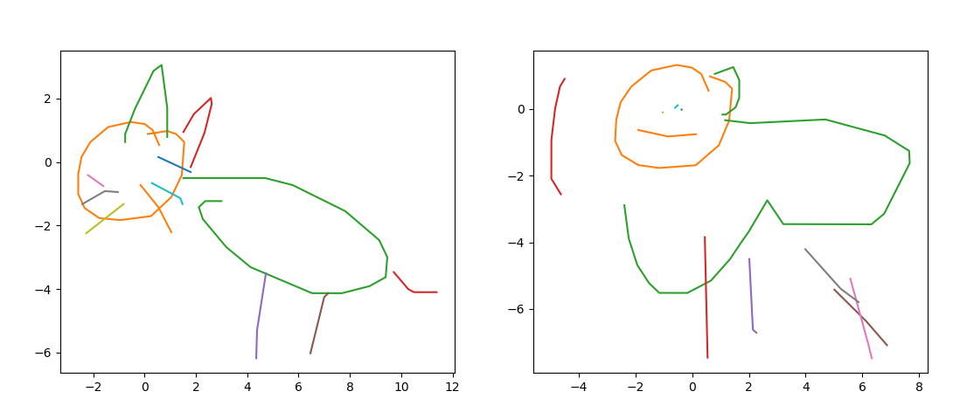
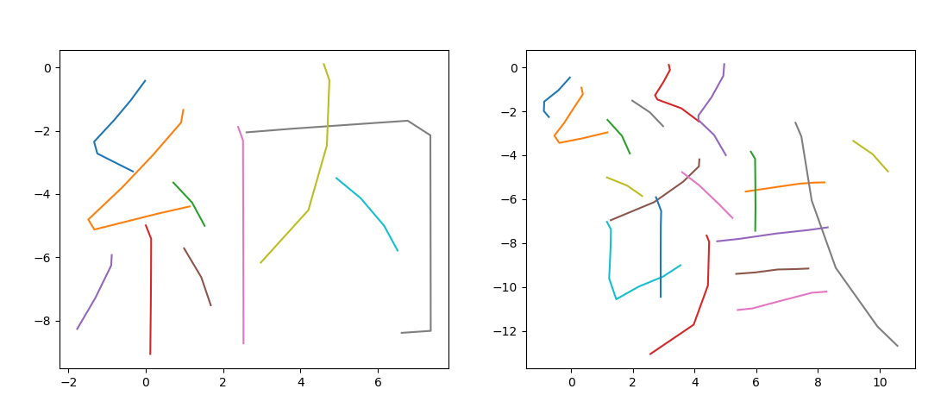
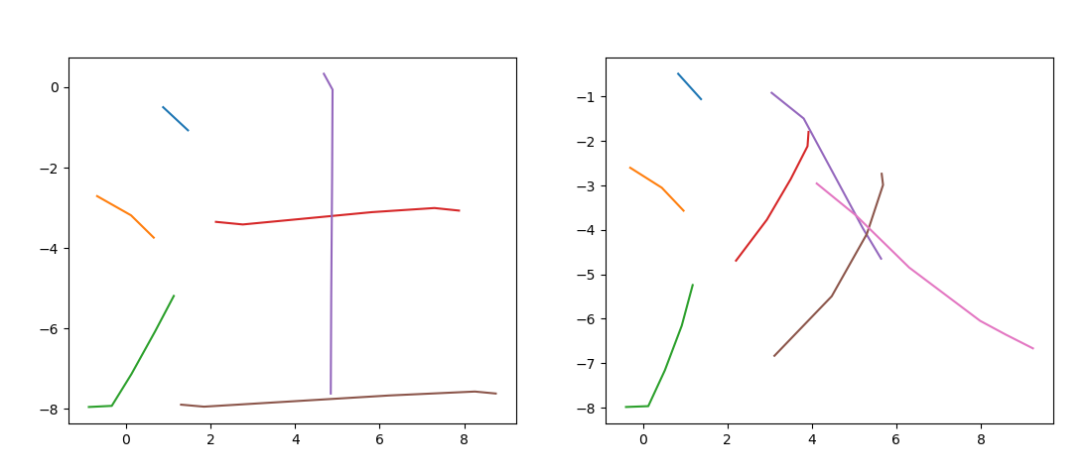
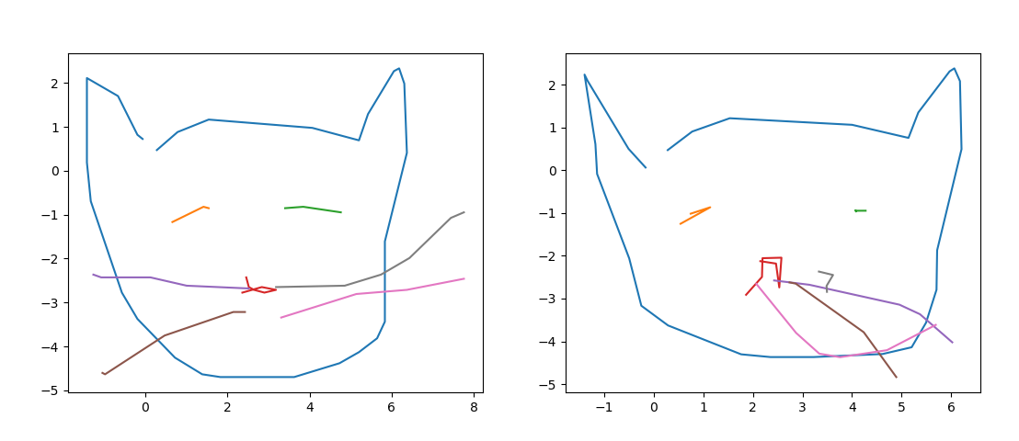
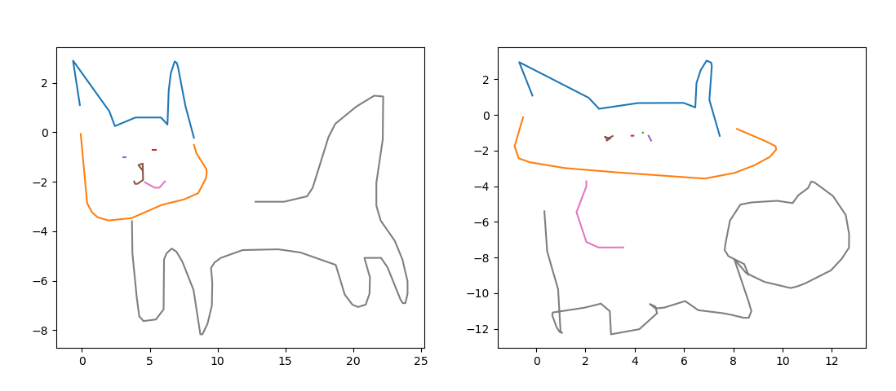
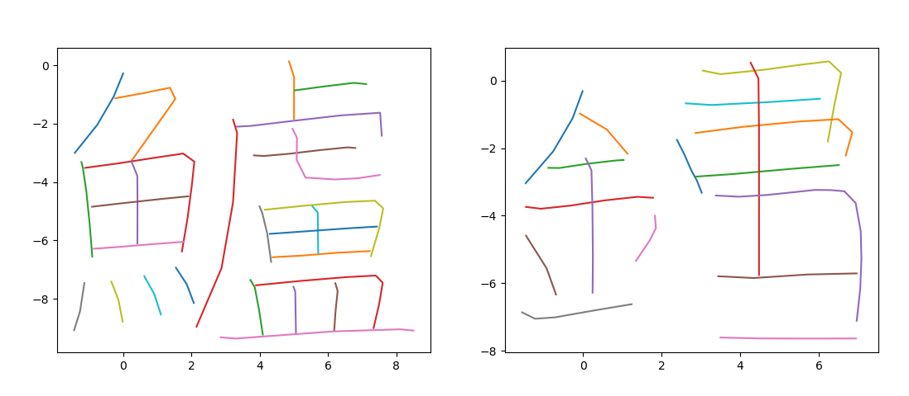
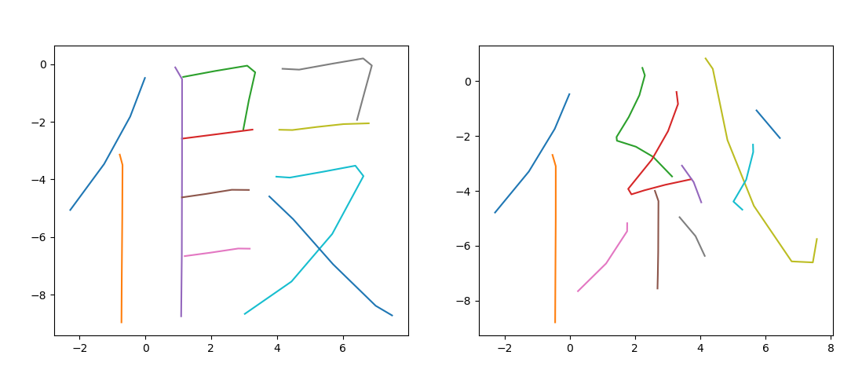
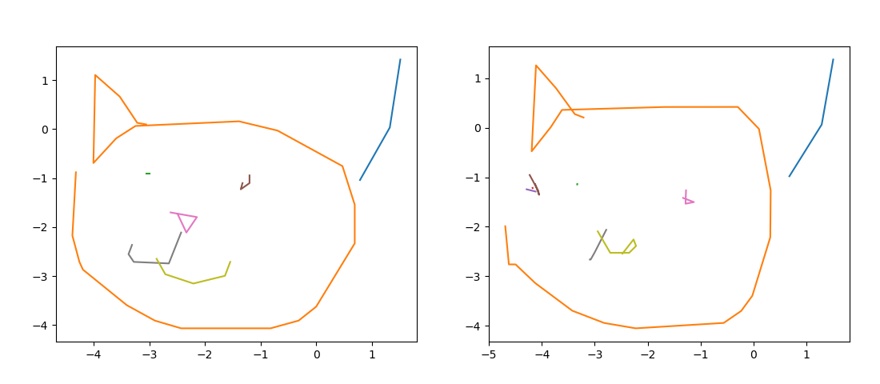
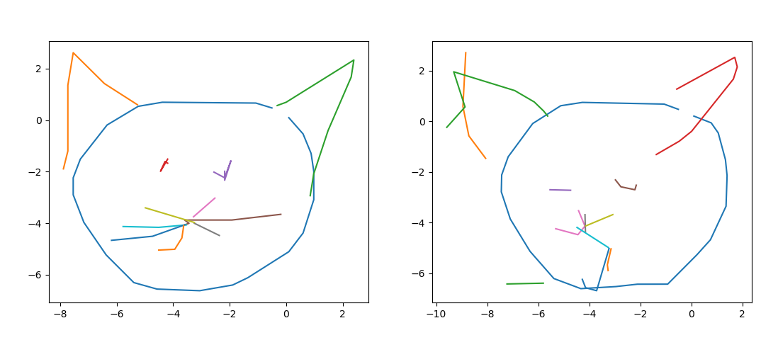
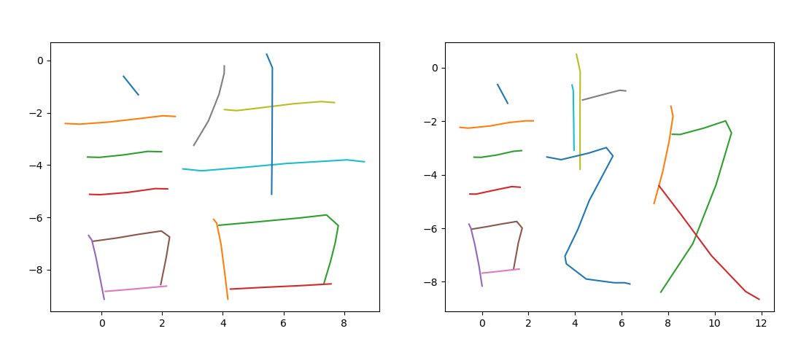
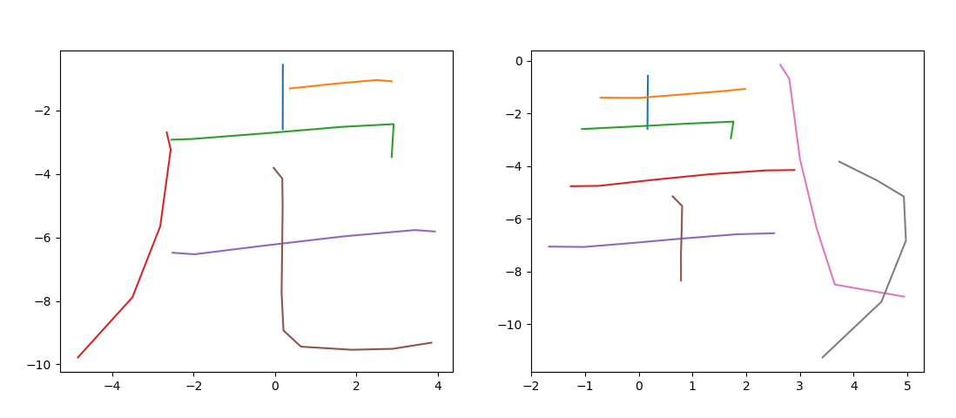
Sketch generation results

Slide 7
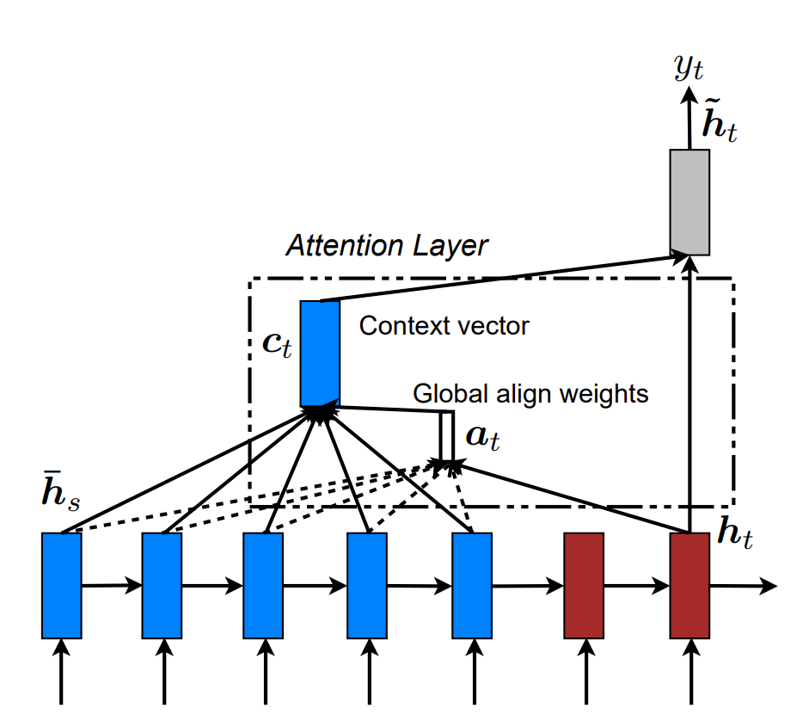
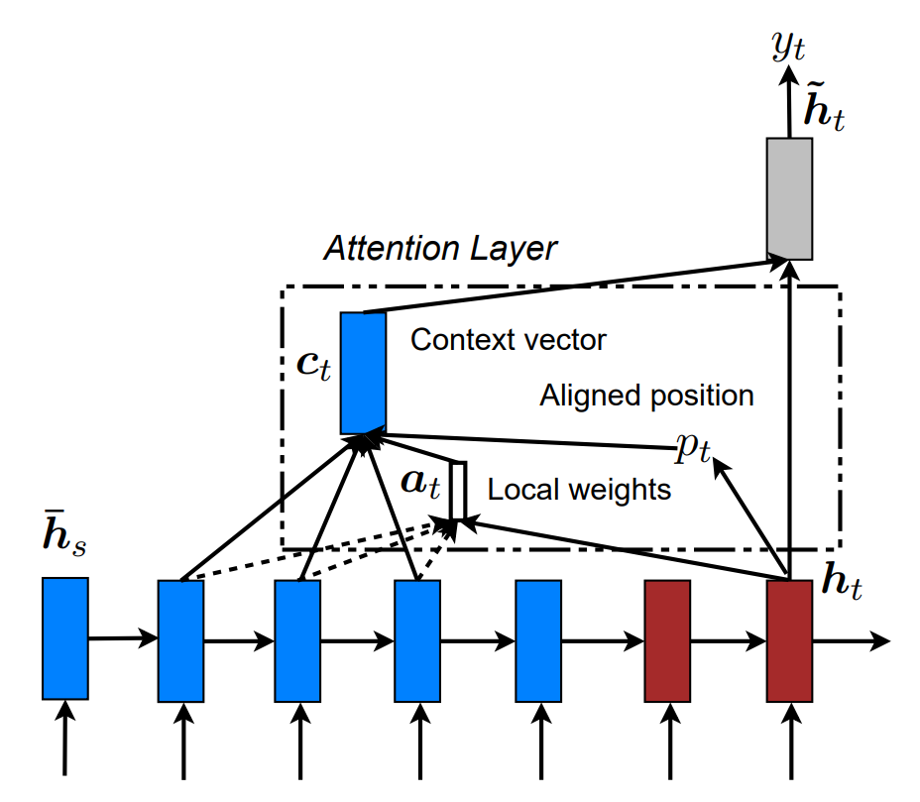
neural machine translation model
Attentional model + context vector
Global and local mechanisms

Slide 8
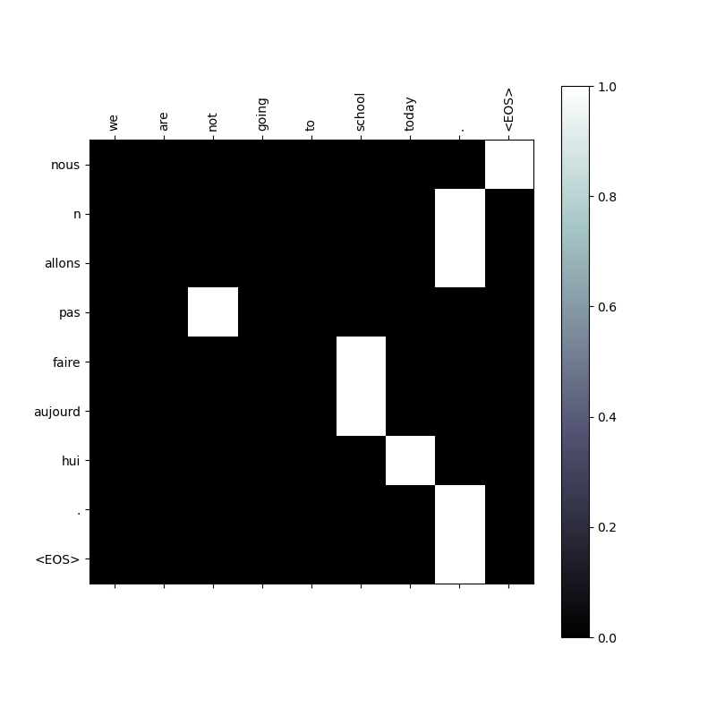
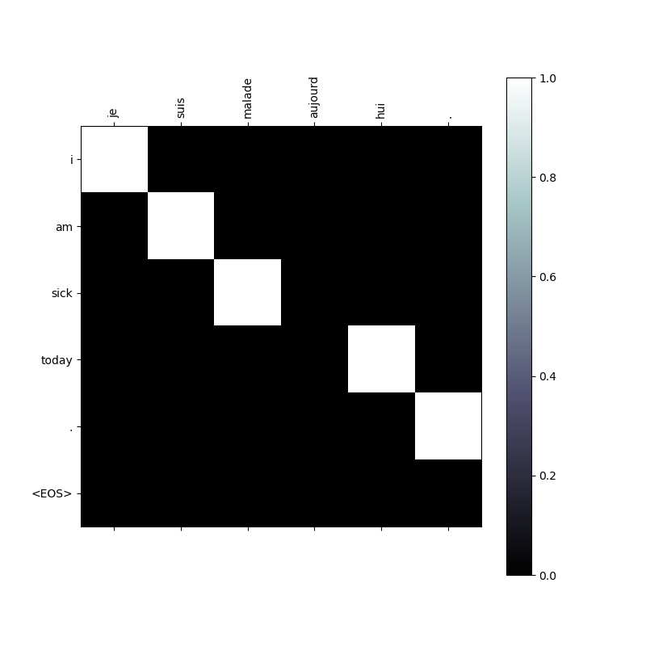
neural machine translation Results

Slide 9
NEURAL MACHINE TRANSLATION Results
English source | French translation
I m fine thank you | Je vais bien
She is very strong | Elle est tres forte
You are here already | Vous etes ici
I m hungry and thirsty | J ai faim et soif
I have something for you here | Je te fais pour toi
It is tall and big | Il est grand et grand
I forgot to tell you about it | Je suis impatient de vous voir ca
French source | English translation
Je suis en forme | I m fit
Il est malade aujourd hui | He is ill today
Tu ne peux pas perdre | You are not going to lose
Tu peux lui faire confiance | You re able to him
Nous avons besoin de toi | We re in of you
J arrive dans une heure | I m in a trouble
Les amis sont faits pour ca | They are friends with this

Slide 10
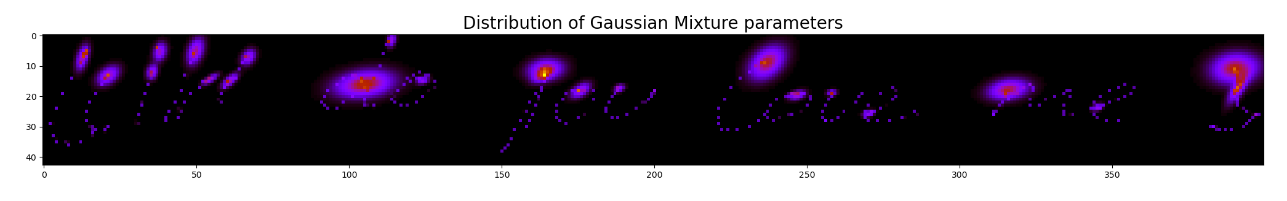
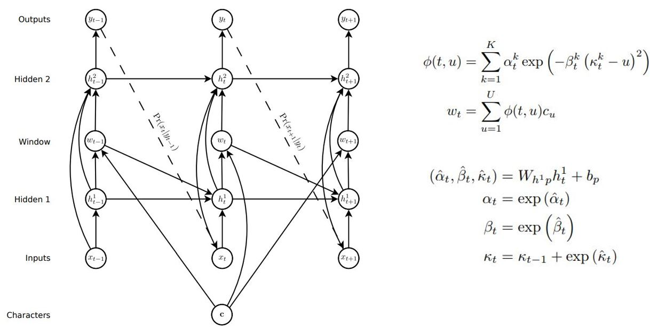
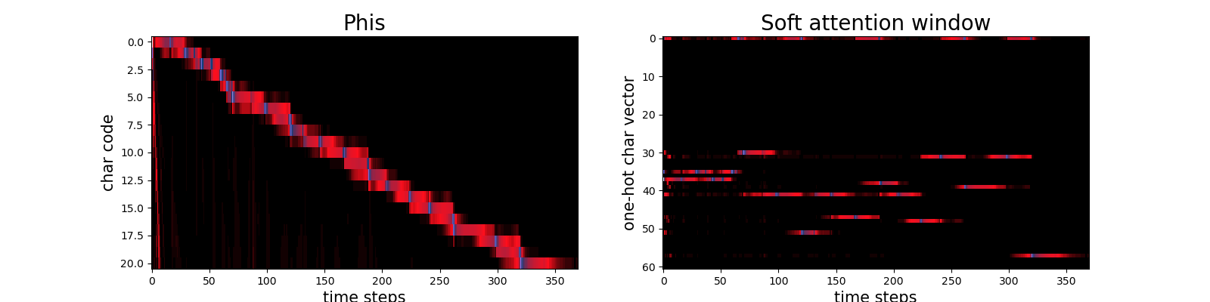
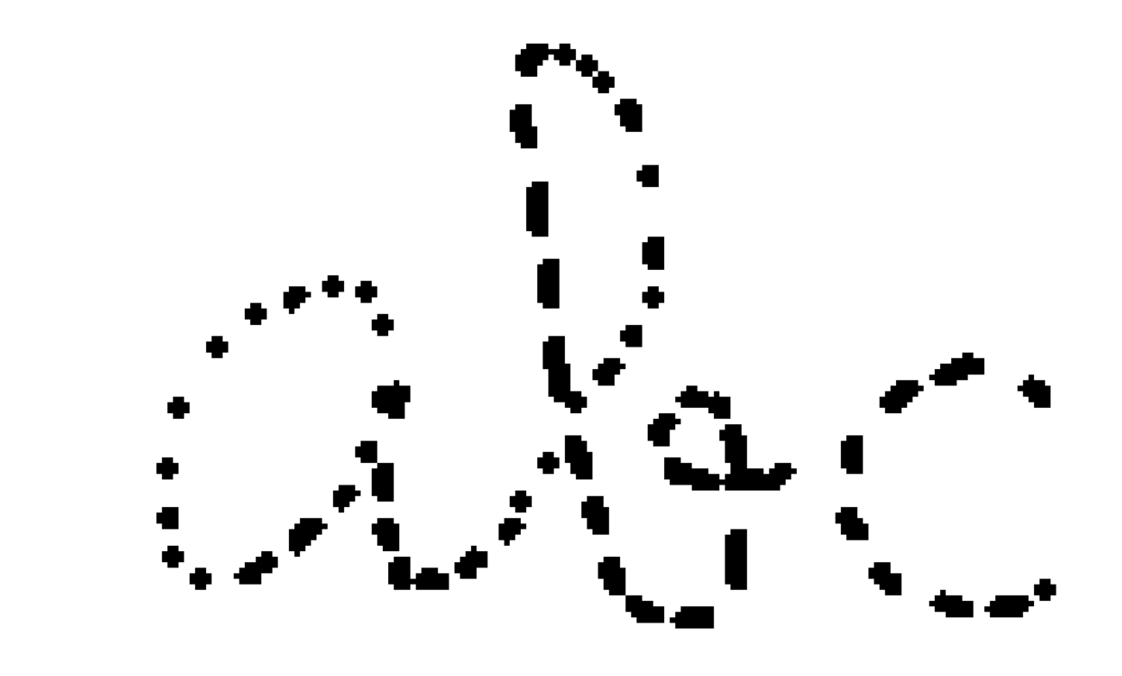





Handwriting synthesis model
soft p
GMM
e
$$Π$$
$$μ, Σ$$
$$α$$
$$β$$
$$κ$$
dx
dy
p

Slide 11

Handwriting synthesis model
kiki do you love me ?
Attention
Prediction
abcdef………xyz

Slide 12
Handwriting synthesis training
Aim: predict the next input from previous output
Probability model chosen: GMM
Parameters | Value
Hidden dimension | 400
Number of layers | 1
GMM number | 20
GMM attention number | 10
Learning rate | 0.005
Epochs | 60

Slide 13






handwriting synthesis result

