Slide 1


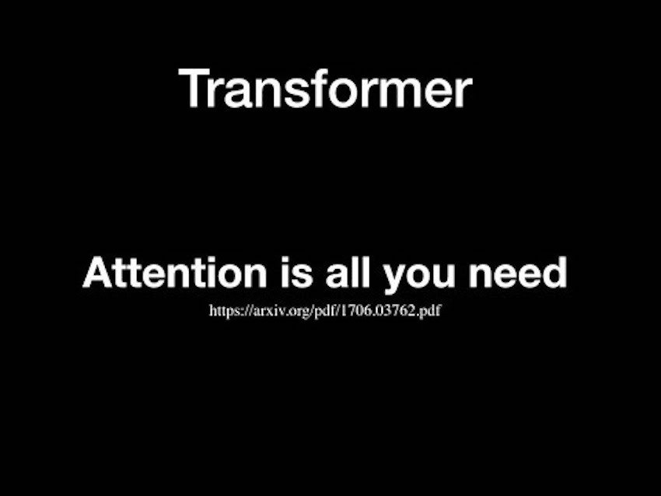
Self-attentive sentence embedding
Group J-2:
-TAZENGOU Christian
-TRAORE MOUSSA
-CAMARA YOANE

Slide 2
Description of the problem
- Extracting an interpretable sentence embedding by introducing self-attention.
- Learning semantically meaningful distributed representations of individual words, also known as word embeddings
- LSTM, BERT, LongFormers models

Slide 3

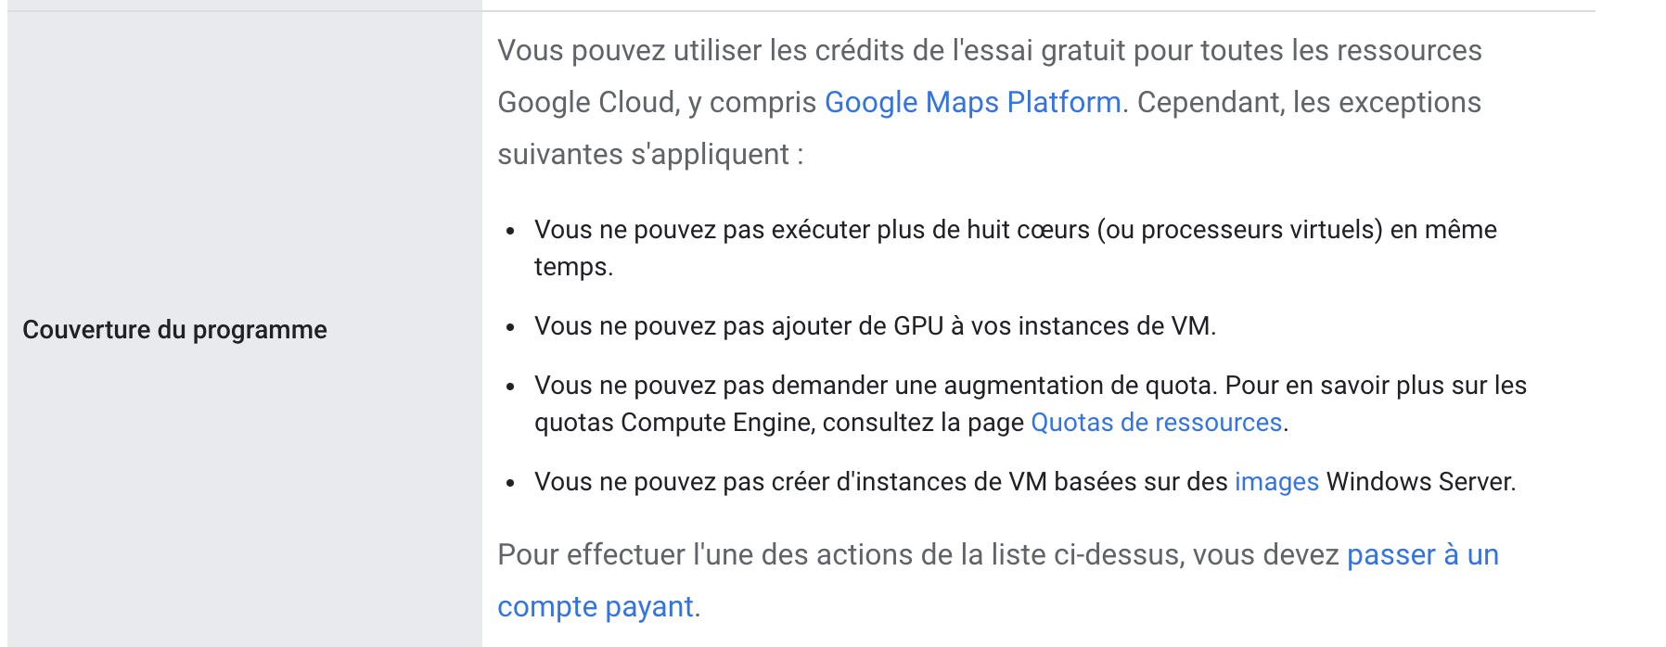
Working on the first model

Slide 4
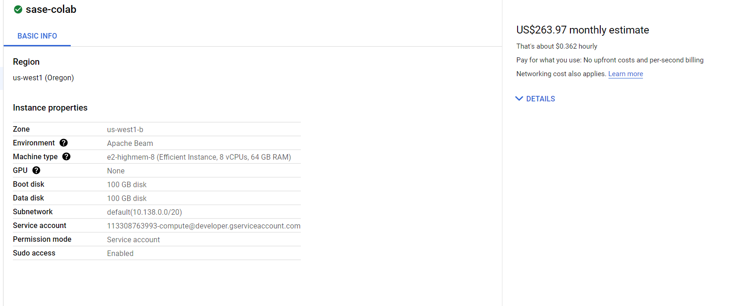
GCP INSTANCE

Slide 5
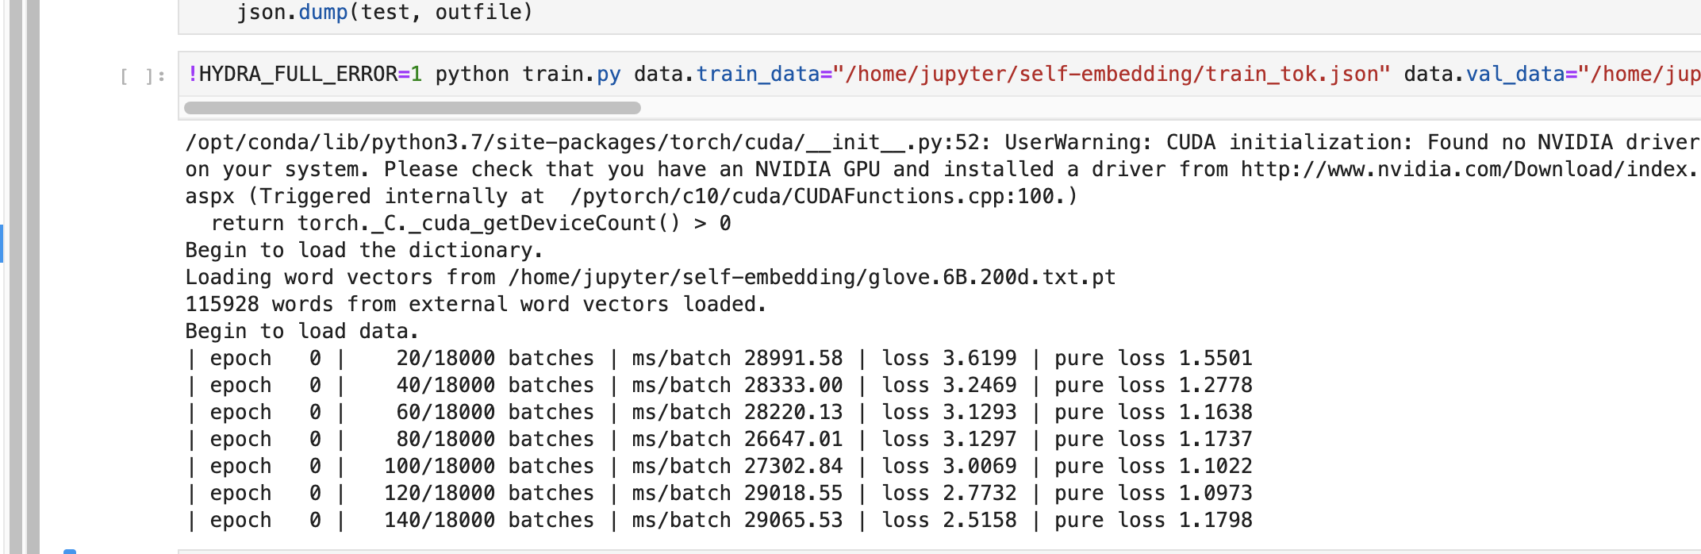
Training the first model
Tokenize only ¼ of the Yelp dataset because too big, no gpu available
Split into train, val and test
Train the model but also too much time

Slide 6
Transformer
Quicker Development
Less Data
Better Results

Slide 7
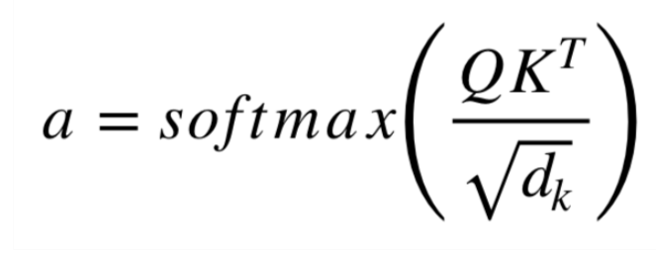
Self-Attention Mechanism
Attention Mechanism as a substitute for RNN
self attention is a mechanism that allows the encoder to look at other positions in the input sequence for clues that can help lead to a better encoding for this word
Matrixes : Q: Query Matrix, K: Key Matrix and Values : Matrix, dk: embedding

Slide 8
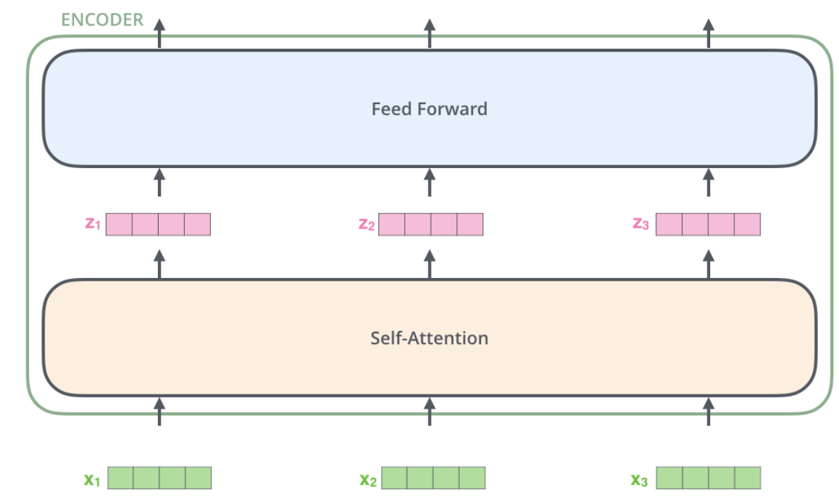
Transformer-encoder
Add Positional Embedding
Residuals+ Normalization after each attention layer
Block of Attention+Feed Forward
Advantages :
The Transformers outperforms the Google Neural
Machine Translation model in specific tasks
It allows parallelization, which make the process
faster.

Slide 9
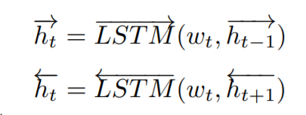
Bert Model- Bi-directional
If we consider a sentence, which has n tokens, represented in a sequence of word embeddings : S = (w1, w2, · · · wn)
With w_i, the embedding for the i-th word
For creating some dependencies
Between adjacent words :
H = (h1, h2, · · · hn)
With h_i taking the aggregation of the left h_i and right h_i.

Slide 10
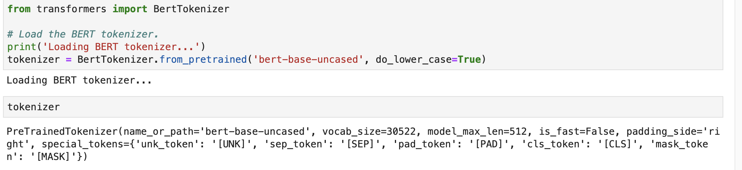
Bert implementation

Slide 11
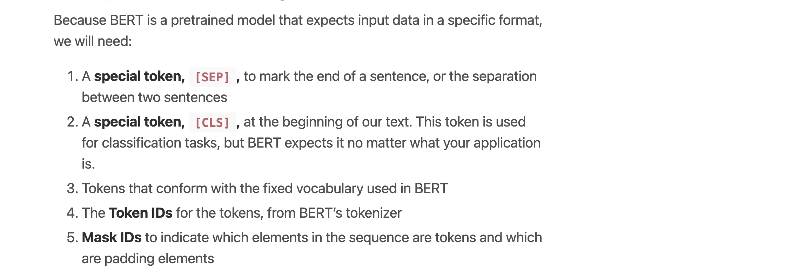
Input Format

Slide 12
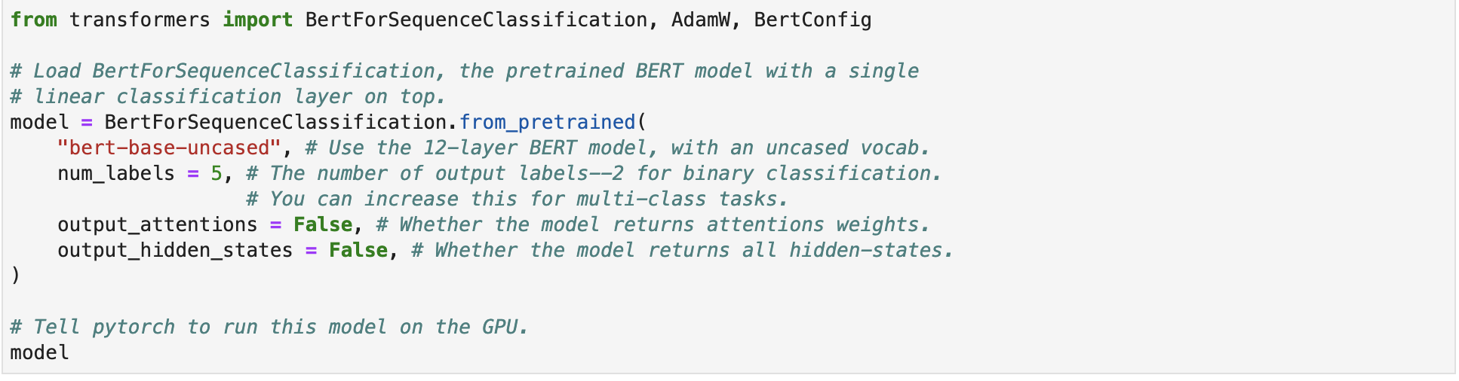
The Model

Slide 13
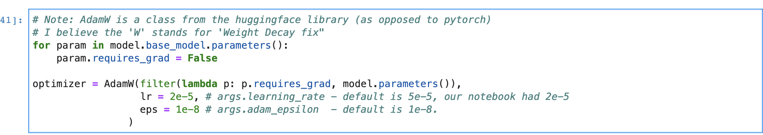
Transfer learning

Slide 14
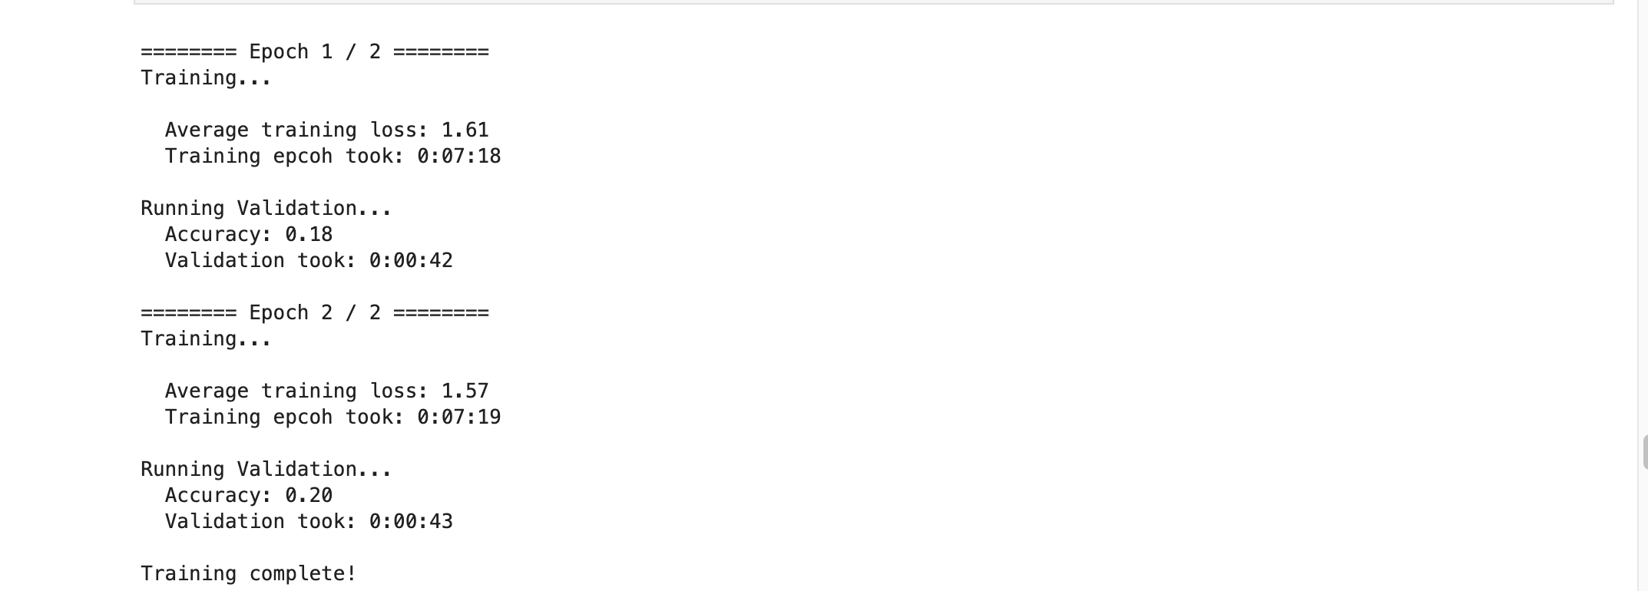
Results

Slide 15
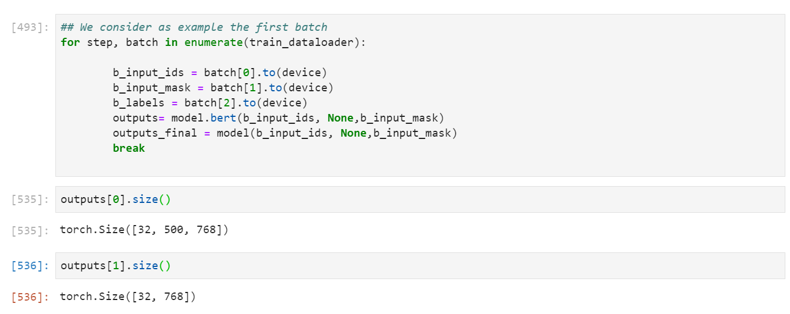
Visualization : Heatmap

Slide 16
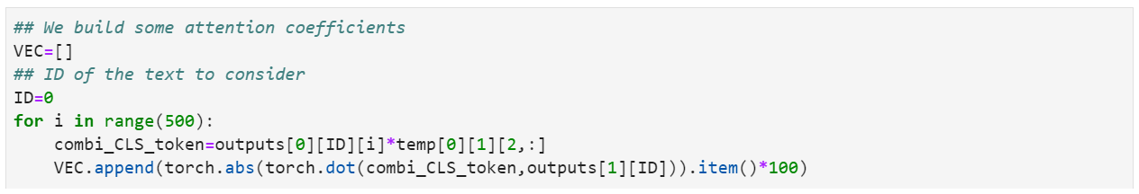
Visulization: Heatmap

Slide 17

Visulization: Heatmap (Results)

Slide 18
Third Model: Longformer
Allows us to use all the words as features (more than 512)

