Slide 1


demystifying
Theory of Change
(in 10 minutes-ish)
Simple language, simple metaphors, clear purpose
The Good Ship · tomcw.xyz · CC BY-NC 4.0

Slide 2

The Good Ship
why 10 minutes?
Why a 10-minute Theory of Change?
“
Understanding and communicating what you do and the value you create is important.
A Theory of Change is one way of doing this. But often it’s seen as something hard, complicated, something that needs an expert. Even the name comes across that way.
And yes, there are times when outside help is useful. But the experts you need are the people in and around your work.
So I challenged groups to create a Theory of Change in 10 minutes. Rather than frameworks, I gave them three metaphors — Journeys, Stones and ripples, Seeds and plants — and set them away.
Will it be perfect? No. Will it need doing again? Yes. But that’s kind of the point.
The best tools are the ones you use. Making it easy for everyone to do this stuff, naturally and ongoing, can really help.
This doesn’t replace well thought-out frameworks or the excellent people who support this work. It helps, so that when support comes it’s even more valuable.
The Good Ship · tomcw.xyz · CC BY-NC 4.0

Slide 3



The Good Ship
three metaphors
Three Ways to Tell Your Story
Pick the one that feels right for your work. Each asks the same core questions in a different way.
01
02
03
The Journey
The Ripple
The Seed
Where are we now? Where do we want to get to? What’s the path? How do we know we’re getting closer?
We drop a stone. It creates ripples. Those ripples spread outward into the wider world.
What are we planting? What does it need? What develops? What’s the harvest?
The Good Ship · tomcw.xyz · CC BY-NC 4.0

Slide 4
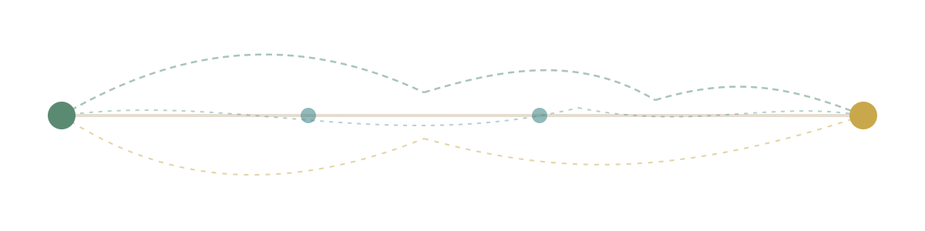
The Good Ship
metaphor 01 · the journey
The Journey
you are here
there are many paths — knowing you’re making progress is what matters
destination
Where are we now?
Where do we want to get to?
What’s the path?
How do we know we’re getting closer?
The Good Ship · tomcw.xyz · CC BY-NC 4.0

Slide 5
The Good Ship
metaphor 02 · the ripple
The Ripple
the water · the challenge
0
The water
The context you work in — the challenge, the community, the need. Where you drop the stone shapes how ripples spread.
longer-term change
immediate effects
1
We drop a stone
The work we do, the activities we deliver
the
stone
2
It creates ripples
The immediate effects we can see and measure
3
Those ripples spread outward
The longer-term change in the wider world
The Good Ship · tomcw.xyz · CC BY-NC 4.0

Slide 6

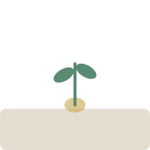
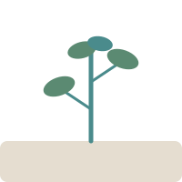
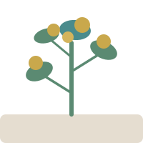
The Good Ship
metaphor 03 · the seed
The Seed
→
→
→
01
02
03
04
Seed
Conditions
Growth
Fruit
What are we planting?
What does it need?
What develops?
What’s the harvest?
Growth takes time and the right conditions, but we can describe what we expect to see
The Good Ship · tomcw.xyz · CC BY-NC 4.0

Slide 7
The Good Ship
putting it together
Four Simple Questions
Instead of "inputs, outputs, outcomes, impact" — try these
01
02
What’s the challenge?
What would better look like?
The problem you see in the world that motivates your work
The change you want to see — your vision
03
04
What can we actually do?
How would we know it’s working?
Your activities — the things within your control
Signs of progress you can point to
The Good Ship · tomcw.xyz · CC BY-NC 4.0

Slide 8

The Good Ship
resilience
Why This Matters
A clear theory of change is the backbone of your Purpose pillar. It answers:
Why do we exist?
Not just "what do we do" — but why it matters
What would be lost if we weren’t here?
Your unique contribution to the change you want to see
purpose
A compass for hard times
When purpose is clear, you have a compass for hard choices
The Good Ship · tomcw.xyz · CC BY-NC 4.0

Slide 9
The best tools are
the ones you use.
Make it easy. Make it natural. Make it ongoing.
good-ship.co.uk
tomcw.xyz
The Good Ship · tomcw.xyz · CC BY-NC 4.0

