Slide 1
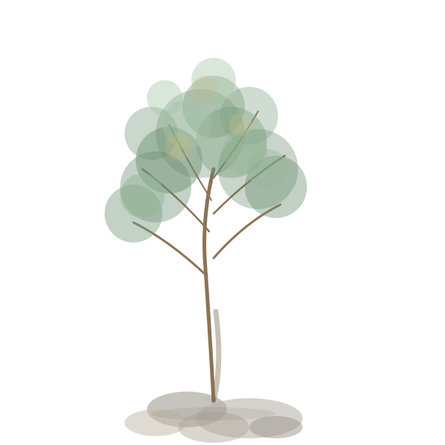
Garden of Ideas
Cultivating ideas together through seasons
of growth, care, and pruning
a facilitation tool for workshops and residentials
Organisational Resilience Programme · Tom Watson · CC BY-NC 4.0

Slide 2

Over the next two days, we're going to be growing a garden together.
Some seeds you bring with you. Some we'll discover along the way.
By the end, we'll know what to plant now, what to save for later, and what to let go.
Organisational Resilience Programme · Tom Watson · CC BY-NC 4.0

Slide 3



How the garden works
Your garden
The seed bank
Our garden
Each person has their own garden to tend throughout the session. Capture seeds as they come — ideas you arrived with, thoughts that emerge, questions worth holding.
When ideas surface that we can't explore right now, they go to the seed bank — not a parking lot where things get forgotten, but a place where seeds are kept safe for later.
At the end, we bring seeds from individual gardens into a shared space. Together we decide: what do we plant now, save for later, or compost?
Write, draw, sketch — whatever helps you hold your thinking.
We'll return to the seed bank at key moments.
The collective garden becomes our shared commitment.
Organisational Resilience Programme · Tom Watson · CC BY-NC 4.0

Slide 4



The garden elements
Seeds
Soil & Conditions
Seasons
Pruning
Your ideas. Each one is a seed with potential — some will grow quickly, others need time underground before they're ready to sprout.
What does each idea need to grow? Resources, people, time, skills? Not all ideas need the same conditions — some thrive in shade, others need full sun.
When is the right time? Some ideas are ready to plant now. Others are seeds to save for a future season when conditions are better.
Some ideas aren't right for this garden, this time. Removing them isn't failure — it's making space for what can truly flourish here.
Organisational Resilience Programme · Tom Watson · CC BY-NC 4.0

Slide 5
Your Individual Garden
Print one per person. Use throughout the session to capture seeds as they emerge.
My seeds
Ideas, questions, thoughts worth holding
Drawing prompts
☀️ Needs visibility or profile
💧 Needs resources or funding
🌱 Needs skills or people
🏠 Needs protection or shelter
⏳ Needs time to develop
Seed shapes
Draw your seeds to show their nature: small or big? Quick win or long-term? Contained or sprawling? How deep does it need planting?
Organisational Resilience Programme · Tom Watson · CC BY-NC 4.0

Slide 6

The seed bank
Seed Bank
When ideas surface that we can't explore right now, they go to the seed bank — not a parking lot where things get forgotten.
Ideas preserved for the right moment
A seed bank is different. Seeds are preserved with care. They're catalogued. They're returned to when the conditions are right.
Language to use
"Let's bank that seed for later"
"That's one for the seed bank"
We'll revisit this at: _______________
"We'll come back to the seed bank at [time]"
Organisational Resilience Programme · Tom Watson · CC BY-NC 4.0

Slide 7
Our Collective Garden
Use at the end of the session. Bring seeds from individual gardens into our shared space.
Plant Now
Seed Bank
Preserved for future seasons
Ideas we commit to cultivating this season
Compost
Letting go with grace
Organisational Resilience Programme · Tom Watson · CC BY-NC 4.0

Slide 8



Bringing it together
At the end of the session, harvest from individual gardens into the collective space.
Review individual gardens
Each person looks at their garden and selects 2–3 seeds to bring to the collective. (5 mins)
Share and cluster
Go round the group. Place seeds on the collective garden, clustering similar ideas. (10 mins)
Sort together
Discuss each cluster. Ask: "Plant now, seed bank, or compost?" Move seeds to their areas. (15 mins)
Name conditions and gardeners
For "Plant Now" seeds: What do they need? Who will tend them? (10 mins)
Set a date for the seed bank
When will you revisit the seed bank? Schedule your garden check-in now. (5 mins)
Organisational Resilience Programme · Tom Watson · CC BY-NC 4.0

Slide 9
Facilitator notes
Throughout the session
The power of the metaphor
Keep the seed bank visible. When ideas surface that aren't for now, use the language: "Let's bank that seed." Return to it at natural breaks.
"Composting" feels kinder than rejecting. "Banking seeds" is strategic, not procrastination. The language gives people permission to let go and wait.
Encouraging drawing
Some people think visually. Encourage them to sketch their seeds — show size, shape, what conditions they need. No artistic skill required.
Helpful questions
"What would this idea need to grow?"
"Is this the right season for this seed?"
Watch out for
"Who might tend this idea?"
Hoarders who can't compost anything. Eager planters who want everything now. Remind both: the garden can only hold so much.
"What would it free up if we composted this?"
Organisational Resilience Programme · Tom Watson · CC BY-NC 4.0

Slide 10
What will you
plant today?
The garden is yours to tend.
Created by Tom Watson · tomcw.xyz
Organisational Resilience Programme · Tom Watson · CC BY-NC 4.0

