Slide 1
RNA-Seq Analysis of Gene Expression:
A Walk-Thru and Tutorial
Helen Nigussie, Michael Mayhew, Dina Machuve
June 4, 2019
Data Science Africa 2019
Addis Ababa University, Ethiopia

Slide 2
What is RNA-Seq analysis?
RNA sequencing (RNA-Seq for short) is a process of assessing the expression of genes across a genome by sequencing the RNA transcripts from a collection of cells

Slide 3
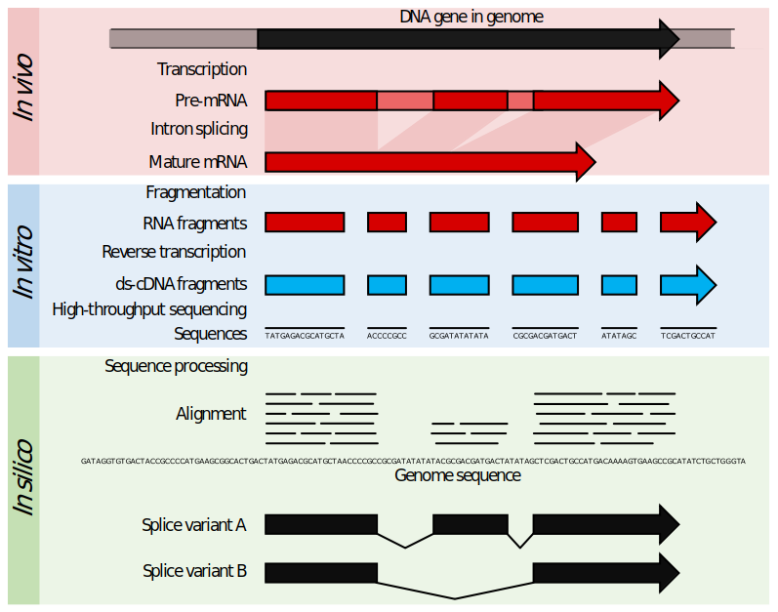
What is RNA-Seq analysis?
These short strands that result from sequencing are called ‘reads’
https://en.wikipedia.org/wiki/RNA-Seq

Slide 4
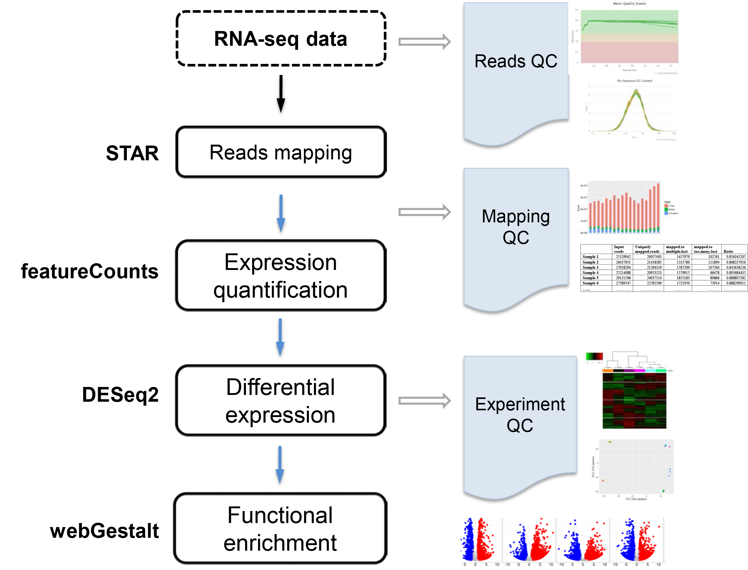
What are the different stages of RNA-Seq analysis?
To what genes do my reads correspond?
How much is each gene expressed?
Is a given gene more or less expressed in a condition of interest?
Are expressed genes associated with certain pathways?
http://bioinfo.vanderbilt.edu/vangard/services-rnaseq.html

Slide 5
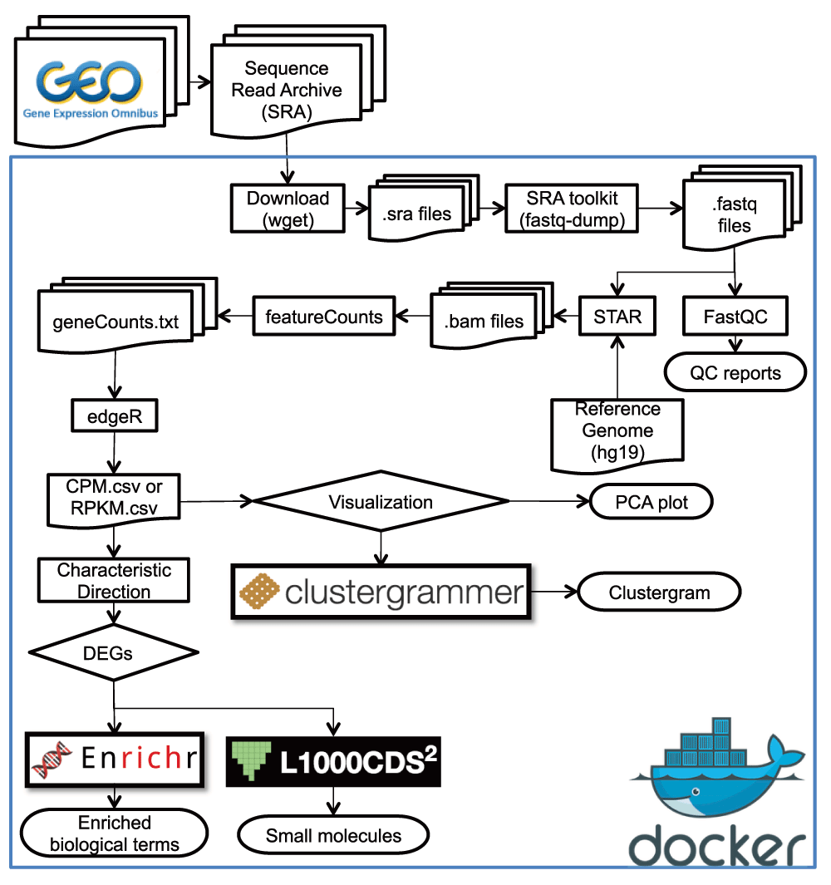
What are the different stages of RNA-Seq analysis?
Quality control
Expression
quantification/normalization
Reads mapping
Differential
expression
analysis
Functional
enrichment
Wang & Ma’ayan, 2016

Slide 6
Stage 1: Processing and quality control of raw sequencing reads
Reads are often assessed for:
Sequencing quality per base
We expect generally high quality at all bases
Sequencing quality per read
We expect high quality for longer reads
Sequence content (nucleotide base composition)
We expect a roughly uniform base composition across the read (except maybe for the initial bases; depends on how RNA prepared)
Per base ‘N’ content (or non-call)
Indicates potential instrument failure
Other measures

Slide 7
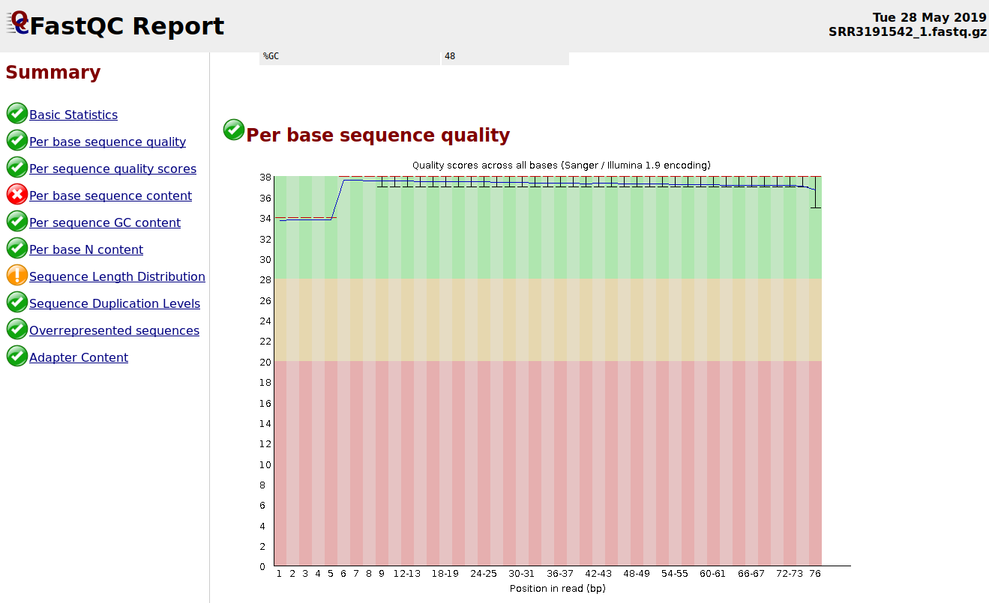
Stage 1: Processing and quality control of raw sequencing reads (cont’d)
NOTE: A ‘failure’ alert in the FastQC summary can be flagged simply because the data given (e.g. RNA sequencing data) isn’t of the same type as that for which FastQC was originally designed (e.g. DNA sequencing data)

Slide 8
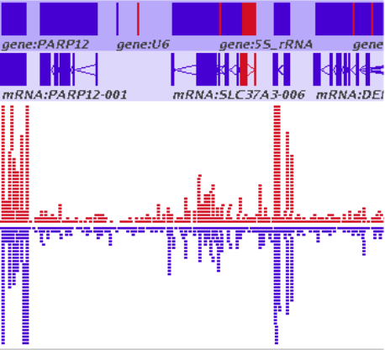
Stage 2: Mapping of sequencing reads to genome
The histogram-like plot to the left indicates the cumulative counts of sequencing reads at different positions in the genome.

Slide 9
Stage 3: Assignment of reads to individual genes to attain expression measurements
Sequencing reads are aligned (‘mapped’) to a reference genome in which locations of genes are known
Algorithms (like featureCounts) assign the aligned reads to each gene
Results in ‘digital’ measures of expression – one unit of expression per mapped read
Counts are then normalized according to sequencing depth and/or gene length
Two common normalized expression measures are:
CPM – transcripts or counts per million
RPKM – reads per kilobase per million
NOTE:
R_{i} – read counts for gene i
L_{i} – length in kilobases of gene i
1.
${RPK}_{i}=\frac{R_{i}}{L_{i}}$
2.
$S=\frac{\sum_{i}{{RPK}_{i}}}{{10}^{6}}$
3.
${CPM}_{i}=\frac{{RPK}_{i}}{S}$
1.
$S=\frac{\sum_{i}{R_{i}}}{{10}^{6}}$
2.
3.
${RPM}_{i}=\frac{R_{i}}{S}$
${RPKM}_{i}=\frac{{RPM}_{i}}{L_{i}}$

Slide 10
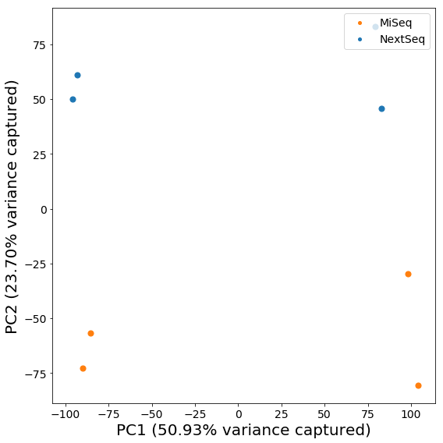
Important considerations when performing an RNA-Seq analysis
Should I consider all genes in my analysis? What about those with low or no expression across all conditions/platforms?
Are the expression differences I’m seeing solely due to the condition? Or some other factor?

Slide 11
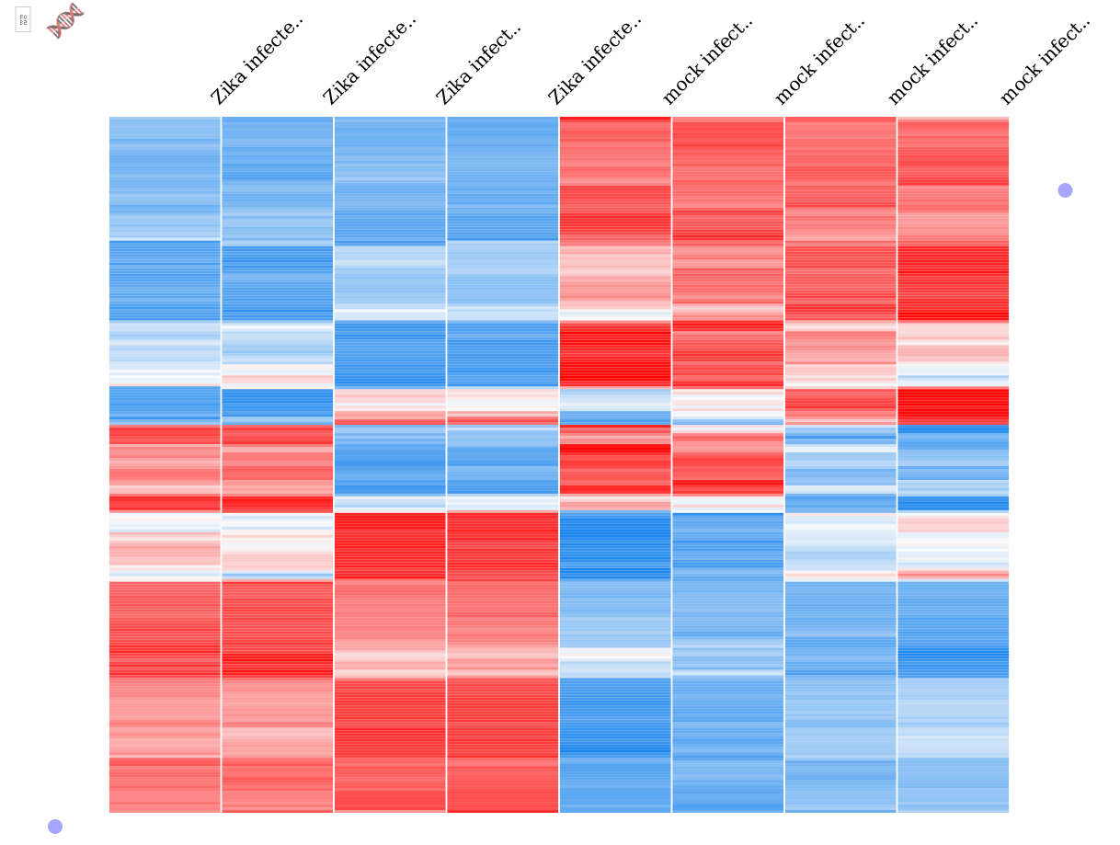
What is the structure in my expression data?
Zika-infected Sample 4 (NextSeq)
Zika-infected Sample 1 (MiSeq)
Zika-infected Sample 3 (NextSeq)
Zika-infected Sample 2 (MiSeq)
Mock Sample 3 (NextSeq)
Mock Sample 1 (MiSeq)
Mock Sample 4 (NextSeq)
Mock Sample 2 (MiSeq)
Most genes cluster by condition.
However, some genes clearly show platform-specific effects.

Slide 12
What genes show different expression patterns in my conditions of interest?
 | MiSeq | NextSeq 500 | Combined
WASH7P | -0.000268 | -0.000969 | -0.000385
LOC729737 | -0.000134 | -0.000529 | -0.000198
LOC100133331 | -0.000755 | -0.000849 | -0.000701
MIR6723 | -0.001514 | -0.000954 | -0.001068
LOC100288069 | -0.000337 | -0.000720 | -0.000428

Slide 13
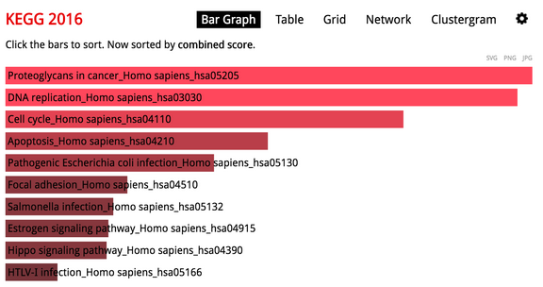
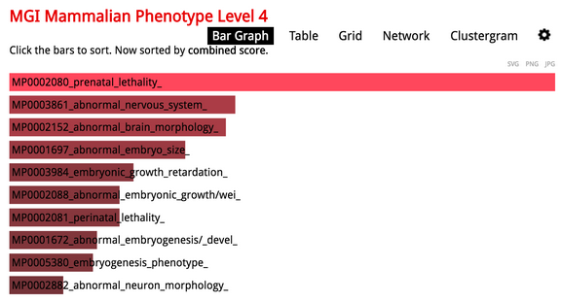
Are differentially expressed genes enriched for any biological processes or pharmacological targets?
Genes with low expression in Zika-infected samples are enriched for cell-cycle and DNA replication processes.
Genes with high expression in Zika-infected samples are enriched for prenatal lethality phenotypes in mice.

Slide 14

An unsolicited advertisement
Oral Presentation Submission Deadline: September 13, 2019
Poster Presentation Submission Deadline: October 15, 2019
https://www.iscb.org/iscbafrica2019

Slide 15
Additional resources
Galaxy Community Hub’s RNA-Seq Introduction: https://galaxyproject.org/tutorials/rb_rnaseq/
FastQC Tutorial & FAQ: https://rtsf.natsci.msu.edu/genomics/tech-notes/fastqc-tutorial-and-faq/
Description of normalized RNA-Seq expression measures:https://statquest.org/2015/07/09/rpkm-fpkm-and-tpm-clearly-explained/

Slide 16
Thanks for your attention and see you at the workshop! Any questions?

