Slide 1

Parcours Datascientist : KAGGLE
Détection de conversations toxiques
François BANGUI

Slide 2
Dataset analysis nan values
Content & target
target 0
comment_text 0
Identities
Toxicity indicators
Toxicity indicators
asian 1399744
atheist 1399744
bisexual 1399744
black 1399744
buddhist 1399744
christian 1399744
female 1399744
heterosexual 1399744
hindu 1399744
homosexual_gay_or_lesbian 1399744
intellectual_or_learning_disability 1399744
jewish 1399744
latino 1399744
male 1399744
muslim 1399744
other_disability 1399744
other_gender 1399744
other_race_or_ethnicity 1399744
other_religion 1399744
other_sexual_orientation 1399744
physical_disability 1399744
psychiatric_or_mental_illness 1399744
transgender 1399744
white 1399744
severe_toxicity 0
obscene 0
identity_attack 0
insult 0
threat 0
funny 0
wow 0
sad 0
likes 0
disagree 0
sexual_explicit 0
Misc informations
id 0
created_date 0
publication_id 0
article_id 0
rating 0
identity_annotator_count 0
toxicity_annotator_count 0
parent_id 778646
Total features : 45
Target feature : [0., 1.0]

Slide 3
Dataset description (1)
 | target | severe_toxicity | obscene | identity_attack | insult | threat | sexual_explicit
The sore losers will be out heavy on this one. The truth drives them batty. Say... come on now king kong... er i mean waveloser. Lets hear your brilliant analysis. Wootwoot!!!! | 0.5 | 0.0 | 0.0 | 0.0 | 0.5 | 0.0 | 0.0
I only got the email notification which said something about Smug. I believe in full disclosure - just so all our presuppositions are on the table. Yes I am a white, Christian, conservative male - just the type you most likely spent most of your years persecuting. You use a clearly isolated incident with the EPD, and ignore the hundreds of thousands of good things they do. Pretty pathetic if you ask me, and the taxpayers are paying you for this as well. SAD | 0.4 | 0.0 | 0.0 | 0.0 | 0.1 | 0.3 | 0.0

Slide 4
Dataset description (2)
0 this is so cool. it's like, 'would you want yo...
1 thank you!! this would make my life a lot less...
2 this is such an urgent design problem; kudos t...
3 is this something i'll be able to install on m...
4 haha you guys are a bunch of losers.
5 ur a sh*tty comment.
6 hahahahahahahahhha suck it.
7 ffffuuuuuuuuuuuuuuu
8 the ranchers seem motivated by mostly by greed...
9 it was a great show. not a combo i'd of expect...
Words obfuscation
Unknowned words from dictionary

Slide 5
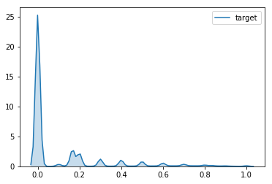
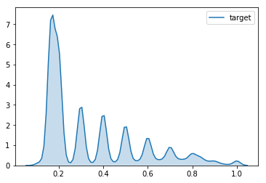
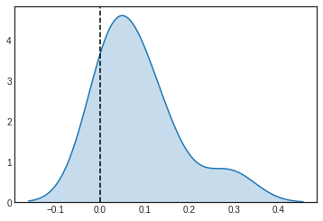
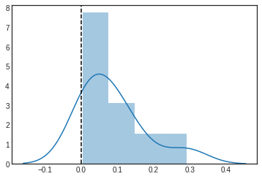
Text toxicity distributions
Toxicity distribution
Toxicity > 0.1 : 30 %

Slide 6
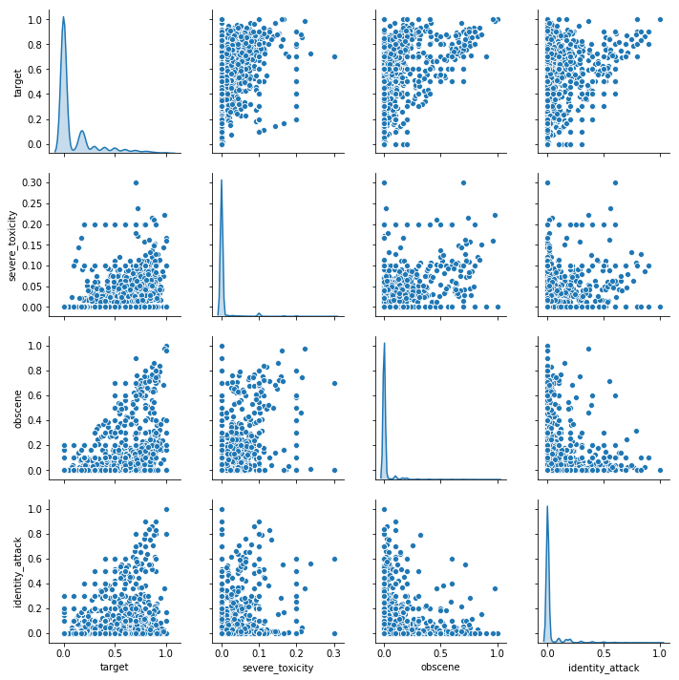
Toxicity contributors analysis (1)
Toxicity contributors
severe_toxicity
obscene
identity_attack
insult
threat
sexual_explicit

Slide 7
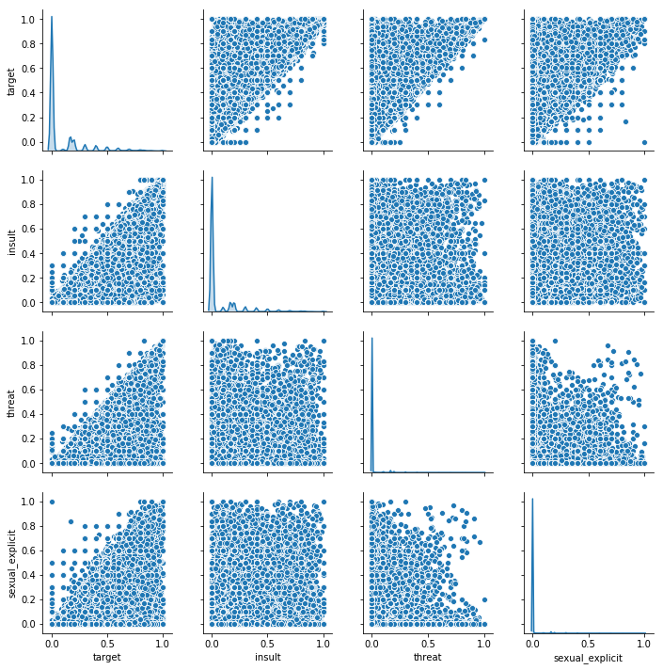
Toxicity contributors analysis (2)
Toxicity contributors
severe_toxicity
obscene
identity_attack
insult
threat
sexual_explicit

Slide 8
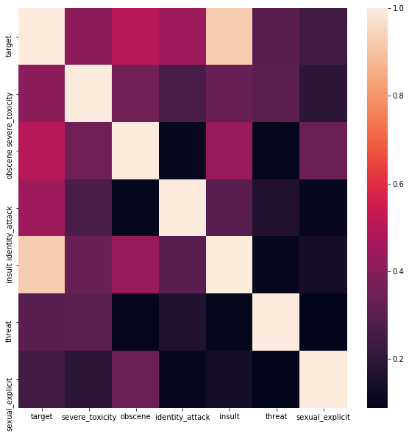
Toxicity contributors : matrix corrrelation

Slide 9
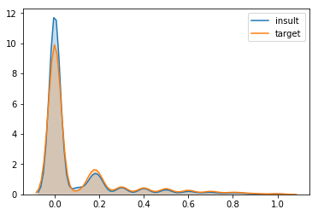
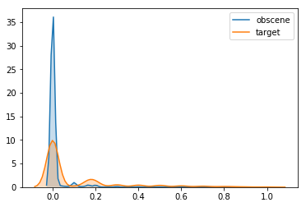
Toxicity contributors : matrix corrrelation
 | target | severe_toxicity | obscene | identity_attack | insult | threat | sexual_explicit
target | 1.000000 | 0.405802 | 0.500494 | 0.448081 | 0.925399 | 0.296270 | 0.244588
severe_toxicity | 0.405802 | 1.000000 | 0.352787 | 0.267649 | 0.333349 | 0.303908 | 0.193290
obscene | 0.500494 | 0.352787 | 1.000000 | 0.104657 | 0.438020 | 0.096228 | 0.338451
identity_attack | 0.448081 | 0.267649 | 0.104657 | 1.000000 | 0.295346 | 0.164630 | 0.107064
insult | 0.925399 | 0.333349 | 0.438020 | 0.295346 | 1.000000 | 0.104562 | 0.139459
threat | 0.296270 | 0.303908 | 0.096228 | 0.164630 | 0.104562 | 1.000000 | 0.087756
sexual_explicit | 0.244588 | 0.193290 | 0.338451 | 0.107064 | 0.139459 | 0.087756 | 1.000000

Slide 10
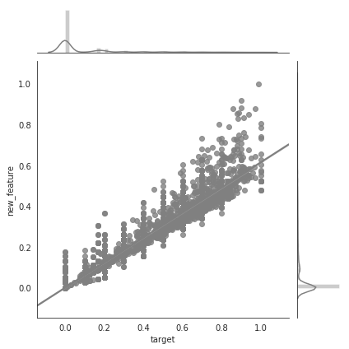
Toxicity contributors : feature engineering
Toxicity contributors:
  threat,
  insult,
  sexual_explicit,
  identity_attack,
  obscene,
  severe_toxicity
are combined all-together forming to a new feature.
Pearson coefficient (target,new_feature) = 0.98

Slide 11
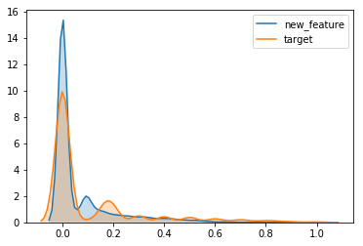

Target / new_feature distributions
Train dataset sample
Test dataset sample

Slide 12
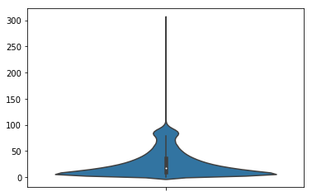
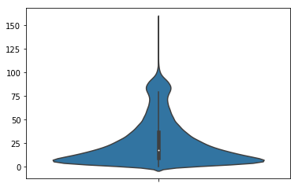
Text length distribution
Train dataset sample
Test dataset sample

Slide 13
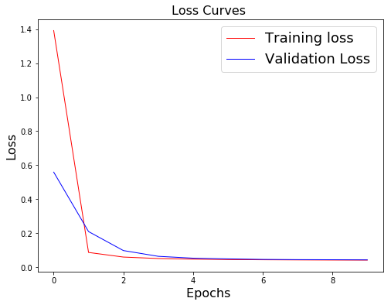
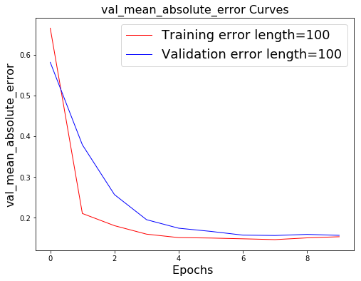
Bag Of Words digitalization : CNN
Poor results :
  NN structure? ⇒ Architecture, Hyper-parameters
  Data investigation?

Slide 14
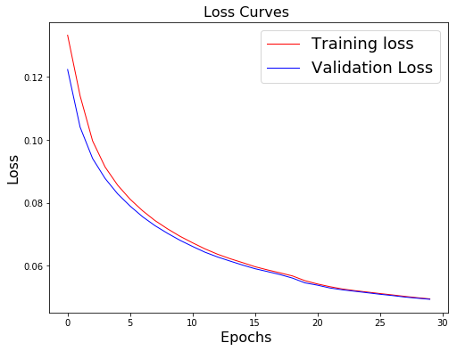
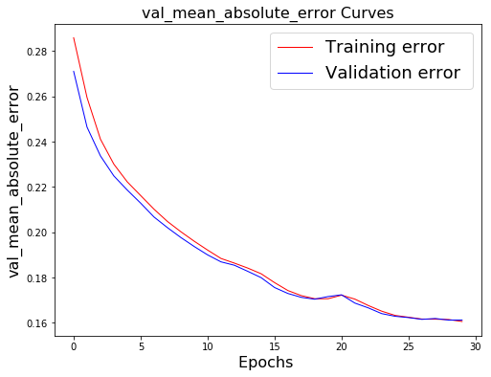
Bag Of Words digitalization : RNN
Results :
  Same issue compared to CNN network
  CNN : 120K parameters
  GRU : 8K parameters
  Data investigation

Slide 15
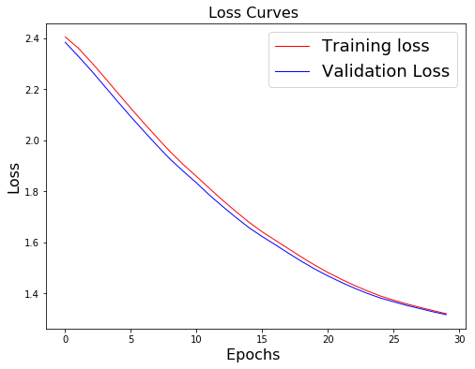
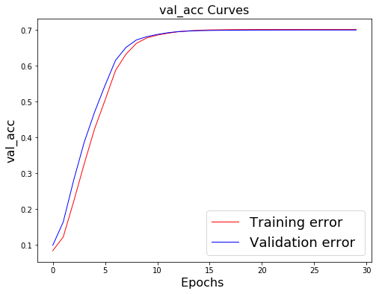
Switch to classification model
Results :
  Same issue compared to regression model

Slide 16
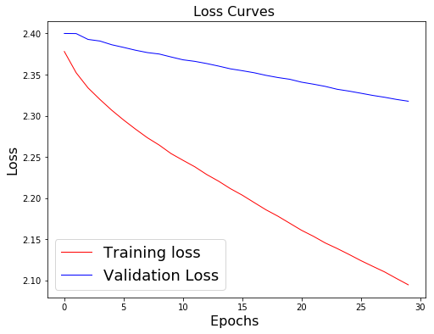
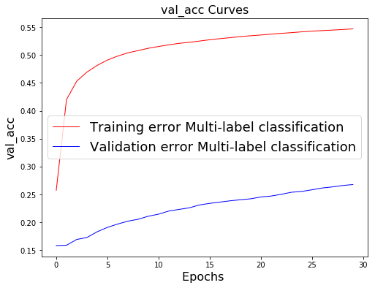
Classification : Adagrad optimizer
Adagrad effect
  Cost decrease not driven by free toxicity only

Slide 17
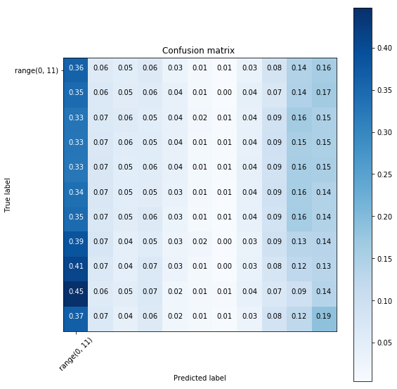
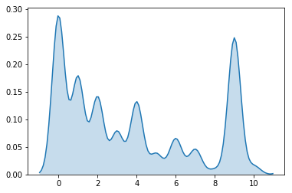
Classification performances (Adagrad)
Distribution of predicted classes
Adagrad effect
  Performances remain poor

Slide 18
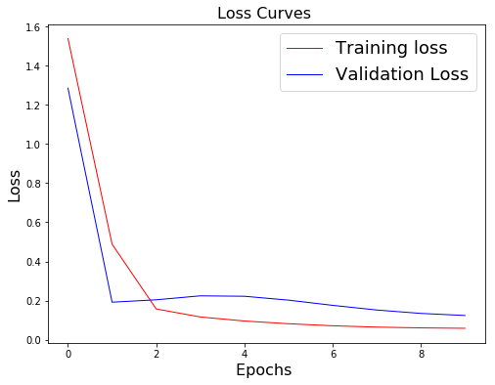
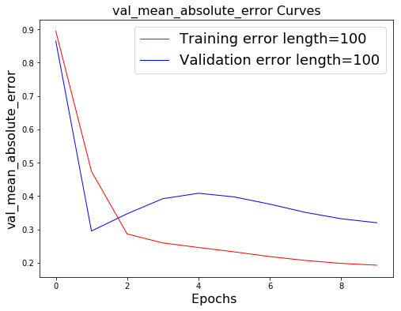
Training network with toxicity >0.
Data splitting :
  Toxicity >0.0
  Toxicity == 0.0
Imbalanced « classes » :
  Toxicity >0.0 : few impact over loss function

Slide 19
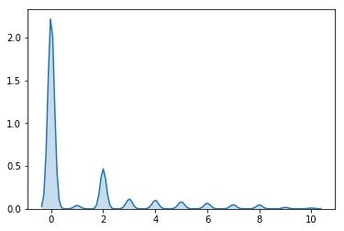
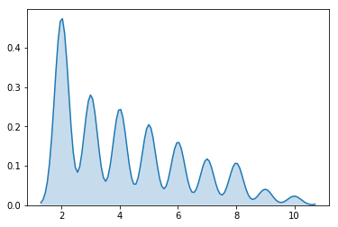
Imbalanced « class » analysis
Transcript : regression to classication
  Classes : [0,…,11]
Imbalanced « classes » :
  Toxicity >0.0 :30 %
  Toxicity >0.3 :10 %

Slide 20
Binary classification

Slide 21
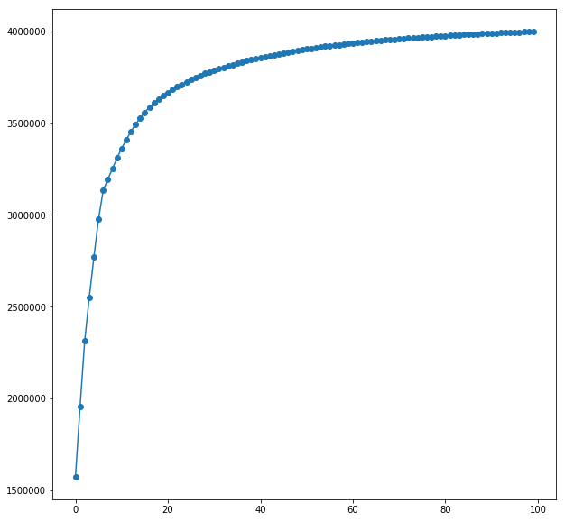
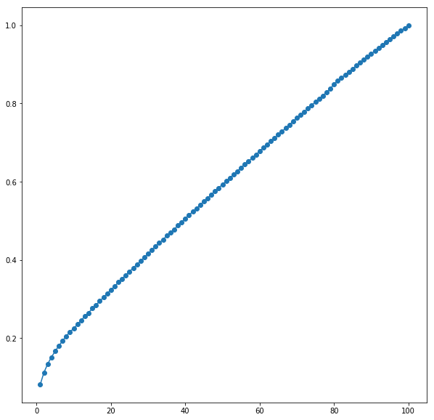
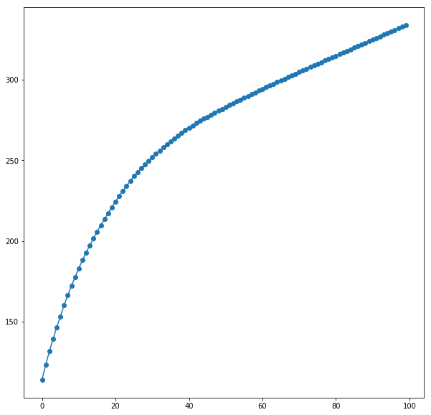
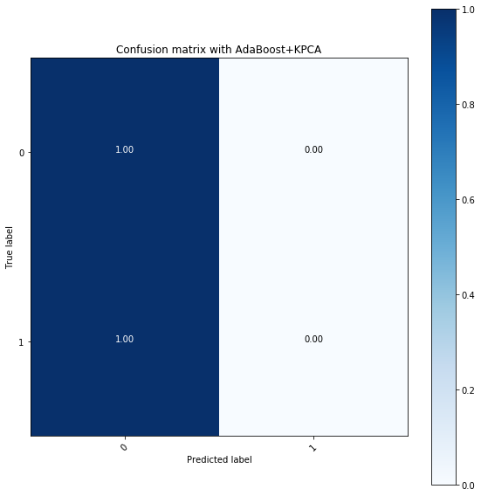
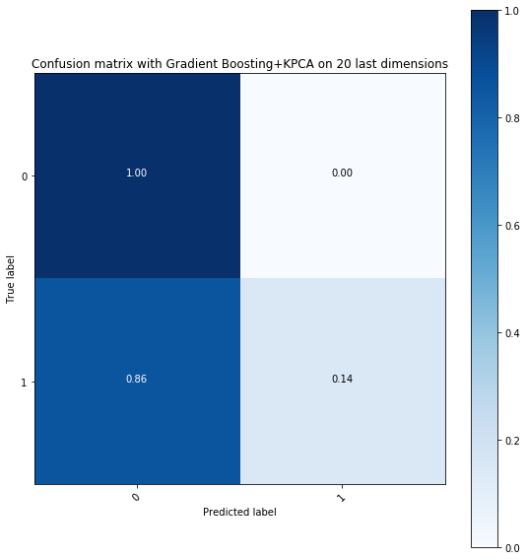
Imbalanced class : PCA transformation
PCA
Kernel : poly
Degree : 3
PCA
Kernel : RBF
Gamma: 1/100
PCA
PCA
All components
Last components
GradientBoosting

Slide 22
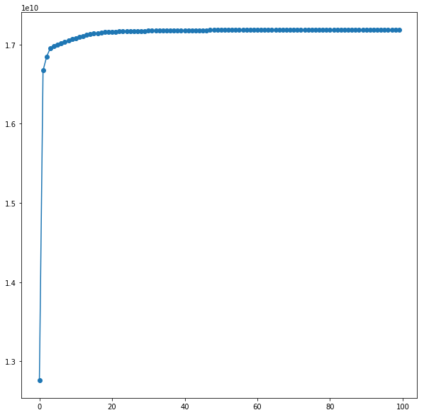
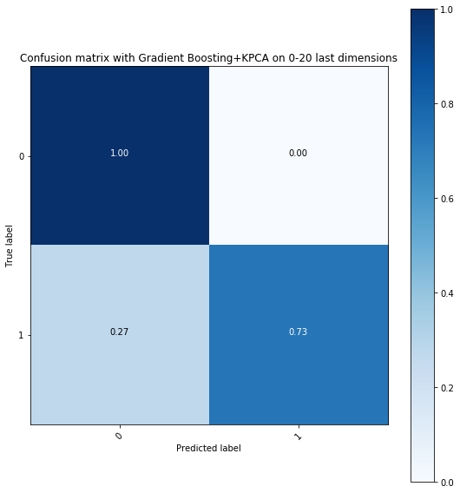
Imbalanced class : KPCA transformation

Slide 23
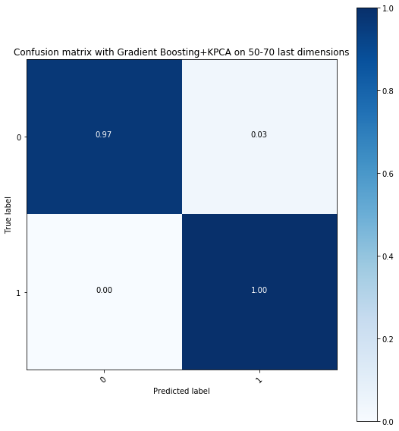
Imbalanced class : PCA transformation
Classes weight :
Class : 0 Weight=0.50
Class : 1 Weight=136/4
Noise

Slide 24
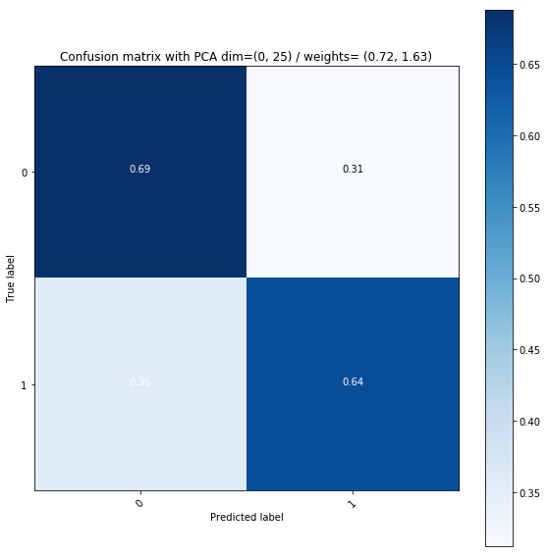
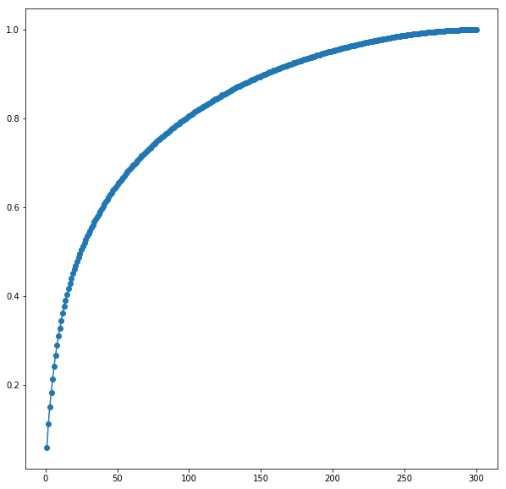
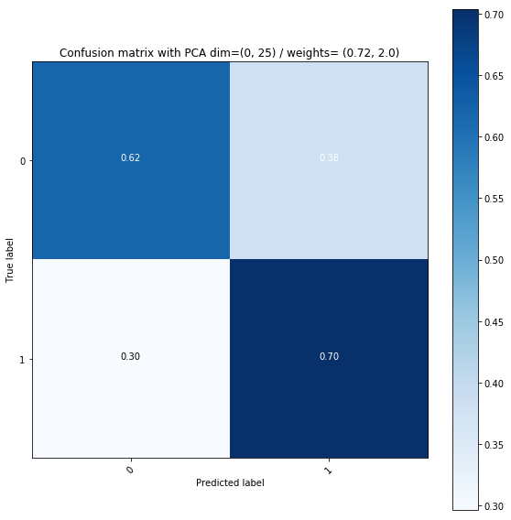
Imbalanced class : PCA transformation

Slide 25
Imbalanced class processing : CSL
Cost Sensitivity Learning : penalization of Falses predictions

