Slide 1

Parcours Datascientist : projet 8
AdaNet
Méthode ensembliste
appliquée aux réseaux CNN, RNN, GAN
François BANGUI

Slide 2
AdaNet : NN model / srtuctural learning
Network with N layers model:
h_{j}: j^{th} Layer of network f
w_{j} : weight from real set
Learning a network :
Step by step architecture:
Adaptative increase : at each step, compute w for risk minimization :
Vectorial functions space :
Base of vectors : coordonates for
Descent algorithm : block coordonates descent (boosting algorithms)

Slide 3
AdaNet : set of h functions
Input data
Weights from layer s
Activation function
Linear function of weights and biais
N_{s} units in layer s

Slide 4

AdaNet : Algorithm description
Minimize (F)
Candidate 1
Weaklearner
Candidate 2
{Y_{k}}
{X_{i}}

Slide 5
AdaNet : Algorithm description
{Y_{k}}
Minimize (F)
{X_{i}}

Slide 6
AdaNet implementation
Estimator
Uses
«adanet.subnetwork.Generator »
Generator
«adanet.subnetwork.Generator »
Builder
RNN
_NNAdaNetBuilder
build_subnetwork()
Creates
CNN
« TF packages »
tf.layers
tf.data.Dataset
Uses
DNN

Slide 7
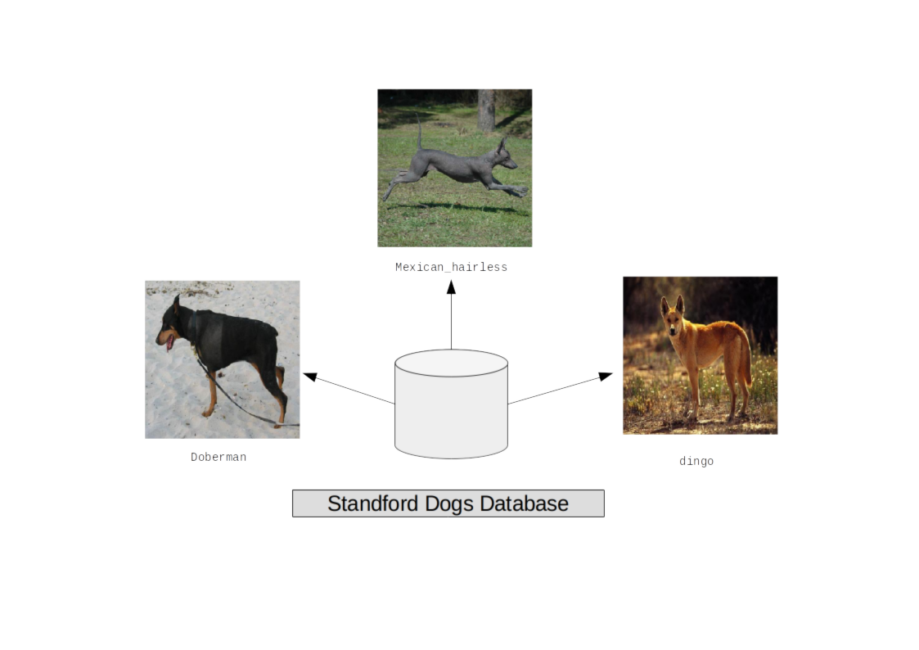
Dataset : 3 breeds
3 breeds
Train dataset : 400 images for3 breeds
Test dataset: 40 images for 3 breeds

Slide 8
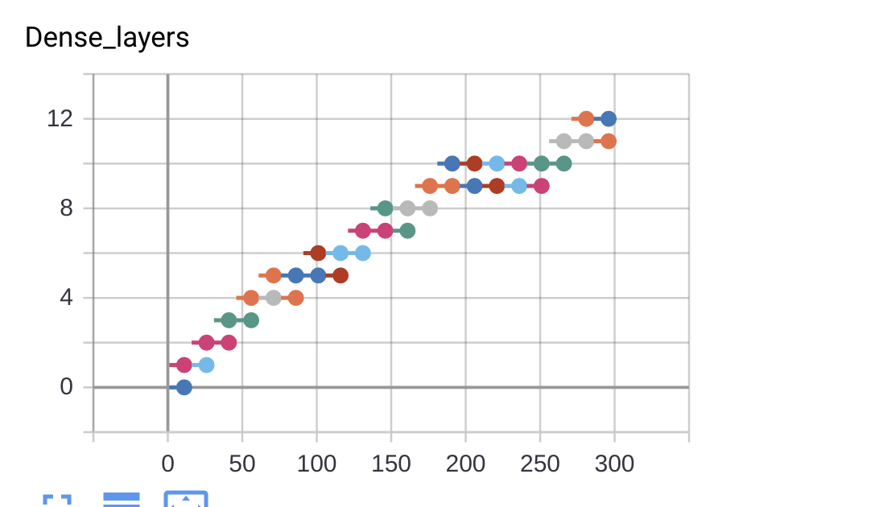
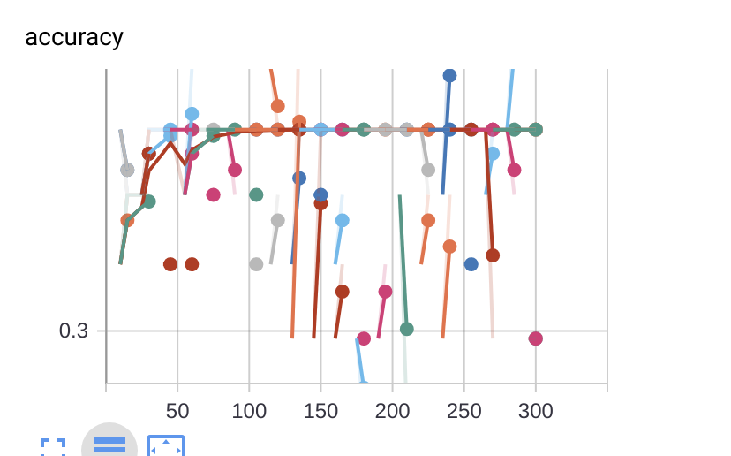
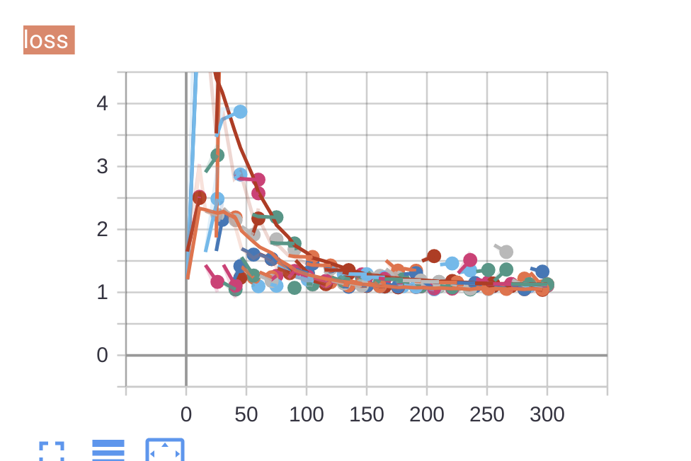
DNN network : no complexity
DNN network
Dense layers : 12
Steps : 300
ADANET iterations : 10
EVALAccuracy : 34 %

Slide 9
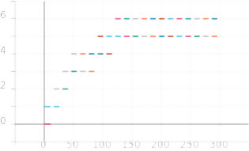
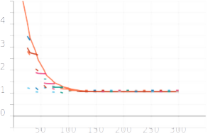
DNN networks : complexity

Slide 10
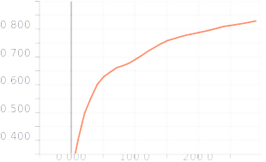
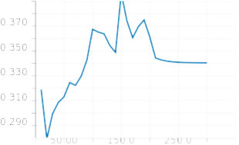
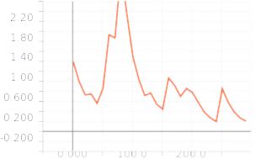
Results from CNN baseline
Train Accuracy
Eval Accuracy
NN type : ............................ CNNBase
Units in dense layer : ............................ 10
Number of layers : ............................ 2
Dropout rate : ............................ 0.0
Seed value : ............................ 42
Nb of classes (logit): ............................ 3
Weights initializer : ............................ xavier
Batch normalization : ............................ True
CNN seed : ............................ 42
Conv. Kernel size : ............................ (5, 5)
Conv. layers : ............................ 2
Dense layers : ............................ 1
Units in conv. layers: ............................ 10
CNN bacth norm. : ............................ True
Features map size : ............................ [64]
Conv filters : ............................ 32
Strides : ............................ 1
Padding : ............................ same
Activation function : ............................ relu
Loss

Slide 11
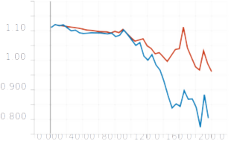
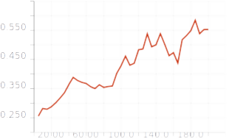
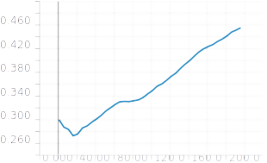
Results from CNN baseline
Loss
Accuracy
CNN network
Conv layers : 3
Dense layers : 1
Kernel : (5,5)
Filters : 32
Steps : 200
Train
Eval
Accuracy

