Slide 1

Parcours Datascientist : projet 8
AdaNet
Méthode ensembliste
appliquée aux réseaux DNN, CNN, RNN
François BANGUI

Slide 2
Adanet : theoritical frame
ADANET
Ensemble
Methods
Statistical
Learning
Ensemble methods applied to N.N.
Build an ensemble N.N from sub-networks
Each sub-network is a weak learner
Empirical Risk Minimization Principle
Structural Risk Minimization Principle
Complexity of family of classifiers
Deep Boosting (2014) extension
Vapnik-Chervonenkis /
Dimension VC (1999)
Koltchinskii : Rademacher (2001)

Slide 3
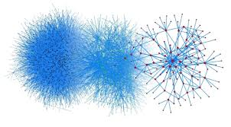

Adanet : modeling complexity
What is complexity ?
  Complex problem : number of informations to « describe » it
  Complex model ↔ Number of elements in model capturing information
  For a N.N elements are:
    Number of layers
    Number of units in each layer
    But also :
      Number of type of layers in model
      ….
What are complexity issues?
  Complex problem ⇒ Complex model
    Low empirical error → Trained Dataset
    Low generalization performance → Test Dataset

Slide 4
Adanet : building a « consistant » model
Model
Complexity
Generalization
Error
Empirical
Risk
Error
Empirical
Risk
Error
Empirical
Risk
Error
Generalization
Error
Conditions ?

Slide 5

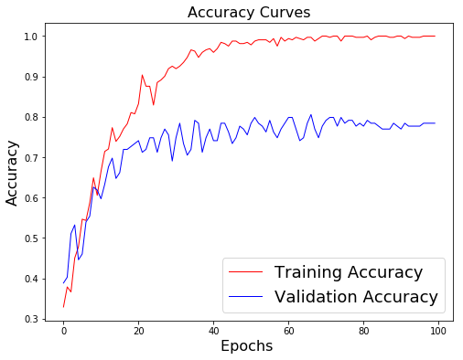
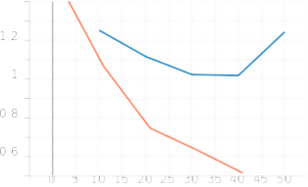
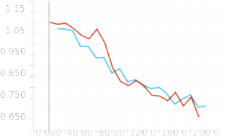
Adanet : Risk Minimization Principles
Empirical Risk Minimization Principle :
Decrease empirical error when building model
Decreasing such risk ⇒ Expectation of good Generalization, whatever ?
NO :
« worst »
When can it be expected :
ERM decrease ⇒ Learning guarantee?
Consistancy of ERM:
Structural Risk Minimization Principale

Slide 6
Adanet : complexity measurement

Slide 7
A.N.N ⇒ Function = W*HiddenLayers
Generalization error < Empiric Error + Complexity
Goal : how to minimize Empiric Error + Complexity ?
Cost function = F(Empiric Error, W, Complexity)

Slide 8
AdaNet : structural adaptative learning
Structural :
h_{j}: j^{th} Layer of network f
w_{j} : mixture weights : matrix, vector or scalar
W_{k,j}
W_{k-1,j}
Neuron j : h_{k-1,j}
Layer k-1 : estimateur h_{k-1}
Cost function : adaptative learning
Layer k : estimateur h_{k}
Descent algorithm : block coordonates descent (boosting algorithms)

Slide 9
AdaNet : structural learning model
Network model with N layers :
h_{j}: j^{th} Layer of network f
w_{j} : mixture weights : matrix, vector or scalar
h₁
h₂
W_{k,j}
W_{k-1,j}
Neuron j : h_{k-1,j}
Layer k : h_{k}
Layer k-1 : h_{k-1}

Slide 10
AdaNet : set of classifiers
Family of classifiers of complexity « k »
Input data
Weights from layer s<k
Activation function
Linear function of weights and biais
N_{s} units in layer s
Classifiers are searched in a family of ensembles H_{k}
Each layer k is modeled by a function belonging such family

Slide 11
AdaNet : Algorithm description
Train
logits
logits
Train
Candidate 1
Weaklearner
Candidate 2
{Y_{k}}
{X_{i}}

Slide 12
AdaNet : Algorithm weak learners (1)
F_{t}(W)
Sub-network 1
Sub-network 2
ADANET Ensemble

Slide 13

AdaNet : Algorithm weak learners
Building a network :
Step by step architecture:
Sub-network 1
Sub-n work 2
Sub-network 3
Argmin_{Loss}(Candidate1, Candidate2)
Loss 1
Loss 2
Cost function
Minimization
Cost function
Minimization
W_{1,1}
Complexity
Sub-network 1
Complexity
W_{s,,1}
W_{S,2}
Trained candidate 1
Sub-network 2
ADANET Ensemble
Trained candidate 2

Slide 14
AdaNet : Algorithm weak learners
Sub-network 1
Sub-n work 2
Sub-network 3
Argmin_{Loss}(Candidate1, Candidate2)
Loss 1
Loss 2
Cost function
Minimization
Cost function
Minimization
W_{1,1}
Complexity
Sub-network 1
Complexity
W_{s,,1}
W_{S,2}
Trained candidate 1
Sub-network 2
ADANET Ensemble
Trained candidate 2

Slide 15
AdaNet : Algorithm weak learners
Sub-network 1
Sub-network 2
Sub-network 3
Argmin_{Loss}(Candidate1, Candidate2)
Loss 1
Loss 2
Cost function
Minimization
W_{1,1}
Complexity
Sub-network 1
Complexity
W_{s,,1}
W_{S,2}
Trained candidate 1
Sub-network 2
Trained candidate 2
ADANET Ensemble

Slide 16

AdaNet : Algorithm description
{Y_{k}}
Minimize (F)
{X_{i}}

Slide 17
AdaNet implementation
Adanet Package
Estimator
TF Package
TF API
tf.layers
tf.data.Dataset
tf.estimator
«adanet.subnetwork.Generator »
Generator
«adanet.subnetwork.Builder»
Builder
Simple RNN
Project package
RNN
LSTM
NNGenerator
generate_candidates()
Creates
NNAdaNetBuilder
build_subnetwork()
Creates
CNN
GRU
DNN
Uses
p8_util
p8_util.config
Uses
BaselineEstimator
Estimator
« Notebook »
Adanet
« Notebook »
Baseline

Slide 18
Conclusions
Formulation preserve « feed-forward » architecture
Formulation allows increase of units in layers as well
Adapt complexes NN models to complex problems
No prior selection of model complexity (number of layers, depth of tree,…)
Apply to any kind of ensemble models (provide layers or logits)
Validation error is not used for model selection
Cost reduction value over trained data is used for model selection
Fine tuning :
  Dropout inside candidates subnetworks

Slide 19
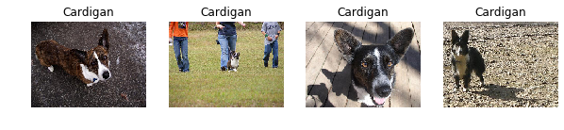
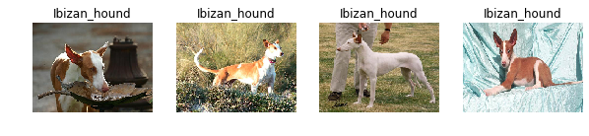
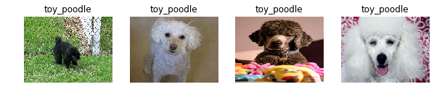
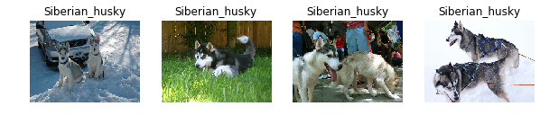
Images complexity : classification issues
Backgrounds
Topics confusion
High variance : colors, profiles, sizes...
Multiple subjects per image

Slide 20
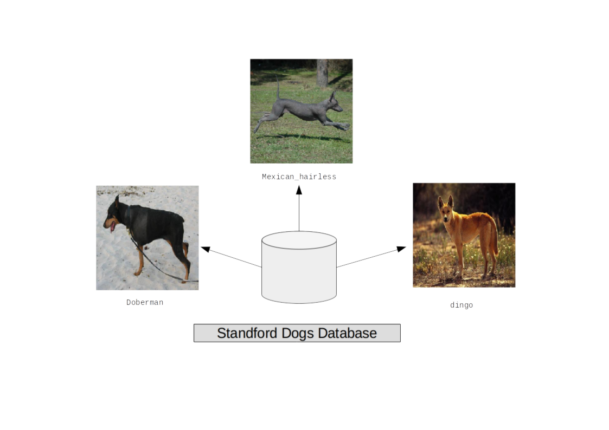
Dataset : 3 breeds
3 breeds
Train dataset : 400 images for 3 breeds
Test dataset: 40 images for 3 breeds

Slide 21
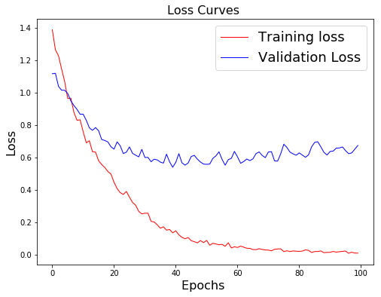
Reference: VGG-16 pre-trained

Slide 22
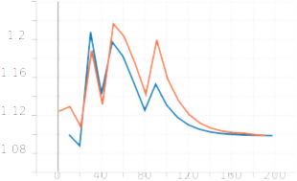
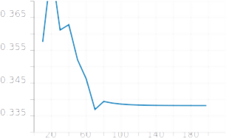
DNN network : baseline
Training loss decreases
Evaluation loss decreases
Accuracy does not improve
No learning Guarantee
Global steps : ............................ 200
NN type : ............................ DNN
Features shape : ............................ (224, 224, 3)
Number of layers : ............................ 3
Dropout rate : ............................ 0.0
Seed value : ............................ 42
Nb of classes (logit): ............................ 3
Weights initializer : ............................ xavier
Batch normalization : ............................ True
Learn mixture weights: ............................ True
Number of layers : ............................ 3
Hidden units : ............................ 128

Slide 23
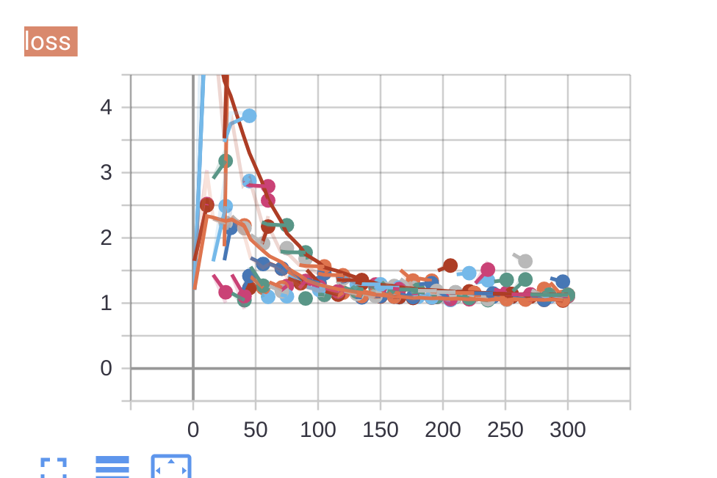
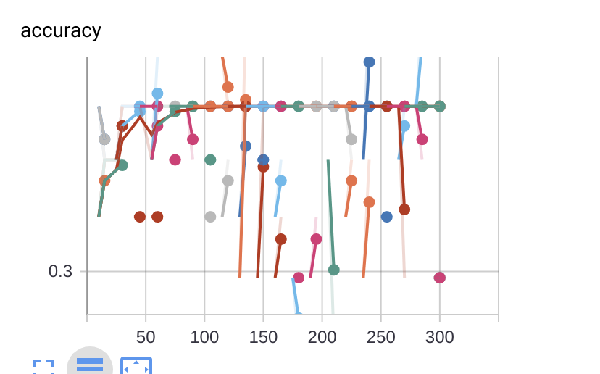
Adanet : DNN performances
Baseline : loss
Train
Eval

Slide 24
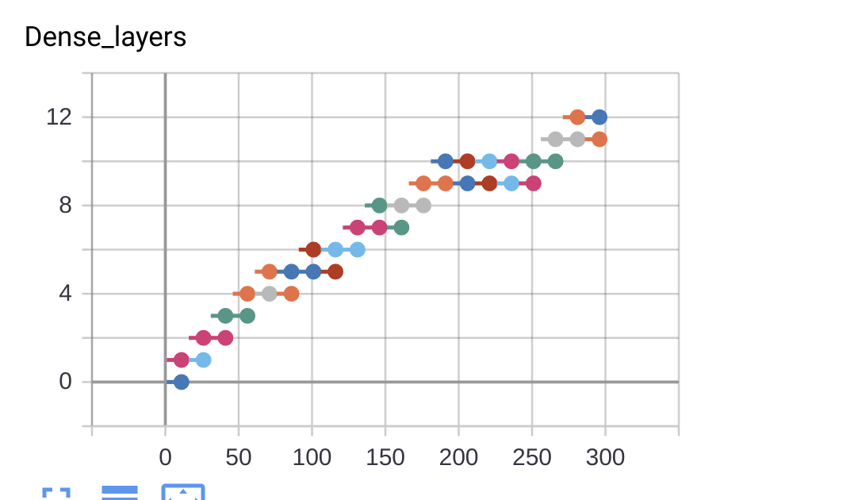
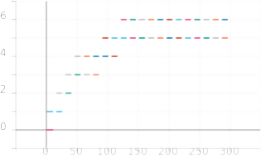
Adanet : complexity impact (DNN)
Rademacher regularization
No regularization
DNN network
Dense layers : 12
Steps : 300
ADANET iterations : 10
EVALAccuracy : 34 %

Slide 25
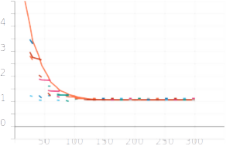
DNN networks : complexity

Slide 26
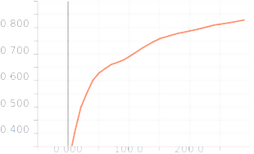
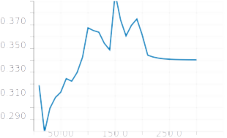
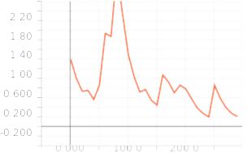
Results from CNN baseline
Train Accuracy
Eval Accuracy
NN type : ............................ CNNBase
Units in dense layer : ............................ 10
Number of layers : ............................ 2
Dropout rate : ............................ 0.0
Seed value : ............................ 42
Nb of classes (logit): ............................ 3
Weights initializer : ............................ xavier
Batch normalization : ............................ True
CNN seed : ............................ 42
Conv. Kernel size : ............................ (5, 5)
Conv. layers : ............................ 2
Dense layers : ............................ 1
Units in conv. layers: ............................ 10
CNN bacth norm. : ............................ True
Features map size : ............................ [64]
Conv filters : ............................ 32
Strides : ............................ 1
Padding : ............................ same
Activation function : ............................ relu
Loss

Slide 27
CNN : Baseline / generalization issue
Global steps : ............................ 50
NN type : ............................ CNN
Dropout rate : ............................ 0.0
Nb of classes (logit): ............................ 3
Batch normalization : ............................ True
Conv. Kernel size : ............................ (5, 5)
Conv. layers : ............................ 3
Dense layers : ............................ None
Units in dense layers: ............................ 128
CNN bacth norm. : ............................ True
Features map size : ............................ [64]
Conv filters : ............................ 32
Strides : ............................ 1
Padding : ............................ same
Activation function : ............................ relu
Empirical error and
Generalization error
to be balanced

Slide 28
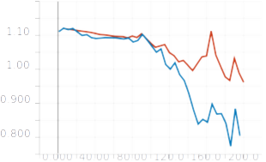
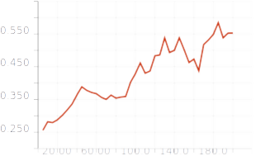
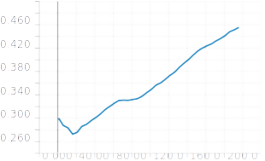
Baseline : CNN
Baseline : Loss
Baseline : Train Accuracy
CNN network
Conv layers : 3
Dense layers : 1
Kernel : (5,5)
Filters : 32
Steps : 200
Train
Baseline : Test Accuracy
Eval

Slide 29
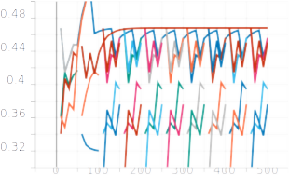
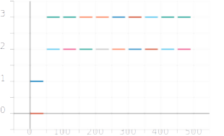
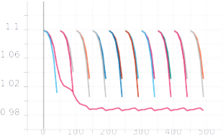
Results of CNN Adanet : conv. layers
Architecture: | CNN_linear | CNN_layer_2 | CNN_layer_2
Accuracy= 0.4893617033958435 / Loss= 1.0893726348876953
Adanet boosting iter.: ............................ 10
Adanet global steps : ............................ 500
Adanet iter per boost: ............................ 50
NN type : ............................ CNN
Features shape : ............................ (224, 224, 3)
Dropout rate : ............................ 0.0
Nb of classes (logit): ............................ 3
Adanet regularization: ............................ 1e-05
Weights initializer : ............................ xavier
Batch normalization : ............................ True
Learn mixture weights: ............................ True
CNN seed : ............................ 42
Conv. Kernel size : ............................ (5, 5)
Dense layers : ............................ 2
Units in dense layers: ............................ 128
CNN bacth norm. : ............................ True
Features map size : ............................ [64]
Conv filters : ............................ 32
Strides : ............................ 1
Padding : ............................ same
Activation function : ............................ relu

Slide 30
Adanet : CNN conv. layers
Adanet Loss
Baseline : Loss
Adanet Accuracy
Baseline Accuracy

Slide 31
CNN: Adanet structure
NN structure : convolutional layers
Rademacher regularization

Slide 32
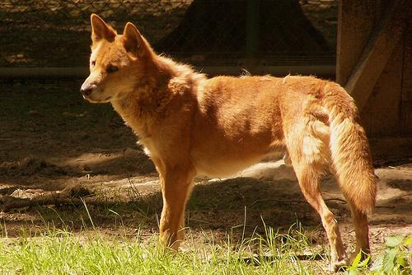
RNN : Colored images serialization
224
224
224 unrolled RNN cells
Serialization
t₁
t₂
t₂₂₄
RNN
RNN
RNN
224*3
Feeding
224

Slide 33
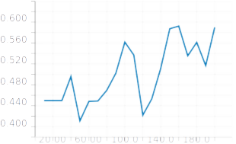
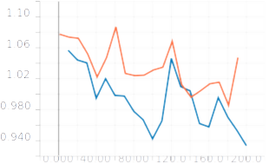
RNN Baseline: Simple RNN cell
Baseline : Accuracy
Baseline : Loss
NN type : ............................ RNN
Units in dense layer : ............................ 10
Number of layers : ............................ 1
Dropout rate : ............................ 0.0
Seed value : ............................ 42
Nb of classes (logit): ............................ 3
Weights initializer : ............................ truncated_normal
Batch normalization : ............................ True
Cell type : ............................ RNN
Hidden units : ............................ 128
Stacked cells : ............................ 1
Time steps : ............................ 224
Time (sec) 86.21402406692505
RNN_EVAL_ACCURACY: 0.699999988079071
LOSS: 0.903887152671814
GLOBAL_STEP: 200

Slide 34
RNN Baseline: Simple RNN cell
NN type : ............................ RNN
Units in dense layer : ............................ 10
Number of layers : ............................ 1
Dropout rate : ............................ 0.0
Seed value : ............................ 42
Nb of classes (logit): ............................ 3
Weights initializer : ............................ truncated_normal
Batch normalization : ............................ True
Cell type : ............................ RNN
Hidden units : ............................ 128
Stacked cells : ............................ 1
Time steps : ............................ 224
Time (sec) 86.21402406692505
RNN_EVAL_ACCURACY: 0.699999988079071
LOSS: 0.903887152671814
GLOBAL_STEP: 200

Slide 35
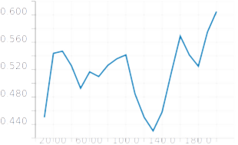
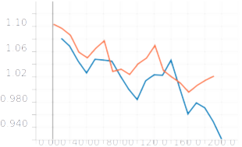
RNN Baseline : LSTM / 2 layers
Baseline : Accuracy
Baseline : Loss
NN type : ............................ RNN
Units in dense layer : ............................ 10
Number of layers : ............................ 2
Dropout rate : ............................ 0.0
Seed value : ............................ 42
Nb of classes (logit): ............................ 3
Weights initializer : ............................ truncated_normal
Batch normalization : ............................ True
Cell type : ............................ SLSTM
Hidden units : ............................ 128
Stacked cells : ............................ 2
Time steps : ............................ 224
Time (sec) 565.1023576259613
RNN_EVAL_ACCURACY: 0.6499999761581421
LOSS: 0.8784809112548828
GLOBAL_STEP: 200

Slide 36
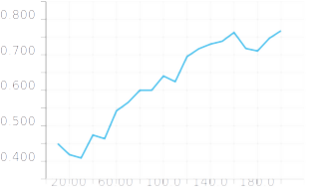
RNN Baseline : GRU 2 layers
Baseline : Accuracy
Baseline : Loss
NN type : ............................ RNN
Units in dense layer : ............................ 10
Number of layers : ............................ 2
Dropout rate : ............................ 0.0
Seed value : ............................ 42
Nb of classes (logit): ............................ 3
Weights initializer : ............................ truncated_normal
Batch normalization : ............................ True
Cell type : ............................ SGRU
Hidden units : ............................ 128
Stacked cells : ............................ 2
Time steps : ............................ 224
Time (sec) 1384.7687520980835
RNN_EVAL_ACCURACY: 0.800000011920929
LOSS: 0.7223628759384155
GLOBAL_STEP: 200

Slide 37
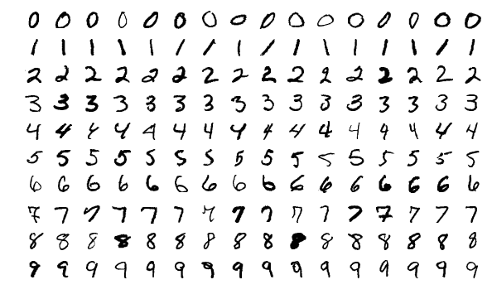
MNIST dataset
Train dataset : 55 000 inputs
Test dataset : 10 000 inputs
Classes : 10

Slide 38
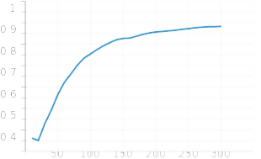
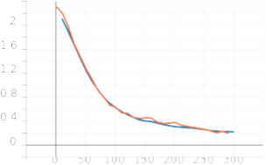
Baseline : GRU & MNIST
Baseline : Accuracy
Baseline : Loss
Global steps : ................................... 300
NN type : ............................ RNN
Features shape : ............................ (28, 28)
Number of layers : ............................ 2
Dropout rate : ............................ 0.0
Seed value : ............................ 42
Nb of classes (logit): ............................ 10
Weights initializer : ............................ truncated_normal
Batch normalization : ............................ True
Learn mixture weights: ............................ True
Cell type : ............................ SGRU
Hidden units : ............................ 128
Stacked cells : ............................ 2
Time steps : ............................ 28
Time (sec) 167
RNN_EVAL_ACCURACY: 0.94
LOSS: 0.21498049795627594
GLOBAL_STEP: 300

Slide 39
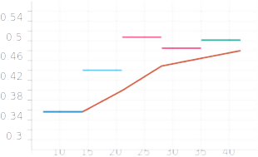
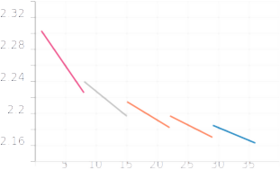
ADANET : GRU & MNIST
Adanet: Accuracy
Adanet: Loss

Slide 40
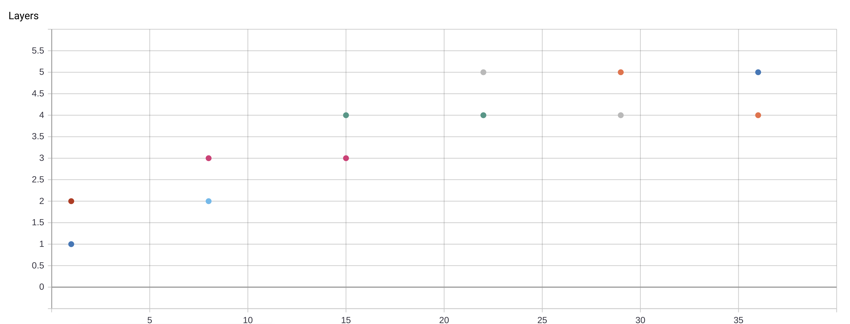
ADANET : architecture
Global steps : ................................... 300
NN type : ............................ RNN
Features shape : ............................ (28, 28)
Adanet boosting iter.: ............................ 40
Adanet iter per boost: ............................ 7
Dropout rate : ............................ 0.0
Seed value : ............................ 42
Nb of classes (logit): ............................ 10
Adanet regularization: ............................ 1e-05
Weights initializer : ............................ truncated_normal
Batch normalization : ............................ True
Learn mixture weights: ............................ True
Cell type : ............................ SGRU
Hidden units : ............................ 128
Stacked cells : ............................ 2
Time steps : ............................ 28
Layers: 5 stacked GRU cells
Classes : 10

Slide 41
Conclusions
Formulation allows flexible ‘feed-forward’ architectures
Formulation allows increase number of units in layers as well
Adapts complexes NN models to complex problems
No prior selection of model complexity (number of layers, depth of tree,…)
Apply to any kind of ensemble models (provide layers or logits)
Candidates fine tuning :
  Dropout inside candidates subnetworks
CNN
  Strategy over convolutional layers : C = (I-F+2P)/S +1
  Strategy for increasing dense layers
RNN
  Strategy to be tuned
  Requires more resources
GAN networks
  To be investigated

