Slide 1

Parcours Datascientist : projet 7
Indexation automatique d’images
issues de la banque d’images Standford Dogs Dataset
Francois BANGUI

Slide 2
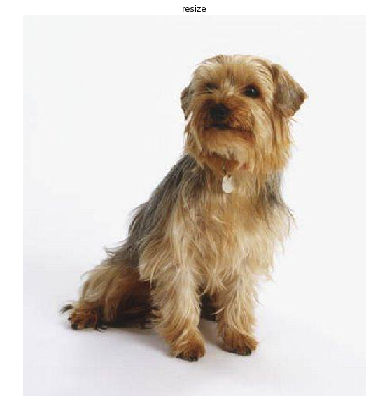
Problem classification type
Yorkshire
Doberman
. . .
Saint_Bernard
Image classification
Yorkshire
Multi-class classification

Slide 3
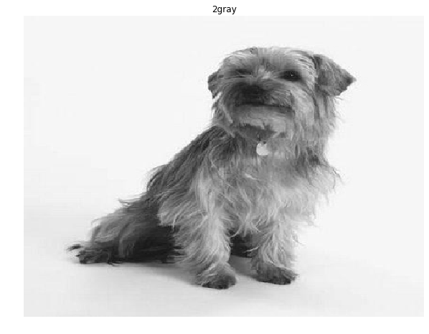
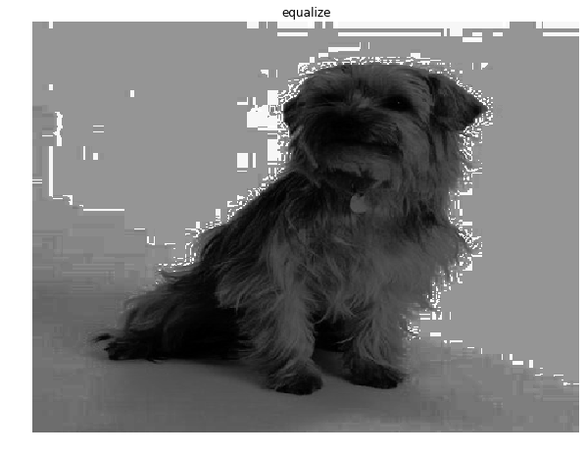
Images processing
Image file loaded
Breed : Yorkshire terrier
Image resized
median(X,Z)
Convert to gray
Equalize

Slide 4
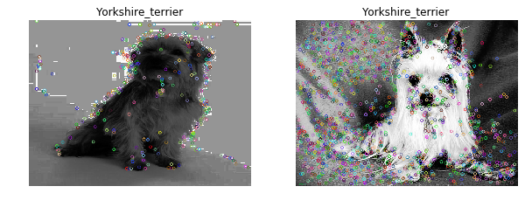
Features extraction with SIFT
405 key points
1881 key points

Slide 5
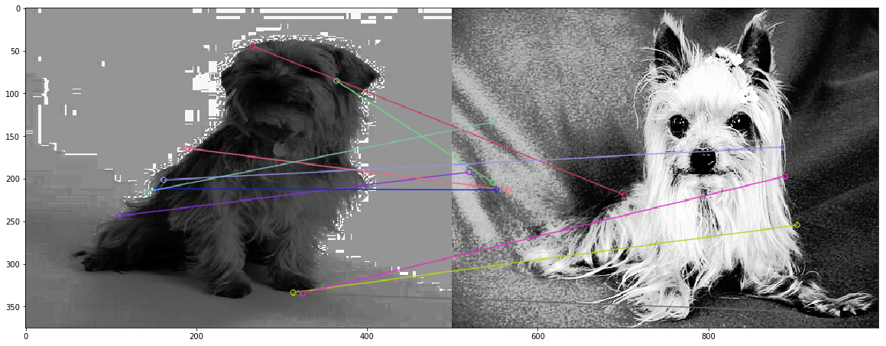
SIFT Key points matching

Slide 6
Clustering

Slide 7
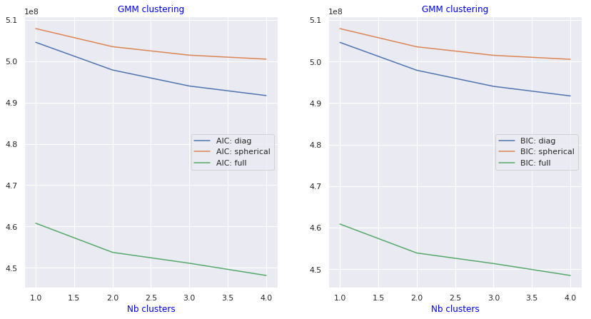
GMM clustering : 2 classes
Breeds :
n02092002-Scottish_deerhound
n02093859-Kerry_blue_terrier
Images samples : 100
Sampling type : random

Slide 8
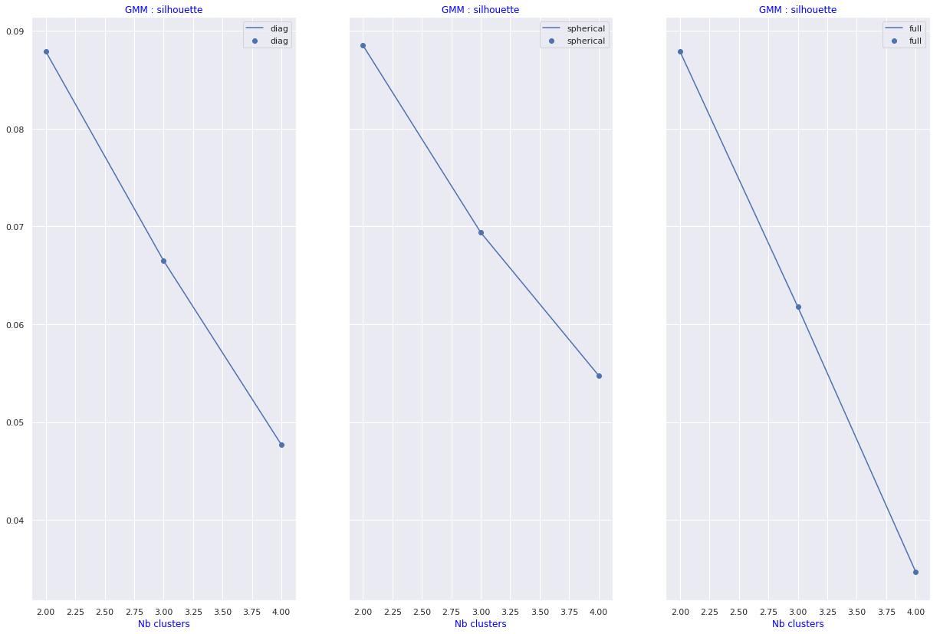
GMM clusters silhouettes

Slide 9
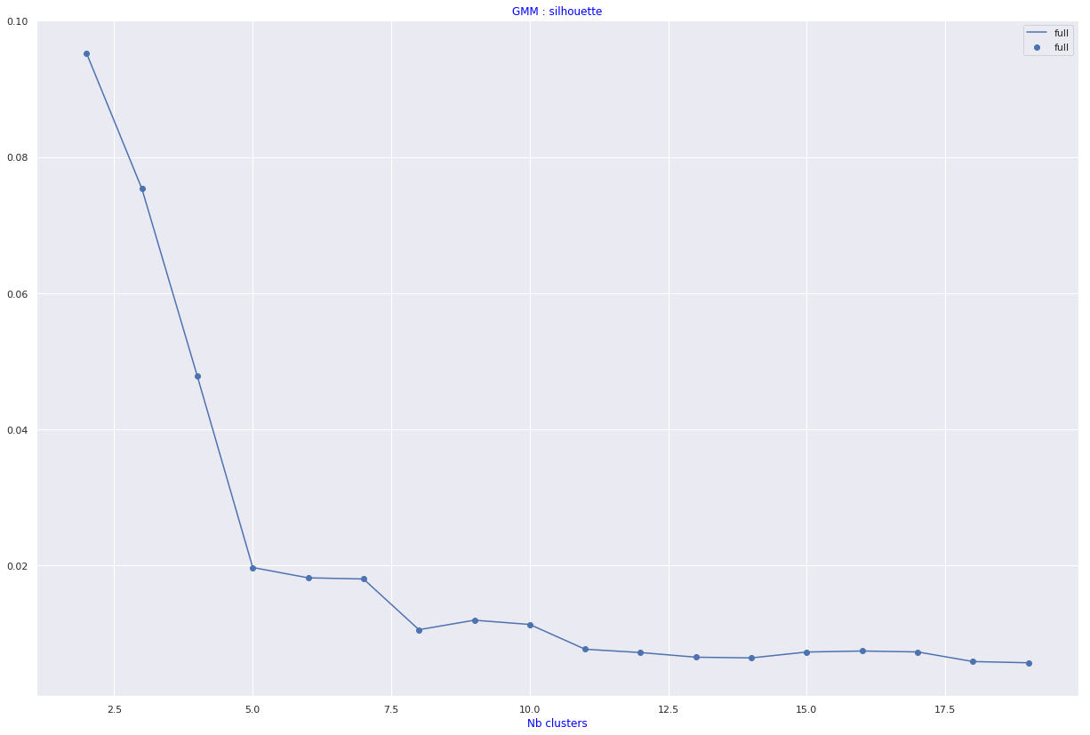
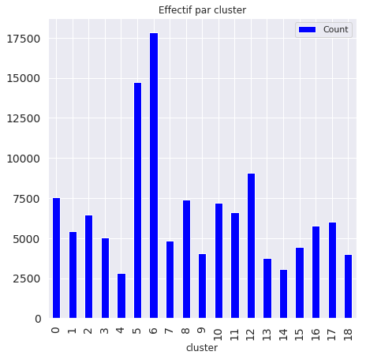
GMM clustering : 10 breeds selected by hand
Count
cluster
6 17835
5 14722
12 9090
0 7548
8 7379
10 7196
11 6613
2 6478
17 6029
16 5760
1 5448
3 5060
7 4821
15 4455
9 4037
18 4013
13 3751
14 3077
4 2804

Slide 10
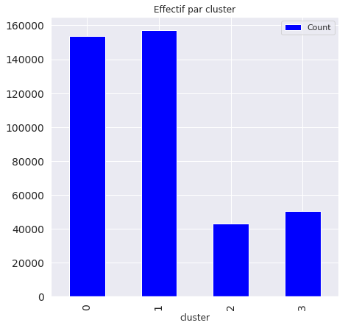
GMM : effectives per cluster
2 main clusters do match with 2 breeds

Slide 11
Supervized method
KP₀
KP₁
.
.
.
KP_{N}

Slide 12
Conclusions & perspectives
Méthodes supervisées :
  La qualité des résultats dépendent de la qualité des features

Slide 13
Annexe 1 : source files organization
Notebooks : notebook
P7_DataAnalysis.ipynb : data analysis
P7_DataBreed.ipynb :
Python source files: src
P7_DataBreed.py : classifier implementation
p7_util.py : functions for P6 project
p6_util.py : functions for P6 project
p6_util_plot.py : functions for plot
p5_util.py : functions from P5 project used in P6 project
p3_util.py : functions from P3 project used in P6 project
Report: report
Openclassrooms_ParcoursDatascientist_P7-V1.pdf : presentation

Slide 14
Annexe 2 : deployment
Classifier object :
oP6_PostClassifier.dump : dumped formated classifier
Application directory
tag_suggested
Launching Flask server :
cd .../<projet>; python3.6 views.py;
API :
http://127.0.0.1:5000?post_id=<number>
http://127.0.0.1:5000?* : random ID for POST

