Slide 1
Pothole and Road Surface Irregularity Detector
Data Science @ Thinkful
Saheed A.Tijani, May 2019
The full Jupyter note for this project is available here

Slide 2
Objective: Predict the presence of potholes and irregularities on road surfaces.
Why do this?
Below are some use cases of this this project:
Vehicle insurance – to aid premium calculation
Road network maintenance – Government Agencies
Autonomous vehicle vision

Slide 3
About the Dataset:
Data was created in an computer vision academic research in South Africa.
It consists of about 4000 positive (with potholes) and negative (no potholes) images with full annotation.
The data was grouped into simplex and complex sets, I have used the simplex sets in this project
See more details about data and it’s source here

Slide 4
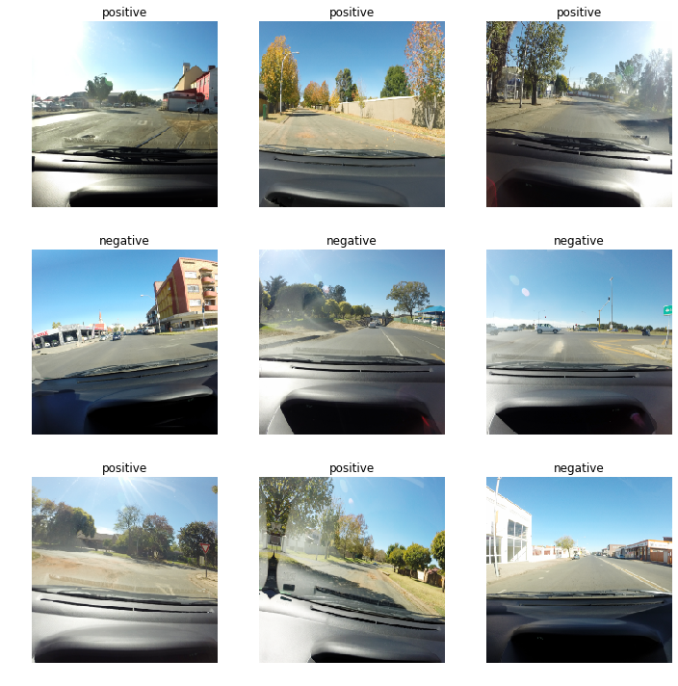
Samples of Data set with Labels
positive
positive
positive
negative
negative
negative
positive
positive
negative

Slide 5
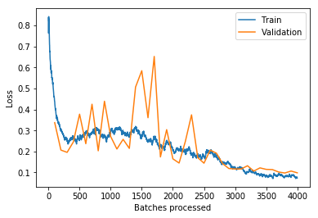
Model Training Report – Loss and Accuracy
Training/Test losses after 40 epochs
epoch | Train Loss | Valid Loss | Accuracy | Time
29 | 0.125914 | 0.116769 | 0.950125 | 07:00
30 | 0.119732 | 0.117049 | 0.952618 | 07:07
31 | 0.101055 | 0.132218 | 0.950125 | 06:58
32 | 0.102475 | 0.106862 | 0.961347 | 07:04
33 | 0.089593 | 0.122064 | 0.956359 | 07:02
34 | 0.086159 | 0.114964 | 0.957606 | 07:07
35 | 0.075728 | 0.113984 | 0.953865 | 07:05
36 | 0.089039 | 0.102409 | 0.958853 | 07:09
37 | 0.080956 | 0.097645 | 0.957606 | 07:04
38 | 0.076529 | 0.106949 | 0.956359 | 07:07
30 | 0.073915 | 0.098528 | 0.957606 | 07:09

Slide 6
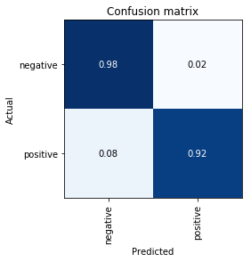
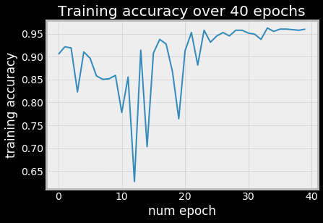
Model’s Accuracy and Confusion Matrix - training
Stabilizing after 24 epochs

Slide 7
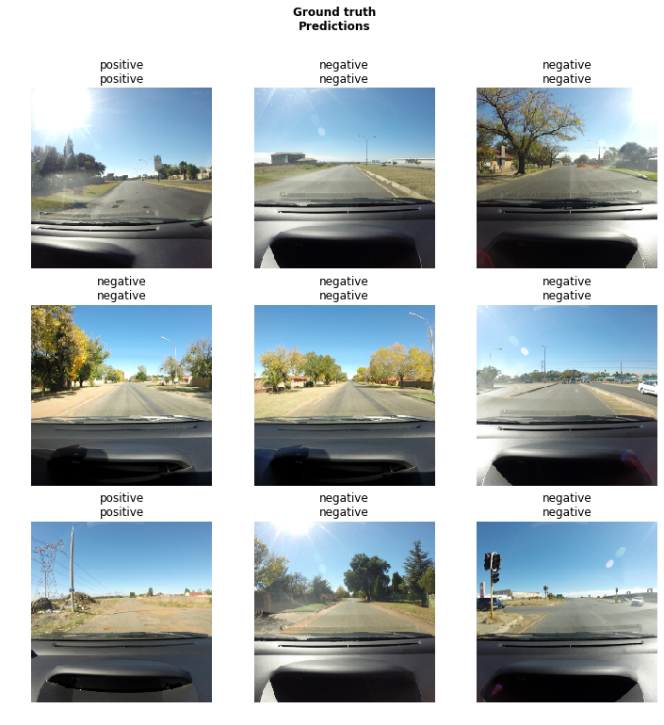
Model Output – Ground Truth Vs Prediction

Slide 8
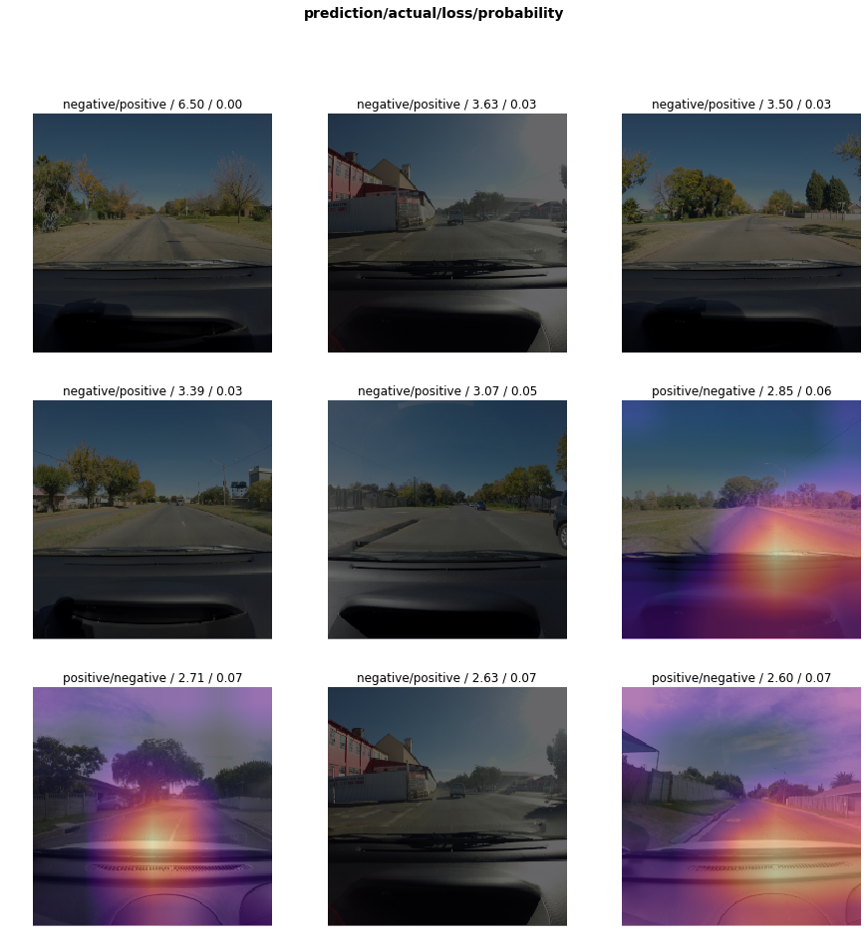
Top losses – prediction/actual/loss/probability

Slide 9
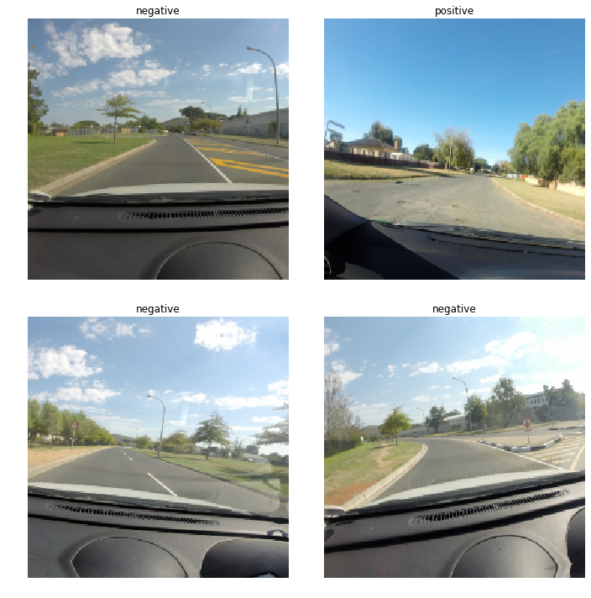
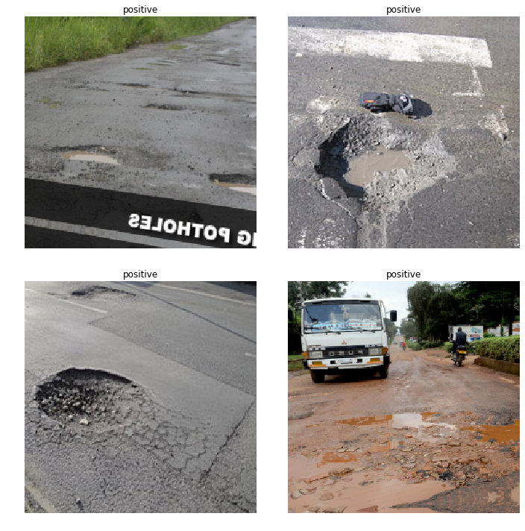
Model Testing – Test set and Google Images
Test Set - Accuracy: 100%, Loss: 0.0487
Google Set - Accuracy: 100%, Loss: 0.0487
negative
positive
positive
positive
negative
negative
positive
positive

Slide 10
Conclusion and Areas of Further Improvement
I will be including a regression model to localise the detected potholes going forward.
I will also have a go with other vision library like other YOLOv3 from localization to solve the same problem.
The data set has a complex set which I did not really utilize in this project, I will like to have a go with in the future.

Slide 11
Thank you …
Notes:
This gives a sense of increment allowing values to be derived.
Delete rain today and tomorrow, go more in depth into wind, what was the problem, why didnt you just want to one hot encode or represent as a linear discrete feature?
If I had more time, I would use Long and Latitude, use zipcode, something to relate distance another. I used one-hot-enocding to save time, however I acknowledge there could potential improvements.

Slide 12
