Slide 1
Will it Rain Tomorrow in Australia?
Data Science @ Thinkful
Saheed A.Tijani, Feb. 2019
The full Jupyter note for this project is available here

Slide 2
Objective: To predict whether or not it will rain anywhere in Australia tomorrow.
Why do this?
Below are some use cases of this information:
Planning of irrigation and other farming activities
Airplane route planning
Construction activities scheduling
Extracurricular activities planning for school children

Slide 3
About the Dataset:
Data was captured daily from numerous weather stations across Australia between 2007 and 2017.
Contains 23 independent variables and 142,193 observations.
There was a sizeable class imbalance, this prompted me to use the AUC ROC metric in model evaluation.
See more details about data and it’s source here

Slide 4
Features in dataset and their types
FEATURE NAME | TYPE
Date | Date
Location | String/Categorical
MinTemp | Numerical
MaxTemp | Numerical
Rainfall | Numerical
Evaporation | Numerical
Sunshine | Numerical
WindGustDir | String/Categorical
WindGustSpeed | String/Categorical
WindDir9am | String/Categorical
WindDir3pm | String/Categorical
WindSpeed9am | Numerical
WindSpeed3pm | Numerical
Humidity9am | Numerical
Temp9am | Numerical
Temp3pm | Numerical
RainToday | Boolean
RISK_MM | Numerical
RainTomorrow | Boolean
Humidity3pm | Numerical
Pressure9am | Numerical
Pressure3pm | Numerical
Cloud9am | Numerical
Cloud3am | Numerical

Slide 5
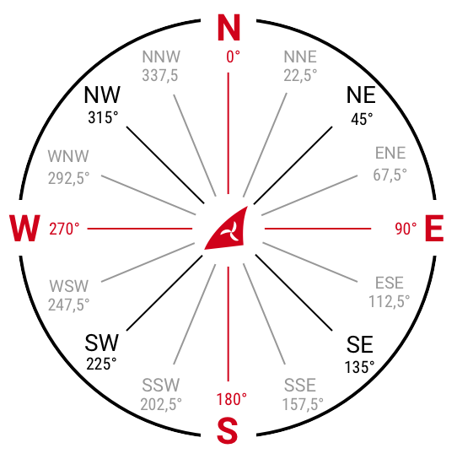
Feature Engineering
I ranked the values for the wind direction features from 0 - 15 using standard clockwise cardinal rotation.
I one-hot-encoded location for the first model iteration for the sake of simplicity.
Standard clockwise cardinal rotation 0 - 360
Notes:
This gives a sense of increment allowing values to be derived.
Delete rain today and tomorrow, go more in depth into wind, what was the problem, why didnt you just want to one hot encode or represent as a linear discrete feature?
If I had more time, I would use Long and Latitude, use zipcode, something to relate distance another. I used one-hot-enocding to save time, however I acknowledge there could potential improvements.

Slide 6
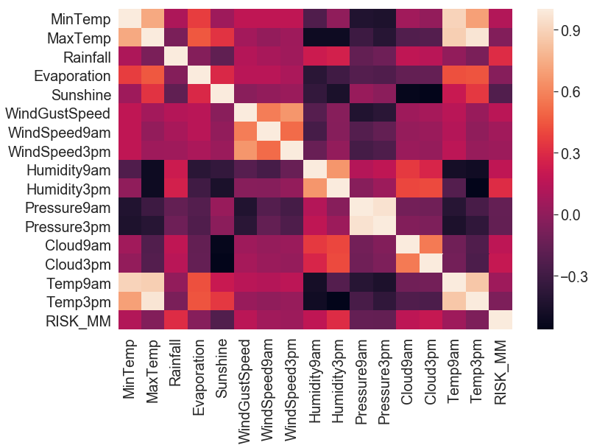
Correlation Assessment of Numerical Features
High Correlation
Humidity vs Rainfall
Temperature vs Evaporation
Humidity vs Cloud

Slide 7
Benchmark Model: Decision Tree(DT)
Confusion Matrix - Train
MODEL REPORT:
Train Test
Accuracy: 1.0 Accuracy:0.7959
AUC score:1.0 AUC score:0.7056
CV_scores (metric: AUC)
Mean: 0.7050
Std: 0.0042
98710
0
0
27998
Confusion Matrix - Test
9348
1528
As expected with a typical DT model, it recorded a 100% training accuracy. But model seems to generalise well and stable considering the CV scores.
1468
1735

Slide 8
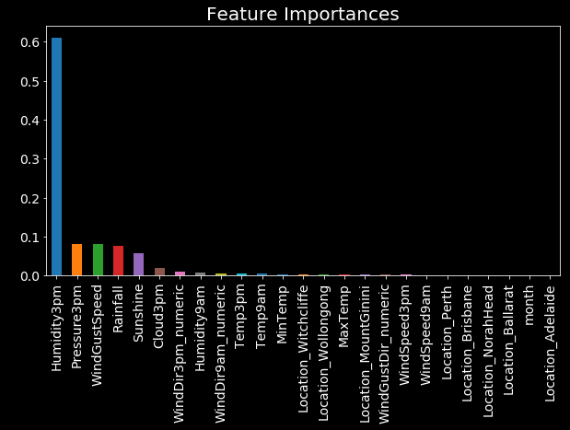
Default Gradient Boost Model
MODEL REPORT – Default BGM:
Train Test
Accuracy:0.8541 Accuracy:0.8545
AUC score: 0.8803 AUC score:0.8788
Cross validation scores:
Mean - 0.8768
Std - 0.0023
Compared to the DT, there's a significant performance improvement here.
On the flip side, about 60% of the variance in the outcome was derived from only Humidity3pm. This was regularized in the tuned model.

Slide 9
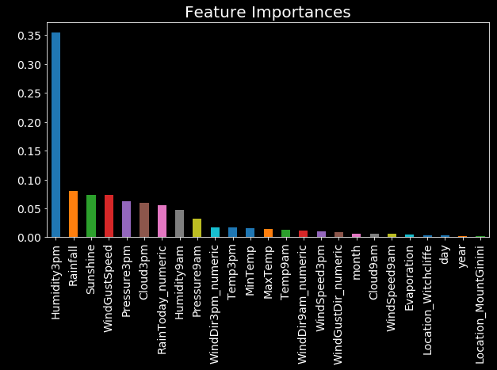
Tuned Gradient Boost Model:
Tuned param values
More distributed feature importances
n_estimators | 30
max_depth | 15
min_samples_split | 600
min_samples_leaf | 100
subsample | 0.7
max_features | 19
random_state | 10

Slide 10
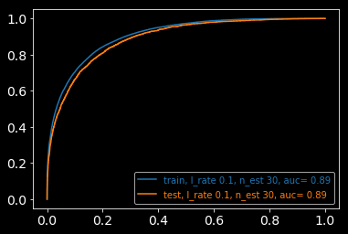
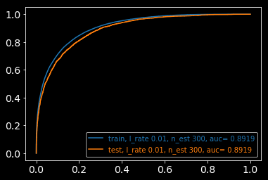
Tuned Gradient Boost Model Scores
Learning_rate(l_rate) | n_est | accuracy | cv_mean | cv_std | AUC_score
0.10 | 30 | 0.8645 | 0.8859 | 0.0019 | 0.9063
0.01 | 300 | 0.8657 | 0.8880 | 0.0020 | 0.9088
Best Model Scores

Slide 11
Model Comparison - Logistic Regression
Running the data through Logistic Regression, the model performed worse than BGM. The accuracy scores peaked at 0.8499 with c=10.
Reg. parameter | accuracy | cv_maean | cv_std | AUC_score
0.001 | 0.8220 | 0.8370 | 0.0014 | 0.8406
0.010 | 0.8435 | 0.8603 | 0.0013 | 0.8618
0.100 | 0.8485 | 0.8682 | 0.0013 | 0.8492
1.000 | 0.8497 | 0.8712 | 0.0012 | 0.8718
10.000 | 0.8499 | 0.8716 | 0.0012 | 0.8721
100.000 | 0.8499 | 0.8716 | 0.001 | 0.8721

Slide 12
Areas of Future Improvement
Further work could be done around feature engineering. For example, location could be converted into coordinates(i.e latitude and longitude) of weather stations rather than encoding as dummies.
Introducing elements of time and trends such as seasonality. For example we could dummify the time of day and the season of the year from when an observation was recorded.
I could try more advanced models like Neural Networks.

Slide 13
Thank you for your time….

Slide 14
Appendix

Slide 15
Navigating the Jupyter Notebook:
In [1 - 3] – Tools and Dataset importation
In [4 – 17] – Initial Data Exploration and Fixing Nans
In [18 – 32] – Feature Engineering and Further Data Exploration
In [19 – 34] – Data Preparation and Ground Work for Modelling
In [62 – 65] – Baseline Models and Evaluation
In [66 – 72] – Hyper Parameter Tuning – GBM
In [67 – 72] – Tuned GBM Model and Evaluation
In [73 – 77] – Model comparison – Logistic Regression
Click here for the GitHub link to the Jupyter notebook

Slide 16
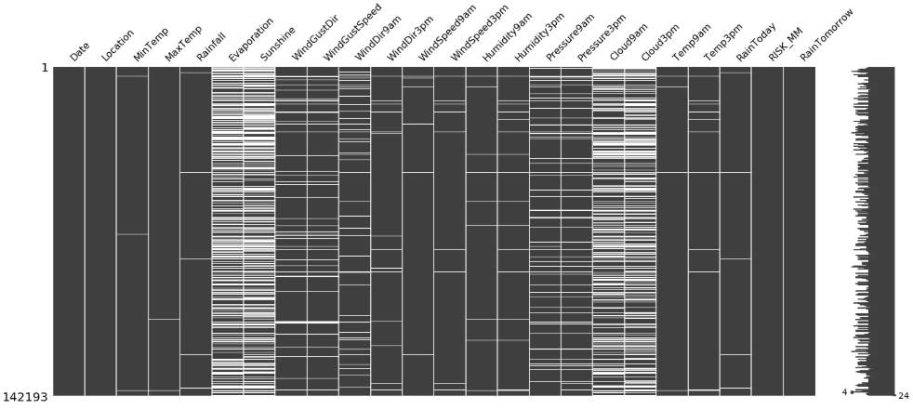
Missing values – white strands indicate missing
Data shape, before treating NaNs: 142,193 x 24 | Data shape after treating NaNs: 140,787 x 24

Slide 17
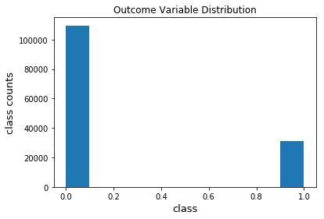
Outcome variable – Indicating Class in Balance
‘0.0’ - No Rain Tomorrow, ‘1.0’ - Rain Tomorrow

Slide 18
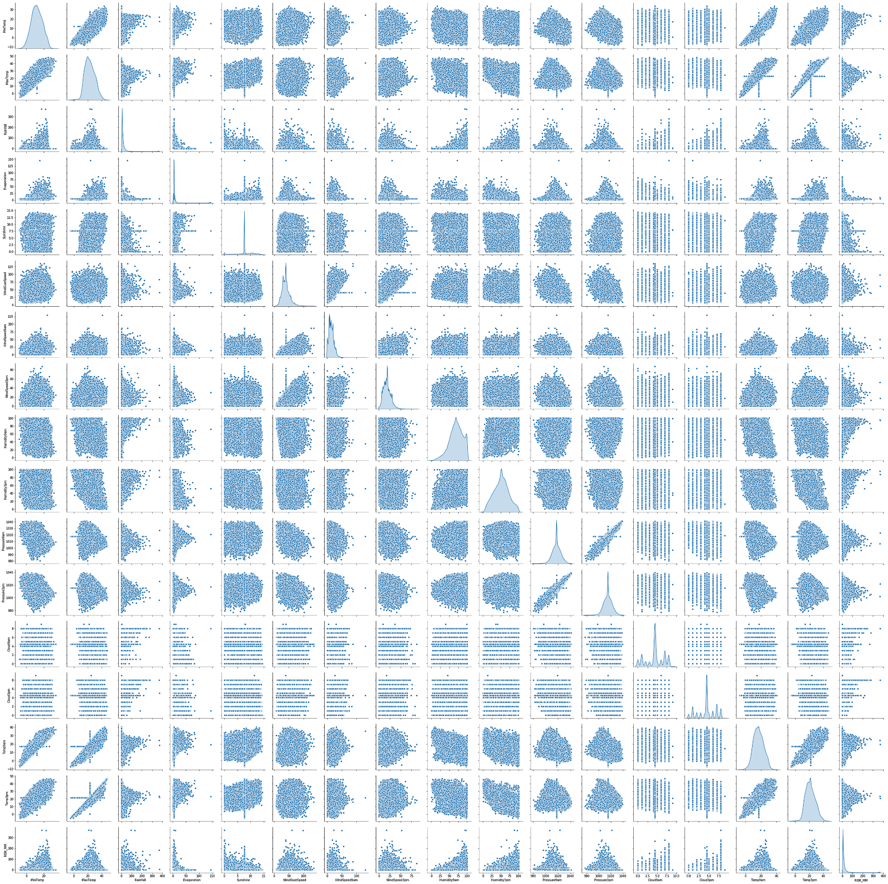
Bivariate Feature Visualization

Slide 19
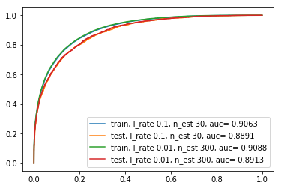
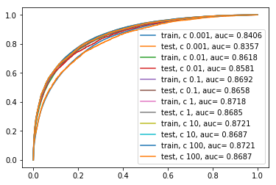
ROC/AUC - Comparison
Logistic Regression
Gradient Boost

