Slide 1
presented by Jurat Shayiding
Clickthrough based Deep Structured Semantic Model

Slide 2
Project outline
1
begin by motivation and approaches

Slide 3
What is Motivation?
LSA model intend to mapping query to its relevant document at semantic level is not successful when keyword based matching is applied (to address the case such as a query and a document, represented as two vectors in the lower dimensional space can still have high similarity score even they do not share any terms )

Slide 4
Motivation (continued)
why clickthrough based deep structured semantic model?
to leverage limitation of LSA model on keyword based semantic matching
use deep neural network to rank a set of documents for given query
use deep auto encoder to extract hierarchical semantic features that embedded in query and document

Slide 5
Project Goals and Outcomes
Data Collection and Preprocessing
Implement proposed wordhashing method
reproduce TF-IDF baseline model for semantic matching
Implement clickthrough based deep structured semantic model
Measure and compare the performance of trained clickthrough based semantic models on training dataset

Slide 6
The Dataset
Data Description: data was collected from OPPO big data competition, which aimed to sort query-title semantic matching problem in mobile web search
Data description:
prefix | User input (query prefix)
query prediction | based on current prefix, the predicted user is going to complete requirement query words up to 10
title | Article title
tag | Article context tag
label | Status of clicked or not

Slide 7
Project Implementation
2
roadmap, performance evaluation

Slide 8
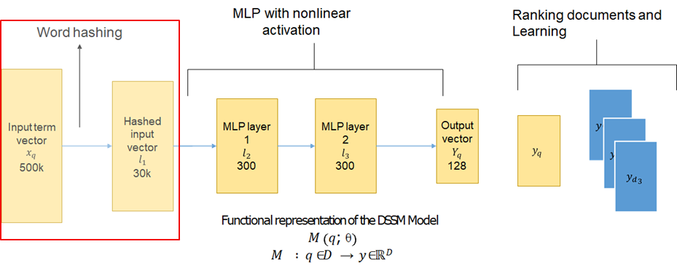
Click-through deep semantic model

Slide 9
Implementation Roadmap
Matching score
Matching layer
presentation layer
(BOW/RNN)
presentation layer
(BOW/RNN)
Input layer
Input layer
query
title

Slide 10
Implementation Roadmap explained
Input layer: map the sentence to a vector space and input it into the click-based deep structured semantic model
input layer processing method of Chinese character is challenging; so no segmentation was applied, only imitate the processing method in English
Presentation layer: input of click-based deep semantic model are queries and documents mapped on so-called n-gram spaces (a.k.a, the output of wordhashing -trigram)
Matching layer: semantic similarity between Query and Doc can be expressed by the cosine distance where softmax function can be used to convert the semantic similarity between Query and the positive sample Doc into a posterior probability to to obtain the parameters {Wi, bi} of each network layer

Slide 11
Project Results
3
We continue by detailing the project results

Slide 12
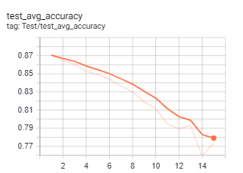
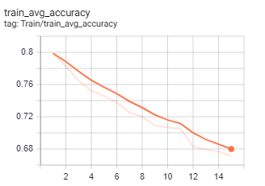
Result of baseline model

Slide 13
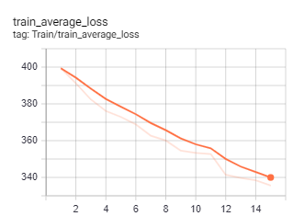
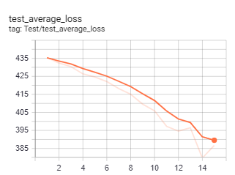
Result of baseline model (continued)

Slide 14
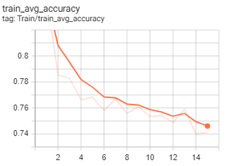
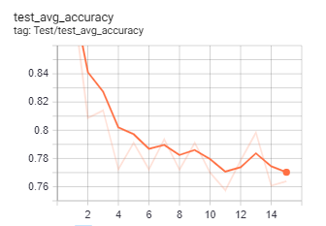
Result of deep semantic model with RNN -1

Slide 15
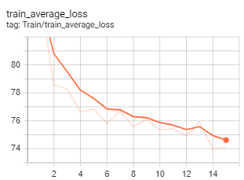
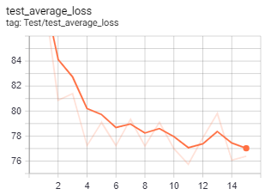
Result of deep semantic model with RNN -2

Slide 16
Project Insights
4
We conclude by discussing what we learned

Slide 17
About the Data & Model
input layer processing method of Chinese is very different from that of English (Chinese word segmentation is very difficult to do)
difficult to retrieve well structured click-based web search data
semantic information of Query and Title in the engine's click exposure log is weak

Slide 18
Future Work
current project can be extended further and integrated to potential semantic matching application such as question-answering application
Better dataset in English corpus can be utilized incurrent click-based deep semantic matching model
optimal parameter optimization to prevent current deep semantic matching model from overfitting

Slide 19
Reference
Xiaodong He et al., 2013, in CIKM 2013;
Learning deep structured semantic models for web search using clickthrough data
Xiaodong He et al., 2014, in WWW 2014
Learning semantic representations using convolutional neural networks for web search
Jianfeng Gao et al., 2011, in SIGIR 2011
Clickthrough-Based Latent Semantic Models for Web Search

Slide 20
Project Source Code
This project is distributed under GNU General Public License v3.0 where source code is available at: https://github.com/jshayiding/CS586-Class-Project.git

Slide 21
Thanks!
Any questions?

