Slide 1
MLOps with Databricks
Presentor :
Tanishka Garg

Slide 2
KnolX Etiquettes
Lack of etiquette and manners is a huge turn off.
Punctuality
Join the session 5 minutes prior to the session start time. We start on time and conclude on time!
Feedback
Make sure to submit a constructive feedback for all sessions as it is very helpful for the presenter.
Silent Mode
Keep your mobile devices in silent mode, feel free to move out of session in case you need to attend an urgent call.
Avoid Disturbance
Avoid unwanted chit chat during the session.

Slide 3
Understanding Databricks
What is MLOps?
Components of MLOps
Benefits of MLOps
MLOps with Databricks
Why Implement MLOps with Databricks?
Development stage
Staging stage
Production stage
Components of MLOps with Databricks
Demo

Slide 4
Introduction to Databricks

Slide 5

Introduction to Databricks
Databricks is a unified, open analytics platform for building, deploying, sharing, and maintaining enterprise-grade data, analytics, and AI solutions at scale. Most of the tasks include:
Data processing scheduling and management, in particular ETL
Generating dashboards and visualizations
Managing security, governance, high availability, and disaster recovery
Data discovery, annotation, and exploration
Machine learning (ML) modeling, tracking, and model serving
Generative AI solutions

Slide 6
02
What is MLOps?

Slide 7
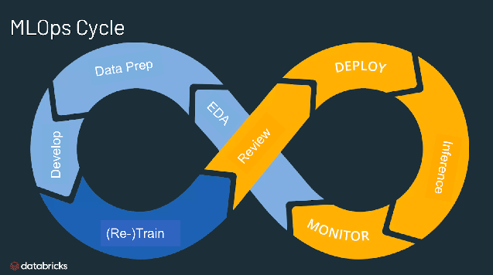
What is MLOps?
MLOps stands for Machine Learning Operations.
MLOps is a core function of Machine Learning engineering, focused on streamlining the process of taking machine learning models to production, and then maintaining and monitoring them.
MLOps is a collaborative function, often comprising data scientists, devops engineers, and IT.

Slide 8
Benefits of MLOps?
Efficiency:
MLOps allows data teams to achieve faster model development, deliver higher quality ML models, and faster deployment and production.
Scalability:
MLOps also enables vast scalability and management where thousands of models can be overseen, controlled, managed, and monitored for continuous integration, continuous delivery, and continuous deployment.
Specifically, MLOps provides reproducibility of ML pipelines, enabling more tightly-coupled collaboration across data teams, reducing conflict with devops and IT, and accelerating release velocity.
Risk reduction:
Machine learning models often need regulatory scrutiny and drift-check, and MLOps enables greater transparency and faster response to such requests and ensures greater compliance with an organization's or industry's policies.

Slide 9
03
MLOps with Databricks

Slide 10
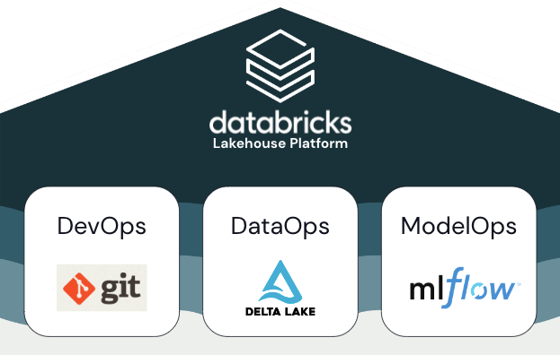
MLOps with Databricks
MLOps is a set of processes and automated steps to manage code, data, and models. It combines DevOps, DataOps, and ModelOps.
Databricks recommends creating separate environments for the different stages of ML code and model development with clearly defined transitions between stages.
Development
Staging
Production

Slide 11
MLOps with Databricks
Development Stage
The focus of the development stage is experimentation.
Data scientists develop features and models and run experiments to optimize model performance. The output of the development process is ML pipeline code that can include feature computation, model training, inference, and monitoring.
Staging Stage
The focus of this stage is testing the ML pipeline code to ensure it is ready for production. All of the ML pipeline code is tested in this stage, including code for model training as well as feature engineering pipelines, inference code, and so on.
ML engineers create a CI pipeline to implement the unit and integration tests run in this stage. The output of the staging process is a release branch that triggers the CI/CD system to start the production stage.
Production Stage
ML engineers own the production environment where ML pipelines are deployed and executed.
These pipelines trigger model training, validate and deploy new model versions, publish predictions to downstream tables or applications, and monitor the entire process to avoid performance degradation and instability.

Slide 12
Why implement MLOps with Databricks?
A unified platform
Scalibilty and performance
MLflow Integration
Simplified ML workflow
Automated deployment
Improved Model Training

Slide 13
04
Components of MLOps with Databricks

Slide 14
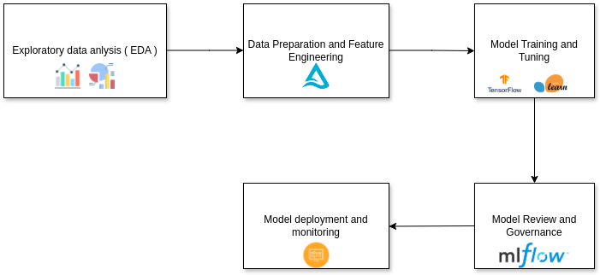
What are the components of MLOps?

Slide 15
Exploratory Data Analysis - EDA
Exploratory data analysis (EDA) includes methods for exploring data sets to summarize their main characteristics and identify any problems with the data.
EDA can also influence which algorithms you choose to apply for training ML models.
Databricks has built-in analysis and visualization tools in both Databricks SQL and in Databricks Runtime.

Slide 16
Data Preparations and Feature Engineering
Data preparation:
Cleaning and formatting data: This includes tasks such as handling missing values or outliers, ensuring data is in the correct format, and removing unneeded columns.
Preprocessing data: This includes tasks like numerical transformations, aggregating data, encoding text or image data, and creating new features.
Combining data: This includes tasks like joining tables or merging datasets.
Storing the data: For storing the data we use Delta Lake, as Delta Lake is the optimized storage layer that provides the foundation for tables in a lakehouse on Databricks. Delta Lake is open source software that extends Parquet data files with a file-based transaction log for ACID transactions and scalable metadata handling.
Feature Engineering
It is the process of converting raw data into features that can be used to develop machine learning models.
For ML applications, Databricks Feature Store helps your team discover and re-use features, track feature lineage, and publish features to online stores for real-time serving and automatic lookup.

Slide 17
Model Training and Tuning
Once you’re done with feature engineering, the next step is to train and tune your model and select the right algorithm or architecture so that your model can achieve the desired accuracy.
Use popular open source libraries such as scikit-learn and hyperopt to train and improve model performance.
As a simpler alternative, use automated machine learning tools such as AutoML to automatically perform trial runs and create reviewable and deployable code.

Slide 18
Model serving and deployment
Databricks Model Serving provides a unified interface to deploy, govern, and query AI models.
Each model you serve is available as a REST API that you can integrate into your web or client application.
Why use Model serving?
Deploy and query any models
Securely customize models with your private data
Govern and monitor models
Reduce cost with optimized inference and fast scaling
Bring reliability and security to Modell serving

Slide 19
05
DEMO

Slide 20
References
https://www.databricks.com/

