Slide 1
Stata 101
Karl Ho

Slide 2
Outline of Session
Stata Basics
Beginning (Opening Program and Data)
Exploring the Data
Modifying the Dataset
Keeping Good Records
Helpful Hints

Slide 3
Groundrules
Point & Click (P&C)
Operation using the mouse
Pro: easy to use, logically linked; Con: cumbersome, not good for replication
Command
Operation using command and typing syntax
Pro: easily replicable, program can be saved; Con: learning curve

Slide 4
Outline of Session
Beginning (Opening program & data)
Exploring the Data
Modifying the Dataset
Keeping Good Records
Helpful Hints

Slide 5

Beginning: Opening STATA
Option 1:
Start → Programs → Stata
Option 2:
Double-click on STATA Icon on your Desktop

Slide 6
Beginning: STATA Windows
Variables
Lists the variables that are in your data set
Command
Where we will tell STATA what to do by typing commands
Review
Lists all the commands that you have already used.
Allows us to easily repeat command by clicking on the right one
Properties
Gives detail of the data set and variable
Results
Where all the output from our commands will appear
Graph

Slide 7
Beginning: STATA Windows
Command → Results
E.g. memory, help
Try:
query mem
How about:
Query mem
Or:
q mem
What do you know about Stata now?
Command case-sensitive
Abbreviated commands

Slide 8
Beginning: STATA Windows
Set command
Setting up system commands
E.g. set more
Try:
set more off
How about setting it on back?
Other examples
help, findit
Hint: Stata is designed for replications, which is great for modeling different specifications. PageUp and PageDown keys are your favorite buttons

Slide 9

Beginning: Opening STATA Data
Point and click (P&C): File → Open or
Command: Use the use command for data already in STATA format
use T:\Ho\stata\BRMAR03.DTA, clear
Note: clear option clears any previous data in the memory
Notes:
SET MEM: 13.8mb

Slide 10
Outline of Session
Beginning (Opening Program and Data)
Exploring the Data
Modifying the Dataset
Keeping Good Records
Helpful Hints

Slide 11
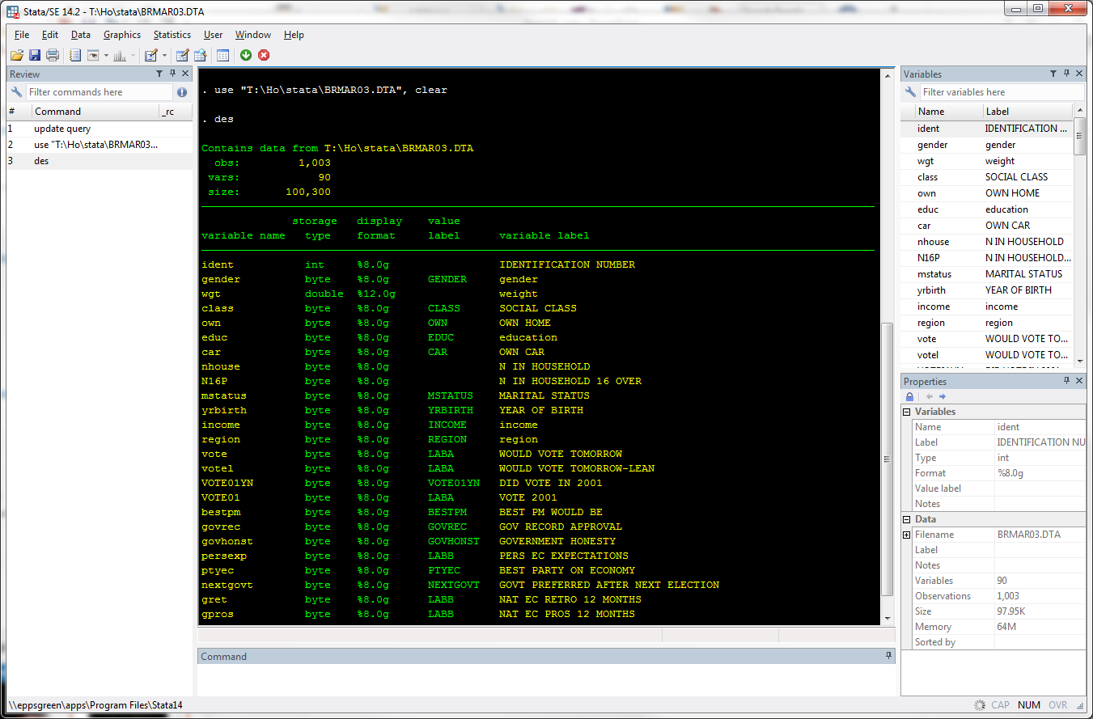
Exploring the Data: Getting to Know the Variables
describe command

Slide 12
Exploring the Data: Getting to Know the Variables
describe command
Overview of the dataset:
The number of observations in the dataset
Number of variables in the dataset
The amount of memory the dataset is using and how much memory you still have to work with
Basic information about the variables in our dataset
codebook command
More detailed overview of the variables
Variable name, label and type
Some basic descriptive statistics for variable

Slide 13
Exploring the Data: Getting to Know the Variables
describe command
Overview of the dataset:
The number of observations in the dataset
Number of variables in the dataset
The amount of memory the dataset is using
Basic information about the variables in our dataset

Slide 14
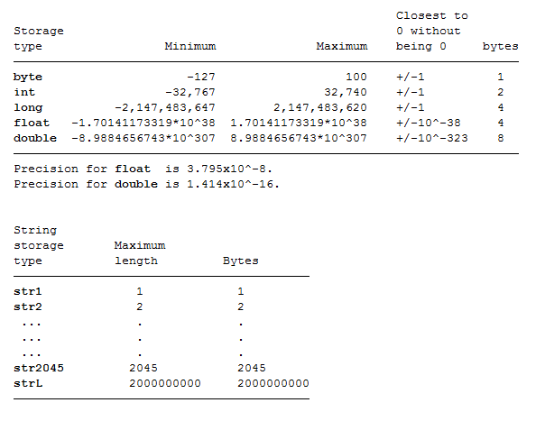
Exploring the Data: Getting to Know the Variables
Note about data type:

Slide 15
Exploring the Data: Variable Types
Variable Types
Numeric
Stata reads as number
Different types: byte, int, long, float, double (different #’s of decimal points stored)
String
Stata reads as text
String types are str1, str2, str3, etc… (indicates # spots available for a variable’s value)
Words can never be in numeric format but numbers can be in string format
Some commands are for numeric variables, some only for string, other for both
Commands in today’s session work mostly with numeric or with both string and numeric

Slide 16
Exploring the Data: Getting to Know the Variables
codebook command
More detailed overview of the variables
Variable name, label and type
Some basic descriptive statistics for variable

Slide 17
Exploring the Data: Looking at the Data
browse command
Type browse in the command window
STATA Matrix:
Column holds the variable
Information we collect on respondents
Row holds the observation
Information on a given person who participated.
Cell of a particular variable for a particular observation is a value
When no information is recorded on a particular observation for a particular variable, it is called a missing value

Slide 18
Exploring the Data: Variable Labels and Value Labels
Variable labels give a brief description of the variable
Value labels puts word labels on category variables
E.g. region each region with a numeric value 01 Rest of South East
02 East Anglia
03 South West
.
.
We can read region names in output even though variable values are numeric

Slide 19
Exploring the Data: Tabulating Values
Gives count of times each value appears in data for specified variable(s)
1 variable specified: tab VARIABLE
Also gives % of observations that take on that value (e.g. % of observations that are male vs. female, % from each province)
2 variables specified: tab VAR1 VAR2
E.g. tab region gender
VAR1 appears as row, VAR2 appears as column
No option specified: gives only # observations in a table cell tells how many observations have both
Can include options to see:
% of obs with each value combination of VAR1 & VAR2
tab region gender, cell
% of obs with each VAR1 value for each VAR2 column separately
tab region gender, col
% of obs with each VAR2 value VAR2 for each VAR1 row separately
tab region gender, row
Options go after the command and before a comma
Can eliminate the variable count and include only percentages by adding nofreq at the end
E.g. tab region gender, row nofreq

Slide 20
Descriptive Statistics and Graphs: Summary Statistics Tables
summarize (or sum)
Returns basic summary statistics (# non-missing observations and mean, sd, min & max of values)
How to use:
sum VAR1 VAR2 VAR3 …. (all the variables you want)
When to use tab vs. sum? General guidelines:
tab: category variables (gender, region) & variables that take on few values (# times hospitalized last year)
sum: continuous variables for which mean, sd, etc. make sense (e.g. income)
Sometimes variables can be tabulated or summarized (e.g. age, household size)

Slide 21
Descriptive Statistics and Graphs: Tabstat
Produces table of statistics you choose for as many variables as you’d like
Often produces nicer tables for presentation than sum
Can also return summary stats by sub-groups in one table
How to Use:
Specify variables and stats you want in table
tabstat VAR1 VAR2 … , s(mean sd … )
Other statistics are also possible (type help tabstat to see them)
Note: if you choose nothing, default is mean only
For stats by sub-group, add by(SUBGROUP) in option section (after command and after comma)
E.g. to see mean & sd of income by region
tabstat income , s(mean sd) by(region)

Slide 22
Descriptive Statistics and Graphs: Exporting Tables to Excel, etc.
Copy & Paste Method
Paste into Word for informal tables
Copy Table & Paste Method
Past into Excel for formal, formatted tables
REMINDER: Copy only the table and not other output to maintain formatting!

Slide 23
Outline of Session
Beginning (Opening Program and Data)
Exploring the Data
Modifying the Dataset
Keeping Good Records
Helpful Hints

Slide 24
Modifying & Managing Data: Some STATA “Grammar”
Basic STATA Command Structure has the following parts
1 Sometimes: “by” qualifying clause
Depends on command
2 Command
3 Variables to which the command will be applied
Sometimes just one, sometimes more (depends on command & your goals)
4 Sometimes: specify more information for the command
Examples in the next slide
5 Sometimes: qualifying “if” clause
When you want command applied only to certain observations (rows)
6 Options
Extra specifications
Always at the end and always after a comma
Putting the pieces together (optional pieces in italics):
[1 By] : [2 Command] [3 Var] [4 Specify] [5 If], [6 Options]

Slide 25
Modifying & Managing Data: “if” clause
[1 By] : [2 command] [3 Var] [4 Specify] [5 If], [6 Options]
Comes after you have told STATA what you want to do
Tells STATA for which observations you want to apply your command
‘Do something” (specified in [3] and [4])] if “such and such is true” (specified in [5])
Common “if” Expressions:
>, >=, <, <=, ==, != or ~=
Note: STATA reads missing values as infinity, so be careful when using > and >=!
For more than one restriction use & (and)
E.g. if age>10 & age<=20
For multiple possibilities use | (or)
E.g. if year==2004 | year==2005

Slide 26
Modifying & Managing Data: “by” clause
[1 By] : [2 command] [3 Var] [4 Specify] [5 If], [6 Options]
Performs commands by sub-groups (specified by a variable)
Examples: Mean income by region
Other sub-group possibilities:
by year, by age group, etc.
At the beginning: by xxx, sort: …..
At the end ….. , by(xxx)

Slide 27
Modifying & Managing Data: Some Basic Commands
drop
Drops the variables or observations specified
keep
Keeps only variables or observations specified (drops all others)
Generate (gen) & extended generate (egen)
Both generate new variables
egen is extension to gen
Some functions work with gen, some with egen
E.g. by gender, sort: egen avg=mean(income)
replace
Replaces values for existing variables
Works the same as the gen command
rename
Changes the name of a variable
Note: all commands (and most variable names) are lower case
[1 By] : [2 Command] [3 Var] [4 Specify] [5 If], [6 Options]

Slide 28
Modifying & Managing Data: Using “gen” & “replace”
[1 By] : [2 command] [3 Var] [4 Specify] [5 If], [6 Options]
Examples of gen command:
gen ones = 1 (column of ones)
gen GENVAR = var1 + var2 (adds var1 & var2)
Functions that work with gen tend to be more basic functions
gen age30=1 if age==30
gen over30=1 if age>30 & age!=.
STATA reads missing values as infinity, so be careful when using > and >=!
Reminder: variable names can’t start with numbers!
Examples of replace command:
replace age=. if age==9999
E.g. questionnaire non-response
replace over30=0 if age<30

Slide 29
Modifying & Managing Data: Renaming and Labeling Variables
[1 By] : [2 command] [3 Var] [4 Specify] [5 If], [6 Options]
Renaming Variables
rename command changes the variable name
To Use:
rename [current variable name] [new variable name]
Example: rename voted voted2001
Labeling Variables
Variable labels describe the variable you created
Good idea to do this so that you remember later and so others understand your dataset!
To Use:
label var [variable] “[short description of the variable]”
Example: label over30 “=1 if respondent is older than 30”

Slide 30
Modifying & Managing Data: Labeling Values
Value labels puts word labels on category variables
Example: no=0 and yes=1 in dataset
We can read Yes & No in output even though variable values are 0 or 1
To make value labels
Step One: Define the label
label def [label name] [value1] “[label for value1]” value2 “[label for value2]”
Remember: Value always comes first and labels always go in quotes
Ex: label def votelabel 0 “No” 1 “Yes”
Step Two: Apply the value label to that variable
label val [variable you are labeling] [label you want to apply]
Ex: label def votelabel 0 No 1 Yes , replace
Note: the same label can be used for multiple variables!

Slide 31
Managing & Modifying Data: Dropping & Keeping Observations
Drop/ Keep Commands
Both used in the same way but with opposite functions
drop deletes observations (rows) or variables (columns) that you tell it to keep
keep gets rid of everything EXCEPT the observations (rows) or variables (columns) that you tell it to keep
Dropping & Keeping variables
Specify the variables you want to drop or keep
drop age
Drops the variable age_months
keep region age voted…
Keeps only these 3 variables
Dropping and Keeping observations
Specify the observations you want to delete using the “if” clause
drop if over30==0
Drops all observations for which variable over10 is equal to zero
keep if over30==1
Keeps all observations for which variable over10 is equal to one
Note: In this case, both commands will lead to the same result!

Slide 32
Managing & Modifying Data: Saving Changes
Save altered dataset with a new name
save NEWDATASET to save a new dataset
save NEWDATASET, replace to save over old
Never write over the original data!!!

Slide 33
Managing & Modifying Data: Merging Datasets
Merge combines multiple datasets into one by matching on the variable you choose
Example: Want to examine health facility usage and health facility quality → Need data from household survey and data from the health facility survey
To do so: combine the two datasets by merging on health facility
Step One: Identify the appropriate variable to use for merging
Note: The variable must exist in both datasets
Step Two: Format data for merging
Make sure variable has the same name in both datasets
If not, rename or create a new variable
Sort both datasets by the merging variable and save
sort facility_id
save xxx.dta, replace
Step Three: Open the “master” dataset (the primary dataset)
Step Four: Merge
merge [variable used for merging] using [DATASET BEING MERGED INTO the current one]
Ex: merge region using [DATASET]
Step Five: Examine merge success
tab _merge
Master only means observations were found in the primary

Slide 34
Outline of Session
Beginning (Opening Program and Data)
Exploring the Data
Modifying the Dataset
Keeping Good Records
Helpful Hints

Slide 35
Keeping Good Records: Log Files
Log and command log:
log records all commands and output during the session while the log file is open
Command log (cmdlog) records all commands typed
Both can be open at same time
To Use:
Open new log:
log using LOGNAME.txt / cmdlog using CLOGNAME.txt
Write over an existing log
log using LOGNAME.txt / cmdlog using CMDLOGNAME.txt, replace
Add to an existing log
log using LOGNAME.txt / cmdlog using CMDLOGNAME.txt, append
Conduct your STATA session
Close log:
log close / cmdlog close

Slide 36
Keeping Good Records: Do Files
List of all the commands you need for your project (in the right order)
Don’t have to repeat work→re-create your dataset by running the do-file
Easy to correct mistakes you find later (just change do-file commands!)
More concise & polished record of your work
To create/ edit do-file:
Starting a new do-file: doedit
Editing an existing do-file: doedit DOFILENAME.do
Remember: If do-file is kept in different folder, must change directory (cd) or include folder name!
Type in Commands
Save do-file (control + s) or, in do-file click File→Save
To use:
do DOFILENAME.do
Be Organized!
Use headings:
To describe do-file content, datasets used, etc. at beginning of do-file
Describing the goals of a particular section of the do-file
Include comments and notes to yourself
For all text in do-files that are not commands, begin the line with “ * ”

Slide 37
Outline of Session
Beginning (Opening Program and Data)
Exploring the Data
Modifying the Dataset
Keeping Good Records
Helpful Hints

Slide 38
Some Helpful Hints
STATA Help
help [STATACOMMAND]
Gives instructions on how to use command, options you can use, etc.
Note: you must know what command you are looking for
Hints for commands with string vs. numeric variables
Always include quotations for string!
Missing values in string and numeric
In string format: “”
In numeric format: .
When “-more-” appears on the screen
Keep going by
Clicking on –more- on the output screen
Tapping space bar
Turn off –more- for future
set more off (set more on to turn back on)
Note: Sometimes makes it difficult to examine output when it appears without stop

