Slide 1
Classification and Regression Trees (CART)
(aka Decision trees)

Slide 2
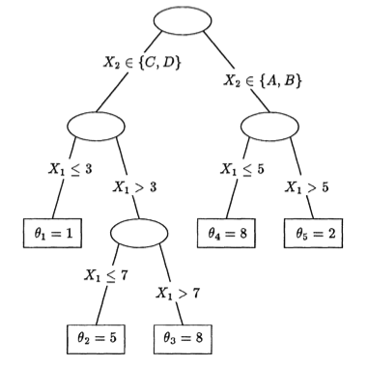
What is CART?
Binary decision tree
Breaks (“branches”) the input space (X) into nodes (“leaves”).
Classification tree: Y is categorical (or binary)
Regression tree: Y is continuous
X’s can be categorical or continuous!

Slide 3
What is CART?
At each node, there is a binary decision rule on a variable (say, Xj).
For a particular data point x, check the value of Xj and depending on the answer (yes/no), we continue to left or right sub-branch.
When we reach a leaf (“terminal node”), we make a prediction for all the x’s that live in that leaf.
Contrary to global models (formula is supposed to hold in the entire space), trees try to partition the input space into small enough parts where we can apply a simple different model on each part.
The non-leaf part of the tree (branches) is just the procedure to determine, for each data point x, the model we will use to classify it (i.e., which leaf should it belong to?).

Slide 4
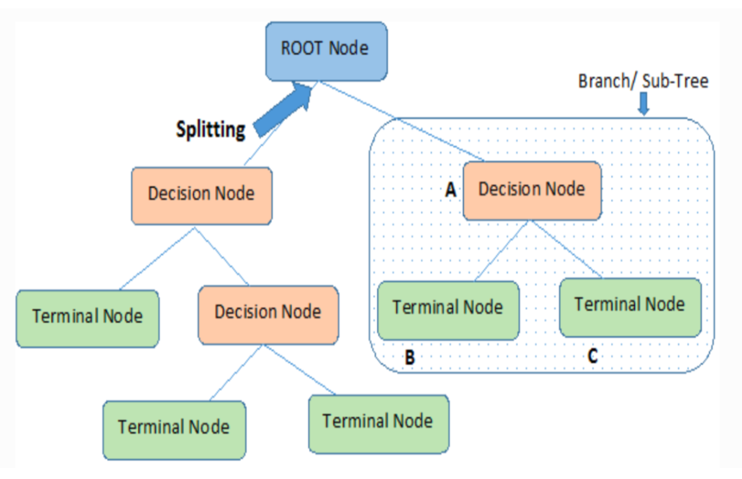
What is CART?

Slide 5
What is CART?
Root node: represents the entire population being analyzed; gets divided based on various features (X’s)
Splitting: process of dividing a node into two or more sub-nodes
Decision node: When a sub-node splits into further sub-nodes, it is called a decision node
Leaf/Terminal node: nodes that do not split
Sub-tree/Branch: a sub-section of a tree
Pruning: removing a node (or branch) from the tree

Slide 6
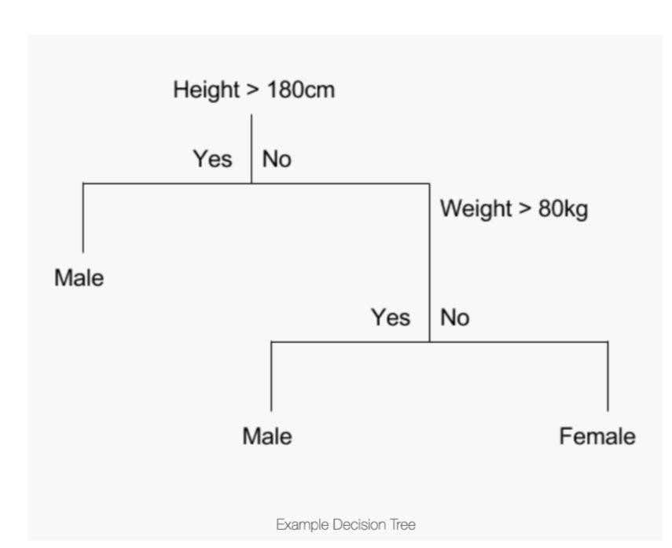
Classification tree
Y = Sex
X’s: Height, Weight
Making predictions: If height=165 cm, weight=65 cm

Slide 7
The Model (Regression Tree)
Subregion of the input space
(there are M of these)
“for x in subregion R_{m}”
Estimated values of the response (y) in region R_{m};
usually c_{m} = mean(y) of x in R_{m}

Slide 8
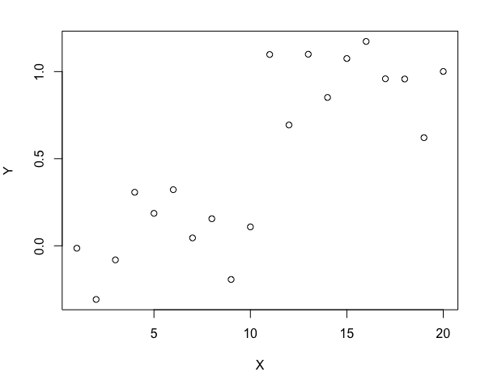
Example 1

Slide 9
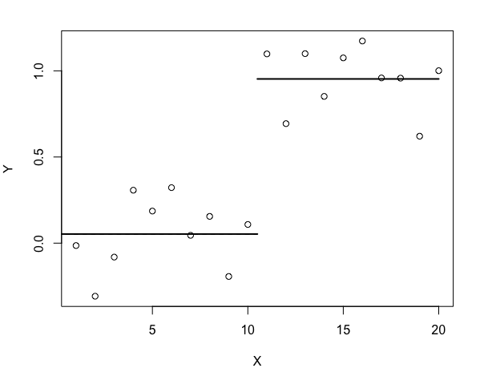
Example 1

Slide 10
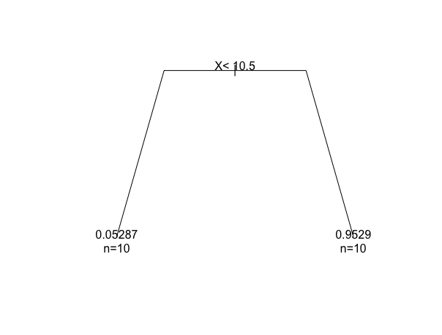
Example 1

Slide 11
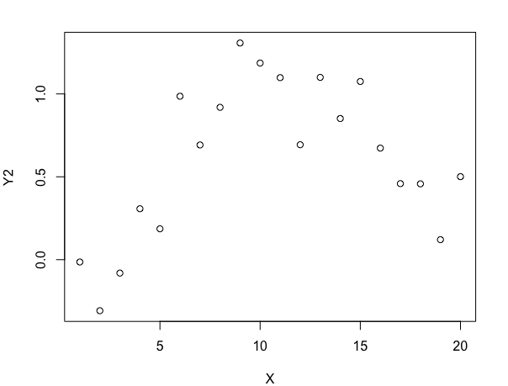
Example 2

Slide 12
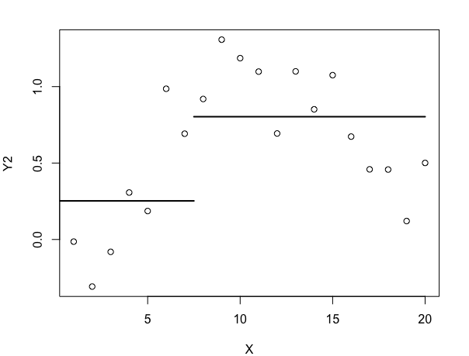
Example 2a

Slide 13
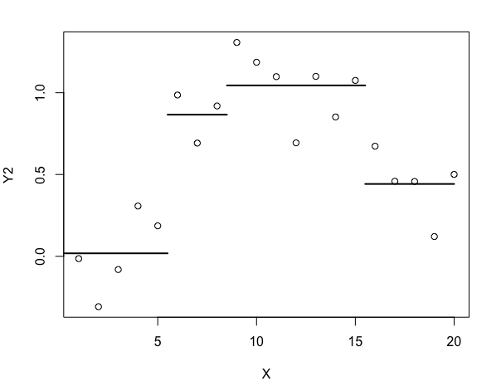
Example 2b

Slide 14
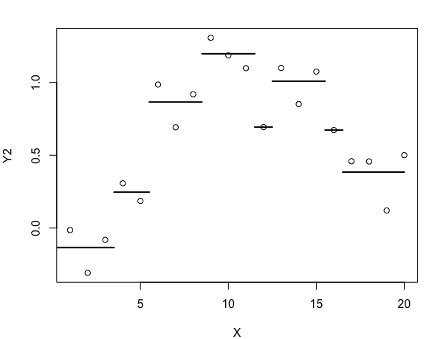
Example 2c

Slide 15
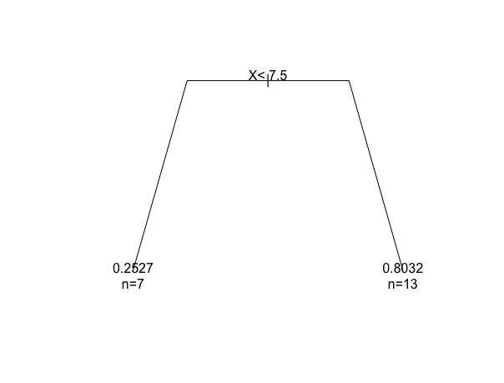
Example 2a

Slide 16
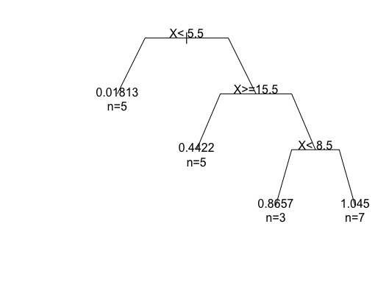
Example 2b

Slide 17
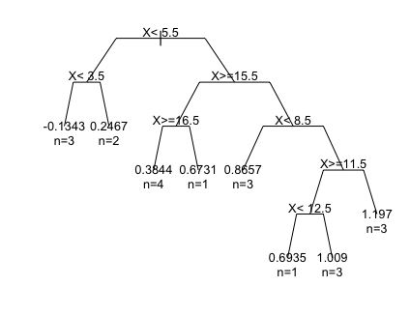
Example 2c

Slide 18
“Growing the tree” How does CART make these splits? (Regression trees)
Minimizes
with respect to c_{m} and R_{m,} for a fixed M.

Slide 19
How does R make these splits?
Will splitting node m (into two “child” nodes) decrease e(T)?
Error from region R_{m}:
Improvement to e(T) of splitting node m: Imp_{m} = e_{m} – (e_{m} for left child) – (e_{m} for right child)
If Imp_{m} ≥ cp, then accept the split, otherwise make m a terminal node. (cp, “complexity parameter”, is a tuning parameter; default is cp = 0.01.)
→ Yes! But how much? Is it worth it?

Slide 20
Recall: Example 2

Slide 21
Example 2a

Slide 22
Example 2b

Slide 23
Example 2c

Slide 24
“Growing the tree” How does CART make these splits? (Classification trees)
Gini Index/Gini impurity:
measure of how often a randomly chosen element from the set would be incorrectly labeled if it was randomly labeled according to the distribution of labels in the subset

Slide 25
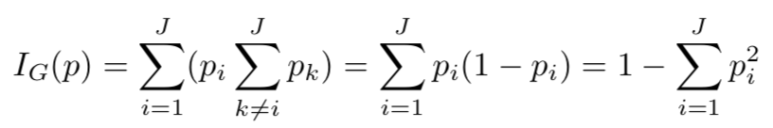
“Growing the tree” How does CART make these splits? (Classification trees)
Gini Index/Gini impurity:
For a set of items with J classes, let p_{i} be the fraction of items labeled with class i in the set.
→ Variables with lower Gini Index values (or more information gain) are split first.
Notes:
The probability pi of an item with label i being chosen, times the probability (1-pi) of a mistake in categorizing that item. It reaches its minimum (zero) when all cases in the node fall into a single target category (all correct or all incorrect).
Information gain = impurity of parent node – weighted average impurity of 2 child nodes

Slide 26
Selecting the “best” tree
Suppose `tree1` is your fitted tree of a certain size.
`printcp(tree1)` or `tree1$cptable` gives tree statistics for tree1 and each tree smaller than tree1
`rel error` is ratio of the objective e(T) to that of single-root tree (no breaks; constant prediction)
This is always decreasing for larger trees
`xerror` is average 10-fold cross-validation error
Leave out 1/10th of the dataset
Train a size M tree on the other 9/10ths
Compute e(T) on the left-out part

Slide 27
Selecting the “best” tree
Ways to choose a tree:
Choose tree size that minimizes `xerror`
Choose tree size that minimizes : N*(`rel error`) + 2*(# of terminal nodes)
This is a measure that penalizes large trees.
c. Weigh R² (or cross-validated R²) against size of tree

Slide 28
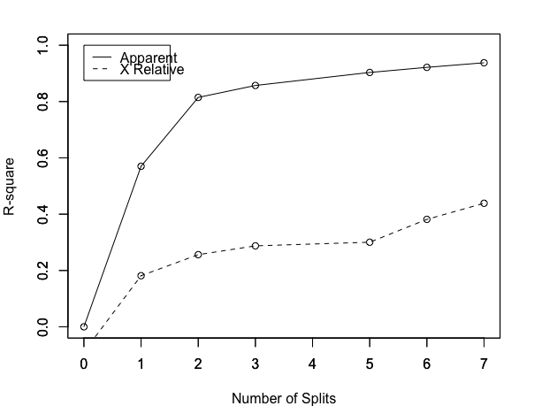
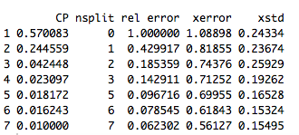
Example 2: Selecting the “best” tree
Method b:
Method c:
Method a:

Slide 29
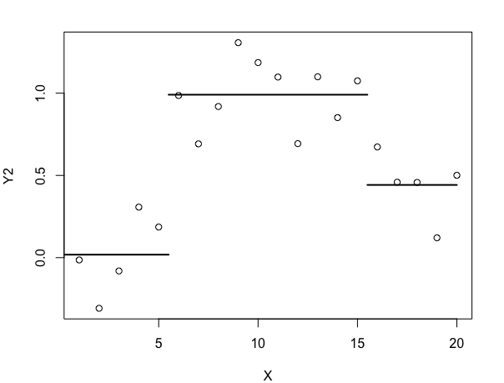
Example 2: Selecting the “best” tree

Slide 30
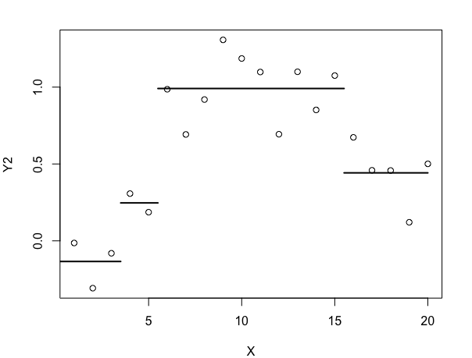
Example 2: Selecting the “best” tree

Slide 31
Advantages of Trees
Fast computations
Works with multiple predictor variables of any type (categorical, ordinal, numerical)
Works with response variables of any type (categorical, numerical)
One tuning parameter (tree size, or cp)
Easy interpretation of model; easy prediction
Robustness:
Scale of x & y doesn’t matter
Immune to x-outliers
Will ignore irrelevant variables
Deals well with missing data
No distributional assumptions!

Slide 32
Disadvantages of Trees
Accuracy:
True model may not actually be piecewise constant
No guarantee that you’re getting the “best” tree or the “right” regions (recursive algorithm)
Each subsequent split depends on the previous ones, so an error in a higher split is propagated down
Small change in data set can cause big change in tree (prone to overfitting)
Works best with lots of data

