Slide 1



diversity_inclusion_dashboard_pwc_Task4
View in Power BI
Last data refresh:
10/31/2021 11:24:21 AM UTC
Downloaded at:
1/17/2022 12:11:56 PM UTC

Slide 2
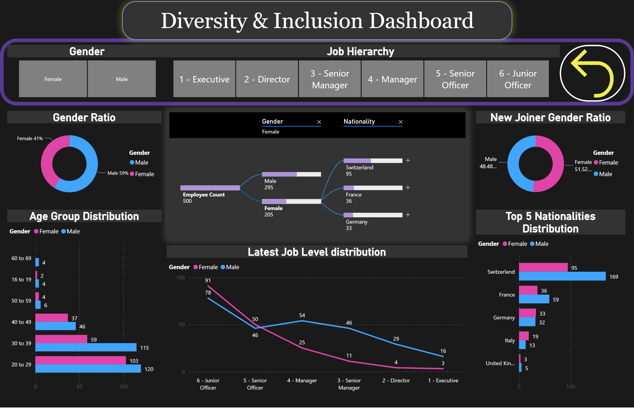
Diversity & Inclusion Dashboard
Notes:
actionButton
No alt text provided
shape
No alt text provided
Gender Ratio
No alt text provided
Age Group Distribution
No alt text provided
Top 5 Nationalities Distribution
No alt text provided
Latest Job Level distribution
No alt text provided
textbox
No alt text provided
New Joiner Gender Ratio
No alt text provided
JL Group PRA Status
No alt text provided
Gender
No alt text provided
Job Hierarchy
No alt text provided

Slide 3
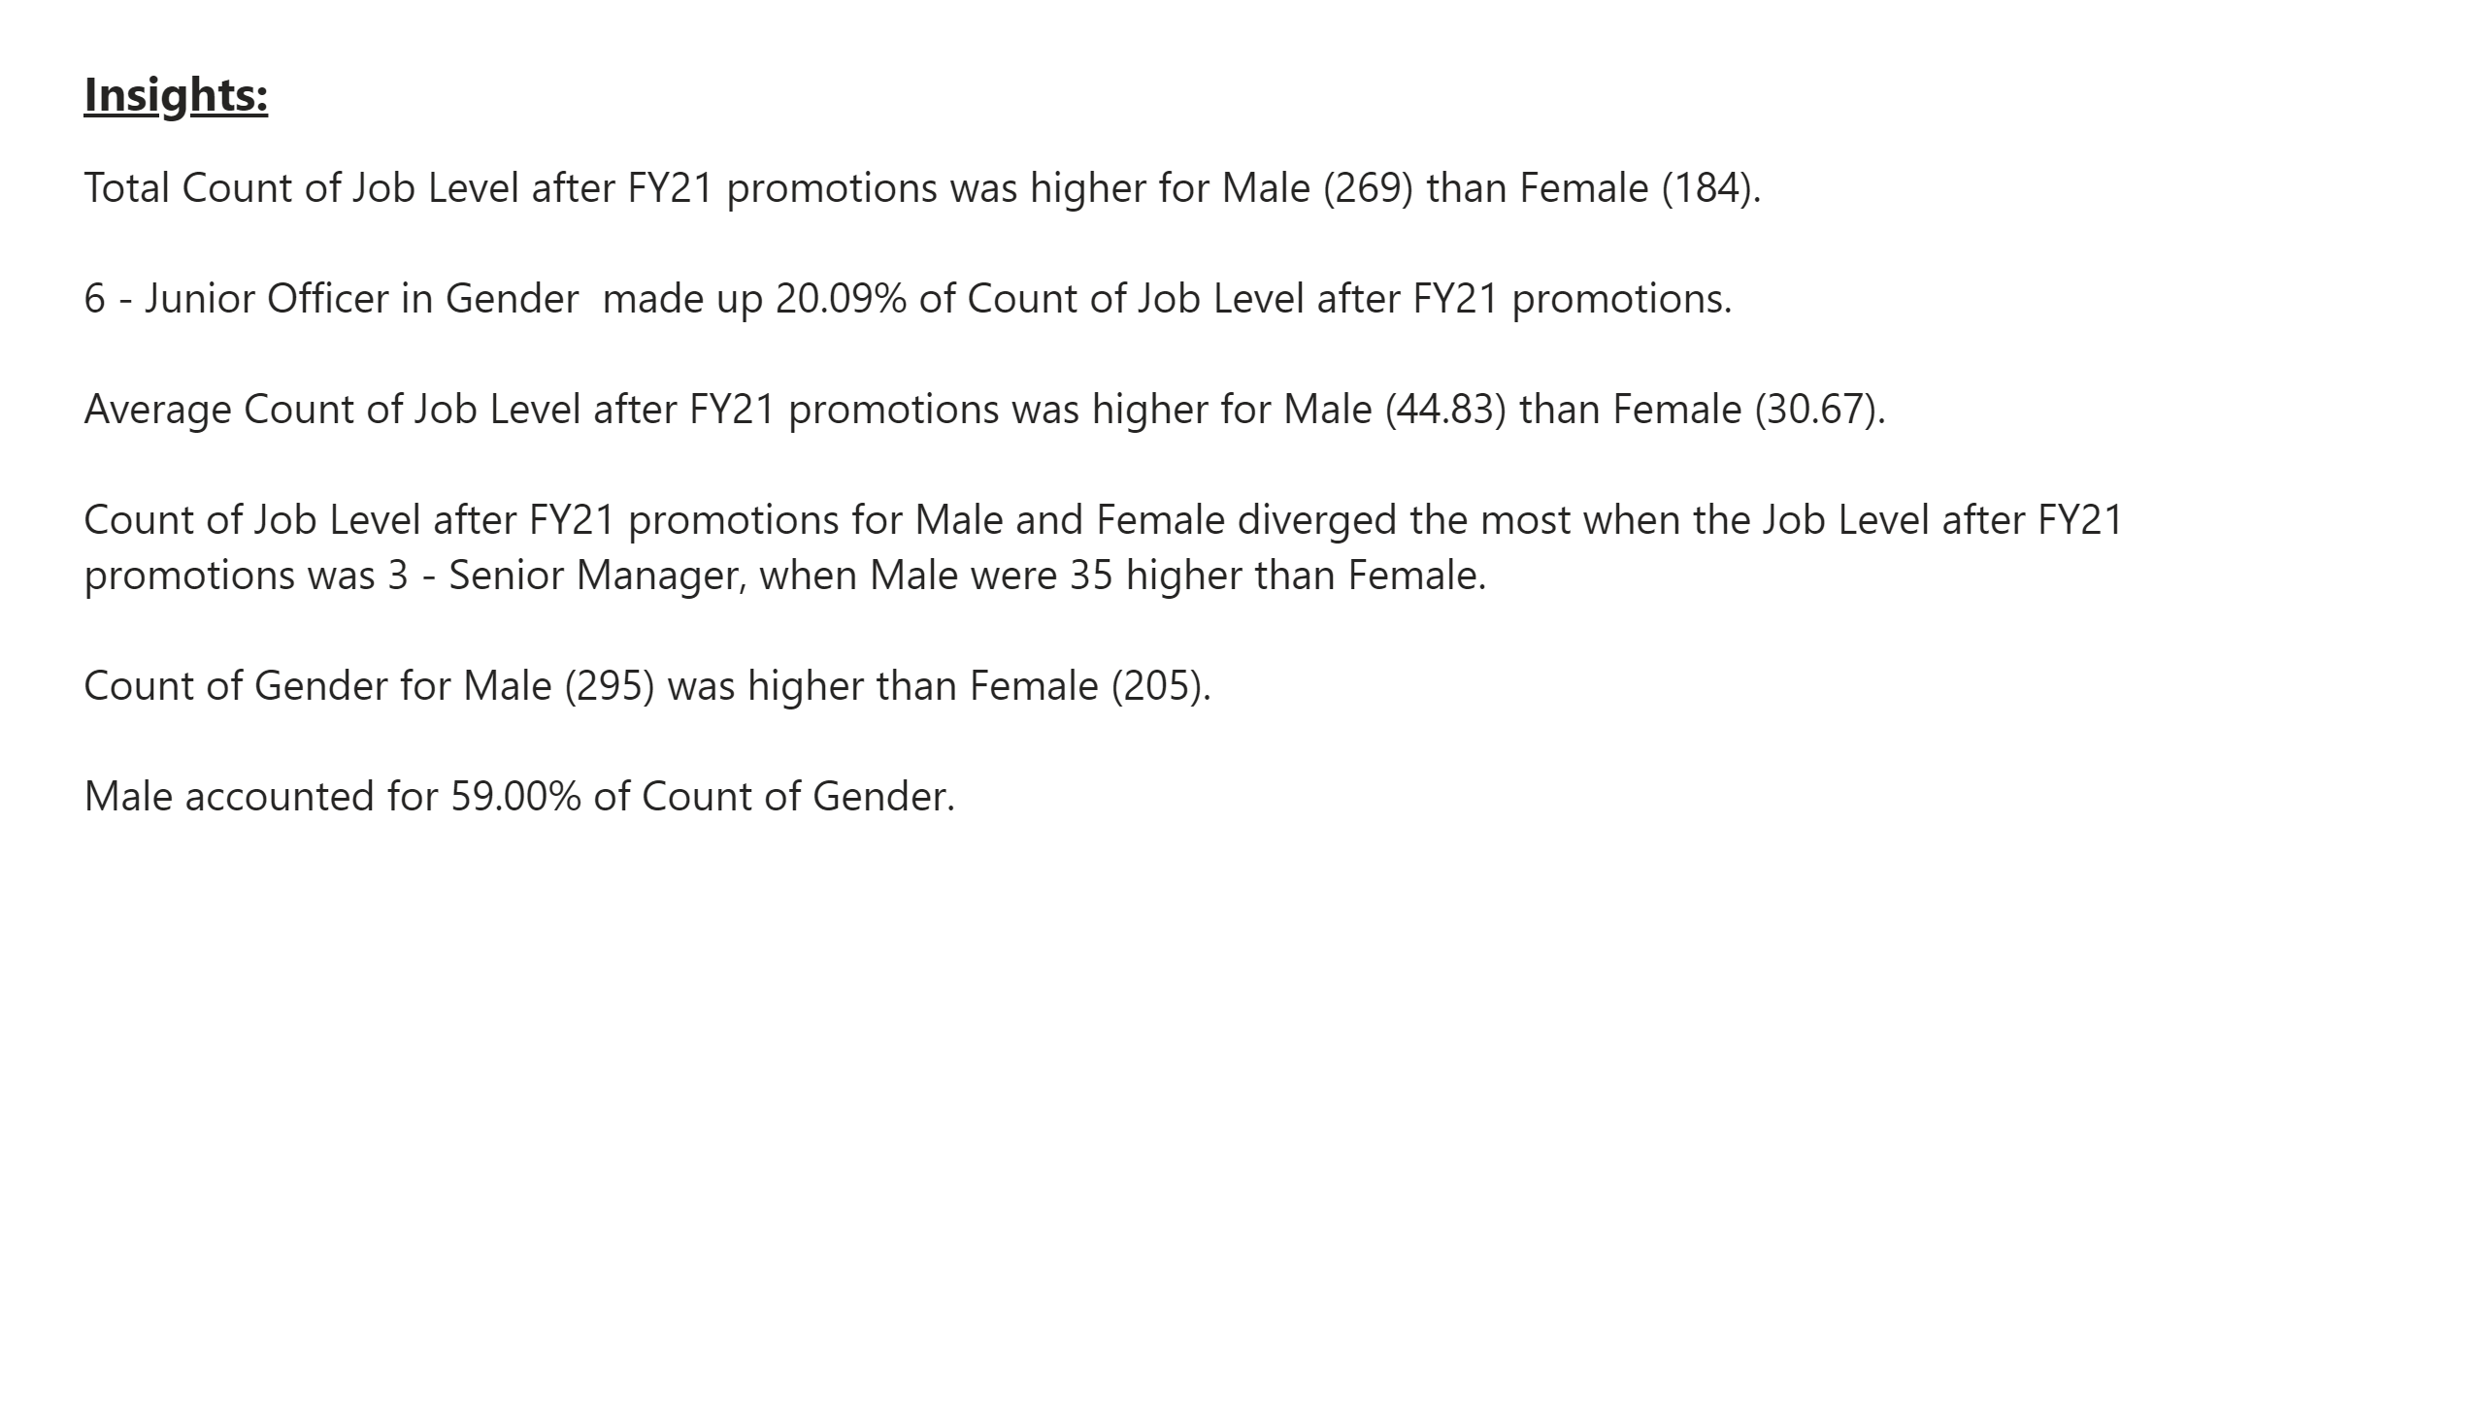
Insights
Notes:
textbox
No alt text provided
textbox
No alt text provided

