Slide 1
How to Process, Visualize, and Analyze Data
Eugene Wu, Adam Marcus

Slide 2
Course Basics
5 lab days: ~30min background, 2.5h lab
1 presentation madness day
No grades
No homework, unless you don’t finish lab

Slide 3
How labs work
Go to http://dataiap.github.com/dataiap
Click on the day’s lab in the syllabus
We’re here to help
Your neighbors are here to help

Slide 4
Day 6 Madness
After lab 4, you will have all the skills you need
Find your own dataset + questions
Tell us a story: 2 slides, 1 minute

Slide 5



Lunch + Thank You

Slide 6
Why is this important?

Slide 7
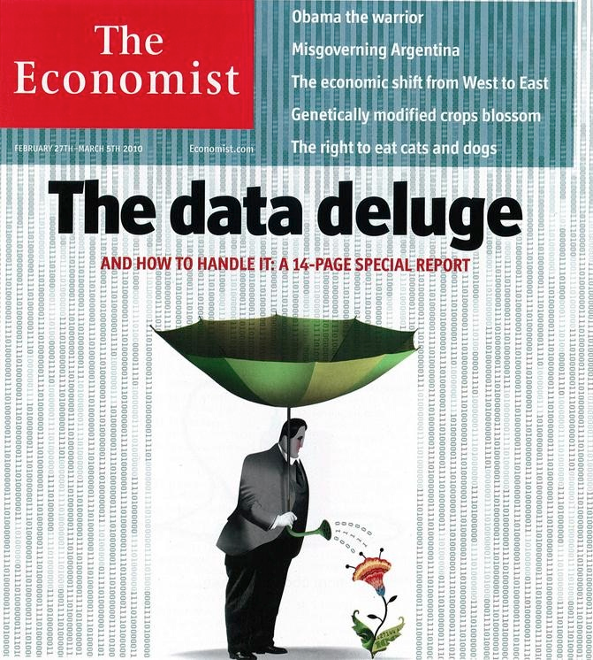
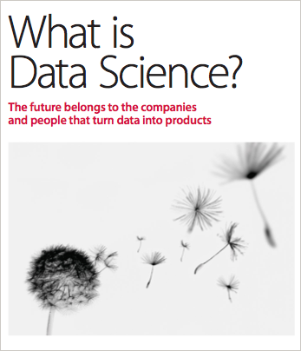
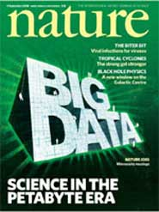
Notes:
Images: The Economist, Nature, O’Reilly

Slide 8
“I keep saying that the sexy job in the next 10 years will be statisticians”
Hal Varian, Chief Economist Google
Statisticians will never have a sexy job.
Data-powered storytellers will.
Notes:
http://www.nytimes.com/2009/08/06/technology/06stats.html

Slide 9
Why now?

Slide 10





Slide 11


Slide 12
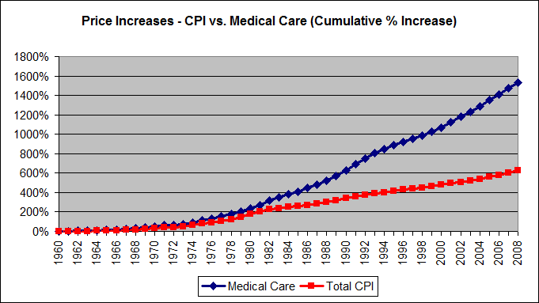

Slide 13



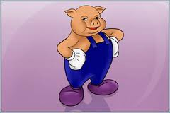




Slide 14
Schedule

Slide 15
Day 0
Setup
Optimistically, you’ve already done this

Slide 16
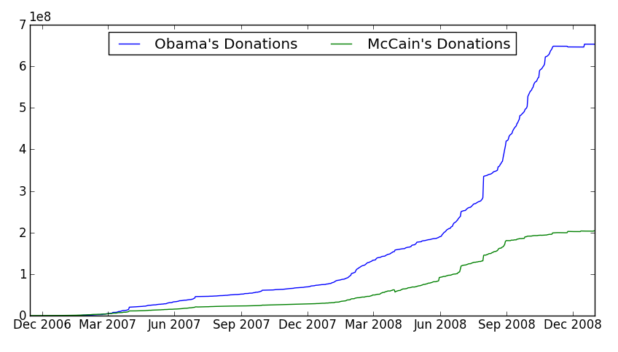
Today

Slide 17
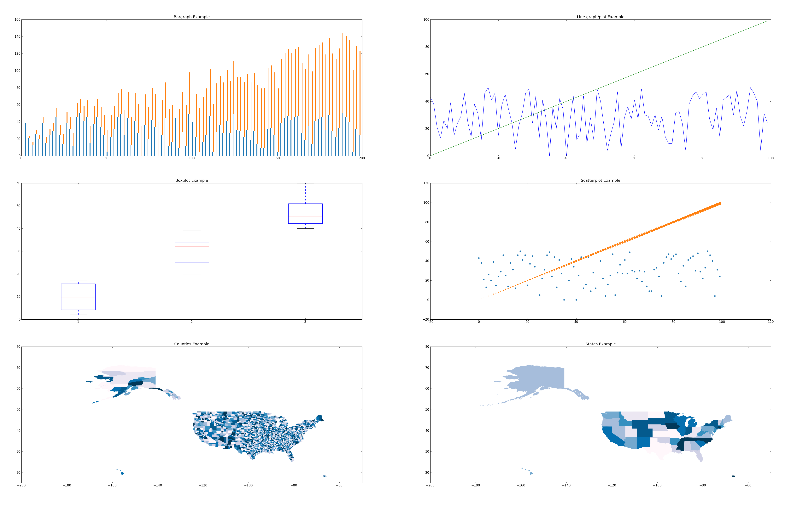
Day 2: Visualizations

Slide 18
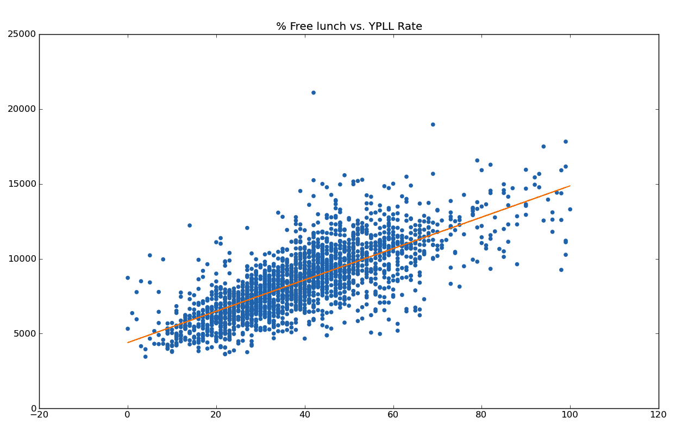
Day 3: Statistics

Slide 19
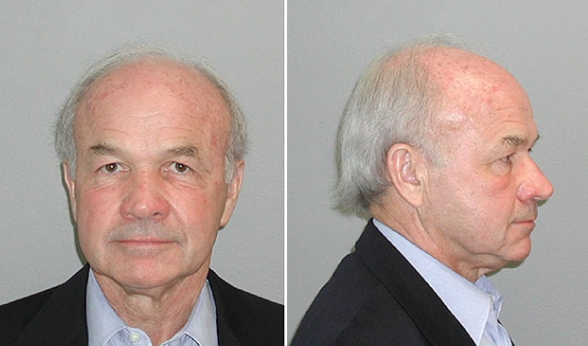
Day 4: Text Analysis with Kenneth Lay
Notes:
http://i.cdn.turner.com/dr/teg/tsg/release/sites/default/files/imagecache/670xX/photos/kenlaymug1.jpg

Slide 20

Day 5: Scaling up with Hadoop/MapReduce

Slide 21
Day 6: Storytelling Madness!
sociology
biology
economics
stackoverflow
web scraping
source code
healthcare
finance

