Slide 1
Day 4: Text Analysis

Slide 2


Slide 3


Slide 4
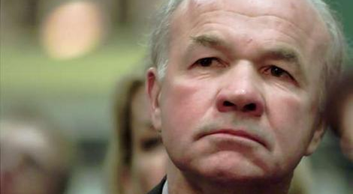
Kenneth Lay

Slide 6
Clean
Regular Expressions

Slide 7
Clean
Extract Terms
Regular Expressions
“Bankrupt”, “Case”,…

Slide 8
Clean
Extract Terms
Score Terms
Regular Expressions
“Bankrupt”, “Case”,…
TF-IDF

Slide 9
Clean
Extract Terms
Score Terms
Find Similar Email Senders
Regular Expressions
“Bankrupt”, “Case”,…
TF-IDF
Cosine Similarity

Slide 11


