Slide 1
The consumer price index: from COICOP 2018 to online prices
PRICE STATISTICS
Definition, basket, compilation methods, and a hands-on lab in Côte d'Ivoire and Senegal
Notes:
This presentation starts with the indicator itself, the CPI, then moves to how it is built: the basket, the COICOP 2018 classification, price collection and compilation. It ends with a hands-on lab, tested on 14 October 2026 in Côte d'Ivoire, showing what online prices and prices published by institutions can bring to a CPI, and what they cannot.

Slide 2



Three key messages
INTRODUCTION
The CPI is a policy instrument before it is a calculation
A high-stakes indicator
It all starts with the basket
New sources
The CPI guides monetary policy, indexes wages and contracts, and deflates the national accounts. A one-point error is paid for everywhere.
What we measure depends on what goes into the basket and how much weight it gets. COICOP 2018 structures the basket across WAEMU since the 2023 base.
In our lab, online prices and prices published by institutions cover 7 of 13 divisions. A useful complement, not a substitute.
Notes:
Three ideas guide the presentation. First, the CPI has direct consequences for public and private decisions. Second, its quality depends on the basket and the weights, which COICOP 2018 organises. Third, new sources are promising, but our own lab shows they leave whole parts of the basket out of reach.

Slide 3
Acronyms
INTRODUCTION
Institutions and technical terms used in this presentation
CPI
Consumer price index
HCPI
Harmonised consumer price index (WAEMU)
HICP
Harmonised index of consumer prices (European Union)
COICOP
Classification of Individual Consumption According to Purpose (United Nations)
WAEMU
West African Economic and Monetary Union
BCEAO
Central Bank of West African States
ECB
European Central Bank
EHCVM
Harmonised survey on household living conditions (WAEMU)
ANSD
National Agency of Statistics and Demography (Senegal)
OCPV
Food products marketing support office (Côte d'Ivoire)
ANARE-CI
National electricity sector regulatory authority (Côte d'Ivoire)
CRSE
Energy sector regulatory commission (Senegal)
ARTP
Telecommunications and postal regulatory authority (Senegal)
NPISHs
Non-profit institutions serving households
Notes:
List of acronyms. The BCEAO is the central bank shared by the eight WAEMU states; in the Union, each state's national CPI is the HCPI. The EHCVM is the household survey that provides the weights of the base-2023 HCPI. OCPV, ANARE-CI, CRSE and ARTP are the institutions whose publications feed the lab. French acronyms are kept because they are the official names.

Slide 4

Understanding the CPI
01
What does the CPI really measure, and what is it for?
Notes:
Part one: the indicator itself, its uses, and what it says about recent inflation.

Slide 5




What is the consumer price index?
01 · UNDERSTANDING THE CPI
A short definition, and four scope choices that make it operational
The CPI measures the average change, between two periods, in the prices of a fixed basket of goods and services acquired by households for consumption, at constant quality.
Who?
Where?
What?
Which prices?
Reference population: all resident households, or a group (urban, wage earners).
Geographic coverage: capital, main cities or whole country, urban and rural.
Consumer goods and services, classified by COICOP. Not investment, not savings.
Purchase prices actually paid, taxes included, including discounts and administered prices.
Notes:
Definition based on the Consumer Price Index Manual (2020), published jointly by the international statistical organisations. The two key words are "fixed basket" and "constant quality": the CPI compares the prices of the same things over time. The four scope choices are specific to each country. In Senegal, for example, HCPI price collection covers six areas (Dakar, Thiès, Kaolack, Diourbel, Saint-Louis, Kolda), urban and rural.

Slide 6





One indicator, five uses that drive decisions
01 · UNDERSTANDING THE CPI
The variety of uses is what demands high standards of quality and transparency
Monetary policy
Indexation
National accounts
Multilateral surveillance
Purchasing power
The BCEAO sets its rates based on WAEMU inflation, measured by the HCPI.
Minimum wages, pensions, rents and contracts are adjusted in line with the CPI.
Price indices deflate consumption to obtain volumes.
The WAEMU inflation criterion is read from each member state's HCPI.
Public debate, wage bargaining, cost-of-living measurement.
Notes:
Each use has its own requirements: the central bank wants a timely index comparable across countries; indexation requires an index that is never revised; national accounts want consistency with household consumption. Hence the importance of a documented methodology.

Slide 7
HCPI, HICP, deflator: cousins, not twins
01 · UNDERSTANDING THE CPI
Three measures of consumer prices, three frameworks, three uses
HCPI (WAEMU)
HICP (European Union)
Consumption deflator
What it is
The national CPI of each member state, harmonised across the eight countries
Harmonised index of EU countries, published by Eurostat
Ratio of consumption at current prices to volume, in the national accounts
Classification
Classification derived from COICOP 2018, 13 divisions, base 2023
ECOICOP version 2, identical to COICOP 2018, since January 2026
COICOP 2018 in EU national accounts since 2024
Weights
EHCVM 2021-2022 household survey
National accounts, updated every year
Change every period (Paasche-type formula)
Main use
BCEAO monetary policy, convergence criterion
ECB 2% inflation target
Macroeconomic analysis, consumption volumes
Sources: BCEAO, annual report on consumer prices in WAEMU in 2025; ANSD, HCPI March 2026; Eurostat; ECB.
Notes:
In WAEMU, the national CPI is the HCPI: its methodology is harmonised across the eight states to support multilateral surveillance. The European HICP pursues the same goal in the EU. The deflator belongs to the national accounts: its weights change every period, so it is not suited to indexation.

Slide 8
WAEMU: from the 2022 peak to stable prices in 2025
01 · UNDERSTANDING THE CPI
Annual average inflation measured by the HCPI, %
Source: BCEAO, Annual report on consumer prices in WAEMU in 2025 (June 2026), annex 1 and table 1. Annual averages.
Notes:
Official BCEAO figures, annual averages. After the 2022 shock (7.4% in WAEMU, 9.7% in Senegal), inflation fell back to 0.0% on average in the Union in 2025. Côte d'Ivoire: 0.1% in 2025; Senegal: 1.4%. Note: year on year, WAEMU inflation was −0.8% in December 2025. Low inflation makes measurement quality even more important: an error of a few tenths changes the diagnosis.

Slide 9

The basket and COICOP 2018
02
What goes into the basket, with what weight, and under which framework?
Notes:
Part two: the basket, the real heart of the CPI.

Slide 10




The basket, a snapshot of consumption
02 · THE BASKET AND COICOP 2018
From household budgets to items priced each month: the example of Senegal's HCPI, base 2023
Budget survey
Classification
Weights
Items
EHCVM 2021-2022: what households spend, item by item
Spending coded in a classification derived from COICOP 2018: 13 divisions
Share of each item in total spending, out of 10,000
Specific products priced each month: "imported broken rice, 1 kg"
Three rules for a good basket
Representative: selected items reflect what households really buy, including at open-air markets.
Stable but updated: the basket is fixed between two rebasings, then renewed to follow consumption.
Traceable: each item is linked to a COICOP subclass, which ensures international comparability.
Notes:
In Senegal, the weights of the base-2023 HCPI come from the EHCVM 2021-2022, and the classification used (NCOA 2018) is derived from COICOP 2018, with 13 divisions. The item example is illustrative. The basket is fixed between rebasings: that is what makes it possible to compare the prices of the same things over time.

Slide 11
Weights: a highly concentrated basket
02 · THE BASKET AND COICOP 2018
Weight of the 13 divisions in Senegal's HCPI, base 2023, % of spending
45.5%
for food: almost half of the basket
64%
in three divisions: food, restaurants, housing-energy
3%
for the four smallest: insurance, alcohol-tobacco, recreation, education
Source: ANSD, HCPI March 2026, table 1 (weights out of 10,000, converted to %).
Notes:
Division 01 accounts for 4,547 points out of 10,000. The top three divisions total 63.8% of the basket; the four smallest, 3.1%. In practice, an index that tracks electronics very well but food poorly says almost nothing about the cost of living. Division 08 weighs 7.46%, a figure we will meet again in the lab. A comparison with Côte d'Ivoire and WAEMU is possible: the BCEAO 2025 report publishes a "food" share (31.9% in Côte d'Ivoire, 45.7% in Senegal, 37.1% in WAEMU), but without defining exactly what this aggregate covers; quote with caution.

Slide 12
COICOP 2018, the framework behind the basket
02 · THE BASKET AND COICOP 2018
Four nested levels and a product type for each subclass
01
Division 15 items
Subclass product type
Food and non-alcoholic beverages
ND
Non-durable goods
bread, milk, fuel
01.1
Group 63 items
Food
SD
Semi-durable goods
clothing, small appliances
01.1.4
Class 186 items
D
Durable goods
Milk, other dairy products and eggs
car, refrigerator
01.1.4.2
Subclass 338 items · new in 2018
S
Services
Skimmed milk
rent, transport, repair
The CPI covers divisions 01 to 13; divisions 14 and 15 cover individual consumption by NPISHs and general government.
Notes:
Reminder of the COICOP 2018 structure, endorsed by the UN Statistical Commission in March 2018: 15 divisions, 63 groups, 186 classes, 338 subclasses. The product type makes it possible to compute aggregates such as goods and services, closely watched by central banks. Divisions 14 and 15 cover services provided free of charge to households (by non-profits or the state): with no price paid by the household, they are outside the CPI scope.

Slide 13




What COICOP 2018 changes for a CPI
02 · THE BASKET AND COICOP 2018
Services better identified, and a European migration that left headline inflation intact
Goods and services separated
Lessons learned: the January 2026 HICP
Repair, rental and installation get their own service items.
≤ 0.1 pp
difference in euro area headline inflation
Delivery identified
Separately invoiced delivery fees and parcels become distinct services.
1.2 pp
maximum revision to unprocessed food
Digital division 08
IT hardware and software join information and communication.
≈ 1%
weight of games of chance, a new HICP item
Dedicated division 12
Insurance and financial services leave "miscellaneous goods and services".
Sources: United Nations (UNSD), COICOP 2018; ECB, Economic Bulletin 3/2026, box "What's new in the HICP?".
Notes:
For a CPI, the main contribution of COICOP 2018 is the separation of goods and services. Example: a refrigerator delivered and installed used to give one price; now the good, the delivery and the installation fall into different items. The European experience is reassuring: well prepared, the migration changed euro area headline inflation by at most 0.1 point, through rounding. Revisions are concentrated in unprocessed food (up to 1.2 points), because chilled and frozen products were reclassified.

Slide 14

Compiling the index
03
How do thousands of price quotes become a single published index?
Notes:
Part three: compiling the index, month after month.

Slide 15






The CPI production chain
03 · COMPILING THE INDEX
Two rhythms: a base set every five to ten years, production repeated every month
EVERY 5 TO 10 YEARS · REBASING
EVERY MONTH · PRODUCTION
Budget survey
Basket and weights
Sample
Collection
Elementary indices
Aggregation
Household spending
Items and weights
Outlets, localities
Monthly price quotes
Jevons by item and locality
Weighting, release
Checks at every stage: outlier prices, missing items, replacements, consistency across localities and with the previous month. Discrepancies are documented before release.
Notes:
The first three steps form the base of the index and only change at rebasing (2023 for the WAEMU HCPI). The last three are repeated every month. The lab presented later works on collection, then reproduces the compilation and aggregation steps on a small scale.

Slide 16




Collecting prices: four complementary sources
03 · COMPILING THE INDEX
Field collection remains the backbone; digital sources extend it
Field collection
Administered prices
Scanner data
Online prices
Price collectors record prices at markets and in shops, on a fixed schedule.
Tariffs set and published: electricity, water, fuel, regulated transport.
Supermarket transactions: prices and quantities actually sold.
Automated collection of prices shown on retail websites.
+ Covers informal and rural markets
+ Comprehensive and official
+ Huge volumes, known quantities
+ Daily, low-cost, very detailed
− Costly, limited sample
− Rarely change: a revision is easily missed
− Agreements to negotiate, large retailers only
− Posted prices, urban buyers, frequent discounts
Notes:
The lab uses online prices (Jumia) and prices published by institutions (administered prices, and market prices collected by the OCPV in Côte d'Ivoire). Scanner data are widely used in Europe; in West Africa, their coverage is limited to large retailers.

Slide 17
Elementary indices: why choose Jevons
03 · COMPILING THE INDEX
Worked example: two products on alternating discount, whose prices return to their starting level
Price (CFA francs) | Month 0 | Month 1 | Month 2
Product A | 100 | 50 | 100
Product B | 100 | 200 | 100
Jevons
geometric mean of price relatives
100 → 100 → 100
Dutot
ratio of average prices
100 → 125 → 100
Chained Carli
arithmetic mean of price relatives
100 → 125 → 156
Illustrative example. Reference: Consumer Price Index Manual (2020), chapter on elementary indices.
Notes:
In month 2, both prices are back exactly to their starting level: the index should be 100. Jevons gives 100 every month: a 50% fall (relative 0.5) and a doubling (relative 2) cancel out exactly. Dutot returns to 100 but depends on price levels. Chained Carli drifts to 156: as an arithmetic mean of price relatives, it systematically overstates when prices bounce, for example with discounts. That is exactly the situation of online prices, hence the choice of Jevons in the lab, which also computes Carli to show this drift.

Slide 18



Aggregating, chaining, rebasing
03 · COMPILING THE INDEX
From elementary indices to the all-items index released every month
Iₜ = Σ wᵢ × Iᵢ,ₜ
The all-items index is the average of elementary indices Iᵢ, weighted by expenditure shares wᵢ from the budget survey.
Young or Laspeyres formula
Chaining
Rebasing
Weights come from the budget survey, earlier than the price base period. ANSD uses the Young formula for Senegal's HCPI.
Weights are renewed at each rebasing, and series are linked to stay continuous over time.
Every 5 to 10 years: new survey, new basket, new classification. In WAEMU, the base is 2023 = 100.
Notes:
The Young formula uses expenditure weights from a period earlier than the price base period, which is the case for most CPIs. ANSD's methodological note states that Young indices are preferred over Laspeyres. In practice, the difference lies in whether the weights are price-updated.

Slide 19




Four challenges that define CPI quality
03 · COMPILING THE INDEX
Measuring at constant quality when products, seasons and discounts change
Missing products
Replacements and quality
Out of stock, outlet closed: impute the price from comparable products rather than carrying it forward.
One model replaces another: separate the price rise from the quality gain, for example with hedonic methods.
Seasonal products
Discounts
Fruit and vegetables missing part of the year: variable baskets or seasonal imputation.
Struck-through prices make series bounce: several quotes per month, geometric mean, and the Jevons formula.
Notes:
These four challenges are amplified for online prices: the catalogue turns over very fast and discounts are everywhere. The lab gives a concrete measure for Côte d'Ivoire: more than 80% of clothing items showed a struck-through price in the October 2026 collection.

Slide 20
An online price index
04
Tested in Côte d'Ivoire: what can online prices and prices published by institutions bring to a CPI?
Notes:
Part four: the lab. All figures shown come from the actual run of the notebooks on 14 October 2026.

Slide 21

Architecture: collect on site, analyse anywhere
04 · LAB
Collection and compilation are separate: only a file travels between them
ON THE OFFICE WORKSTATION
ON COLAB OR ON SITE
3
Analysis
1
Jumia collection
Online prices, robots.txt respected, crawler identified
Merges and checks the archives
Classifies products by COICOP
Compares classification methods
Weights and computes Jevons, Carli, GEKS
Produces a standalone HTML report
.zip archive: Parquet, Excel, manifest
2
Institutional sources
Electricity tariffs, market prices, telecoms index
Notes:
The architecture follows from a technical finding: collection must start from a workstation, not a data centre. The analysis notebook never touches a retail site: it only reads files, so it can run on Colab with nothing to install. The archive carries a provenance manifest and a checksum guaranteeing the quotes have not been altered.

Slide 22
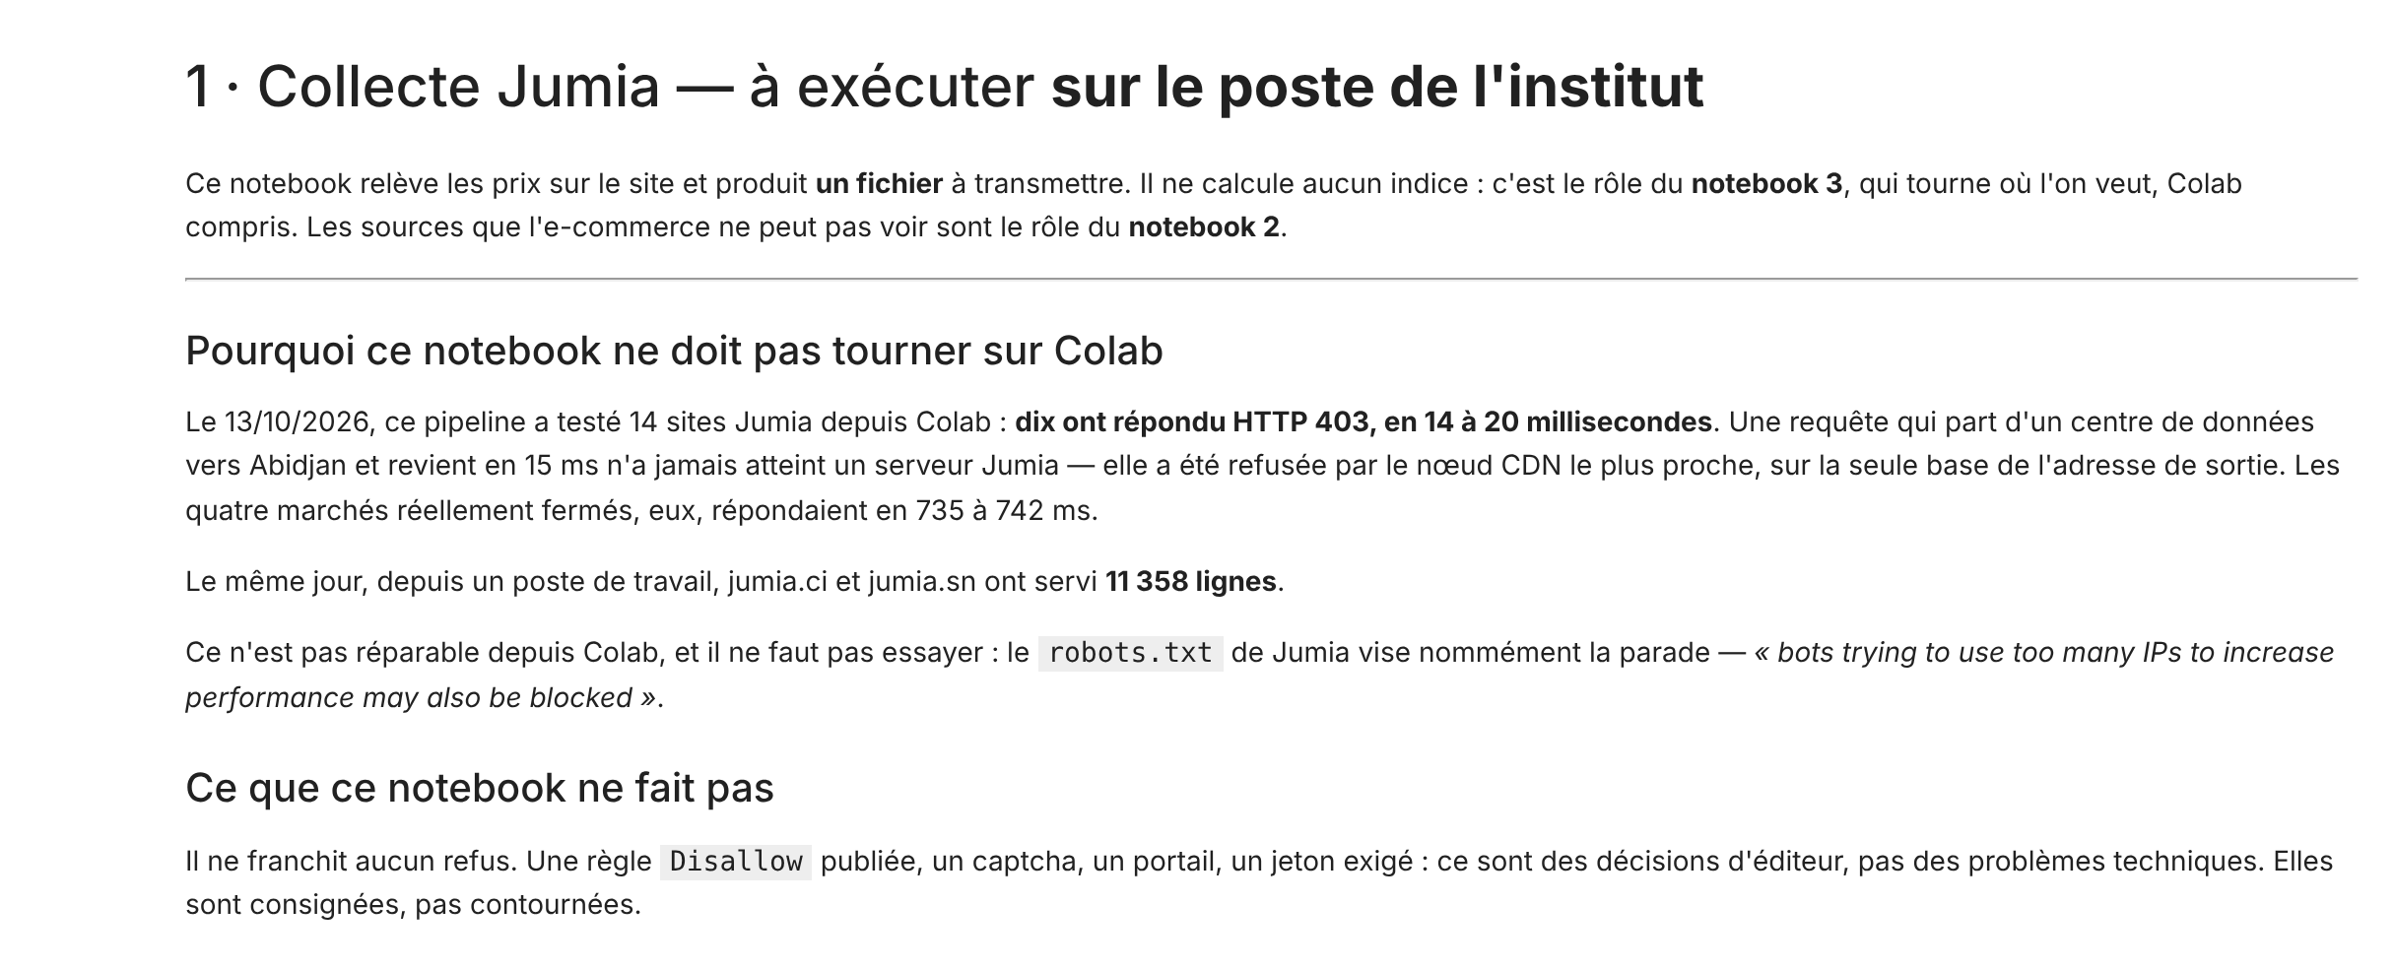
Notebook 1: collecting online prices without forcing anything
04 · LAB
Notebook screenshot (in French): collection must run from the office workstation
10 / 14
Jumia sites refused from Colab, in 14 to 20 ms: blocked by the content delivery network (CDN), not by Jumia
11,358
rows served the same day by jumia.ci and jumia.sn to a workstation
The crawler identifies itself with a contact address
robots.txt and the delay between requests are respected
A refusal is logged, never bypassed
Notes:
On 13 October 2026, ten of fourteen Jumia sites answered HTTP 403 from Colab within 14 to 20 milliseconds. Such a fast reply cannot come from a server in Abidjan: the request was refused by the nearest CDN node, based only on the outgoing address. The same day, from a workstation, jumia.ci and jumia.sn served 11,358 rows. The notebook therefore first checks where requests come from. Ethical principle: a Disallow rule, a captcha or a login wall are the publisher's decisions; they are logged, not bypassed.

Slide 23
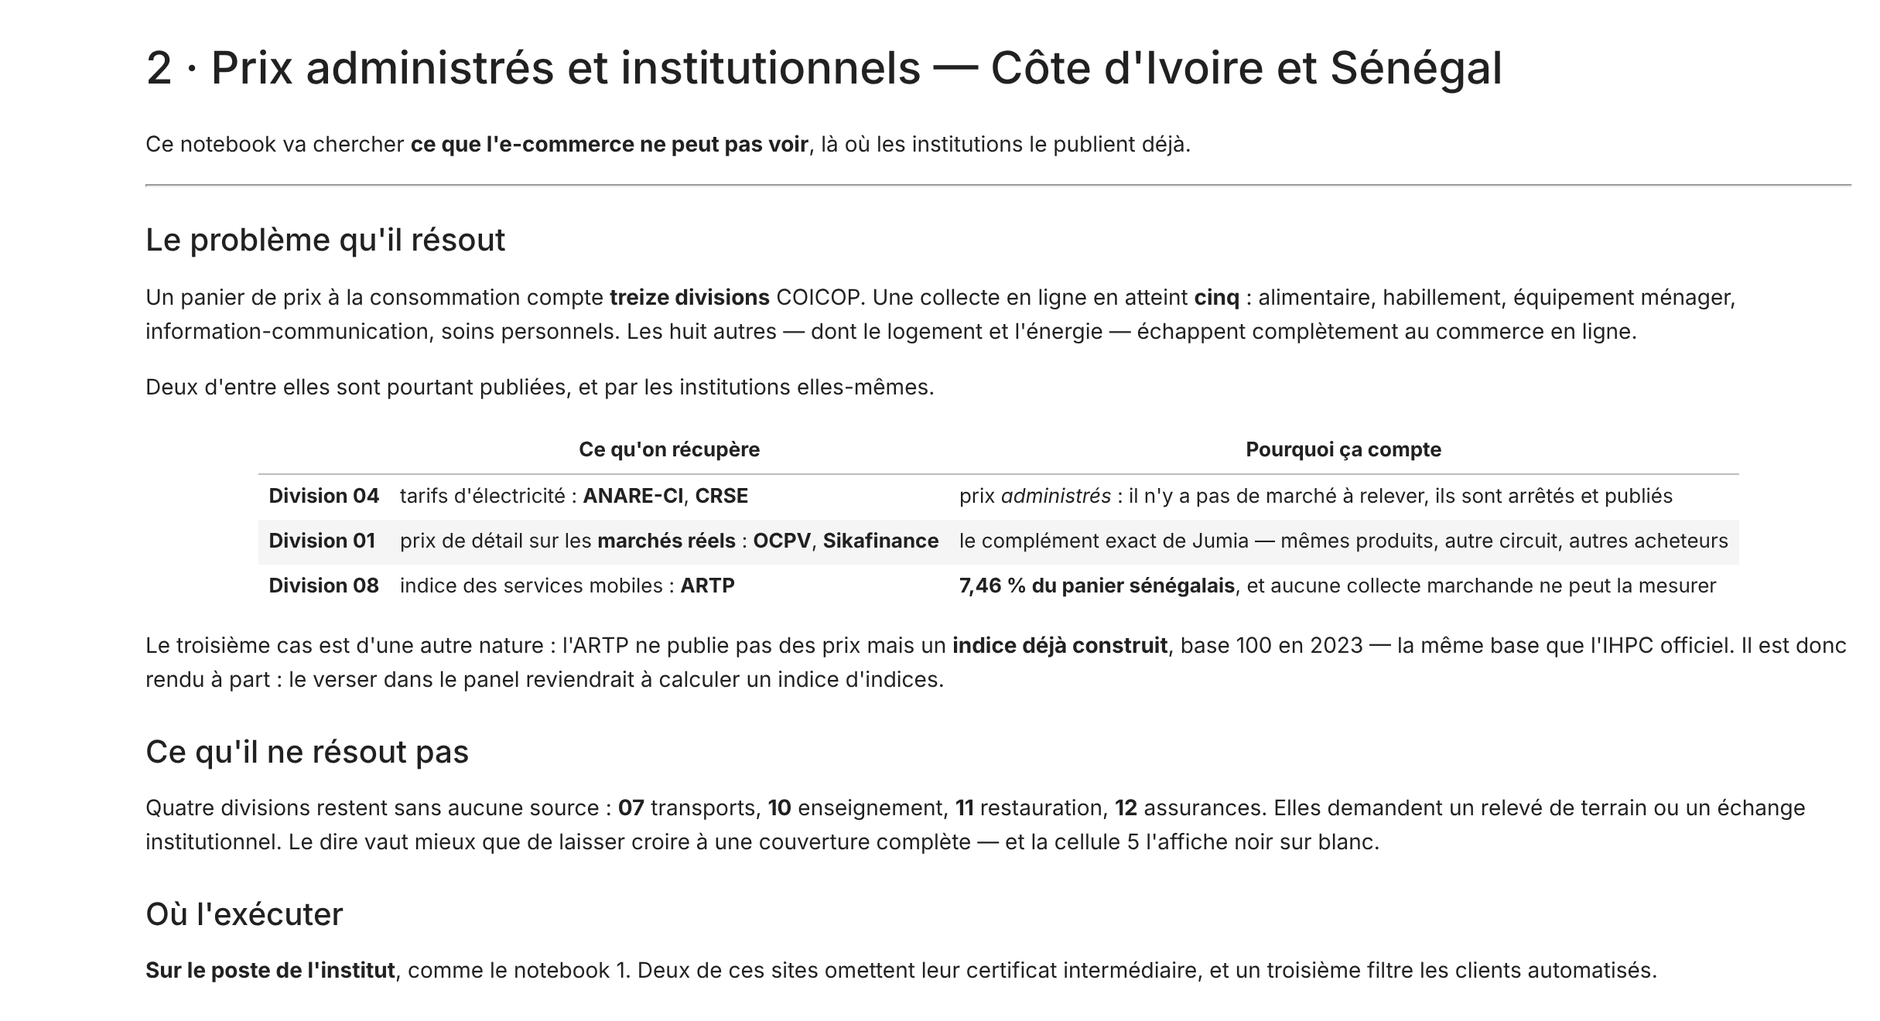

Notebook 2: reaching what e-commerce cannot see
04 · LAB
Administered and market prices already published by Ivorian and Senegalese institutions
04
Electricity
ANARE-CI and CRSE tariffs: administered prices, set and published
01
Physical markets
OCPV and Sikafinance retail prices: the exact complement to Jumia
08
Mobile services
ARTP index, base 2023: 7.46% of Senegal's basket, kept separate
A ready-made index is not mixed with prices: that would compute an index of indices.
Notes:
Notebook 2 targets items that online retail cannot measure. Electricity is an administered price: there is no market to observe, the published tariffs must be read. OCPV prices cover the same products as Jumia, but through other channels and for other buyers. The ARTP index is different in nature: it is already an index, base 100 in 2023, the same base as the HCPI. It is therefore kept separate, to be linked at division level.

Slide 24
Coverage: 7 of 13 divisions, 78% of the weight
04 · LAB
Divisions reached by the 14 October 2026 collection, with each one's weight in Senegal's HCPI (illustration)
01
45.5%
02
0.2%
03
4.8%
04
9.2%
05
5.7%
78%
of the basket weight reached by the 7 covered divisions
Food
Alcohol, tobacco
Clothing
Housing, energy
Equipment
06
4.2%
07
6.1%
08
7.5%
09
1.0%
10
1.8%
17%
in 4 divisions out of reach: transport, education, restaurants, insurance
Health
Transport
Information, comm.
Recreation, culture
Education
11
9.2%
12
0.1%
13
4.9%
4%
in 2 divisions barely touched: alcohol-tobacco and health
Restaurants
Insurance
Personal care, misc.
E-commerce and institutions
E-commerce (Jumia)
Institutions
Only a few products
Out of reach
Notes:
The lab brought price quotes in divisions 01, 03, 04, 05, 08, 09 and 13, according to the notebook 3 log. Weighted with Senegal's HCPI weights, since no Ivorian weights by division were available, these seven divisions represent 78.4% of the basket. But covering a division does not mean covering it well: online food, for example, mostly reflects packaged products bought by urban consumers. Four divisions, 17.2% of the weight, require field collection or an institutional data exchange. Divisions 02 and 06 have only a few products (5 and 33).

Slide 25
First collection: 10,523 price quotes in one day
04 · LAB
Côte d'Ivoire, 14 October 2026: distinct products by COICOP division after classification
7,759
Jumia quotes (notebook 1)
2,764
institutional quotes: OCPV, Sikafinance, tariffs (notebook 2)
15
duplicates detected and removed when merging
100%
of the 10,508 products assigned to a COICOP class
Source: notebook 3 run (jumia-cpi 1.0.0), archives panel_CI_2026-10-14_1331.zip and officiel_CI_2026-10-14_1418.zip.
Notes:
The two merged archives total 10,523 quotes: 7,759 from Jumia and 2,764 from institutional sources. Fifteen duplicates were removed. Food dominates thanks to OCPV market prices, followed by household equipment and information-communication, which are well represented online. The checksums of both files were verified on loading.

Slide 26
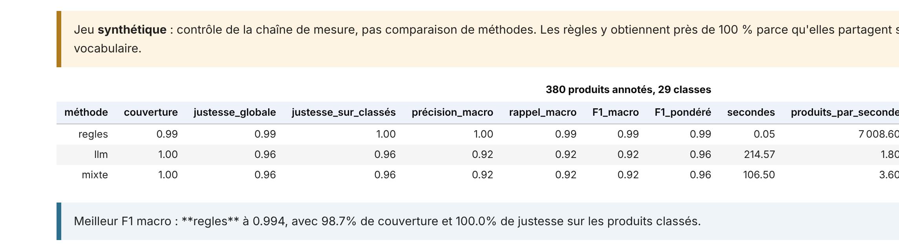
Classifying by COICOP: rules, model and benchmark
04 · LAB
A method is not chosen in advance: it is measured on a set whose correct answer is known
99%
rules F1 on the synthetic set: a pipeline check, not proof
92%
language model macro F1, with transport / housing confusions
× 3,894
rules speed compared with the model: hours saved on 10,000 products
Source: notebook 3, benchmark on 380 annotated products and 29 classes (demo set). 94 real products are ready to be annotated for a conclusive benchmark.
Notes:
Of 10,508 products, 8,104 were classified by rules, 1,903 by the site category, and about 500 by the language model (Groq, gpt-oss-120b), of which 260 fell back to rules when the API was rate-limited (HTTP 429 errors). Key point: the benchmark ran on the synthetic set. Rules score 99% there because they share its vocabulary; the notebook says so itself. To decide, a sample of real quotes must be annotated: the notebook has prepared 94, stratified by division. Allow one to two hours per hundred products.

Slide 27
Discounts: the specific challenge of online prices
04 · LAB
Share of products showing a struck-through price, by division, October 2026 collection in Côte d'Ivoire
83%
of clothing items show a struck-through price, against 9% for food
What the lab does
Computes the index on posted prices and on regular prices
Recommends three quotes per month, combined by geometric mean
Uses Jevons, and shows the Carli drift
Source: notebook 3, figure "Frequency of struck-through prices by division and month". Divisions 02 and 07 excluded (fewer than 10 products).
Notes:
This chart uses the values of the heatmap produced by notebook 3 for October 2026. Struck-through prices are everywhere online for clothing, personal care and electronics, but rare for food and energy, where prices come mostly from markets and tariffs. A struck-through price is not always a real discount: it is often a reference price shown permanently. Hence the value of computing the index on both bases and taking several quotes per month.

Slide 28




What this index measures, and what it does not
04 · LAB
A complement to the official CPI, to be presented with its limits
Urban, connected buyers : open-air markets and the informal sector are covered only through the OCPV
Before releasing a figure
The institute's weights, not equal shares
File with a provenance manifest
Not the demo data set
Benchmark on your own data
At least two months of quotes
Mostly goods : housing, transport, health and education remain barely or not covered
Posted, not paid, prices : no quantities sold; discounts weigh heavily
Fast-moving catalogue : 2,900 new products in October; new items only enter the following month
Status on 14 October 2026: a single collection, so the index stands at 100. A second collection, the following month, is needed to measure a change.
Notes:
We need to be transparent about the lab's status. With a single collection, the notebook shows an index of 100: an index compares two periods. The weights used in the test were equal shares, which makes it a trend indicator, not a measure comparable to the CPI. The 2,900 figure comes from the catalogue turnover chart produced by the notebook. The five checks in the box repeat those of the notebook, plus the two-month condition.

Slide 29






Testing the lab in six steps
04 · LAB
From setup to report; collection is repeated every month at the same time
01
Set up
02
Collect online
03
Complete
Run preparer.bat in the jumia-cpi folder: it creates a dedicated environment.
Notebook 1 on the workstation: choose the country, fill in CONTACT_EMAIL.
Notebook 2: administered and market prices for Côte d'Ivoire or Senegal.
04
Share
05
Analyse
06
Publish
Share the .zip archives, never the Excel file alone: it can retype codes.
Notebook 3 on Colab: official weights, benchmark on your data.
Download rapport.html: charts included, it opens anywhere.
Notes:
Notebooks 1 and 2 run on the office workstation, notebook 3 on Colab. The demo data set lets you run notebook 3 with no data to see a complete result. Warning from a related project: an Excel workbook silently reduced 970 products to 130 by retyping codes. Hence the Parquet archive with a manifest. Equivalent command without a notebook: python scripts/collect.py --country CI --contact you@institute.org --max-pages 10.

Slide 30

Challenges and conclusion
05
What challenges remain for measuring prices reliably?
Notes:
Part five: current debates around the CPI, then the summary and next steps.

Slide 31




Current challenges for the CPI
05 · CHALLENGES AND CONCLUSION
Four debates every CPI compiler should be able to explain
Measurement bias
Owner-occupied housing
Product substitution, new products, quality effects, outlet changes: the CPI tends to slightly overstate inflation.
Owner-occupiers' housing costs are not yet in the European HICP; approaches are still debated.
E-commerce
Perceived inflation
A growing share of purchases, very volatile prices, and delivery fees now identified by COICOP 2018.
Frequent purchases, low-income households more exposed to food: the gap with the average index fuels distrust.
Notes:
On owner-occupied housing, the ECB noted in 2026 that this item is not yet included in the new HICP classification, and that European statisticians are studying several approaches. On perceived inflation, food weighs 45.5% of the basket in Senegal: a low-income household spends more on it, and therefore feels a rise in food prices more strongly than the average index shows.

Slide 32
In summary
05 · CHALLENGES AND CONCLUSION
A reliable CPI rests on a well-built basket, a documented method and diverse sources
01
The CPI drives decisions
Next steps
Monetary policy, indexation, national accounts: measurement quality has a real cost.
Second collection in November
Official weights for Côte d'Ivoire
Annotate the 94 benchmark products
Add rents (division 04)
Compare with the official HCPI
02
COICOP 2018 structures the basket
Thirteen divisions, services better identified, a 2023 base shared across WAEMU.
03
New sources complement
78% of the weight reached in the lab, but four divisions still require field collection.
Notes:
Rents are the heaviest non-food item in an African basket: the project registry identifies thirteen rent sources, three of them already collected elsewhere. This is the extension that would add the most. Comparison with the official HCPI is built into notebook 3: just provide the official series as a CSV.

Slide 33
Sources
05 · CHALLENGES AND CONCLUSION
Reference documents and data used in this presentation
Consumer Price Index Manual (2020)
BCEAO (2026)
Concepts and Methods. Joint publication of the international statistical organisations.
Annual report on consumer prices in WAEMU in 2025 (in French).
imf.org
bceao.int
ANSD (2026)
United Nations, UNSD (2018)
Harmonised consumer price index, March 2026: base-2023 weights and methodological note (in French).
Classification of Individual Consumption According to Purpose (COICOP) 2018.
ansd.sn
unstats.un.org/unsd/classifications
ECB (2026)
jumia-cpi 1.0.0 lab (2026)
What's new in the HICP? The 2026 classification update. Economic Bulletin 3/2026.
Collection and analysis notebooks; run of 14 October 2026 in Côte d'Ivoire.
ecb.europa.eu
notebooks 1, 2 and 3
Notes:
All figures in this presentation come from these sources. Lab results are those of the actual run on 14 October 2026; the worked example of elementary formulas is illustrative.

Slide 34
Thank you
THE CONSUMER PRICE INDEX
Measuring prices rigorously, and opening the CPI to new data sources
Notes:
Closing slide.

