Slide 1
DATA INNOVATION FOR AFRICA (DI4A) INITIATIVE
Establishing a Data Innovation Lab
Applying the AfDB’s Data Innovation Maturity Model
Based on the practical guide by the AfDB Statistics Department (October 2025)
Notes:
This presentation summarises the AfDB practical guide on setting up Data Innovation Labs and applying its twelve-dimension maturity model.

Slide 2






Agenda
OVERVIEW
01
02
03
Context
The DIL initiative
The maturity model
Why official statistics must innovate
Objectives, pillars and functions of a DIL
Twelve dimensions to assess readiness
04
05
06
Implementation
Country experiences
Way forward
Lessons from the pilot countries
Good practices and early results
Next steps and points of attention
Notes:
Six parts: context, the AfDB initiative, the maturity model, implementation, country experiences and the way forward.

Slide 3
01
Context
Why must official statistics innovate?
Notes:
The guide starts from one observation: official statistics face an unprecedented convergence of pressures.

Slide 4





Five pressures are converging on African NSOs
01 · CONTEXT
Data deluge
Timeliness gap
Fast-moving technology
Scarce skills
Tight budgets
Official statistics must defend their visibility against faster but less reliable data.
Users want immediate, granular data; rigour takes time.
Tools evolve constantly, requiring monitoring, agility and resources.
Few data scientists in the public sector, facing private-sector competition.
Strained national budgets; short-term, narrowly targeted aid.
Innovate or die: transformation is now a condition for relevance.
Notes:
The guide identifies five challenges. The most structural is the timeliness gap: users expect immediacy while rigour takes time.

Slide 5


Modernising is no longer enough: transform
01 · CONTEXT
System modernisation
Ecosystem transformation
Purpose
Quality and accessibility of official statistics
Purpose
An open, collaborative environment around data
Nature
Internal, institutional
Nature
Global, systemic
Who
NSS members
Who
All data holders and users
Key issues
Reliability, independence
Key issues
Interoperability, governance, innovation
Reach beyond the NSS
Cross-cutting innovation
Co-create solutions
Notes:
Current NSDSs mostly target internal modernisation of the NSS. The guide argues for a systemic transformation of the whole data ecosystem.

Slide 6







Innovation at every stage of the value chain
01 · CONTEXT
Sources
Collection
Processing
Storage
Dissemination
Analysis
Satellite imagery
Mobile phone data
Administrative records
CAPI
Web scraping
Internet of things
Automated validation
Machine learning
Cloud pipelines
Data catalogues
Large-scale databases
Cybersecurity
Open data portals
APIs
Dashboards
Predictive analytics
Real-time monitoring
AI, Python, R
Key principle: innovation starts with the technicians who know the tools and processes.
Notes:
The guide describes six stages and stresses that innovation should start with the teams who run the processes.

Slide 7

02
The AfDB DIL initiative
What does the Bank offer to accelerate innovation?
Notes:
Launched in 2023 under the Africa Information Highway (AIH) programme, the initiative is both an incubator and a collaboration platform.

Slide 8



Four objectives, two pillars, four principles
02 · THE DIL INITIATIVE
OBJECTIVES
PILLARS
1 Innovation for value and impact
1
2
Enable innovation
Augmented data
2 Networks and collaboration
Within the Bank and Regional Member Countries
Faster, more granular and cheaper
PRINCIPLES
3
4
Data augmentation
Collect once, reuse
Demystify data science
Open-source tools
Reduce friction
Through training and joint projects
A tested, reusable repository
Partnership at the core
Notes:
Objectives state what the initiative aims for; pillars how it is organised; principles how it works.

Slide 9




A DIL plays three complementary roles
02 · THE DIL INITIATIVE
Catalyst
Facilitator
Sparks ideas, encourages experimentation and spreads an innovation culture.
Data
Innovation
Lab
Connects actors, builds capacity, sets sharing rules, helps mobilise funding.
A platform bringing together government, academia, the private sector and development partners.
The innovator role must respond to needs expressed by users, or risk isolation.
Innovator
Testbed for AI, geospatial and agile methods; reproducible proofs of concept.
Notes:
Catalyst, facilitator, innovator. The guide insists the innovator role must not operate in isolation.

Slide 10

03
The maturity model
How ready is a data ecosystem to transform?
Notes:
The core of the guide: a twelve-dimension diagnostic that serves as a baseline and a monitoring tool.

Slide 11



Twelve dimensions for a full diagnostic
03 · THE MATURITY MODEL
12 Funding
1 Leadership
94 open questions
11 Research & analysis
2 Strategic vision
adaptable to each country’s context
10 Users & comms
Readiness for transformation
3 Legal framework
No weighting, no ranking
a dialogue tool, not a benchmark
9 Quality & norms
4 Human resources
Supported first
8 Partnerships
5 IT capacity
first diagnostic with the AfDB, then country-led follow-ups
7 Non-conv. sources
6 Admin. data
Notes:
The dimensions cover the NSO and the wider ecosystem: legal framework, partnerships, users and funding. The model neither weights nor ranks.

Slide 12
A participatory diagnostic, reported as a traffic light
03 · THE MATURITY MODEL
1
Questionnaire
Green
Initial answers from the NSO and its partners
Favourable situation
2
Expert mission
Five to six days at most, to mobilise teams
Orange
3
Colour coding
Room for improvement, sustained attention
One colour per question, looking for trends
Red
4
Feedback
Further reflection and priority measures
Technical analysis and summary for decision-makers
Two formats: 12 dimensions for decision-makers, about 60 components for detail.
2–3 months per country, end to end
Notes:
The process takes two to three months per country. The guide stresses that stakeholder dialogue matters more than the colour assigned.

Slide 13


Two families of levers to transform the ecosystem
03 · THE MATURITY MODEL
Supporting factors
Transformation of the data ecosystem
Steering factors
Within the NSO’s control
Less control, but decisive
Internal vision
Legal framework
Human resources
DIL
innovator
catalyst
facilitator
Strategic framework
ICT infrastructure
Partnerships
Innovative experiences
Communication and users
Quality and standards
Funding
The diagnostic is the first step
Data analytics
Notes:
Supporting factors are within the NSO’s control; steering factors less so, but they are decisive. The DIL links the two.

Slide 14
04
Implementation
What have the pilots taught us?
Notes:
The diagnostics highlighted organisational choices and concrete bottlenecks.

Slide 15



Physical or virtual DIL: a trade-off to make
04 · IMPLEMENTATION
Physical DIL
Virtual DIL
A dedicated unit, often under IT or methods
Shared responsibility across departments, light coordination
Advantages
Risks
Advantages
Risks
Visible in the organisation chart
Clear staff assignments
Simpler budget management
The unit monopolises innovation
Technical departments disengage
Whole institution engaged
Investment close to operations
Diluted responsibilities
Loss of overall coherence
Two conditions: keep innovation close to operations and coordinate all investments.
Notes:
Countries chose different set-ups. The right answer often lies in between, provided two rules are respected.

Slide 16




Four lessons to remove bottlenecks
04 · IMPLEMENTATION
Introduce “innovation time”
Create a data-roles competency framework
Like training time, with a light committee reviewing projects and results.
Without civil-service status, data scientists remain hard to recruit.
Start with a core group of partners
Start with existing infrastructure
Deliver tangible results with a few actors, then expand the coalition.
Share public capacity, technology watch and even purchases.
Notes:
Technical departments have ideas; they lack time, expertise and decision channels. These four avenues address that.

Slide 17

05
Country experiences
What the pilot countries are already doing
Notes:
Six countries applied the model between late 2023 and 2025; Annex 7 of the guide also lists Botswana.

Slide 18
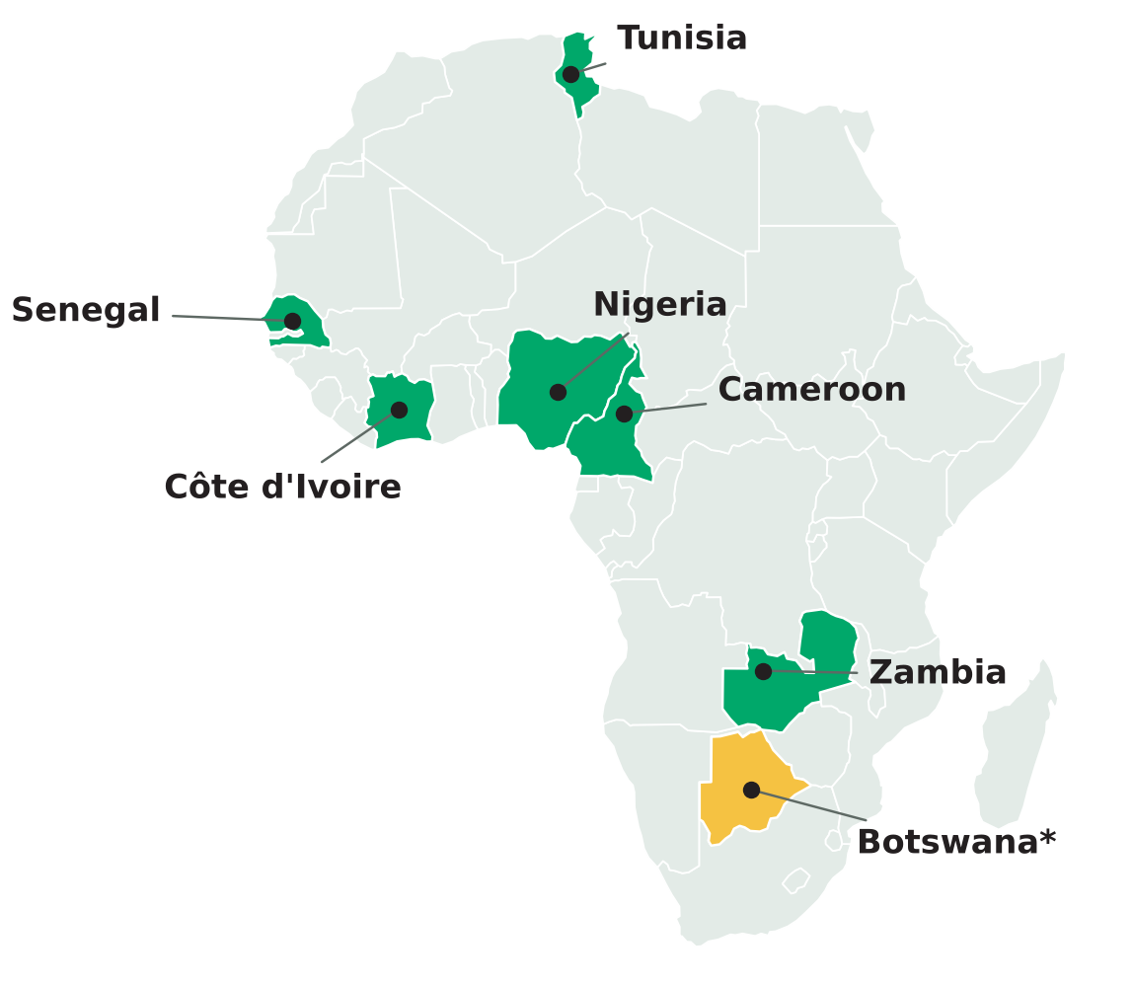
The model tested in six pilot countries
05 · COUNTRY EXPERIENCES
Nov 2023
Tunisia
Feb 2024
Senegal
Mar 2024
Côte d’Ivoire
Jun 2024
Nigeria
Sep 2024
Cameroon
Apr 2025
Zambia
* Botswana: listed only in Annex 7 of the guide.
Map: Natural Earth (public domain). Dates: AfDB guide, October 2025.
Notes:
Dates come from the guide’s introduction. Chapter 9 gives March 2024 for Senegal and April 2024 for Côte d’Ivoire.

Slide 19





Good practices across the value chain
05 · COUNTRY EXPERIENCES
Senegal
Tunisia
Côte d’Ivoire
Use cases with ENSAE interns; mobile data to predict poverty indicators; algorithmic household targeting.
Mobile data for internal migration, validated against the census; partnership with the national remote-sensing centre.
Talks with an operator on cost-sharing; Sentinel-2 then commercial imagery; an “innovation café”.
Nigeria
Cameroon
Web scraping
A base of national strategies: data, data protection, cloud, interoperability, open data.
Workshop on satellite data for population statistics, open to the NSS, universities and private sector.
Consumer prices (Côte d’Ivoire, Cameroon, Senegal) and job vacancies (Côte d’Ivoire).
Notes:
Examples reported in the guide. They are described without measured results, which future diagnostics should document.

Slide 20
The AfDB DIL’s activities in figures
05 · COUNTRY EXPERIENCES
127
48
351
participants · 22 countries
participants · 13 countries
communes analysed
“Innovate Africa” symposium, Kigali 2024
DIHAP health-data programme, 2024
Night-time lights (VIIRS), Burkina Faso
117
13
2
participants
countries convened
agreements signed
“Brown Bag” webinar series, 2024
AU STG17 group, Kigali, Sep 2025
Data licence agreements (Meta, JBA)
Source: AfDB guide, Annex 7 (activities 2022–2025).
Notes:
Figures from Annex 7 of the guide. They measure activity rather than impact.

Slide 21
06
Way forward
How can the initiative scale up?
Notes:
The AfDB foresees five directions to expand the initiative.

Slide 22





Five directions for the initiative
06 · WAY FORWARD
01
02
03
04
05
Support national action plans
Expand country diagnostics
Support follow-up self-diagnostics
Strengthen country networks
Mobilise continental actors
Already under way: in September 2025 the AU STG17 group adopted a 2026–2030 action plan on big data and AI in official statistics.
Notes:
The directions combine direct support, more diagnostics, self-assessment, networks and continental mobilisation.

Slide 23

Points of attention for a future edition
06 · WAY FORWARD
What the guide does not yet say
Suggested improvements
No criteria for assigning colours
A scoring rubric per question
No monitoring and evaluation indicators
A results framework with indicators
No cost estimates
A typical three-year DIL budget
Ethics, privacy and generative AI barely covered
A data-protection and AI component
Some inconsistent dates and figures
Editorial review and harmonisation
Notes:
Critical reading: the guide is rich in tools but would gain from a measurement component and an editorial review.

Slide 24



Sources
06 · WAY FORWARD
African Development Bank, Statistics Department (October 2025)
Establishing a Data Innovation Lab: A Practical Guide to Applying the AfDB’s Data Innovation Maturity Model.
afdb.org/en/documents/data-innovation-africa-di4a-initiative-practical-guide-applying-afdbs-data-innovation-maturity-model
Natural Earth
1:110m cartographic data, public domain (pilot-country map).
naturalearthdata.com
Note on visual identity
Design inspired by the AfDB visual identity; this is not an official Bank document.
Notes:
References used for this presentation.

Slide 25
IN SUMMARY
Innovation starts by letting go of old ways of thinking
Thank you
1
Diagnose with the twelve dimensions
2
Choose a fitting organisation
3
Build coalitions and measure progress
Notes:
Closing message: the diagnostic is a starting point; success depends on internal ownership, partnerships and regular monitoring.

