Slide 1


AfDB – Data Innovation for Africa (DI4A)
Registering for Google Earth Engine
A step-by-step guide to registering a Google Cloud project for noncommercial use
Notes:
Welcome. In this guide from the African Development Bank – Data Innovation for Africa (DI4A), we walk through the Google Earth Engine registration in the Google Cloud console, all the way to a project registered for noncommercial use. Each slide shows a real screenshot. You will need this project for the night-lights and geospatial sessions.

Slide 2







ROADMAP
The process in six steps
01
02
03
Organization type
Noncommercial eligibility
Plan selection
State what kind of organization you are (e.g. Nonprofit).
Answer the questionnaire on how you use Earth Engine.
Select the right quota tier (Community).
04
05
06
Describe your work
Review & API
Project management
Indicate climate categories and areas of use.
Check the summary, then enable the API.
Track or update the registration, or create a project.
Registering for Google Earth Engine · AfDB – Data Innovation for Africa (DI4A)
2
Notes:
The registration form has five steps in the console, followed by enabling the API and managing the project. We group them here into six sections; each keeps its own colour, shown in the progress dots at the top right of every slide.

Slide 3



WHY REGISTER NOW
What your Earth Engine project will be used for
Night lights: measuring activity from orbit Use case 1
Download and clip NASA Black Marble monthly data; mask, aggregate, compare regions and build a national series.
Night lights in practice: what they have measured Use case 2
Review common applications, assess how proxy indicators are validated, and replicate one application.
Using geospatial tools and data Use case 3
Cropland statistics for agriculture; land cover classification and land-use analysis.
Register in advance so your Earth Engine project is ready before the hands-on sessions.
Registering for Google Earth Engine · AfDB – Data Innovation for Africa (DI4A)
3
Notes:
Why register today: several sessions work with satellite data — night lights from NASA Black Marble, and geospatial tools for cropland statistics and land cover classification. Completing the registration now means your Earth Engine project is ready before those sessions start.

Slide 4
SECTION 01 · STEP 1 OF 6
01
Organization type
What kind of organization do you represent?
Notes:
Step one: tell Google what type of organization will use Earth Engine. This choice shapes the rest of the questionnaire.

Slide 5
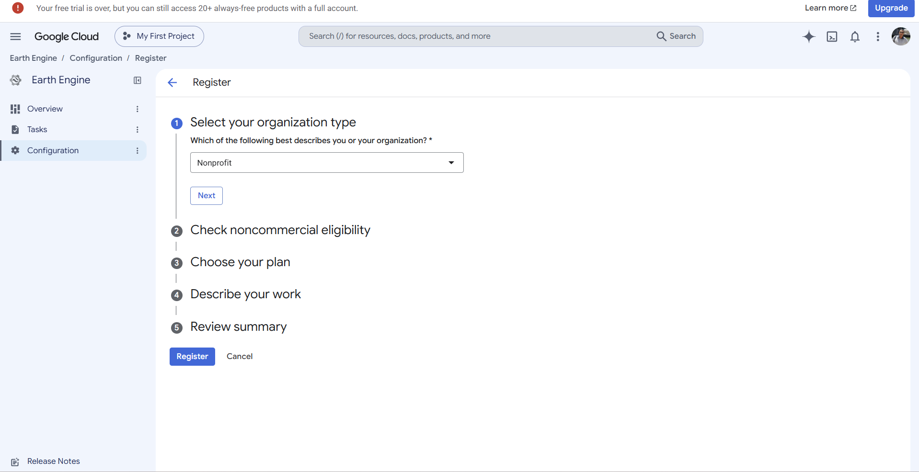

01 · ORGANIZATION TYPE
Select your organization type
1
In Earth Engine › Configuration, click Register.
2
Pick the type from the list — here Nonprofit.
3
Click Next to move to step 2.
All 5 form steps stay visible, so you can track your progress.
Source: Google Cloud console, Earth Engine › Configuration › Register (screenshot).
Registering for Google Earth Engine · AfDB – Data Innovation for Africa (DI4A)
5
Notes:
Open the Google Cloud console, go to Earth Engine, then Configuration and Register. The first question asks for the organization type: in our example, Nonprofit. Confirm with Next. The form shows all five steps: organization type, noncommercial eligibility, plan, description of your work and review summary.

Slide 6
SECTION 02 · STEP 2 OF 6
02
Noncommercial eligibility
Is your use of Earth Engine noncommercial?
Notes:
Step two: the eligibility questionnaire. Your answers determine whether the project qualifies for free noncommercial access.

Slide 7
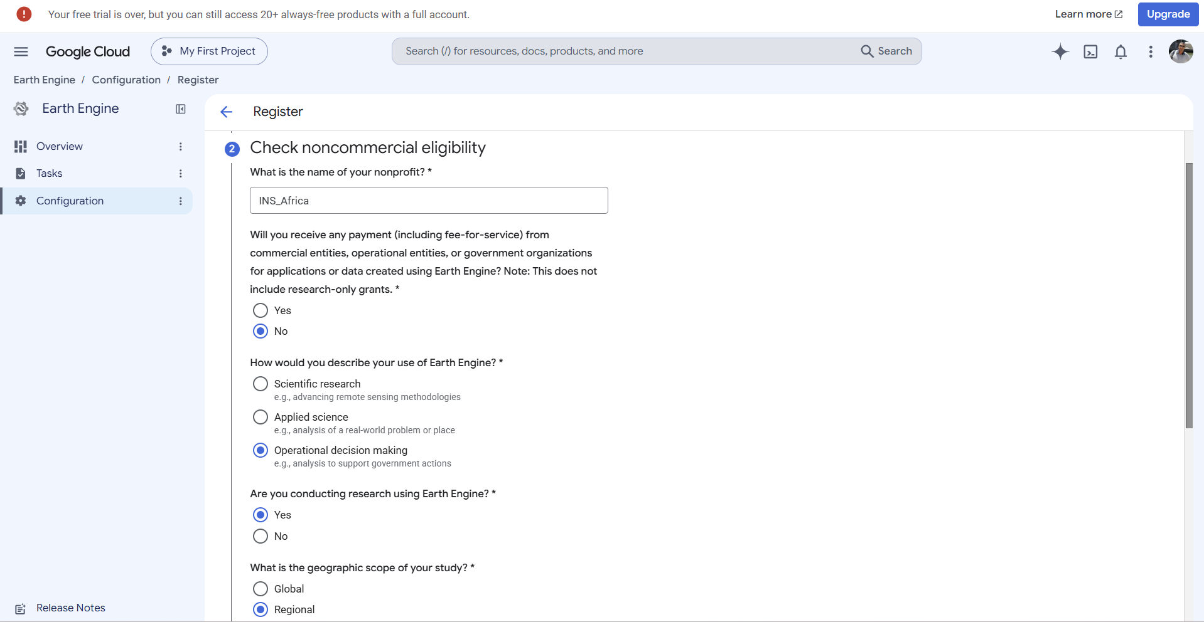
02 · NONCOMMERCIAL ELIGIBILITY
Complete the eligibility questionnaire
1
Organization name: INS_Africa.
2
Paid by commercial or government entities? No.
3
Type of use: Operational decision making.
Research-only grants do not count as payment.
Source: Google Cloud console, “Check noncommercial eligibility” step (screenshot).
Registering for Google Earth Engine · AfDB – Data Innovation for Africa (DI4A)
7
Notes:
Enter the organization name, here INS_Africa. To the question about payments from commercial, operational or government entities, answer No; the form notes that research-only grants are excluded. For the type of use, choose Operational decision making, meaning analysis that supports government action. Participants should enter their own institution here — their national statistics office or central bank.

Slide 8
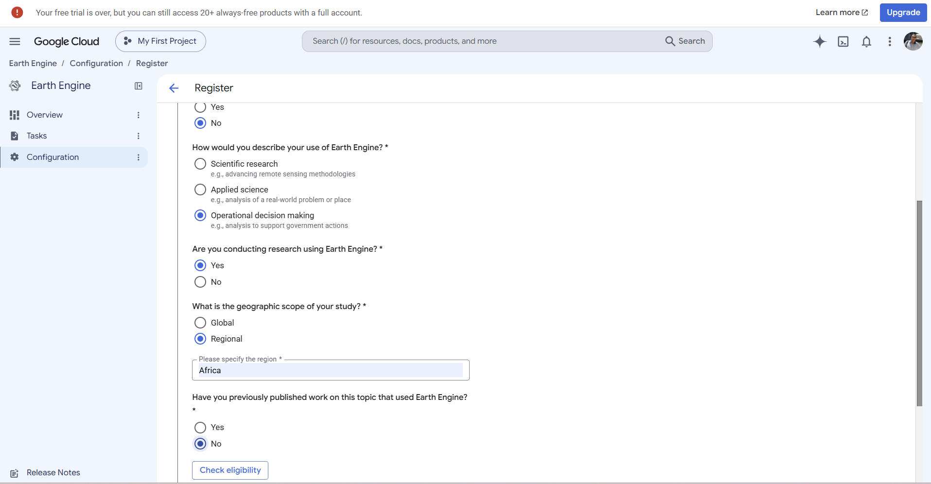
02 · NONCOMMERCIAL ELIGIBILITY
Specify research and geographic scope
1
Research using Earth Engine: Yes.
2
Scope: Regional, region Africa.
3
Previously published work: No.
4
Click Check eligibility.
Source: Google Cloud console, “Check noncommercial eligibility” step (screenshot).
Registering for Google Earth Engine · AfDB – Data Innovation for Africa (DI4A)
8
Notes:
Continue the questionnaire: we are conducting research with Earth Engine, the study scope is regional and the region is Africa. We have not yet published work on this topic using Earth Engine. Then click Check eligibility.

Slide 9
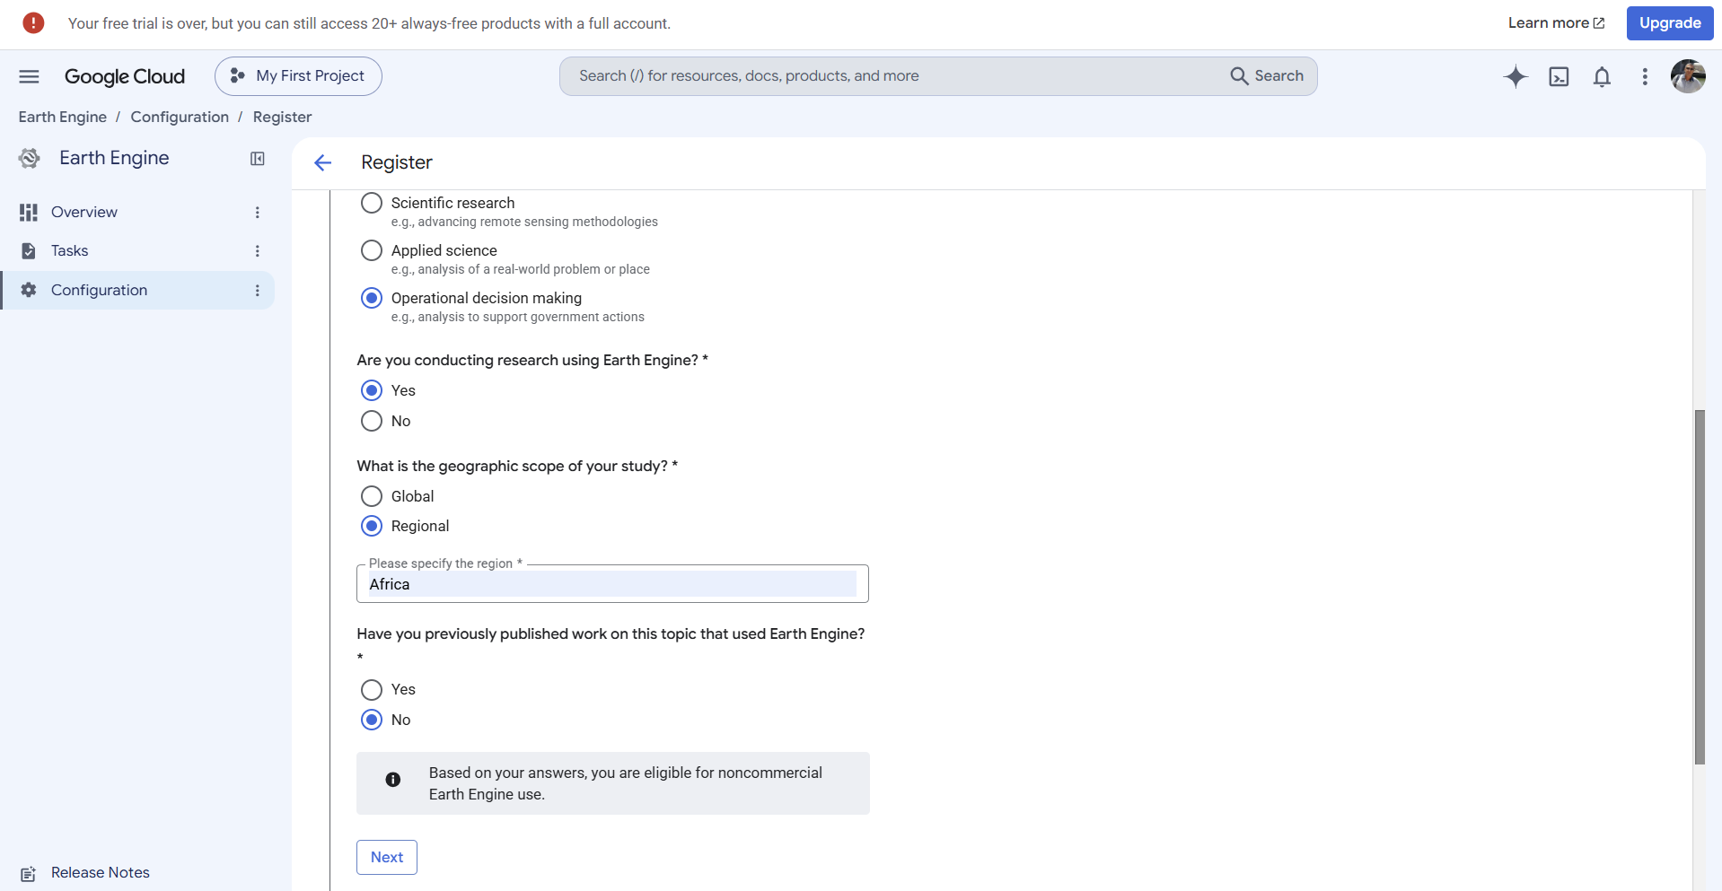

02 · NONCOMMERCIAL ELIGIBILITY
Confirm eligibility
Eligible
“Based on your answers, you are eligible for noncommercial Earth Engine use.”
1
Read the confirmation message.
2
Click Next to choose your plan.
Source: Google Cloud console, eligibility message (screenshot).
Registering for Google Earth Engine · AfDB – Data Innovation for Africa (DI4A)
9
Notes:
After the check, the console displays a message confirming eligibility for noncommercial Earth Engine use. If this message does not appear, review your previous answers. Click Next to move on to plan selection.

Slide 10
SECTION 03 · STEP 3 OF 6
03
Plan selection
How much computing power do you need?
Notes:
Step three: choose a quota tier. Two tiers are offered to verified noncommercial projects.

Slide 11
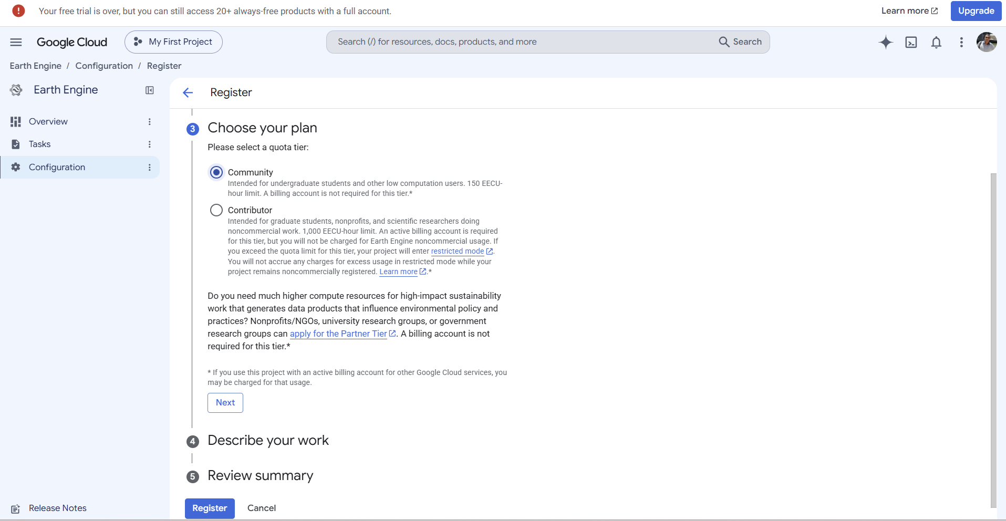
03 · PLAN SELECTION
Choose a quota tier
COMMUNITY
150 EECU-h / month
No billing account required. Tier selected here.
CONTRIBUTOR
1,000 EECU-h / month
Active billing account required, but no charge for noncommercial Earth Engine use.
Source: Google for Developers, “Earth Engine Noncommercial Tiers”; Google Cloud console (screenshot). EECU = Earth Engine Compute Unit.
Registering for Google Earth Engine · AfDB – Data Innovation for Africa (DI4A)
11
Notes:
Two tiers are available. Community: 150 EECU-hours per month, no billing account, suited to low-compute users. Contributor: 1,000 EECU-hours per month; an active billing account is required, but noncommercial Earth Engine use is not charged. For even larger needs, organizations can apply for the Partner tier. We choose Community, then Next.

Slide 12
SECTION 04 · STEP 4 OF 6
04
Describe your work
Which climate challenges does your work address?
Notes:
Step four: describe the work done with Earth Engine, using climate categories and areas of use.

Slide 13
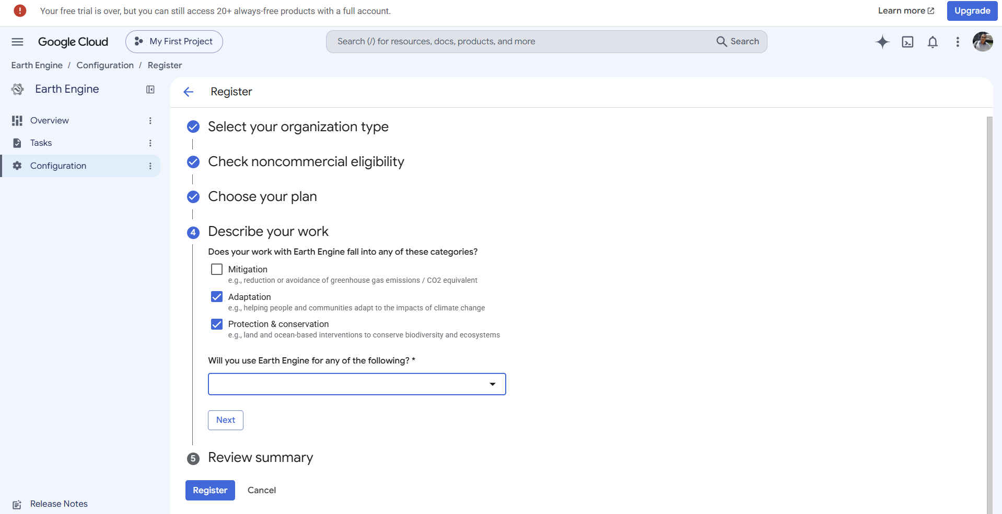
04 · DESCRIBE YOUR WORK
Describe your work
Selected categories
– Mitigation
✓ Adaptation
✓ Protection & conservation
1
Tick the relevant categories.
2
Fill in Will you use Earth Engine for… (required).
Source: Google Cloud console, “Describe your work” step (screenshot).
Registering for Google Earth Engine · AfDB – Data Innovation for Africa (DI4A)
13
Notes:
The first three steps are complete. Now indicate whether the work relates to mitigation, adaptation, or protection and conservation. Here, Adaptation and Protection & conservation are ticked. Then the areas-of-use field must be completed.

Slide 14
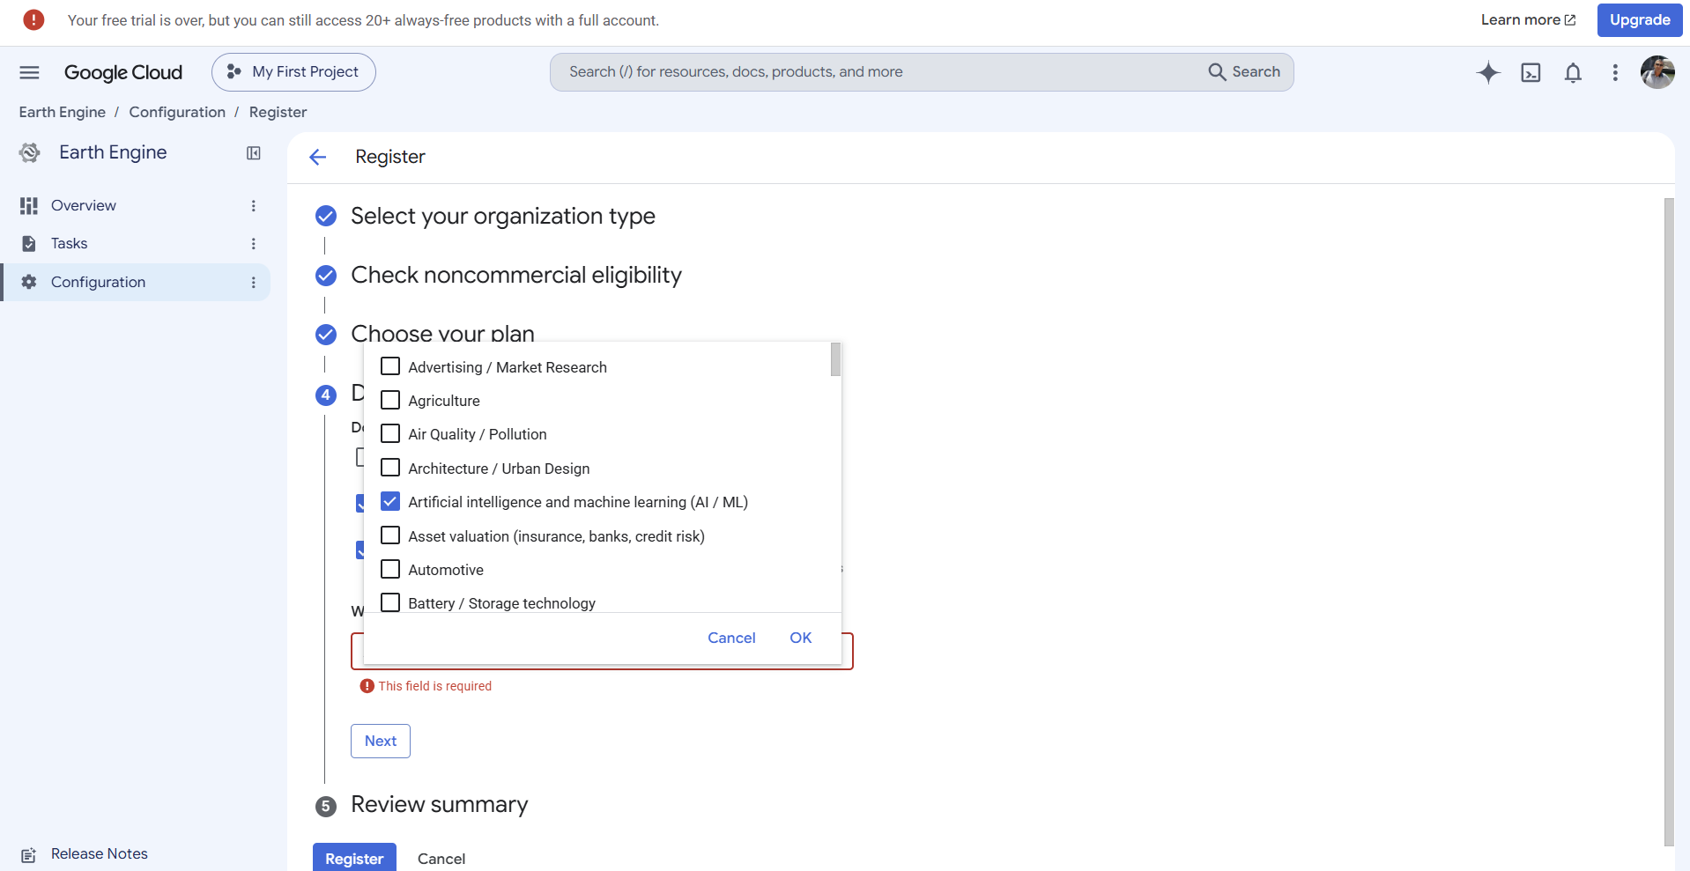

04 · DESCRIBE YOUR WORK
Select areas of use
1
Open the drop-down list.
2
Tick at least one area — here AI / ML.
3
Confirm with OK, then Next.
Required field: with nothing selected, “This field is required” blocks you.
Source: Google Cloud console, areas-of-use list (screenshot).
Registering for Google Earth Engine · AfDB – Data Innovation for Africa (DI4A)
14
Notes:
The drop-down offers many areas: agriculture, air quality, urban design, artificial intelligence and more. You must tick at least one, otherwise the message This field is required stops you from continuing. Here, select Artificial intelligence and machine learning, then OK and Next. You can also tick areas that match your work, such as agriculture, which is relevant to the cropland use case.

Slide 15
SECTION 05 · STEP 5 OF 6
05
Review & API
Is everything correct before you submit?
Notes:
Step five: review the summary, submit the registration and enable the Earth Engine API.

Slide 16
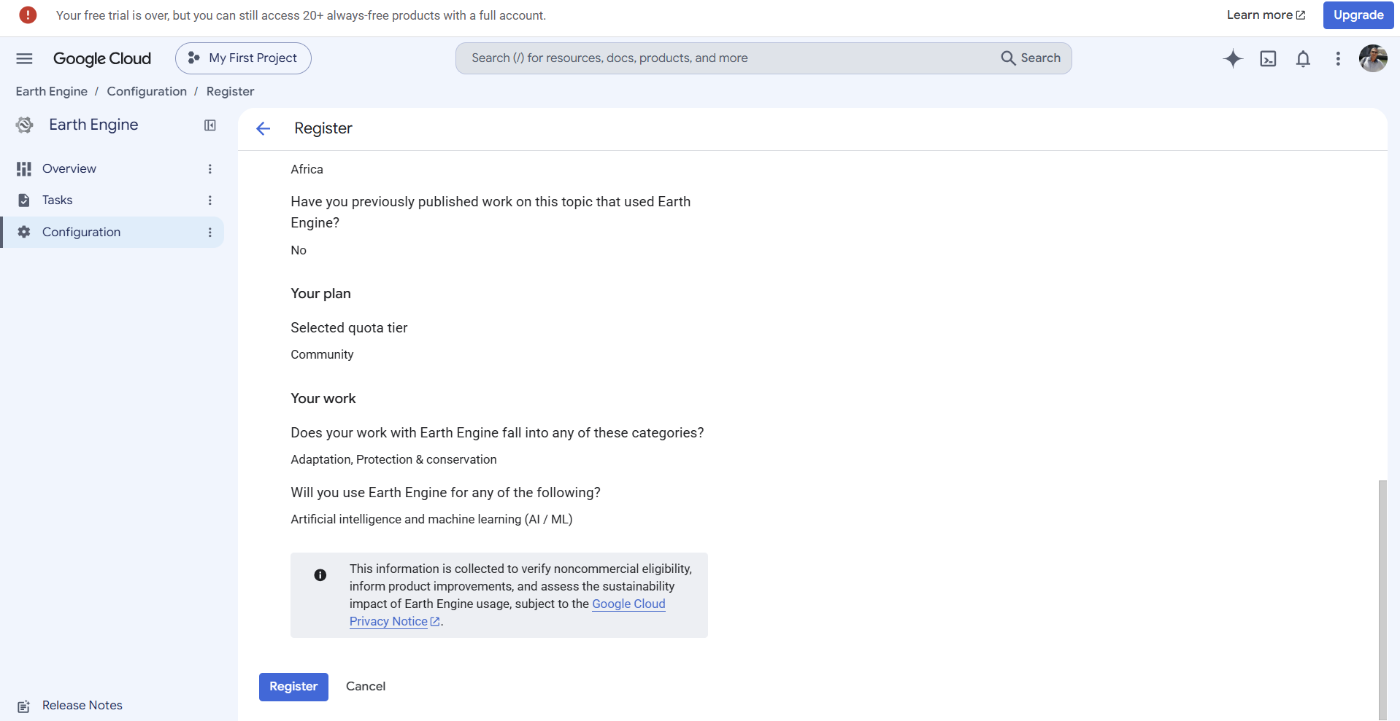
05 · REVIEW & API
Check the summary
PLAN
Community
CATEGORIES
Adaptation, Protection & conservation
USE
AI / ML
REGION
Africa
All correct? Click Register.
Source: Google Cloud console, “Review summary” step (screenshot).
Registering for Google Earth Engine · AfDB – Data Innovation for Africa (DI4A)
16
Notes:
The summary lists all answers: region Africa, no previous publications, Community plan, Adaptation and Protection & conservation categories, AI/ML use. A notice explains that this information is used to verify eligibility and assess Earth Engine's impact. If everything is correct, click Register.

Slide 17
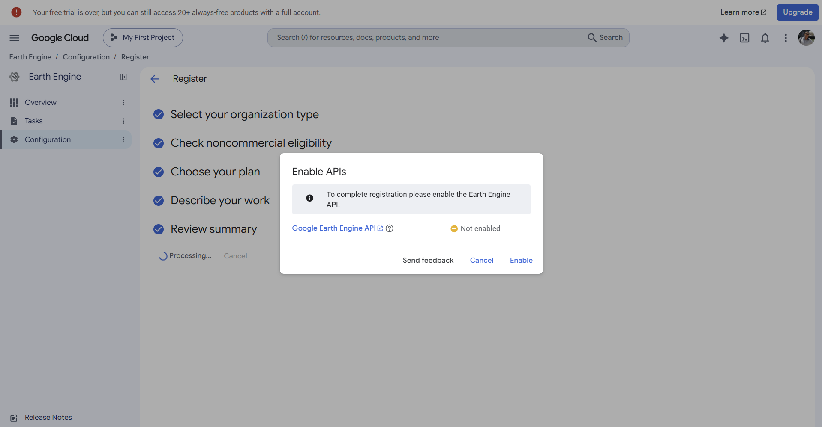
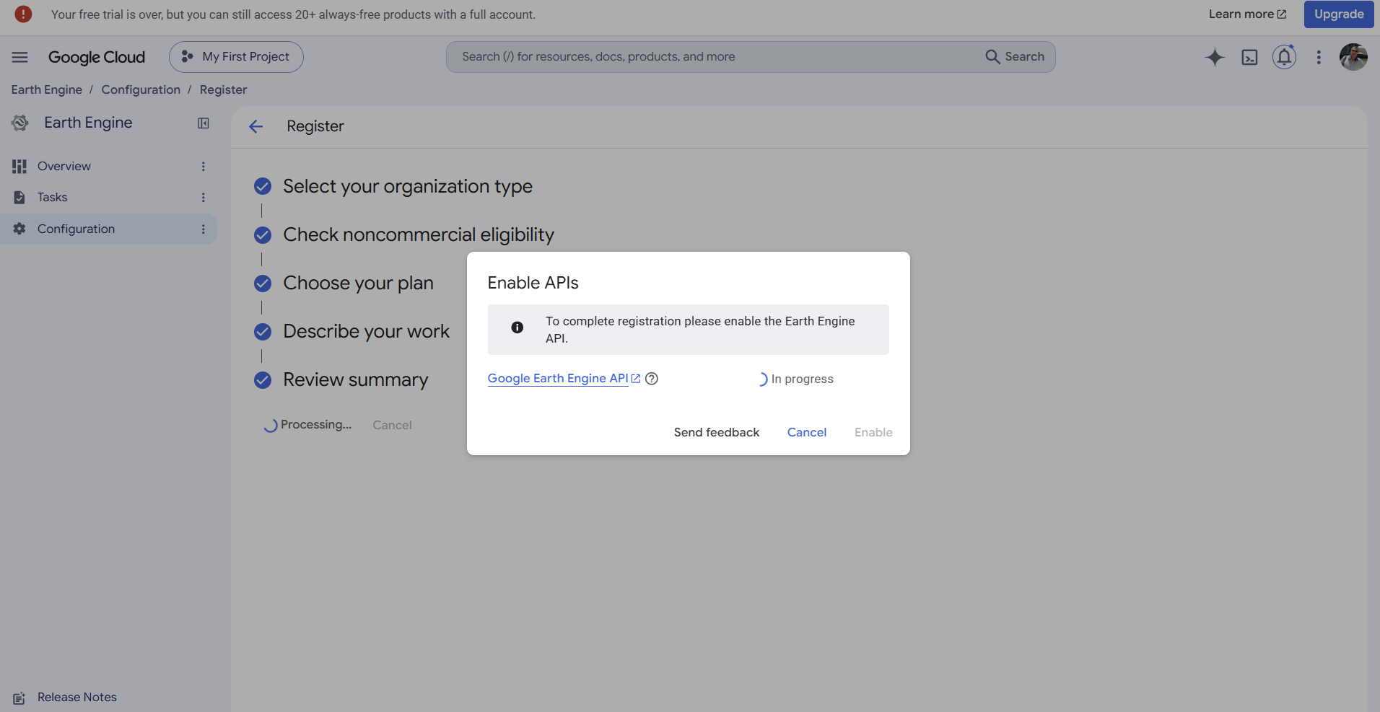
05 · REVIEW & API
Enable the Earth Engine API
BEFORE
Status “Not enabled”: click Enable.
DURING
Status “In progress”: wait, do not close the window.
Source: Google Cloud console, “Enable APIs” dialog (screenshots).
Registering for Google Earth Engine · AfDB – Data Innovation for Africa (DI4A)
17
Notes:
To complete the registration, the console asks you to enable the Google Earth Engine API. The status first shows Not enabled: click Enable. The status then changes to In progress and Processing appears. Just wait a few moments without closing the window.

Slide 18
SECTION 06 · STEP 6 OF 6
06
Project management
How do you manage your registration over time?
Notes:
Final section: the registration is confirmed; we look at how to manage it and, if needed, create a new project.

Slide 19
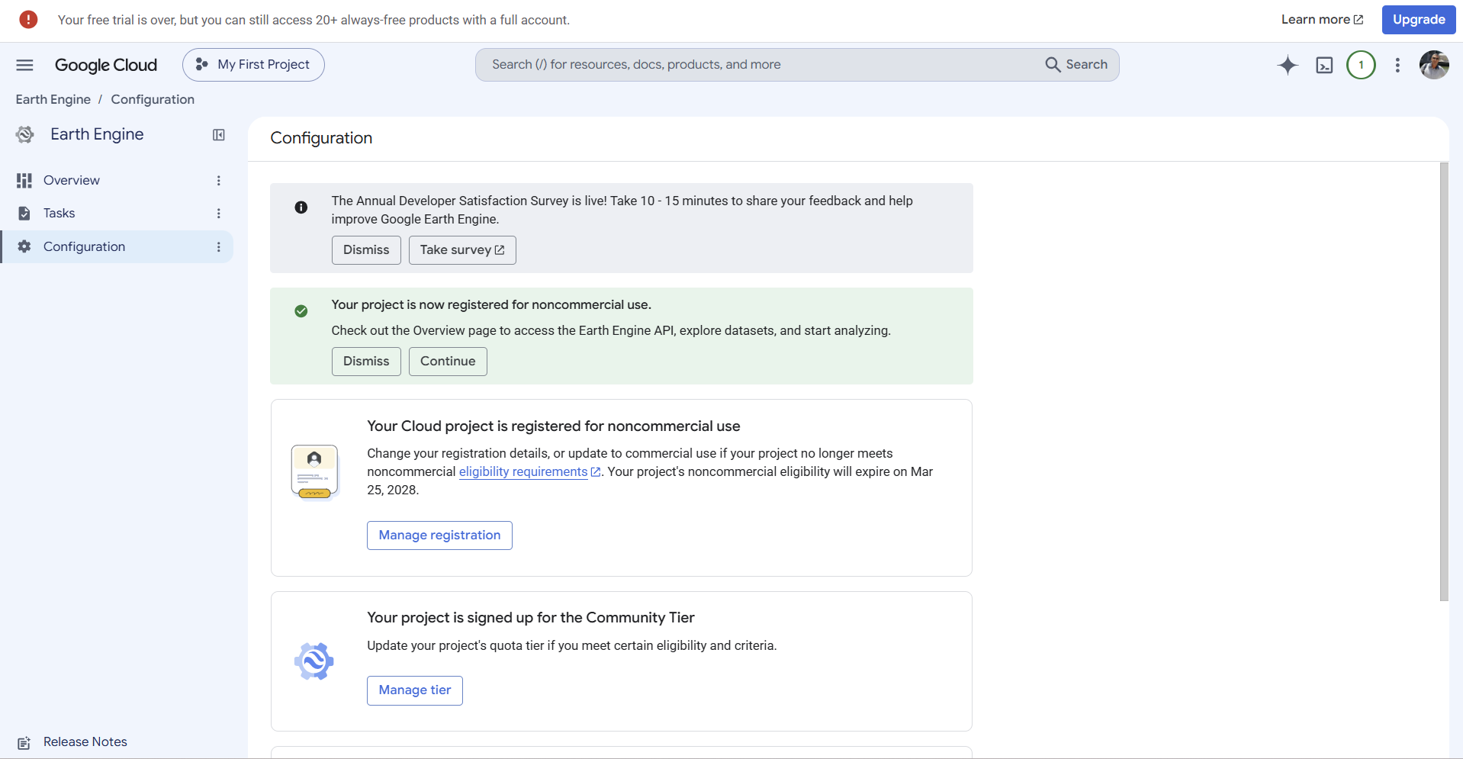
06 · PROJECT MANAGEMENT
Registration confirmed
ELIGIBILITY VALID UNTIL
25 March 2028
Tier: Community
1
Continue: open the Overview page.
2
Manage registration: edit the registration.
Source: Google Cloud console, Configuration page (screenshot); expiry date specific to this project.
Registering for Google Earth Engine · AfDB – Data Innovation for Africa (DI4A)
19
Notes:
The project is now registered for noncommercial use, on the Community tier. The page also shows when eligibility expires — here 25 March 2028 for this project. Continue leads to the Overview page to access the API and datasets. The highlighted Manage registration button lets you edit the registration.

Slide 20
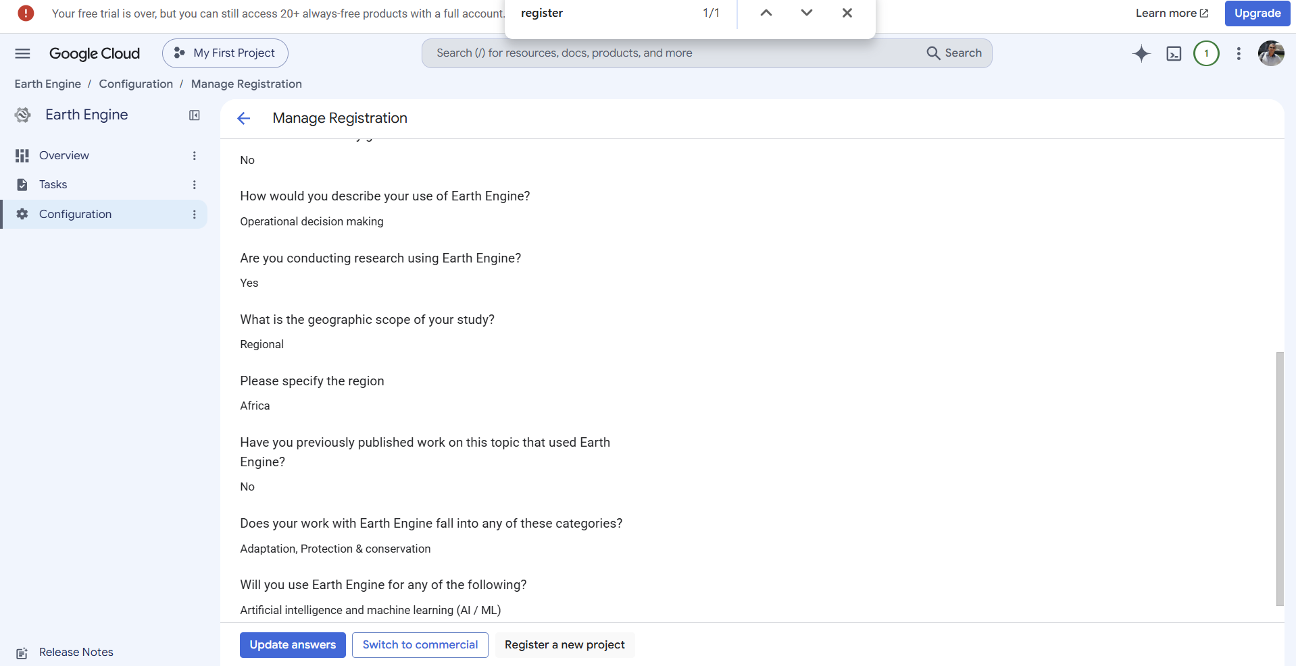
06 · PROJECT MANAGEMENT
Manage the registration
Update answers
Edit your answers.
Switch to commercial
Move to commercial use.
Register a new project
Register another project.
Source: Google Cloud console, “Manage Registration” page (screenshot).
Registering for Google Earth Engine · AfDB – Data Innovation for Africa (DI4A)
20
Notes:
The Manage Registration page lists all saved answers. At the bottom are three actions: Update answers to change them, Switch to commercial if the project no longer meets the noncommercial criteria, and the highlighted Register a new project to register another project.

Slide 21
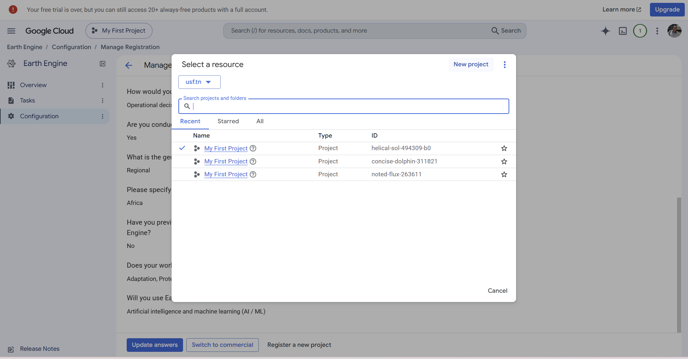
06 · PROJECT MANAGEMENT
Select or create a project
1
The Select a resource dialog lists your projects.
2
Pick an existing project by its ID…
3
… or click New project.
Several projects can share a name: rely on the ID.
Source: Google Cloud console, “Select a resource” dialog (screenshot).
Registering for Google Earth Engine · AfDB – Data Innovation for Africa (DI4A)
21
Notes:
Clicking Register a new project opens the Select a resource dialog. It lists recent projects; note that several are named My First Project, and only the ID tells them apart. You can pick an existing project or click the highlighted New project.

Slide 22
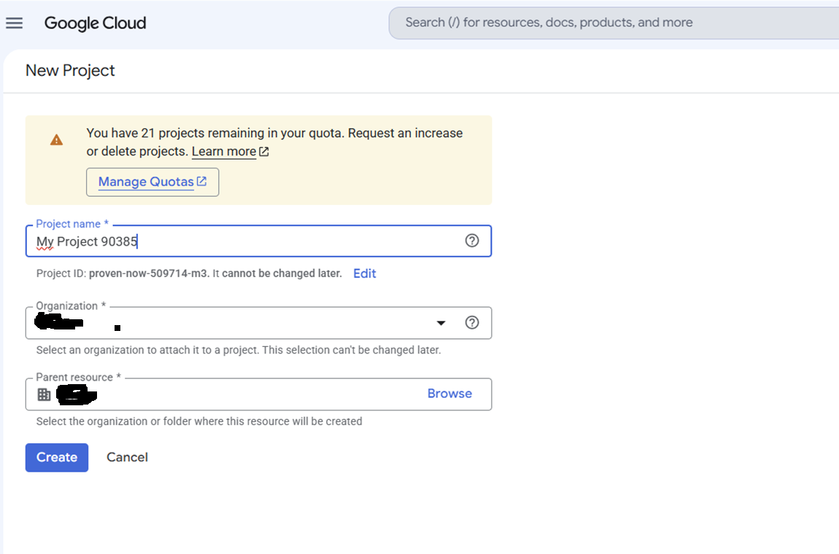
06 · PROJECT MANAGEMENT
Create a new project
1
Enter the Project name.
2
Set Organization and Parent resource.
3
Click Create.
The project ID and organization cannot be changed after creation.
Source: Google Cloud console, “New Project” page (screenshot).
Registering for Google Earth Engine · AfDB – Data Innovation for Africa (DI4A)
22
Notes:
To create a project, enter its name; the console generates an ID, which you can change with Edit but not after creation. Choose the organization and parent resource, which are also permanent, then Create. You will then need to register this new project for Earth Engine by repeating the steps covered earlier.

Slide 23



SOURCES
Sources and references
Screenshots — Google Cloud console — Earth Engine › Configuration
console.cloud.google.com/earth-engine/configuration
Google for Developers — Earth Engine access — registering a Cloud project
developers.google.com/earth-engine/guides/access
Google for Developers — Earth Engine Noncommercial Tiers — Community and Contributor tiers
developers.google.com/earth-engine/guides/noncommercial_tiers
Screenshots taken while registering a demonstration project; the console interface may change.
Registering for Google Earth Engine · AfDB – Data Innovation for Africa (DI4A)
23
Notes:
All screenshots come from the Google Cloud console. Quota tier information is taken from the official Google for Developers documentation. As the interface may change, refer to the documentation if anything looks different.

Slide 24

AFDB – DATA INNOVATION FOR AFRICA (DI4A) · CONCLUSION
Your project is ready
You are set for the satellite-data sessions: night-time lights and geospatial analysis.
African Development Bank (AfDB) · Data Innovation for Africa (DI4A)
Notes:
Your Earth Engine project is ready. Keep the project ID at hand: you will use it in the night-lights sessions and in the geospatial tools and data sessions. Questions?

