Slide 1



AFDB · DATA INNOVATION FOR AFRICA (DI4A) · HANDS-ON GUIDE
Generate a GitHub API Key
Create a personal access token (classic) in six steps
African Development Bank (AfDB)
Data Innovation for Africa (DI4A)
Notes:
Welcome to this AfDB – Data Innovation for Africa (DI4A) hands-on session. In the next few minutes each participant will create a GitHub personal access token (classic). It lets our scripts and notebooks talk to the GitHub API on your behalf — for the hands-on exercises and for your team’s projects. Make sure you are signed in to GitHub before we start.

Slide 2







OVERVIEW · THE SIX STEPS
From your profile to a working token
›
›
›
›
›
01
02
03
04
05
06
Open settings
Developer settings
Tokens (classic)
Generate
Configure
Copy & store
Avatar menu › Settings
Bottom of the left sidebar
Under Personal access tokens
New token (classic)
Note, expiry, scopes
Shown only once
Treat the token like a password. A classic token can be used instead of your password for Git over HTTPS and to authenticate to the GitHub API.
Generate a GitHub API Key · AfDB – Data Innovation for Africa (DI4A)
2
Notes:
Here is the whole path at a glance: open Settings from the avatar menu, go to Developer settings, choose Tokens (classic), generate a new token, configure it, then copy and store it. Stress the warning: this token grants access like a password.

Slide 3




WHY YOU NEED IT · HANDS-ON WORK
Where GitHub fits in your data work
Data infrastructure
Team projects
Data access and governance; Cloud, GitHub and Colab working together.
Shared repositories for code, data and project deliverables.
Hands-on notebooks
Sharing results
Machine learning for GDP nowcasting; trade nowcasting with PortWatch.
Version, review and publish your team’s code and results.
The token authenticates your scripts and notebooks to the GitHub API.
Generate a GitHub API Key · AfDB – Data Innovation for Africa (DI4A)
3
Notes:
Why the token matters. GitHub is a core part of the data infrastructure — alongside Cloud and Colab. The token lets your notebooks and scripts read and push to repositories, which helps in hands-on exercises such as GDP nowcasting and for sharing your team’s code and results, from project set-up to final presentation.

Slide 4

BEFORE YOU START · NO GITHUB ACCOUNT YET?
Create a GitHub account with your Gmail address
About 5 minutes. Keep your Gmail inbox open: GitHub sends you a code to confirm the address.
Notes:
This section is for participants who do not have a GitHub account yet. Everyone else can skip to the token steps. You only need a Gmail address you can open right now — GitHub sends a verification code to it during sign-up.

Slide 5


00 · CREATE AN ACCOUNT
Two ways to sign up with Gmail
A
FASTEST WITH GMAIL
B
Continue with Google
Sign up with your Gmail address
Use your Gmail account to sign in to GitHub. No separate GitHub password to create.
Create a classic GitHub login: your Gmail address plus a new password.
1
Open github.com/signup
1
Open github.com/signup
2
Click “Continue with Google”
2
Enter Gmail address, password, username
3
Pick your Gmail account, then follow the prompts
3
Confirm with the code sent to Gmail
Either way, use an address you check regularly: without a verified email you cannot create repositories.
Generate a GitHub API Key · AfDB – Data Innovation for Africa (DI4A)
5
Notes:
There are two ways to create the account with Gmail. Option A, Continue with Google, is the quickest: GitHub uses your Google account to sign you in. Option B uses your Gmail address with a new GitHub password. The next two slides walk through option B, which most participants will see by default.

Slide 6
00 · CREATE AN ACCOUNT
Fill in the sign-up form
1
Go to github.com/signup
Or click Sign up on github.com.
github.com/signup
Sign up for GitHub
2
Email
Your Gmail address, e.g. firstname.lastname@gmail.com.
Email *
firstname.lastname@gmail.com
3
Password
At least 15 characters, or at least 8 with a number and a lowercase letter.
Password *
••••••••••••••••
Username *
4
Username
Letters, numbers and single hyphens. It appears in your URLs: keep it professional.
firstname-lastname
Country/Region *
Your country
5
Country/Region
Select it, then click Continue.
Continue ›
Schematic illustration — the live page may look slightly different.
Generate a GitHub API Key · AfDB – Data Innovation for Africa (DI4A)
6
Notes:
Go to github.com/signup. Enter your Gmail address, then a password: GitHub requires at least 15 characters, or at least 8 characters including a number and a lowercase letter. Choose a username with letters, numbers and single hyphens — it appears in the address of your repositories, so prefer something like firstname-lastname. Select your country or region and continue.

Slide 7

00 · CREATE AN ACCOUNT
Prove you are human, then verify your email
6
Solve the visual puzzle
A short check, e.g. pick or rotate an image. Then click Create account.
GitHub <noreply@github.com>
Your GitHub launch code
7
Open your Gmail inbox
Look for the email from GitHub with your launch code. Check Spam or Promotions.
Enter this code on GitHub to finish signing up.
• • • • • • • •
8
Enter the code on GitHub
Type the code in the GitHub page. If it expires, ask for a new one.
github.com · Enter code
9
Personalise or skip
Answer the short questions or skip them: you reach your dashboard.
_ _ _ _ _ _ _ _
Schematic illustration — the live page may look slightly different.
Generate a GitHub API Key · AfDB – Data Innovation for Africa (DI4A)
7
Notes:
After the form, GitHub shows a short visual puzzle to confirm you are a person. Then it emails a launch code to your Gmail address. Open Gmail — the message can land in Spam or Promotions — and type the code on the GitHub page. GitHub may then ask a few optional questions; you can skip them.

Slide 8




00 · CREATE AN ACCOUNT
Your account is ready: secure it
Keep your email verified
Turn on two-factor authentication
A verified email is needed for basic tasks such as creating a repository.
Strongly recommended by GitHub: Settings › Password and authentication.
Use a professional profile
The Free plan is enough
Add your name and institution so teammates can find you.
Public and private repositories at no cost: no payment details needed.
Sources: GitHub Docs — “Creating an account on GitHub”, “Creating a strong password”, “Verifying your email address”.
Next: generate your API key ›
Generate a GitHub API Key · AfDB – Data Innovation for Africa (DI4A)
8
Notes:
Your account exists. Make sure the email is verified, turn on two-factor authentication as GitHub strongly recommends, and complete your profile with your name and institution so your teammates can find you. The free plan is all you need for this guide. Now everyone can move on to creating the token.

Slide 9
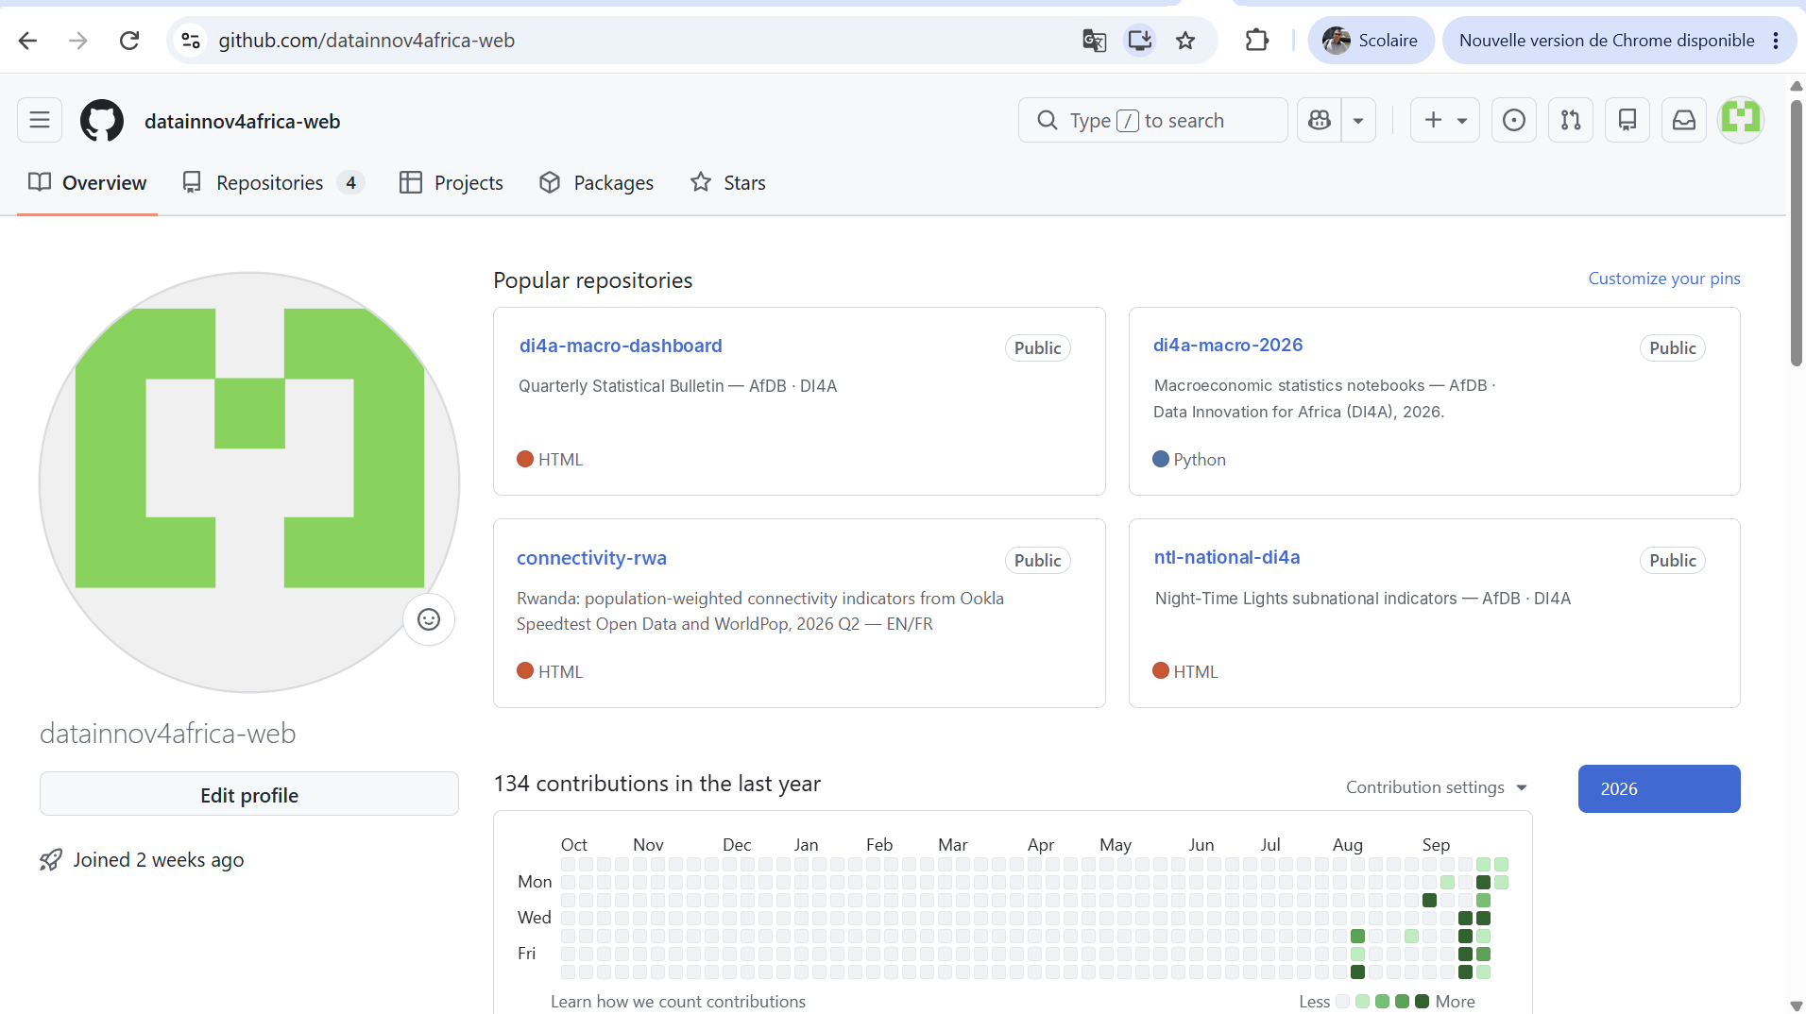

01 · OPEN SETTINGS
Open your account menu
Sign in to GitHub
Go to github.com and sign in with your GitHub account.
Click your avatar
Top-right corner of any GitHub page. It opens the account menu.
Screenshot: github.com — your profile page
Generate a GitHub API Key · AfDB – Data Innovation for Africa (DI4A)
9
Notes:
Sign in, then click your profile picture in the top-right corner. That opens the account menu.

Slide 10
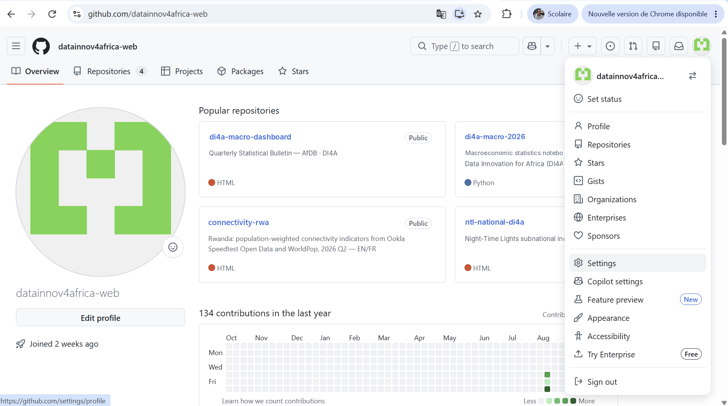


01 · OPEN SETTINGS
Go to Settings
Scan the menu
It lists Profile, Repositories, Stars, Organizations and more.
Choose Settings
It opens your profile settings at github.com/settings/profile.
Screenshot: github.com — account menu
Generate a GitHub API Key · AfDB – Data Innovation for Africa (DI4A)
10
Notes:
In the dropdown, click Settings, about two-thirds of the way down the menu.

Slide 11
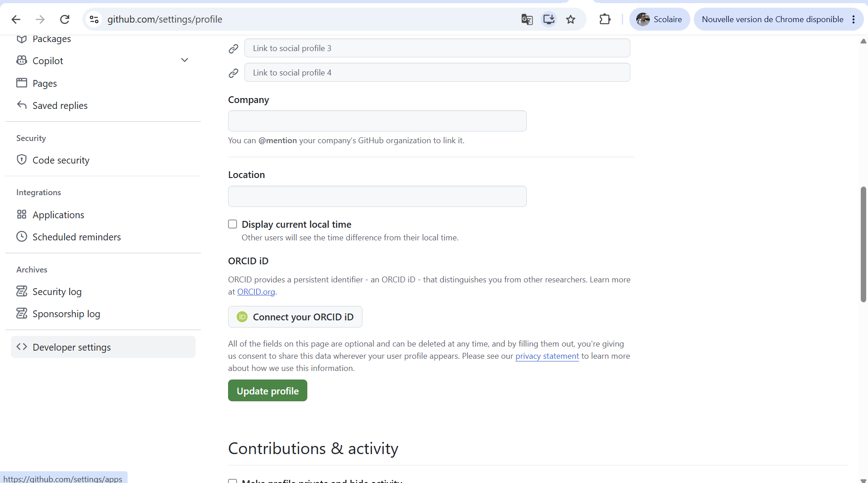

02 · DEVELOPER SETTINGS
Open Developer settings
Scroll the left sidebar
Go all the way down, below the Archives section.
Click Developer settings
This is where GitHub Apps, OAuth Apps and access tokens live.
Screenshot: github.com/settings/profile
Generate a GitHub API Key · AfDB – Data Innovation for Africa (DI4A)
11
Notes:
In the settings page, scroll the left sidebar to the very bottom and click Developer settings.

Slide 12
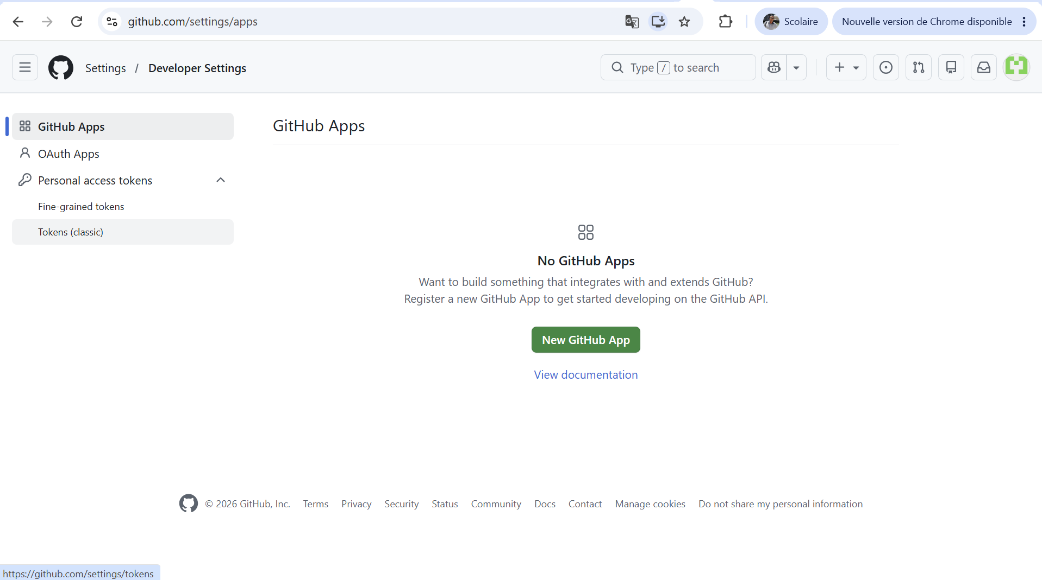

03 · CLASSIC TOKENS
Select Tokens (classic)
Expand Personal access tokens
Two options appear: Fine-grained tokens and Tokens (classic).
Click Tokens (classic)
The token type used in this guide.
Screenshot: github.com/settings/apps
Generate a GitHub API Key · AfDB – Data Innovation for Africa (DI4A)
12
Notes:
Expand Personal access tokens and choose Tokens (classic). Fine-grained tokens also exist, but in this guide we use classic tokens.

Slide 13
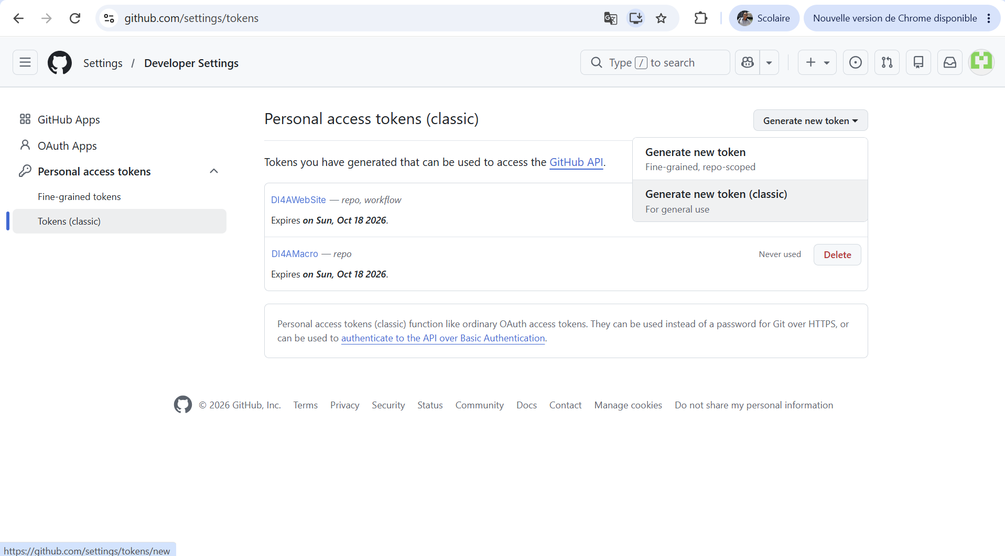

04 · GENERATE
Generate a new classic token
Open "Generate new token"
The dropdown button above your list of tokens.
Pick "Generate new token (classic)"
Labelled "For general use". GitHub may ask you to confirm your password.
Screenshot: github.com/settings/tokens
Generate a GitHub API Key · AfDB – Data Innovation for Africa (DI4A)
13
Notes:
Click the Generate new token dropdown and choose Generate new token (classic), the "For general use" option. If GitHub asks for your password or 2FA code, confirm it.

Slide 14
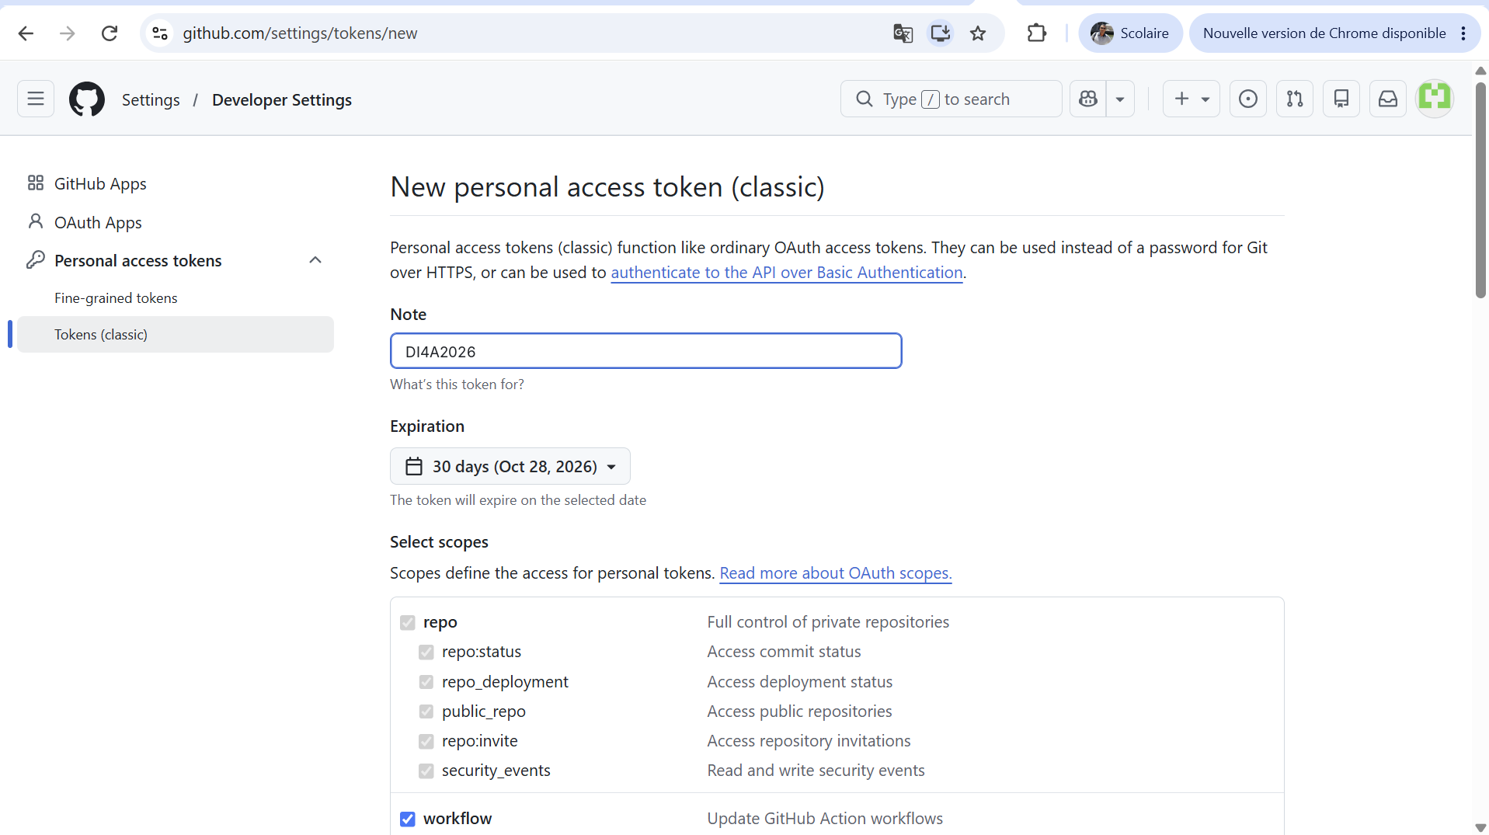



05 · CONFIGURE
Name it, set expiry, pick scopes
Add a note
A name you will recognise, e.g. DI4A2026.
Set an expiration
30 days covers the hands-on work and follow-up.
Tick repo and workflow
Then scroll down and click "Generate token".
Screenshot: github.com/settings/tokens/new
Generate a GitHub API Key · AfDB – Data Innovation for Africa (DI4A)
14
Notes:
Give the token a clear note such as DI4A2026, keep a short expiration such as 30 days — enough for the hands-on work and follow-up on your team project — and tick the repo and workflow scopes. Then scroll to the bottom of the page and click Generate token.

Slide 15
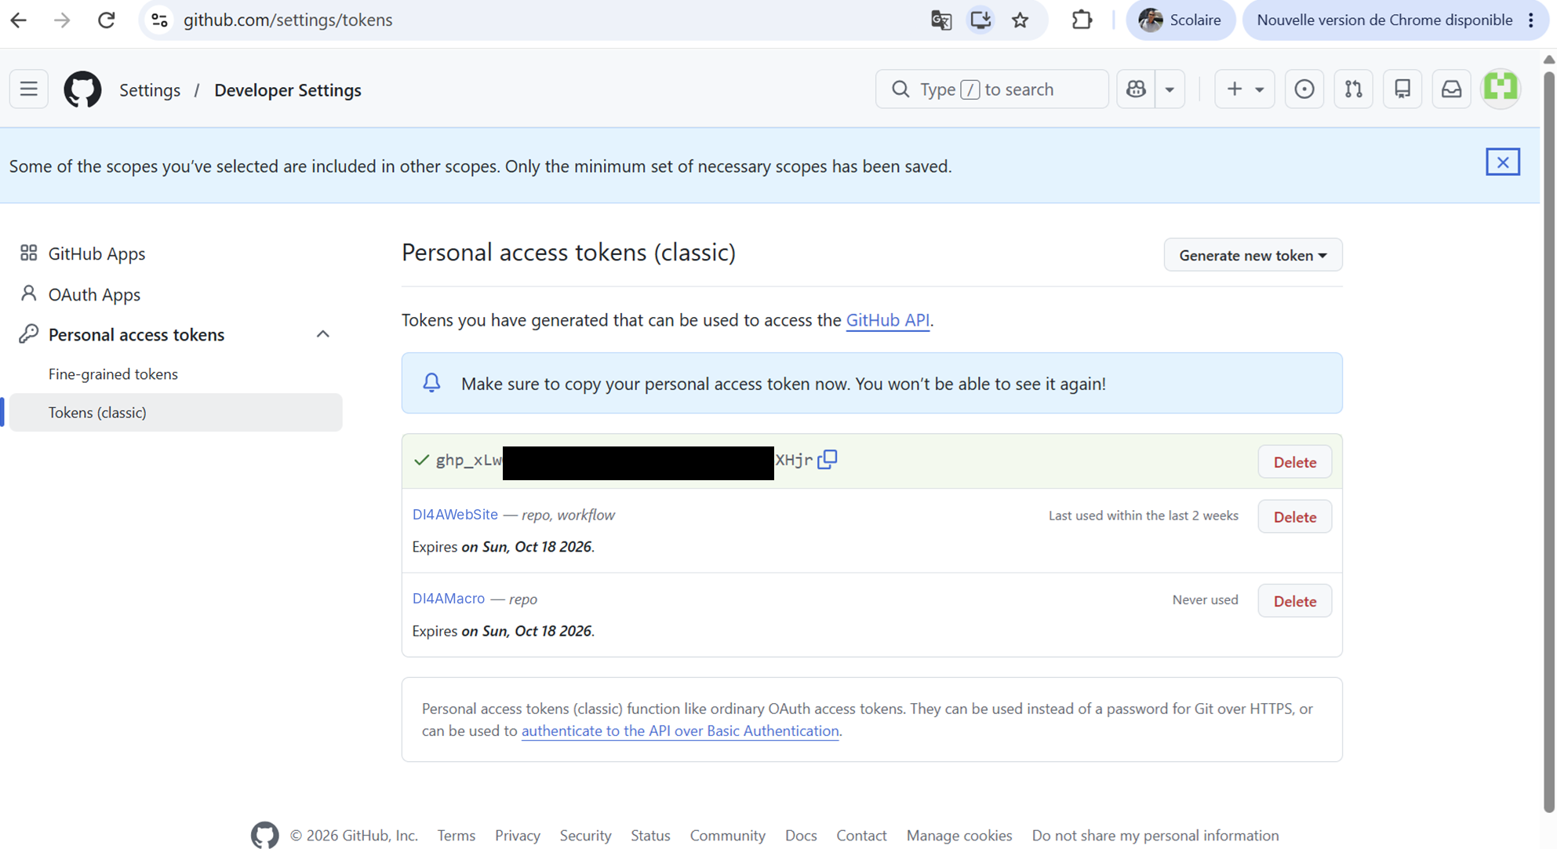

06 · COPY & STORE
Copy your token now
Click the copy icon
Next to the new token, which starts with ghp_.
Store it safely
In a password manager or an environment variable.
You won't be able to see it again. If you lose it, generate a new one.
Screenshot: github.com/settings/tokens — token masked
Generate a GitHub API Key · AfDB – Data Innovation for Africa (DI4A)
15
Notes:
Copy the token immediately with the copy icon. GitHub shows it only once. Store it in a password manager or environment variable, never in a document or a repository.

Slide 16




06 · COPY & STORE
Keep your token safe
Never commit it
Always set an expiry
Keep tokens out of code and repositories. Use an environment variable or a GitHub Actions secret.
Short-lived tokens limit the damage if one leaks. Regenerate when it expires.
Grant minimum scopes
Revoke if exposed
Tick only the scopes your script needs. For this guide: repo and workflow.
Developer settings › Tokens (classic) › Delete, then generate a new token.
Source: GitHub Docs, "Managing your personal access tokens".
Generate a GitHub API Key · AfDB – Data Innovation for Africa (DI4A)
16
Notes:
Four habits: never commit a token, always set an expiry, grant only the scopes you need, and revoke immediately if a token is exposed, for example pushed to a public repository.

Slide 17

SOURCES
Sources
GitHub Docs — Managing your personal access tokens
docs.github.com/en/authentication/keeping-your-account-and-data-secure/managing-your-personal-access-tokens
Screenshots: github.com, captured with the datainnov4africa-web demo account (token value masked).
Generate a GitHub API Key · AfDB – Data Innovation for Africa (DI4A)
17
Notes:
Reference for participants who want the official documentation.

Slide 18
YOU ARE READY
Your token unlocks the GitHub API
African Development Bank (AfDB)
Data Innovation for Africa (DI4A)
Notes:
Quick check: set the token as an environment variable and call the /user endpoint. If you get your profile back as JSON, the token works. You will use it throughout the hands-on exercises and to share your team’s code and results. Questions?

