Slide 1
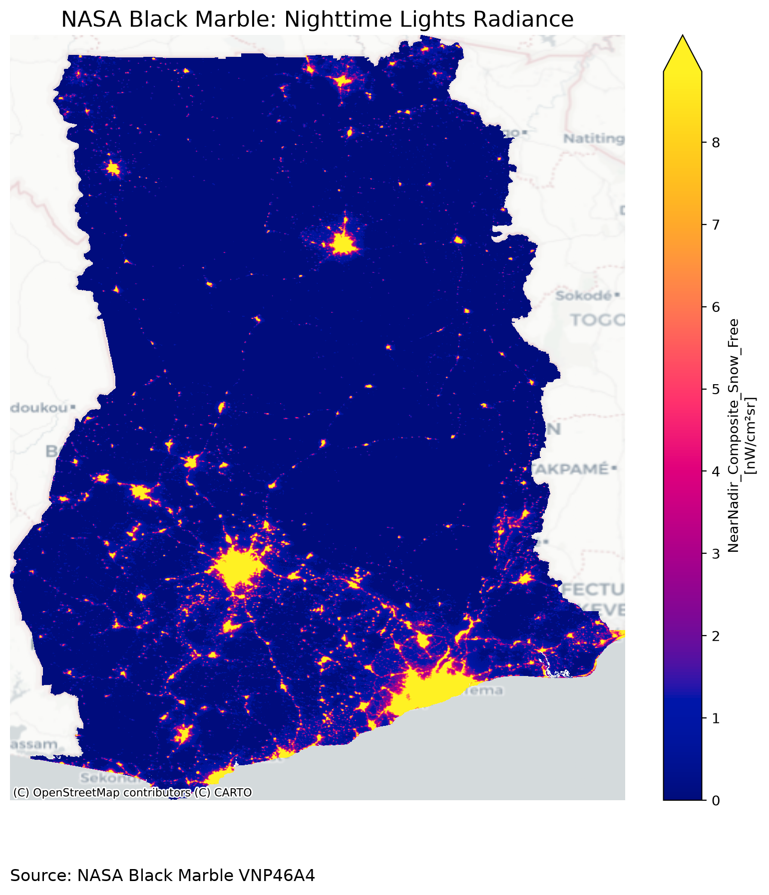
AFRICAN DEVELOPMENT BANK
DATA INNOVATION FOR AFRICA (DI4A)
Night-time lights in practice
What they have made it possible to measure — from satellite to published dashboard
Analysis notebook “NTL hands-on, part 3”: a reproducible pipeline driven by one ISO3 code
AFDB – DATA INNOVATION FOR AFRICA (DI4A)
Hands-on series · Satellite data for economic statistics
Part 3 · Analyse and publish
Black Marble VNP46A4 (2025), Ghana — real image
Source: NASA Black Marble via blackmarblepy (World Bank, MIT licence)
Notes:
Welcome to this hands-on session. In parts 1 and 2 we saw how to collect and understand a Black Marble file. Now we move to use: what can we measure about the economy with night-time lights, and how do we do it rigorously and reproducibly? Everything you will see comes from the “part 3” notebook, which starts from a single ISO3 country code and ends with a dashboard published on the web. The image on the right is real: the 2025 Black Marble annual composite for Ghana. You can see Accra, Kumasi and the road corridors. Question for the room: what exactly do you think this image measures?

Slide 2




By the end of this session, you will be able to…
OPENING
Explain
Reproduce
what night-time lights measure, why they inform on economic activity, and where their limits lie.
the end-to-end pipeline: one ISO3 code → national and regional indicators → a public dashboard.
Interpret
Publish with care
the key metrics: STL, Theil–Sen, convergence, NTL–GDP elasticity, shocks, Gini, population “in the dark”.
results that carry a confidence level, intervals and full traceability.
Common thread: a measurement is only useful if you can say how far it can be trusted.
Notes:
Four objectives. First, understand the signal: lights are not GDP, but they bear witness to it. Second, reproduce: the notebook is designed so that one parameter, the ISO3 code, changes the country analysed. Third, interpret: we will see each metric with a simple formula, a graphical intuition and how to read the result. Finally, publish with care: every message produced by the notebook carries a confidence level. That is the common thread of the session. Keep asking yourself: how far can I trust this number?

Slide 3




Session outline (75 minutes)
OPENING
10 min
A
Why lights measure the economy
Where we are
10 min
B
Sensors and data
Parts 1–2
Collect and understand a Black Marble file
15 min
C–D
Architecture, pipeline and preprocessing
Part 3
25 min
E
Analyses: trends, regions, GDP, shocks, inequality
Analyse and publish — this session
7 min
F
Confidence, dashboard and publishing
Next step
Apply the pipeline to your own country
8 min
G
Limitations, wrap-up and bridge to your projects
Notes:
Here is the flow. We start with the intuition and the literature, then the sensors. Next the pipeline architecture and preprocessing, often the most underestimated part. The core of the session is part E: six families of analyses, each with its economic question, its metric and its pitfall. We finish with confidence and publishing, then a bridge to your own projects. Keep some questions for the end: we will have a few minutes for discussion.

Slide 4
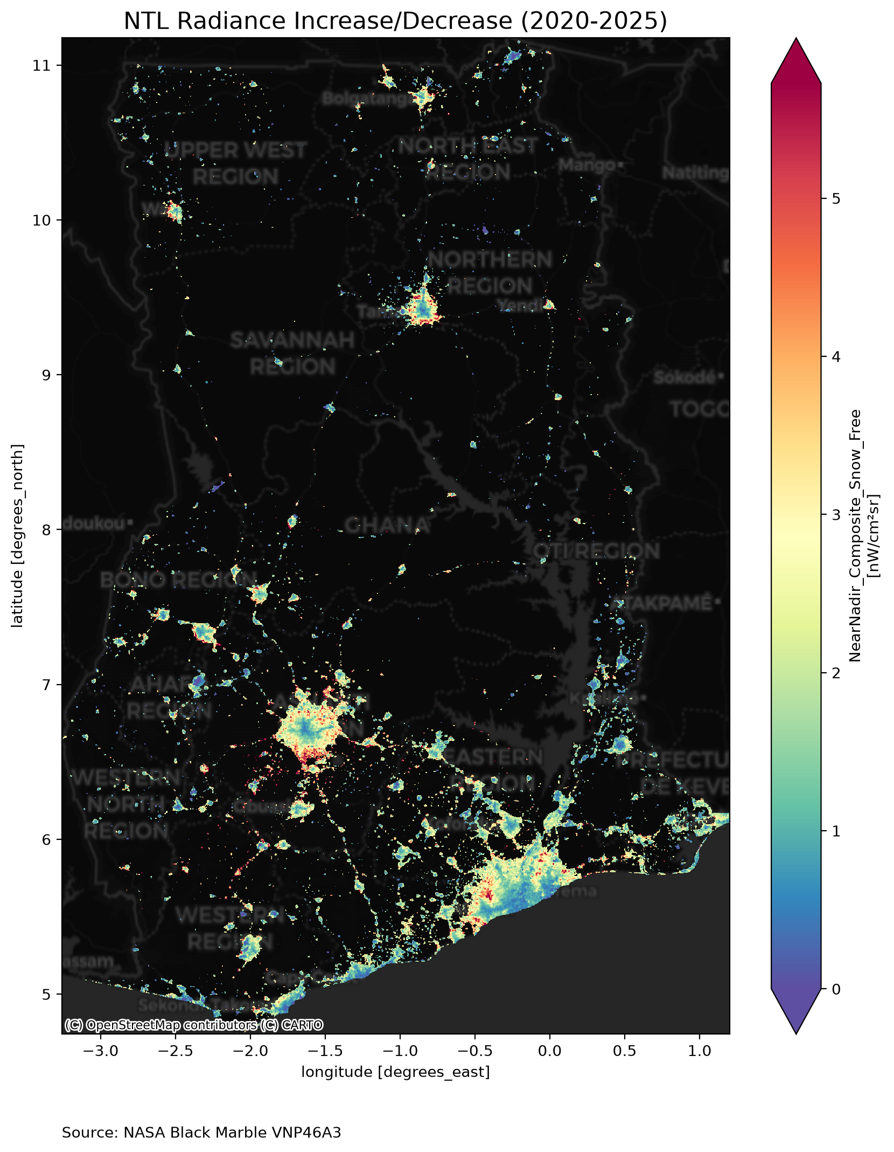


The intuition: human activity is visible from space
A · WHY LIGHTS
Activity
Energy
Light
Measurement
producing, transporting, trading, consuming
activity requires electricity
part of it escapes skywards at night
the VIIRS sensor records it every night
Homogeneous
Detailed
Timely
same sensor, same method, everywhere
~500 m pixel: regions, districts, cities
monthly or even daily, without waiting for the accounts
Why it matters national accounts are annual, published late and rarely regional; lights fill these gaps without replacing official statistics.
Radiance change 2020→2025, Ghana (Black Marble). Source: blackmarblepy, World Bank (MIT).
Notes:
The intuition is simple: all activity consumes energy, and part of that energy escapes at night as light. The more active an area, the brighter it shines. The map on the left is real: it shows where light increased or decreased in Ghana between 2020 and 2025. The signal's three strengths are homogeneity, spatial detail and timeliness. But careful: these are strengths for complementing official statistics, not replacing them. Question: in your country, which statistic is most lacking at regional level?

Slide 5
What the literature says
A · WHY LIGHTS
2011
Chen & Nordhaus · PNAS
≈ 0.3
Lights add information mainly where statistics are weak, and for regions.
2012
Henderson, Storeygard & Weil · AER
Growth in lights tracks GDP growth; they improve growth estimates.
elasticity of GDP with respect to lights (Henderson et al., 2012): +1% light ↔ ≈ +0.3% GDP, on average across a global panel
2017–21
Elvidge et al. · IJRS · RS
Monthly and annual VIIRS products (VNL V2): stray light corrected, background and ephemeral lights masked.
2018
Román et al. · RSE
NASA Black Marble: BRDF and lunar corrections, suited to daily series.
Key point
2020
Li et al. · Sci. Data
This figure is an international average. Your country will have its own elasticity, estimated on only 10 to 30 years: it will be more uncertain. The notebook estimates it and shows its interval.
Harmonised DMSP–VIIRS series 1992–2018: the long run, to be read as a trend.
2020–21
Gibson et al. · JDE · JES
Limits in rural and sparsely populated areas: the signal is weak there.
Notes:
Six references structure the field. Chen and Nordhaus show that lights are most useful where statistics are weak. Henderson, Storeygard and Weil, the founding paper in economics, find an elasticity of about 0.3: it is an order of magnitude, not a constant. Elvidge and Román describe the products we use. Li et al. provide the harmonised long series. Gibson and co-authors remind us of the limits in rural areas. Key point: the notebook estimates your country's own elasticity, with its confidence interval.

Slide 6






What lights see… and what they miss
A · WHY LIGHTS
Satellite overpass around 01:30 local time. Lights measure night-time radiance, not value added.
✓ Well captured
✗ Poorly captured or misleading
Cities, street lighting, commercial areas
Agriculture and the rural informal economy
Industry, ports, mines, energy sites
Daytime trade and dimly lit services
Transport corridors, new electrification
Gas flares, fires, aurora: light without local activity
Consequence a country whose growth comes from agriculture or daytime services can grow without its light moving. Notebook section 10 and the dashboard's “Methods & limitations” page detail these biases.
Notes:
This is the most important slide for avoiding misinterpretation. The satellite passes around half past one in the morning. It therefore sees urban lighting, industry, ports, corridors. It sees agriculture, daytime trade and the rural informal economy poorly. And it sees light without local activity: gas flares, bush fires. Consequence: the relationship between light and GDP depends on the structure of the economy. Question: what share of your GDP is barely visible at night?

Slide 7
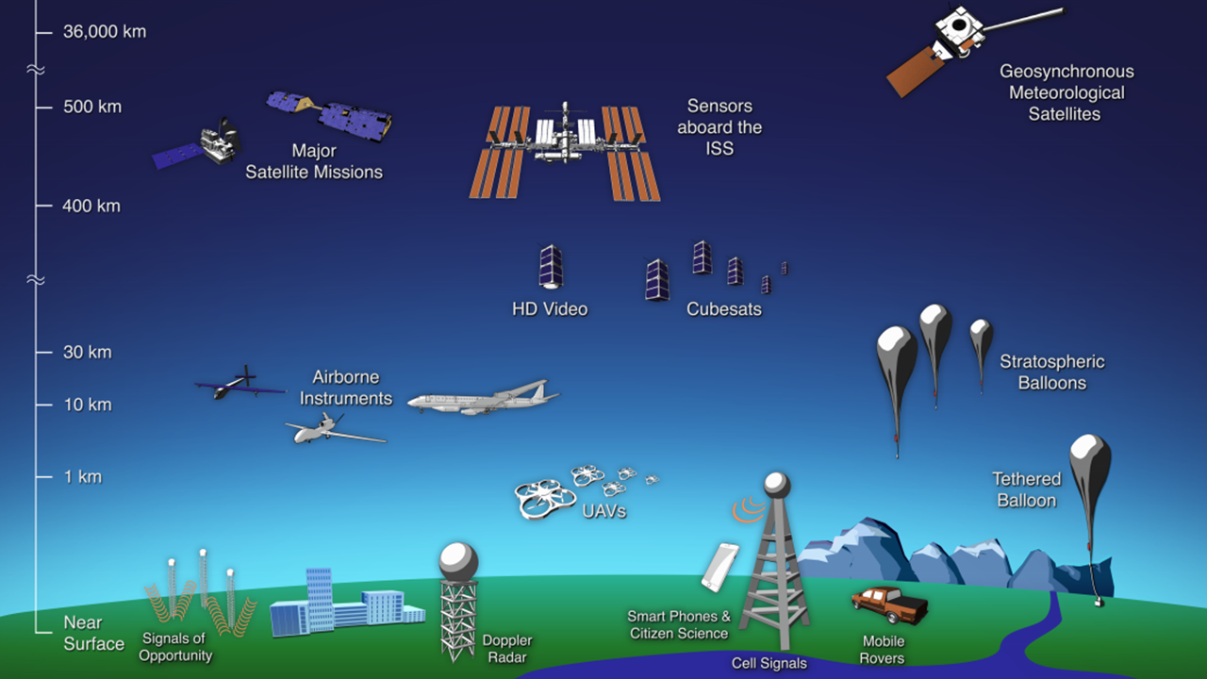



How a satellite sees at night
B · SENSORS AND DATA
Suomi-NPP · NOAA-20
sun-synchronous polar orbit, ~830 km altitude
VIIRS sensor, DNB band
Day/Night Band: sensitive to very faint night-time light
One overpass per night
around 01:30 local time: same time everywhere
~500 m grid
Observation platforms, from ground to geostationary orbit. Source: NASA Goddard, via Open Nighttime Lights (World Bank, CC BY 4.0).
15 arc-seconds; monthly and annual composites
Unit: nW·cm⁻²·sr⁻¹ = nanowatt per cm² per steradian — upward-emitted radiance
Notes:
The satellite we care about is in polar orbit at about 830 kilometres. Its VIIRS sensor has a special band, the Day/Night Band, able to measure extremely low light levels. It passes every night around half past one, which makes measurements comparable across countries. Products are resampled onto a grid of about 500 metres. The unit is a radiance: nanowatts per square centimetre per steradian. Remember that it is a light intensity, not energy consumed.

Slide 8
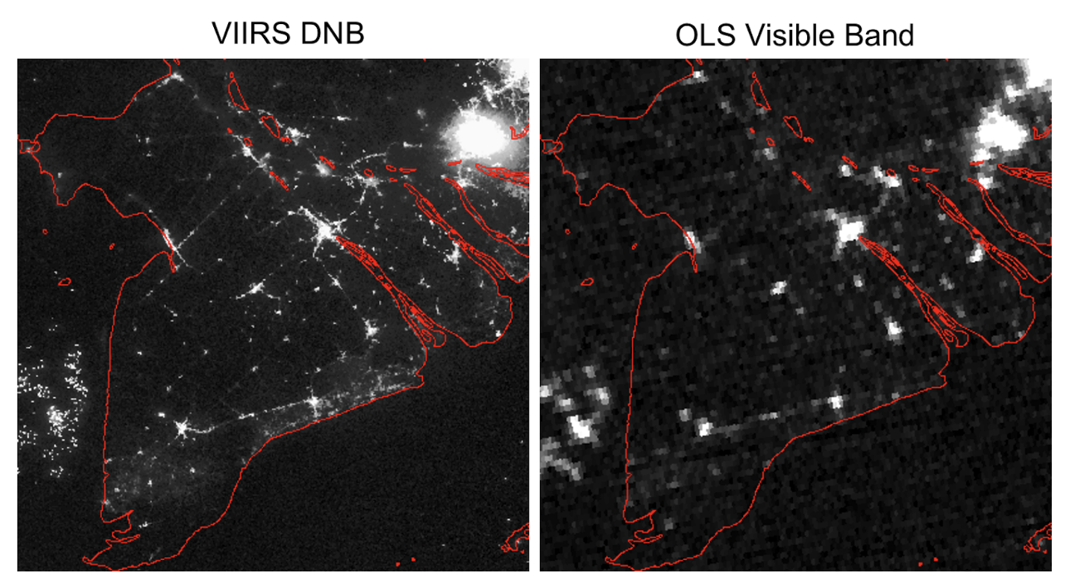
Two sensor generations: DMSP-OLS and VIIRS
B · SENSORS AND DATA
Sensor | DMSP-OLS | VIIRS DNB | Black Marble VNP46A2
Period | 1992–2013 | 2012 → | 2012 →
Resolution | ~1 km | ~500 m | ~500 m, daily
Measurement | number 0–63, saturates | calibrated radiance | BRDF/moon-corrected radiance
Use here | long series (harmonised) | main analyses | shocks, day by day
Mekong Delta, 23 Nov 2014: VIIRS DNB (left) vs DMSP-OLS (right). Source: Elvidge et al. (2013), via Open Nighttime Lights (CC BY 4.0).
Key point VIIRS is finer, calibrated and does not saturate. DMSP is only useful to go back before 2012, through a harmonised series to be read as a trend only.
Sensor break in 2013→2014: the notebook checks continuity at the junction (quality control 3.4)
Notes:
Two sensor generations coexist. DMSP-OLS, from 1992 to 2013, is an uncalibrated military sensor at about one kilometre, which codes light from 0 to 63 and saturates in city centres. VIIRS, since 2012, is calibrated, finer and does not saturate. The real image of the Mekong Delta shows it: on the left VIIRS distinguishes villages, on the right DMSP gives a blur. Black Marble is the corrected daily version of VIIRS. The notebook uses VIIRS for everything, DMSP only for the long series, and checks the junction between the two.

Slide 9
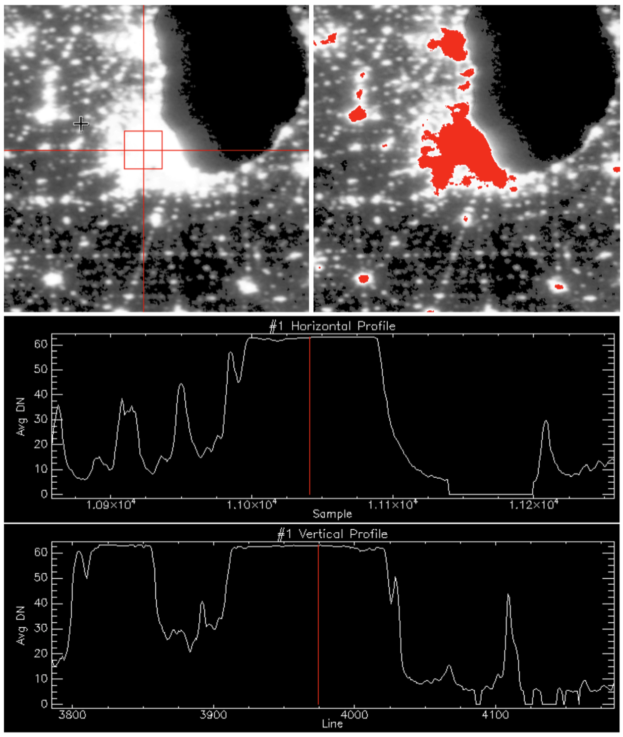
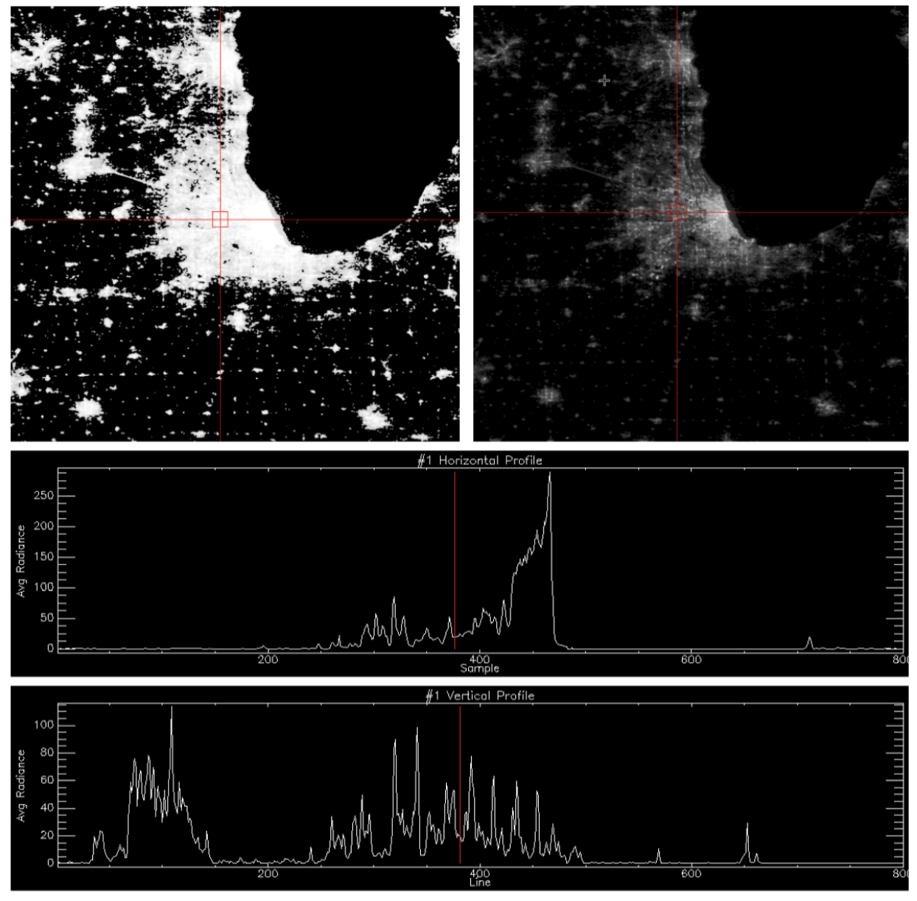



Saturation and blooming: why VIIRS changes the game
B · SENSORS AND DATA
Saturation
DMSP caps at 63: the city centre looks flat, its growth is invisible.
Blooming
Light “spills” around cities and inflates the lit area.
VIIRS: 25 to 280 nW
DMSP-OLS 2013
VIIRS DNB 2016
in the urban core that was capped
Chicago: saturated pixels in red (DMSP). Profiles along the red lines. Source: Open Nighttime Lights (World Bank, CC BY 4.0).
Notes:
Two real images of Chicago. On the left, DMSP in 2013: everything in red is saturated at the maximum value of 63. The profile becomes a plateau: growth in the centre can no longer be seen. On the right, VIIRS in 2016 over the same area: values range from 25 to 280 nanowatts, the urban structure reappears. Blooming still exists with VIIRS but is weaker. For your analyses: prefer VIIRS, and be wary of small administrative units next to large cities.

Slide 10
The pipeline's data catalogue
B · SENSORS AND DATA
1990
2000
2010
2020
VIIRS monthly (VCMSLCFG)
monthly series, STL, shocks
VIIRS annual VNL V2
annual levels, regions, GDP
Black Marble VNP46A2
daily zoom on shocks
DMSP-OLS
saturation diagnostics
Harmonised DMSP–VIIRS
long-run trend (Li et al.)
GHSL · WorldPop
population, degree of urbanisation
Sentinel-5P NO₂
industrial activity (complement)
World Bank (WDI)
real GDP, electricity access
+ geoBoundaries administrative boundaries (FAO GAUL fallback) · ESA WorldCover 10 m · event catalogue (COVID-19, ACLED, EM-DAT)
Notes:
Here are all the sources used, with their coverage period. The core is VIIRS, monthly and annual. Daily Black Marble is used to zoom in on shocks. DMSP and the harmonised series allow us to go back to 1992, to be read as a trend. GHSL or WorldPop provide population, essential for per-capita reasoning and for the population in the dark. Sentinel-5P adds nitrogen dioxide as a complementary industrial indicator. Finally the World Bank provides real GDP and the electricity access rate for validation. All these data are read in Google Earth Engine, except the World Bank indicators.

Slide 11









The end-to-end pipeline: from one ISO3 code to a public site
C · ARCHITECTURE AND PIPELINE
Parameter
Earth Engine
Cache
Preprocessing
Analyses
Export
GitHub Pages
ISO3 + period
server-side compute
aggregated tables
clouds, flares…
6 families
CSV, JSON, PNG
public site
notebook §2
notebook §3
notebook §4–10
notebook §11
notebook §12
Reproducible
Lightweight
Cached
Traceable
no country-specific value is hard-coded: changing ISO3 is enough.
imagery stays in Earth Engine; only aggregated tables come back.
a second run does not query GEE again (FORCE_DOWNLOAD to force it).
a manifest keeps parameters, versions and data availability.
Notes:
Here is the full pipeline. You set an ISO3 code and a period. Earth Engine does the heavy computation server-side: we never download imagery, only tables aggregated by administrative unit and by month. These tables are cached. Then come preprocessing, the analyses of sections 4 to 10, the export of static files and publication on GitHub Pages. Four principles: reproducible, lightweight, cached, traceable. The green labels show the notebook section matching each step.

Slide 12

Software architecture: one notebook, a src/ package, a static site
C · ARCHITECTURE AND PIPELINE
Acquisition
Preprocessing
Analysis
Delivery
gee.py
preprocessing.py
timeseries.py
viz.py
connection, availability
clouds, flares, outliers
STL, anomalies, breaks
charts, maps
boundaries.py
cache.py
indicators.py
messages.py
ADM0/1/2 boundaries
caching
Theil–Sen, Gini, Theil, HHI
messages, confidence
acquisition.py
config.py
econometrics.py
export.py
zonal statistics
parameters, datasets
elasticity, nowcast
static files
worldbank.py
shocks.py
publish.py
WDI API
events, impacts
GitHub Pages
pipeline.py
orchestration
Notebook (13 sections)
Dashboard (8 pages)
Colab · Kaggle · Jupyter; src/ code embedded and auto-unpacked
static HTML + JavaScript, data in dashboard/data/<ISO3>/
Notes:
The code is organised in four layers. Acquisition talks to Earth Engine and the World Bank API. Preprocessing applies quality rules and manages the cache. Analysis contains the statistical methods: time series, indicators, econometrics, shocks, and an orchestration module. Delivery produces charts, key messages with their confidence, exported files and publication. The notebook embeds all this code: it runs on its own, even opened directly in Colab. The dashboard is a static site, with no server.

Slide 13




One cell to edit
C · ARCHITECTURE AND PIPELINE
ISO3
# ⚙️ PARAMETERS — the only cell to edit
ISO3 = "TUN"
START_YEAR = 2014
END_YEAR = None # last full year
ADMIN_LEVELS = ("ADM1", "ADM2")
GEE_PROJECT = None # Google Cloud project
FORCE_DOWNLOAD = False # ignore the cache
CUSTOM_EVENTS = [ # country-specific shocks
{"label": "Cyclone X", "start": "2019-03-01",
"end": "2019-05-31", "type": "disaster"},
]
PUBLISH = False # True -> GitHub Pages
REPO_NAME = "ntl-dashboard"
3-letter country code (ISO 3166-1). TUN = Tunisia, SEN = Senegal, KEN = Kenya…
ADM1 / ADM2
1st and 2nd administrative levels: regions, then districts
CUSTOM_EVENTS
your known shocks (cyclone, conflict, energy crisis) for section 8
Other thresholds
documented defaults in src/config.py, overridable in NTLConfig(...)
Notes:
In practice, here is the only cell you edit. The ISO3 code determines everything: boundaries, population, GDP, region names. The period starts in 2014, the first full year of monthly VIIRS; if you leave END_YEAR empty, the notebook takes the last full year available. The CUSTOM_EVENTS block lets you add your country's known shocks, which greatly improves the shocks section. All other thresholds, such as the cloud or gas-flare threshold, have documented defaults. Exercise: which event would you add for your country?

Slide 14
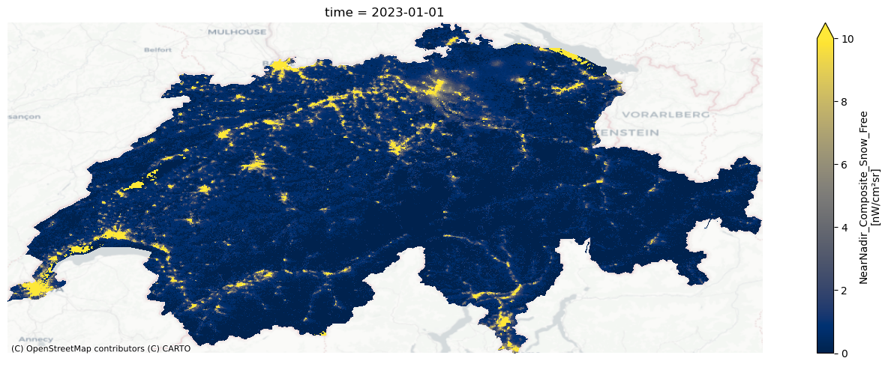
Basic quantities: radiance, SoL, light per capita
D · PREPROCESSING
Pixel radiance
r ᵢ [nW·cm⁻²·sr⁻¹]
light intensity measured over ~500 m
Sum of lights (SoL)
SoL = Σ rᵢ (i ∈ unit)
Monthly Black Marble (VNP46A3), Switzerland, January 2023 — real image. Source: blackmarblepy (World Bank, MIT).
an activity index, not an energy
Golden rule a pixel that was never observed (clouds) is not dark: it is missing. Treating it as zero manufactures a false recession.
Light per capita
SoL / population
separates an active region from a populous one
Pitfall comparing the SoL of two regions of very different sizes: also reason per capita and as a national share.
Notes:
Three quantities recur everywhere. Radiance is a pixel's measurement. The sum of lights, or SoL, adds up the radiances of all pixels in an administrative unit: it is an activity index, not an amount of energy. Light per capita divides SoL by population and distinguishes a truly active region from one that is merely populous. The real image of Switzerland also shows grey areas: these are unobserved pixels. Golden rule: a missing pixel is not a dark pixel.

Slide 15


The 6-step preprocessing chain
D · PREPROCESSING
Clouds
1
Negatives
2
Outliers
3
pixel valid if cf_cvg ≥ 2; unit-month kept if ≥ 80% of pixels are valid, then rescaled
values < 0 set to 0
cap of 1,000 nW; spike > 5 × the pixel's annual median → median
Why: don't mistake a cloudy month for a recession
Why: calibration noise over dark areas
Why: fires, lightning, glints
Background
4
Gas flares
5
DMSP
6
pixels unlit in the VNL V2 annual composite → 0
≥ 50 nW, < 5 inhabitants, not built-up (union of years) + 2 km halo
share of saturated pixels measured; DN > 7 threshold on the harmonised series
Why: EOG already masks background and ephemeral lights
Why: removes flared gas and its spill-over
Why: recommendation of Li et al. (2020)
Notes:
Preprocessing turns thousands of images into clean tables. Six rules, each with its rationale. One: clouds; a pixel is kept only if it has at least two cloud-free observations in the month, and a unit-month is kept only if 80% of its pixels are valid. Two: negative values, noise, set to zero. Three: outliers, capped or replaced by the median. Four: unlit background. Five: gas flares, masked with a two-kilometre halo. Six: DMSP saturation. Every threshold is a documented, adjustable choice.

Slide 16
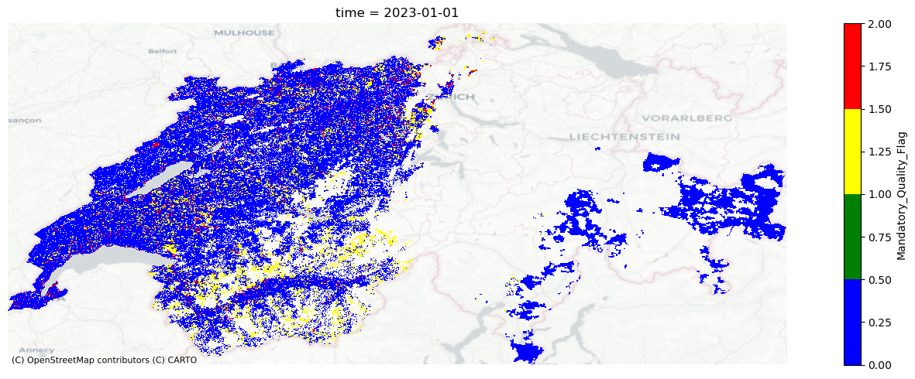
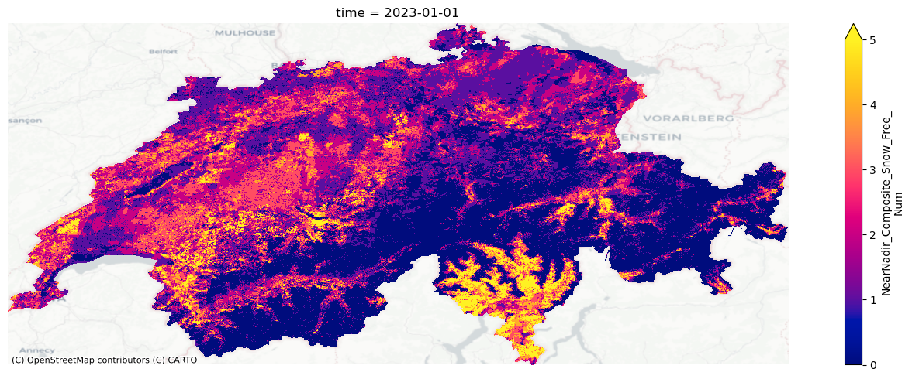
Clouds and quality: a missing pixel is not a dark pixel
D · PREPROCESSING
Daily quality flag (VNP46A2), Switzerland, 1 Jan 2023
Number of snow-free observations (VNP46A3), January 2023
Real images — Source: NASA Black Marble via blackmarblepy, “quality-assessment” notebook (World Bank, MIT).
Quality flags
Coverage cf_cvg
Rescaling
Daily Black Marble: 0 = high-quality persistent, 1 = high-quality ephemeral, 2 = poor quality (clouds, moon…). The notebook keeps high quality only, cloud- and snow-free.
Monthly VIIRS: number of cloud-free observations per pixel. In cloudy equatorial areas, one month may not be enough.
if 80–100% of pixels are valid, SoL is scaled up to the whole unit; below that, the month is excluded.
Notes:
Two real images of Switzerland in January. On the left, the daily quality flag: huge areas of poor quality, due to clouds and snow. On the right, the number of usable observations in the month: it varies strongly from one area to another. If these pixels were treated as dark, national light would drop artificially in winter. Hence three rules: filter by quality, require minimum coverage, and rescale only when at least 80% of pixels are valid. Question: which months are cloudiest in your country?

Slide 17
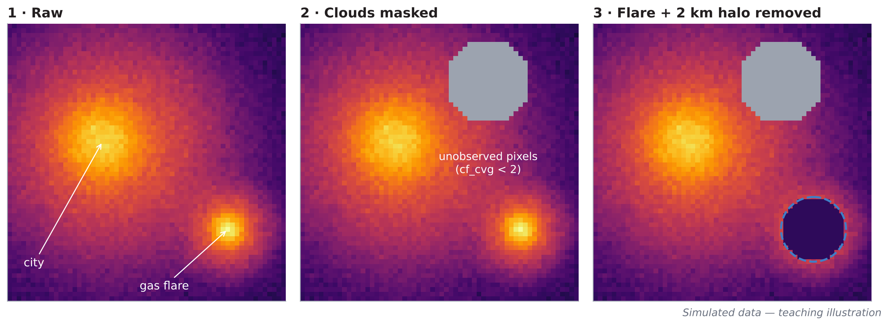
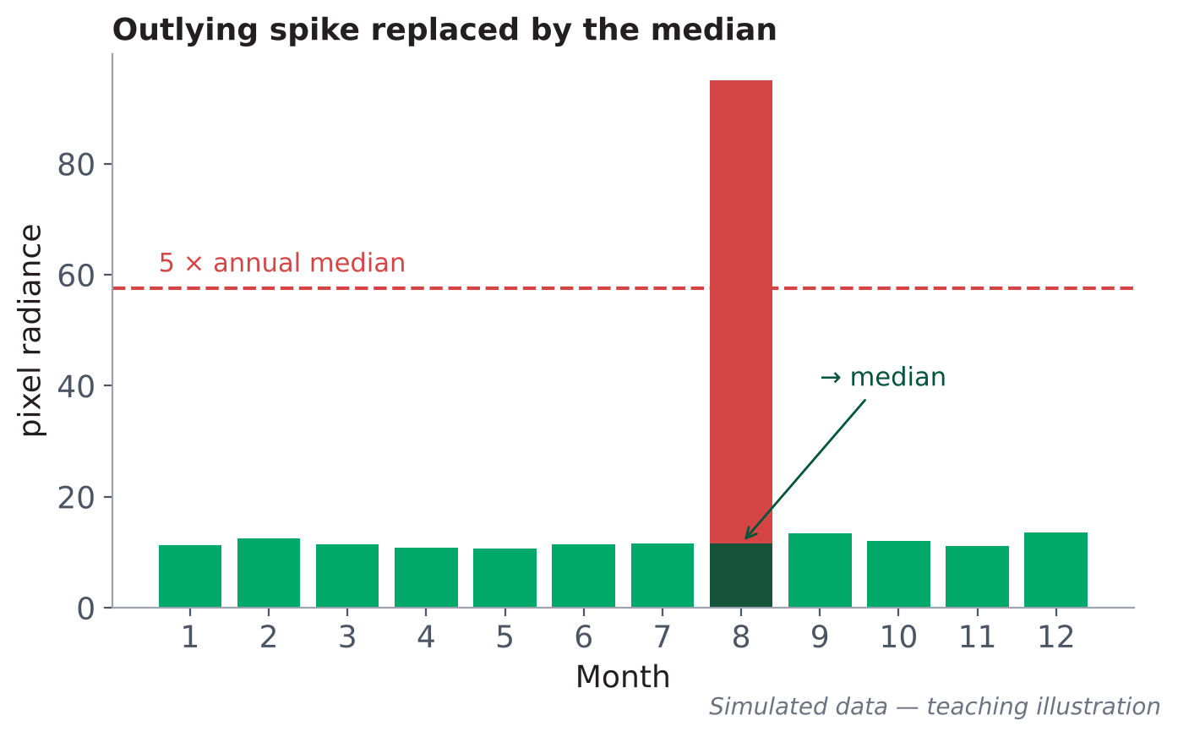

Gas flares and outliers: light without local activity
D · PREPROCESSING
Detect
Vectorise
Mask
How to read the quality-control table shows the share of light removed as gas flares. In an oil-producing country it can be large: check the exported list (flare_candidates.csv) on a map.
very bright (≥ 50 nW), nearly uninhabited (< 5 inhabitants), not built-up pixels, over the union of years
candidates become polygons, cached and exported for visual checking
the polygon + a 2 km halo is removed from every year
Notes:
Gas flares shine as brightly as a city, with no local economic activity. The notebook detects them automatically: very bright, nearly uninhabited, not built-up pixels. It turns them into polygons, adds a two-kilometre halo for blooming, and removes them from every year. The simulated figure on the left shows the three steps: raw image, clouds masked, flare removed. On the right, the treatment of outlying spikes: a value above five times the pixel's annual median is replaced by the median. Careful: the mask can also remove an isolated mine or port; check the exported list.

Slide 18


Quality control: six indicators to read before any analysis
D · PREPROCESSING
Months observed (national)
Mean cloud-free coverage
DMSP → VIIRS junction
The notebook compares growth 2012→13, the 2013→14 junction and 2014→15. A jump at the junction very different from neighbouring years signals a residual sensor break: the long series must then be read with caution.
e.g. 132 / 132
e.g. 94%
gaps = broken series
< 80%: caution in the rainy season
Unit-months excluded
Light removed (flares)
e.g. 3.1%
e.g. 0.8%
high: fragile regional series
high: check the masked sites
How to read the “e.g.” values are format examples. If any indicator is high, the results that depend on it are less reliable.
Population source
DMSP saturation
GHSL — 2025
e.g. 0.45%
GHSL by default, WorldPop as an option
high: long series less reliable in cities
Notes:
Before interpreting anything, read the quality-control table in section 3.4. Six indicators: the number of months observed, cloud-free coverage, the share of unit-months excluded, the share of light removed as gas flares, the population source and DMSP saturation. The values shown here are format examples, not results. The notebook also checks the continuity of the long series at the junction between DMSP and VIIRS. Practical tip: copy this table into any methodological note you publish.

Slide 19
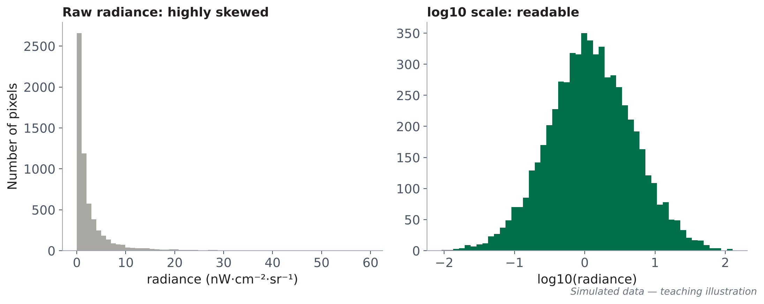


Exploration: look before you compute
E · ANALYSES — SECTION 4
Interactive map
Before / after
ADM1 statistics
annual composite with a time slider
first vs last year, split map
SoL, national share, light per capita
Annual Black Marble 2025, Ghana (real). Source: blackmarblepy (MIT).
Pitfall mistaking a residual flare or a very bright isolated site for a city
How to read radiance is highly skewed: a few very bright urban pixels, many faint ones. Hence mapping on a log scale.
Notes:
Notebook section 4 is exploration: look at the data before computing. First reflex: the logarithmic scale. The simulated figure on the left shows why: in raw radiance almost everything is squashed near zero; on a log scale the distribution becomes readable. The notebook offers an interactive map by year, a before/after map and a table by region. The real map of Ghana shows the typical geography: the capital, the second city, corridors. Exercise: spot a possible artefact by eye on your country's map.

Slide 20
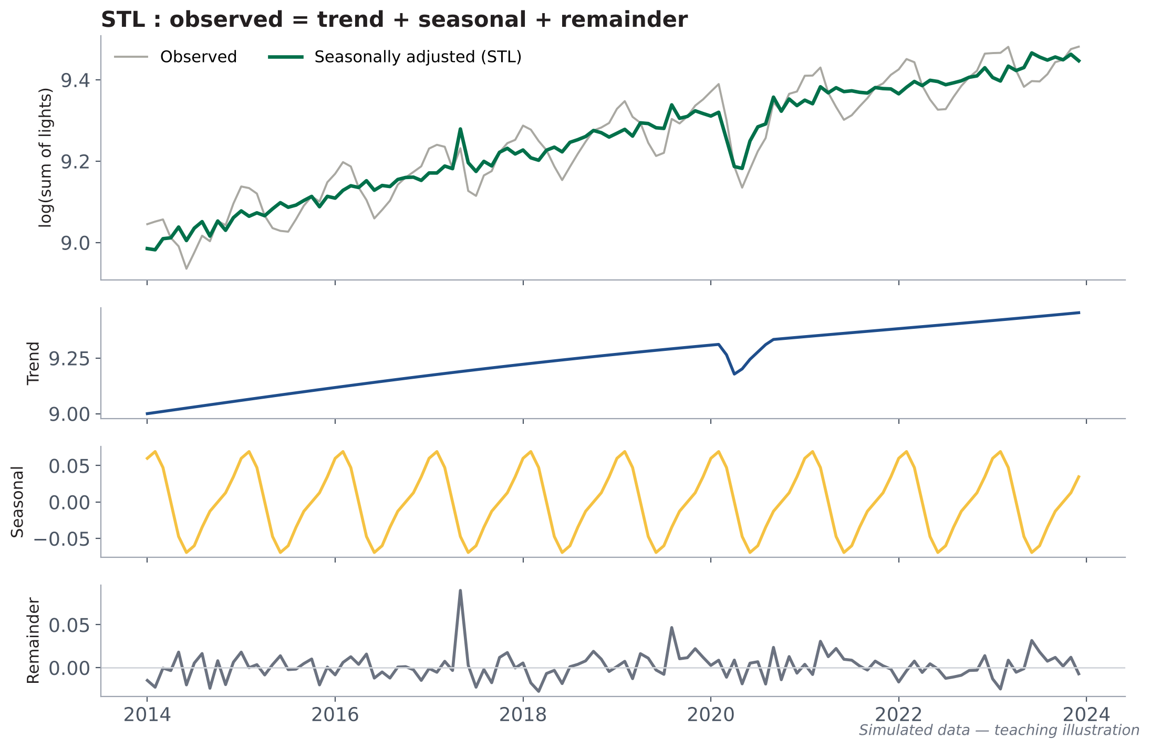
Seasonality and STL decomposition
E · ANALYSES — SECTION 5
Economic question
Is light activity really rising once seasonal effects are removed?
log(SoLₜ) = Tₜ + Sₜ + Rₜ
STL = Seasonal-Trend decomposition using Loess. Applied to the log, period 12, robust version that resists atypical months.
How to read read the seasonally adjusted curve (green). Year-on-year change (same month, previous year) also neutralises the season.
Pitfall comparing December with November: festivities, snow and night length distort the reading.
Notes:
Light varies through the year for reasons unrelated to the economy: year-end festivities, reflecting snow, vegetation, night length. To isolate the trend, the notebook applies an STL decomposition to the log of the sum of lights. The observed series, in grey, splits into a trend, a seasonal component and a remainder. The green, seasonally adjusted curve is the one to read. STL is applied to the log because the seasonal amplitude is proportional to the level. Here, on simulated data, we see a dip in 2020 that will reappear in the shocks section.

Slide 21
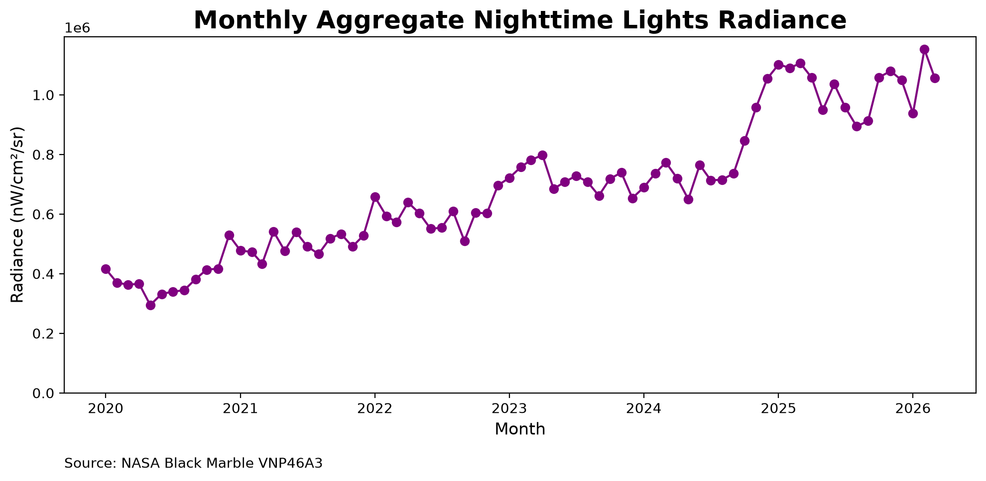
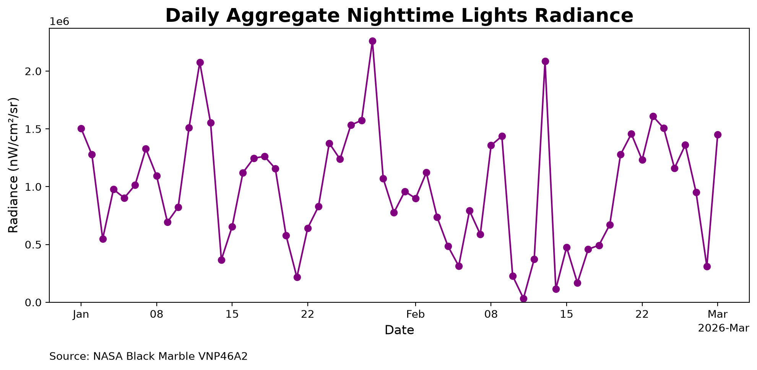
On real data: monthly or daily?
E · ANALYSES — SECTION 5
Monthly (VNP46A3), Ghana, 2020–2026: readable trend
Daily (VNP46A2), Ghana, Jan–Mar 2026: very noisy
Real images — Source: NASA Black Marble via blackmarblepy (World Bank, MIT).
Monthly → trends
Daily → dated shocks
Annual → levels
STL, year-on-year change, regional growth, elasticity
base-100 index + 7-day rolling median, high quality only
masked VNL V2 composites: regional levels, GDP, inequality
Notes:
Here are two real series for Ghana. On the left, the monthly series from 2020 to 2026: despite fluctuations, the trend is readable. On the right, the daily series over three months: it jumps from day to day because of clouds, the moon and viewing angle. That is why the notebook uses each frequency for what it does well: monthly for trends, daily only to date a shock, with a high-quality filter and a seven-day rolling median, and annual for levels.

Slide 22
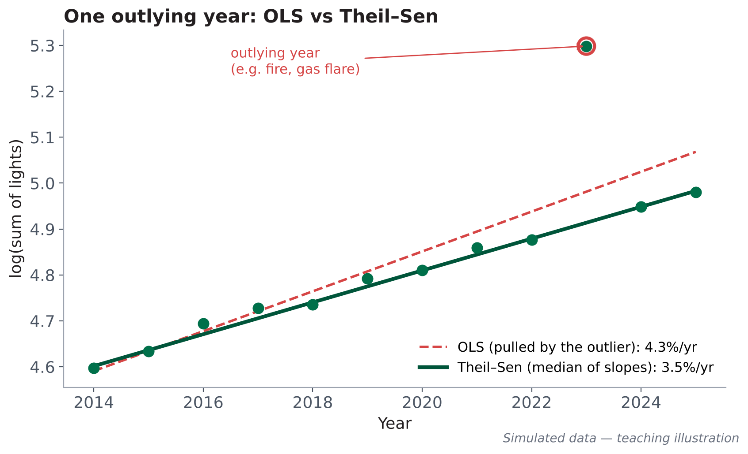
Measuring a robust trend: Theil–Sen and Mann–Kendall
E · ANALYSES — SECTION 6
Theil–Sen slope
median of the slopes between all pairs of years, on log(SoL). An outlying year barely moves it.
β̂ = median [ (yⱼ − yᵢ) / (tⱼ − tᵢ) ]
Mann–Kendall test
is the trend significant or due to chance? Counts rising vs falling pairs.
S = Σ sign(yⱼ − yᵢ)
Class “Growth” or “Decline” if |slope| ≥ 1%/yr AND p < 0.10; otherwise “Stagnation”
How to read annual growth = exp(β̂) − 1, with its 95% confidence interval.
Notes:
To measure a region's growth we do not use ordinary regression, which is too sensitive to extreme values. The simulated figure shows it: a single outlying year, a fire for example, pulls the least-squares line upwards. The Theil–Sen slope, the median of all slopes between pairs of years, stays faithful to the trend. The Mann–Kendall test tells whether this trend is statistically established. The notebook combines both: a region is classed as growing or declining only if its slope exceeds 1% per year and the test is significant at 10%.

Slide 23
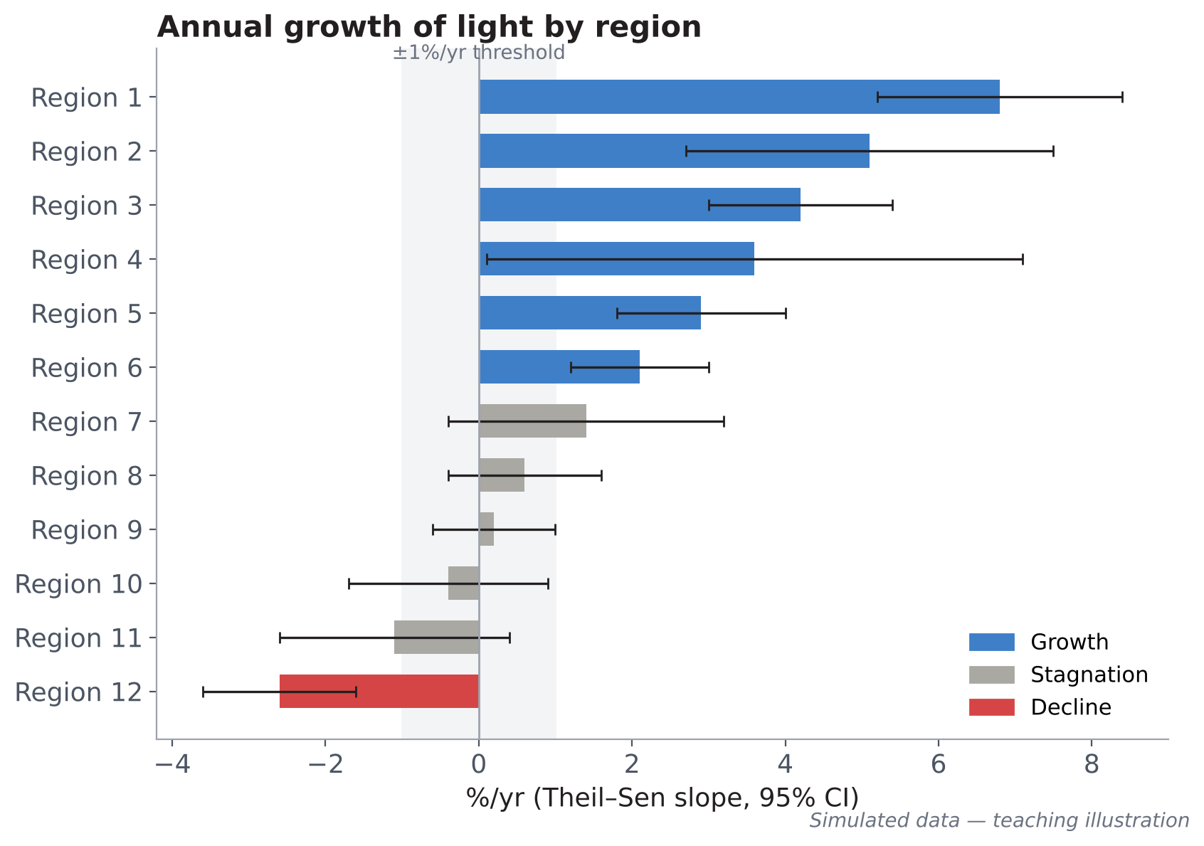
Who grows, who stagnates, who declines?
E · ANALYSES — SECTION 6
Economic question
Where is activity rising, and where is it falling, over the period?
Growth — slope ≥ +1%/yr and significant
Stagnation — |slope| < 1%/yr, or trend not established
Decline — slope ≤ −1%/yr and significant
How to read error bars are 95% CIs. Region 7 has a positive slope but its CI touches zero: it stays in “stagnation”.
Pitfall reading “stagnation” as “standing still”: it often means “not enough information”.
Notes:
This chart ranks regions by their annual growth of light, with confidence intervals. The colours match the three classes. Read the error bars carefully: region 7 has a positive slope but its interval touches zero, so we cannot say it is growing. The notebook also produces a choropleth map of the classes. A lot of stagnation often means a lack of information, not an absence of change. Question: which region of your country do you expect to see at the top?

Slide 24
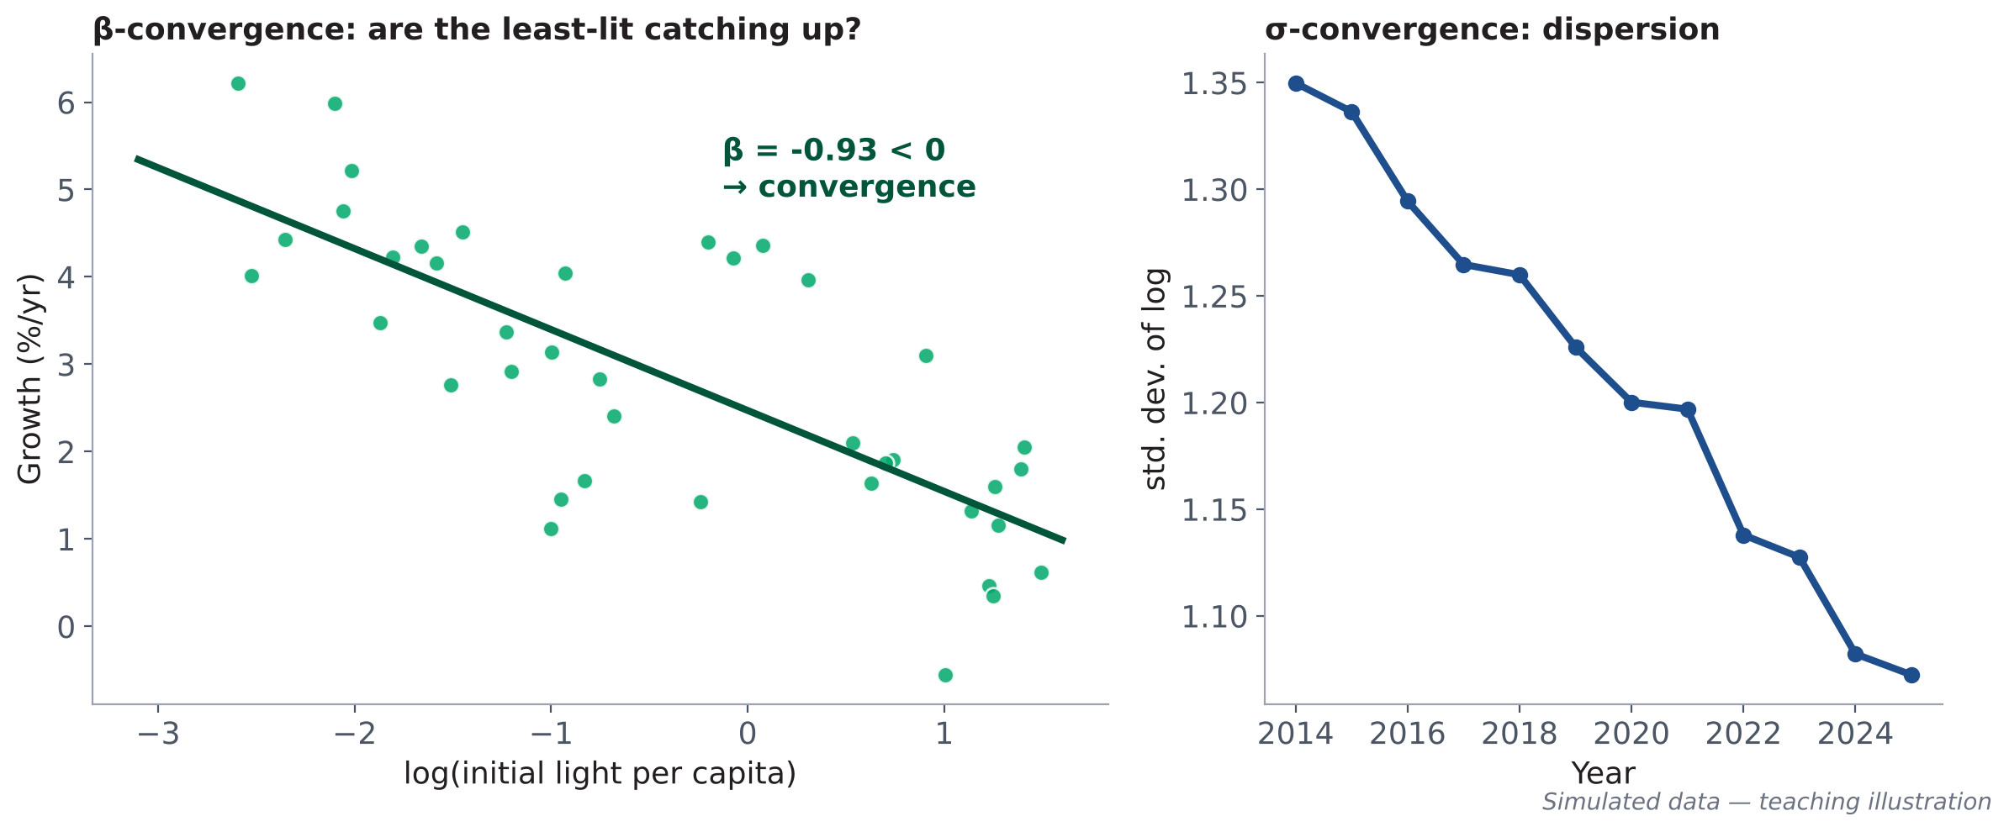
Convergence and concentration: is activity spreading out?
E · ANALYSES — SECTION 6
Economic question
Does growth benefit peripheral regions, or concentrate around the capital?
NO₂ (Sentinel-5P)
Spearman correlation with light: a complementary industrial indicator.
β-convergence
σ-convergence
Herfindahl (HHI)
Economic reading rising concentration = polarisation (capital, ports); convergence = electrification spreading to the periphery.
gᵢ = a + β · log(xᵢ,₀) + εᵢ
σₜ = std. dev. [ log(xᵢ,ₜ) ]
HHI = Σ sᵢ²
β < 0: initially dimly lit regions grow faster — they catch up.
σ falls: gaps between regions narrow.
sᵢ = share of national light; 1 = everything in one unit.
Notes:
Two complementary questions. β-convergence: do initially dimly lit regions grow faster? We regress growth on the initial level of light per capita; a negative slope means catching up. σ-convergence: does the dispersion between regions fall over time? And the Herfindahl index measures concentration: the sum of squared shares. The notebook adds the correlation with nitrogen dioxide, an industrial indicator. The interpretation is economic: polarisation around the capital or electrification spreading out.

Slide 25
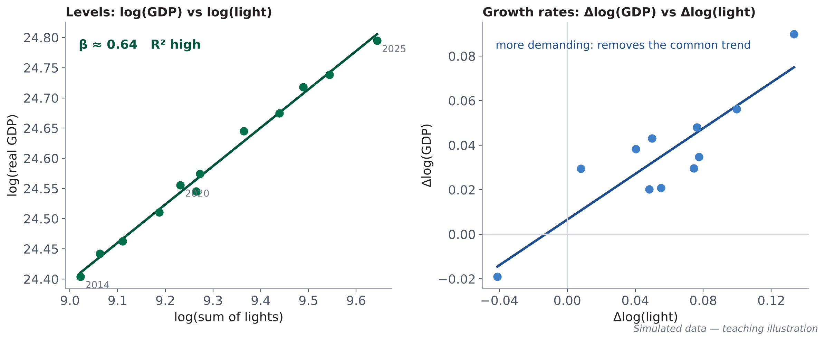
The lights–GDP relationship: estimating an elasticity
E · ANALYSES — SECTION 7
log(NTLₜ) = α + β · log(GDPₜ) + εₜ
β = elasticity: +1% GDP ↔ +β% light.
Levels (VIIRS) — long-run relationship; spurious-regression risk
Growth (VIIRS) — Δlog: removes the common trend; more demanding
Long series — harmonised DMSP–VIIRS, with a sensor dummy
Why two specifications?
Economic reading β < 1: light grows more slowly than GDP (services, LEDs, efficiency). β unstable across specifications: use lights only as a directional signal.
Two series that both rise over time look correlated even with no causal link: this is spurious regression. If β stays similar in growth rates, the relationship is credible.
Notes:
This is the central question for national accountants: do lights track official GDP? The notebook estimates the elasticity β with three specifications: in levels, in growth rates, and on the long series. The left panel, in levels, shows a very clear relationship, but careful: two rising series always seem correlated. The right panel, in growth rates, is more demanding and more honest. If β stays comparable in both, the relationship is credible. GDP comes from the World Bank API, in constant 2015 dollars.

Slide 26
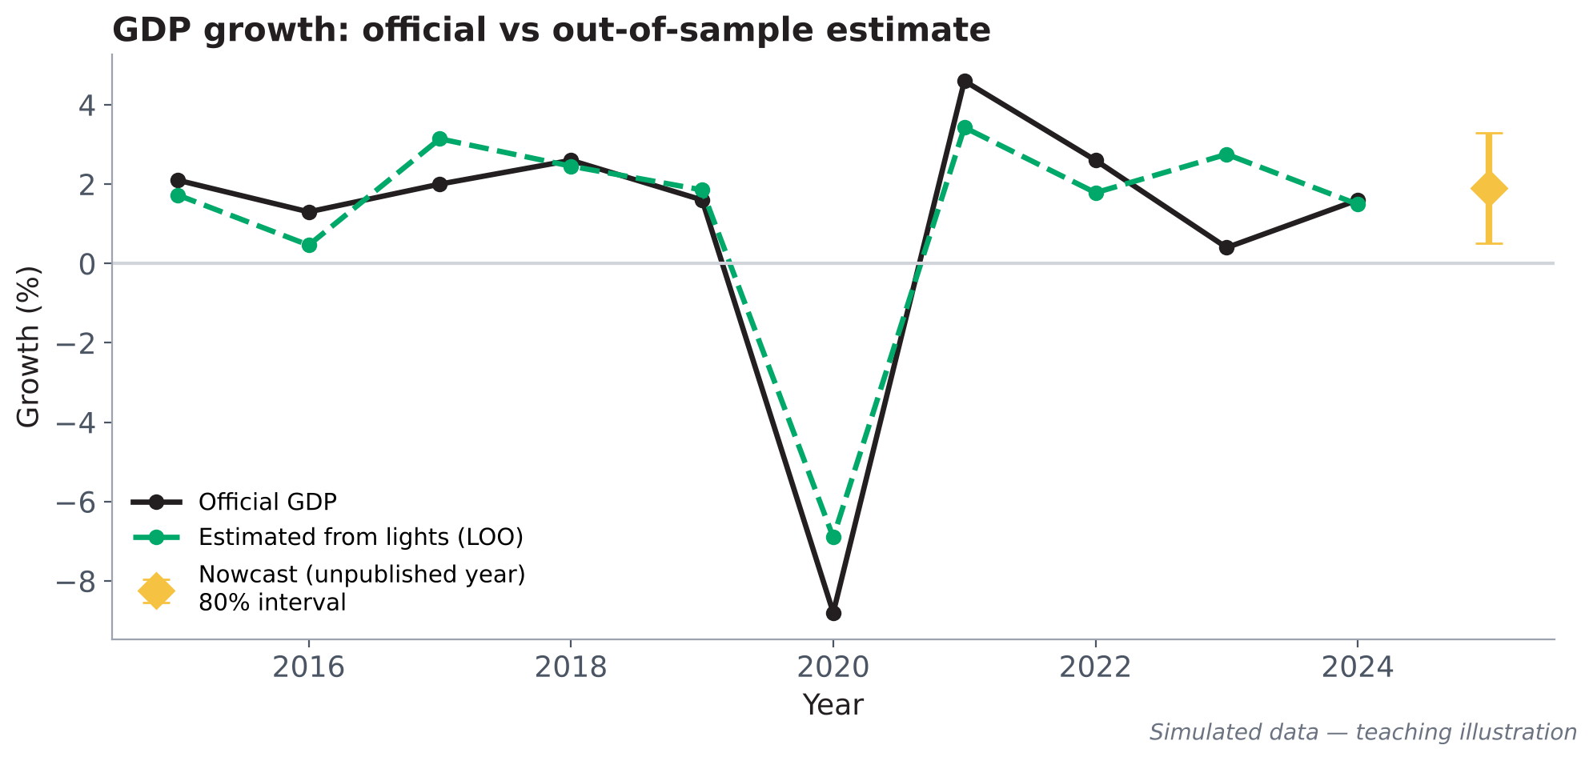
Diagnostics and out-of-sample prediction: an honest test
E · ANALYSES — SECTION 7
HAC (Newey–West)
standard errors corrected for autocorrelation in annual residuals
Durbin–Watson
residual autocorrelation; ≈ 2 if absent
Breusch–Pagan
heteroskedasticity: does error variance change?
Jarque–Bera
normality of residuals
Out-of-sample prediction (leave-one-out)
Pitfall settling for the R² in levels: it is almost always high. Read β's CI and the out-of-sample error.
Each year is predicted by a model estimated without it. The notebook reports the correlation and the mean absolute error (in growth points): the honest measure of predictive ability.
Notes:
An elasticity is only worth something if the model is sound. The notebook computes robust Newey–West standard errors, because annual residuals are often autocorrelated, and three classic diagnostics: Durbin–Watson, Breusch–Pagan and Jarque–Bera. Above all, it measures out-of-sample prediction: each year is predicted by a model that has not seen it. The simulated figure compares official growth with growth estimated from lights; the 2020 shock is captured well, but not perfectly. The gold diamond is an estimate for the not-yet-published year, with its interval.

Slide 27
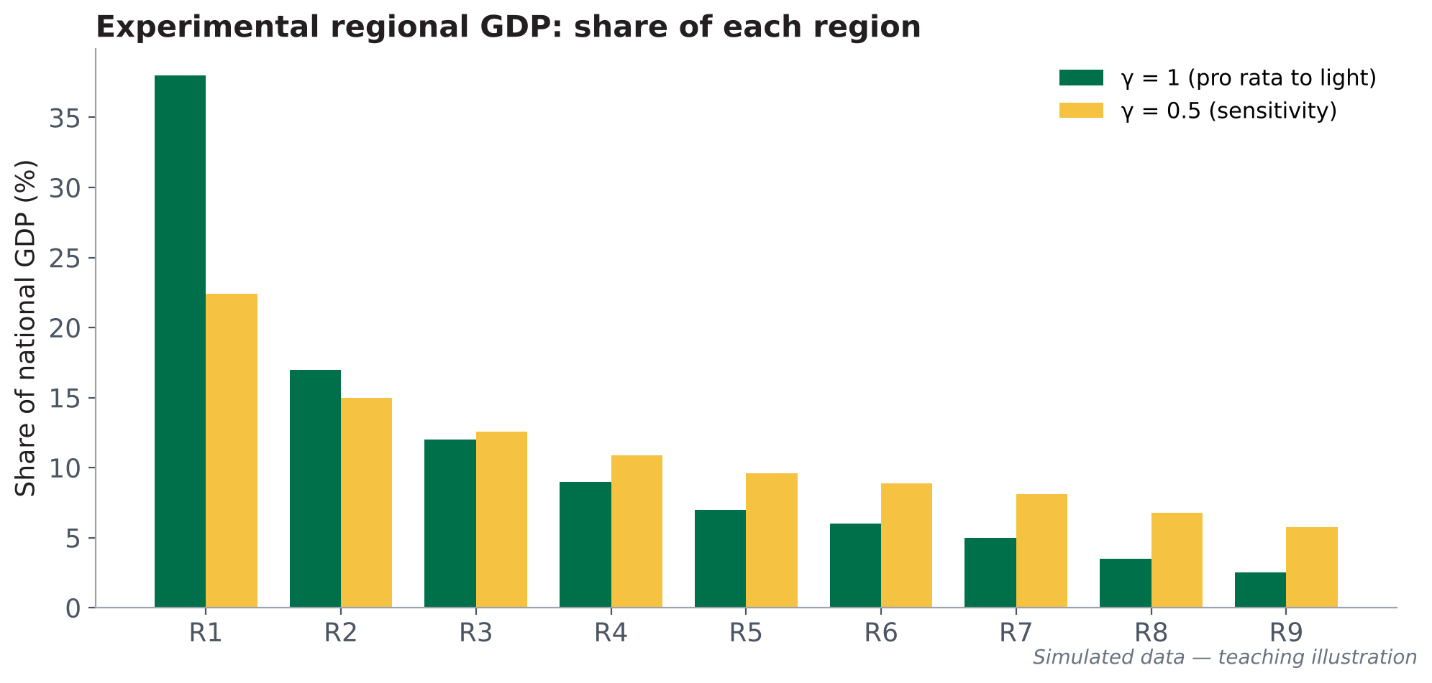
Estimating activity where statistics are missing
E · ANALYSES — SECTION 7
Nowcast: the not-yet-published year
GDP growth for the recent year is estimated from light growth, with 80% and 95% prediction intervals.
Δlog(GDPₜ) = a + γ · Δlog(NTLₜ)
Status: experimental statistics
GDPᵣ = national GDP × SoLᵣ^{γ} / Σ SoL^{γ}
These estimates carry “low” confidence by construction: extrapolation from a model estimated on few years. Publish with intervals and a methodological note, after comparison with available regional accounts.
Experimental regional GDP. γ = 1: pro rata to light; γ = 0.5: sensitivity giving more weight to dimly lit regions. The gap between the two measures the uncertainty due to the assumption.
Notes:
Two operational uses. The nowcast: estimating GDP growth for the year the World Bank has not yet published, from light growth, with a prediction interval. Experimental regional GDP: allocating national GDP across regions pro rata to light. The parameter γ is an assumption: with γ equal to 0.5, dimly lit regions get more weight, which partly corrects the under-representation of agriculture. The simulated figure shows this choice strongly changes the first region's share. These figures are experimental by construction.

Slide 28
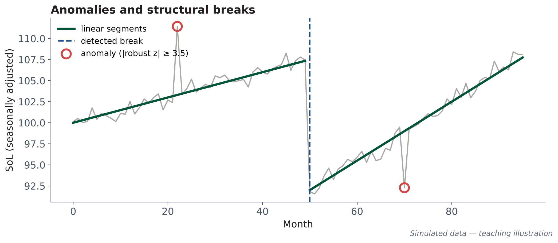
Detecting shocks: anomalies and structural breaks
E · ANALYSES — SECTION 8
Anomaly
month whose STL remainder is extreme: |robust z| ≥ 3.5 AND deviation ≥ 5%
z = (Rₜ − median) / (1.4826 × MAD)
Structural break
lasting change in level or slope; piecewise linear segmentation, BIC-type penalty, ≥ 12 months on each side
Event catalogue
COVID-19 (generic, March 2020 – June 2021) + your CUSTOM_EVENTS + optional ACLED (conflict) or EM-DAT (disaster) export. A break with no known event within ±6 months is flagged: it must be documented (sensor, outage) before being interpreted.
MAD = median absolute deviation: a dispersion measure robust to extreme values.
Notes:
Section 8 detects shocks. Two tools. An anomaly is an isolated month whose STL remainder is extreme; we use a robust z-score, based on the median and the median absolute deviation, and also require a deviation of at least 5%. A structural break is a lasting change: the series is split into linear segments, with a penalty that avoids cutting too often. Breaks are matched against the event catalogue. A break with no explanation must be documented before being interpreted: it may be a sensor change.

Slide 29
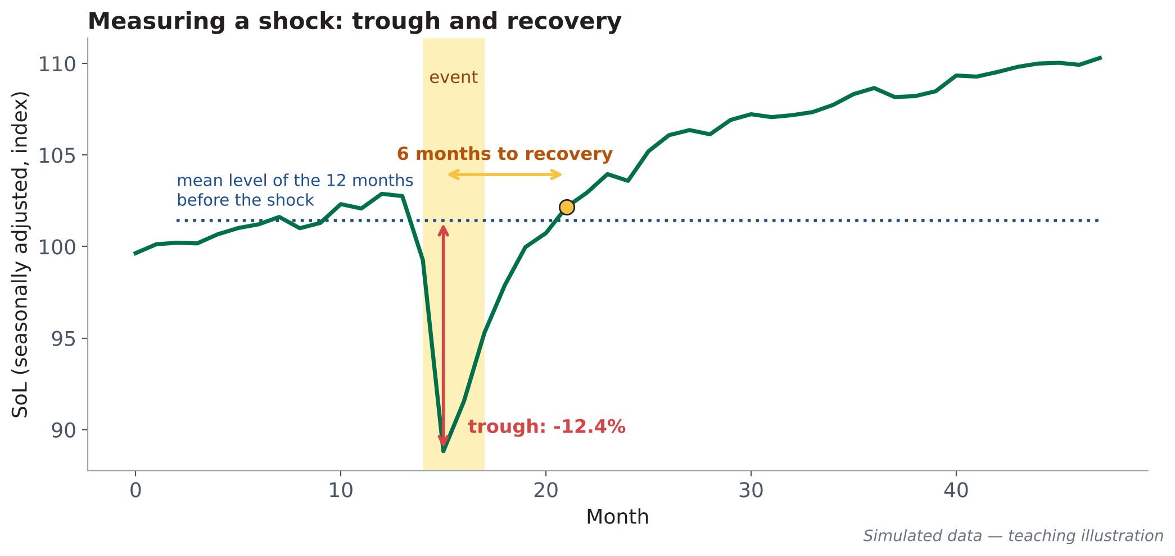
Measuring a shock: depth of the trough and speed of recovery
E · ANALYSES — SECTION 8
Pre-shock level
mean of the 12 months before the event, seasonally adjusted series
Trough
maximum deviation from that level during the event (in %)
Recovery
number of months to return to the pre-shock level
Distinguishable from noise?
the trough is compared with pre-shock monthly variability
Daily Black Marble zoom
Reading light captures stoppages of night-time activity well (lockdowns, outages, displacement); it underestimates agricultural or daytime-service shocks.
To date a shock to the day: base-100 index (median of the first 60 days), high-quality cloud- and snow-free pixels, 7-day rolling median. Impact also computed by region (heat table).
Notes:
Once an event is identified, we measure it. We compute the mean level of the twelve preceding months, on the seasonally adjusted series. The trough is the maximum deviation from that level. Recovery is the number of months needed to return to it. The simulated figure shows a trough of about 13% and recovery within a few months. The notebook also checks that the trough exceeds ordinary variability: otherwise confidence is low. For precise dating we use daily Black Marble, with a base-100 index and a rolling median. Question: which recent shock would you like to measure this way?

Slide 30
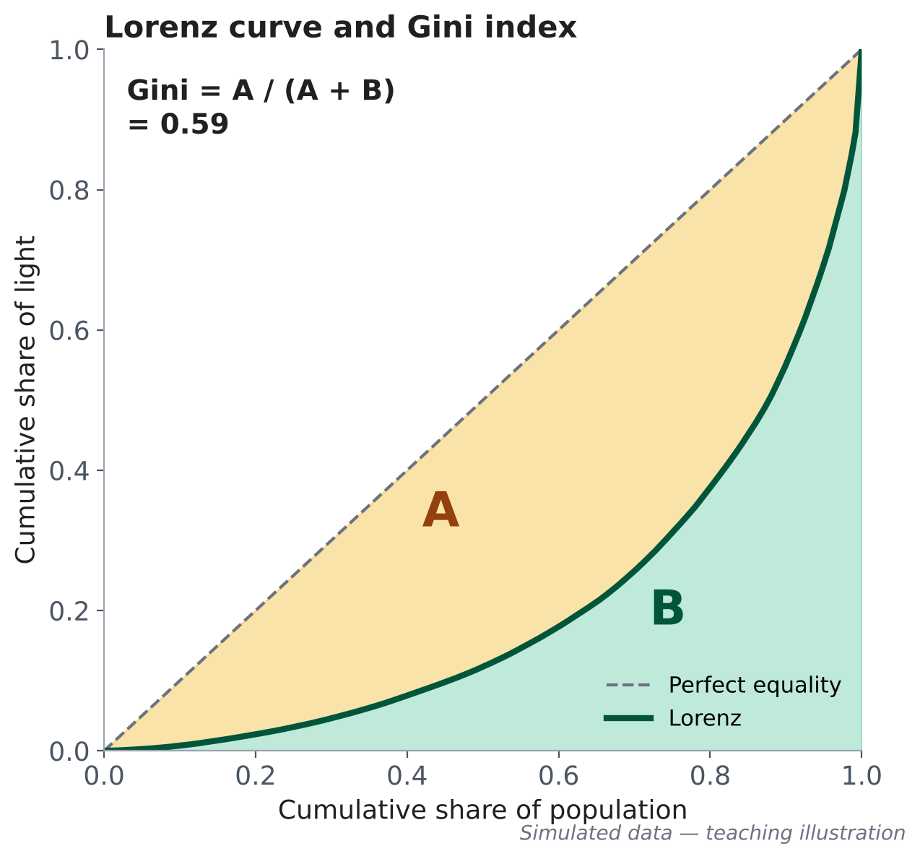
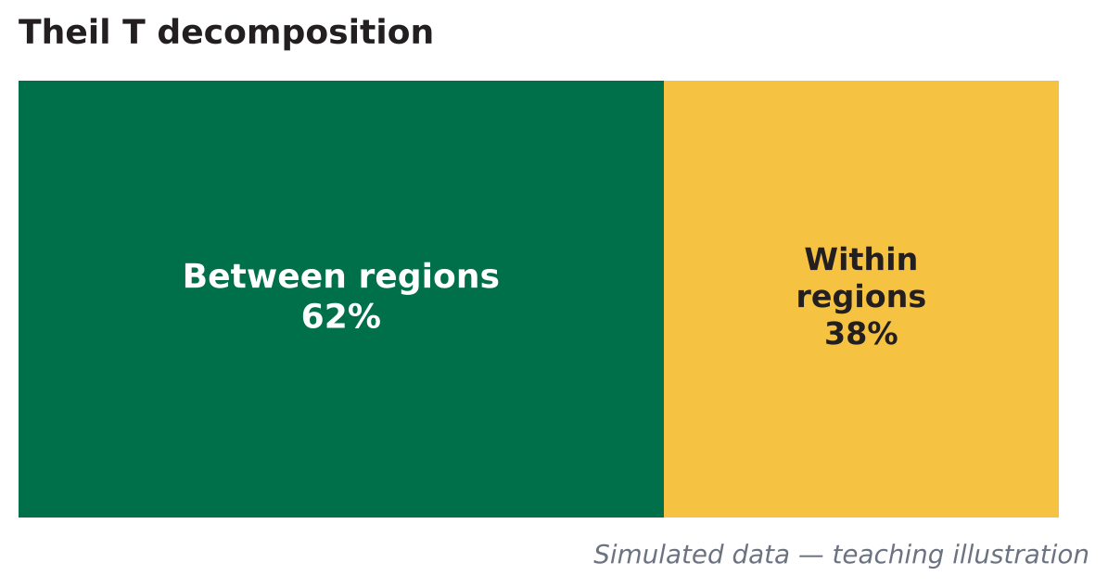
Spatial inequality: Lorenz, Gini and Theil
E · ANALYSES — SECTION 9
Economic question
Is access to light, a proxy for development, fairly distributed across people?
Gini
Theil T
0 = equality, 1 = all light in a single unit. Population-weighted, on the finest units.
decomposes into between-region and within-region inequality: at which level to act?
Change in Gini
Urban / rural gap
95% bootstrap interval (300 draws): is the rise or fall significant?
urban ÷ rural light per capita (GHSL degree of urbanisation)
How to read curve far from the diagonal = high inequality. Gini = area A / (A + B).
Notes:
Section 9 measures spatial distribution. The Lorenz curve ranks units from least to most lit per capita and accumulates population on the x-axis and light on the y-axis. The further the curve from the diagonal, the higher the inequality. The Gini is the ratio of areas A over A plus B. The Theil index has the advantage of decomposing: how much inequality comes from gaps between regions, and how much from within regions? The notebook also computes a bootstrap interval to know whether the Gini has changed significantly.

Slide 31
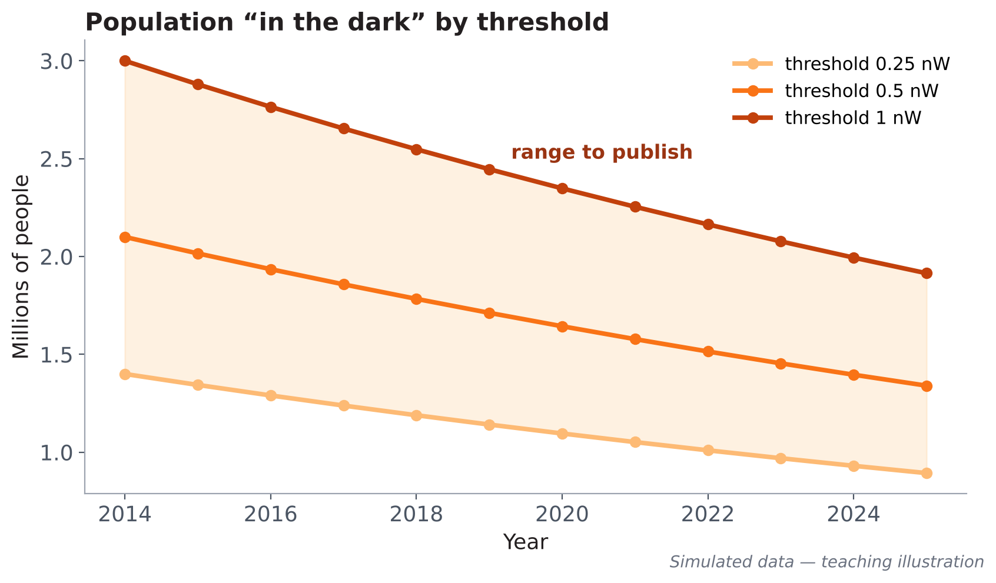
The population “in the dark”: a proxy for electricity access
E · ANALYSES — SECTION 9
Definition
Inhabitants of populated pixels (≥ 5 inhabitants, ~0.21 km²) whose radiance stays below the detection threshold (0.5 nW by default).
thresholds tested: 0.25 · 0.5 · 1 nW
World Bank comparison
gap with the EG.ELC.ACCS.ZS access rate (household surveys)
Pitfall “inhabited without light” ≠ “not connected”: a connected low-consumption household is invisible; the result depends on the threshold and the population map.
Publishing always publish a range (by threshold), never a figure to the nearest person. The map of dark areas helps target electrification.
Notes:
A very telling indicator for decision-makers: how many people live in inhabited areas with no detectable light? We cross the population map with the light map. But the result depends heavily on the chosen threshold: the simulated figure shows three thresholds, and the gap between them is considerable. That is why the notebook publishes a range, not a single figure. We then compare with the World Bank access rate, from household surveys. Careful: a connected household that consumes little is invisible from space.

Slide 32
The confidence system: high, medium, low
F · CONFIDENCE AND PUBLISHING
Example: NTL–GDP elasticity (src/econometrics.py)
High
Rules tested in order; the first true one wins
significant, sufficient sample, insensitive to choices → publishable message
1
n < 8 years
● LOW
no
2
p < 0.01 · CI < 1 · R² ≥ 0.6 · n ≥ 15
Medium
● HIGH
significant but short sample or threshold-sensitive → publish with caveats
no
3
p < 0.01 · CI < 1 · R² ≥ 0.6 (n < 15)
● MEDIUM
Low
no
4
p < 0.10
not significant, extrapolation, strong dependence on assumptions → a lead, not a conclusion
● MEDIUM
no
5
otherwise
● LOW
Trends follow a similar rule (n ≥ 6; p < 0.01 → high; p < 0.10 → medium). Every message shows its confidence AND its reason.
Notes:
This is the heart of the publishing approach. Every result receives a confidence level, computed by explicit rules. The tree on the left is the one for the elasticity: fewer than eight years is low; significant at 1%, a narrow interval, high R² and at least 15 years is high; the same conditions with fewer than 15 years is medium; significant at 10% is medium; otherwise low. On the right, what each level implies for publication. A low message is a lead, not a conclusion. The notebook always shows the reason next to the level.

Slide 33



Publishing light-based statistics: five good practices
F · CONFIDENCE AND PUBLISHING
Always an interval
Experimental status
Traceability
Documented thresholds
Never alone
95% CI, range by threshold, prediction interval: never a bare number.
Regional GDP and nowcast: labelled “experimental statistics”.
manifest: parameters, versions, data availability, extraction date.
every threshold is shown on the dashboard's “Methods & limitations” page.
as a complement to accounts and surveys, never a substitute.
Recommendations produced automatically by the notebook (section 10)
Use lights as a leading, subnational indicator · Do not release GDP estimates if the NTL–GDP link is weak · Cross the “in the dark” map with connection registers · Document unexplained breaks · Update every quarter.
Notes:
Five rules for publishing. Always an interval. An explicit experimental-statistics status for regional GDP and the nowcast. Traceability, thanks to the manifest that records parameters and versions. Publicly documented thresholds. And above all, lights complement official statistics, they do not replace them. The notebook also generates recommendations tailored to the results: for example, if the link between lights and GDP is weak, it explicitly recommends not releasing a GDP estimate.

Slide 34

The dashboard: 8 pages, no server
F · CONFIDENCE AND PUBLISHING
https://<user>.github.io/ntl-dashboard/?country=TUN
Static export (section 11)
Overview
Map
Trends
Regions
Shocks
Inequality
Methods
Data
simplified GeoJSON, CSV, JSON, PNG under dashboard/data/<ISO3>/ — GEE tiles expire, a PNG does not.
+3.5%/yr
0.62
0.54
1.4–3.0M
growth of light
light–GDP elasticity
light per capita Gini
people in the dark
Multi-country
Key messages
🟢 National trend
🟠 Regions
🟠 Link with GDP
🔴 Recent estimate
🟠 Inequality and access
countries.json: several countries can coexist on the same site.
Manifest
parameters, versions, references: the reproducibility guarantee.
Illustrative mock-up (dummy values)
Notes:
The final output is an eight-page web dashboard: overview with indicators and key messages, interactive map with a time slider and before/after view, trends, regions, shocks, inequality, methods and limitations, and downloadable data. It is a static site: no server, no database. Files are exported in section 11. Several countries can coexist on the same site. The mock-up shown uses dummy values; the real site displays your country's results with their confidence level.

Slide 35



Publish in one call, with a secure token
F · CONFIDENCE AND PUBLISHING
publish_dashboard(ISO3, REPO_NAME, GITHUB_USER)
Check the token
Create the public repo
Push the site
Enable Pages
Show the URL
GET /user
if it does not exist
gh-pages branch, one timestamped commit
and wait for the build
<user>.github.io/<repo>
Token security: read before running
Fine-grained token, short expiry (7–30 days), limited to the dashboard repository only.
Minimum permissions: Contents and Pages (read/write); Administration only to create the repository.
Storage: Colab secret GITHUB_TOKEN or .env file — never in code, outputs or URLs.
Before sharing: clear the publishing cell's output, then revoke the token.
Notes:
Publishing takes a single function call. It checks the token, creates the public repository if it does not exist, pushes the site to the gh-pages branch, enables GitHub Pages, waits for the build and displays the address. Re-running updates the site without duplicating the repository. Security is essential: use a narrowly scoped token with a short expiry, stored as a secret. The code never displays it and redacts error messages. And before sharing your notebook, clear the output of the publishing cell.

Slide 36
Limitations and biases: what must always be said
G · WRAP-UP
What lights measure
Saturation, blooming
Flares, isolated sites
Clouds, seasons, moon
radiance at ~01:30; agriculture, daytime trade and rural informal economy poorly captured
DMSP saturates; blooming still inflates the lit area
the mask may remove a mine or miss a small flare
partially observed months; STL removes the average season, not an abnormal one
Product breaks
NTL–GDP elasticity
Electricity access
Administrative boundaries
DMSP and VIIRS not comparable; modelled long series, trend only
10 to 30 points: wide intervals, non-causal and unstable relationship
“inhabited without light” ≠ “not connected”; threshold-sensitive
geoBoundaries / GAUL may differ from official boundaries
Notes:
Eight limitations, which the notebook also exports to the dashboard's methodology page. Stating them does not weaken your results: it makes them credible. The most important for a statistician are the first, what lights actually measure, and the sixth: the elasticity is estimated on few points, it is unstable and not causal. For electricity access, always recall that a connected low-consumption household is invisible. Finally, the administrative boundaries used may differ from your country's official boundaries.

Slide 37
What lights have made it possible to measure
G · WRAP-UP
The activity trend
The geography of growth
Convergence
seasonally adjusted annual growth, with CI
regions growing, stagnating, declining
catching up or polarisation
A GDP signal
The impact of shocks
Inequality and access
elasticity, nowcast, experimental regional GDP
trough, recovery, day-level dating
Gini, Theil, population in the dark (range)
One pipeline, one parameter, and for every result: a value, an interval, a confidence level and its reason.
Notes:
To answer the session's title: here is what lights have made it possible to measure. A seasonally adjusted activity trend. The geography of growth, region by region. Convergence or polarisation. A GDP signal, with its limits. The impact of shocks, dated and quantified. And spatial inequality, including a proxy for electricity access. The main message fits in one sentence: one pipeline, one parameter, and for every result a value, an interval and a confidence level.

Slide 38

Towards your own projects
G · WRAP-UP
Sub-annual tracking
Assess a shock
Questions to frame your project
Which economic question?
Which statistical product, for which user?
Which official validation data?
Which confidence level is targeted?
Which limitations to state?
a quarterly leading indicator of regional activity for your country
cyclone, conflict, energy crisis: trough, recovery, affected regions
Electricity access
Experimental regional GDP
map of “dark” areas crossed with connection registers
compare γ = 1 and γ = 0.5 with existing regional accounts
To get started: open the part 3 notebook in Colab, replace ISO3 with your country, add an event to CUSTOM_EVENTS, and click “Run all”.
Notes:
Here are four project ideas that can be done directly with this notebook. A quarterly leading indicator of regional activity. The assessment of a known shock in your country. A map of dark areas to compare with connection registers. Or an experimental regional GDP compared with your regional accounts. For each project, ask yourself the framing questions: the economic question, the user, the validation data, the targeted confidence level and the limitations to state. The simplest way to start: change the ISO3 code and run everything.

Slide 39
Thank you — over to your questions
“A measurement is only useful if you can say how far it can be trusted.”
1
Lights = a witness of activity, not GDP
2
Preprocess before interpreting: clouds, flares, season
3
Always an interval and a confidence level
4
One ISO3 code → a public, traceable dashboard
African Development Bank – Data Innovation for Africa (DI4A)
Night-time lights in practice · Analysis notebook “NTL hands-on, part 3”
Notes:
Thank you. Four messages to remember. Lights are a witness of activity, not GDP. Always preprocess before interpreting. Every figure is published with an interval and a confidence level. And a simple ISO3 code is enough to produce a public, traceable dashboard. I now suggest a few minutes of questions. The annexes that follow contain the glossary of acronyms, the references and a one-page cheat sheet.

Slide 40
Glossary of acronyms (1/2)
ANNEX A
Acronym | Full form | Meaning here
AfDB / BAD | African Development Bank | institution behind DI4A
DI4A | Data Innovation for Africa | AfDB data-innovation programme
NTL | Night-Time Lights | night-time lights
VIIRS | Visible Infrared Imaging Radiometer Suite | sensor on Suomi-NPP and NOAA-20
DNB | Day/Night Band | VIIRS band sensitive to faint light
DMSP-OLS | Defense Meteorological Satellite Program – Operational Linescan System | older sensor (1992–2013)
VNL V2 | VIIRS Nighttime Lights, version 2 | EOG annual composites
VNP46A1–A4 | NASA Black Marble products | A2 daily, A3 monthly, A4 annual
EOG | Earth Observation Group (Colorado School of Mines) | producer of VIIRS composites
BRDF | Bidirectional Reflectance Distribution Function | viewing-angle correction
GEE | Google Earth Engine | geospatial computing platform
ISO3 | ISO 3166-1 alpha-3 | three-letter country code
ADM0 / 1 / 2 | administrative levels | country / regions / districts
SoL | Sum of Lights | sum of a unit's radiances
cf_cvg | cloud-free coverage | number of cloud-free observations
GHSL | Global Human Settlement Layer (JRC) | population (GHS-POP), urbanisation (GHS-SMOD)
Notes:
Glossary of the acronyms used in the presentation and in the notebook. Each acronym is spelled out at first use in the slides; this table is a reference.

Slide 41
Glossary of acronyms (2/2)
ANNEX A
Acronym | Full form | Meaning here
S5P · NO₂ | Sentinel-5P · nitrogen dioxide | industrial activity indicator
WDI | World Development Indicators | World Bank database (GDP, access)
PIB / GDP | Gross Domestic Product | constant 2015 USD here
STL | Seasonal-Trend decomposition using Loess | trend + season + remainder
Loess | LOcally Estimated Scatterplot Smoothing | smoothing by local regressions
MCO / OLS | Ordinary Least Squares | classic linear regression
HAC | Heteroskedasticity and Autocorrelation Consistent | Newey–West standard errors
IC / CI | Confidence Interval | 95% here
MAD | Median Absolute Deviation | robust dispersion
BIC | Bayesian Information Criterion | penalty against over-segmentation
HHI | Herfindahl–Hirschman Index | concentration index
LOO | Leave-One-Out | validation leaving one year out
ACLED | Armed Conflict Location & Event Data | conflict event database
EM-DAT | Emergency Events Database | disaster database
GAUL | Global Administrative Unit Layers (FAO) | administrative boundaries (fallback)
PAT | Personal Access Token (GitHub) | access token used to publish
LED | Light-Emitting Diode | lighting less visible to VIIRS
Notes:
Glossary of the acronyms used in the presentation and in the notebook. Each acronym is spelled out at first use in the slides; this table is a reference.

Slide 42
References and image sources
ANNEX B
Chen, X., Nordhaus, W. D. (2011). Using luminosity data as a proxy for economic statistics. PNAS 108(21).
Henderson, J. V., Storeygard, A., Weil, D. N. (2012). Measuring economic growth from outer space. AER 102(2).
Elvidge, C. D. et al. (2017). VIIRS night-time lights. Int. J. Remote Sensing 38(21).
Elvidge, C. D. et al. (2021). Annual time series of global VIIRS nighttime lights. Remote Sensing 13(5).
Román, M. O. et al. (2018). NASA's Black Marble nighttime lights product suite. Remote Sensing of Environment 210.
Li, X. et al. (2020). A harmonized global nighttime light dataset 1992–2018. Scientific Data 7, 168.
Gibson, J. et al. (2021). Which night lights data should we use in economics, and where? JDE 149.
Cleveland, R. B. et al. (1990). STL: a seasonal-trend decomposition procedure based on Loess. JOS 6(1).
Schiavina, M. et al. (2023). GHS-POP R2023A. European Commission, JRC · Runfola, D. et al. (2020). geoBoundaries. PLoS ONE 15(4).
Image sources
Real images
• NASA Black Marble (Ghana, Switzerland) via blackmarblepy, World Bank — MIT licence
• Mekong, Chicago, platforms: Open Nighttime Lights, World Bank — CC BY 4.0 (after Elvidge et al.; NASA Goddard)
Teaching figures
• generated from simulated data, for illustration only; they describe no real country
Methods and thresholds
• NTL hands-on part 3 notebook and src/ package (config.py)
Notes:
Scientific references cited and sources of all images. Teaching figures are built on simulated data; real images come from World Bank public repositories under open licences.

Slide 43
Cheat sheet: the metrics at a glance
ANNEX C
SoL
STL
Theil–Sen
β-convergence
Σ rᵢ
log SoL = T + S + R
median of slopes
g = a + β log x₀
activity index; also reason per capita
read the seasonally adjusted series
robust growth; class if ≥ 1%/yr and p < 0.10
β < 0: catching up
HHI
Elasticity
Nowcast
Anomaly
Σ sᵢ²
log NTL = α + β log GDP
Δlog GDP = a + γ Δlog NTL
|z| ≥ 3.5 ; ≥ 5 %
concentration; 1 = a single unit
compare levels and growth; read the CI
experimental statistic, 80% interval
robust z (median, MAD) on the STL remainder
Trough
Gini
Theil T
In the dark
max. gap / 12 months before
A / (A + B)
between + within
pop. ≥ 5 · r < 0.5 nW
+ months to recovery
0 equality · 1 all in one unit
at which level to act?
publish a range (0.25–1 nW)
Notes:
One-page cheat sheet: for each metric, its formula and its reading rule. You can print it and keep it next to the notebook during your group work.

