Slide 1
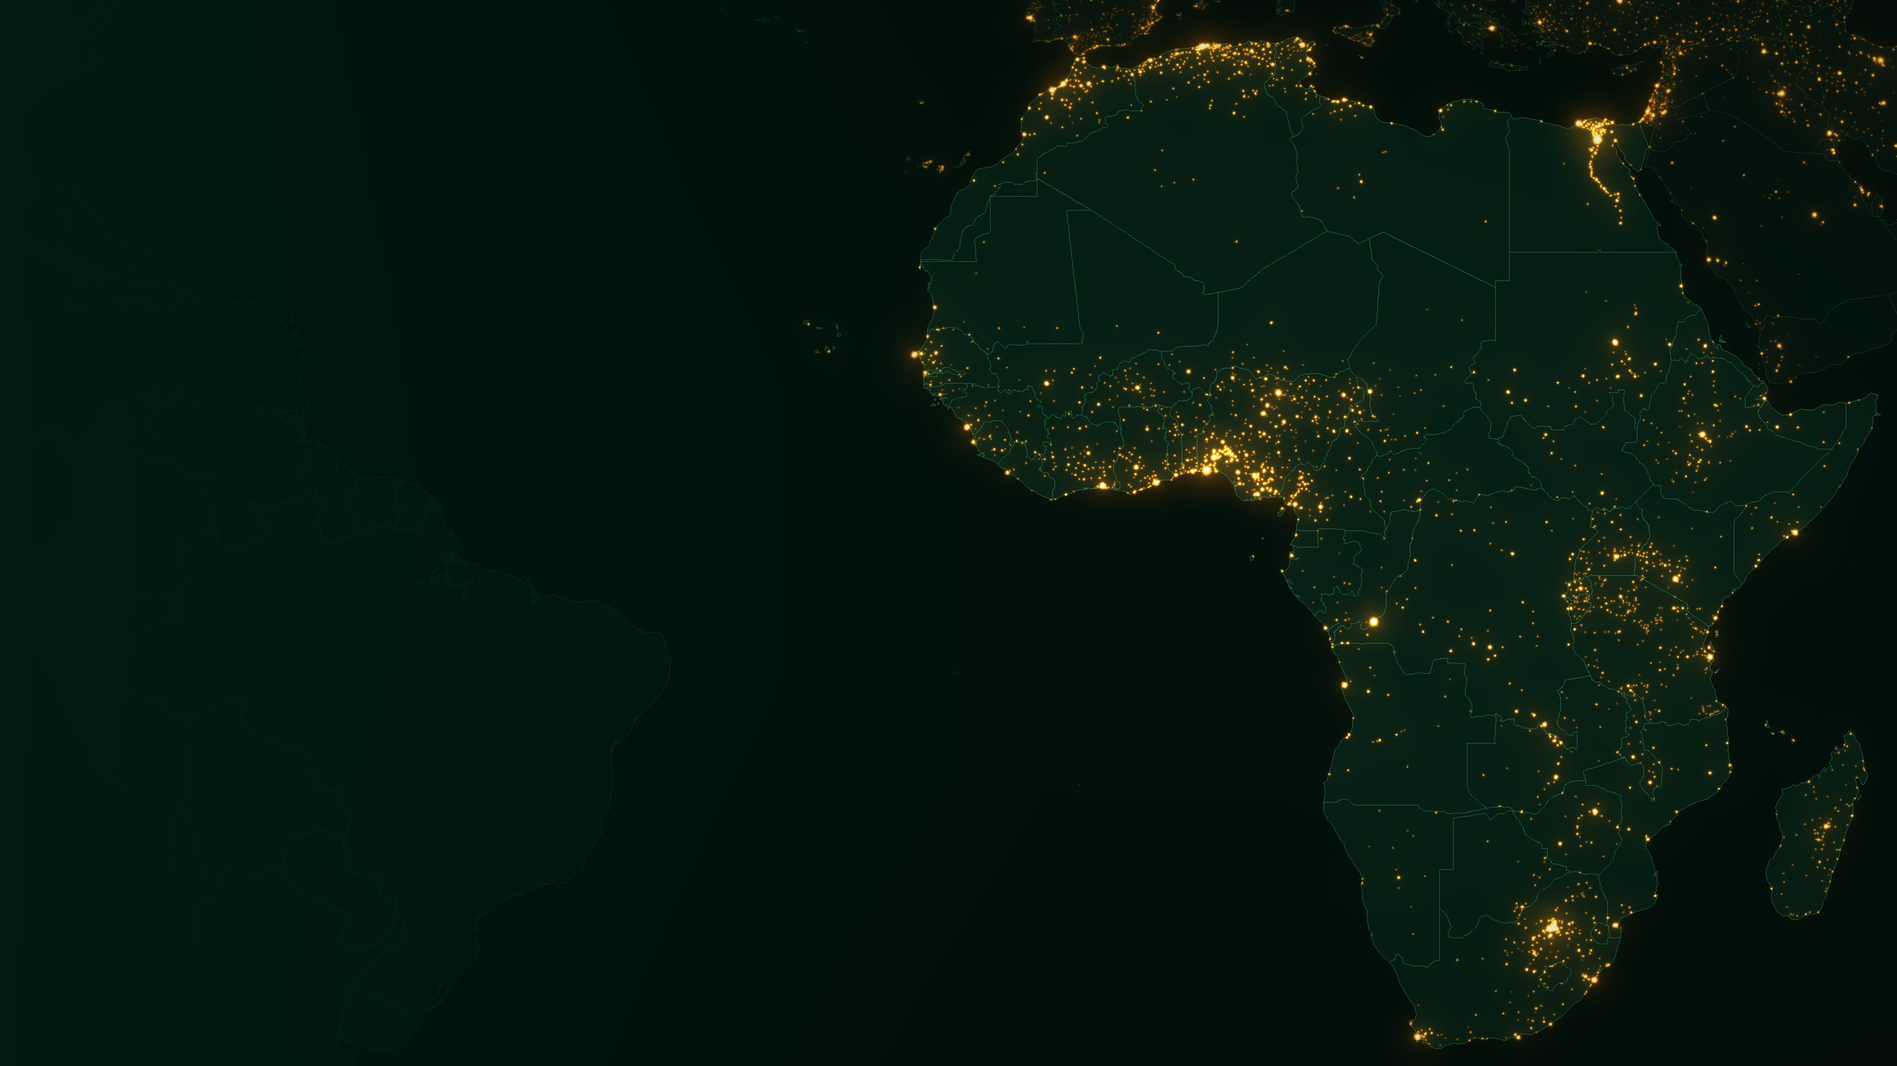
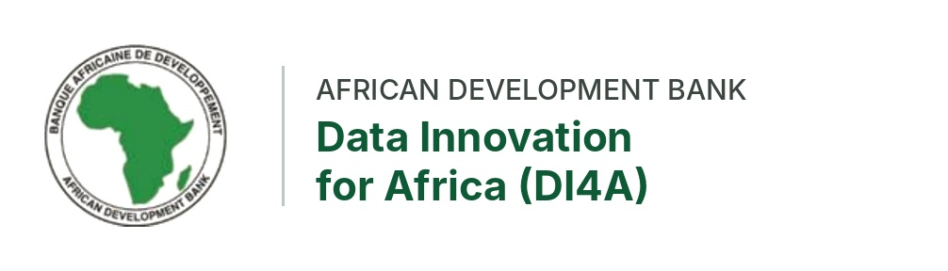
AFRICAN DEVELOPMENT BANK · DATA INNOVATION FOR AFRICA (DI4A)
Night-Time Lights
Measuring activity from orbit — and what lights have been used to measure
Night-time lights for macroeconomic statistics
Africa · Illustrative rendering: GeoNames settlement populations, Natural Earth borders
Notes:
[1 min] Welcome. This module follows naturally from an overview of non-traditional data sources and prepares geospatial work on cropland and built-up structures. Frame the session: this is not a gallery of beautiful pictures of Africa at night. It is a session about a measurement instrument that a statistical office or central bank can use, test and publish from. Opening question to the room: “If you could take only one photograph of your country to judge how its economy is doing, what would you photograph?” The answer this field gives is: photograph it at night. Slides tagged REFERENCE are there for the hands-on work; skim them live.

Slide 2



SESSION OVERVIEW · LEARNING OBJECTIVES
CONTEXT
Two sessions and what you will be able to do
SESSION A · 45 MIN
SESSION B · 90 MIN
Night-time lights: measuring activity from orbit
Night-time lights in practice: what they have been used to measure
Collect NASA Black Marble data and clip a monthly composite for a selected country
Identify what night-time lights proxy well — and what they do not
Review key artefacts: blooming, saturation, gas flares, seasonality, cloud cover, sensor discontinuity
Apply masks, aggregate over time and compare regions
Produce a national series with notes on data limitations
Review common applications: output proxies, electrification, urbanisation, damage assessment, activity mapping
Assess how each use case was validated and where the proxy performs well
Rebuild one application and compare it with an official indicator
Report where the relationship holds — and where it breaks
By the end you will hold three outputs: ① a clipped monthly composite for your country ② a masked national series with a limitations note ③ one rebuilt application, compared with an official indicator.
Night-Time Lights · Data Innovation For Africa (DI4A) — AfDB
2
Notes:
[1 min] Read the objectives aloud. Session A is about the instrument and the data: getting Black Marble data, knowing its artefacts and producing a clean national series. Session B is about inference: what lights have been used to measure, how those uses were validated, and whether the relationship holds in your own country. Make the three outputs explicit — participants should leave with files, not just impressions.

Slide 3




SESSION OVERVIEW · RUNNING ORDER
CONTEXT
How the sessions run: concepts, then hands-on, twice
SESSION A
SESSION B
Concepts
Lab A1
Lab A2
Break
Applications
Lab B
Report back
0′
15′
30′
45′
60′
90′
135′
150′
Concepts · 15 min
Lab A · 30 min
Lab B · 45 min
Report back · 15 min
Fast tour of the physics, sensors and products. Reference slides are flagged — return to them during the labs.
Download, clip, mask and aggregate one country. Output: a monthly national series plus a short limitations note.
Choose output, electrification, urbanisation or shock. Compare your NTL indicator with an official series.
Each table states in one sentence where the relationship held, where it broke, and why.
Afterwards The boundaries, grids and zonal statistics produced here can be reused for cropland and built-up analyses.
Night-Time Lights · Data Innovation For Africa (DI4A) — AfDB
3
Notes:
[30 sec] The session alternates short concept blocks with hands-on work. Keep the concept blocks to time — 15 minutes before the first lab and 30 minutes before the second. The detailed reference slides (products, artefacts, code, templates) are there to be consulted during the labs, not presented in full. The final report-back is short and structured: one sentence per table.

Slide 4
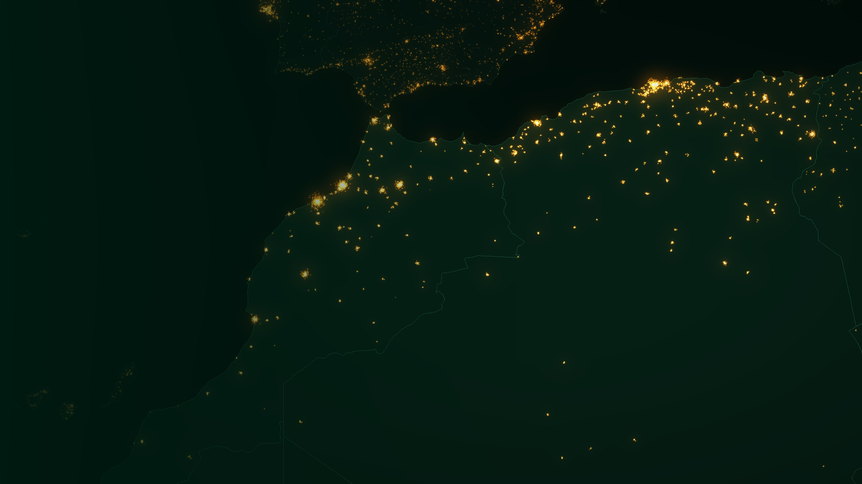
SECTION 1
01
Foundations
Why should a photograph of the dark tell us anything about an economy?
The core idea · Definitions · The inferential chain · What the sensor sees · Why it matters
SESSION A · ≈ 5 MIN
Maghreb coast · Illustrative rendering: GeoNames settlement populations, Natural Earth borders
4
Notes:
[Section 1 · ~5 min] Transition. We start with the physical idea, then define the object precisely, then show the chain of assumptions that every study depends on — and finish with why this matters for macroeconomic statistics specifically.

Slide 5




01 · FOUNDATIONS · THE CORE IDEA
SESSION A
Light is what human activity leaks
Almost everything people do after sunset requires light — and part of that light escapes upward, into the field of view of a satellite.
1992
Start of the continuous digital DMSP record — three decades of history
That physical fact turns the night side of the planet into an observation of human presence that no census, survey or administrative register can match on all four properties at once:
≈ 500 m
Black Marble grid (15 arc-seconds); native VIIRS DNB pixel ≈ 742 m, near-constant across the swath
Globally consistent
Spatially continuous
Same method in every country
Every ≈ 500 m grid cell
Nightly
Global VIIRS overpass around 01:30 local time, since 2012
Politically neutral
Freely available
For a statistical office: censuses come roughly once a decade, surveys every few years, quarterly GDP with a lag — lights arrive every night, for every district.
Independent of reporting
Open NASA / EOG products
Night-Time Lights · Data Innovation For Africa (DI4A) — AfDB
5
Notes:
[1 min] The four properties together are what make NTL unusual: no other source is globally consistent, spatially continuous, independent of national reporting and free. DMSP = Defense Meteorological Satellite Program, the US Department of Defense weather satellite programme dating from the 1960s. Precision on resolution: the VIIRS Day/Night Band’s native pixel is about 742 m and stays nearly constant across the scan; NASA Black Marble re-grids it to 15 arc-seconds, about 500 m at the equator. For a macro-statistics audience, add the timeliness point: quarterly GDP arrives with a lag; lights arrive nightly.

Slide 6



01 · FOUNDATIONS · DEFINITIONS
SESSION A
What night-time lights are — and are not
WORKING DEFINITION
Night-time lights (NTL) are measurements of visible and near-infrared radiance travelling upward from the Earth’s surface, recorded by a satellite sensor during local night, when the scene is free of direct sunlight.
What it is
What it is not
A physical measurement
A photograph
Radiance in nW·cm⁻²·sr⁻¹ for calibrated sensors (VIIRS).
The familiar “Earth at night” is a statistical composite of many cloud-free nights.
A consistent grid
A direct measure of people or income
Same method over every country — small islands and large states alike.
Those are inferences — each needs its own justification.
A near-real-time record
A complete record of lighting
Daily since 2012; monthly and annual composites, free of charge.
Indoor, shielded and sideways light never reaches the sensor.
Night-Time Lights · Data Innovation For Africa (DI4A) — AfDB
6
Notes:
[1 min] Read the working definition once. Then dwell on the right-hand column. The most common error in applied work is treating the composite as a picture and reasoning about it visually rather than radiometrically. The second is jumping from radiance to population or income without justifying the link. Units matter: nanowatts per square centimetre per steradian — you will see them in the HDF5 files in Lab A1.

Slide 7






01 · FOUNDATIONS · THE INFERENTIAL CHAIN
SESSION A
From electricity to a pixel value: five links
1
2
3
4
5
Energy & infrastructure
Activity after dark
Upward emission
Atmospheric transfer
Sensor response
›
›
›
›
A grid, generator or fuel supply exists and is operating.
People use that energy for lighting: streets, homes, markets, industry.
A fraction of the light escapes upward rather than being shielded.
Photons cross the atmosphere, attenuated by aerosols, vapour and cloud.
The detector integrates them over its band into a radiance value.
Where the chain breaks in African contexts — a dark pixel can mean …
Link 1
Load-shedding or fuel shortage — people are there, power is not
Link 2–3
Solar lanterns and small home systems too faint to detect
Link 4
Rainy-season cloud, harmattan dust, biomass-burning smoke
Link 5
Rural light below the sensor’s detection floor
Night-Time Lights · Data Innovation For Africa (DI4A) — AfDB
7
Notes:
[1.5 min] Walk the chain forwards, then backwards. Backwards is the diagnostic exercise: given a dark pixel in your country, list every link that could have produced it. The bottom panel gives African-context examples for each link: load-shedding breaks link 1; low-power solar lanterns may not produce enough upward light to cross the detection floor; rainy-season cloud and dry-season dust or biomass-burning smoke attenuate link 4. Participants should be able to generate at least five distinct explanations for darkness. This is exactly the reasoning required in Lab B when the relationship with an official indicator breaks.

Slide 8



01 · FOUNDATIONS · WHAT THE SENSOR SEES
SESSION A
The sensor sees one band, at one hour of the night
VIIRS Day/Night Band ≈ 500 – 900 nm
The LED paradox
Swapping sodium for white LED street lights can make a city look dimmer to VIIRS while it is actually better lit on the ground.
400
500
600
700
800
900
1000
wavelength (nm)
Sodium-lamp peak ≈ 589 nm — inside the band
The 01:30 snapshot
VIIRS passes after midnight. Evening markets, traffic and commerce (18:00–22:00) are largely unobserved; street lighting dominates.
White-LED blue peak ≈ 450 nm — outside the band
Why this matters for statistics
Two cities with the same economic activity can produce different radiance because of lamp type, curfew habits or building form. Changes in lighting technology — Africa’s accelerating LED and solar roll-out — can move the series without any change in activity. Treat technology change as a known source of drift and prefer within-unit changes over short windows.
Only upward light
Shielded fixtures, indoor lighting and light blocked by trees or buildings never reach the sensor.
Night-Time Lights · Data Innovation For Africa (DI4A) — AfDB
8
Notes:
[1 min · NEW] The Day/Night Band is panchromatic, roughly 500 to 900 nanometres. Traditional high-pressure sodium lamps emit mostly around 589 nm, squarely in the band. White LEDs emit a large share of their energy in a blue peak near 450 nm, outside the band. So an LED retrofit can lower measured radiance while the street is brighter to the eye (Kyba et al. 2017 discuss this for global trends). Second point: the overpass time. VIIRS observes around 01:30 local time — what it sees is the after-midnight city, dominated by street and security lighting, not the evening economy. Both points mean that radiance is a proxy with technology- and behaviour-dependent drift, which is why within-unit changes over short windows are more robust than cross-sectional levels.

Slide 9




01 · FOUNDATIONS · WHY IT MATTERS
SESSION A
What lights add to macroeconomic statistics
What lights add
What lights cannot give you
Timeliness
Granularity
Value added by sector. Agriculture, mining and many services create value with little light.
Prices or deflators. Lights are a volume-like signal at best.
Household income. Bright pixels are not people, and not their incomes.
Daytime activity. Markets, farms and offices that close before dark are invisible.
Monthly composites are typically available within weeks; daily products within days — ahead of quarterly national accounts.
A 500 m grid can be aggregated to any boundary: province, district, city, corridor or economic zone.
Coverage of the unrecorded
Independent cross-check
Informal and unregistered activity still needs light; it shows up even where registers and surveys miss it.
A source no national institution produces — useful to benchmark, flag anomalies and support credibility.
Positioning: a complement to official statistics for disaggregation, nowcasting and verification — never a replacement for national accounts, surveys or the census.
Night-Time Lights · Data Innovation For Africa (DI4A) — AfDB
9
Notes:
[1 min · NEW] Speak to this audience: national accountants, statisticians, central bank economists. The four gains — timeliness, granularity, coverage of informal activity and independence — map directly onto the known weaknesses of macro statistics in many African countries: lags in quarterly GDP, little or no subnational GDP, large informal sectors and occasional credibility questions. Then the right panel, firmly: lights cannot tell you sectoral value added, prices, household income or daytime activity. Everything we do in this module sits between those two columns.

Slide 10
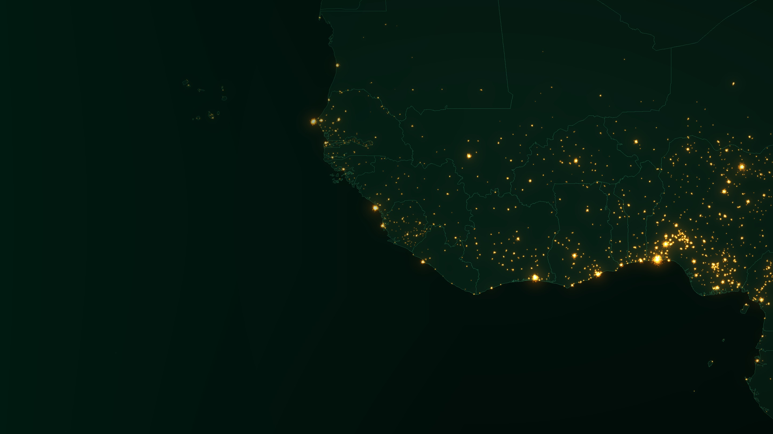
SECTION 2
02
The instruments
What exactly is doing the measuring, and what can it resolve?
History · DMSP versus VIIRS · Dynamic range · Observation geometry · Long series
SESSION A · ≈ 4 MIN
West Africa · Illustrative rendering: GeoNames settlement populations, Natural Earth borders
10
Notes:
[Section 2 · ~4 min] The choice of sensor determines which questions are answerable. Keep this section brisk; the geometry and harmonisation slides are reference material for the labs.

Slide 11
02 · THE INSTRUMENTS · HISTORY
SESSION A
Fifty years of looking down at the dark
DMSP-OLS night imagery (film). City lights noticed as a by-product of cloud detection.
Suomi NPP launched with VIIRS: first sensor calibrated for night-time radiance.
NOAA-20 launched with a second VIIRS; Black Marble twin products follow.
SDGSAT-1 Glimmer imager: colour night imagery at 10–40 m.
1970s
2011
2017
2021
1992
2012
2018
2022
Start of the digital DMSP archive → “stable lights” annual series to 2013.
VIIRS monthly cloud-free composites; NASA Black Marble record begins (Jan 2012).
Luojia-1-01 demonstrates ≈ 130 m night imaging from a small satellite.
NOAA-21 launched: a third VIIRS extends the record into the 2030s.
The irony: the first instrument was built to see moonlit clouds. City lights were noise — it took two decades for anyone to treat the noise as the signal.
Night-Time Lights · Data Innovation For Africa (DI4A) — AfDB
11
Notes:
[1 min] The historical irony is worth saying aloud: DMSP was built to see clouds by moonlight for military weather forecasting. City lights were noise; it took two decades before anyone treated that noise as the signal. Key message for continuity: VIIRS now flies on three satellites (Suomi NPP, NOAA-20, NOAA-21), so an institution investing in NTL methods today is investing in a data stream with a future. Black Marble products are produced for both Suomi NPP (VNP46) and NOAA-20 (VJ146).

Slide 12
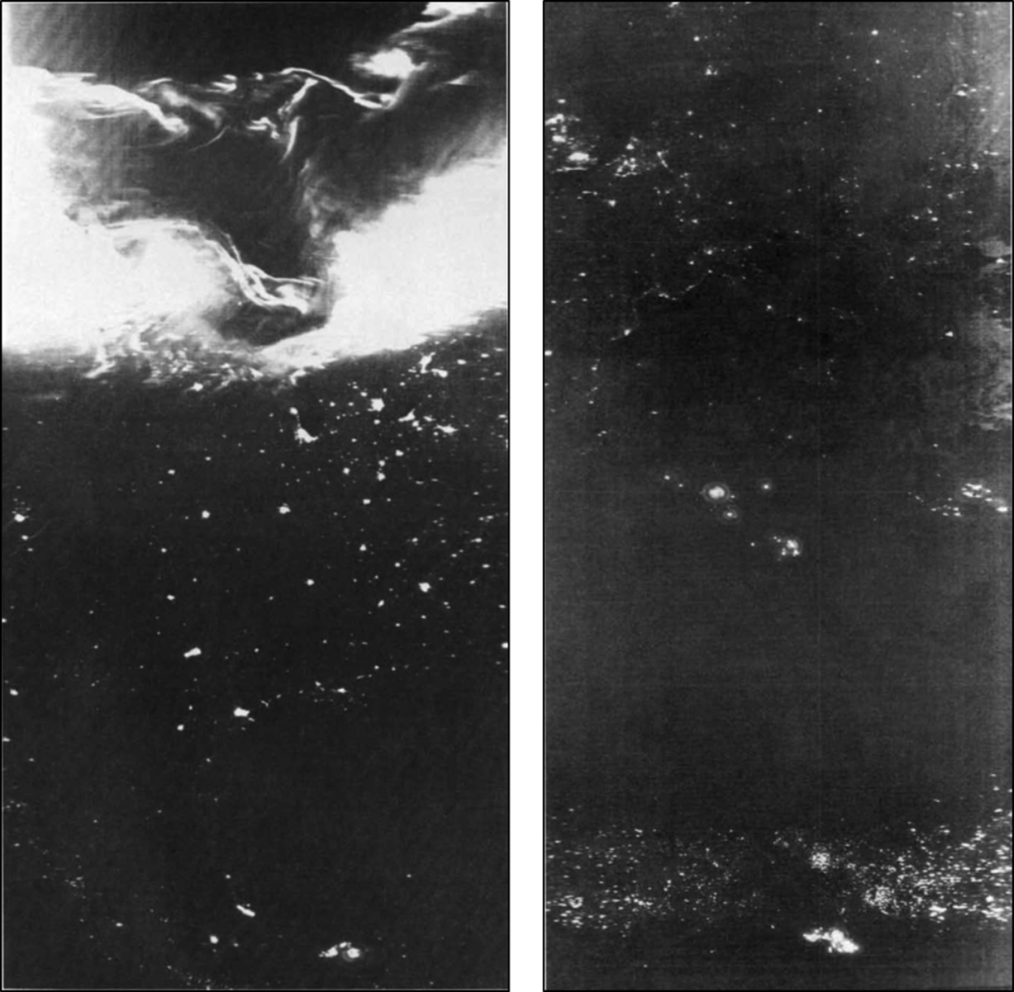

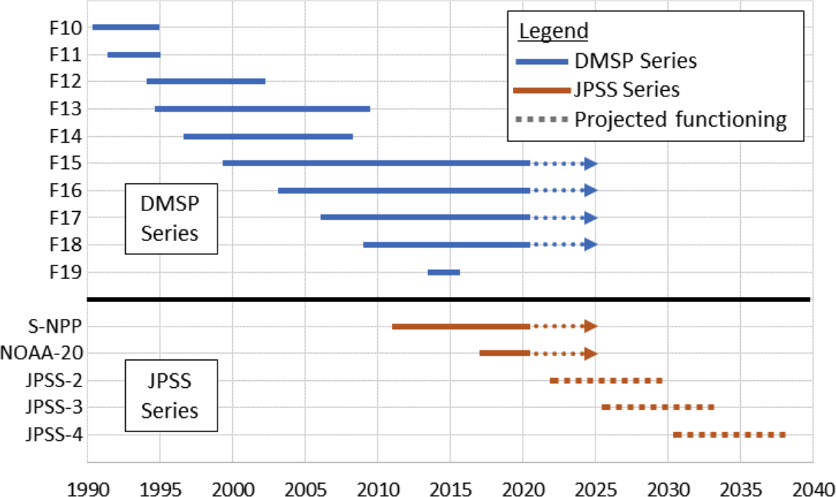



02 · THE INSTRUMENTS · REAL IMAGERY
REAL IMAGERY
The first night images: DMSP film, 1974
Left orbit · 18 April 1974
Low-light satellites, 1990 – 2040
City lights of the central United States and Mexico — and an aurora over Canada.
Right orbit · Europe to central Africa
City lights of Europe and Asia down to central Africa.
A band of fires across Africa
Agricultural burning: bright, seasonal and nothing to do with cities.
Why show this here? Fires and gas flares were the first African signals ever recorded from orbit — and they are still the first artefacts you must mask.
Gas flares
Nigerian offshore flares, Algeria and Libya — already visible 50 years ago.
Source: Croft (1978), reproduced in World Bank Open Nighttime Lights tutorials (CC BY 4.0). Timeline: NOAA NCEI via the same source.
Night-Time Lights · Data Innovation For Africa (DI4A) — AfDB
12
Notes:
[1 min · REAL IMAGERY] Two single-orbit DMSP-OLS frames from Croft (1978), among the earliest published night images. Left, 18 April 1974: US and Mexican cities, plus an aurora over Canada. Right: Europe and Asia down to central Africa — the band of lights across the bottom is agricultural fires in Africa, the bright cluster lower centre is Nigerian offshore gas flaring, and Algeria and Libya flares appear in the centre. The point here: Africa’s first appearance in night imagery was through fires and flares — exactly the two artefacts Lab A asks you to mask. The timeline on the right (NOAA NCEI) shows the DMSP series handing over to the VIIRS/JPSS series that will fly into the 2030s.

Slide 13

02 · THE INSTRUMENTS · SENSOR COMPARISON
SESSION A
Two sensors, two different sciences
 | DMSP-OLS · historical | VIIRS Day/Night Band · modern
Period | 1992 – 2013 (archive) | 2012 – present (standard)
Radiometry | 6-bit digital numbers 0–63, no on-board calibration | 14-bit, calibrated radiance in nW·cm⁻²·sr⁻¹
Resolution | ≈ 2.7 km, gridded at 30 arc-seconds (≈ 1 km) | ≈ 742 m native, gridded at 15 arc-seconds (≈ 500 m)
Saturation | City cores clip at 63 | Wide dynamic range, three gain stages
Sensitivity | Misses faint, rural lighting | Detects far fainter light than DMSP
Products | Annual composites only | Daily, monthly and annual — open licence
Next generation: Luojia-1-01 (≈ 130 m), SDGSAT-1 Glimmer (10 m panchromatic, 40 m colour) and commercial constellations resolve streets and can distinguish lamp types by colour — the dimension both legacy sensors lack.
Night-Time Lights · Data Innovation For Africa (DI4A) — AfDB
13
Notes:
[1.5 min] Teaching point: DMSP gives a long history but crude, saturated, uncalibrated values; VIIRS gives precision but only since 2012. Any long-run series for your country needs both, and therefore an explicit harmonisation step — this is the “sensor discontinuity” artefact named in the session objectives (see the long-series slide). Mention that the next generation (SDGSAT-1, Luojia, commercial) adds colour, the dimension both legacy sensors lack.

Slide 14
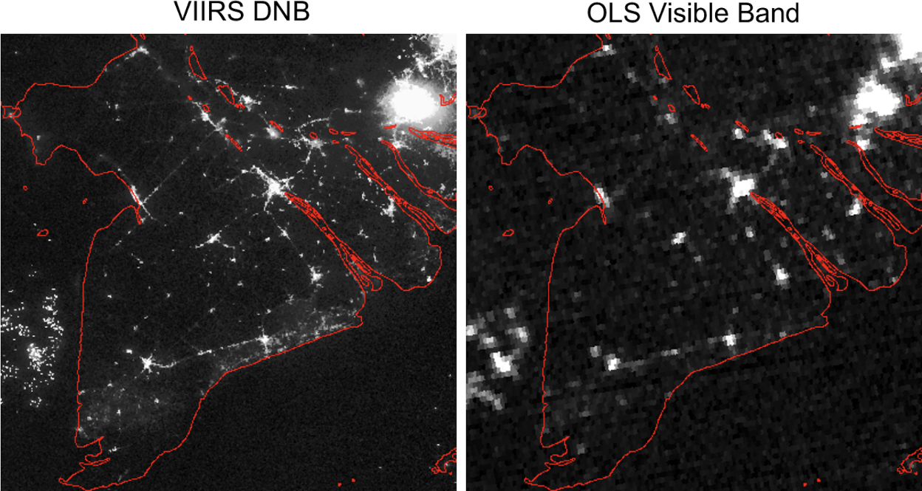



02 · THE INSTRUMENTS · REAL IMAGERY
REAL IMAGERY
Same night, two sensors: Mekong Delta, 23 November 2014
Finer detail
VIIRS (left) resolves individual towns, canals and roads; DMSP (right) blurs them into blobs.
Higher sensitivity
Faint rural lights along the waterways appear only in VIIRS — the lights that matter most in rural Africa.
Less blooming
DMSP’s large footprint spreads light beyond its source and overstates lit area.
Take-away: for anything after 2012, use VIIRS; DMSP is for history only, and only after harmonisation.
Source: Elvidge et al. (2013), reproduced in World Bank Open Nighttime Lights tutorials (CC BY 4.0).
Night-Time Lights · Data Innovation For Africa (DI4A) — AfDB
14
Notes:
[1 min · REAL IMAGERY] The same place on the same night, observed by both sensors (Elvidge et al. 2013). Ask the room to find three differences before revealing the cards: spatial detail, sensitivity to faint lights, and blooming. A delta of small towns and waterways is a good analogue for many African river and coastal settlements.

Slide 15



02 · THE INSTRUMENTS · DYNAMIC RANGE
SESSION A
Why the brightest places say the least
DMSP returns 63 above a certain brightness — a suburb and a downtown core look identical.
VIIRS spans roughly seven orders of magnitude, with three switchable gain stages.
Its low noise floor makes a single lit fishing boat visible on a dark lake or ocean.
Read this before you regress
Saturation is a ceiling, not noise you can average away. The information was never recorded — correcting it means modelling what the sensor failed to see.
Schematic illustration — not fitted data. VIIRS range per Elvidge et al. (2017).
Night-Time Lights · Data Innovation For Africa (DI4A) — AfDB
15
Notes:
[1 min] The clearest analogy: imagine a thermometer that only reads “40°C or more”. You can still study cold places with it, but every question about heat becomes a question about your model rather than your data. That is DMSP for city centres such as Lagos, Cairo or Johannesburg. VIIRS was designed around that limit: its Day/Night Band spans about seven orders of magnitude using three gain stages. The chart is schematic — not fitted data. For Africa, the opposite end of the range matters just as much: most rural settlements sit near the detection floor, which is why sensitivity matters more to us than saturation.

Slide 16
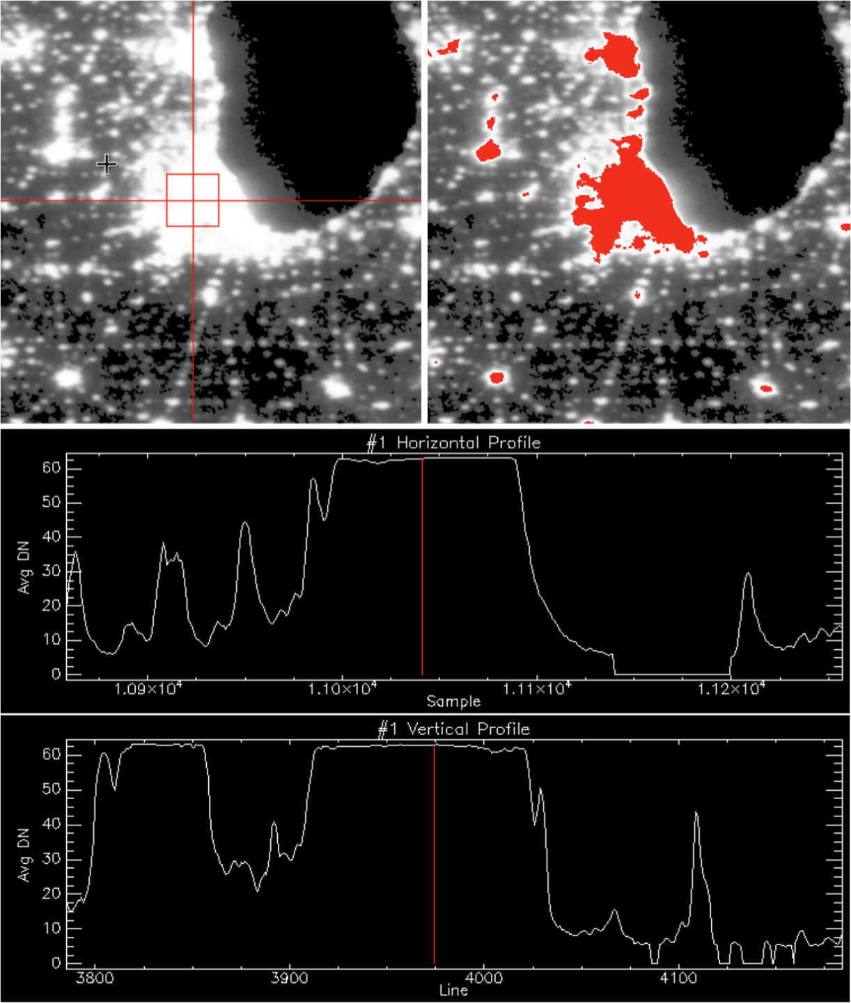
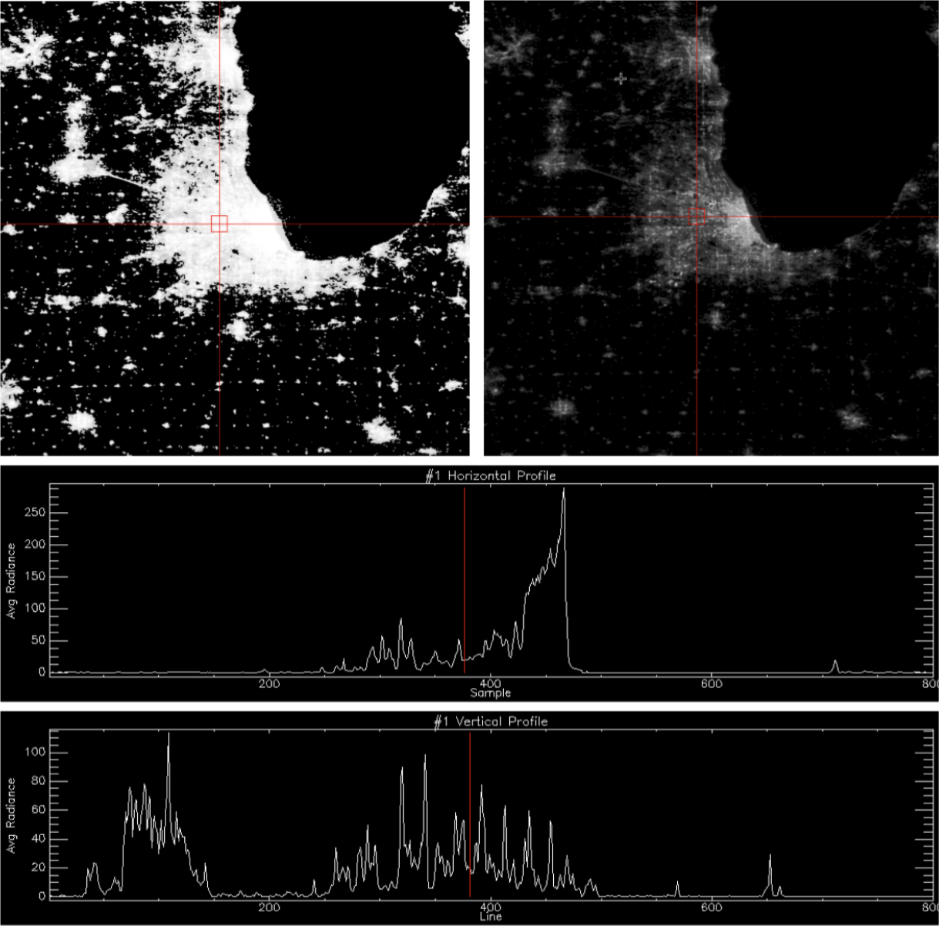
02 · THE INSTRUMENTS · REAL IMAGERY
REAL IMAGERY
Saturation on real data: the same city, 2013 vs 2016
DMSP-OLS · 2013 · saturated pixels in red
VIIRS-DNB · 2016 · the same area
Read the profiles
DMSP: transects flatten at 63 across the whole metro area — no information left in the core.
VIIRS: the same transects keep rising and falling across the city.
For Africa: Lagos, Cairo and Johannesburg cores behave like this in DMSP; rural lights sit at the other end of the range.
Chicago region. DMSP-OLS F18 2013 stable lights vs VIIRS-DNB 2016 composite. Source: World Bank Open Nighttime Lights tutorials (CC BY 4.0).
Night-Time Lights · Data Innovation For Africa (DI4A) — AfDB
16
Notes:
[1 min · REAL IMAGERY] This turns the schematic chart into evidence. Left: DMSP 2013 stable lights; red pixels are saturated, and the profile plots are flat at DN 63 across Chicago. Right: VIIRS 2016 over the same region, shown with two contrast stretches because its dynamic range is too wide for one; the transects now vary across the urban core. Use it to explain why any regression on DMSP levels in big cities is a regression on a ceiling.

Slide 17



02 · THE INSTRUMENTS · OBSERVATION GEOMETRY
REFERENCE
When and how VIIRS looks at your country
≈ 01:30
≈ 3,000 km
≈ 742 m
3
local equator-crossing time of the night pass (sun-synchronous orbit)
swath width — every point on Earth is seen at least once a night
native DNB pixel, held near-constant from nadir to edge of scan
VIIRS instruments in orbit: Suomi NPP, NOAA-20, NOAA-21
View angle changes every night
The Moon changes the scene
Aggregate before you interpret
The same place is seen from directly above one night and obliquely the next. Tall buildings, trees and slopes block or reveal light differently, so daily radiance fluctuates for purely geometric reasons.
Moonlight reflected from bright surfaces (sand, salt pans, cloud tops) adds radiance that must be modelled out — the lunar cycle leaves a ≈ 29.5-day rhythm in uncorrected data.
Composites average many view angles and lunar phases. Use daily data only when the question needs it, and smooth it (7-day or monthly) before reading a trend.
Night-Time Lights · Data Innovation For Africa (DI4A) — AfDB
17
Notes:
[REFERENCE · NEW] Use during Lab A if participants see noisy daily data. VIIRS flies in a sun-synchronous polar orbit with a night-side equator crossing around 01:30 local time; its wide swath gives global coverage every night. A clever on-board aggregation scheme keeps the Day/Night Band pixel near 742 m across the scan, unlike older sensors whose pixels grow towards the edge. Two sources of night-to-night variation that are not activity: viewing angle (the same city seen at nadir versus at the edge of the swath) and lunar illumination. Black Marble VNP46A2 corrects for the Moon; angular effects remain and are one reason daily series must be smoothed.

Slide 18
02 · THE INSTRUMENTS · SENSOR DISCONTINUITY
SESSION A
Bridging the sensors: building a long series honestly
DMSP-OLS
1992 – 2013 · digital numbers 0–63
VIIRS
2012 – present · radiance
Overlap: only 2012–2013
1992
2000
2008
2016
2024
1
VIIRS only (2012 →)
2
A published harmonised product
3
Splice growth rates yourself
Cleanest choice for most macro questions: calibrated, consistent, monthly. Accept a shorter history.
e.g. Li et al. (2020) DMSP-like series 1992–2018; Chen et al. (2021) VIIRS-like series 2000–2018. These are model outputs — cite them as estimates.
Use DMSP growth before 2013 and VIIRS growth after, linked at the overlap. Document the method and test it against an alternative.
Recommended default
For long-run questions
Only with documentation
Li, X. et al. (2020) Scientific Data 7; Chen, Z. et al. (2021) Earth System Science Data 13; Elvidge, C. D. et al. (2021) Remote Sensing 13(5).
Night-Time Lights · Data Innovation For Africa (DI4A) — AfDB
18
Notes:
[1 min · NEW] This is the sensor discontinuity artefact named in the objectives. Never splice raw DMSP digital numbers onto VIIRS radiance: different units, resolution, saturation and sensitivity, and only two years of overlap. Three honest options. (1) VIIRS only — for nowcasting and most macro uses since 2012, this is the right default. (2) A harmonised product: Li et al. (2020, Scientific Data) produced a harmonised global DMSP-like series 1992–2018; Chen et al. (2021, ESSD) produced an extended VIIRS-like series 2000–2018. Both are statistical models of what the other sensor would have seen; treat them as estimates and cite them. (3) Splice growth rates at the overlap, document, and test. EOG’s VNL V2 annual series (Elvidge et al. 2021) is the standard consistent VIIRS annual product.

Slide 19
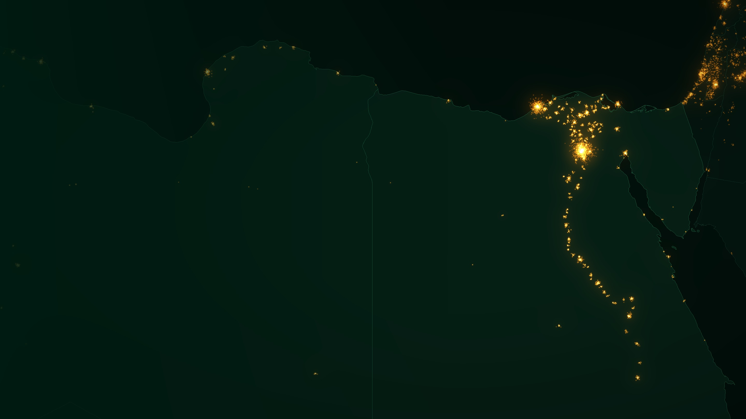
SECTION 3
03
From photons to data
How does a night of observations become a number you can publish?
Processing · Products · Access routes · What glows · Artefacts · Indicators · Example
SESSION A · ≈ 6 MIN
Nile valley and delta · Illustrative rendering: GeoNames settlement populations, Natural Earth borders
19
Notes:
[Section 3 · ~6 min] This is the section closest to the hands-on work. The product family, access routes, artefacts table and indicators slide are the ones participants will return to during Lab A.

Slide 20






03 · FROM PHOTONS TO DATA · METHOD
SESSION A
How a night-lights image is manufactured
1
2
3
4
5
Screen for cloud
Remove sunlight
Correct for the Moon
Filter transients
Composite & tile
Only nights flagged cloud-free enter a composite. In the wet tropics most nights may be discarded.
Twilight, glint and instrument stray light are corrected or excluded.
Moonlight reflected by the ground mimics emitted light; it is modelled out.
Fires, lightning, aurora and moving boats are flagged by their instability.
Surviving nights are averaged into a monthly or annual grid, tiled globally.
You will meet these steps as layers in Lab A1
A product, not a snapshot
Black Marble VNP46A2 carries the corrected radiance plus its evidence: cloud-mask flag, lunar irradiance, snow flag and a Mandatory_Quality_Flag (0 = high-quality persistent, 1 = high-quality ephemeral, 2 = poor quality, 255 = no retrieval).
Two products for the same month can legitimately differ. Always record the product, collection and version.
Sources: Román et al. (2018); NASA LAADS DAAC VNP46A2 collection 2 product page.
Night-Time Lights · Data Innovation For Africa (DI4A) — AfDB
20
Notes:
[1.5 min] Stress step 1 for our continent. Cloud screening is why the Congo Basin and coastal West Africa have far fewer usable observations than the Sahara or the Kalahari — a systematic geographic bias in any cross-country comparison. Ask: do fewer observations bias the result, or merely widen the error bars? In Lab A1 you will see each of these steps as a layer in the file: the cloud mask, the lunar irradiance, the snow flag and the Mandatory_Quality_Flag. In VNP46A2 the Mandatory_Quality_Flag distinguishes high-quality persistent lights (0), high-quality ephemeral lights (1), poor-quality retrievals such as outliers or possible cloud contamination (2) and no retrieval / fill (255); gap-filled values are tracked in a separate layer. Check the current user guide for the version you download. The image is a statistical product, not a snapshot — two products for the same month can legitimately differ.

Slide 21
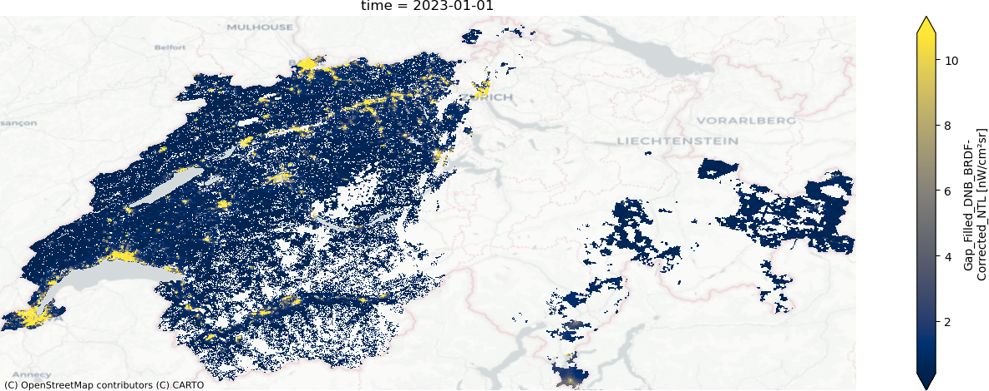

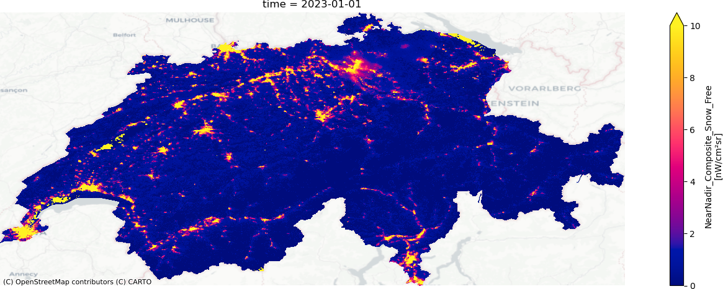

03 · FROM PHOTONS TO DATA · REAL IMAGERY
REAL IMAGERY
One night versus a composite: why quality flags matter
VNP46A2 · one night, poor-quality pixels removed
Gaps are clouds, not darkness
Masked pixels (white, top) are missing data — never treat them as zero light.
Composites fill the gaps
Averaging the valid nights of a month gives a complete, smoother map (bottom).
VNP46A3 · monthly composite, same area
Choose your flag threshold
Keeping only high-quality pixels is cleaner but leaves fewer valid nights — test both.
In Africa the gaps come from rainy-season cloud rather than snow — the lesson is the same: missing is not dark.
Switzerland, January 2023. Source: BlackMarblePy quality-assessment notebook (World Bank, MIT licence); NASA Black Marble; basemap © OpenStreetMap contributors © CARTO.
Night-Time Lights · Data Innovation For Africa (DI4A) — AfDB
21
Notes:
[1 min · REAL IMAGERY] Real output from the BlackMarblePy quality-assessment example. Top: a daily VNP46A2 image after removing pixels flagged as poor quality — large white gaps where clouds or snow made retrieval impossible. Bottom: the monthly VNP46A3 composite of the same area. In Africa the gaps are driven by rainy-season cloud rather than snow, but the lesson is identical: missing is not dark.

Slide 22
03 · FROM PHOTONS TO DATA · PRODUCTS
REFERENCE
The NASA Black Marble product family
USED IN LAB A
 | VNP46A1 DAILY | VNP46A2 DAILY | VNP46A3 MONTHLY | VNP46A4 ANNUAL
Content | At-sensor radiance (top of atmosphere) | Moonlight-adjusted, gap-filled NTL | Composite of corrected daily NTL | Composite of corrected daily NTL
Corrections | Uncorrected — inputs & geometry only | Cloud, lunar, atmosphere, terrain, stray light | As A2, plus number of observations & quality | As A2, plus number of observations & quality
Typical use | Advanced users | Blackouts, reliability, events | Programme evaluation, seasonality, nowcasting | Long-run trends, subnational panels
Common to all: 15 arc-second grid (≈ 500 m at the equator) · 10° × 10° tiles · HDF5 · from January 2012 · NOAA-20 twins named VJ146*.
Gotcha: radiance is stored as scaled integers — apply the scale factor in the file metadata and mask the fill value (65535 for radiance, 255 for quality). Tools such as BlackMarblePy do this for you; raw HDF5 readers do not.
Variables: A2 → DNB_BRDF-Corrected_NTL · A3 / A4 → NearNadir_Composite_Snow_Free (also OffNadir_ and AllAngle_ variants).
Night-Time Lights · Data Innovation For Africa (DI4A) — AfDB
22
Notes:
[1 min live — REFERENCE for Lab A1] Four products. A1 is uncorrected top-of-atmosphere radiance: do not use it for statistics without doing the corrections yourself. A2 is the daily corrected product — the basis of everything else. A3 and A4 are monthly and annual composites built from the daily inputs; here we use A3. All share a 15 arc-second grid, 10°×10° tiles, HDF5 format and a record from January 2012. Composites come in near-nadir, off-nadir and all-angle versions; the near-nadir snow-free composite is the usual default and is what BlackMarblePy returns for A3/A4. Practical gotcha: radiance is stored as scaled integers with a fill value — forget either and your numbers are wrong by a factor or contaminated by fill values. NOAA-20 twins carry the VJ146 prefix.

Slide 23
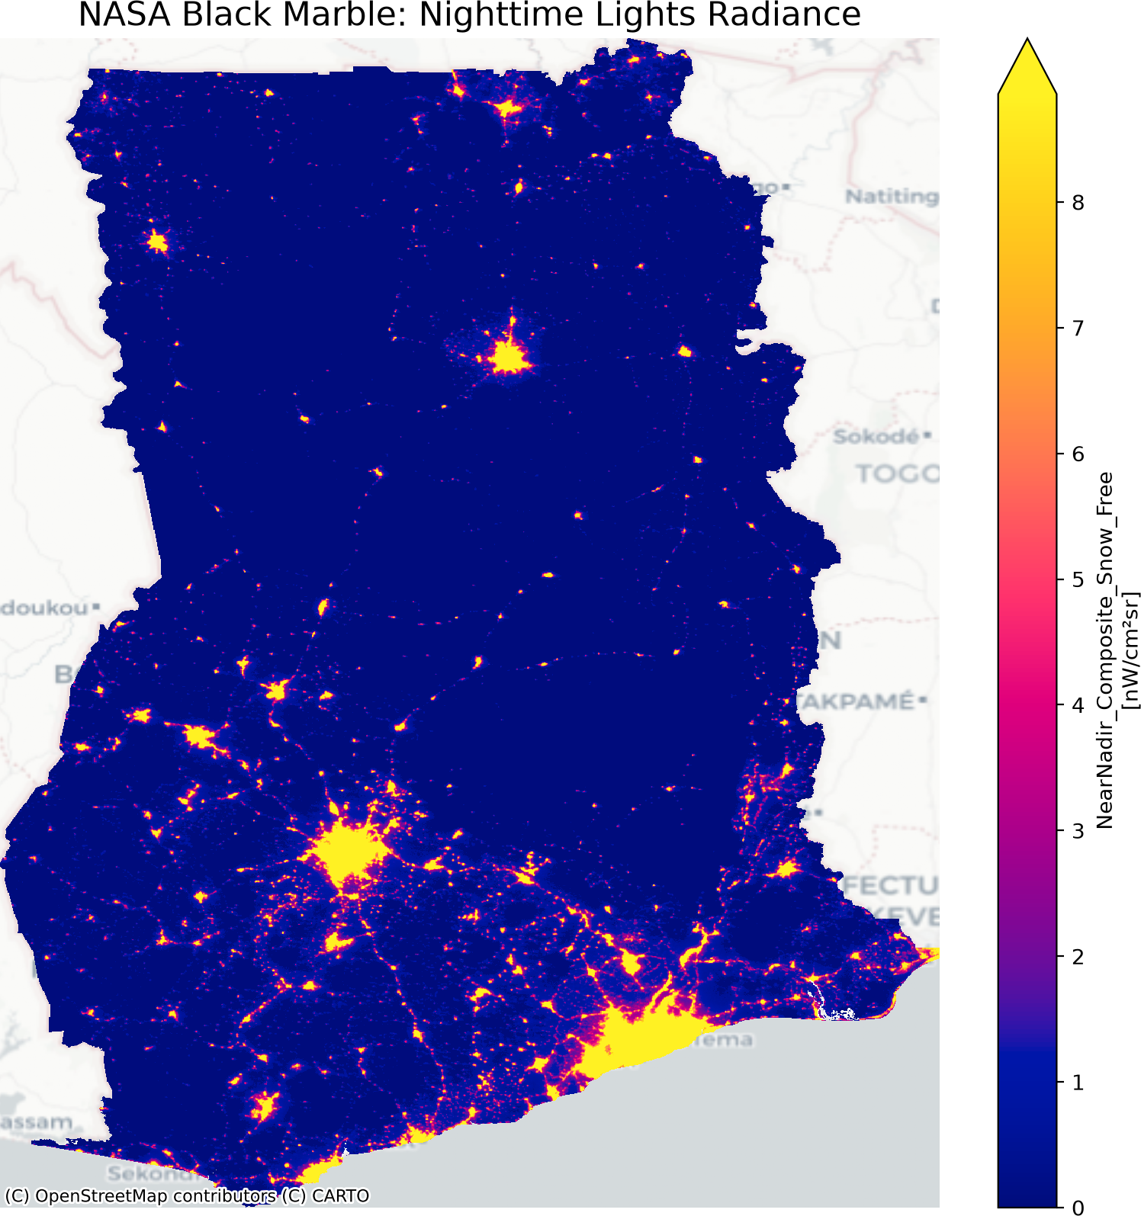
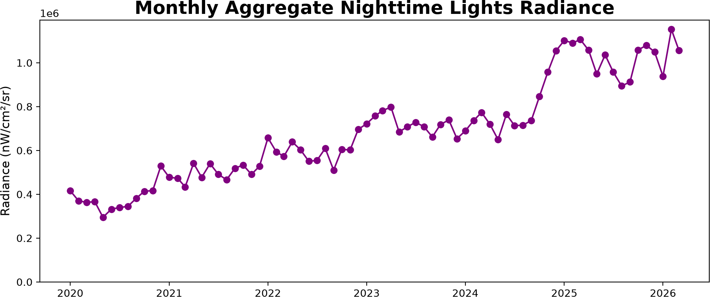

03 · FROM PHOTONS TO DATA · REAL DATA
REAL IMAGERY
What Black Marble gives you: Ghana
Monthly national Sum of Lights, VNP46A3, January 2020 onwards
Lab A1 output
Lab A2 output
This is the map you will produce for your own country: clipped, in radiance units.
And this is the series: one point per month, ready for masks, quarters and growth rates.
Annual composite, VNP46A4 — Accra, Kumasi, Tamale and the corridors between them
Source: NASA Black Marble VNP46A4 (annual) and VNP46A3 (monthly), produced with BlackMarblePy (World Bank, MIT licence); basemap © OpenStreetMap contributors © CARTO.
Night-Time Lights · Data Innovation For Africa (DI4A) — AfDB
23
Notes:
[1 min · REAL IMAGERY] Real BlackMarblePy outputs for Ghana. Left: the annual VNP46A4 near-nadir snow-free composite — Accra on the coast, Kumasi in the centre, Tamale in the north and the road corridors between them. Right: the monthly VNP46A3 Sum of Lights for the whole country from January 2020 — a clear upward trend with month-to-month noise. These are exactly the two outputs of Lab A, so show this as the target before teams start.

Slide 24




03 · FROM PHOTONS TO DATA · ACCESS ROUTES
REFERENCE
Five ways to get the data — pick one and stick to it
NASA LAADS DAAC / Earthdata
Black Marble VNP46 & VJ146 tiles in HDF5. Free Earthdata login and download token.
Choosing a route
PRIMARY SOURCE
Reproducible pipeline? BlackMarblePy or blackmarbler, scripted and versioned.
No local compute? Earth Engine — but record collection IDs and dates.
Long annual series? EOG VNL V2 annual composites.
Never mix products in one series without documenting it.
BlackMarblePy (World Bank)
Python: download, mosaic, clip to your boundary and compute zonal statistics in a few lines. R twin: blackmarbler.
USED IN LAB A
Google Earth Engine
Hosted catalogue: NOAA/VIIRS/DNB/MONTHLY_V1/VCMSLCFG · NOAA/VIIRS/DNB/ANNUAL_V21 & V22 · Black Marble collections.
FALLBACK
Earth Observation Group (EOG)
VIIRS Nighttime Lights (VNL) annual V2.x and monthly GeoTIFFs; VIIRS Nightfire for gas flares.
ANNUAL SERIES
World Bank Light Every Night
Every nightly DMSP and VIIRS observation as open data on AWS, with tutorials.
ADVANCED
Night-Time Lights · Data Innovation For Africa (DI4A) — AfDB
24
Notes:
[REFERENCE · NEW] Access routes. Here we use BlackMarblePy (World Bank) because it hides the tile mosaicking, scale factors and fill values, and can return zonal statistics directly. Earth Engine is the fallback if downloads are slow on the local network. Earth Engine hosts the EOG monthly composites (VCMCFG, and the stray-light-corrected VCMSLCFG which gives better coverage at high latitudes and in summer months) and the EOG annual V2.1 and V2.2 composites. The World Bank’s Light Every Night archive on AWS holds every nightly observation and is for advanced users. Golden rule: one product, one version per series.

Slide 25






03 · FROM PHOTONS TO DATA · INTERPRETATION
SESSION A
What actually glows over Africa at night
Cities & settlements
SIGNAL
Corridors, ports & mines
SIGNAL
Gas flares
MASK
Streets, buildings, markets, vehicles. The dominant and most-studied part of the signal.
Highways, ports, airports, mining and industrial sites: the network between the bright spots.
Very bright, isolated points in oil & gas regions — e.g. the Niger Delta, Algeria, Libya. Mask them.
Fishing lights
CONTEXT
Fires
MASK
Natural & reflected light
REMOVE
Lamp-attraction fishing on Lake Victoria and Lake Tanganyika; offshore fleets around island states.
Savanna and agricultural burning: intense, short-lived and strongly seasonal.
Moonlight on bright desert sand or salt pans, airglow. Not a human signal at all.
Gas flares are catalogued separately by the VIIRS Nightfire product (Earth Observation Group).
Night-Time Lights · Data Innovation For Africa (DI4A) — AfDB
25
Notes:
[1 min] This slide prevents the most embarrassing class of error: reporting a booming economy in an oil-producing region when what changed was flaring, or a surge of activity in the middle of Lake Victoria that is actually a fishing fleet. For island economies such as Mauritius, offshore fishing and shipping lights sit right next to the coast. Only one of these six sources is usually the signal a statistician wants. Always look at the map before trusting the number.

Slide 26
03 · FROM PHOTONS TO DATA · ARTEFACTS
LAB A · REF
Six artefacts you must check before you trust a series
Artefact | What you see | Quick test | Treatment
Blooming / overglow | Light spreads beyond its source; small towns merge; lit area overstated | Compare lit area with a built-up footprint (GHSL, WSF) | Raise / test the threshold; use built-up masks; prefer sums at coarse boundaries
Saturation | Flat tops in city cores (DMSP); bright cores stop growing | Do maxima cluster at the sensor ceiling? | Use VIIRS; for DMSP use a harmonised or radiance-calibrated product
Gas flares | Very bright isolated points in oil & gas regions | Overlay VIIRS Nightfire flare locations | Mask flare sites with a buffer before aggregating
Seasonality | A recurring calendar pattern: festivals, fire season, rainy-season gaps | Plot each calendar month across years | Compare year-on-year; seasonally adjust before modelling
Cloud cover | Months with few valid nights; noisy or missing values | Read the number-of-observations layer | Drop months below a minimum count; gap-fill or move to quarterly
Sensor discontinuity | Jumps at DMSP→VIIRS, product versions or satellite switches | Break test around known change dates | One product and version per series; harmonise and document
Log every artefact you find, where, and how you treated it — it becomes the core of the limitations note you produce in Lab A2.
Night-Time Lights · Data Innovation For Africa (DI4A) — AfDB
26
Notes:
[1.5 min · NEW — REFERENCE for Lab A2] These are exactly the six artefacts listed in the session objectives. For each, a symptom, a quick test you can run in a minute, and a standard treatment. Point out that two of them — seasonality and cloud cover — interact in Africa: the rainy season both reduces valid observations and coincides with real seasonal patterns in activity. Seasonal adjustment deserves a dedicated treatment in nowcasting data preparation; for now, comparing the same month across years is enough.

Slide 27



03 · FROM PHOTONS TO DATA · AFRICA-SPECIFIC
SESSION A
Clouds, seasons and calendars: Africa’s special problem
Rainy seasons thin the record
Coastal and equatorial regions can have only a handful of valid nights in peak rainy months — the monthly value rests on very little data.
Dust and smoke dim the signal
Harmattan dust and dry-season biomass-burning smoke attenuate light even on ‘clear’ nights.
Calendars move the lights
Ramadan, end-of-year festivities and harvest periods change night-time behaviour; holidays measurably shift radiance.
Schematic profiles for illustration only — read the actual number-of-observations layer for your country. Calendar effects: Román & Stokes (2015), Earth’s Future 3(6).
Night-Time Lights · Data Innovation For Africa (DI4A) — AfDB
27
Notes:
[1 min · NEW] The chart is schematic, not measured: it illustrates the typical contrast between a Sahelian location, whose rainy season is short and late in the year, and a Gulf of Guinea coastal location, cloudy for much of the year. In your own data, the VNP46A3 product reports the number of observations per pixel — read it before trusting any month. Two further African specifics: aerosols (Harmattan dust, biomass-burning smoke) and calendar effects. Román and Stokes (2015) showed measurable changes in night-time lights during Ramadan and the Christmas–New Year period — a reminder that seasonality in lights is partly cultural, not just meteorological.

Slide 28
03 · FROM PHOTONS TO DATA · INDICATORS
LAB A · REF
Turning an image into a number
Toy district · radiance per pixel (nW·cm⁻²·sr⁻¹)
30.1
Sum of Lights (SOL)
0.1
0.3
0.2
0.0
Total radiance inside a boundary. Workhorse of the economics literature; most sensitive to background noise.
0.4
2.5
6.0
0.6
8 px
Lit area
Pixels above a chosen threshold. Intuitive — but the threshold is a researcher choice.
0.2
4.0
12.0
1.5
3.6
Mean radiance (lit)
0.0
0.8
1.2
0.3
Brightness independent of extent. Separates a district getting brighter from one getting bigger.
Raise the threshold to 1.0 → lit area falls from 8 to 6 pixels (−25%). Always report product, version, boundary, threshold and masks — and test the threshold.
Shaded blue = above threshold 0.5
Illustrative values. Light concentration (Gini of radiance) is a fourth family, used for spatial inequality.
Night-Time Lights · Data Innovation For Africa (DI4A) — AfDB
28
Notes:
[1.5 min] Work the toy example live — it is the fastest way to make the three indicators concrete. A 4×4 district of pixels, radiance in nW·cm⁻²·sr⁻¹. Sum of Lights adds everything: 30.1. Lit area counts pixels above the threshold: with 0.5 we get 8 pixels. Mean radiance over lit pixels is 28.6 / 8 = 3.6. Now raise the threshold to 1.0: lit area drops from 8 to 6 pixels — a 25% change produced by a choice, not by the world. That is why the threshold must be reported and tested. Sum of Lights is sensitive to background noise because every faint pixel contributes. Mean radiance separates a district getting brighter from one getting bigger. A fourth family — concentration or Gini of light — is used as a spatial inequality proxy.

Slide 29


03 · FROM PHOTONS TO DATA · DESIGN CHOICES
LAB A · REF
Normalise and aggregate deliberately
Across space
Normalisation
Across time
Boundary: admin-1 for macro comparisons; settlement footprints for programmes.
Statistic: sum for ‘how much’, mean for ‘how bright’, lit area for ‘how big’.
Zonal tool: exactextract weights partial pixels at boundaries.
Per km²: compares intensity across units of different size.
Per capita: only with an independent population source (census).
Logs: log(SOL) tames skew; set a noise floor before taking logs.
Monthly → quarterly: average the months to match quarterly GDP.
Growth: year-on-year change in the same month removes most seasonality.
Gaps: never average a missing month as zero.
Workhorse transformation for macro work: g(r, t) = log SOL(r, t) − log SOL(r, t − 12) — year-on-year growth in monthly Sum of Lights for region r.
Night-Time Lights · Data Innovation For Africa (DI4A) — AfDB
29
Notes:
[REFERENCE · NEW] Three groups of choices that change results more than most people expect. Space: the boundary and the statistic. Exactextract handles pixels that straddle a boundary by weighting them, which matters for small districts and islands. Normalisation: per km² compares intensity; per capita needs a population denominator that is not itself built from night lights (WorldPop uses NTL as a covariate). Time: average months to quarters to match quarterly GDP; year-on-year growth in the same calendar month removes most of the seasonal and lunar-related noise. The log year-on-year growth formula on the bar is the transformation most nowcasting models will expect.

Slide 30

03 · FROM PHOTONS TO DATA · WORKED EXAMPLE
SESSION A
One question, end to end
Did the 2023 mini-grid programme actually bring light to its target villages?
1
State the claim in light terms
2
Choose the product
3
Define the units
Electrified villages should show more nights above their background radiance after commissioning.
VNP46A3 monthly to date the change; VNP46A2 daily if you also want reliability. Record the version.
Settlement footprints plus a small buffer — not whole districts, where a few lit villages vanish.
4
Pick indicator & control
5
Read the difference
6
Try to break it
Mean radiance and share of lit nights; controls = similar villages outside the programme.
A step change in programme villages that is absent in controls is evidence; a common rise is regional.
Check fires, flares, moon and season; compare with utility connection or programme monitoring records.
Night-Time Lights · Data Innovation For Africa (DI4A) — AfDB
30
Notes:
[1.5 min] Walk this slowly — it is the slide people will reuse. The question is typical of what a ministry might ask a statistical office. Step 3 matters in rural Africa: if you average over a whole district, a few newly lit villages disappear into the dark background, so use settlement footprints. Step 4 — the control group of comparable villages outside the programme — is what turns a description into evidence, and it costs almost nothing. Step 6 is where most published work is thinnest: try to break your own result before someone else does.

Slide 31
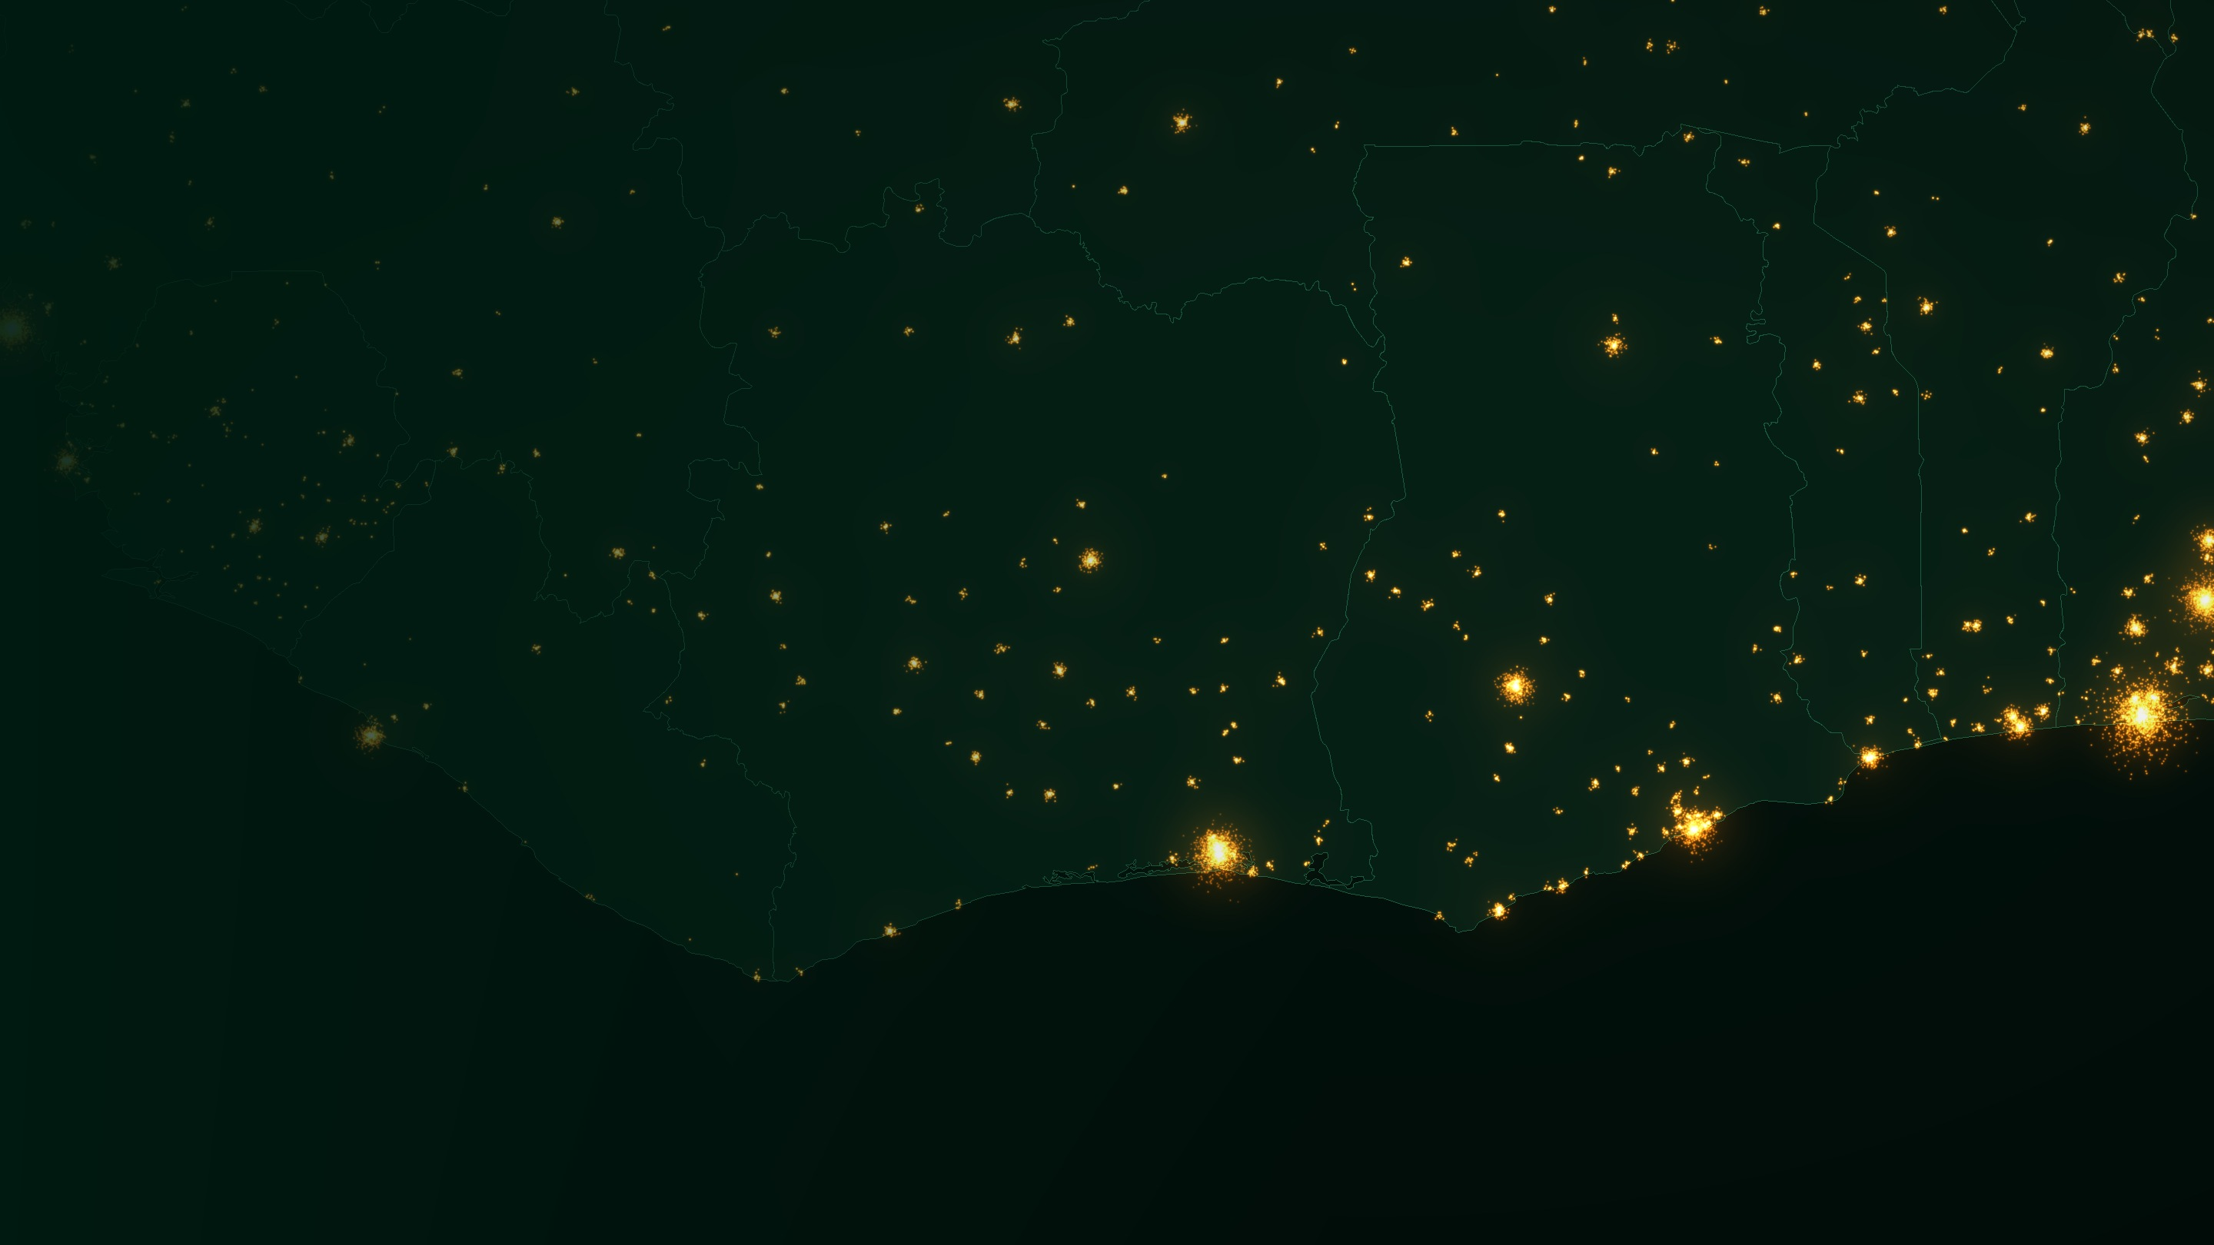
HANDS-ON · LAB A
A
From download to a national series
Collect, clip, mask, aggregate — and write down what the data cannot tell you.
A1 Collect & clip a monthly composite · A2 Masks, aggregation, regional comparison, national series
LAB A · 30 MIN
Gulf of Guinea: Abidjan – Accra – Lagos · Illustrative rendering: GeoNames settlement populations, Natural Earth borders
31
Notes:
[Lab A · 30 min] Hand over to the notebook. Teams of two or three, one country per team — ideally the country of one team member. If downloads are slow, switch to the Earth Engine fallback or to pre-staged files.

Slide 32
LAB A1 · COLLECT & CLIP · 15 MIN
LAB A
Collect Black Marble data and clip a monthly composite
Get access
PYTHON · BLACKMARBLEPY
1
Create a free NASA Earthdata account and generate a download token.
# pip install blackmarblepy geopandas
import geopandas as gpd, pandas as pd
from blackmarble import BlackMarble
bm = BlackMarble(token=EARTHDATA_TOKEN,
output_directory="data")
gdf = gpd.read_file("boundaries/adm1.geojson")
# Monthly composites, Jan 2019 onwards
months = pd.date_range("2019-01-01", "2025-12-01",
freq="MS")
ntl = bm.raster(gdf, product_id="VNP46A3",
date_range=months)
ntl = ntl["NearNadir_Composite_Snow_Free"]
# Inspect one month before going further
ntl.isel(time=-1).plot(robust=True)
Pick a boundary
2
National and admin-1 polygons: your NSO’s official boundaries, or geoBoundaries / GADM.
Request VNP46A3
3
Monthly composites, January 2019 to the latest month available.
Clip & inspect
4
Map one month. Do cities, corridors — and flares or fishing lights — appear where you expect?
Code is illustrative — check the BlackMarblePy documentation for the version installed in your environment.
Night-Time Lights · Data Innovation For Africa (DI4A) — AfDB
32
Notes:
[Lab A1 · 15 min] Steps one to four. BlackMarblePy wraps the LAADS DAAC download, mosaics the 10°×10° tiles, clips to your polygons and applies scale factors and fill values. The raster method returns an xarray object with one layer per month; the extract method returns zonal statistics directly. Insist on step four: look at the map. Ask each team to name one thing that glows that is not the economy. Fallback: Earth Engine collection NOAA/VIIRS/DNB/MONTHLY_V1/VCMSLCFG clipped with the same boundary.

Slide 33


LAB A2 · MASKS & AGGREGATION · 15 MIN
LAB A
Apply masks, aggregate, compare regions, build the series
PYTHON · MASK → AGGREGATE → COMPARE
Masks applied
# 1 Mask: noise floor and gas-flare buffers
ntl = ntl.where(ntl >= 0.5) # noise floor
ntl = ntl.where(~flare_mask) # Nightfire buffer
# 2 Zonal sums by admin-1, per month
df = zonal_sum(ntl, gdf, id="ADM1") # notebook helper
# 3 Aggregate & transform
nat = df.groupby("date")["ntl_sum"].sum()
q = nat.resample("QS").mean()
yoy = np.log(nat).diff(12)
# 4 Compare regions: share of national light
share = df.pivot(index="date", columns="ADM1",
values="ntl_sum")
share = share.div(share.sum(axis=1), axis=0)
Quality flags, noise floor, flare buffers, water bodies for fishing lights.
National series
Monthly SOL, quarterly average and year-on-year growth.
Regional comparison
Each region’s share of national light, over time.
Limitations note
Five lines: product & version, masks, threshold, cloud-poor months, known breaks.
zonal_sum wraps exactextract in the lab notebook; print df.head() before aggregating. Threshold 0.5 nW·cm⁻²·sr⁻¹ is a starting point to be tested.
Night-Time Lights · Data Innovation For Africa (DI4A) — AfDB
33
Notes:
[Lab A2 · 15 min] Four moves: mask, extract, aggregate, compare. Participants who finish early should test the threshold (0.3, 0.5, 1.0) and see how much the series changes. The limitations note is not optional: five lines, committed alongside the series. This is the ‘national series with notes on data limitations’ in the session objectives. Keep the outputs — they are inputs for Lab B and potentially for GDP nowcasting models.

Slide 34
LAB A · WHAT A GOOD OUTPUT LOOKS LIKE
LAB A
A national series you can defend
LIMITATIONS NOTE — EXAMPLE
Data: VNP46A3, collection 2, Jan 2023 – Dec 2025, near-nadir snow-free.
Masks: quality flags; noise floor 0.5; 2 km flare buffers; inland water.
Gaps: July–August have < 5 valid nights in coastal provinces; flagged, not imputed.
Breaks: flare episode Apr–Jun 2024 removed by mask; no product change.
Do not use for: levels of GDP, household income, small-settlement counts.
Illustrative synthetic data — shows the shape of the expected output, not any real country.
Night-Time Lights · Data Innovation For Africa (DI4A) — AfDB
34
Notes:
[30 sec] Show this as the target. The grey line is what you get without masks: a spurious spike from a flaring episode and dips in cloud-poor rainy-season months. The navy line is the masked, quality-filtered series. On the right, the limitations note in five lines. Emphasise: the data are synthetic — the point is the shape of the deliverable, not any real country’s numbers.

Slide 35
LAB A · TROUBLESHOOTING
LAB A · REF
When the numbers look wrong: symptom, cause, fix
Symptom | Likely cause | Fix
Values ten times too large, or huge spikes | Scale factor not applied; fill value (65535) read as radiance | Use BlackMarblePy, or apply scale and mask fill manually
Straight seam across the country | Tile boundary — one 10° tile missing for that month | Check every tile downloaded; re-request the missing one
Boundary and raster do not overlap | CRS mismatch (projected boundary vs geographic raster) | Reproject the boundary to EPSG:4326 before clipping
Coastal districts lose light | Pixels straddling the coastline dropped by the clip | Use all-touched clipping or exactextract partial weights
One month is empty or near zero | Too few cloud-free nights; whole month gap | Flag as missing; never average it as zero
Sudden jump in a single region | Gas flare, fire, fishing fleet — or a real event | Map the month; check Nightfire and news before believing it
Keep a pre-staged copy of VNP46A3 for your countries in case downloads stall.
Night-Time Lights · Data Innovation For Africa (DI4A) — AfDB
35
Notes:
[REFERENCE · NEW] Keep this slide up while teams work in Lab A. These six problems account for most of the support questions in NTL labs. The first is the most common when people read HDF5 files directly; the last is the one that matters most analytically — a sudden jump is an artefact until proven otherwise.

Slide 36
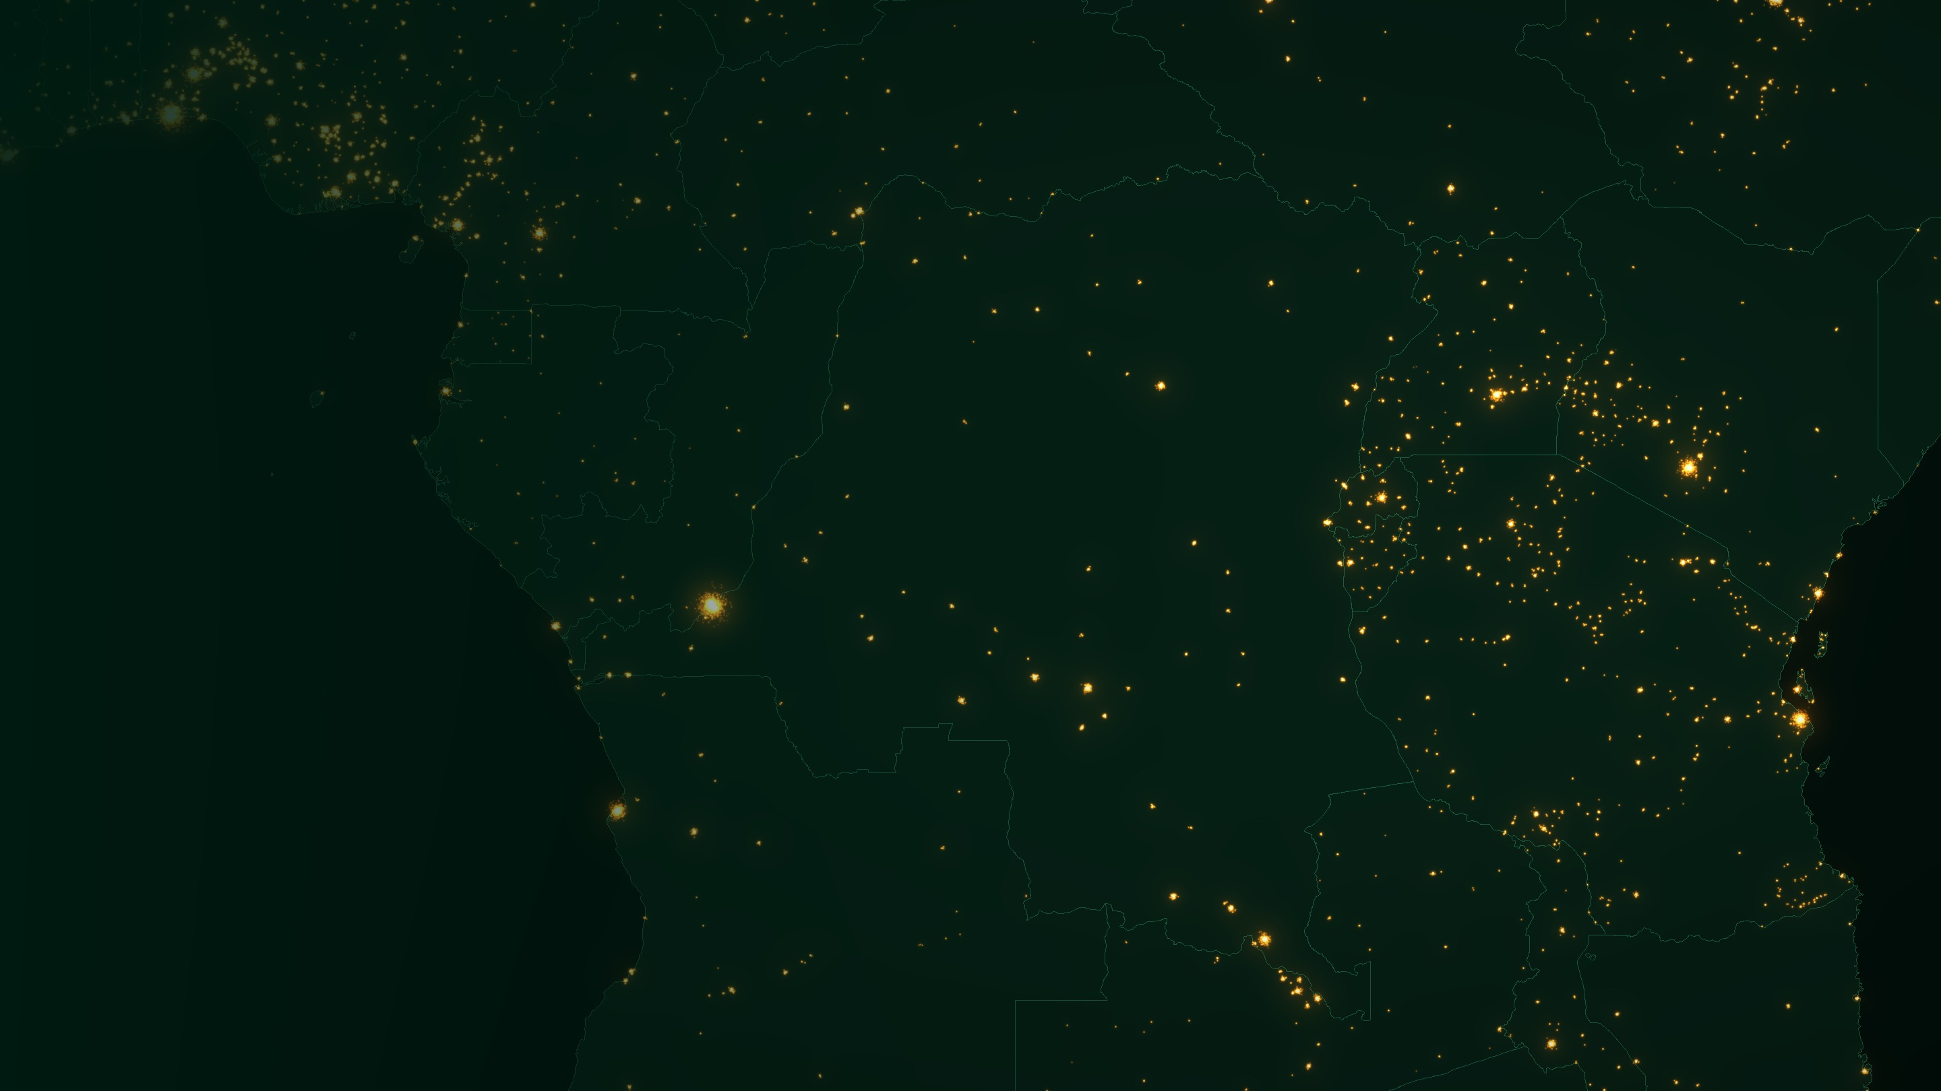
SECTION 4
04
Applications
Which statistical questions can this data actually answer — and how do we know?
SDG map · Validation · Economy & nowcasting · Energy access · Urbanisation · Crises & shocks · Islands
SESSION B · 30 MIN
Central and East Africa · Illustrative rendering: GeoNames settlement populations, Natural Earth borders
36
Notes:
[Section 4 · 30 min] Session B opens here. For each application, keep asking two questions: what would have to be true about lighting behaviour for this inference to hold, and how was it validated in the literature? Those two questions are the session objectives.

Slide 37




04 · APPLICATIONS · OVERVIEW
SESSION B
Where lights can support SDG and macro monitoring
SDG 1
SDG 7
SDG 8
Poverty & wealth mapping
Electricity access & reliability
Economic activity
Small-area estimates combining lights with survey data
Locate unserved settlements; track how often lights are on
Subnational GDP downscaling; nowcasting; short-term activity signals
SDG 9
SDG 11
SDG 16 · humanitarian
Infrastructure
Urbanisation
Conflict & disasters
Corridors, ports, industrial and special economic zones
Urban extent, sprawl versus densification, new towns
Blackouts, displacement signals, recovery tracking
A complement, not a replacement. Lights add spatial detail, frequency and independent verification to official statistics — they do not replace the census, the survey or the national accounts.
Night-Time Lights · Data Innovation For Africa (DI4A) — AfDB
37
Notes:
[1 min] A map of uses, framed by the SDGs and macro indicators participants already report on. The key word is “support”: night lights are a complement to official statistics, useful for disaggregation, nowcasting and verification, never a replacement. Invite participants to pick the one box most relevant to their institution — that is the application to rebuild in Lab B.

Slide 38
04 · APPLICATIONS · HOW EACH USE WAS VALIDATED
SESSION B
Five use cases, five validation strategies
Use case | NTL indicator | Validated against | Performs well | Performs poorly
Output proxy | Growth in Sum of Lights | National & subnational GDP; quarterly GDP | Weak statistical systems; subnational; urban & industrial economies | Agriculture- or mining-led economies; saturated rich cores
Electrification | Share of nights lit per settlement | Household surveys (DHS, LSMS), census, utility records | Grid-connected settlements; reliability over time | Solar home systems; very low consumption
Urbanisation | Lit area and radiance growth | Built-up grids (GHSL, WSF); census urban population | City extent and growth of large towns | Small towns (blooming); dense informal areas
Damage assessment | Drop vs pre-event baseline | UNOSAT and ground damage reports; outage records | Grid outages; large-scale destruction; recovery | Localised damage; areas already dark
Activity mapping | Daily / monthly radiance change | Electricity consumption, mobility, firm surveys | Lockdowns, holidays, large events | Daytime and low-light activity
Henderson et al. (2012); Beyer, Hu & Yao (2022); Falchetta et al. (2019); Min & O’Keeffe (HREA); Román et al. (2019); Beyer et al. (2021); Li & Li (2014).
Night-Time Lights · Data Innovation For Africa (DI4A) — AfDB
38
Notes:
[2 min · NEW] This table is the heart of Session B’s second objective: assess how each use case was validated and where the proxy performs well. Read across one row as an example. Output proxies were validated against national and subnational GDP — and they work best precisely where GDP is weakest. Electrification was validated against surveys, census and utility records. Urbanisation against built-up grids and census urban counts. Damage against field and UNOSAT assessments. Activity mapping against electricity consumption and mobility data. The right-hand column is the honest part: every use case has a regime where the proxy fails, and in African economies those regimes are common.

Slide 39







04 · APPLICATIONS · APPLICATION 01
SESSION B
Measuring the economy from orbit
What the evidence shows
Why the lights–output link is not stable
Henderson, Storeygard & Weil (2012)
Sector mix: agriculture and mining create value with little light
Lights carry real information on economic growth and can improve GDP estimates where national accounts are weak.
Income level: bright cores saturate or plateau
Bruederle & Hodler (2018)
Lighting technology: LED retrofits change light per watt
Lights track household wealth, education and health at the local level, using DHS survey clusters in Africa.
Power supply: load-shedding dims lights, not output
Martinez (2022)
Lights used as an independent benchmark to test the credibility of reported GDP growth.
WHERE LIGHTS HELP MOST
Subnational
High-frequency
Informal economy
Henderson et al. (2012) AER 102(2); Bruederle & Hodler (2018) PLOS ONE 13(9); Martinez (2022) JPE 130(10).
Night-Time Lights · Data Innovation For Africa (DI4A) — AfDB
39
Notes:
[1.5 min] The honest version: night lights are a poor substitute for good national accounts and an excellent complement to weak or coarse ones. Henderson, Storeygard and Weil (2012) showed lights carry real information on growth. Bruederle and Hodler (2018) linked lights to household-level development indicators from DHS surveys at the local level in Africa. Martinez (2022) used lights as an independent benchmark for reported GDP growth — a reminder that NTL is also a credibility tool for official statistics. The elasticity of lights to output is neither one nor stable: agriculture and mining generate much value with little light, which matters for most African economies. Lights help most where statistics are coarsest: subnational, high-frequency and informal.

Slide 40
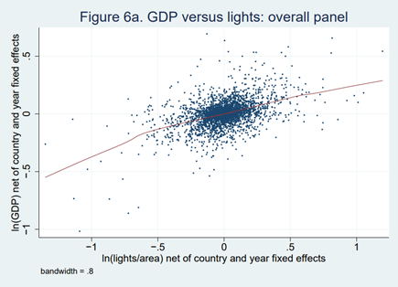
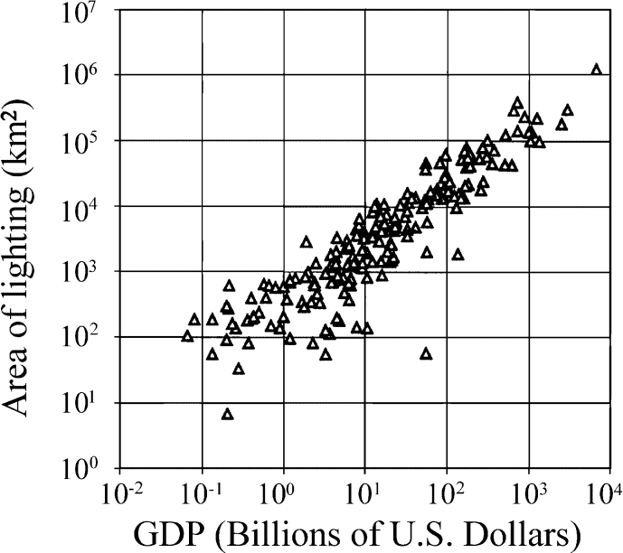
04 · APPLICATIONS · THE PUBLISHED EVIDENCE
SESSION B
The evidence, as published
Henderson, Storeygard & Weil (2012) · GDP vs lights, within countries
Elvidge et al. (2001) · lit area vs GDP, 200 countries
Changes in lights and changes in GDP move together after removing country and year effects — but with wide scatter.
Across countries, lit area rises almost one-for-one with GDP on a log scale — the pattern that launched the field.
Henderson, Storeygard & Weil (2012), Fig. 6a; Elvidge et al. (2001). Both reproduced in World Bank Open Nighttime Lights tutorials (CC BY 4.0).
Night-Time Lights · Data Innovation For Africa (DI4A) — AfDB
40
Notes:
[1 min · REAL IMAGERY] The two figures people cite. Left: Henderson, Storeygard and Weil (2012), figure 6a — growth in GDP against growth in lights, net of country and year fixed effects; the relationship is real but noisy, which is why they combine lights with official data rather than replace it. Right: Elvidge et al. (2001), lit area versus GDP for 200 countries on log–log axes — a strong cross-country relationship. Link to Lab B: the left panel is the ‘changes’ test, the right panel is the ‘levels’ test.

Slide 41
04 · APPLICATIONS · ECONOMY · METHODS
SESSION B
Four ways to turn lights into an output estimate
1
Elasticity regression
2
Combine with official data
Δlog GDP(r,t) = β · Δlog NTL(r,t) + region & year effects
ŷ = λ · official growth + (1 − λ) · lights-predicted growth
Estimate how strongly output growth co-moves with light growth, using regions with good data.
Weight the two noisy signals by their reliability — more weight on lights where accounts are weak.
3
Spatial downscaling
4
Nowcasting
GDP(cell) = GDP(region) × NTL share(cell), refined with covariates
Quarterly GDP ← f(monthly NTL growth, other indicators)
Distribute known regional totals to a grid or to districts with no accounts.
Use the monthly series as a timely feature before official data are released.
The elasticity is not a constant. Hu & Yao (2022) find the lights–GDP relationship is non-linear and differs by income level — estimate it for your context rather than borrowing a number.
Henderson et al. (2012); Hu & Yao (2022) Journal of Econometrics 228(2); Beyer, Hu & Yao (2022) IMF Working Paper 22/109.
Night-Time Lights · Data Innovation For Africa (DI4A) — AfDB
41
Notes:
[1.5 min · NEW] Four families of method. (1) The elasticity regression — Henderson, Storeygard and Weil’s starting point — run in growth rates with region and year effects. (2) Combining official and lights-based growth with weights that reflect the measurement error of each; this is the logic behind using lights to improve GDP where national accounts are weak. (3) Downscaling: allocate known regional or national GDP to smaller units using light shares, ideally refined with population, built-up and cropland covariates — which is exactly what cropland and built-up analyses produce. (4) Nowcasting. Hu and Yao (2022, Journal of Econometrics) show the relationship is non-linear and varies with income level; Beyer, Hu and Yao (2022, IMF WP 22/109) use lights to measure quarterly growth. Lesson: estimate the relationship locally.

Slide 42


04 · APPLICATIONS · ECONOMY · NOWCASTING
SESSION B
Lights as a nowcasting feature — from series to model
Monthly NTL
Transform
Model
Nowcast
›
›
›
VNP46A3, masked, national & regional
log, year-on-year growth, quarterly average
bridge equation, MIDAS or machine learning
quarterly GDP growth, before release
Strengths
Pitfalls
Evidence
Available weeks after the month ends
Independent of surveys and administrative reporting
Regional detail that national indicators lack
Look-ahead bias: use only data available at nowcast date
Breaks from product changes look like recessions
Seasonality and cloud gaps must be treated first
Beyer, Hu & Yao (2022, IMF WP 22/109) use night-time lights to measure quarterly economic growth across countries. Beyer et al. (2021) combine daily lights with electricity consumption to track the COVID-19 shock in India.
Night-Time Lights · Data Innovation For Africa (DI4A) — AfDB
42
Notes:
[1 min · NEW] Bridge to data preparation and machine learning for GDP nowcasting. The monthly series you build in Lab A is a candidate feature. Three pitfalls to flag now: look-ahead bias (a monthly composite has a release date — respect it in back-tests); breaks from product or version changes that a model will read as a recession; and seasonality and cloud gaps, which careful data preparation must treat systematically. Evidence: Beyer, Hu and Yao (2022) on quarterly growth; Beyer, Franco-Bedoya and Galdo (2021, World Development) on India’s COVID-19 shock with daily lights and electricity data.

Slide 43




04 · APPLICATIONS · APPLICATION 02
SESSION B
Energy access and SDG 7: Africa’s defining gap
655 M
> 560 M
Locate the unserved
Settlements visible by day but dark at night are candidate unelectrified communities.
people without electricity worldwide (2024)
of them in sub-Saharan Africa
Verify programmes
A grid extension that produces no new light has not, in a meaningful sense, been delivered.
Measure reliability
Daily data reveal how often lights are on — load-shedding a binary “connected” statistic hides.
Plan the last mile
Distance to lit corridors informs grid extension vs mini-grid vs stand-alone solar.
Mission 300 (World Bank Group & AfDB): 300 M people connected by 2030 — monitoring at that scale needs spatial evidence.
Sources: Tracking SDG 7: The Energy Progress Report (IEA, IRENA, UN DESA, World Bank, WHO), 24 June 2026; HREA, Min & O’Keeffe (Univ. of Michigan).
Night-Time Lights · Data Innovation For Africa (DI4A) — AfDB
43
Notes:
[1.5 min] The Tracking SDG 7 report released on 24 June 2026 puts the global access deficit at 655 million people in 2024, with more than 560 million in sub-Saharan Africa. The rural deficit in the region grew from 376 million in 2010 to 447 million in 2024 — population growth has outpaced connections. Mission 300, led by the World Bank Group and the African Development Bank, aims to connect 300 million Africans by 2030; programmes of that scale need independent, spatially detailed monitoring. The surprising point: reliability. Official statistics record a household as connected whether it has power four hours a day or twenty-four. Nightly VIIRS observations can tell the difference.

Slide 44
04 · APPLICATIONS · ENERGY · RELIABILITY
SESSION B
Connected is not the same as powered
Thirty nights in two villages that both count as “connected” (illustrative)
For a statistical office
Village A · stable grid
29 / 30 nights lit
Add a reliability column next to access rates
Flag districts where access rose but lit nights did not
Cross-check utility outage logs
Village B · load-shedding
15 / 30 nights lit
■ lit night ■ dark night
How it works: for each settlement, compare every night’s radiance with a statistical model of the dark background around it. The share of nights clearly above background is a reliability proxy; its trend shows whether access is improving.
Illustrative nights. Method in the spirit of HREA (Min & O’Keeffe, University of Michigan / World Bank); see also Falchetta et al. (2019), Scientific Data 6.
Night-Time Lights · Data Innovation For Africa (DI4A) — AfDB
44
Notes:
[1 min · NEW] Make the reliability idea concrete. Both villages would be recorded as ‘connected’ in a census or survey. Daily VIIRS data show Village A lit on 29 of 30 nights and Village B on 15 — the signature of load-shedding. The High Resolution Electricity Access (HREA) dataset from the University of Michigan and the World Bank applies this logic at settlement level, comparing each night’s radiance with the statistical distribution of unlit background pixels. The nights shown are illustrative, not real data. For an NSO, the practical output is a reliability column next to access rates.

Slide 45




04 · APPLICATIONS · APPLICATION 03
SESSION B
Urbanisation and the shape of a city
Sprawl
Densification
Map the footprint where registers are missing
Footprint expands outward at low intensity
The same footprint intensifies
Lights reveal built-up extent where cadastral records or recent maps do not exist.
Separate sprawl from densification
Compare growth in lit area with growth in radiance — it matters for transport and services.
Detect new towns early
Mining boomtowns, economic zones and displacement settlements appear before official geography.
Pair with population grids
Lit area +40% · Radiance +6%
Lit area +6% · Radiance +40%
Use census-based or built-up grids — bright pixels are not people.
Same Sum of Lights — two very different cities (illustrative).
Night-Time Lights · Data Innovation For Africa (DI4A) — AfDB
45
Notes:
[1 min] Africa is urbanising fast, and cadastral records rarely keep up. The sprawl-versus-densification diagnostic is the most transferable idea here: it needs two indicators, not one — which is exactly why Sum of Lights alone is insufficient for urban work. The two illustrative cities have the same total light but completely different policy implications for transport, services and emissions. Always pair lights with population and built-up grids: bright pixels are not people, and an empty lit highway proves it.

Slide 46
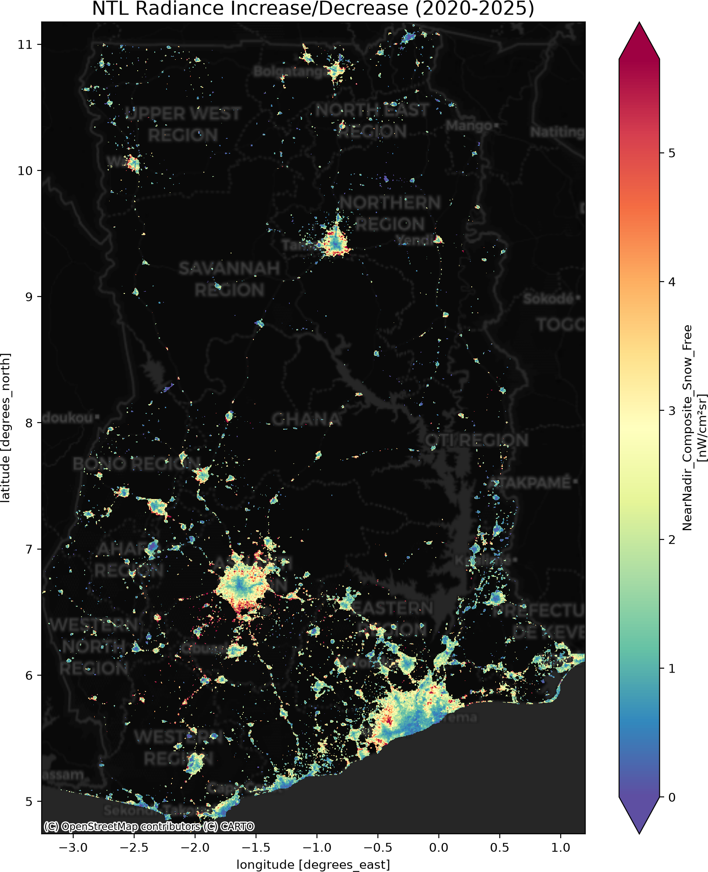

04 · APPLICATIONS · CHANGE DETECTION ON REAL DATA
REAL IMAGERY
Where did the lights grow? Ghana, 2020 – 2025
Urban edges light up
The strongest gains ring Accra and Kumasi — expansion at the edge, not only brighter cores.
Corridors fill in
New light along the roads linking the main cities: the settlement network densifying.
New lights in the north
Small new spots in northern regions: candidate electrification gains to verify on the ground.
Test it in Lab B
Compare regional change with census or utility data — do the regions that brightened most also grow fastest?
Source: NASA Black Marble VNP46A3 change 2020–2025, produced with BlackMarblePy (World Bank, MIT licence); basemap © OpenStreetMap contributors © CARTO.
Night-Time Lights · Data Innovation For Africa (DI4A) — AfDB
46
Notes:
[1 min · REAL IMAGERY] A real change map from BlackMarblePy: the difference in monthly radiance between 2020 and 2025 across Ghana. Read it with the urbanisation diagnostic from the previous slide in mind — growth at the edges of Accra and Kumasi looks like sprawl; the corridors filling in show network densification; isolated new spots in the north may be new electrification. Each of these is a hypothesis that Lab B asks you to test against an official indicator.

Slide 47



04 · APPLICATIONS · COMBINING SOURCES
SESSION B
Lights are strongest in combination with other grids
Lights × built-up
Built-up grids
Lights × cropland
Cropland maps
GHSL, World Settlement Footprint, Google Open Buildings
Cropland masks and crop-type maps
Built but dark = candidate unelectrified or abandoned settlements. Lit but unbuilt = flares, fires, fishing, roads.
Explains weak lights–GDP links in agricultural regions; separates farm output from urban activity.
Lights × population
Validation slide
Lights × networks
Trade & ports
Census-based grids; WorldPop with care
Roads, ports, grid lines, mines
Light per capita and unlit population. Beware circularity: WorldPop uses NTL as a covariate.
Distinguishes corridors and enclaves from settlements; supports trade and infrastructure analysis.
Night-Time Lights · Data Innovation For Africa (DI4A) — AfDB
47
Notes:
[1 min · NEW] Bridge to other geospatial layers. Cropland statistics and built-up structure grids are exactly the layers that make lights interpretable. Built-but-dark is the most policy-relevant combination for energy access; cropland explains why lights under-predict output in agricultural regions; population grids give light per capita, with the circularity caveat for WorldPop; and networks connect to trade and port-activity analysis. Encourage teams to keep their boundaries and zonal-statistics code — it is reused in every one of these combinations.

Slide 48




04 · APPLICATIONS · APPLICATION 04
SESSION B
When the lights go out: conflict and disaster
Conflict · Sudan, 2023
Conflict · Syria, 2011–2014
Disaster · Puerto Rico, 2017
After fighting began in Khartoum in April 2023, the capital’s lights fell to the noise level by May (EOG). UNOSAT mapped power outages from NTL in June 2023.
Li & Li (2014) measured a loss of more than 70% of night-time light nationally, with losses tracking displacement province by province.
After Hurricane Maria, NASA Black Marble daily data mapped the blackout and tracked restoration neighbourhood by neighbourhood.
The interpretive rule: absence of light is not absence of people
Darkness may mean displacement, destruction, fuel shortage, curfew, a grid failure — or a decision to switch off street lights. The satellite cannot tell which. Corroboration with ground information is not optional, and uncertainty must be stated.
Sources: Payne Institute / EOG (Sept 2024); UNOSAT (June 2023); Li & Li (2014) IJRS 35(18); Román et al. (2019) PLOS ONE 14(6).
Night-Time Lights · Data Innovation For Africa (DI4A) — AfDB
48
Notes:
[1.5 min] The most ethically loaded application in the deck. Sudan is the African case: after fighting broke out in Khartoum on 15 April 2023, the Earth Observation Group reported that by May 2023 the capital’s lights had dimmed to the noise level, and UNOSAT published a power-outage assessment from night-time imagery in June 2023. Syria (Li and Li, 2014) and Puerto Rico after Hurricane Maria (Black Marble daily products) are the reference studies. Night lights are used in humanitarian and human-rights reporting, so errors have consequences: insist on triangulation with ground information and honest statements of uncertainty. For statistical offices, the value is rapid situational evidence when field collection is impossible.

Slide 49



04 · APPLICATIONS · APPLICATION 05
SESSION B
Activity mapping: shocks, events and calendars
Lockdowns
Event-study recipe
Daily lights and electricity use tracked the depth and timing of the 2020 COVID-19 shock at district level in India.
1
Daily VNP46A2 for the affected area and a comparison area
Festivals & holidays
Same calendar window in the previous year as baseline
Ramadan and end-of-year holidays measurably change night-time light — a calendar effect to model, or a signal to study.
2
3
7-day rolling mean to absorb view-angle noise
Grid events
National blackouts and rationing episodes show up as abrupt, wide-area drops in daily data.
Express as % deviation from baseline, with a band of normal variation
4
Cyclones & floods
5
Corroborate with utility, news or field reports
Outage extent and restoration speed after storms — highly relevant for Indian Ocean economies.
Beyer, Franco-Bedoya & Galdo (2021) World Development 140; Román & Stokes (2015) Earth’s Future 3(6).
Night-Time Lights · Data Innovation For Africa (DI4A) — AfDB
49
Notes:
[1 min · NEW] Activity mapping is the fifth application in this module. Daily data shine for shocks with a clear start date. Beyer, Franco-Bedoya and Galdo (2021) combined daily night-time lights with electricity consumption to track the COVID-19 lockdown in India. Román and Stokes (2015) documented holiday effects during Ramadan and Christmas. The recipe on the right is a minimal event study — baseline from the same window last year, a 7-day smoother, deviation from baseline with a band of normal variation, and corroboration. Teams choosing the ‘shock’ option in Lab B will follow it.

Slide 50




04 · APPLICATIONS · SMALL ISLANDS & COASTS
SESSION B
An island lens: small islands and coastal economies
Few pixels
Coast and sea mix
Lights offshore
A small island state covers only thousands of 500 m cells; one bright resort, port or power plant can dominate the total.
Coastal pixels blend land light with reflection from the water; clip with care and test all-touched versus centre-only rules.
Fishing fleets, ships at anchor and offshore platforms sit just beyond the coastline — mask the sea or keep it as a separate maritime indicator.
Orographic cloud
Tourism signal
Cyclone season
Trade-wind cloud over central plateaus thins valid observations inland — check the observations layer by district.
Hotel strips are very bright relative to their population; normalise carefully and read alongside arrivals data.
Daily data can map outages and restoration after tropical cyclones — an operational use for disaster statistics.
Rule for small units: the fewer the pixels, the more each masking and boundary choice matters — report sensitivity to them explicitly.
Night-Time Lights · Data Innovation For Africa (DI4A) — AfDB
50
Notes:
[1 min · NEW] A lens for the many coastal and island economies, with Mauritius as the example. Mauritius covers roughly 2,000 km², on the order of ten thousand 15-arc-second cells; at that scale, a single port, power station or hotel strip can dominate the total. Coastline handling, offshore fishing and shipping lights, and orographic cloud over the central plateau all matter more than they would for a large continental country. Tropical cyclones make daily outage mapping operationally relevant. The rule: the fewer the pixels, the more you must report sensitivity to choices.

Slide 51
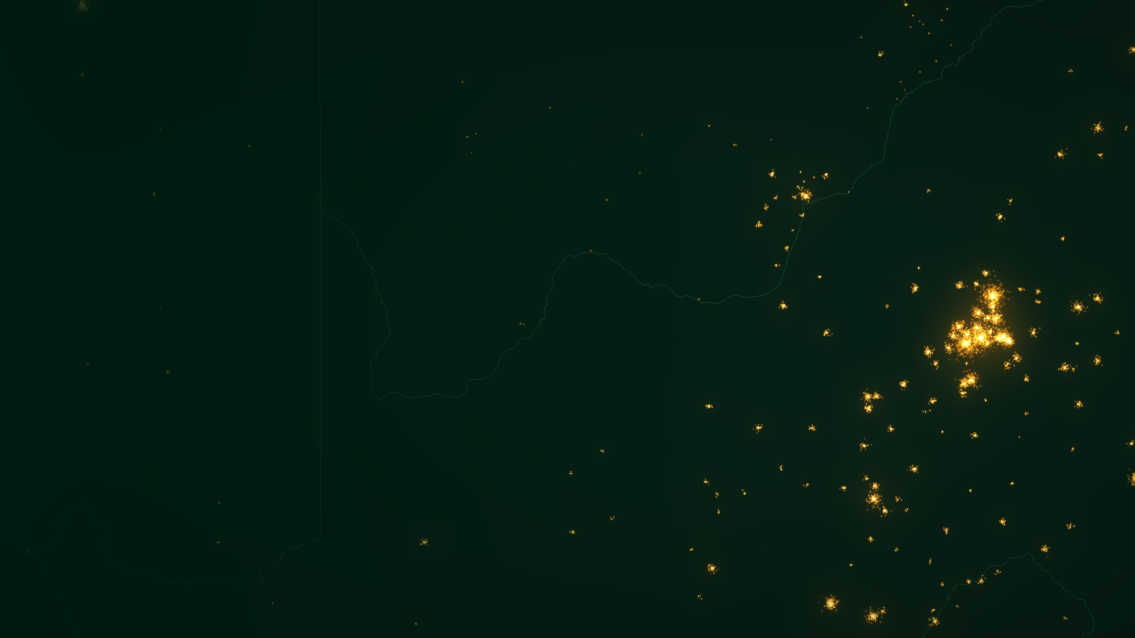
HANDS-ON · LAB B
B
Rebuild one application
Compare your night-lights indicator with an official one — and say where the relationship holds.
Choose an application · Align units & periods · Compare in levels and changes · Map residuals · Report
LAB B · 45 + 15 MIN
Gauteng and the Highveld · Illustrative rendering: GeoNames settlement populations, Natural Earth borders
51
Notes:
[Lab B · 45 min + 15 min report-back] Same teams as Lab A, same country. Each team picks one of four applications. The official indicator can come from your own institution or from the files provided with the lab.

Slide 52

LAB B · STEP 1 · CHOOSE
LAB B
Pick one application and its official comparator
A
B
C
D
Output proxy
Electrification
Urbanisation
Shock
NTL INDICATOR
NTL INDICATOR
NTL INDICATOR
NTL INDICATOR
Annual SOL by region (VNP46A4 or VNP46A3 averaged)
Share of settlements lit, by district
Lit area above threshold, by district
Daily or monthly radiance vs baseline
OFFICIAL COMPARATOR
OFFICIAL COMPARATOR
OFFICIAL COMPARATOR
OFFICIAL COMPARATOR
Regional GDP / GVA, or national quarterly GDP
Census or DHS share of households with electricity
Census urban population or built-up area
Utility outage reports, disaster or activity statistics
TEST
TEST
TEST
TEST
Elasticity in growth rates; fit by region
Correlation across districts; outliers
Levels and growth; sprawl vs densification
Timing and depth of the drop; recovery
Rebuild means: reproduce the logic of a published use case on your own country, with your own official data.
Night-Time Lights · Data Innovation For Africa (DI4A) — AfDB
52
Notes:
[Lab B · 5 min] Each team chooses one of four options, matching the applications we just reviewed. A — output proxy against regional GDP or gross value added where it exists, or national quarterly GDP otherwise. B — electrification against census or DHS household electricity access. C — urbanisation against census urban population or a built-up grid. D — a shock (cyclone, outage, holiday, lockdown) against utility or official reports. The point is not to replicate a paper exactly but to rebuild its logic with your own official data.

Slide 53
LAB B · STEPS 2–5 · COMPARE
LAB B
Compare in levels and in changes — then map what is left
2
Align
PYTHON · OPTION A EXAMPLE
Same units (regions or districts) and the same periods for both series.
import numpy as np, statsmodels.formula.api as smf
d = ntl_region.merge(official, on=["region", "year"])
d["ln_ntl"], d["ln_y"] = np.log(d.sol), np.log(d.gdp)
# Levels: cross-section, pooled years
lev = smf.ols("ln_y ~ ln_ntl + C(year)", d).fit()
# Changes: growth within region over time
d = d.sort_values(["region", "year"])
g = d.groupby("region")[["ln_y", "ln_ntl"]].diff()
chg = smf.ols("ln_y ~ ln_ntl", g.dropna()).fit()
print(lev.params, lev.rsquared)
print(chg.params, chg.rsquared)
d["resid"] = lev.resid # map this
3
Transform
Logs for skewed totals; growth rates for change; per km² or per capita if justified.
4
Compare
Scatter, correlation and slope — once in levels, once in changes.
5
Map residuals
Where does the official indicator sit far above or below what lights predict?
6
Stress-test
Drop the capital; change the threshold; remove masks one at a time.
Adapt variable names to your files. For options B–D, swap the comparator and keep the levels-versus-changes logic.
Night-Time Lights · Data Innovation For Africa (DI4A) — AfDB
53
Notes:
[Lab B · 30 min] The single most important habit: estimate the relationship twice, in levels and in changes. Levels across regions are dominated by size — big regions are bright and produce a lot — so correlations look impressive. Changes within a region over time are the real test for monitoring and nowcasting, and they are usually much weaker. The residual map is where the insight is: regions far above the line may be agricultural or mining economies; regions far below may have flares or a bright port. Stress tests: drop the capital, change the threshold, remove masks one at a time.

Slide 54
LAB B · WHAT TO EXPECT
LAB B
Strong in levels, weaker in changes — the usual pattern
Size drives both axes: big regions are bright and productive. A high correlation here proves little on its own.
The real test for monitoring: does light growth track output growth within the same region over time?
Illustrative synthetic data showing a typical pattern — not results for any country.
Night-Time Lights · Data Innovation For Africa (DI4A) — AfDB
54
Notes:
[1 min] Show this before teams interpret their own results so that nobody is surprised. The left panel — levels — usually shows a tight cloud because size drives both axes. The right panel — changes — is noisier, and that is normal: growth rates strip out size and expose all the artefacts and the unstable elasticity. Synthetic data: the slide shows a typical pattern, not any country. A team that finds a strong relationship in changes has a genuinely useful monitoring indicator.

Slide 55

LAB B · REPORT BACK · 15 MIN
LAB B
Report where the relationship holds — in one sentence
REPORTING CARD — ONE PER TEAM
Application & country
e.g. Output proxy · regions of country X · 2013–2024
The one-sentence report
Official comparator
Source, unit, years, number of units
“Night-time lights track [official indicator] well in [where / when], because [lighting behaviour holds]; they break down in [where / when], because [link in the chain fails]. We classify the indicator as [decision].”
Strength in levels
Correlation / slope / R²
Strength in changes
Correlation / slope / R² of growth rates
Holds where …
Regions, periods or sectors where the fit is good
Breaks where …
…and which link of the inferential chain explains it
Two minutes per team. The cards are collected to seed follow-up project briefs.
Decision
Experimental statistic · diagnostic tool · not fit for purpose
Night-Time Lights · Data Innovation For Africa (DI4A) — AfDB
55
Notes:
[Report-back · 15 min] Each team fills the card and reads its one-sentence report. This is the session’s final objective: report where the relationship holds. The decision row anticipates the validation decision guide in the next section. Collect the cards; several typically become project briefs.

Slide 56
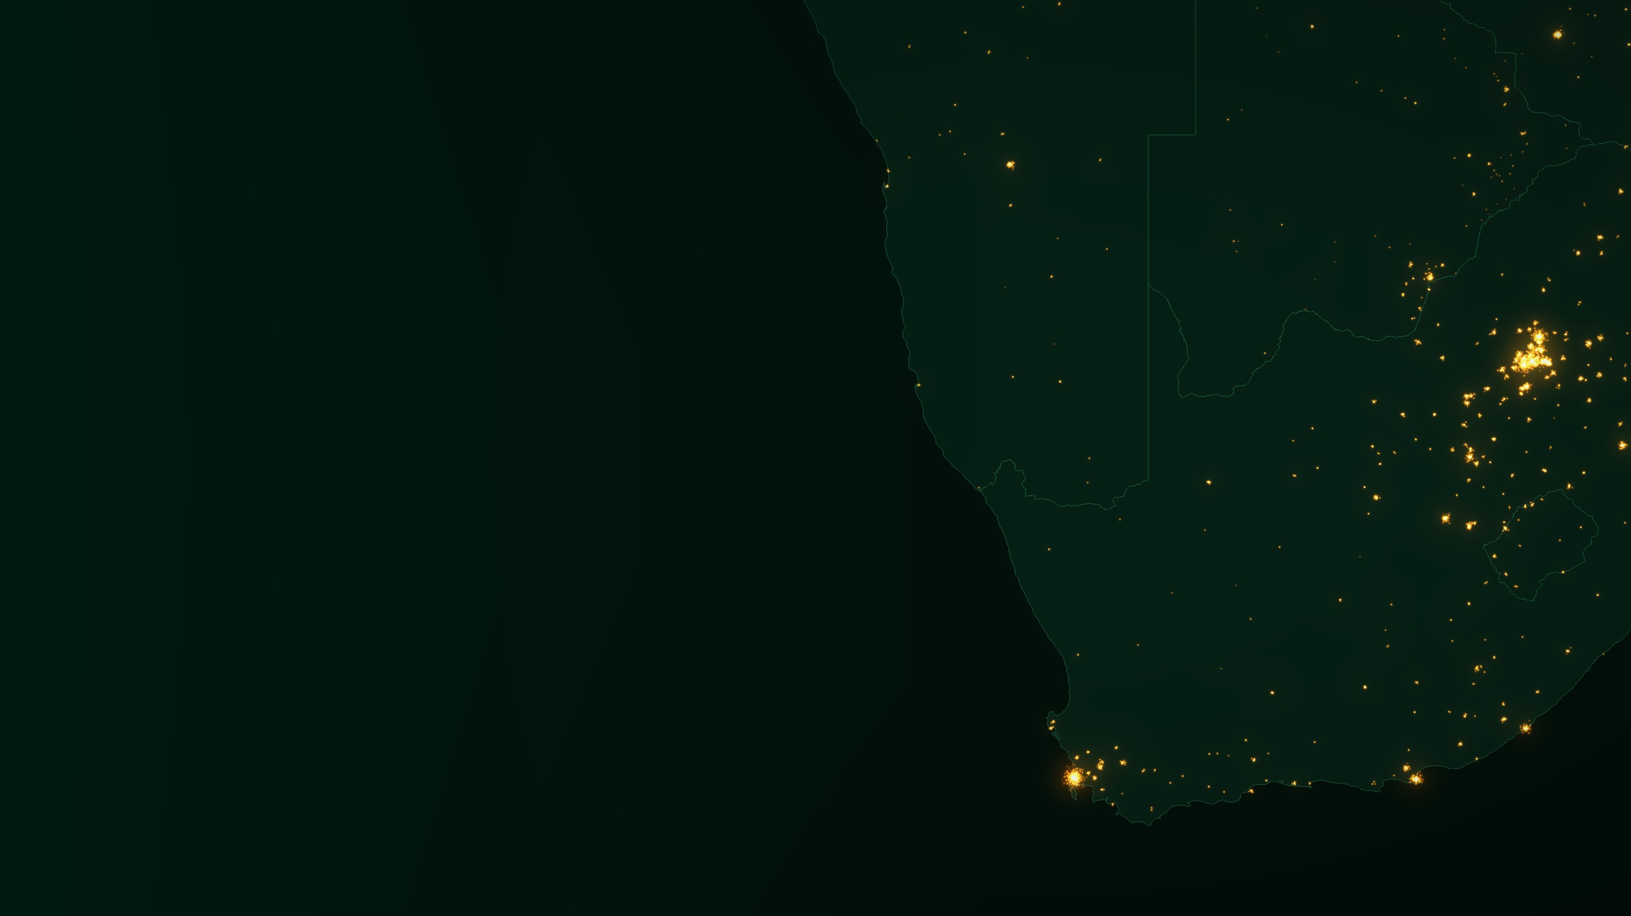
SECTION 5
05
From session to practice
How do these outputs become something your institution can publish?
Pipeline · Choosing a product · Validation · Checklist · Ethics · Project briefs
REFERENCE · FOR FOLLOW-UP WORK
Southern Africa · Illustrative rendering: GeoNames settlement populations, Natural Earth borders
56
Notes:
[Section 5] Reference material that supports Lab B decisions and follow-up project work. Present briefly at the end of Session B, or leave for teams to consult.

Slide 57




05 · FROM SESSION TO PROJECTS · WORKFLOW
REFERENCE
Five stages, one reproducible pipeline
Collect
Explore
Analyse
Validate
Publish
NASA Earthdata / LAADS DAAC
BlackMarblePy · Earth Engine
Bands & quality flags
Histograms & maps
Cloud & quality masks
Month-to-month variation
Zonal stats by admin level
Annual & monthly series
Change detection
Official subnational data
Census, surveys, utilities
Fitness-for-use decision
Notebooks & maps
Limitations statement
README: method, sources, licence
↓
↓
↓
↓
↓
National subset
Artefact log
Tables & maps
Evidence + decision
Public repository
Example open-source stack: BlackMarblePy / rasterio / xarray (read), geopandas (boundaries), exactextract or rasterstats (zonal statistics), statsmodels (validation), matplotlib (maps).
Night-Time Lights · Data Innovation For Africa (DI4A) — AfDB
57
Notes:
[1 min — REFERENCE] The full pipeline in one picture. Each stage has a data source or tool and a concrete output that feeds the next. The Python libraries listed are examples of common open-source options, not requirements. Emphasise reproducibility: every stage ends in a file committed to GitHub, so that another country — or your own office next year — can re-run it.

Slide 58


05 · FROM SESSION TO PROJECTS · CHOOSING A PRODUCT
REFERENCE
Which cadence for which question?
Annual
Monthly
Daily
VNP46A4 · EOG VNL annual
VNP46A3 · EOG VNL monthly
VNP46A2
STRENGTH
STRENGTH
STRENGTH
Cleanest series; noise and ephemeral lights largely filtered.
Dates a change to within a season; feeds quarterly nowcasts.
Every night, corrected for moon, atmosphere and terrain.
WATCH OUT FOR
WATCH OUT FOR
WATCH OUT FOR
A change cannot be dated within the year.
Rainy-season months may rest on very few valid nights.
Large volumes; a single night is noisy — aggregate first.
TYPICAL USE
TYPICAL USE
TYPICAL USE
Subnational panels, long-run trends, urban expansion, poverty mapping, GDP downscaling.
Nowcasting, programme evaluation, seasonal activity, conflict & recovery timelines.
Blackouts, disaster response, reliability of electricity supply, event studies.
Rule of thumb: start annual. The finer the cadence, the more corrections you must trust and the more noise you must handle.
Night-Time Lights · Data Innovation For Africa (DI4A) — AfDB
58
Notes:
[1 min — REFERENCE] The instinct to reach for daily data is almost always wrong at the start of a project. Annual composites answer most statistical questions with a fraction of the processing burden, and they fail loudly rather than quietly. Monthly is the natural cadence for nowcasting, which is why Lab A uses it. Move to daily only when you can say precisely what temporal resolution your question needs — for example, dating the start of a conflict, or measuring reliability of supply.

Slide 59

05 · FROM SESSION TO PROJECTS · VALIDATION
REFERENCE
Publish, or keep as a diagnostic?
Is the relationship strong and stable across units and years?
Limitations statement — template
Q1
Set your bar before you look.
Part of the deliverable, committed to GitHub
Are artefacts identified and treated?
Data
Product, collection version, period, cadence
Q2
Flares, blooming, seasonality, cloud, noise.
Choices
Boundaries, radiance threshold, masks applied
Is the benchmark independent?
Q3
Artefacts
Which of the six were found, where, and how treated
WorldPop uses NTL as a covariate — circular.
All three yes → Experimental statistic — publish with limitations
Validation
Benchmark, year, number of units, strength in levels & changes
Partly → Diagnostic tool — internal use only
Decision
Experimental, diagnostic or not fit — and why
No → Not fit for purpose — document why
Must not be used for
e.g. household income, small-settlement counts
Suggested guide — adapt to your national quality assurance framework. Circularity: see Falchetta et al. (2019), Scientific Data.
Night-Time Lights · Data Innovation For Africa (DI4A) — AfDB
59
Notes:
[1 min — REFERENCE for Lab B] A suggested decision guide, to be adapted to your office’s own quality assurance framework. Three questions. First, set the bar BEFORE you look at the result: what correlation and stability would you require? Second, have the artefacts been identified and treated? Third — the trap specific to this field — is your benchmark independent? WorldPop population models use night-time lights as one of their covariates, so correlating NTL with WorldPop partly correlates NTL with itself. Prefer census or survey benchmarks for validation. The outcome is one of three decisions, and the limitations statement on the right is part of the deliverable whichever you choose.

Slide 60

05 · FROM SESSION TO PROJECTS · GOOD PRACTICE
REFERENCE
A checklist for defensible analysis
1
Name product and version
2
Never splice sensors naively
THE GOLDEN RULE
VNP46A3 collection 2, VNL V2.x — they are not interchangeable.
Any DMSP–VIIRS series needs documented harmonisation.
State, in one sentence, what would have to be true about lighting behaviour for your conclusion to hold.
3
Report and test the threshold
4
Mask what you are not studying
Show the finding survives a reasonable range.
Background noise, gas flares, fishing lights, fires.
5
Normalise deliberately
6
Validate against the ground
Per capita, per km², or neither — state and defend it.
Census, surveys, utility records — independent sources.
If you cannot write that sentence, you do not yet have a result.
7
Prefer changes to levels
8
Publish code and limitations
Differences cancel much of the calibration error.
README with method, sources, licence and caveats.
Share it: a documented, reusable repository is how your institution contributes to a shared community of practice.
Night-Time Lights · Data Innovation For Africa (DI4A) — AfDB
60
Notes:
[30 sec — REFERENCE] Keep this open during the labs. Item 7 is the practical heart of the list: most credible work identifies effects from changes within the same unit over time rather than from cross-sectional levels, because calibration problems largely cancel out — exactly what the levels-versus-changes comparison in Lab B showed. The golden rule is the test for any result you present.

Slide 61





05 · FROM SESSION TO PROJECTS · ETHICS & GOVERNANCE
REFERENCE
Ethics, privacy and governance for night-lights statistics
Privacy
Conflict sensitivity
Licensing & sovereignty
At ≈ 500 m, lights rarely identify individuals. Risk rises when they are combined with building footprints or high-resolution imagery for very small settlements.
Maps of darkening can reveal displacement or vulnerable populations. Consider aggregation and release timing before publishing.
NASA and EOG products are open; commercial night imagery often is not. Check licences before redistributing derived products.
Labelling
Coordination
AI & models
Publish as experimental statistics with a limitations statement; never present a proxy as the official measure.
Agree with the national statistical system who produces, validates and publishes — avoid parallel numbers.
If machine-learning models use lights, document features and training data, and apply your AI governance rules.
Builds on good practice in data access, governance, AI, ethics and privacy, and on the UN Fundamental Principles of Official Statistics.
Night-Time Lights · Data Innovation For Africa (DI4A) — AfDB
61
Notes:
[REFERENCE · NEW] Ties back to broader questions of governance, AI, ethics and privacy. Night lights are low-risk for individual privacy at 500 m, but not risk-free: combined with building footprints for small settlements, or published during conflict, they can expose vulnerable groups. Licensing matters for commercial products. And the statistical-system point: agree who publishes what, label experimental statistics clearly, and avoid parallel numbers that undermine official figures — consistent with the UN Fundamental Principles of Official Statistics.

Slide 62





05 · FROM SESSION TO PRACTICE · PROJECT BRIEFS
PROJECTS
Six night-lights project briefs for your institution
Subnational activity index
Nowcasting feature
Electricity reliability monitor
Monthly SOL by region, masked and validated against regional accounts.
NTL growth added to a GDP nowcasting model; test the gain out-of-sample.
Share of lit nights per district from daily data, next to official access rates.
Output: Experimental regional indicator
Output: Nowcast with and without lights
Output: Reliability dashboard
Urban expansion monitor
Rapid outage assessment
Credibility cross-check
Lit area and radiance growth combined with built-up grids.
Event-study template for cyclones, floods or grid failures.
Compare regional GDP growth with light growth; investigate the largest gaps.
Output: Sprawl vs densification map
Output: Reusable notebook + brief
Output: Residual map + memo
Each brief states its question, data sources and intended output · small enough to prototype in a few days.
Night-Time Lights · Data Innovation For Africa (DI4A) — AfDB
62
Notes:
[1 min · NEW] Six project briefs that build directly on this module. Each team states its brief, data sources and intended output. The nowcasting feature brief is a natural bridge to GDP nowcasting work; the urban expansion monitor to built-up analysis. Each output is small enough to prototype in a few days.

Slide 63
CHECK YOUR UNDERSTANDING
WRAP-UP
Five questions to check your understanding
Why can a city look dimmer to VIIRS after switching to LED street lights?
Its blue peak (≈ 450 nm) lies outside the Day/Night Band.
1
A district’s lit area fell 25% when you changed the threshold from 0.5 to 1.0. What changed in the world?
Nothing — it is a researcher choice. Report and test it.
2
Your NTL indicator correlates 0.9 with WorldPop. Is it validated?
No — WorldPop uses NTL as a covariate. The benchmark is not independent.
3
Correlation is high in levels but weak in growth rates. What does that mean?
Size drives levels; the indicator is not yet a reliable monitoring tool.
4
A coastal province goes dark for a month in the rainy season. First check?
The number-of-observations layer: cloud, not collapse.
5
Tip for presenters: hide the right-hand column with a shape or reveal answers one by one.
Night-Time Lights · Data Innovation For Africa (DI4A) — AfDB
63
Notes:
[2 min · NEW] Ask the room before revealing each answer. Answers: (1) White LEDs emit much of their energy near 450 nm, outside the 500–900 nm Day/Night Band. (2) Nothing changed in the world; the threshold is a researcher choice that must be reported and tested. (3) Not independent: WorldPop uses NTL as a covariate, so the correlation is partly circular. (4) Levels are dominated by size; weak growth-rate correlation means the indicator is not yet a reliable monitoring tool. (5) Check the number-of-observations layer: a rainy-season dark month is usually cloud, not collapse. These map onto the key messages of the module.

Slide 64

IN CLOSING
Five things to take into the labs
1
Night lights are a proxy, never the quantity of interest — name the assumption that links them to your question.
2
The instrument defines the science: DMSP saturates, VIIRS calibrates, and neither sees blue light.
3
The data is most valuable where official statistics are thinnest: subnational, high-frequency, in crises and informal economies.
4
Darkness is not emptiness — off-grid light, cloud and load-shedding all look alike from orbit.
5
Validate against independent sources, in levels and in changes, and publish your limitations with your results.
The darkness tells us a great deal. It does not tell us everything — and it never speaks unprompted.
Mauritius · Illustrative rendering: GeoNames settlement populations, Natural Earth borders
Notes:
[30 sec] Land on the last line. Extracting the signal is now routine and largely automated; the discipline is in knowing what the signal is entitled to mean. Then hand over to the labs.

Slide 65

APPENDIX · GLOSSARY
REFERENCE
The vocabulary you will meet in this module
Radiance
Digital number (DN)
Energy leaving a surface per unit area and solid angle; for NTL in nW·cm⁻²·sr⁻¹.
Uncalibrated sensor count with no physical unit; DMSP reports 0–63.
Composite
Stable lights
Grid assembled from many cloud-free nights — not a photograph of one night.
Product with fires, aurora and other unstable sources removed.
Sum of Lights (SOL)
Blooming / overglow
Total radiance summed over all pixels inside a boundary.
Apparent spread of light beyond its source (scattering, geolocation error).
BRDF correction
Zonal statistics
Adjustment for how reflected (moon)light varies with viewing and lighting angles.
Summary of raster values (sum, mean, count) within each polygon.
Nadir
Elasticity
Point directly beneath the satellite, where the pixel footprint is smallest.
% change in output associated with a 1% change in light; not a constant.
Night-Time Lights · Data Innovation For Africa (DI4A) — AfDB
65
Notes:
REFERENCE — hand out rather than read. The two terms that cause most confusion in practice: composite (people keep treating it as a photograph) and digital number (people keep treating it as a physical quantity). ‘Elasticity’ is added for Session B.

Slide 66
APPENDIX · SOURCES
REFERENCE
Selected references
Beyer, R., Franco-Bedoya, S. & Galdo, V. (2021). Examining the economic impact of COVID-19 in India through daily electricity consumption and nighttime light intensity. World Development, 140.
Beyer, R., Hu, Y. & Yao, J. (2022). Measuring quarterly economic growth from outer space. IMF Working Paper 22/109.
Bruederle, A. & Hodler, R. (2018). Nighttime lights as a proxy for human development at the local level. PLOS ONE, 13(9).
Croft, T. A. (1978). Nighttime images of the Earth from space. Scientific American, 239(1).
Chen, Z. et al. (2021). An extended time series (2000–2018) of global NPP-VIIRS-like nighttime light data. Earth System Science Data, 13.
Elvidge, C. D. et al. (2001). Night-time lights of the world: 1994–1995. ISPRS Journal of Photogrammetry and Remote Sensing, 56(2).
Elvidge, C. D. et al. (2013). Why VIIRS data are superior to DMSP for mapping nighttime lights. Proceedings of the Asia-Pacific Advanced Network, 35.
Elvidge, C. D. et al. (2017). VIIRS night-time lights. International Journal of Remote Sensing, 38(21).
Elvidge, C. D. et al. (2021). Annual time series of global VIIRS nighttime lights derived from monthly averages: 2012 to 2019. Remote Sensing, 13(5).
Falchetta, G. et al. (2019). A high-resolution gridded dataset to assess electrification in sub-Saharan Africa. Scientific Data, 6.
Henderson, J. V., Storeygard, A. & Weil, D. N. (2012). Measuring economic growth from outer space. American Economic Review, 102(2).
Hu, Y. & Yao, J. (2022). Illuminating economic growth. Journal of Econometrics, 228(2).
IEA, IRENA, UN DESA, World Bank, WHO (2026). Tracking SDG 7: The Energy Progress Report.
Kyba, C. et al. (2017). Artificially lit surface of Earth at night increasing in radiance and extent. Science Advances, 3(11).
Li, X. & Li, D. (2014). Can night-time light images play a role in evaluating the Syrian crisis? IJRS, 35(18).
Li, X. et al. (2020). A harmonized global nighttime light dataset 1992–2018. Scientific Data, 7.
Martinez, L. R. (2022). How much should we trust the dictator’s GDP growth estimates? Journal of Political Economy, 130(10).
Román, M. O. & Stokes, E. C. (2015). Holidays in lights: tracking cultural patterns in demand for energy services. Earth’s Future, 3(6).
Román, M. O. et al. (2018). NASA’s Black Marble nighttime lights product suite. Remote Sensing of Environment, 210.
Román, M. O. et al. (2019). Satellite-based assessment of electricity restoration efforts in Puerto Rico after Hurricane Maria. PLOS ONE, 14(6).
Night-Time Lights · Data Innovation For Africa (DI4A) — AfDB
66
Notes:
Leave this on screen during questions. The new references for this edition cover nowcasting (Beyer, Hu & Yao 2022; Hu & Yao 2022), harmonised long series (Li et al. 2020; Chen et al. 2021; Elvidge et al. 2021), calendar effects (Román & Stokes 2015) and short-term shocks (Beyer et al. 2021).

Slide 67







APPENDIX · DATA & TOOLS
REFERENCE
Data, tools and tutorials to keep
NASA Black Marble
Earth Observation Group
LAADS DAAC · Earthdata — VNP46 / VJ146 products
VNL annual & monthly composites; VIIRS Nightfire
Google Earth Engine
BlackMarblePy / blackmarbler
Hosted, analysis-ready EOG and Black Marble collections
World Bank packages for Python and R
HREA
Light Every Night
Settlement-level electricity access & reliability
Every nightly DMSP & VIIRS observation, open on AWS
GHSL · WSF · Open Buildings
World Bank Open Nighttime Lights
Built-up grids to pair with lights
Tutorials, notebooks — and most real images in this deck (CC BY 4.0)
Night-Time Lights · Data Innovation For Africa (DI4A) — AfDB
67
Notes:
For a five-minute first experiment, point people to the Radiance Light Trends web application or the World Bank Open Nighttime Lights tutorials before any heavy pipeline. BlackMarblePy and blackmarbler are the quickest route to a reproducible country pipeline.

Slide 68
AFRICAN DEVELOPMENT BANK · DATA INNOVATION FOR AFRICA (DI4A)
Thank you
Data Innovation For Africa (DI4A) — African Development Bank
Africa · Illustrative rendering: GeoNames settlement populations, Natural Earth borders
Notes:
Close. Remind participants to keep their Lab A and Lab B outputs and code — they are reused in later geospatial, nowcasting and project work.

