Slide 1

STG17 · DAY 4 · AFRICA AFTER DARK
Setting up a Google Earth Engine project
To access VIIRS night-time lights from the NTL notebook — step by step, with screenshots
Notes:
This guide takes participants from their Google account to the first VIIRS image loaded in the NTL_Africa_STG17 notebook. It follows the exact order in which the screens appear. The annotated screenshots are real; screens we did not capture are marked as schematics, because Google's interface changes regularly. The screenshots were taken with a French-language interface: menu names may read differently in English.

Slide 2




00 · BEFORE YOU START
Three things to know before you click
0 $
1 project
≈ 15 min
Free for research, teaching and training. No billing account to create.
Mandatory since 13 November 2024: every Earth Engine call goes through a Google Cloud project.
From project creation to the first VIIRS image in the notebook (workshop estimate).
Operational use: Google classes training and research as noncommercial, but steers any government agency using Earth Engine for operational purposes to the paid offer. Training staff this week: free. Producing the official indicator every month: to be clarified with Google.
Sources: Google Earth Engine — Transition to Cloud projects; Noncommercial use (earthengine.google.com/noncommercial).
Setting up an Earth Engine project · STG17 · Day 4
2
Notes:
Three messages. One: it is free for training and research, with no credit card. Two: since 13 November 2024, a Google Cloud project is mandatory, even for free use — it is an administrative container, not a paid service. Three: allow about fifteen minutes; that is a workshop estimate, not a Google figure. The ochre box is the nuance not to skip: a government agency using Earth Engine to produce an official indicator routinely is steered by Google towards the commercial offer. Learning the method this week is free; industrialising production is a different conversation.

Slide 3





00 · BEFORE YOU START
Five steps, in this order
1
2
3
4
5
Google account
Create the project
Declare the use
Check
Connect
the same everywhere
registration page
noncommercial + tier
ID, API, configuration
the notebook
accounts.google.com
console.cloud.google.com/earth-engine
…/earth-engine/configuration
…/apis/library/earthengine…
Colab · Kaggle · Jupyter
Steps 2 and 3: a single visit to the registration page is enough — it creates the project, enables the Earth Engine API and registers the use in one flow.
Source: Google Earth Engine — Earth Engine access (developers.google.com/earth-engine/guides/access).
Setting up an Earth Engine project · STG17 · Day 4
3
Notes:
The route map. Each step has a precise address, shown under its block. Stress step 1: the account. Almost every blockage in the room comes from a participant who creates the project with one account and authorises Colab with another. Steps 2 and 3 happen in a single visit to the registration page. Step 4 is a check. Step 5 happens in the notebook.

Slide 4
01
CREATE AND REGISTER
Create and register the project
Which account to use, and where it all starts
Notes:
Part one: three screens. Choosing the account, creating the project, and declaring noncommercial use with the quota tier.

Slide 5



01 · CREATE AND REGISTER
Step 1 · One Google account, used everywhere
One account per person
Every participant who runs Earth Engine code needs their own Google identity (Gmail or Workspace).
The same account everywhere
Cloud Console, Colab and the authorisation window: one and the same account. It is the number-one cause of failure in the room.
Institutional account?
Some organisations forbid creating Cloud projects. In that case, ask IT to create the project and add you to it.
Setting up an Earth Engine project · STG17 · Day 4
5
Notes:
The account is the first source of errors in the room. Many participants have several Google accounts open in the same browser: personal, institutional, school. The notebook authenticates with the account chosen in the authorisation window; if it is not the one that owns the project, initialisation fails with a permission error. Practical tip: work in a browser window where only one account is signed in.

Slide 6
01 · CREATE AND REGISTER
Step 2 · Create the project from the registration page
1
Open the page
console.cloud.google.com/earth-engine
console.cloud.google.com/earth-engine — signed in with the right account.
Register a project for Earth Engine
2
Create or choose
◉ Create a project ○ Use an existing project
“Create a project”, or attach an existing one.
Project name
NTL-STG17
3
Name it
Free-form name; Google derives a unique, permanent ID. E.g. ntl-stg17 (a suffix is added if taken).
Project ID — permanent
ntl-stg17
4
Confirm
The flow enables the Earth Engine API and moves on to the use declaration.
Continue
SCHEMATIC — the real screen may differ
Source: Google Earth Engine — Earth Engine access, “Create a project”.
Setting up an Earth Engine project · STG17 · Day 4
6
Notes:
The registration page is Google's recommended entry point: it automatically chains project creation, Earth Engine API activation and use registration. Important: the project ID is suggested from the name but is fixed at creation and cannot be changed afterwards. Choose it carefully. Google suggests the form ee-yourname; for the workshop, an ID that says what the project does, such as ntl-stg17, will be easier to read in six months. Note: Google does not accept underscores, neither in the name nor in the ID; use a hyphen. The schematic on the right is indicative.

Slide 7
01 · CREATE AND REGISTER
Step 3 · Declare noncommercial use
The questionnaire, mandatory since 26 September 2025, confirms the project's eligibility for free access. It must be revalidated periodically.
Noncommercial — free
Commercial — paid
A training workshop such as STG17
University research and teaching
A nonprofit organisation, for noncommercial activities
A PhD thesis on natural resources
Selling a service built on Earth Engine
Internal R&D for a commercial product
Promotional white papers for a product
A government agency using Earth Engine for operational purposes
How to answer: for this workshop, the declared use is training. Answer honestly: a project reclassified as commercial loses free access.
Sources: earthengine.google.com/noncommercial; Earth Engine access, “Configuring noncommercial access”.
Setting up an Earth Engine project · STG17 · Day 4
7
Notes:
The questionnaire is not a formality: since 26 September 2025, every noncommercial project must have completed it, or access is suspended. It must also be renewed periodically. The examples come straight from Google's page. The case that concerns our institutes is bottom right: a government agency using Earth Engine for operational purposes is referred to the commercial offer. This week, the use is training; answer exactly that.

Slide 8
01 · CREATE AND REGISTER
Step 3 (continued) · Choose a quota tier
RECOMMENDED
Community
Contributor
Partner
Default tier
Higher quota
Highest quota
No billing account. Enough for this notebook.
Requires an attached billing account — not charged for Earth Engine under noncommercial use.
Its own eligibility criteria, for Google's partners.
Caution: if you attach a billing account (Contributor tier), do not enable any other Google Cloud API on this project: Earth Engine stays free, but other services can be charged. The tier can be changed at any time under Configuration.
Source: Google Earth Engine — Noncommercial tiers (developers.google.com/earth-engine/guides/noncommercial_tiers).
Setting up an Earth Engine project · STG17 · Day 4
8
Notes:
Since 2026, every noncommercial project has a quota tier that sets a monthly compute ceiling in EECU-hours. Community is the default tier and needs no billing account. For the notebook — one country, a handful of annual images, four years of monthly data — it is more than enough. The Contributor tier requires attaching a billing account; Google states that Earth Engine will not be charged while the project stays noncommercial, but other Cloud services enabled on the project could be. Hence the rule: do not enable any other API.

Slide 9
02
CHECK IN THE CONSOLE
Check in the console
Is your project really ready?
Notes:
Part two: we look at what the console shows, retrieve the ID, and check the registration and the API.

Slide 10
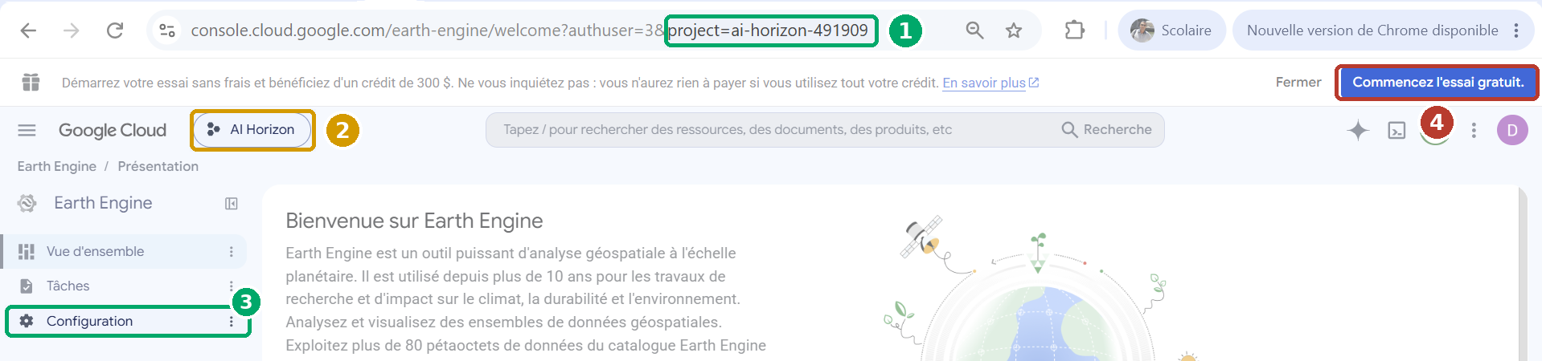
02 · CHECK IN THE CONSOLE
The Earth Engine console: four areas to spot
1
The project ID
2
The project name
3
Configuration
4
$300 free trial
in the address, after project=: this is what the notebook asks for.
“AI Horizon”: a free label, not the ID.
registration, questionnaire and quota tier.
unrelated to Earth Engine. Do not click.
ID to enter in the notebook: ai-horizon-491909 — specific to this account; each participant has their own.
Real screenshot · Google Cloud console, Earth Engine home page of the workshop project (French interface).
Setting up an Earth Engine project · STG17 · Day 4
10
Notes:
Real screenshot of a workshop project, with a French-language interface. One: the ID, readable in the address after project=. It is exactly the string the notebook asks for. Two: the selector at top left shows the project name, not its ID; do not copy “AI Horizon”. Three: the Configuration menu, where you check registration, questionnaire and tier. Four: the 300-dollar free-trial banner concerns general Google Cloud billing; it has nothing to do with Earth Engine. Do not click it.

Slide 11
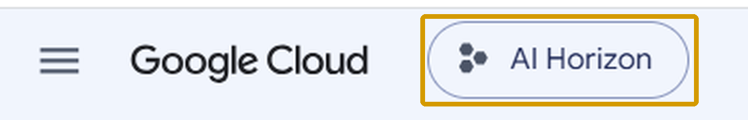
02 · CHECK IN THE CONSOLE
Name ≠ ID: do not mix them up
PROJECT NAME
PROJECT ID
ai-horizon-491909
Readable, editable, not necessarily unique. Earth Engine does not accept it.
Lowercase, digits, hyphens. Unique across Google Cloud. Permanent. This is what you type.
THREE WAYS TO FIND IT
1
Console address
2
Project selector
3
Code Editor Earth Engine
the project= parameter in the URL
click the name: the window shows name and ID
profile menu, top right
Real screenshot (project selector, Google Cloud console).
Setting up an Earth Engine project · STG17 · Day 4
11
Notes:
This is the most common mistake at the notebook prompt. The name is a display label: it may contain capitals and spaces, and it can be changed. The ID is unique across all of Google Cloud, lowercase with digits and hyphens, and permanent. Earth Engine only accepts the ID. Three places to find it: the console address, the project selector window which shows both columns, and the profile menu of the Earth Engine Code Editor.

Slide 12
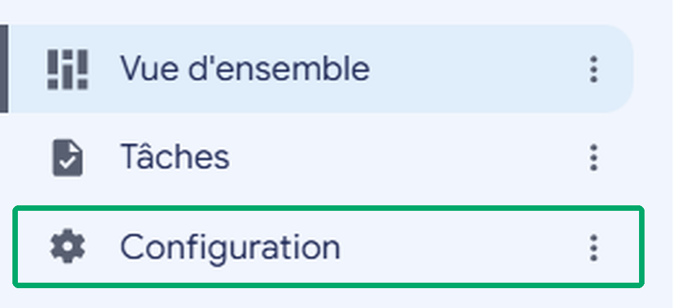



02 · CHECK IN THE CONSOLE
Check the registration and the API
Registration incomplete?
Resume the flow at this address, replacing with your ID:
code.earthengine.google.com/register?project=YOUR-ID
Real screenshot · Earth Engine menu.
UNDER “CONFIGURATION”, YOU SHOULD SEE
Is the Earth Engine API enabled?
Project registered — noncommercial use
Normally yes if you went through the registration page. Otherwise, open this page, check the project selected at the top, then click “Enable”:
Eligibility questionnaire completed
Quota tier selected
console.cloud.google.com/apis/library/earthengine.googleapis.com
Sources: Earth Engine access; Authentication and Initialization, Troubleshooting section.
Setting up an Earth Engine project · STG17 · Day 4
12
Notes:
Two checks before moving to the notebook. On the left, the Configuration menu of the Earth Engine console: it should show a project registered for noncommercial use, with the questionnaire completed and a tier chosen. If registration is unfinished, the address code.earthengine.google.com/register followed by your ID resumes the flow where it stopped. On the right, the API: if the notebook shows “Earth Engine API has not been used in project … or it is disabled”, either the API is not enabled or the ID entered is wrong.

Slide 13
03
CONNECT THE NOTEBOOK
Connect the notebook
The last mile: from the ID to the first image
Notes:
Part three: the notebook prompt, the authorisation window, the thirty-second test, and the available datasets.

Slide 14
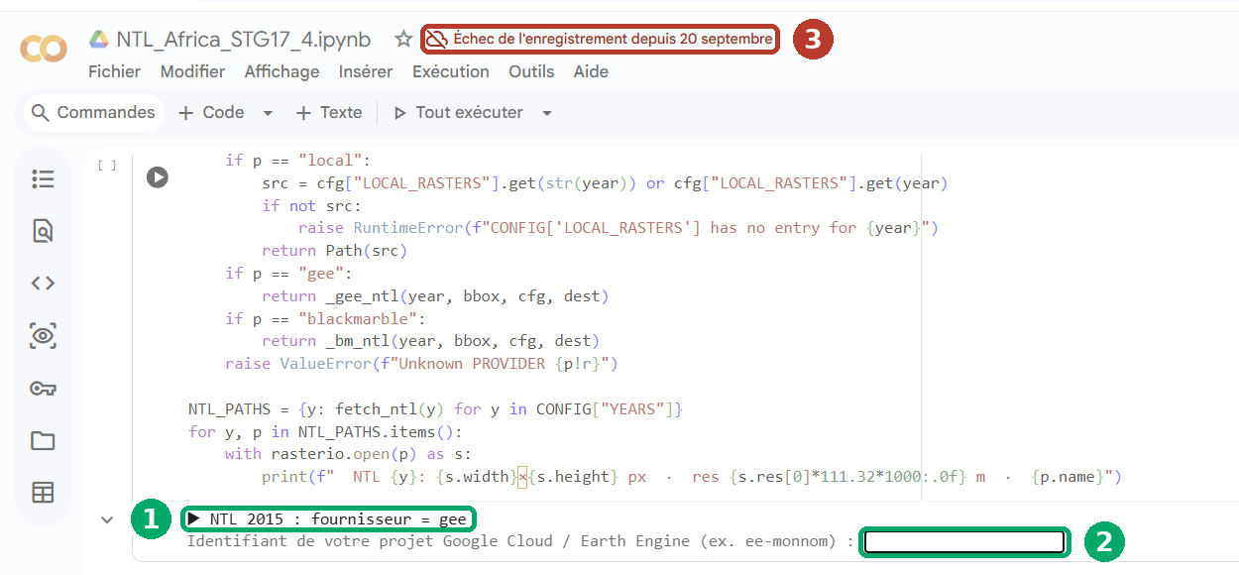
03 · CONNECT THE NOTEBOOK
Answering the notebook prompt in Colab
1
The “gee” provider
the notebook starts the real acquisition of 2015.
2
The input box
type the ID — no quotes or spaces — then Enter.
3
Save failure
the file is no longer saved. Close the other tabs, then File ▸ Save a copy in Drive.
ZOOMED IN
Type: ai-horizon-491909 ↵
Real screenshot · Google Colab, cell 4.2 of the NTL_Africa_STG17 notebook (cropped, French interface).
Setting up an Earth Engine project · STG17 · Day 4
14
Notes:
Real screenshot, French interface. One: the notebook announces it will fetch 2015 from the gee provider; real acquisition starts. Two: the input box. Click in it, type the ID, press Enter. No quotes, no space before or after. Three, in red: this participant has a problem unrelated to Earth Engine that could cost them their work. Colab no longer saves the file because it is open in another tab. Before going further: close the other tabs, then File, Save a copy in Drive.

Slide 15
03 · CONNECT THE NOTEBOOK
Authorising access: what appears next
1
2
3
4
Authorisation window
Choose the account
Accept
Back to the notebook
Colab asks to access your Google credentials.
The same one that owns the project.
Confirm the requested permissions.
“Earth Engine initialisé”, then acquisition continues.
▶ NTL 2015 : fournisseur = gee
Identifiant … : ai-horizon-491909
! Authentification Earth Engine requise…
✓ Earth Engine initialisé
Nothing opens?
Allow pop-ups for colab.research.google.com, then rerun the cell.
Wrong account chosen?
Run ee.Authenticate(force=True), then rerun the cell.
Expected notebook output (reconstructed; the notebook prints in French). Source: Authentication and Initialization, “colab” mode.
Setting up an Earth Engine project · STG17 · Day 4
15
Notes:
After the ID, the notebook tries to connect. In Colab, the Earth Engine library automatically uses Colab's own authentication mode: a window asks you to share your Google credentials with the notebook environment. Choose the same account as in the console. Once authorised, the notebook displays “Earth Engine initialisé” (initialised) and carries on by itself. Credentials are reused afterwards; to switch accounts, force a new authentication with ee.Authenticate(force=True). If nothing opens, it is almost always a pop-up blocker.

Slide 16

03 · CONNECT THE NOTEBOOK
The 30-second test, before “Run all”
import ee
ee.Authenticate()
ee.Initialize(project="ai-horizon-491909")
viirs = ee.ImageCollection("NOAA/VIIRS/DNB/ANNUAL_V22")
print(viirs.size().getInfo())
print(viirs.first().date().format("YYYY-MM-dd").getInfo())
It works
A positive integer, then a date. Project, API, permissions and authentication are in order.
It fails
The error message points to the cause. Recheck the account, the ID, the registration and the API.
Replace ai-horizon-491909 with your own project ID.
Standard calling code: ee.Authenticate() then ee.Initialize(project=…) — Authentication and Initialization.
Setting up an Earth Engine project · STG17 · Day 4
16
Notes:
Facilitation tip: have participants run these six lines in an empty cell before launching the whole notebook. If they fail, the notebook will fail too, and the cause lies in the project, not in the code. If they pass, you get a number of annual images and a date: project, API, permissions and authentication are all in order. Replace the ID with your own, of course.

Slide 17
03 · CONNECT THE NOTEBOOK
Night-time lights available in Earth Engine
Earth Engine collection | Time step | Period | Use in the notebook
NOAA/VIIRS/DNB/ANNUAL_V22 | Annual | 2012 → 2024 | CONFIG["YEARS"] — scenarios A to E and G
NOAA/VIIRS/DNB/MONTHLY_V1/VCMSLCFG | Monthly, stray-light corrected | Jan 2014 → Mar 2025 | CONFIG["MONTHLY_YEARS"] — scenario F
NOAA/VIIRS/DNB/MONTHLY_V1/VCMCFG | Monthly | Apr 2012 → Mar 2025 | Alternative, not used by default
NASA/VIIRS/002/VNP46A2 | Daily (Black Marble, BRDF-corrected) | see the catalogue | Not used — for going further
Practical consequence: the monthly series stops in March 2025 in the catalogue: keep MONTHLY_YEARS up to 2024 for complete years. Check the bounds before every run.
Resolution: 463.83 m for the NOAA/EOG products · Public-domain data, no restriction on use (Colorado School of Mines).
Source: Earth Engine Data Catalog — pages NOAA_VIIRS_DNB_ANNUAL_V22, MONTHLY_V1/VCMSLCFG, MONTHLY_V1/VCMCFG; release notes (VNP46A2).
Setting up an Earth Engine project · STG17 · Day 4
17
Notes:
The table links each catalogue collection to what the notebook does with it. The annual V2.2 feeds the baseline and endline years; according to the catalogue it covers 2012 to 2024. The stray-light-corrected monthly series feeds scenario F; it runs from January 2014 to March 2025, which means 2025 is incomplete: keep MONTHLY_YEARS up to 2024. These bounds change with every catalogue update; check them before setting your years. All these NOAA data are in the public domain, with no restriction on use.

Slide 18

RECAP
The checklist, before “Run all”
One Google account, the same everywhere
Project created from the registration page
Noncommercial questionnaire completed
Quota tier chosen — Community is enough
Earth Engine API enabled
ID noted down — not the name
30-second test passed
Notebook saved in Drive
Tick in order: each box assumes the previous ones.
Setting up an Earth Engine project · STG17 · Day 4
18
Notes:
To project while participants finish. Eight boxes. When they are all ticked, the notebook can be run in full: it will ask for the ID, open the authorisation window, then work on its own through to the dashboard.

Slide 19
REFERENCES
Sources
Earth Engine access
developers.google.com/earth-engine/guides/access
Authentication and Initialization
developers.google.com/earth-engine/guides/auth
Control access to resources (IAM roles)
developers.google.com/earth-engine/guides/access_control
Noncommercial tiers
developers.google.com/earth-engine/guides/noncommercial_tiers
Transition to Cloud projects
developers.google.com/earth-engine/guides/transition_to_cloud_projects
Noncommercial use — eligibility
earthengine.google.com/noncommercial
Catalogue: VIIRS DNB Annual V2.2
developers.google.com/earth-engine/datasets/catalog/NOAA_VIIRS_DNB_ANNUAL_V22
Catalogue: VIIRS DNB Monthly VCMSLCFG
developers.google.com/earth-engine/datasets/catalog/NOAA_VIIRS_DNB_MONTHLY_V1_VCMSLCFG
Documentation consulted in September 2026. Screenshots come from a real workshop project (French interface); schematics are indicative.
Setting up an Earth Engine project · STG17 · Day 4
19
Notes:
All information in this guide comes from the official Google Earth Engine documentation, consulted in September 2026. Access policies change regularly: check them before every session.

Slide 20

READY TO LAUNCH
Your project is ready. Lights on.
Type the ID, press Enter, authorise access — then let the notebook work through to the dashboard.
Notes:
Conclusion. Once the project is ready, the rest is automatic: the notebook asks for the ID once per session, then chains acquisition, seven scenarios, the dashboard and, if you wish, publication on GitHub Pages.

