Slide 1

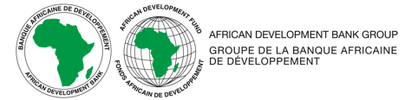
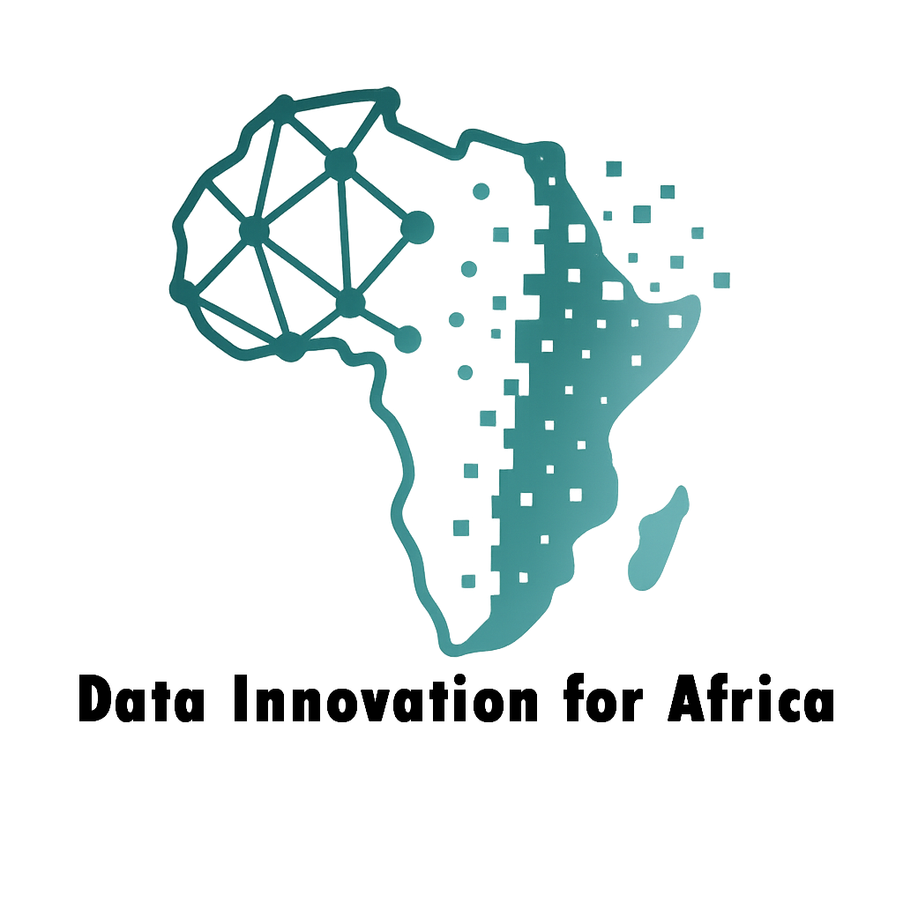
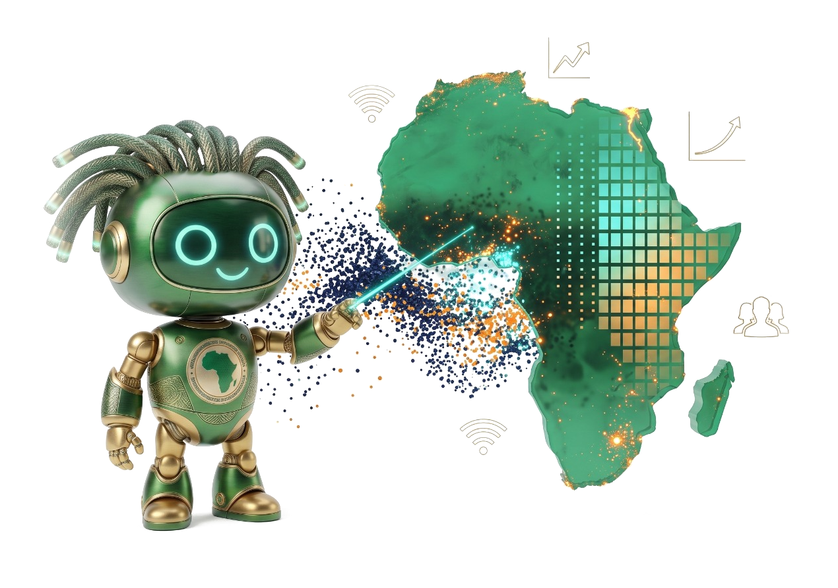
DATA INNOVATION LAB · AfDB
Data Innovation
for Africa
From Promise to Practice
Institutionalise
›
Prove
›
Build capacity
Statistics Department (ECST)
African Development Bank Group
Notes:
Opening. Data Innovation for Africa (DI4A) is the Statistics Department's programme to move data innovation from promise to practice. Three pillars structure the talk: institutionalise, prove, build capacity — and we close with the STG17 workshop in Kigali.

Slide 2


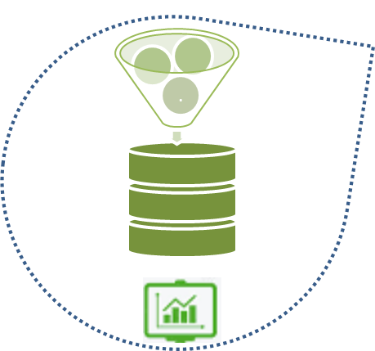

01 · THE MONITORING NEEDS
Development agendas demand better data
Relevant and Reliable
Granular
Frequent
Data Innovation for Africa · AfDB Statistics Department (ECST)
2
Notes:
Development agendas — the High 5s, the SDGs and Agenda 2063 — all depend on data that is frequent, granular, relevant and reliable. Traditional sources alone cannot keep up with this monitoring demand.

Slide 3




01 · THE ISSUE
When statistics and technology fall out of step
High
Late
Effective
Solid statistics, but slow and manual production
Sound methods powered by modern technology
STATISTICS
Perilous
Ambiguous
Weak statistics and weak technology
Abundant data, but weak statistical rigour
Low
TECHNOLOGY
High
Data Innovation for Africa · AfDB Statistics Department (ECST)
3
Notes:
Four situations depending on the maturity of statistics and technology: late, effective, perilous and ambiguous. Many offices sit in 'late' — solid methods, slow manual production. The arrow marks the risk of the 'ambiguous' quadrant: abundant data without statistical rigour.

Slide 4





01 · THE ACTION
A tailored response for every starting point
High
Boost Statistical Competence
Sustain, Monitor and Adjust
STATISTICS
Build From Scratch
Boost Technological Competence
Low
TECHNOLOGY
High
Data Innovation for Africa · AfDB Statistics Department (ECST)
4
Notes:
For each starting point, a tailored response: build from scratch, boost statistical competence, boost technological competence, or sustain, monitor and adjust for offices that are already effective.

Slide 5





01 · DECISION-MAKING NECESSITIES
Better decisions start with better data
01
Reliable
Better understand the world in which we live — and its causalities
Real time
Granular
02
Better decisions with immediate impact…
must be driven by data that is:
Forward looking
Integrated
Data Innovation for Africa · AfDB Statistics Department (ECST)
5
Notes:
Two goals: understand the world and its causalities, and take decisions with immediate impact. Both require data that is reliable, real-time, granular, forward-looking and integrated.

Slide 6


02 · INSTITUTIONALISE · FROM CREATION TO NETWORK
From DIL creation
to a DIL network
DILs Creation
Data needs and access
Accelerate innovation
Data augmentation and use
Developing data skills
Empowering data culture
Leadership & Legal framework
Finance
DILs Network
Collaborative environment
Knowledge & data sharing
Identify priorities
Technology transfer
Complementarity & interoperability
Mobilize funds
Data Innovation for Africa · AfDB Statistics Department (ECST)
6
Notes:
Institutionalisation happens in two stages: first creating Data Innovation Labs around data needs, skills, culture, leadership and finance; then connecting them into a network for sharing, priorities, technology transfer and joint resource mobilisation.

Slide 7
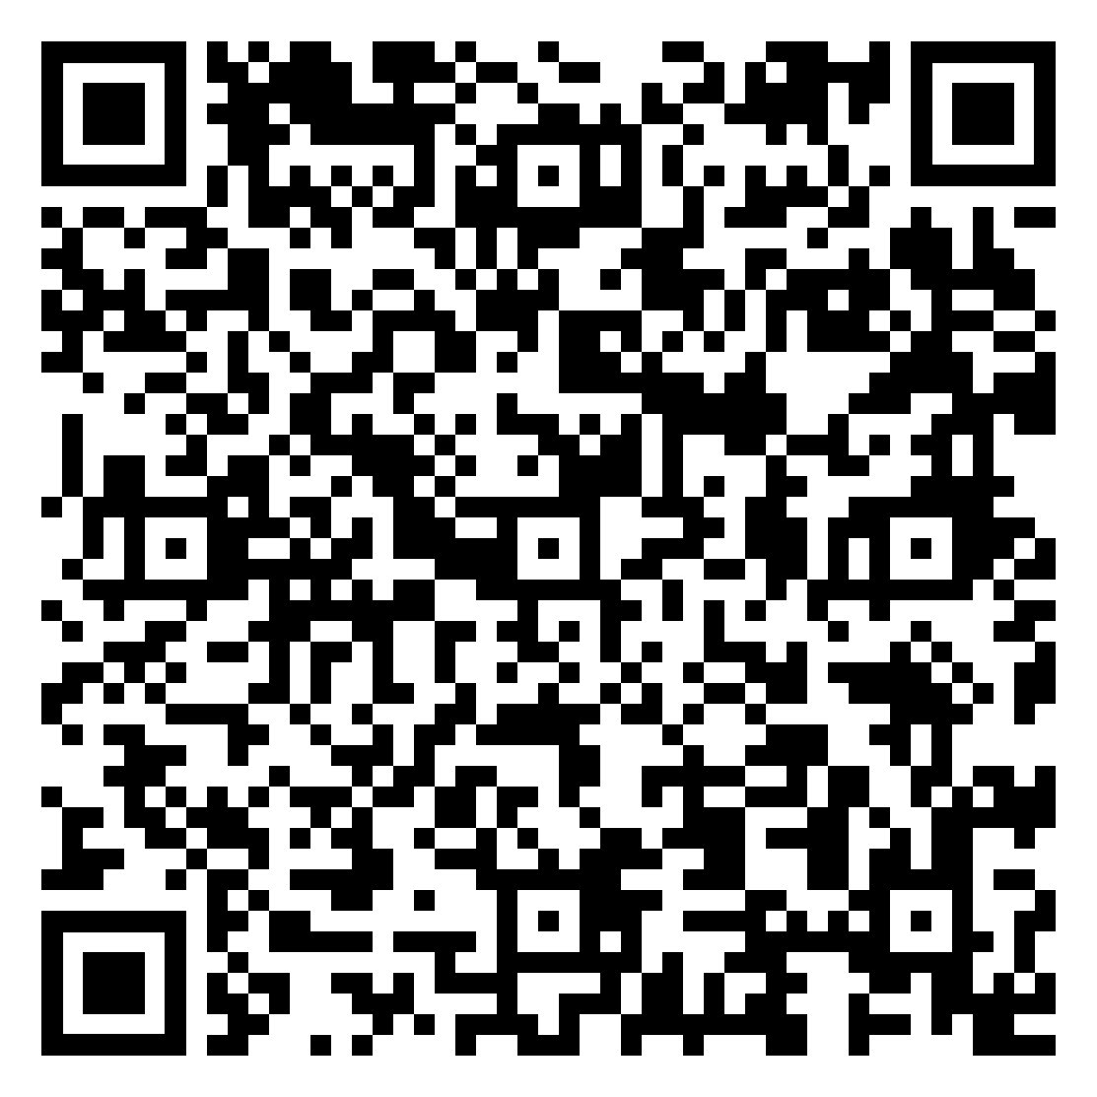
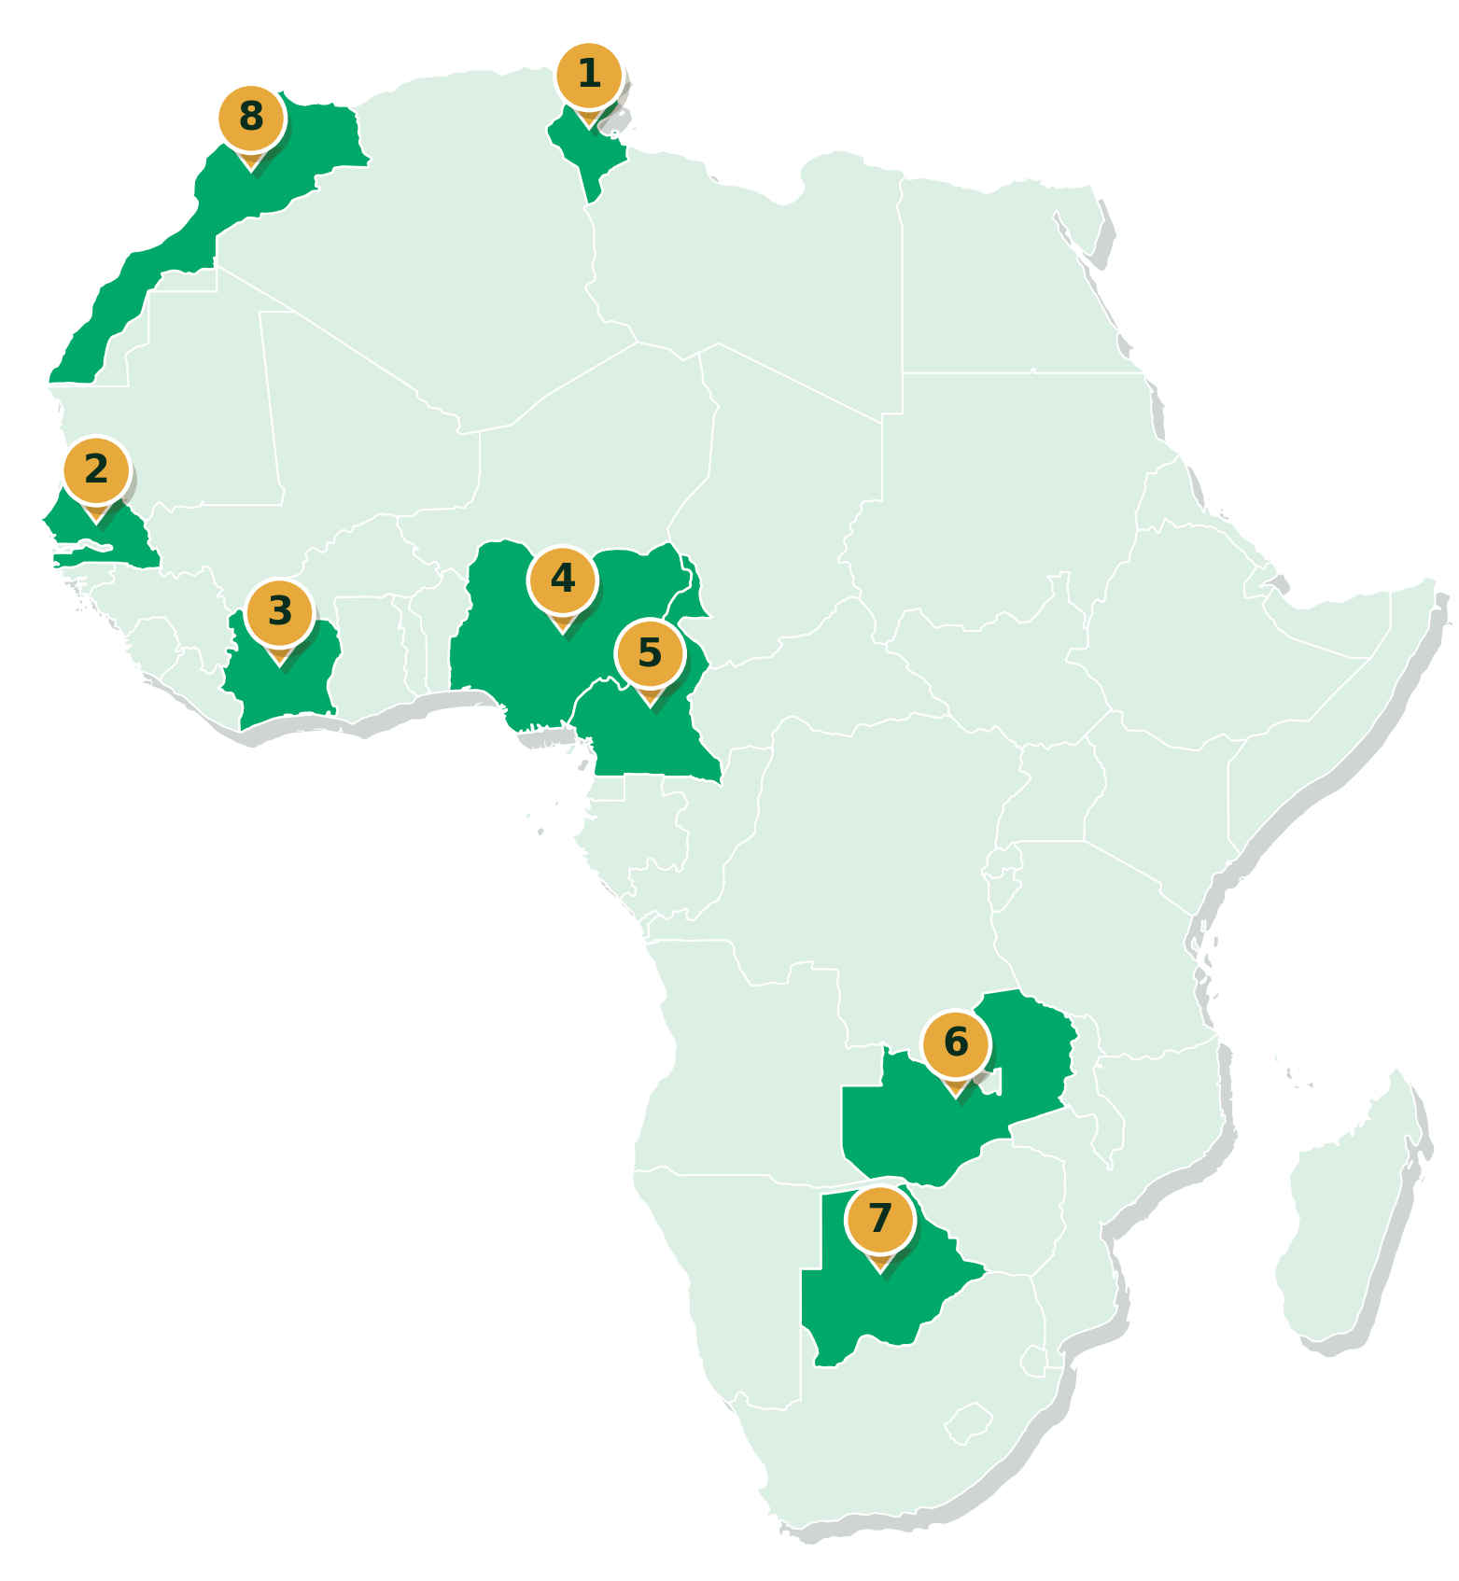

02 · INSTITUTIONALISE · THE MATURITY MODEL IN RMCs
The Data Innovation Maturity Model
THE 12 DIMENSIONS
01
APPLIED IN 8 RMCs
01
Leadership & membership
12
02
02
Strategic transformation vision
03
Legal & institutional framework
11
03
04
Human resources
05
Information technology
12
Financing
10
04
06
07
Partnerships
DIMENSIONS
08
Expertise in research & analysis
09
05
09
Quality, norms & standards
10
Non-traditional sources
08
06
Tunisia
Cameroon
1
5
11
Communication
07
2
Senegal
6
Zambia
12
Comms & user relations
3
Côte d'Ivoire
7
Botswana
4
Nigeria
8
Morocco
Support Data Innovation Lab (DIL) creation in RMCs: through the Bank's Data Innovation Maturity Model — a 12-dimension diagnostic applied in 8 countries to guide national action plans.
Data Innovation for Africa · AfDB Statistics Department (ECST)
7
Notes:
The Data Innovation Maturity Model is a 12-dimension diagnostic, applied in eight regional member countries to guide national action plans. The QR code links to the practical guide.

Slide 8
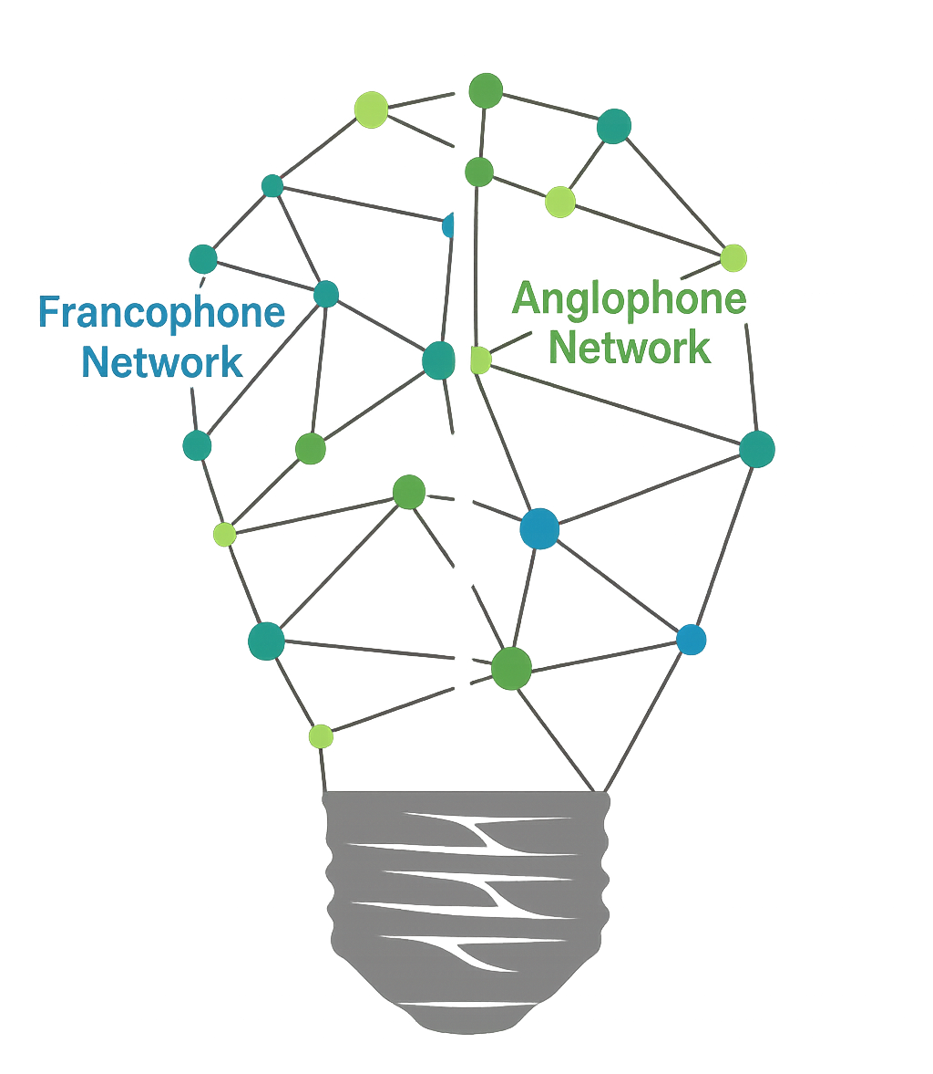
02 · INSTITUTIONALISE · THE DIL NETWORK
The DIL Network
Knowledge sharing across labs
Facilitate continuous exchange of expertise
Capacity building and training programs
Organize workshops, certifications, and mentorship programs
Cross-country collaborative projects
Encourage joint initiatives between DILs
Open innovation platform
Create a shared digital platform
Standardized data governance practices
Develop and promote harmonized frameworks
Innovation challenges and hackathons
Host regular innovation challenges and hackathons
DIL Network
Data Innovation for Africa · AfDB Statistics Department (ECST)
8
Notes:
The DIL Network links francophone and anglophone labs through six mechanisms: knowledge sharing, joint projects, harmonised data governance, capacity building, an open innovation platform, and challenges and hackathons.

Slide 9





03 · PROVE · DATA INNOVATION IN ACTION
Data Innovation Lab: from non-traditional data to development insight
Accessibility Indicator
Nighttime Lights
Displacement Mapping
Connectivity Gaps
Geospatial distance-and-time analysis measuring people’s real access to schools, health facilities & education — piloted in Rwanda’s Nyagatare District.
NASA satellite radiance analysed across Africa to track economic activity and resilience where official statistics are thin — feeding development planning.
Satellite lights × Meta settlement data to track forced displacement across conflict-affected countries.
Ookla × Meta data maps under-served populations across 11 East African countries to target investment.
The engine: the Data Innovation Lab (DIL). Each product runs on governed, licensed data — turning legal access into analytical capability, and analytics into development outcomes in health, energy, education and digital inclusion.
Data Innovation for Africa · AfDB Statistics Department (ECST)
9
Notes:
Proving value: four products built on governed, licensed non-traditional data — accessibility, night-time lights, displacement mapping and connectivity gaps — each tied to development outcomes.

Slide 10

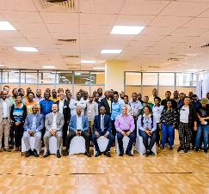
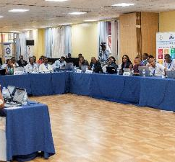
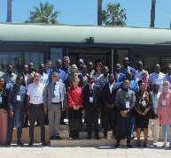
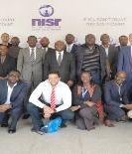
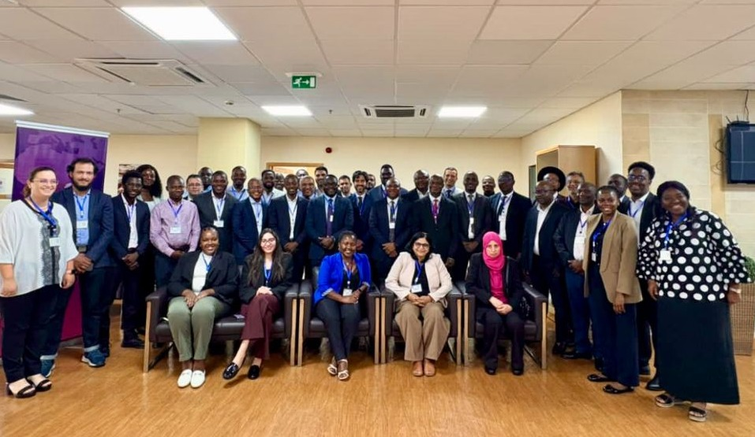
04 · BUILD CAPACITY
From standards to practice
Applied problem-solving through real use cases
Project-based learning for national priorities
Data collection & integration aligned with standards
Tunis · 27–31 May 2024
AfDB & World Bank joint workshop
Kigali · 15–19 May 2023
Kigali · 28 Aug – 1 Sep 2023
Big Data technologies for official statistics
End-to-end data pipelines ensuring quality & traceability
Infrastructure as Code for scalable deployments
AI-ready data infrastructures supporting innovation
Kigali · 23–27 Sep 2024
AfDB & IMF joint workshop
Mauritius · 19–23 May 2025
AfDB & IMF joint workshop
Data Innovation for Africa · AfDB Statistics Department (ECST)
10
Notes:
Capacity building since 2023: five joint workshops with the World Bank and the IMF, moving from standards to practice through real use cases, pipelines, infrastructure as code and AI-ready data infrastructure.

Slide 11











05 · STG17 WORKSHOP · KIGALI 2026
Emerging Issues, Emerging Practice
A capacity-building workshop delivered by the African Development Bank with AU STATAFRIC, under Specialized Technical Group 17 of SHaSA II — AI, large language models and big data for official statistics.
28 September – 2 October 2026
Kigali, Rwanda · English & French
5
27
12
2
days of intensive,
hands-on training
contact hours with
expert facilitators
hands-on laboratories,
each with a fallback
languages — every
notebook in EN & FR
THE WEEK · ONE PIPELINE, FIVE DAYS
DAY 1
DAY 2
DAY 3
DAY 4
DAY 5
AI Concepts
Prompt Engineering
Non-Traditional Data
Night-Time Lights
Publishing & Results
AI, LLMs, RAG, agents & MCP; NSO infrastructure and sovereignty
Designing prompts; choosing models and inference providers
Ookla Speedtest & WorldPop; bias, access and big-data tools
A proxy indicator validated against official subnational figures
Reproducible products on GitHub; country presentations
Source: STG17 workshop website — datainnov4africa-web.github.io/stg17-workshop (accessed September 2026).
Data Innovation for Africa · AfDB Statistics Department (ECST)
11
Notes:
Next milestone: the STG17 workshop 'Emerging Issues, Emerging Practice', Kigali, 28 September to 2 October 2026, delivered with AU STATAFRIC under SHaSA II. Five days, 27 contact hours, 12 hands-on labs, fully bilingual. The week moves from AI concepts to prompt engineering, non-traditional data, night-time lights and finally publishing on GitHub.

Slide 12
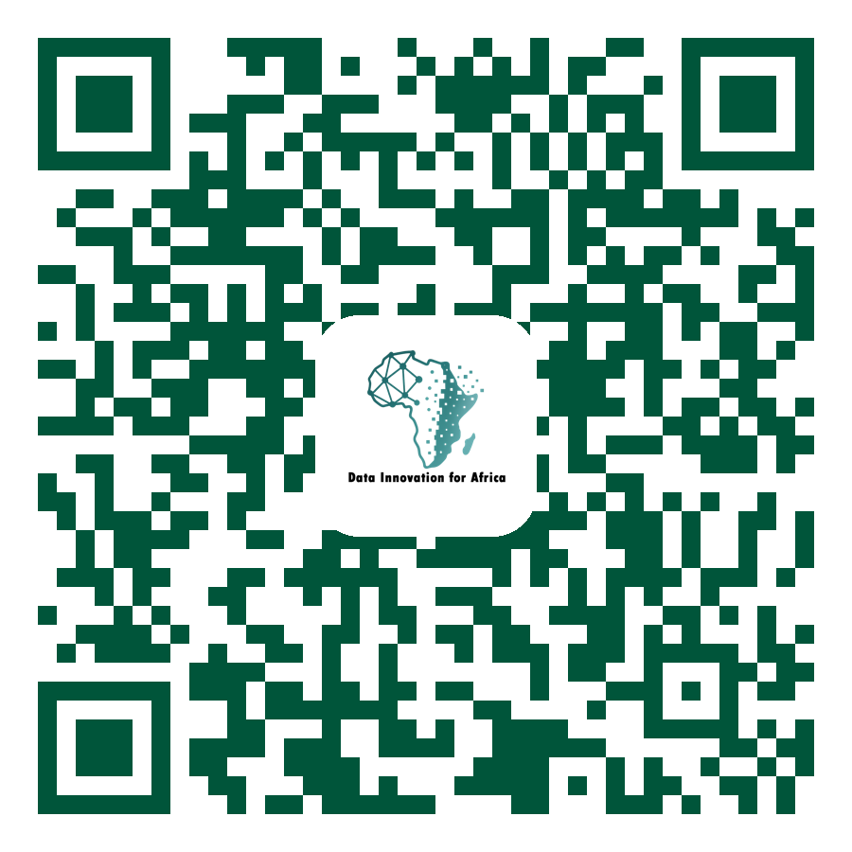
05 · STG17 WORKSHOP · WHAT MAKES IT DIFFERENT
From Kigali’s obstacles to working pipelines
SCAN TO ACCESS THE WORKSHOP
Workshop website
datainnov4africa-web.github.io/stg17-workshop
Agenda, labs, notebooks and slides in English & French. Create your free accounts before you arrive.
Data Innovation for Africa · AfDB Statistics Department (ECST)
12
Notes:
What makes it different: every AU member state is covered by the country registry, every lab has a tested fallback, and the limitations statement is part of the deliverable. It responds directly to the obstacles identified in Kigali in 2025 and to Work Package 4.2 of the Action Plan. Invite participants to scan the QR code and create their accounts before arrival — Earth Engine approval takes time.

Slide 13


THANK YOU · MERCI
Reveal the Power
of Data in Africa
Data Innovation for Africa (DI4A) · Statistics Department (ECST)
Notes:
Thank you. Reveal the power of data in Africa — questions and discussion.

