Slide 1

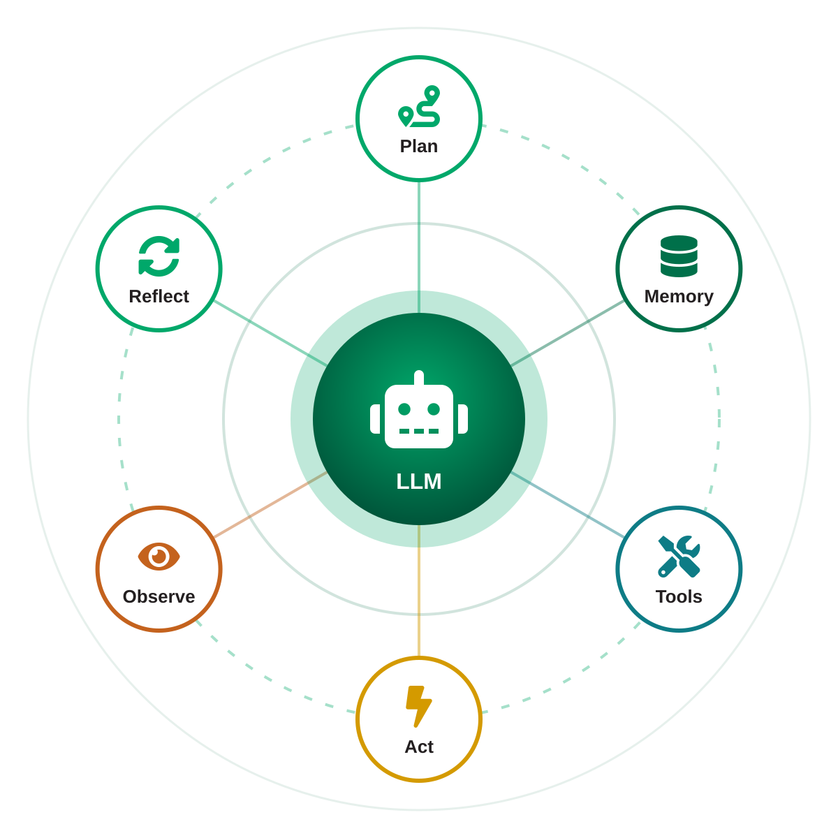
EXECUTIVE BRIEFING
AI Agents &
Agentic AI
From models that answer to systems that act
Concepts
Architectures
Ecosystem
Risks
Data Innovation For Africa (DI4A) - African Development Bank
Notes:
Welcome. This briefing explains what AI agents are, how they work, how they are built, where the field stands and how to deploy them responsibly.

Slide 2







AGENDA
What we will cover
01
02
03
The shift
Definitions
How agents work
Why AI is moving from answering questions to completing tasks
Agent vs. agentic, and the autonomy spectrum
Anatomy, the agent loop, reasoning and memory
04
05
06
Architectures
State of the field
Doing it right
Tools & protocols, workflow patterns, multi-agent systems
Milestones, ecosystem, benchmarks and momentum
Risks, best practices and a decision guide
AI Agents & Agentic AI
02
Notes:
Six parts, from concepts to practice. Each section opens with the question it answers.

Slide 3

SECTION
01
The shift
Why is AI moving from answering to acting?
Notes:
Section transition: introduce the question this section answers.

Slide 4



01 · THE SHIFT
From answering to acting
Generative AI assistant
Agentic AI system
e.g. a classic chatbot
e.g. a coding or research agent
TRIGGER
Responds to a single prompt
TRIGGER
Pursues a goal
PROCESS
One pass: prompt → answer
PROCESS
Multi-step loop: plan → act → observe
OUTPUT
Text, code or images to review
OUTPUT
Completed task & changed state
WHO ACTS?
The human does the work
WHO ACTS?
The agent, under human oversight
Generative AI creates content. Agentic AI gets tasks done.
AI Agents & Agentic AI
04
Notes:
An assistant produces an answer that a human then uses. An agent pursues a goal: it takes actions, checks the results and continues until the task is done.

Slide 5
SECTION
02
Definitions
What exactly is an agent — and what is not?
Notes:
Section transition: introduce the question this section answers.

Slide 6





02 · DEFINITIONS
What is an AI agent?
KEY PROPERTIES
CLASSICAL AI
“Anything that can be viewed as perceiving its environment through sensors and acting upon that environment through actuators.”
Autonomy
Decides the next step without a script
— Russell & Norvig, Artificial Intelligence: A Modern Approach
Goal-directed
Works toward an outcome, not a single reply
LLM ERA
Tool use
Systems where the LLM dynamically directs its own process and tool usage, keeping control over how it accomplishes the task.
Calls APIs, runs code, searches, clicks
Memory
— Anthropic, “Building Effective Agents” (Dec 2024)
Keeps context within and across tasks
In practice: an LLM + tools + memory, running in a loop toward a goal.
Adaptation
Observes results and corrects course
AI Agents & Agentic AI
06
Notes:
The agent concept is old — Russell and Norvig framed AI around agents in the 1990s. What is new is using an LLM as the decision-maker. Practical definition: an LLM using tools in a loop toward a goal.

Slide 7
02 · DEFINITIONS
Agent vs. agentic: a matter of degree
AGENT (noun)
AGENTIC (adjective)
A system that perceives, decides and acts to reach a goal — the “what”.
The degree of autonomy a system has. Popularised by Andrew Ng (2024) to move past the yes/no debate.
THE AUTONOMY SPECTRUM
More autonomy = more flexibility… and more cost, latency & risk
LLM chat
Augmented LLM
Workflow
Agent
Multi-agent
Answers from its training and the prompt
Adds retrieval, tools and memory
LLM steps on predefined code paths
LLM chooses its own steps and tools
Several agents coordinate on a goal
AI Agents & Agentic AI
07
Notes:
Rather than asking 'is this an agent?', ask 'how agentic is it?'. Levels 1–3 are predictable; levels 4–5 are flexible but cost more and carry more risk. Choose the lowest level that solves the problem.

Slide 8

SECTION
03
How agents work
What happens inside an agent?
Notes:
Section transition: introduce the question this section answers.

Slide 9


02 · DEFINITIONS
Not everything that automates is an agent
RPA bot
AI assistant
AI agent
HOW IT WORKS
Follows fixed rules and scripts
Answers prompts in natural language
Reasons, plans and uses tools in a loop
UNEXPECTED INPUT
Breaks when screens or formats change
Understands it, but only replies
Adapts its plan to what it observes
WHO DECIDES THE STEPS
The developer, in advance
The human, turn by turn
The agent, within guardrails
BEST FOR
Stable, high-volume, rule-based tasks
Q&A, drafting, summarising
Variable multi-step tasks with clear goals
EXAMPLE
Copying invoice data into an ERP
Explaining an HR policy
Resolving a support ticket end-to-end
Beware of “agent washing”: rebranding assistants, chatbots or RPA as agents without real agentic capabilities (Gartner).
AI Agents & Agentic AI
09
Notes:
RPA follows scripts; assistants reply; agents decide the steps. Gartner warns that many products marketed as agents are rebranded assistants or RPA.

Slide 10



03 · HOW AGENTS WORK
Anatomy of an AI agent
Planning
Tools
Breaks goals into sub-tasks; reflects on and refines its plan
APIs, code execution, search, databases, computer use
LLM
reasoning engine
Memory
Environment
Short-term (context window) and long-term (external stores)
Where it perceives inputs and observes the effects of its actions
Guardrails · Human oversight
Component view adapted from Lilian Weng, “LLM Powered Autonomous Agents” (2023)
AI Agents & Agentic AI
10
Notes:
The LLM is the reasoning engine. Planning, memory and tools extend it; the environment is where it acts and observes. Guardrails and oversight wrap the whole system.

Slide 11
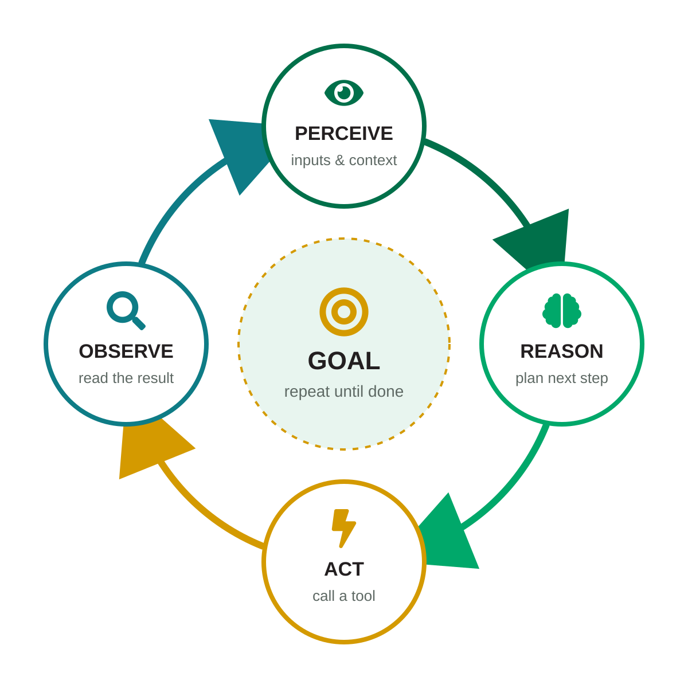
03 · HOW AGENTS WORK
The agent loop
REACT IN ACTION · illustrative trace
Goal: “Remind Acme about their overdue invoice”
Thought
Find the latest unpaid invoice first.
Action
search_invoices(client="Acme")
Observe
INV-2291 · €12,400 · 34 days overdue
Thought
Draft a polite reminder with these details.
Action
create_email_draft(to="billing@acme…")
Observe
Draft saved → request human approval
The loop stops when the goal is met, a limit is reached (steps, time, budget), or human input is needed.
AI Agents & Agentic AI
11
Notes:
ReAct (Yao et al., 2022) interleaves reasoning and acting. Every tool result becomes input to the next reasoning step. Note the final step: the agent asks a human before sending.

Slide 12
03 · HOW AGENTS WORK
Reasoning & planning techniques
Chain-of-Thought
2022
ReAct
2022
Reflexion
2023
Reason step by step before answering; improves multi-step problem solving.
Interleave reasoning with actions and observations — the basis of most agents.
Self-critique after feedback; lessons stored in memory for the next attempt.
Wei et al.
Yao et al.
Shinn et al.
Tree of Thoughts
2023
Plan-and-Solve
2023
Reasoning models
2024
Explore several reasoning paths, evaluate them and backtrack.
First devise a plan of sub-tasks, then execute them one by one.
Models trained to think at length before acting (e.g. OpenAI o1, Sept 2024).
Yao et al.
Wang et al.
Industry
AI Agents & Agentic AI
12
Notes:
These techniques are complementary. Most production agents combine ReAct-style tool use with planning, and increasingly rely on reasoning models trained to think before acting.

Slide 13



03 · HOW AGENTS WORK
Memory: how agents remember
TYPE
WHAT IT HOLDS
TYPICAL IMPLEMENTATION
HUMAN ANALOGY
Working
The current task: instructions, recent steps, tool results
The context window
What you hold in mind right now
Episodic
Past interactions and experiences
Logs, conversation history, reflections
Remembering last week’s meeting
Semantic
Facts and knowledge about the world or the business
Vector databases, RAG, knowledge graphs
Knowing that Paris is in France
Procedural
Skills and how to do things
Model weights, prompts, code, reusable skills
Knowing how to ride a bike
Taxonomy from CoALA — Sumers et al., “Cognitive Architectures for Language Agents” (2023)
AI Agents & Agentic AI
13
Notes:
The context window is working memory and is limited. Long-term memory lives outside the model: logs, vector databases, knowledge graphs — and skills stored as prompts or code.

Slide 14

SECTION
04
Architectures
How are agentic systems built?
Notes:
Section transition: introduce the question this section answers.

Slide 15

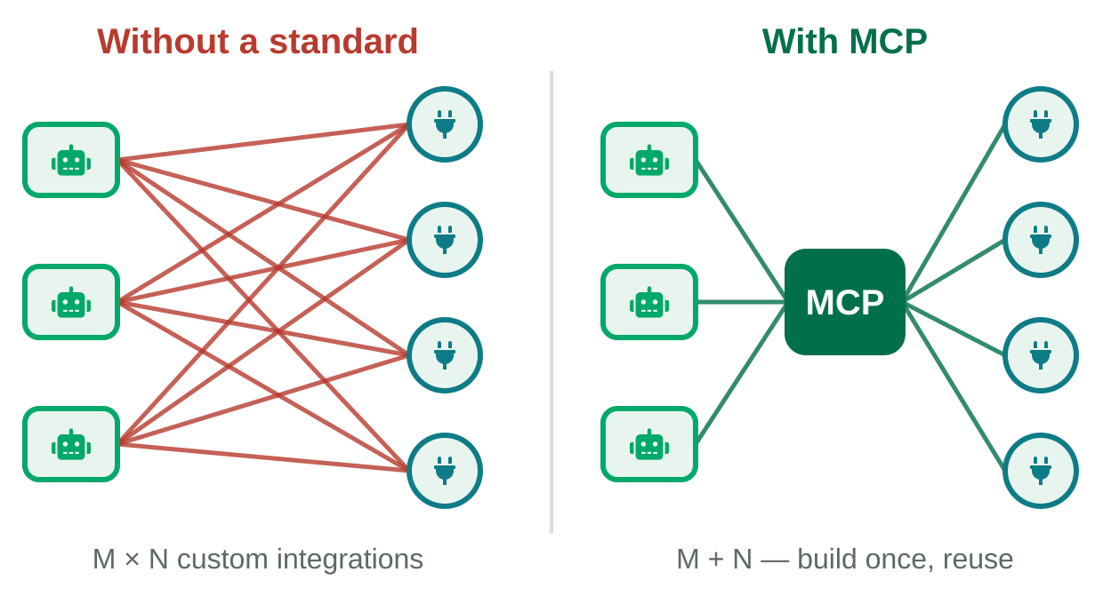



04 · ARCHITECTURES
Tools & protocols: connecting agents to the world
Function calling
WHY A STANDARD MATTERS
The model emits a structured tool call; the application runs it and returns the result.
Model Context Protocol (MCP)
Open standard to connect agents to tools and data. Anthropic, Nov 2024; donated to the Linux Foundation’s Agentic AI Foundation in Dec 2025.
Agent2Agent (A2A)
Open protocol for agents to discover and collaborate with other agents. Google, Apr 2025; now a Linux Foundation project.
Computer use
Agents operate graphical interfaces via screenshots, mouse and keyboard (Anthropic, Oct 2024; OpenAI Operator, Jan 2025, now part of ChatGPT agent).
MCP = agent ↔ tools & data A2A = agent ↔ agent
AI Agents & Agentic AI
15
Notes:
Without a standard, every agent needs a custom connector for every tool. MCP standardises agent-to-tool connections; A2A standardises agent-to-agent collaboration. Both are now under Linux Foundation governance.

Slide 16
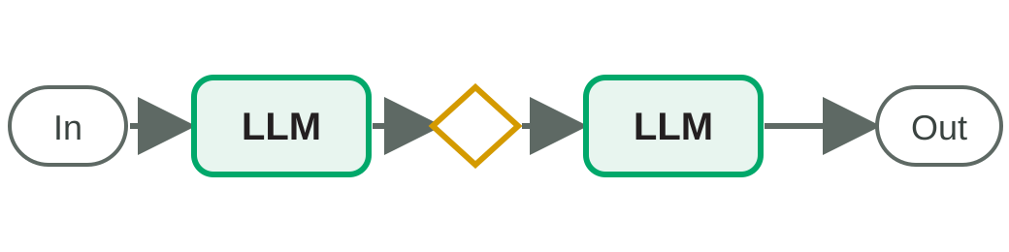
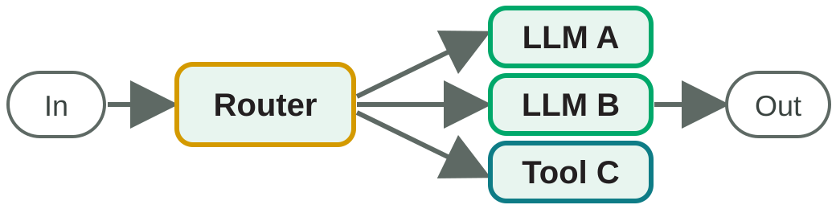
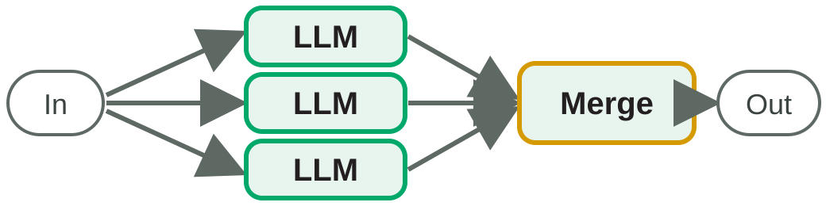
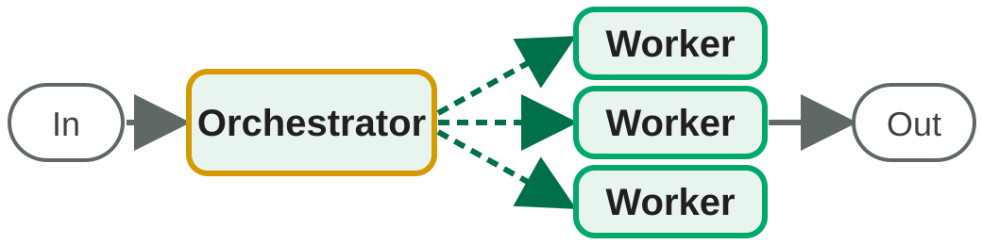
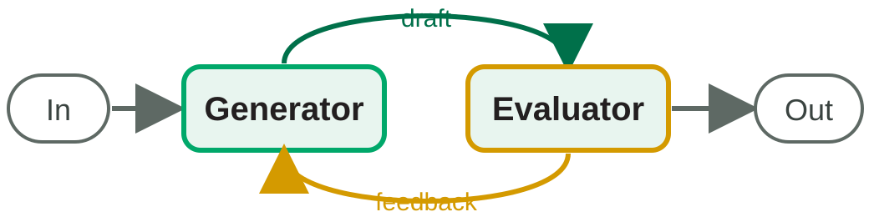
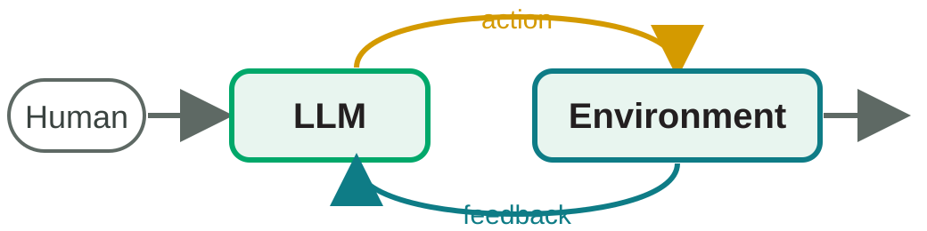
04 · ARCHITECTURES
Building blocks: workflows vs. agents
Prompt chaining
Routing
Parallelization
Fixed sequence of LLM calls, with optional checks (gates) between steps.
Classify the input, then send it to the most suitable specialised handler.
Run sub-tasks simultaneously (sectioning) or several times (voting), then merge.
Orchestrator–workers
Evaluator–optimizer
Autonomous agent
A central LLM breaks down the task dynamically and delegates to workers.
One LLM generates, another critiques, in a loop until quality is met.
The LLM decides its own steps, using environment feedback, until it stops.
WORKFLOWS follow predefined code paths — predictable. AGENTS direct themselves — flexible. Source: Anthropic (2024)
AI Agents & Agentic AI
16
Notes:
From Anthropic's 'Building Effective Agents'. Workflows are predictable and cheaper; agents are flexible. Many successful systems are workflows with a few agentic steps.

Slide 17
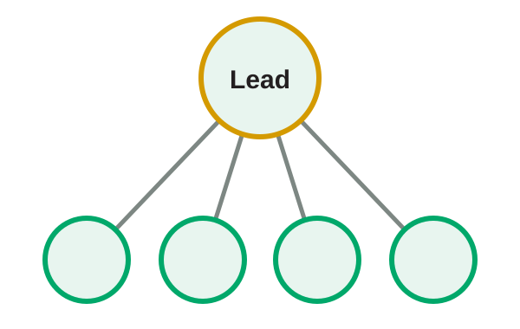
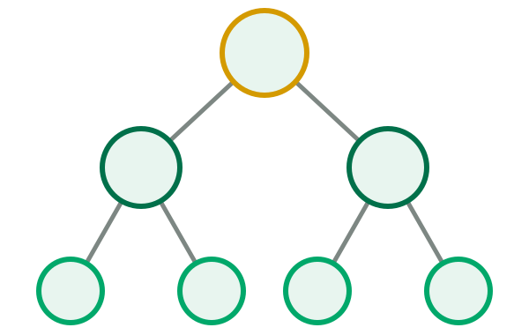
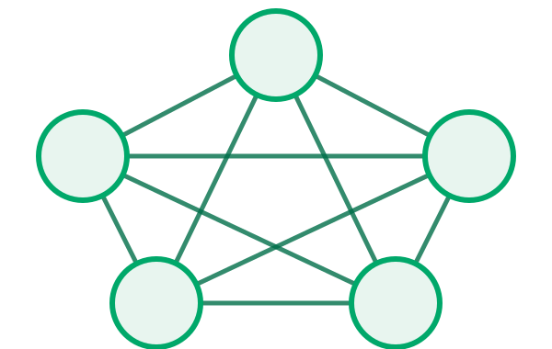
04 · ARCHITECTURES
Multi-agent systems
Orchestrator–subagents
Hierarchical
Peer network
A lead agent plans and delegates to specialists working in parallel
Managers of managers — teams of agents organised in layers
Agents hand off or negotiate directly with one another
+90.2%
Anthropic’s multi-agent research system (Claude Opus 4 lead + Sonnet 4 subagents) vs. a single Opus 4 agent on an internal research eval (2025)
AI Agents & Agentic AI
17
Notes:
Anthropic reported that its multi-agent research system outperformed a single agent by 90.2% on an internal eval, but agents use about 4x the tokens of chat and multi-agent systems about 15x. Use them for high-value, parallelisable work.

Slide 18

SECTION
05
State of the field
Where do we stand today?
Notes:
Section transition: introduce the question this section answers.

Slide 19
05 · STATE OF THE FIELD
Key milestones of the agentic era
Jun 2017
Nov 2022
Jun 2023
Nov 2024
Apr 2025
Transformer architecture (“Attention Is All You Need”)
ChatGPT launches
Function calling in the OpenAI API
Anthropic open-sources MCP
Google announces the A2A protocol
Oct 2022
Mar 2023
Oct 2024
Feb 2025
Dec 2025
ReAct paper: reasoning + acting
AutoGPT sparks the autonomous-agent wave
Anthropic releases computer use
Agentic coding & deep research tools go mainstream
Linux Foundation forms the Agentic AI Foundation
Feb 2025 examples: Anthropic Claude Code (research preview) and OpenAI Deep Research.
AI Agents & Agentic AI
19
Notes:
The agentic wave rests on the Transformer (2017) and on ReAct-style prompting (2022). From late 2024, computer use and open protocols moved agents from demos to products.

Slide 20




05 · STATE OF THE FIELD
The ecosystem at a glance
Open-source frameworks
Vendor agent SDKs
Agent products
Open standards
LangGraph (LangChain)
CrewAI
Microsoft Agent Framework (successor to AutoGen & Semantic Kernel)
LlamaIndex
goose (now under AAIF)
OpenAI Agents SDK
Claude Agent SDK (Anthropic)
Agent Development Kit (Google)
Amazon Bedrock Agents
Coding: Claude Code, OpenAI Codex, GitHub Copilot, Cursor
Research: Deep Research (OpenAI, Google)
Enterprise: Salesforce Agentforce, Microsoft Copilot Studio
MCP — agent ↔ tools
A2A — agent ↔ agent
AGENTS.md — guidance for coding agents
Non-exhaustive selection — the landscape evolves rapidly.
AI Agents & Agentic AI
20
Notes:
A non-exhaustive map: open-source frameworks, vendor SDKs, finished products and the open standards that connect them.

Slide 21
05 · STATE OF THE FIELD
Measuring agents: benchmarks & progress
SWE-bench Verified
Fix real GitHub issues (500 human-validated tasks)
SWE-bench Pro
Harder, more contamination-resistant successor (Scale AI, 2025)
OSWorld
Complete tasks on real desktop operating systems
WebArena · GAIA
Web tasks · general-assistant questions with tools
τ-bench
Customer-service dialogues with tools and policies
Caveat: in Feb 2026 OpenAI stopped reporting SWE-bench Verified (contamination, flawed tests) and now recommends SWE-bench Pro.
Vendor-reported at launch (GPT-5 on 477 of 500 tasks). Scaffolds differ: compare trends, not decimals.
AI Agents & Agentic AI
21
Notes:
SWE-bench Verified asks models to fix real GitHub issues. Launch scores rose from about a third to over 80% in roughly 15 months. Scaffolds differ between labs, so read the trend rather than exact rankings. Important: in February 2026 OpenAI stopped reporting this benchmark, citing contamination and flawed tests, and recommends SWE-bench Pro. Later scores on Verified should be read with caution.

Slide 22
05 · STATE OF THE FIELD
Momentum: capability and adoption
~7 mo
<5% → 40%
2% → ~30%
Doubling time of the length of tasks frontier agents complete with 50% reliability (2019–2025)
Enterprise apps integrating task-specific AI agents, 2025 → end of 2026 (forecast)
Share of enterprise app software revenue driven by agentic AI, 2025 → 2035 (best case, >$450B)
METR, Mar 2025
Gartner, Aug 2025
Gartner, Aug 2025
GARTNER’S EXPECTED EVOLUTION OF ENTERPRISE AI
2025
2026
2029
AI assistants embedded in almost every enterprise app
Task-specific agents in 40% of enterprise apps
Multi-agent ecosystems collaborating across apps
AI Agents & Agentic AI
22
Notes:
METR measures the length of tasks, in human time, that agents complete with 50% reliability; it has doubled roughly every 7 months since 2019. Gartner figures are forecasts, not measurements.

Slide 23




05 · APPLICATIONS
Where agents are creating value
Software engineering
Customer service
Navigate codebases, write & test code, fix bugs, open pull requests
Resolve requests end-to-end with tools, escalate to humans when needed
Research & analysis
IT & security ops
Search many sources, cross-check them and write cited reports
Triage alerts and incidents, gather evidence, propose remediation
Finance & back-office
Sales & marketing
Process documents, reconcile records, prepare reports
Research accounts, qualify leads, personalise outreach
AI Agents & Agentic AI
23
Notes:
Agents work best where success is verifiable — tests pass, the ticket is resolved, sources are cited — and where humans can review high-impact actions.

Slide 24

SECTION
06
Doing it right
How do we deploy agents safely — and create value?
Notes:
Section transition: introduce the question this section answers.

Slide 25
06 · DOING IT RIGHT
Why reliability is the hard part
Errors compound over long tasks
If every step succeeds independently with probability p, a task of n steps succeeds with probability:
P(success) = p^{n}
95% per step → only 36% after 20 steps
Real steps are not fully independent — this is a simplified model
Remedy: verification, checkpoints, retries and human review
AI Agents & Agentic AI
25
Notes:
Simplified model: with 95% reliability per step, a 20-step task succeeds only about 36% of the time. This is why verification, retries and checkpoints matter so much.

Slide 26






06 · DOING IT RIGHT
Key risks and challenges
Prompt injection
Excessive agency
40%+
Malicious instructions hidden in web pages, documents or emails hijack the agent. #1 in the OWASP Top 10 for LLM Apps (2025).
Too many permissions or too much autonomy turn a small error into real damage (OWASP LLM06:2025).
of agentic AI projects will be canceled by end of 2027 — due to rising costs, unclear business value or weak risk controls.
Confident errors
Cost & latency
Hallucinated facts or wrong actions, amplified over long multi-step tasks.
Many model calls per task: agents use far more tokens and time than chat.
~130
genuine agentic vendors among thousands — the rest is “agent washing”.
Accountability
Data exposure
Who approved what? Actions must be traceable, auditable and reversible.
Agents with broad data access can leak sensitive information (OWASP LLM02:2025).
Gartner, June 2025
AI Agents & Agentic AI
26
Notes:
Prompt injection is ranked #1 in the OWASP Top 10 for LLM applications (2025). Gartner expects over 40% of agentic AI projects to be canceled by end-2027 for cost, value or risk-control reasons.

Slide 27



06 · DOING IT RIGHT
Match human oversight to the risk
OVERSIGHT
OVERSIGHT
OVERSIGHT
Human in the loop
Human on the loop
Human out of the loop
A person approves each key action before it runs.
The agent acts; a person monitors and can intervene or roll back.
Fully autonomous within strict, tested limits.
USE FOR
USE FOR
USE FOR
High-impact or irreversible actions
Medium risk, reversible actions
Low risk, easily reversible, well-evaluated tasks
EXAMPLES
EXAMPLES
EXAMPLES
Payments, emails to clients, production deployments
Ticket triage, code changes on a separate branch
Tagging documents, summarising logs
Rule of thumb: the higher the impact and the harder to undo, the closer the human must stay. Loosen oversight only as evaluations build trust.
AI Agents & Agentic AI
27
Notes:
Oversight is a dial, not a switch. Start with humans in the loop, measure performance, and move to on-the-loop only when evaluations justify it.

Slide 28



06 · DOING IT RIGHT
Design principles for reliable agents
BUILD
SECURE
OPERATE
Start simple
Least privilege
Set limits
A single LLM call or workflow first; add autonomy only when it measurably helps.
Minimum permissions; sandbox code execution and browsing.
Cap steps, time and budget; define clear stop conditions.
Invest in tool design
Treat inputs as untrusted
Make it observable
Clear names, descriptions, examples and error messages.
Separate instructions from data to limit prompt injection.
Trace every reasoning step, tool call and result.
Evaluate continuously
Gate risky actions
Plan for failure
Task-level evals built from real cases, run before every change.
Human approval for irreversible, costly or sensitive steps.
Prefer reversible actions, checkpoints and a rollback path.
AI Agents & Agentic AI
28
Notes:
Principles drawn from Anthropic's 'Building Effective Agents' (simplicity, transparency, tool design) and OWASP guidance for LLM applications.

Slide 29
06 · DOING IT RIGHT
Do you really need an agent?
Q1 Are the steps hard to predict in advance?
No
Use a script, RPA or a fixed workflow
Yes
Q2 Is the value high enough to justify cost & latency?
No
Use a single LLM call or a simple workflow
Yes
Q3 Can errors be detected and recovered (tests, review)?
No
Keep a human approving each key action
Yes
An agent is a good fit — start narrow, measure, then expand.
Guided by Anthropic’s “Building Effective Agents” (2024)
AI Agents & Agentic AI
29
Notes:
Many tasks marketed as agentic do not need an agent. Answer these three questions before building one.

Slide 30




KEY TAKEAWAYS
Agents turn AI from a tool you use into a system that works for you.
An agent is an LLM using tools in a loop, toward a goal.
“Agentic” is a spectrum — choose the least autonomy that works.
Open standards (MCP, A2A) are making agents interoperable.
Value comes with discipline: evals, guardrails, human oversight.
Thank you · Questions?
Notes:
Summary: agents are LLMs using tools in a loop; start simple, add autonomy where it pays off, and keep humans in control of high-impact actions.

Slide 31
APPENDIX
Sources & further reading
Russell & Norvig — Artificial Intelligence: A Modern Approach (4th ed., 2020)
Anthropic — “Building Effective Agents” (Dec 2024)
Anthropic — “How we built our multi-agent research system” (Jun 2025)
L. Weng — “LLM Powered Autonomous Agents” (2023)
Wei et al. — Chain-of-Thought Prompting (2022)
Yao et al. — ReAct: Synergizing Reasoning and Acting (2022)
Shinn et al. — Reflexion (2023)
Yao et al. — Tree of Thoughts (2023)
Wang et al. — Plan-and-Solve Prompting (2023)
Sumers et al. — Cognitive Architectures for Language Agents (2023)
Kwa et al. (METR) — Measuring AI Ability to Complete Long Tasks (2025)
Jimenez et al. — SWE-bench (2023); OpenAI — SWE-bench Verified (2024) and its retirement note (Feb 2026)
Gartner press releases — 25 Jun 2025 & 26 Aug 2025
Linux Foundation — Agentic AI Foundation announcement (9 Dec 2025)
OWASP — Top 10 for LLM Applications (2025)
modelcontextprotocol.io · a2a-protocol.org
AI Agents & Agentic AI
31
Notes:
All figures in this deck come from the sources listed here.

