Slide 1



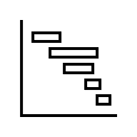
Interpretive Enhancement
Dashboard | Sales by Month
Highlights of Peak and Low-Performing
Contextual Cues
Insight Narratives
Performance
Baseline/Benchmark
Explanation
Layer 3
Meaning
100
Multi-
dimensional
Context
Sales (M)
50
Total 4-month sales reached 300M, averaging 75M per month. February was the peak at 100M due to reason K. The business can explore and implement solutions X and Y to leverage this trend.
Month 1 2 3 4
Cognitive Alignment
Sales by Month
Highlights of Peak and Low-Performing
Layer 2
Reasoning
Chart Types
Pattern, Focus
Semantic Consitency
Interactivity
Filter
Drill-down
100
Enhanced Visual EDA Framework
Sales (M)
50
Sales (M)
Focus
Month 1 2 3 4
Week 1 2 3 4
Visual Encoding
Layer 1
Perceptual
Graphical Accuracy
Gestalt Principles
Color Strategy
Layout & Clutter Reduction
Text & Labelling
Highlights
Sales by Month
Visual Defaults
Highlights
Layer 0
Display Data
Basic Graphical
Display Data
Default Layout
Baseline
Sales by Month

Slide 2
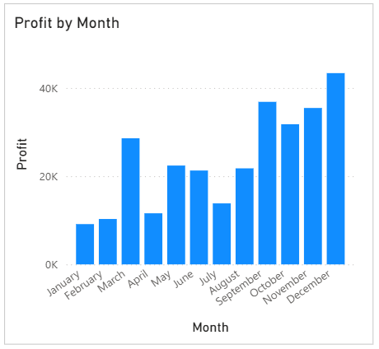
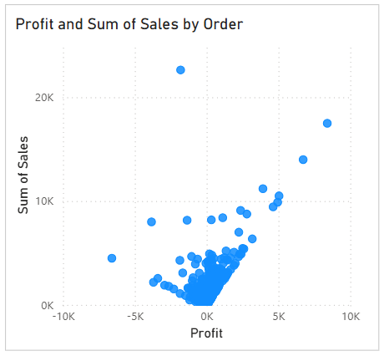
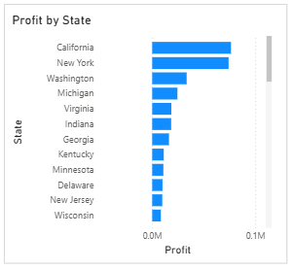


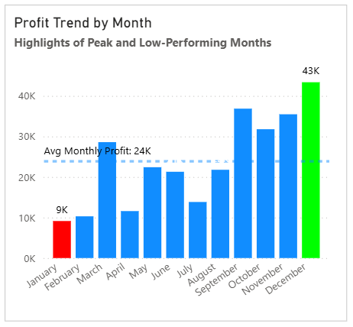
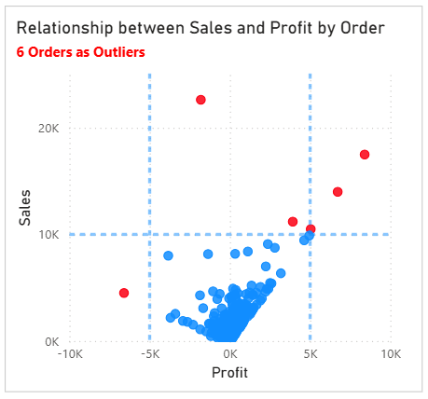
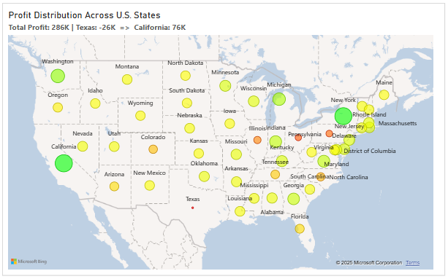
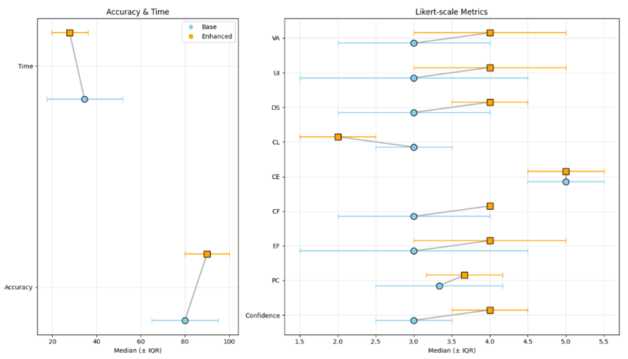

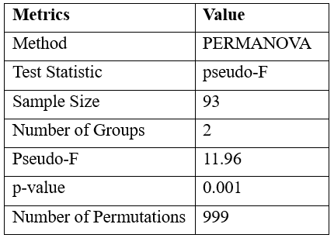
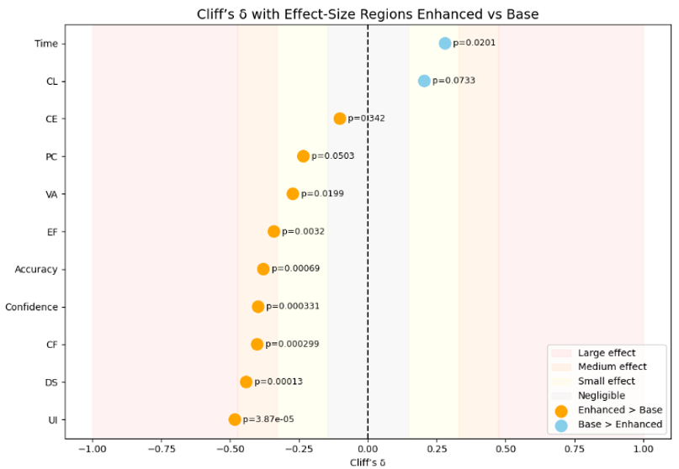
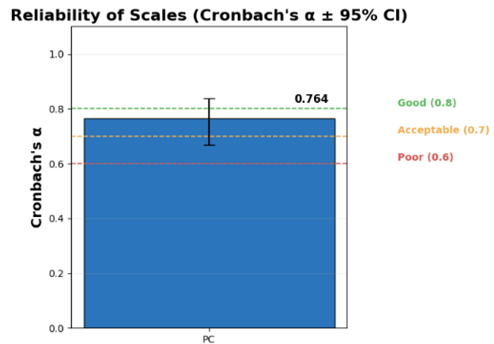
H0: The Enhanced EDA dashboard has a significant impact on participants’ analytical performance, cognitive load, engagement, and user experience.
Pre-Processing
↑ Accuracy
(H1)
↓ Time
Baseline Dashboard
47 people (94%)
↑ Confidence
Power Analysis with Cliff’s Delta
↓ Cognitive Load (CL)
50 people
(H2)
↑ Perceived Clarity (PC)
↑ Analytical Confidence (CF)
Descriptive Statistics
Mean, SD
Median, IQR
↑ Decision Support (DS)
46 people (92%)
(H3)
Enhanced Dashboard
↑ Cognitive Engagement (CE)
50 people
↑ Usability (UI)
Interpretive
Cognitive
(H4)
↑ Visual Attractiveness (VA)
Visual
↑ Efficiency (EF)
Good Dashboard
EDA as a Pre-Model Explainability Layer
Information Visualization as an Interpretive Medium
Mann-Whitney and Cliff’s Delta Testing
PERMANOVA Testing
Reliabiliity Testing
PC items
The data processing is carried out using Python

Slide 3
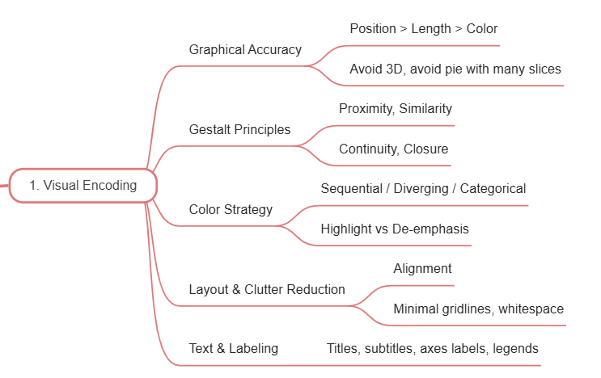
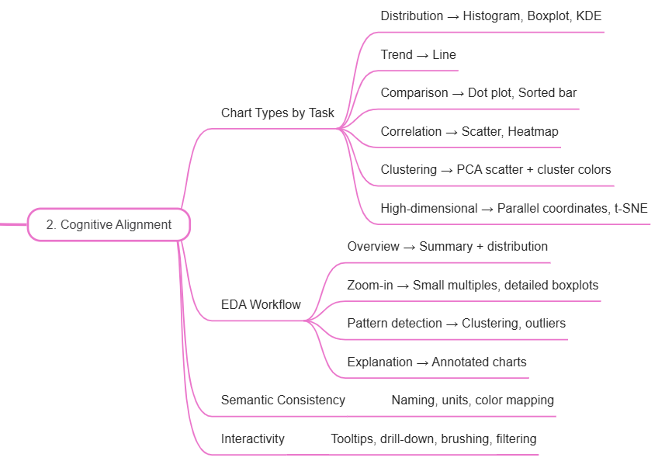
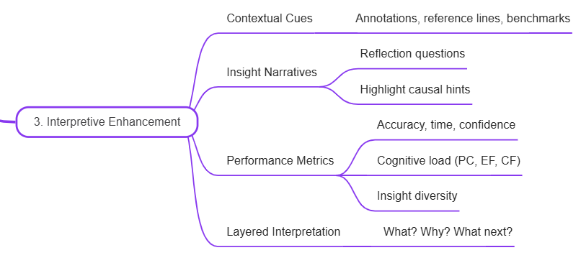
EDA Process
Sub-Process
Visual Suggestion
Visual Enhancement
Business Object Definition
Understanding the dataset
Summary Table
Removing Redundant Variable
Bar, Pairplot, Correlation
Cleaning the dataset
Handing Missing Value
Missing Matrix, Missing Heatmap
Handing Outliers
Boxplot, Violin, Scatter
Distribution Analysis
Historgram, KDE, Bar
Analyzing relationship
Correlation Analysis
Heatmap, Pairplot, Scatter
Target/Measure Analysis
Pareto, Pie, Bar, Map, Line
Synthesize insights
Dasboard Summary

Slide 4
Raw Data Input
Enhanced Visual EDA Framework
Understanding Data Structure
Distribution
Outliers
Noise
Detecting Bias and Ethical Risk
Imbalance
Proxy Attributes
MNAR, Leakage
Revealing Feature Relationships
Correlation
Nonlinearity
Interaction
Pre-Model Explainability
Understanding the learning environment
Establishing interpretability priors
Identifying risks before modelling
Model Design Decision
Choose interpretable models if feasible
Apply regularization based on collinearity
Address imbalance, noise, outliers
Ensure fairness-aware model choice
Model Training and Post-Model XAI
(e.g., SHAP, LIME …)
Holistic Explainability (Pre and Post XAI)
Interpretation anchored in EDA baseline
More robust, fair, transparent decisions

