Slide 1


UBS PITCH 2023
Team: Number Crunchers
Stevens Institute of Technology

Slide 2
OBJECTIVE
Help develop innovative solutions that will :
Help investors make informed investment decisions,
Find balance between risk adjusted returns and ESG alignment
Promote sustainable practices.

Slide 3
IDEAS
A chatbot for ESG awareness
New metric compatibility along with predefined metric (ESG score) from Bloomberg
Customer Centric Approach
Portfolio optimization considering ESG

Slide 4
BLOOMBERG ASSESSMENT
Bloomberg ESG Scores and Industry specific ESG Scores to help identify ESG risks and opportunities.

Slide 5
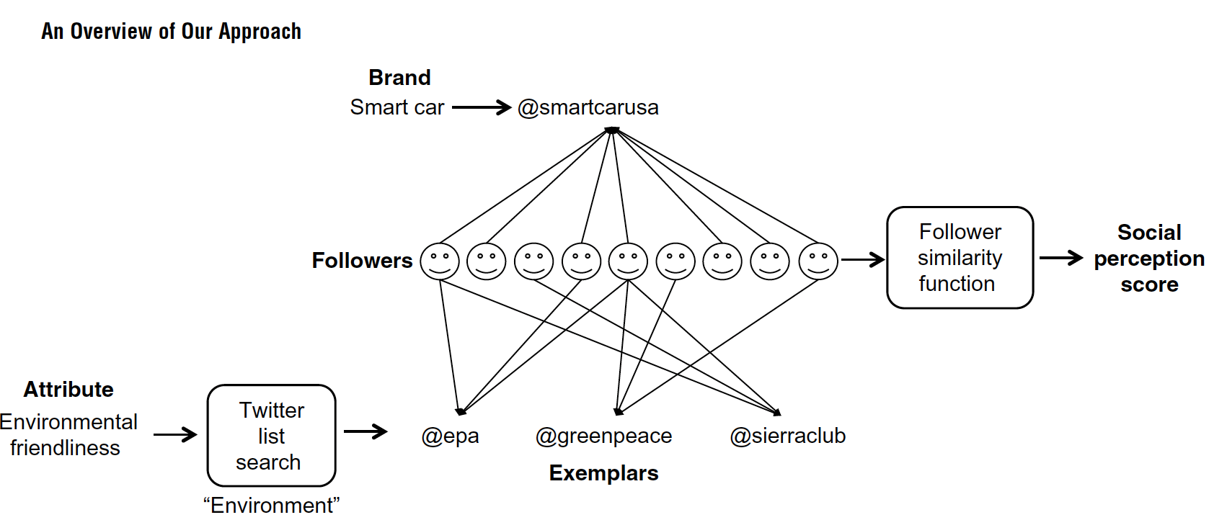
SOCIAL FEEDBACK SCORE

Slide 6
THE OPTIMIZATION METHODOLGY
The methodology is as follows:
1. Creation of a portfolio of stocks having the leading ESG scores among peer companies
2. Generation of return distributions for each asset adjusted by the ESG factors
3. Calculation of a Correlation matrix
4. Using Monte Carlo simulation to generate random portfolio weights for each asset constrained by investment
objectives and asset allocation targets
5. Evaluation of portfolio performance based on returns, volatility, and risk measure
6. Optimization of portfolio considering ESG factors and other investment constraints
7. Monitoring the portfolio to ensure that it continues to meet the investment objectives and aligns with ESG factors.

Slide 7
Thankyou!

