Slide 1

COURSERA CAPSTONE PROJECT
APPLIED DATA SCIENCE

Slide 2
INTRODUCTION
NYC has an enourmous population density
Resteraunt market is highly competitive.
To be successful a business needs to invest in its strategy, pricing aswell as location. Analyzing the market is one of the key methods to set up a business for long-term success.

Slide 3

Question: where to locate an upper class pizza resteraunt in NYC?
Business case: Ferrari Family wants to open up a Pizza Place in NYC but is unsure where to locate it.

Slide 4
DATA
To solve the problem the following data sources will be used
Data about Neighbourhoods of New York provided in .json format
Data about venues retrieved from Foursquares API

Slide 5
DATA
To solve the problem the following data sources will be used
Data about Neighbourhoods of New York provided in .json format
Data about venues retrieved from Foursquares API

Slide 6
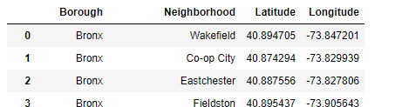
DATA
306 Neighbourhoods of New York from this link: https://cf-courses-data.s3.us.cloud-object-storage.appdomain.cloud/IBMDeveloperSkillsNetwork-DS0701EN-SkillsNetwork/labs/newyork_data.json
Essentiell step:
Data population from JSON format into Pandas DataFrame

Slide 7
DATA
Foursquares API: https://www.foursquares.com
Essentiell step:
API calls from Foursquares API. Data population into pandas DataFrame

Slide 8
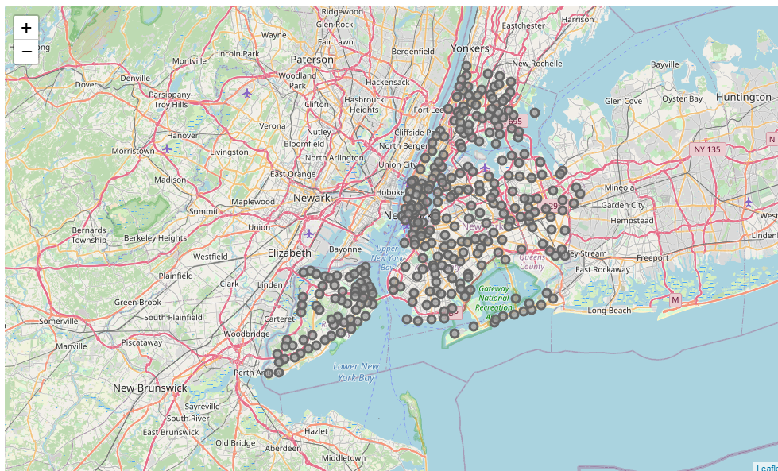
DATA
Visualization as sanity check…

Slide 9
METHODOLOGY
Data crawling
Data preperation
k-means clustering
Result visualization

Slide 10
METHODOLOGY k-means clustering
k-means clustering identifies k number of centroids and allocates the specific Neighbourhoods to one oft he clusters
Due to its simplicity it is one oft he most popular unsupervised machine learning algorithms.
The frequency of occurance of Pizza Places within the Neighbourhood will be the main factor for the k-means clustering.

Slide 11
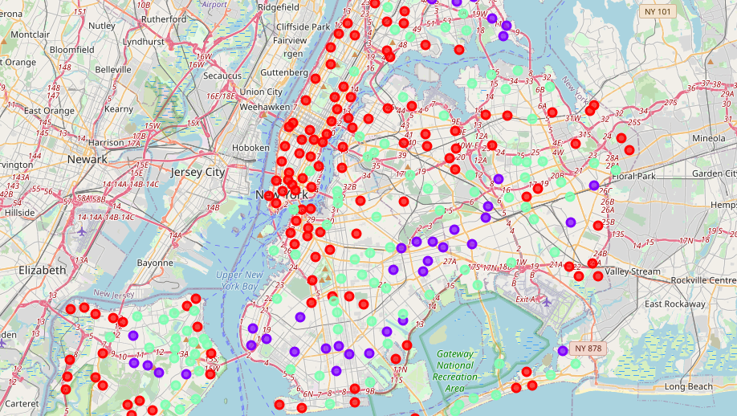
RESULT of k-means clustering

Slide 12
RESULT DISCUSSION
Lot of Neighbourhoods with no big competitionin NYC Manhattan
Many Pizza places in suburban areas where most of population lives -> not good choices
This analysis is only the first filter. Another criteries such as demand within the Neighbourhoods or other information should be obtained. But red Neihbourhoods seem suitable!

Slide 13
CONCLUSION
Various neighbourhoods with competitor-less markers
Interestingly high amound of Pizza places in suburban areas, not in city center
More factors to be taken into consideration before giving a bulletproof recommendation for a location but first filter applicable with this report

