Slide 1
Estimated Parish Level Emissions
XXX Ben Anderson

Slide 2
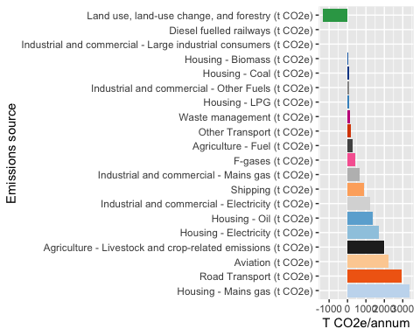
Territorial emissions: Parish

Slide 3
Total territorial emissions: 1.624404^{4}`

Slide 4
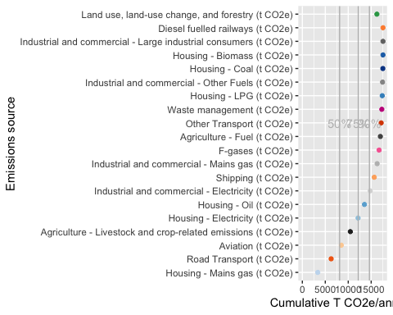
Territorial emissions: Parish

Slide 5
## Territorial emissions: comparing parish and district

Slide 6
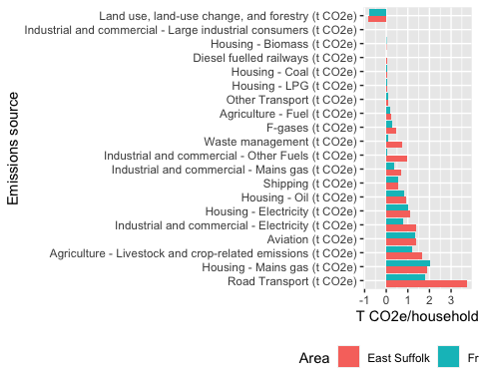

Slide 7
Data
Parish level estimates from the Centre for Sustainable Energy’s ‘Impact Tool’:
Data download
Methodology Guidance

