Slide 1
IntroML ML. 8 Unsupervised learning
DataLab CSIC

Slide 2
Objectives and schedule
Introduce key concepts about dimension reduction, generation and clustering beyond those seen earlier. To be mentioned: PCA, encoders, GANS, t-SNE, UMAP. K-means, k-medoids, mixture models (and others)
Contents
Intro
Dimension reduction
Generation
Clustering
Case by Simón R., Pablo V., Edu G. using VAEs to generate interesting molecules (for drug discovery)
ISLR 10, Bishop 9, 12, Goodfellow et al 14, 20, Chollet and Allaire 8

Slide 3
Lab 8
Matrix factorization
PCA vs tSNE
UMAP
K-means
Hierarchical clustering
Gaussian mixtures

Slide 4
Motivation

Slide 5
Elements of unsupervised learning
Given
Input space
Training set
Objective
Learn model
Infer some property
Sample

Slide 6
Challenges in unsupervised learning
High dimension feature space
Properties of interest more complex than parameter estimation
No direct error quantification measure

Slide 7
Taxonomy of unsupervised learning algos
Density estimation
Manifold learning: PCA, non-linear PCA, Autoencoders,…
Finding modes and groups: cluster analysis, mixture models,…
Sampling: GANs, Variational autoencoders,…

Slide 8
Dimension reduction

Slide 9
Dimension reduction
PCA
Non-Negative matrix factorization
Autoencoders
t-SNE
UMAP

Slide 10
PCA
Given
Find linear projection to space of smaller dimension maximizing variance of projected data

Slide 11
PCA: Maximum variance
1 dimensional projection
Projection defined by
Projection is
Mean of projected data
Variance of projected data

Slide 12
PCA: Maximum variance
Problem to be solved
Lagrangian formulation
Solution
Projection is eigenvector associated with first eigenvalue!!!
(and so on)

Slide 13

NMF: Non-negative matrix factorisation
Approximate data matrix X nxp with W nxr and H rxp so that
and W, H minimising a certain cost function. Two typical choices
Frobenius norm min s st
‘Kullback-Leibler divergence’ min st
Dimension reduction, text mining, recommender systems, communities
KL version. ML with

Slide 14
NMF: Recommender systems
X, number of Product units that Customer bought
Each column of W defines a market segment (weights-relevance of Product for such Segment)
Each column of H defines belongness of Customer to Segment
Each Customer generated as combination of latent variables (segments)
Recomm: To a Customer, Products with bigger weight
For a Product, to Customer with bigger weights

Slide 15
Autoencoders
For fast tutorials
http://ufldl.stanford.edu/tutorial/unsupervised/Autoencoders/
https://jaan.io/what-is-variational-autoencoder-vae-tutorial/

Slide 16
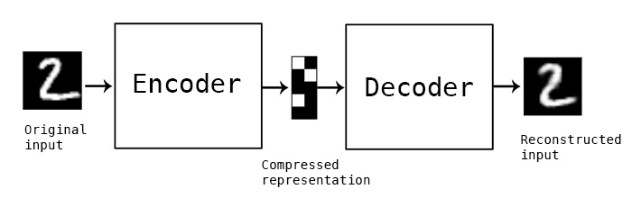
Autoncoders
Data compression algos with compression and decompression functions
Comp and decomp are typically NNs. Called Encoder, Decoder
Unsupervised learning (or self supervised learning)

Slide 17
Autoencoders

Slide 18
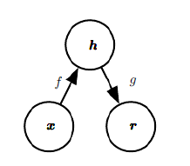
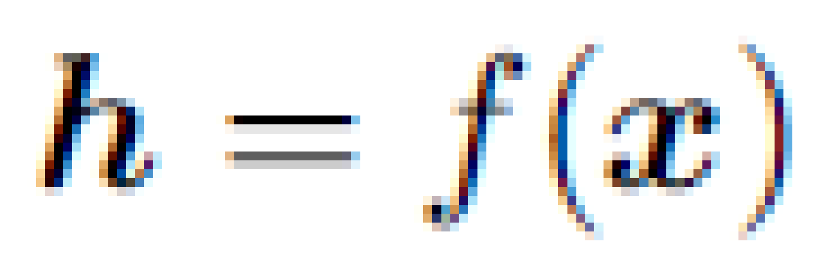
Autoencoder
Neural net trained to copy its input as output (ie output=input)
Encoder f, Decoder g
Main uses:
Feature extraction
Dimension reduction
Network initialization Generative models
Then used for something else
As layer in other architectures
Hidden

Slide 19
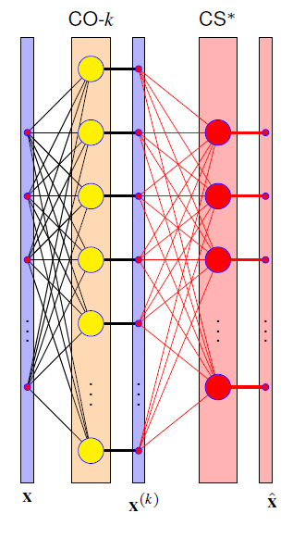
Autoencoder
Training in hidden layer to obtain a projection of input with little information loss
Input
Desired output
Output layer ‘thrown away’
Just a mechanism to avoid info loss (projection is reversible)
Hopefully, we learn relevant features in the process

Slide 20

Autoencoder
Once designed, the usual method
Min
Sample minibatch
Forward prop in graph to get loss (possibly + regulariser)
Backward prop in graph to estimate gradient
Update parameters with gradient

Slide 21
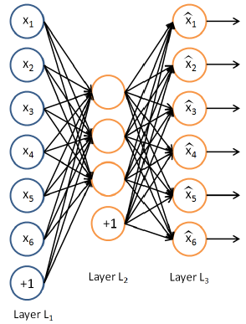
Incomplete autoencoder
Constrain h to have dimension smaller than x
Capture more relevant data features

Slide 22

Incomplete autoencoder
Min
When decoder is linear and L is MSE, PCA…
When f and g nonlinear, nonlinear generalisation of ACP
But if too much capacity to f and g, may be not much is learnt

Slide 23
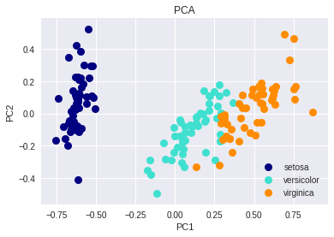
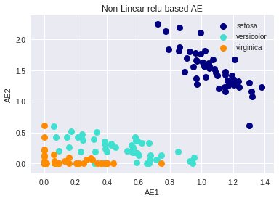
PCA vs AE
Example with Iris, projecting in two latent dimensions

Slide 24


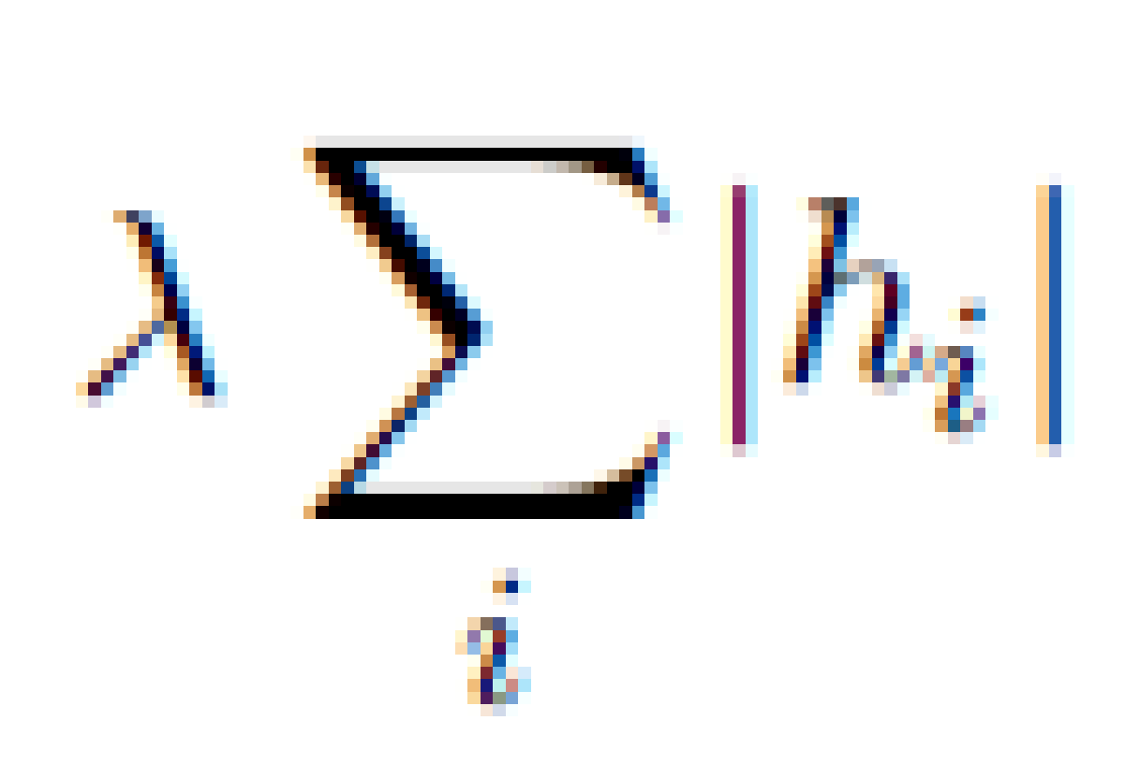
Regularised autoencoder
When the dimension of hidden layer is greater than that of
Input, supercomplete autoencoder
Introduce a regulariser
Min
where is the regulariser, e.g.
to obtain a sparse representation

Slide 25


Denoising autoencoder
Include noise to input to obtain robust projections
Input
Desired output

Slide 26
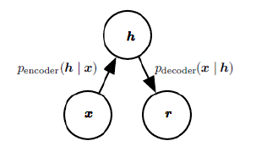
Other important concepts (but little time available…..)
Stacked autoencoders: hierarchy of representations
Stochastic encoders and decoders: probabilistic vision,
encoding and decoding functions as distributions

Slide 27
Variational autoencoders
Variational autoencoders: Bayesian version, incorporating prior info about internal data representation. Variational Bayes.

Slide 28
GANs
Goodfellow’s tutorial in github
https://www.youtube.com/watch?v=9reHvktowLY

Slide 29
GANs
Purpose generate new data
Learns training set distribution(density estimation) and generates images not seen before

Slide 30
GANS

Slide 31
GANS

Slide 32
GANS

Slide 33
A sketch of GAN training
Observed variables x
Latent variables z
Generator, a NN
Discriminator, a NN
Cost for generator
Cost for discriminator
Min Max expected cost. Nash equilibria. SGD

Slide 34
tSNE: t-distributed stochastic neighbour embedding
Underlying problem. Find nonlinear transfo
such that both distributions are as similar as possible, so as to minimise some divergence
so as to preserve distances, topologies,…
https://lvdmaaten.github.io/tsne/

Slide 35
SNE
SNE converts euclidean distances in similarities, interpretable as probabilities
Distributions of neighbours of point i
Optimize Kullback-Leibler divergence

Slide 36
From SNE to tSNE
Optimize more efficiently defining (symmetric SNE)
Change Gaussian kernel by t-Student kernel (heavier tails entail ‘’less of a collapse” over Y)

Slide 37
Conceptual example
PCA vs tSNE
If you plan to use it plz read https://distill.pub/2016/misread-tsne/

Slide 38
UMAP: Uniform manifold approximation and projection
Check for an intro
https://pair-code.github.io/understanding-umap/
The original paper (very recent)
https://arxiv.org/abs/1802.03426

Slide 39
UMAP
Associate weighted graph to (high-dimensional) dataset
Weights represent likelihood of points being connected
UMAP extends radius from each point, connecting when radii overlap
Too small isolated, too large everything connected. Chooses radius locally in connection with n-th nearest neighbour
Fuzzifies graph (as in fuzzy set theory) https://en.wikipedia.org/wiki/Fuzzy_set
Find a low dimensional representation fo graph (as tSNE but a bit faster)

Slide 40
Clustering

Slide 41
Cluster Analysis
Make groups of individuals (heterogeneity in population)
Individuals in same cluster more similar than those in different clusters
Determine hierarchies of individuals
Marketing, Natural Sciences, Social Sciences

Slide 42
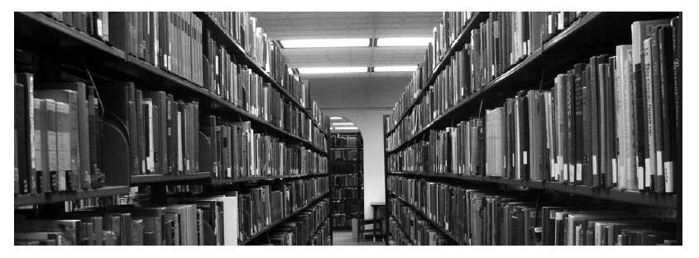
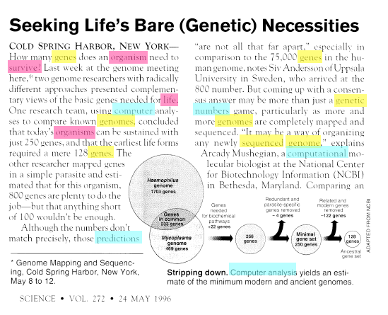
Example: Probabilistic topic modelling

Slide 43
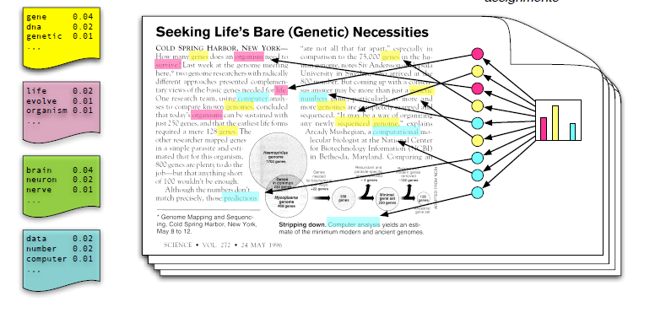
PTM
Each topic is a distribution over words
Each topic is a mixture over the corpus topics
Each Word is sampled from such topics
We only observe documents, the rest are latent variables

Slide 44
PTM. 1.8 M NYT articles

Slide 45
Basic ingredient
Proximity matrix
If not symmetric
Choice of dissimilarity (not necessarily a distance…)

Slide 46
Algos
Combinatorial (no underlying probabilistic model)
Mixture models (underlying probabilistic model)

Slide 47
Combinatorial. k-means

Slide 48
k means
K groups
Assignment-partition
Minimise dispersion
Total dispersion
Minimize W(C) equivalent to maximise B(C)
Combinatorial optimisation-→ Heuristics

Slide 49
A decent heuristic (local optimum)

Slide 51
Local optima…

Slide 52
Choice of K
Obviously results depend on K

Slide 53
Choice of K
Sometimes given, e.g., marketing
Try sequentially an observe reductions in W. Elbow graph

Slide 54
Combinatorial. k-medoids

Slide 55
K-medoids
Rather than centroid, use one of the actual observations as cluster representative
Tends to be more robust

Slide 56
Combinatorial. Hierarchical

Slide 57
Aggregative
Type of linkage: Maximum, mínimum, mean, between centroids

Slide 59
Dendrogram (and linkages)

Slide 60
Mixture models

Slide 61
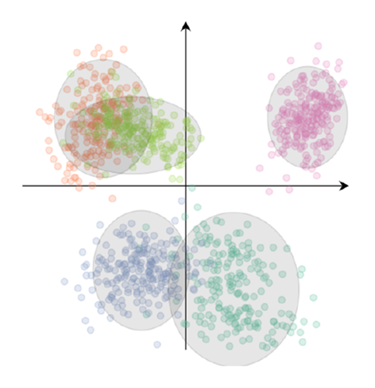
Gaussian mixture models

Slide 62
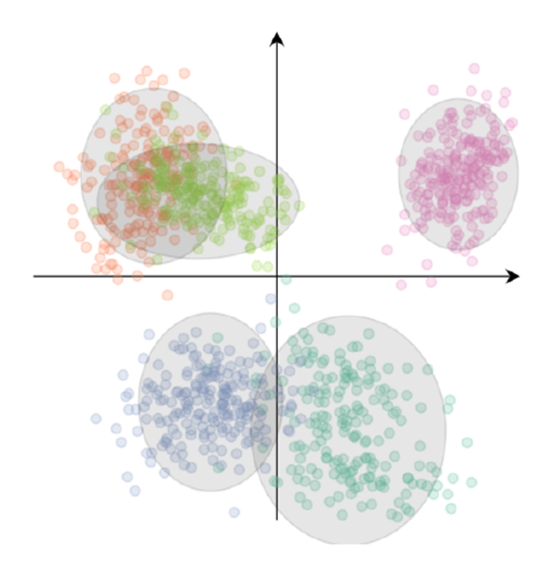
Mixture of gaussians
Mixture of K unit-variance (1-d) Gaussians
For each observation x, a cluster assignment c
Full model is
Joint density of parameters, latent and observed variables

Slide 63
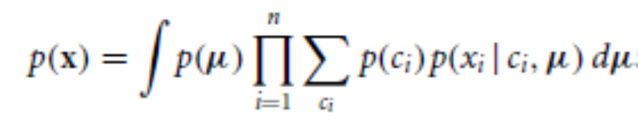
Aim
p(c|x) Evidence intractable
MCMC (Gibbs sampler), Variational Bayes

Slide 64
Or MLE (shame on you!!!)
Given data x1,…, xN
EM https://en.wikipedia.org/wiki/Expectation%E2%80%93maximization_algorithm

Slide 65
EM for MoG
From log likelihood
To completed loglikelihood

Slide 66
EM for MoG
Step E. Estimate
Step M. Update maximising

Slide 67
Final comments

Slide 68
Recall from NNs, GANs and VAEs
Mixtures beyond gaussians (eg gamma mixtures, mixtures of Dirichlet processes, latent Dirichlet allocations,…)

