Slide 1
EM: Expectation Maximization
Sun Kim
Computer Science and Engineering
Bioinformatics Institute
Seoul National University

Slide 2
EM?
Many people say “I know EM is used in many applications but I do not know what it is.”
I hope I can help you understand EM today

Slide 3
Basics
Model
Likelihood
Prior probability
Posterior probability
Latent variables

Slide 4
Coin Model
Tossing a coin produces either
head (앞면) or tail (뒷면)
A model for a coin ?
Prob[head], Prob[tail]
A fair or loaded coin
Fair coin: Prob[head] = 0.5, Prob[tail] = 0.5
Loaded coin at Casino: Prob[head] = 0.6, Prob[tail] = 0.4

Slide 5
Likelihood
We have a sequence of tossing a coin:
HTHHHTT
Is this generated using a fair coin or a loaded coin?
For a fair coin,
Pr[HTHHHTT | Fair] = 0.5 * 0.5 * 0.5 * 0.5 * 0.5 * 0.5 * 0.5 = .0078125
For a loaded coin,
Pr[HTHHHTT | Loaded] = 0.6 * 0.4 * 0.6 * 0.6 * 0.6 * 0.4 * 0.4 = .0082944
카지노 딜러가 나를 속였군. 나쁜놈!

Slide 6
Prior Probability
카지노 딜러 왈 “너 기계학습 여름 학교 강의 이해 했니?”
The government regulates Pr[Fair]= 0.99, Pr[Loaded]= 0.01
➔ Prior probability

Slide 7
Posterior Probability
“카지노 딜러가 속였을까요?” 를 수식으로 나타내면
Pr[HTHHHTT | Fair] vs. Pr[HTHHHTT | Loaded]
그런데 이건 계산이 직접 안되어서 Bayes rule을 이용해야함.
Pr[Fair | HTHHHTT ]
= Pr[HTHHHTT | Fair] * Pr[Fair] / P[HTHHHTT]
Okay, but Pr[HTHHHTT] ??
Pr[HTHHHTT]
= Pr[HTHHHTT | Fair] * Pr[Fair]+ Pr[HTHHHTT | Loaded] * Pr[Loaded]

Slide 8
Posterior Probability
Weighted likelihood로 생각하면 쉬움.
Pr[Fair | HTHHHTT ] = Pr[HTHHHTT | Fair] * Pr[Fair] / P[HTHHHTT]
Pr[Loaded | HTHHHTT ] = Pr[HTHHHTT | Fair] * Pr[Loaded] / P[HTHHHTT]
Pr[Fair | HTHHHTT ] vs. Pr[Loaded | HTHHHTT ]
➔➔
Pr[HTHHHTT | Fair]*Pr[Fair] vs. Pr[HTHHHTT|Fair]*Pr[Loaded]

Slide 9
ML vs. MAP
When we set model parameters,
ML (maximum likelihood)
Among all possible model parameter configurations,
Select one that is ML.
MAP (maximum a posteriori)
Among all possible model parameter configurations,
Select one that is MAP.

Slide 10
Three Problems to be reviewed today
Gaussian Mixture
Baum-Welch algorithm for HMM model parameter estimation
Motif prediction

Slide 11
Problem 1: K Clustering Algorithms

Slide 12
K Clustering Algorithms and EM
K means clustering algorithm
A probabilistic version of K means clustering algorithm
K Gaussian mixtures algorithm

Slide 13
K means clustering algorithm
D₁
D₂
D₁
D₂
C₁
C₂
C₁
C₂
D₄
D₃
D₄
D₃

Slide 14
A probabilistic version of
K means clustering algorithm
D₁
D₂
D₁
D₂
0.3
0.7
C₁
C₂
C₁
C₂
D₄
D₃
D₄
D₃
민주적인 결정 : 모든 데이터가 참여해서 cluster center를 정함.
➔ model parameter수가 증가함.

Slide 15
Two Gaussian Mixture EM Clustering
아래 숫자들이 2개의 Gaussian distribution에 의해 생성이 되었는데, 2개의 그룹으로 클러스링을 하고자 한다.
1 3 4 5 6 8 9 11 12 13 14 15 17 18

Slide 16


ESTIMATION1: 아래 2개의 Gaussian distribution
1 2 3 4 5 6 7 8 9 10 11 12 13 14 15 16 17
$$μ_{1}$$
$$μ_{2}$$

Slide 17


ESTIMATION2: 아래 2개의 Gaussian distribution
1 2 3 4 5 6 7 8 9 10 11 12 13 14 15 16 17
$$μ_{1}$$
$$μ_{2}$$
이 estimation 이 더 좋은가요? 왜?

Slide 18
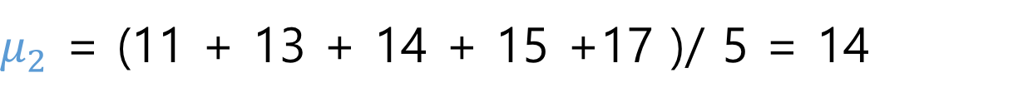
If we know which distribution the number are from.
1 | 3 | 4 | 5 | 6 | 8 | 11 | 13 | 14 | 15 | 17
G1 | G1 | G1 | G1 | G1 | G1
 |  |  |  |  |  | G2 | G2 | G2 | G2 | G2
$μ_{1}$ = (1 + 3 + 4 + 5 + 6 + 8 ) / 6 = 4.5
$μ_{2}$ = (11 + 13 + 14 + 15 +17 )/ 5 = 14

Slide 19
Of course, we do not know which distribution the numbers are from.
1 | 3 | 4 | 5 | 6 | 8 | 11 | 13 | 14 | 15 | 17
G1 | G1 | G1 | G1 | G1 | G1 | G1 | G1 | G1 | G1 | G1
G2 | G2 | G2 | G2 | G2 | G2 | G2 | G2 | G2 | G2 | G2

Slide 20
Democracy again using latent variables: Of course, we do not know which distribution the numbers are from.
1 | 3 | 4 | 5 | 6 | 8 | 11 | 13 | 14 | 15 | 17
P[G1] | P[G1] | P[G1] | P[G1] | P[G1] | P[G1] | P[G1] | P[G1] | P[G1] | P[G1] | P[G1]
P[G2] | P[G2] | P[G2] | P[G2] | P[G2] | P[G2] | P[G2] | P[G2] | P[G2] | P[G2] | P[G2]
${STEP 1: }_{}$Estimate P[1 from G1], P[3 from G1], …
${STEP 2: μ}_{1}$ = (P[1 from G1] * 1 + P[3 from G1] * 3 + …) / (P[1 from G1] + P[3 from G1] + … + P[17 from G1] )

Slide 21
개념을 이해 하셨으면 이제 구체적인 계산 방법을 논의 합니다. The material is from Andrew Rosenberg at Queens College / CUNY http://eniac.cs.qc.cuny.edu/andrew/ml/syllabus.html

Slide 22
Mixture Models
Formally a Mixture Model is the weighted sum of a number of pdfs where the weights are determined by a distribution,

Slide 23
Mixture Models
Formally a Mixture Model is the weighted sum of a number of pdfs where the weights are determined by a distribution,

Slide 24
Gaussian Mixture Models
GMM: the weighted sum of a number of Gaussians where the weights are determined by a distribution,

Slide 25
Expectation Maximization
Both the training of GMMs and Graphical Models with latent variables can be accomplished using Expectation Maximization
Step 1: Expectation (E-step)
Evaluate the “responsibilities” of each cluster with the current parameters
Step 2: Maximization (M-step)
Re-estimate parameters using the existing “responsibilities”
Similar to k-means training.

Slide 26
Latent Variable Representation
We can represent a GMM involving a latent variable
What does this give us?
TODO: plate notation

Slide 27
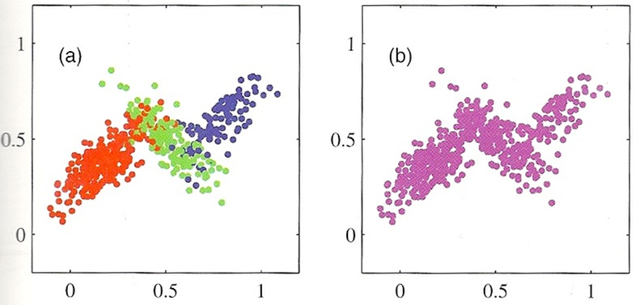
GMM data and Latent variables

Slide 28
One last bit
We have representations of the joint p(x,z) and the marginal, p(x)…
The conditional of p(z|x) can be derived using Bayes rule.
The responsibility that a mixture component takes for explaining an observation x.

Slide 29
Maximum Likelihood over a GMM
As usual: Identify a likelihood function
And set partials to zero…

Slide 30
Maximum Likelihood of a GMM
Optimization of means.

Slide 31
Maximum Likelihood of a GMM
Optimization of covariance
Note the similarity to the regular MLE without responsibility terms.

Slide 32
Maximum Likelihood of a GMM
Optimization of mixing term
Notes:
\frac{\partial \ln p(x|\pi, \mu,\Sigma) + \lambda\left(\sum_{k=1}^K \pi_k -1\right)}{\partial \pi_k}&=&

Slide 33
MLE of a GMM

Slide 34
EM for GMMs
Initialize the parameters
Evaluate the log likelihood
Expectation-step: Evaluate the responsibilities
Maximization-step: Re-estimate Parameters
Evaluate the log likelihood
Check for convergence

Slide 35
EM for GMMs
E-step: Evaluate the Responsibilities

Slide 36
EM for GMMs
M-Step: Re-estimate Parameters

Slide 37
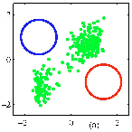
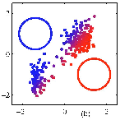
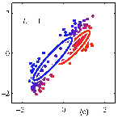

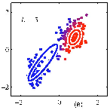
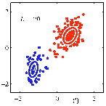
Visual example of EM

Slide 38
Relationship to K-means
K-means makes hard decisions.
Each data point gets assigned to a single cluster.
GMM/EM makes soft decisions.
Each data point can yield a posterior p(z|x)
Soft K-means is a special case of EM.

Slide 39
Soft means as GMM/EM
Assume equal covariance matrices for every mixture component:
Likelihood:
Responsibilities:
As epsilon approaches zero, the responsibility approaches unity.
Notes:
p(x|\mu_k,\Sigma_k) = \frac{1}{(2\pi\epsilon)^{M/2}}\exp\left\{-\frac{1}{2\epsilon}\lVert x-\mu_k\rVert^2\right\}

Slide 40
Soft K-Means as GMM/EM
Overall Log likelihood as epsilon approaches zero:
The expectation of soft k-means is the intercluster variability
Note: only the means are reestimated in Soft K-means.
The covariance matrices are all tied.

Slide 41
General form of EM
Given a joint distribution over observed and latent variables:
Want to maximize:
Initialize parameters
E Step: Evaluate:
M-Step: Re-estimate parameters (based on expectation of complete-data log likelihood)
Check for convergence of params or likelihood

Slide 42
Problem 2: HMM Model Parameter Estimation

Slide 43
Hidden Markov Model
We have a sequence of tossing a coin:
HTHHHTH
이 번에는 카지노 딜러가 fair, loaded coin을 번갈아서 사용했는데, 이 걸 어떻게 모델을 하나?

Slide 44
Hidden Markov Model
We have a sequence of tossing a coin:
HTHHHTH
Pr[F→F]
Pr[F→L]
Pr[L→L]
Pr^{Fair}[H] = 0.5
Pr^{Fair}[T] = 0.5
Pr^{Loaded}[H] = 0.7
Pr^{Loaded}[T] = 0.3
Pr[L→F]
Note that there are TWO different types of model parameters.
Character emission
State transition

Slide 45
HMM1
We have a sequence of tossing a coin:
HTHHHTH
Pr[F→F]
Pr[F→L]
Pr[L→L]
Pr^{Fair}[H] = 0.5
Pr^{Fair}[T] = 0.5
Pr^{Loaded}[H] = 0.7
Pr^{Loaded}[T] = 0.3
Pr[L→F]
HMM1 이 좋은 가요? In terms of likelihood, Pr[HTHHHTH | HMM1].

Slide 46
HMM2
We have a sequence of tossing a coin:
HTHHHTH
Pr[F→F]
Pr[F→L]
Pr[L→L]
Pr^{Fair}[H] = 0.5
Pr^{Fair}[T] = 0.5
Pr^{Loaded}[H] = 0.2
Pr^{Loaded}[T] = 0.8
Pr[L→F]
HMM2 이 좋은 가요? In terms of likelihood, Pr[HTHHHTH | HMM2].

Slide 47
HMM model parameter estimation
Algorithm:
가능한 모든 HMM을 고려해서,
HMM1, HMM2, ……
가장 likelihood가 좋은 HMM을 선정한다.
그런데 가능한 모든 HMM의 수는 무수히 많다. 따라서 위의 알고리즘은 불가능.
EM !!
Baum-Welch algorithm!

Slide 48
Computing Likelihood Pr[HTHHHTH | HMM]
H |  | T |  | H |  | H |  | H |  | T |  | H
F |  | F |  | F |  | F |  | F |  | F |  | F
L |  | L |  | L |  | L |  | L |  | L |  | L
Pr[F→F]
Pr[F→L]
Pr[L→F]
Pr[L→L]
Pr[F→F]
Pr[F→L]
Pr[L→F]
Pr[L→L]
Pr[F→F]
Pr[F→L]
Pr[L→F]
Pr[L→L]
Pr[F→F]
Pr[F→L]
Pr[L→F]
Pr[L→L]
Pr[F→F]
Pr[F→L]
Pr[L→F]
Pr[L→L]
Pr[F→F]
Pr[F→L]
Pr[L→F]
Pr[L→L]
HTHHHTH를 이 HMM으로 생성하는 경우의 수는?
너무 많아서 계산이 불가능해지는데, 다행히 dynamic programming으로 쉽게 계산 가능.
→ Forward or Backward algorithm

Slide 49
Baum-Welch algorithm for HMM model parameter estimation
Set HMM model parameters randomly.
Repeat until no improvement in likelihood.
Estimate model parameters in a democratic way (How?)
Compute likelihood

Slide 50
Estimate model parameters in a democratic way
Define latent variables.
(Expectation) Estimate latent variables.
(Maximization) Estimate model parameters.

Slide 51
Latent variables
What were the latent variables for the Gaussian mixture problem?
1 | 3 | 4 | 5 | 6 | 8 | 11 | 13 | 14 | 15 | 17
P[G1] | P[G1] | P[G1] | P[G1] | P[G1] | P[G1] | P[G1] | P[G1] | P[G1] | P[G1] | P[G1]
P[G2] | P[G2] | P[G2] | P[G2] | P[G2] | P[G2] | P[G2] | P[G2] | P[G2] | P[G2] | P[G2]
${STEP 1: }_{}$Estimate P[1 from G1], P[3 from G1], …
${STEP 2: μ}_{1}$ = (P[1 from G1] * 1 + P[3 from G1] * 3 + …) / 11

Slide 52
Latent variables for HMM model parameter estimation
Unfortunately, complicated.
But if you understand why we need latent variables, you are okay.
Why?
To estimate model parameters in M-step !
Pr^{Fair}[H], Pr^{Fair}[T], Pr^{Loaded}[H], Pr^{Loaded}[T]
Pr[F→F], Pr[F→L], Pr[L→F], Pr[L→L]
Then, how to define latent variables in E-step?
Of course, different latent variables for different types of parameters.

Slide 53
Latent variables for “counting”
H |  | T |  | H |  | H |  | H |  | T |  | H
#F1 |  | #F2 |  | #F3 |  | #F4 |  | #F5 |  | #F6 |  | #F7
#L1 |  | #L2 |  | #L3 |  | #L4 |  | #L5 |  | #L6 |  | #L7
#[F1→F2]
#[F1→L2]
#[L1→F2]
#[L1→L2]
#[F2→F3]
#[F2→L3]
#[L2→F3]
#[L2→L3]
#[F3→F4]
#[F3→L4]
#[L3→F4]
#[L3→L4]
#[F4→F5]
#[F4→L5]
#[L4→F5]
#[L4→L5]
#[F5→F6]
#[F5→L6]
#[L5→F6]
#[L5→L6]
#[F6→F7]
#[F6→L7]
#[L6→F7]
#[L6→L7]
HTHHHTH를 이 HMM으로 생성하는 경우의 수는?
너무 많아서 계산이 불가능해지는데, 다행히 dynamic programming으로 쉽게 계산 가능.
→ Forward or Backward algorithm

Slide 54
How to estimate Latent variables for “counting”
H |  | T |  | H |  | H |  | H |  | T |  | H
? |  | ? |  | ? |  | #F4 |  | ? |  | ? |  | ?
? |  | ? |  | ? |  | #L4 |  | ? |  | ? |  | ?
#[?→?]
#[?→?]
#[?→?]
#[F4→F5]
#[F4→L5]
#[L4→F5]
#[L4→L5]
#[?→?]
#[?→?]
#F4를 계산하려면 앞, 뒤로 경우의 수가 너무 많음.
다행히 dynamic programming으로 쉽게 계산 가능.
→ Forward or Backward algorithm

Slide 55
M-step: maximum likelihood estimation of model parameters.
H |  | T |  | H |  | H |  | H |  | T |  | H
#F1 |  | #F2 |  | #F3 |  | #F4 |  | #F5 |  | #F6 |  | #F7
#L1 |  | #L2 |  | #L3 |  | #L4 |  | #L5 |  | #L6 |  | #L7
#[F1→F2]
#[F1→L2]
#[L1→F2]
#[L1→L2]
#[F2→F3]
#[F2→L3]
#[L2→F3]
#[L2→L3]
#[F3→F4]
#[F3→L4]
#[L3→F4]
#[L3→L4]
#[F4→F5]
#[F4→L5]
#[L4→F5]
#[L4→L5]
#[F5→F6]
#[F5→L6]
#[L5→F6]
#[L5→L6]
#[F6→F7]
#[F6→L7]
#[L6→F7]
#[L6→L7]
Pr^{Fair}[H] = (#F1+#F3+#F4+#F5+#F7)/ (#F1+#F3+#F4+#F5+#F7+ #L1+#L3+#L4+#L5+#L7)

Slide 56
More formal material by Andrew McCallum at University of Massachusetts Amherst
https://people.cs.umass.edu/~mccallum/courses/inlp2004a/lect10-hmm2.pdf

Slide 57
Larry Moss at Indiana University Bloomington
A good example of HMM model parameter estimation
http://www.indiana.edu/~iulg/moss/hmmcalculations.pdf

Slide 58
Problem 3: Motif Discovery

Slide 59
Motif Discovery Problem: a search problem
Input: N sequences
Output: set of conserved regions
N

Slide 60
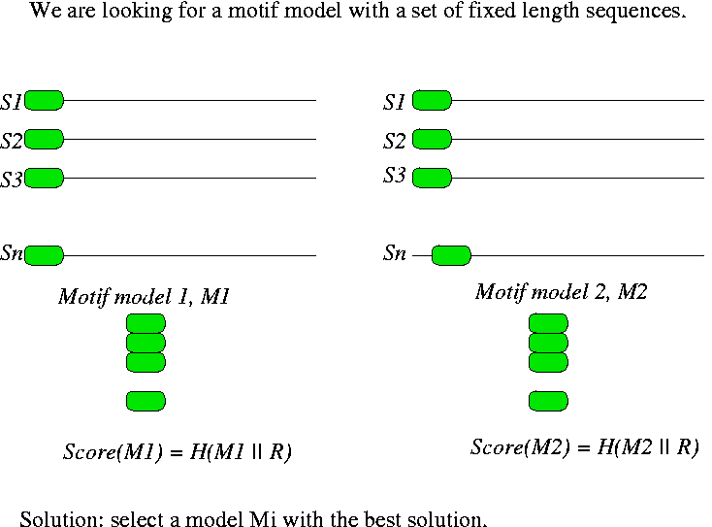
Motif search in unaligned seqs: an optimization problem

Slide 61
MEME, a motif discovery algorithm using EM in 1994 and it is still the best, showing how powerful EM is.

Slide 62
From Eric Xing at Carnegie Mellon University http://www.cs.cmu.edu/~epxing/Class/10810-06/ppt/lecture6.ppt

Slide 63
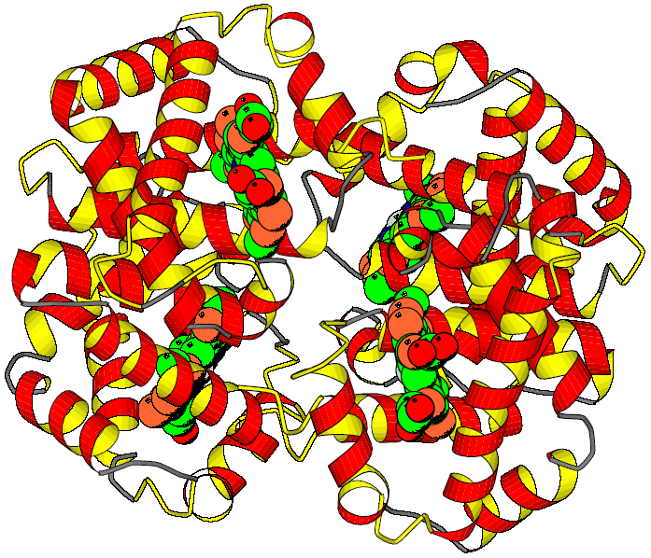
Example: Globin Motifs
xxxxxxxxxxx.xxxxxxxxx.xxxxx..........xxxxxx.xxxxxxx.xxxxxxxxxx.xxxxxxxxx
HAHU V.LSPADKTN..VKAAWGKVG.AHAGE..........YGAEAL.ERMFLSF..PTTKTYFPH.FDLS.HGSA
HAOR M.LTDAEKKE..VTALWGKAA.GHGEE..........YGAEAL.ERLFQAF..PTTKTYFSH.FDLS.HGSA
HADK V.LSAADKTN..VKGVFSKIG.GHAEE..........YGAETL.ERMFIAY..PQTKTYFPH.FDLS.HGSA
HBHU VHLTPEEKSA..VTALWGKVN.VDEVG...........G.EAL.GRLLVVY..PWTQRFFES.FGDL.STPD
HBOR VHLSGGEKSA..VTNLWGKVN.INELG...........G.EAL.GRLLVVY..PWTQRFFEA.FGDL.SSAG
HBDK VHWTAEEKQL..ITGLWGKVNvAD.CG...........A.EAL.ARLLIVY..PWTQRFFAS.FGNL.SSPT
MYHU G.LSDGEWQL..VLNVWGKVE.ADIPG..........HGQEVL.IRLFKGH..PETLEKFDK.FKHL.KSED
MYOR G.LSDGEWQL..VLKVWGKVE.GDLPG..........HGQEVL.IRLFKTH..PETLEKFDK.FKGL.KTED
IGLOB M.KFFAVLALCiVGAIASPLT.ADEASlvqsswkavsHNEVEIlAAVFAAY.PDIQNKFSQFaGKDLASIKD
GPUGNI A.LTEKQEAL..LKQSWEVLK.QNIPA..........HS.LRL.FALIIEA.APESKYVFSF.LKDSNEIPE
GPYL GVLTDVQVAL..VKSSFEEFN.ANIPK...........N.THR.FFTLVLEiAPGAKDLFSF.LKGSSEVPQ
GGZLB M.L.DQQTIN..IIKATVPVLkEHGVT...........ITTTF.YKNLFAK.HPEVRPLFDM.GRQ..ESLE
xxxxx.xxxxxxxxxxxxx..xxxxxxxxxxxxxxx..xxxxxxx.xxxxxxx...xxxxxxxxxxxxxxxx
HAHU QVKGH.GKKVADA.LTN......AVA.HVDDMPNA...LSALS.D.LHAHKL....RVDPVNF.KLLSHCLL
HAOR QIKAH.GKKVADA.L.S......TAAGHFDDMDSA...LSALS.D.LHAHKL....RVDPVNF.KLLAHCIL
HADK QIKAH.GKKVAAA.LVE......AVN.HVDDIAGA...LSKLS.D.LHAQKL....RVDPVNF.KFLGHCFL
HBHU AVMGNpKVKAHGK.KVLGA..FSDGLAHLDNLKGT...FATLS.E.LHCDKL....HVDPENF.RL.LGNVL
HBOR AVMGNpKVKAHGA.KVLTS..FGDALKNLDDLKGT...FAKLS.E.LHCDKL....HVDPENFNRL..GNVL
HBDK AILGNpMVRAHGK.KVLTS..FGDAVKNLDNIKNT...FAQLS.E.LHCDKL....HVDPENF.RL.LGDIL
MYHU EMKASeDLKKHGA.TVL......TALGGILKKKGHH..EAEIKPL.AQSHATK...HKIPVKYLEFISECII
MYOR EMKASaDLKKHGG.TVL......TALGNILKKKGQH..EAELKPL.AQSHATK...HKISIKFLEYISEAII
IGLOB T.GA...FATHATRIVSFLseVIALSGNTSNAAAV...NSLVSKL.GDDHKA....R.GVSAA.QF..GEFR
GPUGNI NNPK...LKAHAAVIFKTI...CESATELRQKGHAVwdNNTLKRL.GSIHLK....N.KITDP.HF.EVMKG
GPYL NNPD...LQAHAG.KVFKL..TYEAAIQLEVNGAVAs.DATLKSL.GSVHVS....K.GVVDA.HF.PVVKE
GGZLB Q......PKALAM.TVL......AAAQNIENLPAIL..PAVKKIAvKHCQAGVaaaH.YPIVGQEL.LGAIK
xxxxxxxxx.xxxxxxxxx.xxxxxxxxxxxxxxxxxxxxxxx..x
HAHU VT.LAA.H..LPAEFTPA..VHASLDKFLASV.STVLTS..KY..R
HAOR VV.LAR.H..CPGEFTPS..AHAAMDKFLSKV.ATVLTS..KY..R
HADK VV.VAI.H..HPAALTPE..VHASLDKFMCAV.GAVLTA..KY..R
HBHU VCVLAH.H..FGKEFTPP..VQAAYQKVVAGV.ANALAH..KY..H
HBOR IVVLAR.H..FSKDFSPE..VQAAWQKLVSGV.AHALGH..KY..H
HBDK IIVLAA.H..FTKDFTPE..CQAAWQKLVRVV.AHALAR..KY..H
MYHU QV.LQSKHPgDFGADAQGA.MNKALELFRKDM.ASNYKELGFQ..G
MYOR HV.LQSKHSaDFGADAQAA.MGKALELFRNDM.AAKYKEFGFQ..G
IGLOB TA.LVA.Y..LQANVSWGDnVAAAWNKA.LDN.TFAIVV..PR..L
GPUGNI ALLGTIKEA.IKENWSDE..MGQAWTEAYNQLVATIKAE..MK..E
GPYL AILKTIKEV.VGDKWSEE..LNTAWTIAYDELAIIIKKE..MKdaA
GGZLB EVLGDAAT..DDILDAWGK.AYGVIADVFIQVEADLYAQ..AV..E
 | Hemoglobin alpha subunit

Slide 64
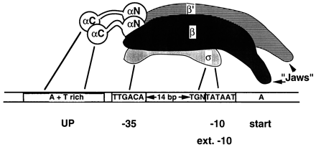
DNA Motif
RNA polymerase-promotor interactions
Transcription Initiation in E. coli
In E. coli transcription is initiated at the promotor , whose sequence is recognised by the Sigma factor of RNA polymerase.

Slide 65
Motif Representation

Slide 66
Determinism 2: Regular Expressions
The characteristic motif of a Cys-Cys-His-His zinc finger DNA binding domain has regular expression
C-X(2,4)-C-X(3)-[LIVMFYWC]-X(8)-H-X(3,5)-H
Here, as in algebra, X is unknown. The 29 a.a. sequence of an example domain 1SP1 is as follows, clearly fitting the model.
1SP1:
KKFACPECPKRFMRSDHLSKHIKTHQNKK

Slide 67
Weight Matrix Model (WMM)
Weight matrix model (WMM) = Stochastic consensus sequence
Weight matrices are also known as
Position-specific scoring matrices
Position-specific probability matrices
Position-specific weight matrices
A motif is interesting if it is very different from the background distribution
A
C
G
T
9 | 214 | 63 | 142 | 118 | 8
22 | 7 | 26 | 31 | 52 | 13
18 | 2 | 29 | 38 | 29 | 5
193 | 19 | 124 | 31 | 43 | 216
A
C
G
T
.04 | .88 | .26 | .59 | .49 | .03
.09 | .03 | .11 | .13 | .21 | .05
.07 | .01 | .12 | .16 | .12 | .02
.80 | .08 | .51 | .13 | .18 | .89
Counts from 242 known σ⁷⁰ sites Relative frequencies: θ_{li}
less interesting
more interesting

Slide 68
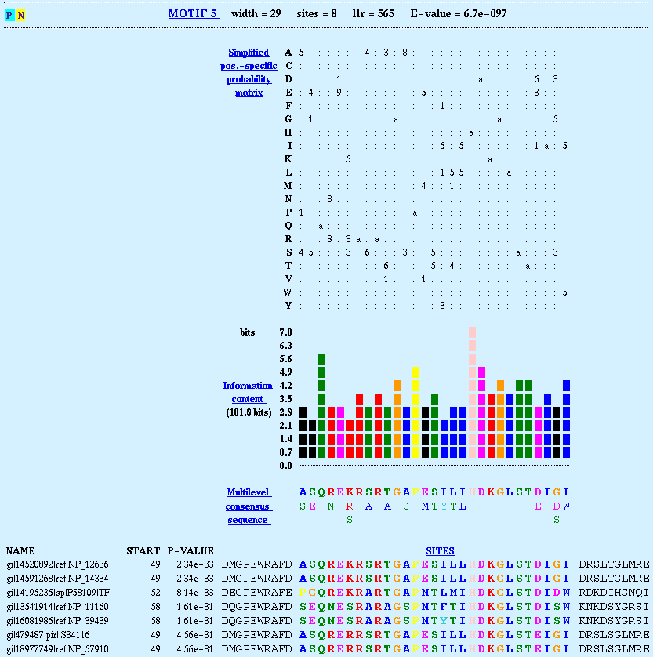
Relative entropy
A motif is interesting if it is very different from the background distribution
Use relative entropy:
Relative entropy is sometimes called
information content
θ_{li} = probability of i in matrix position l
θ_{0i} = background frequency (in non-motif sequence)
A
C
G
T
.04 | .88 | .26 | .59 | .49 | .03
.09 | .03 | .11 | .13 | .21 | .05
.07 | .01 | .12 | .16 | .12 | .02
.80 | .08 | .51 | .13 | .18 | .89
Informativeness: 2-Σ_{i}θ_{li} log₂θ_{li}/θ_{0i}

Slide 69
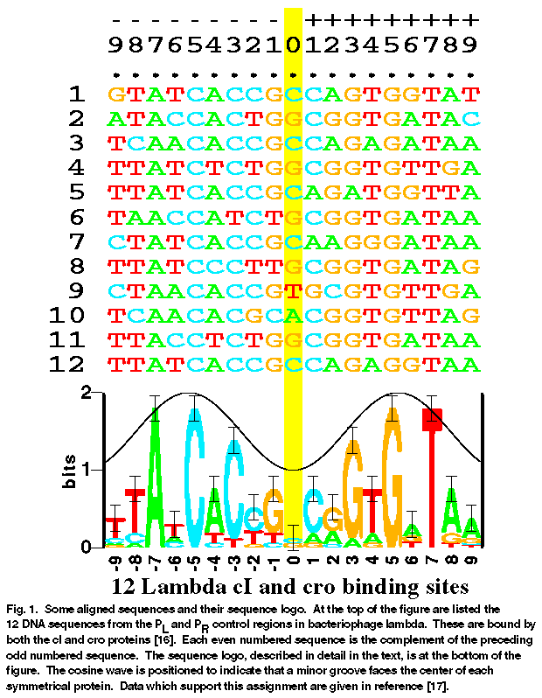
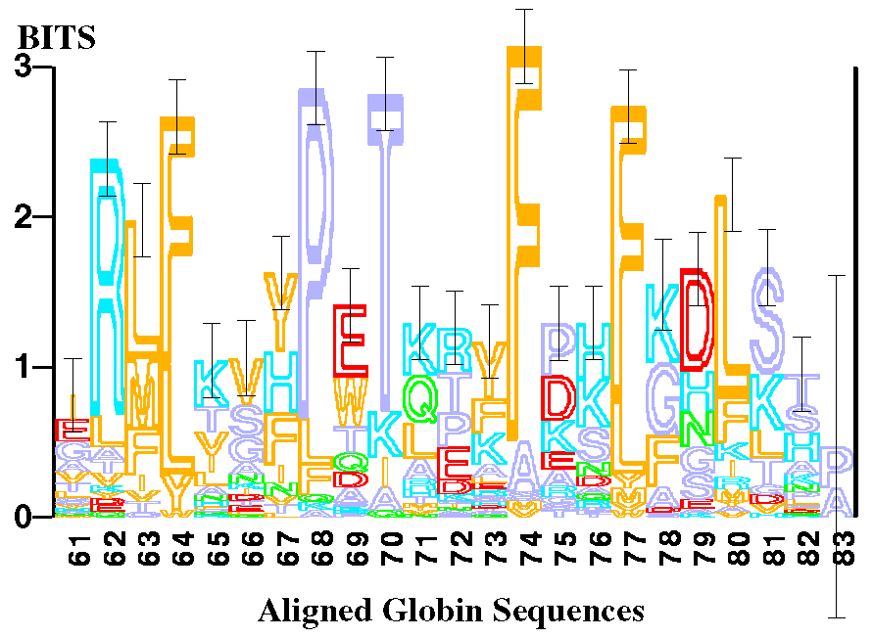
Sequence Logo
Information at pos’n l, H(l) = – Σ_{{letter i}} θ_{li} log₂ θ_{li}
Height of x at pos’n l, L(l,i) = θ_{li} (2 – H(l))
Examples:
θ_{lA} = 1; H(l) = 0; L(l, A) = 2
A: ½; C: ¼; G: ¼; H(l) = 1.5; L(l, A) = ¼; L(l, not T) = ¼

Slide 70

de novo motif detection
Unsupervised learning
Given no training examples, predict locations of all instances of novel motifs in given sequences, and learn motif models simultaneously.
Learning algorithms:
Expectation Maximization: e.g., MEME
Gibbs Sampling: e.g., AlignACE, BioProspector
Advanced models: Bayesian network, Bayesian Markovian models
5’- TCTCTCTCCACGGCTAATTAGGTGATCATGAAAAAATGAAAAATTCATGAGAAAAGAGTCAGACATCGAAACATACAT
…HIS7
?
…ARO4
5’- ATGGCAGAATCACTTTAAAACGTGGCCCCACCCGCTGCACCCTGTGCATTTTGTACGTTACTGCGAAATGACTCAACG
5’- CACATCCAACGAATCACCTCACCGTTATCGTGACTCACTTTCTTTCGCATCGCCGAAGTGCCATAAAAAATATTTTTT
…ILV6
5’- TGCGAACAAAAGAGTCATTACAACGAGGAAATAGAAGAAAATGAAAAATTTTCGACAAAATGTATAGTCATTTCTATC
…THR4
5’- ACAAAGGTACCTTCCTGGCCAATCTCACAGATTTAATATAGTAAATTGTCATGCATATGACTCATCCCGAACATGAAA
…ARO1
5’- ATTGATTGACTCATTTTCCTCTGACTACTACCAGTTCAAAATGTTAGAGAAAAATAGAAAAGCAGAAAAAATAAATAA
…HOM2
5’- GGCGCCACAGTCCGCGTTTGGTTATCCGGCTGACTCATTCTGACTCTTTTTTGGAAAGTGTGGCATGTGCTTCACACA
…PRO3

Slide 71
Expectation-maximization
For each subsequence of width W
convert subsequence to a matrix
do {
re-estimate motif occurrences from matrix
re-estimate matrix model from motif occurrences
} until (matrix model stops changing)
end
select matrix with highest score
EM

Slide 72
Expectation-maximization
For each subsequence of width W
convert subsequence to a matrix
do {
re-estimate motif occurrences from matrix
re-estimate matrix model from motif occurrences
} until (matrix model stops changing)
end
select matrix with highest score
EM

Slide 73
Sample DNA sequences
>ce1cg
TAATGTTTGTGCTGGTTTTTGTGGCATCGGGCGAGAATA
GCGCGTGGTGTGAAAGACTGTTTTTTTGATCGTTTTCAC
AAAAATGGAAGTCCACAGTCTTGACAG
>ara
GACAAAAACGCGTAACAAAAGTGTCTATAATCACGGCAG
AAAAGTCCACATTGATTATTTGCACGGCGTCACACTTTG
CTATGCCATAGCATTTTTATCCATAAG
>bglr1
ACAAATCCCAATAACTTAATTATTGGGATTTGTTATATA
TAACTTTATAAATTCCTAAAATTACACAAAGTTAATAAC
TGTGAGCATGGTCATATTTTTATCAAT
>crp
CACAAAGCGAAAGCTATGCTAAAACAGTCAGGATGCTAC
AGTAATACATTGATGTACTGCATGTATGCAAAGGACGTC
ACATTACCGTGCAGTACAGTTGATAGC

Slide 74
Motif occurrences
>ce1cg
taatgtttgtgctggtttttgtggcatcgggcgagaata
gcgcgtggtgtgaaagactgttttTTTGATCGTTTTCAC
aaaaatggaagtccacagtcttgacag
>ara
gacaaaaacgcgtaacaaaagtgtctataatcacggcag
aaaagtccacattgattaTTTGCACGGCGTCACactttg
ctatgccatagcatttttatccataag
>bglr1
acaaatcccaataacttaattattgggatttgttatata
taactttataaattcctaaaattacacaaagttaataac
TGTGAGCATGGTCATatttttatcaat
>crp
cacaaagcgaaagctatgctaaaacagtcaggatgctac
agtaatacattgatgtactgcatgtaTGCAAAGGACGTC
ACattaccgtgcagtacagttgatagc

Slide 75
Motif occurrences
>ce1cg
taatgtttgtgctggtttttgtggcatcgggcgagaata
gcgcgtggtgtgaaagactgttttTTTGATCGTTTTCAC
aaaaatggaagtccacagtcttgacag
>ara
gacaaaaacgcgtaacaaaagtgtctataatcacggcag
aaaagtccacattgattaTTTGCACGGCGTCACactttg
ctatgccatagcatttttatccataag
>bglr1
acaaatcccaataacttaattattgggatttgttatata
taactttataaattcctaaaattacacaaagttaataac
TGTGAGCATGGTCATatttttatcaat
>crp
cacaaagcgaaagctatgctaaaacagtcaggatgctac
agtaatacattgatgtactgcatgtaTGCAAAGGACGTC
ACattaccgtgcagtacagttgatagc

Slide 76
Starting point
…gactgttttTTTGATCGTTTTCACaaaaatgg…
T T T G A T C G T T
A 0.17 0.17 0.17 0.17 0.50 ...
C 0.17 0.17 0.17 0.17 0.17
G 0.17 0.17 0.17 0.50 0.17
T 0.50 0.50 0.50 0.17 0.17
This a special initialization scheme, many others scheme, including random starts, are also valid

Slide 77
Re-estimating motif occurrences
TAATGTTTGTGCTGGTTTTTGTGGCATCGGGCGAGAATA
T T T G A T C G T T
A 0.17 0.17 0.17 0.17 0.50 ...
C 0.17 0.17 0.17 0.17 0.17
G 0.17 0.17 0.17 0.50 0.17
T 0.50 0.50 0.50 0.17 0.17
Score = 0.50 + 0.17 + 0.17 + 0.17 + 0.17 + ...

Slide 78
Scoring each subsequence
Score from each sequence the subsequence with maximal score.
Sequence: TGTGCTGGTTTTTGTGGCATCGGGCGAGAATA
Subsequences Score
TGTGCTGGTTTTTGT 2.95
GTGCTGGTTTTTGTG 4.62
TGCTGGTTTTTGTGG 2.31
GCTGGTTTTTGTGGC ...

Slide 79
Re-estimating motif matrix
From each sequence, take the substring that has the maximal score
Align all of them and count:
Occurrences
TTTGATCGTTTTCAC
TTTGCACGGCGTCAC
TGTGAGCATGGTCAT
TGCAAAGGACGTCAC
Counts
A 000132011000040
C 001010300200403
G 020301131130000
T 423001002114001

Slide 80
Adding pseudocounts
Counts
A 000132011000040
C 001010300200403
G 020301131130000
T 423001002114001
Counts + Pseudocounts
A 111243122111151
C 112121411311514
G 131412242241111
T 534112113225112

Slide 81
Converting to frequencies
Counts + Pseudocounts
A 111243122111151
C 112121411311514
G 131412242241111
T 534112113225112
T T T G A T C G T T
A 0.13 0.13 0.13 0.25 0.50 ...
C 0.13 0.13 0.25 0.13 0.25
G 0.13 0.38 0.13 0.50 0.13
T 0.63 0.38 0.50 0.13 0.13

Slide 82
Expectation-maximization
For each subsequence of width W
convert subsequence to a matrix
do {
re-estimate motif occurrences from matrix
re-estimate matrix model from motif occurrences
} until (matrix model stops changing)
end
select matrix with highest score
Problem:
This procedure doesn't allow the motifs to move around very much. Taking the max is too brittle.
Solution:
Associate with each start site a probability of motif occurrence.
EM

Slide 83
Expectation Maximization: E-step
Expectation:
Find expected value of log likelihood:
where the expected value of Z can be computed as follows:
recall the weights for each substring in the MEME algorithm

Slide 84
Expectation Maximization: M-step
Maximization:
Maximize expected value over θ and ε independently
For ε, this is easy:

Slide 85
Expectation Maximization: M-step
For Θ = (θ, θ₀), define
c_{l,j} = E[ # times letter j appears in motif position l]
c_{0,j} = E[ # times letter j appears in background]
c_{l,j} values are calculated easily from E[Z] values
It easily follows:
to not allow any 0’s, add pseudocounts

Slide 86
Summary

Slide 87
EM
Define latent variables
Typically, estimation of latent variables is done by computing posteriori probabilities.
The posteriori probabilities are used as “contributions” or “responsibilities” when estimating model parameters. Again, this is a democratic process!

Slide 88
EM
Expectation of what?
Maximization of what?
At the end of each EM iteration, what is computed?

Slide 89
Latent Variables in Gaussian Mixture
Latent variables = hidden data
1 | 3 | 4 | 5 | 6 | 8 | 11 | 13 | 14 | 15 | 17
P[G1] | P[G1] | P[G1] | P[G1] | P[G1] | P[G1] | P[G1] | P[G1] | P[G1] | P[G1] | P[G1]
P[G2] | P[G2] | P[G2] | P[G2] | P[G2] | P[G2] | P[G2] | P[G2] | P[G2] | P[G2] | P[G2]
${STEP 1: }_{}$Estimate P[1 from G1], P[3 from G1], …
${STEP 2: μ}_{1}$ = (P[1 from G1] * 1 + P[3 from G1] * 3 + …) / (P[1 from G1] + P[3 from G1] + … + P[17 from G1] )

Slide 90
Democracy again using latent variables: Of course, we do not know which distribution the numbers are from.
1 | 3 | 4 | 5 | 6 | 8 | 11 | 13 | 14 | 15 | 17
P[G1] | P[G1] | P[G1] | P[G1] | P[G1] | P[G1] | P[G1] | P[G1] | P[G1] | P[G1] | P[G1]
P[G2] | P[G2] | P[G2] | P[G2] | P[G2] | P[G2] | P[G2] | P[G2] | P[G2] | P[G2] | P[G2]
${STEP 1: }_{}$Estimate P[1 from G1], P[3 from G1], …

Slide 91
Latent variables in HMM model parameter estimation
H |  | T |  | H |  | H |  | H |  | T |  | H
#F1 |  | #F2 |  | #F3 |  | #F4 |  | #F5 |  | #F6 |  | #F7
#L1 |  | #L2 |  | #L3 |  | #L4 |  | #L5 |  | #L6 |  | #L7
#[F1→F2]
#[F1→L2]
#[L1→F2]
#[L1→L2]
#[F2→F3]
#[F2→L3]
#[L2→F3]
#[L2→L3]
#[F3→F4]
#[F3→L4]
#[L3→F4]
#[L3→L4]
#[F4→F5]
#[F4→L5]
#[L4→F5]
#[L4→L5]
#[F5→F6]
#[F5→L6]
#[L5→F6]
#[L5→L6]
#[F6→F7]
#[F6→L7]
#[L6→F7]
#[L6→L7]
HTHHHTH를 이 HMM으로 생성하는 경우의 수는?
너무 많아서 계산이 불가능해지는데, 다행히 dynamic programming으로 쉽게 계산 가능.
→ Forward or Backward algorithm

Slide 92
Latent variables in motif discovery
N

Slide 93
Complications come from latent variables to model parameter estimation
Gaussian mixture
Parametric distribution → small # of model parameters
HMM model parameter estimation
Sequence data → emission & transition model parameters
Because of hidden states for sequence data, latent variable estimation is complicated.
Motif discovery
Motif model is a matrix of numbers
Connecting latent variables to motif model needs a good thinking.
Otherwise, it is straightforward.
In the end, we use latent variables to estimate model parameters, which should be remembered clearly when you design an EM algorithm.

Slide 94
감사합니다!

