Slide 1
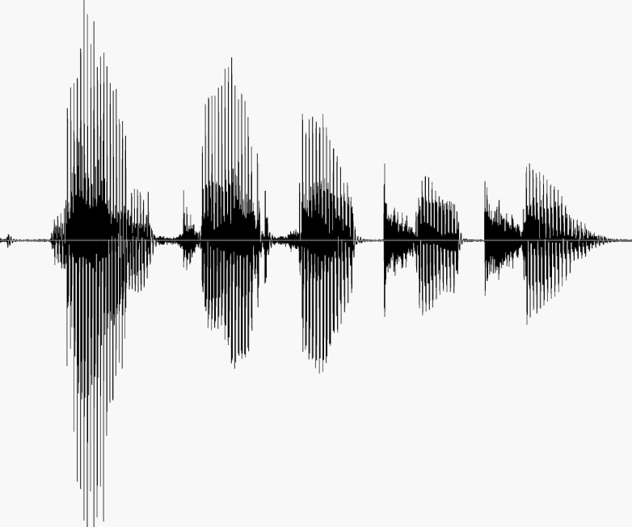
CS 224S / LINGUIST 285 Spoken Language Processing
Andrew Maas
Stanford University
Spring 2014
Lecture 16: Acoustic Modeling with Deep Neural Networks (DNNs)

Slide 2
Logistics
Poster session Tuesday!
Gates building back lawn
We will provide poster boards and easels (and snacks)
Please help your classmates collect data!
Android phone users
Background app to grab 1 second audio clips
Details at http://ambientapp.net/

Slide 3
Outline
Hybrid acoustic modeling overview
Basic idea
History
Recent results
Deep neural net basic computations
Forward propagation
Objective function
Computing gradients
What’s different about modern DNNs?
Extensions and current/future work

Slide 4
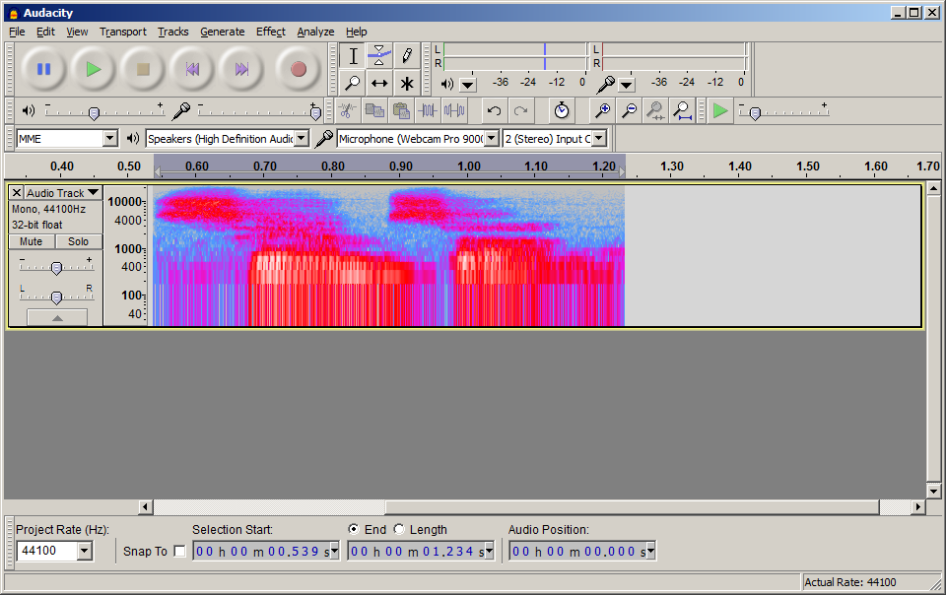
Acoustic Modeling with GMMs
Transcription:
Pronunciation:
Sub-phones :
Hidden Markov Model (HMM):
Acoustic Model:
Audio Input:
Samson
S – AE – M – S –AH – N
942 – 6 – 37 – 8006 – 4422 …
942
942
6
GMM models:
P(x|s)
x: input features
s: HMM state
Features
Features
Features
Notes:
This is a generative model, meaning we need to understand all of how an HMM state ‘creates’ input features x

Slide 5
DNN Hybrid Acoustic Models
Transcription:
Pronunciation:
Sub-phones :
Hidden Markov Model (HMM):
Acoustic Model:
Audio Input:
Samson
S – AE – M – S –AH – N
942 – 6 – 37 – 8006 – 4422 …
942
942
6
P(s|x₁)
P(s|x₂)
P(s|x₃)
Use a DNN to approximate:
P(s|x)
Apply Bayes’ Rule:
P(x|s) = P(s|x) * P(x) / P(s)
DNN * Constant / State prior
Features (x₁)
Features (x₂)
Features (x₃)

Slide 6
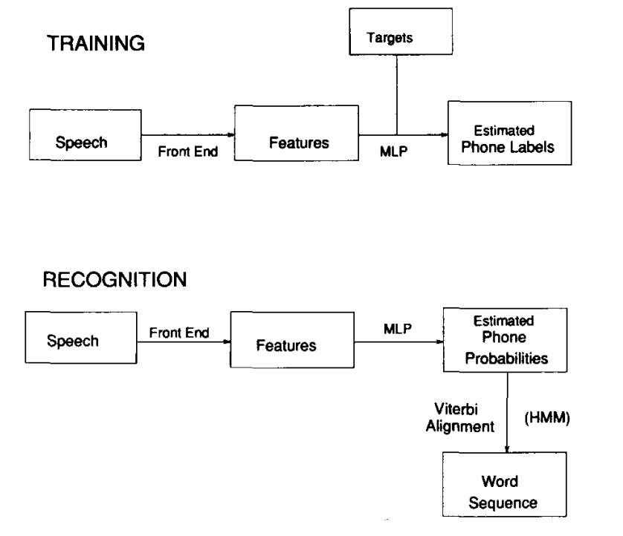
Not Really a New Idea
Renals, Morgan, Bourland, Cohen, & Franco. 1994.

Slide 7
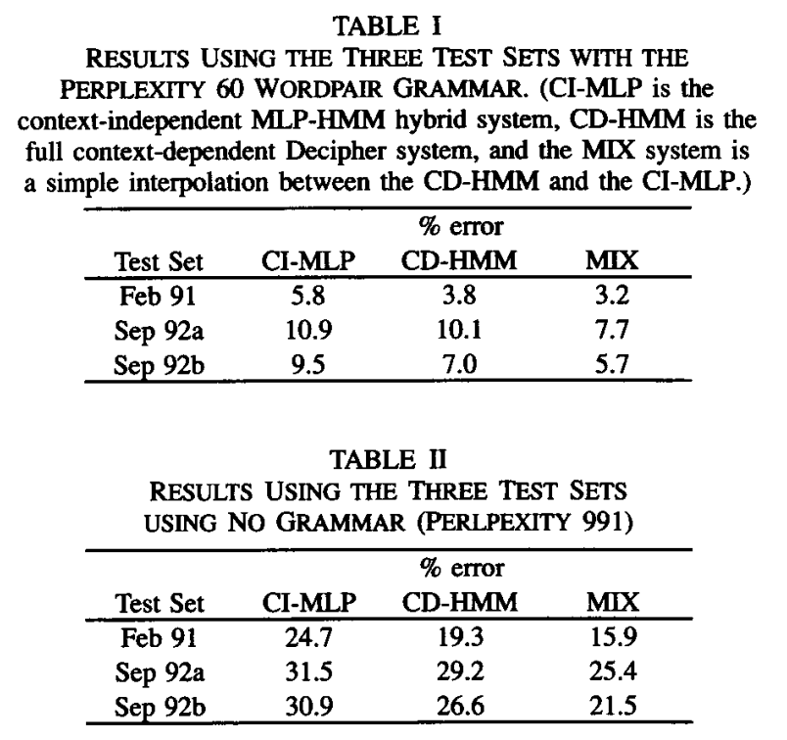
Hybrid MLPs on Resource Management
Renals, Morgan, Bourland, Cohen, & Franco. 1994.

Slide 8
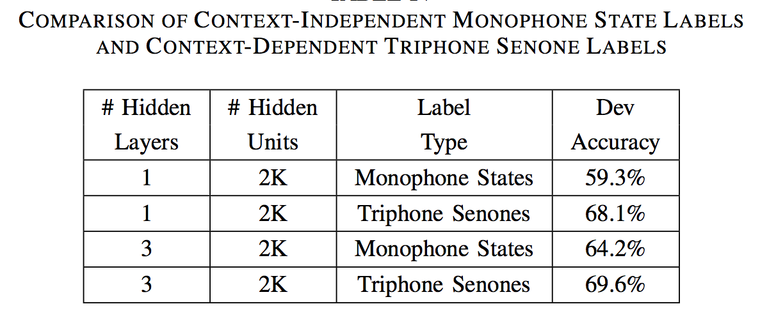
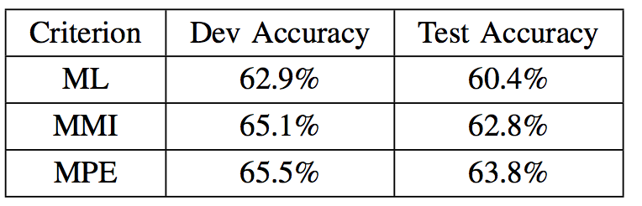
Modern Systems use DNNs and Senones
Dahl, Yu, Deng & Acero. 2011.
Notes:
Bing voice search task.

Slide 9
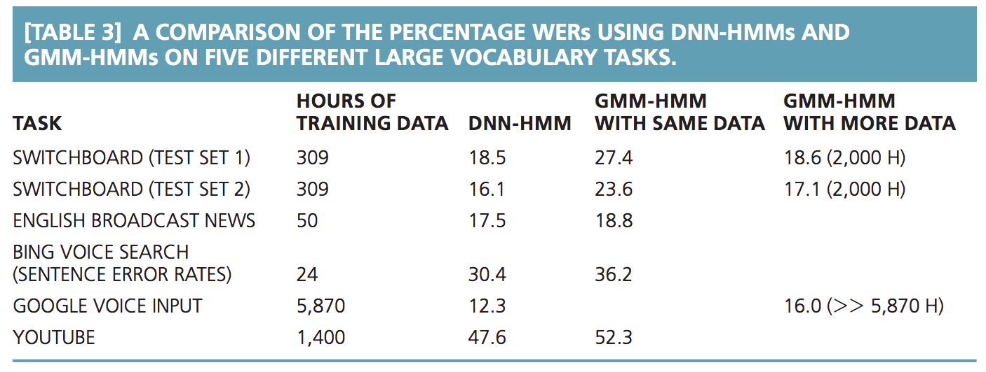
Hybrid Systems now Dominate ASR
Hinton et al. 2012.

Slide 10
Outline
Hybrid acoustic modeling overview
Basic idea
History
Recent results
Deep neural net basic computations
Forward propagation
Objective function
Computing gradients
What’s different about modern DNNs?
Extensions and current/future work

Slide 11



Neural Network Basics: Single Unit
Logistic regression as a “neuron”
x₁
w₁
w₂
Σ
Output
x₂
w₃
x₃
b
+1
Slides from Awni Hannun (CS221 Autumn 2013)
Notes:
-note f can be any activation function not just sigmoid, including tanh and rectified linear functions

Slide 12
Single Hidden Layer Neural Network
Stack many logistic units to create a Neural Network
x₁
w₁₁
w₂₁
a₁
x₂
a₂
x₃
+1
+1
Layer 2 /
hidden layer
Layer 1 / Input
Layer 3 / output
Slides from Awni Hannun (CS221 Autumn 2013)

Slide 13
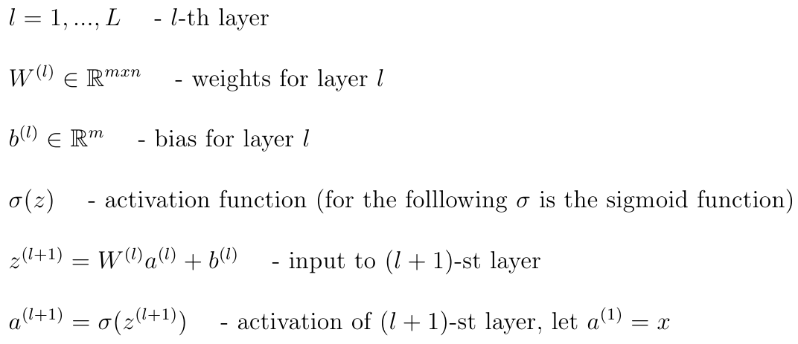
Notation
Slides from Awni Hannun (CS221 Autumn 2013)

Slide 14

Forward Propagation
x₁
w₁₁
w₂₁
x₂
x₃
+1
+1
Slides from Awni Hannun (CS221 Autumn 2013)

Slide 15

Forward Propagation
x₁
x₂
x₃
+1
+1
Layer 2 /
hidden layer
Layer 1 / Input
Layer 3 / output
Slides from Awni Hannun (CS221 Autumn 2013)

Slide 16


Forward Propagation with Many Hidden Layers
. . .
. . .
+1
+1
Layer l
Layer l+1
Slides from Awni Hannun (CS221 Autumn 2013)

Slide 17

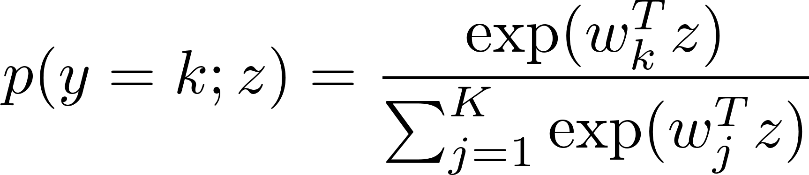
Forward Propagation as a Single Function
Gives us a single non-linear function of the input
But what about multi-class outputs?
Replace output unit for your needs
“Softmax” output unit instead of sigmoid

Slide 18
Outline
Hybrid acoustic modeling overview
Basic idea
History
Recent results
Deep neural net basic computations
Forward propagation
Objective function
Computing gradients
What’s different about modern DNNs?
Extensions and current/future work

Slide 19
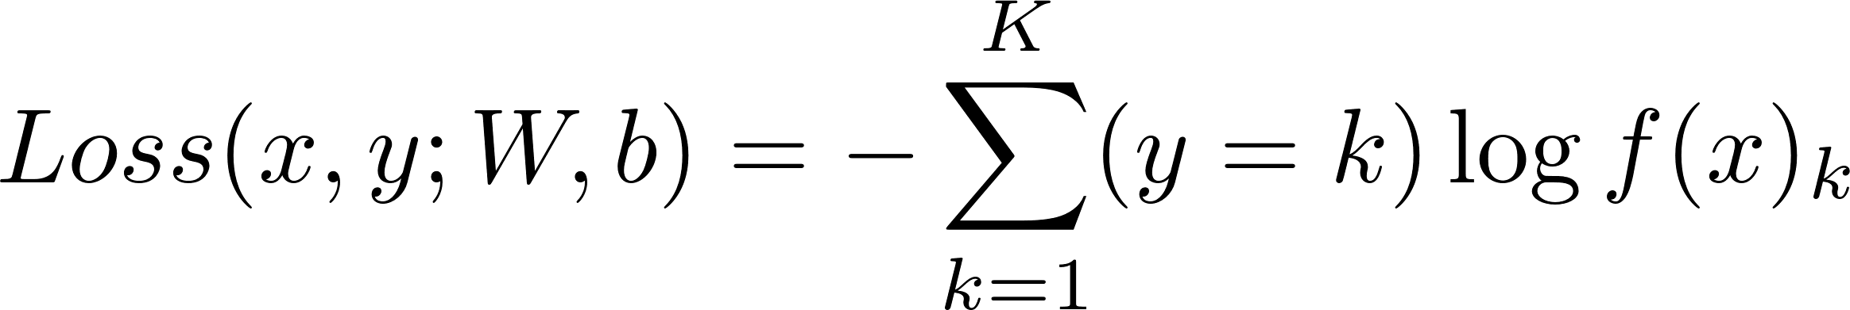
Objective Function for Learning
Supervised learning, minimize our classification errors
Standard choice: Cross entropy loss function
Straightforward extension of logistic loss for binary
This is a frame-wise loss. We use a label for each frame from a forced alignment
Other loss functions possible. Can get deeper integration with the HMM or word error rate

Slide 20
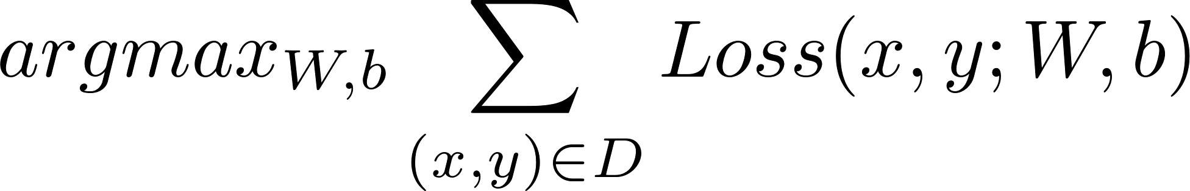
The Learning Problem
Find the optimal network weights
How do we do this in practice?
Non-convex
Gradient-based optimization
Simplest is stochastic gradient descent (SGD)
Many choices exist. Area of active research

Slide 21
Outline
Hybrid acoustic modeling overview
Basic idea
History
Recent results
Deep neural net basic computations
Forward propagation
Objective function
Computing gradients
What’s different about modern DNNs?
Extensions and current/future work

Slide 22


Computing Gradients: Backpropagation
Backpropagation
Algorithm to compute the derivative of the loss function with respect to the parameters of the network
Slides from Awni Hannun (CS221 Autumn 2013)

Slide 23


Chain Rule
Recall our NN as a single function:
x
g
f
Slides from Awni Hannun (CS221 Autumn 2013)
Notes:
Regular chain rule

Slide 24

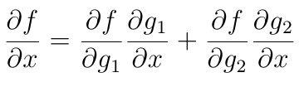
Chain Rule
g₁
x
f
g₂
CS221: Artificial Intelligence (Autumn 2013)
Notes:
Regular chain rule

Slide 25
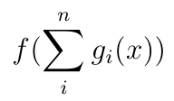
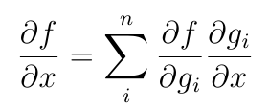
Chain Rule
g₁
x
f
. . .
g_{n}
CS221: Artificial Intelligence (Autumn 2013)
Notes:
Regular chain rule

Slide 26


Backpropagation
Idea: apply chain rule recursively
x
w₁
f₁
w₂
f₂
w₃
f₃
δ⁽³⁾
δ⁽²⁾
CS221: Artificial Intelligence (Autumn 2013)
Notes:
Regular chain rule

Slide 27
Backpropagation
x₁
x₂
δ⁽³⁾
Loss
x₃
+1
+1
CS221: Artificial Intelligence (Autumn 2013)
Notes:
Backprop intuition

Slide 28
Outline
Hybrid acoustic modeling overview
Basic idea
History
Recent results
Deep neural net basic computations
Forward propagation
Objective function
Computing gradients
What’s different about modern DNNs?
Extensions and current/future work

Slide 29
What’s Different in Modern DNNs?
Fast computers = run many experiments
Many more parameters
Deeper nets improve on shallow nets
Architecture choices (easiest is replacing sigmoid)
Pre-training does not matter. Initially we thought this was the new trick that made things work

Slide 30
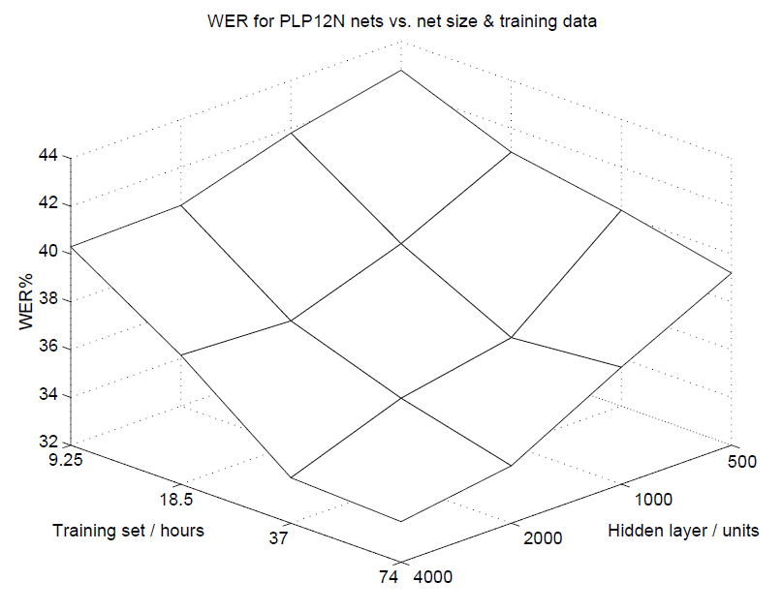
Scaling up NN acoustic models in 1999
0.7M total NN parameters
[Ellis & Morgan. 1999]
Notes:
Context for 0.7M params.
Modern LVCSR hybrid systems use ~36M params
I’ll present results for 200M params and we are currently training models with 400M params

Slide 31
Adding More Parameters 15 Years Ago
Size matters: An empirical study of neural network training for LVCSR. Ellis & Morgan. ICASSP. 1999.
Hybrid NN. 1 hidden layer. 54 HMM states.
74hr broadcast news task
“…improvements are almost always obtained by increasing either or both of the amount of training data or the number of network parameters … We are now planning to train an 8000 hidden unit net on 150 hours of data … this training will require over three weeks of computation.”

Slide 32
Adding More Parameters Now
Comparing total number of parameters (in millions) of previous work versus our new experiments
Maas, Hannun, Qi, Lengerich, Ng, & Jurafsky. In submission.

Slide 33
Sample of Results
2,000 hours of conversational telephone speech
Kaldi baseline recognizer (GMM)
DNNs take 1 -3 weeks to train
Acoustic Model | Training hours | Dev CrossEnt | Dev Acc(%) | FSH WER
GMM | 2,000 | N/A | N/A | 32.3
DNN 36M | 300 | 2.23 | 49.9 | 24.2
DNN 200M | 300 | 2.34 | 49.8 | 23.7
DNN 36M | 2,000 | 1.99 | 53.1 | 23.3
DNN 200M | 2,000 | 1.91 | 55.1 | 21.9
Maas, Hannun, Qi, Lengerich, Ng, & Jurafsky. In submission.
Notes:
This is a larger dataset with 2,000 hours of telephone speech. We previously used a 300 hour dataset where we already outperform MSR and JHU, but our DNNs need more training data to leverage

Slide 34
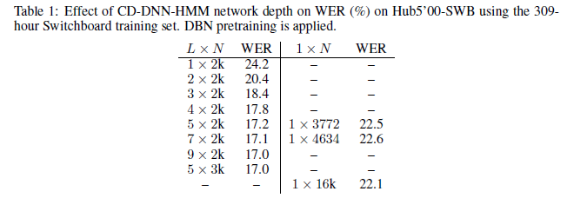
Depth Matters (Somewhat)
Warning! Depth can also act as a regularizer because it makes optimization more difficult. This is why you will sometimes see very deep networks perform well on TIMIT or other small tasks.
Yu, Seltzer, Li, Huang, Seide. 2013.

Slide 35
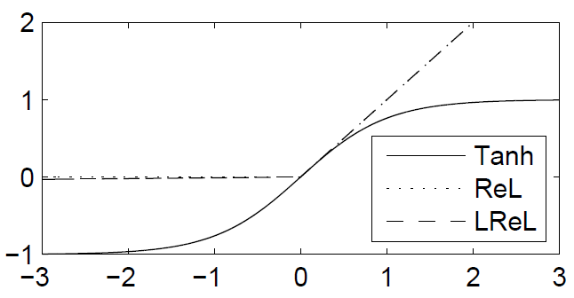
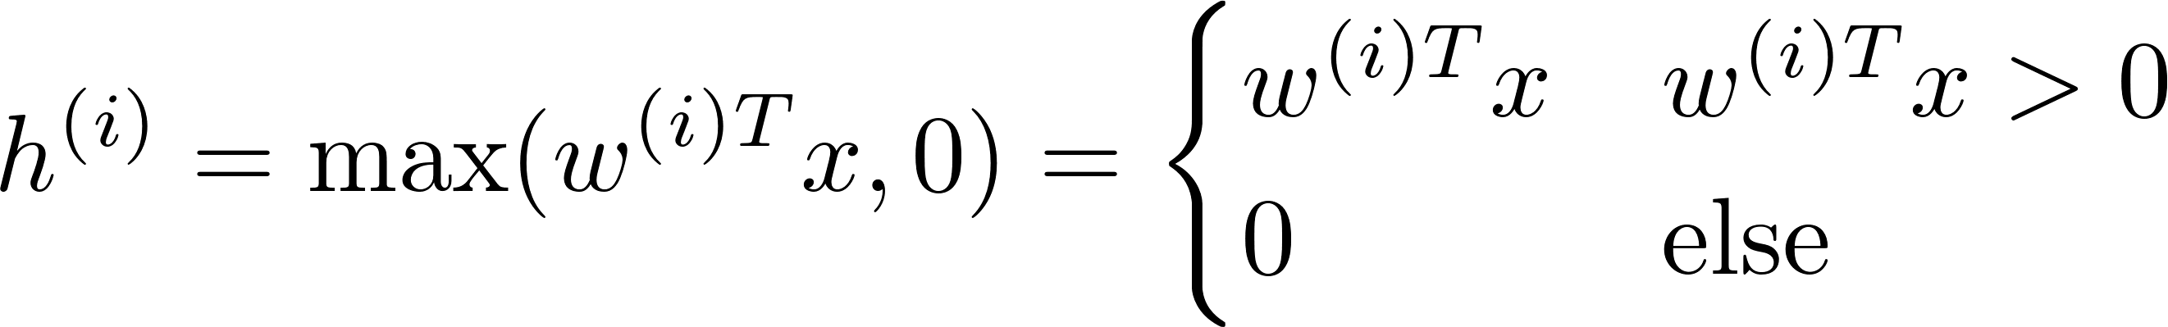
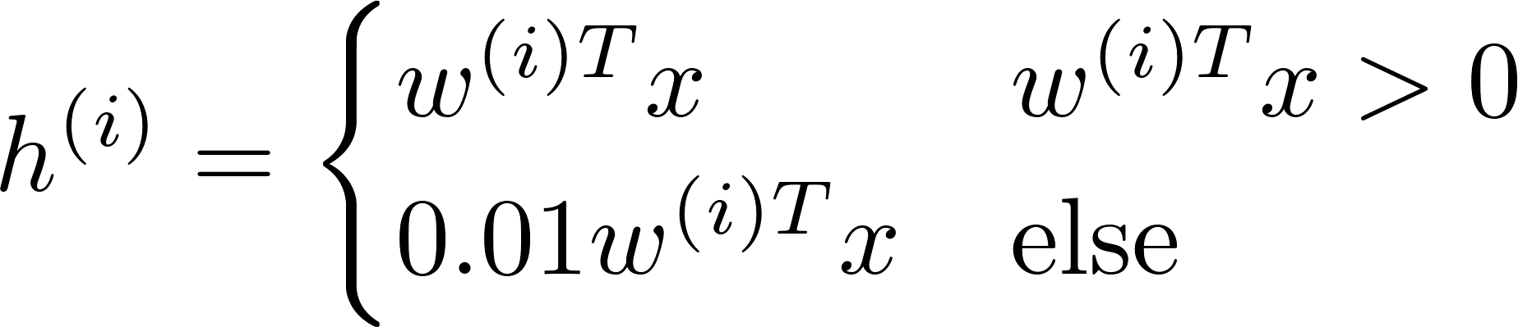
Architecture Choices: Replacing Sigmoids
Rectified Linear (ReL)
[Glorot et al, AISTATS 2011]
Leaky Rectified Linear (LReL)
Notes:
So we waited 15 years, computers got faster and datasets got larger. Is that all there is to DNNs?
No, it turns out that success of DNNs also relies on advances to optimization techniques and in some cases network architecture choices.
We found that rectifiers were critical to easily producing a nearly SOTA hybrid system

Slide 36
Rectifier DNNs on Switchboard
Model | Dev CrossEnt | Dev Acc(%) | Switchboard WER | Callhome WER | Eval 2000 WER
GMM Baseline | N/A | N/A | 25.1 | 40.6 | 32.6
2 Layer Tanh | 2.09 | 48.0 | 21.0 | 34.3 | 27.7
2 Layer ReLU | 1.91 | 51.7 | 19.1 | 32.3 | 25.7
2 Layer LRelU | 1.90 | 51.8 | 19.1 | 32.1 | 25.6
3 Layer Tanh | 2.02 | 49.8 | 20.0 | 32.7 | 26.4
3 Layer RelU | 1.83 | 53.3 | 18.1 | 30.6 | 24.4
3 Layer LRelU | 1.83 | 53.4 | 17.8 | 30.7 | 24.3
4 Layer Tanh | 1.98 | 49.8 | 19.5 | 32.3 | 25.9
4 Layer RelU | 1.79 | 53.9 | 17.3 | 29.9 | 23.6
4 Layer LRelU | 1.78 | 53.9 | 17.3 | 29.9 | 23.7
9 Layer Sigmoid CE [MSR] | -- | -- | 17.0 | -- | --
7 Layer Sigmoid MMI [IBM] | -- | -- | 13.7 | -- | --
Maas, Hannun, & Ng,. 2013.
Notes:
Baseline GMM triphone system contains 3,034 senones. Speaker-level CMVN and fMLLR adaptation are applied to MFCC features . For DNNs, we use a context of +/- 3 frames and apply LDA to reduce features to 300 dimensions
Report frame-level cross entropy (CrossEnt) and class accuracy (Acc) on a separate development set
Evaluate word error rate (WER) using DNN senone likelihoods in a hybrid recognizer. The Eval2000 test set contains the switchboard and callhome subsets
Each DNN hidden layer has 2048 hidden units. A 3 layer DNN thus has ~15.2 million parameters
Relatively simple optimization setup. SGD with momentum without preconditioning or other tricks. No pretraining

Slide 37
Rectifier DNNs on Switchboard
Model | Dev CrossEnt | Dev Acc(%) | Switchboard WER | Callhome WER | Eval 2000 WER
GMM Baseline | N/A | N/A | 25.1 | 40.6 | 32.6
2 Layer Tanh | 2.09 | 48.0 | 21.0 | 34.3 | 27.7
2 Layer ReLU | 1.91 | 51.7 | 19.1 | 32.3 | 25.7
2 Layer LRelU | 1.90 | 51.8 | 19.1 | 32.1 | 25.6
3 Layer Tanh | 2.02 | 49.8 | 20.0 | 32.7 | 26.4
3 Layer RelU | 1.83 | 53.3 | 18.1 | 30.6 | 24.4
3 Layer LRelU | 1.83 | 53.4 | 17.8 | 30.7 | 24.3
4 Layer Tanh | 1.98 | 49.8 | 19.5 | 32.3 | 25.9
4 Layer RelU | 1.79 | 53.9 | 17.3 | 29.9 | 23.6
4 Layer LRelU | 1.78 | 53.9 | 17.3 | 29.9 | 23.7
9 Layer Sigmoid CE [MSR] | -- | -- | 17.0 | -- | --
7 Layer Sigmoid MMI [IBM] | -- | -- | 13.7 | -- | --
Maas, Hannun, & Ng,. 2013.
Notes:
Baseline GMM triphone system contains 3,034 senones. Speaker-level CMVN and fMLLR adaptation are applied to MFCC features . For DNNs, we use a context of +/- 3 frames and apply LDA to reduce features to 300 dimensions
Report frame-level cross entropy (CrossEnt) and class accuracy (Acc) on a separate development set
Evaluate word error rate (WER) using DNN senone likelihoods in a hybrid recognizer. The Eval2000 test set contains the switchboard and callhome subsets
Each DNN hidden layer has 2048 hidden units. A 3 layer DNN thus has ~15.2 million parameters
Relatively simple optimization setup. SGD with momentum without preconditioning or other tricks. No pretraining

Slide 38
Outline
Hybrid acoustic modeling overview
Basic idea
History
Recent results
Deep neural net basic computations
Forward propagation
Objective function
Computing gradients
What’s different about modern DNNs?
Extensions and current/future work

Slide 39
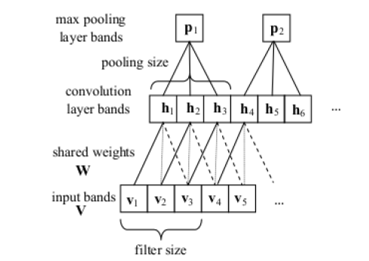
Convolutional Networks
Slide your filters along the frequency axis of filterbank features
Great for spectral distortions (eg. Short wave radio)
Sainath, Mohamed, Kingsbury, & Ramabhadran . 2013.

Slide 40
Recurrent DNN Hybrid Acoustic Models
Transcription:
Pronunciation:
Sub-phones :
Hidden Markov Model (HMM):
Acoustic Model:
Audio Input:
Samson
S – AE – M – S –AH – N
942 – 6 – 37 – 8006 – 4422 …
942
942
6
P(s|x₁)
P(s|x₂)
P(s|x₃)
Features (x₁)
Features (x₂)
Features (x₃)

Slide 41
Other Current Work
Changing the DNN loss function. Typically using discriminative training ideas already used in ASR
Reducing dependence on high quality alignments. In the limit you could train a hybrid system from flat start / no alignments
Multi-lingual acoustic modeling
Low resource acoustic modeling

Slide 42
End
More on deep neural nets:
http://ufldl.stanford.edu/tutorial/
http://deeplearning.net/
MSR video: http://youtu.be/Nu-nlQqFCKg
Class logistics:
Poster session Tuesday! 2-4pm on Gates building back lawn
We will provide poster boards and easels (and snacks)

