Slide 1
LVCSR Decoding with CTC Output
Wonyong Sung 2017

Slide 2
목차
Basic CTC decoding
CTC decoding with word language model (WLM): First-pass large vocabulary continuous speech recognition with Bi-directional Recurrent DNNs
CTC decoding with character language model (CLM):
CTC decoding with WFST

Slide 3
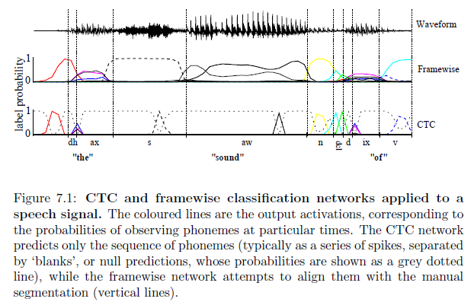
CTC Output

Slide 4
Advantages of CTC Training
End-to-end training: speech to character (including blank lable). CTC training predict the character sequences of utterances, instead of using context dependent phonemes.
Again, p(c; xt) is a distribution over possible characters in the alphabet , which includes the blank symbol, given audio input xt.
문제: very large character error rate!

Slide 5
Basic decoding
Let S = (s1, . . . , sT ) be the character sequence where st = argmaxc2 p(c; xt). The sequence S is mapped to a transcription by collapsing repeat characters and removing blanks. This gives a sequence which can be scored against the reference transcription using both CER and WER.
This first approximation lacks the ability to include the constraint of either a lexicon or a language model.

Slide 6
1. First-pass decoding with LM
Hannun, Awni Y., et al. "First-pass large vocabulary continuous speech recognition using bi-directional recurrent DNNs." arXiv preprint arXiv:1408.2873 (2014).
Acoustic modeling: bidirectional recurrent deep neural networks (not LSTM)

Slide 7
First-pass decoding with LM
The transcription W maximizes the probability
Beam search
Here the overall probability of the transcription is modeled as the product of two factors: p_{net} given by the network and p_{lm} given by a language model prior.

Slide 9
Incorporating Lexicon or Word Language Model
In Lexicon, decided (1 or 0) if the last word of l+ is in the lexicon
Act as a word language model when generalized

Slide 10
Decoding results
20K word vocabulary, WSJ training
Beam size: 200
What if the results are rescored with RNN LM?

Slide 11
Acoustic modeling comparison

Slide 12
Implementation complexity
Acoustic RNN runs only once.
The word language model inference is needed for each beam, but not very frequently.
The decoding complexity is proportional to the beam width.
Memory size: language model (full trigram model: about 300MB)

Slide 14
2. CTC decoding with character language model(CLM)
Maas, Andrew L., et al. "Lexicon-Free Conversational Speech Recognition with Neural Networks." HLT-NAACL. 2015.
CTC output is the probability distribution of characters (although there is word CTC output), thus it is more logical to incorporate CLM to filter out noisy CTC output
The decoding procedure is simpler than the WLM constrained CTC decoding (first-pass…)
CLM does not need a highly demanding softmax function
The CLM is applied every time step, while the WLM based approach only be applied when we consider adding a space or by computing the likelihood of a sequence being the prefix of a word in the lexicon<- (demand more computation!)
Can better handle OOV (the result does not care whether the word in in the lexicon or not)

Slide 16
Results
Character error rate (CER) and word error rate results on the Eval2000 test set. We report word error rates on the full test set (EV) which consists of the Switchboard (SWBD) and CallHome (CH) subsets. As baseline systems we use an HMMGMM system and HMM-DNN system. We evaluate our DBRNN trained using CTC by decoding with several character-level language models: 5-gram, 7-gram, densely connected neural networks with 1 and 3 hidden layers (NN-1, and NN-3), as well as recurrent neural networks s with 1 and 3 hidden layers.

Slide 17
OOV performance

Slide 18
OOV performance (2)
The DBRNN sometimes correctly transcribes OOV words with respect to our audio training corpus.
We find that OOVs tend to trigger clusters of errors in the HMM-GMM system, an observation that has been systematically explored in previous work (Goldwater et al., 2010).
As shown in example utterance (3), HMM-GMM errors can introduce word substitution errors which may alter meaning whereas the DBRNN system outputs word fragments or non-words which are phonetically similar and may be useful input features for SLU systems.

Slide 19
Implementation complexity
Acoustic RNN runs only once.
The character language model inference is needed for each beam and more frequently (compared to word-model).
The decoding complexity is proportional to the beam width.
Memory size: character language model

Slide 22
3. CHARACTER-LEVEL INCREMENTAL SPEECH RECOGNITION WITH RECURRENT NEURAL NETWORKS
Hwang, Kyuyeon, and Wonyong Sung. "Character-level incremental speech recognition with recurrent neural networks." Acoustics, Speech and Signal Processing (ICASSP), 2016 IEEE International Conference on. IEEE, 2016.
On-line speech recognition: spontaneous dictation
Cannot use bi-directional RNN for acoustic modeling, only uni-directional RNN is allowed (LSTM RNN)
Use RNN based CLM for long range modeling of characters
No Lexicon needed, better handling OOV

Slide 23
Incorporating CTC with CLM
Tree beam search
Pruning: width and depth pruning
Width: 128~512 (0.5% ~ 1% WER difference)

Slide 25
Implementation complexity
Acoustic RNN runs only once.
The character language model inference is needed for each beam and more frequently (compared to word-model).
CLM is very computationally complex, and needs to store the status for each beam

Slide 26
4. Character-Level Speech Recognition with Hierarchical Recurrent Neural Networks
Hwang, Kyuyeon, and Wonyong Sung. "Character-Level Language Modeling with Hierarchical Recurrent Neural Networks." arXiv preprint arXiv:1609.03777 (2016).
Use hierarchical language model to predict inter-word correlations

Slide 27
Hierarchical CLM
Basically, the input and output are character based
The softmax is very simple, no need to support hundreds K labels

Slide 28
Performance HCLM

Slide 32
5. CTC Decoding with WFST
Miao, Yajie, Mohammad Gowayyed, and Florian Metze. "EESEN: End-to-end speech recognition using deep RNN models and WFST-based decoding." Automatic Speech Recognition and Understanding (ASRU), 2015 IEEE Workshop on. IEEE, 2015.
Research on end-to-end ASR faces major obstacle; it is challenging to incorporate lexicons and language models into decoding. When decoding CTC-trained models, past work [6, 8, 10] has successfully constrained search paths with lexicons. However, how to integrate word-level language models efficiently still is an unanswered question

Slide 33
EESEN
Deep Bidirectional LSTM RNN for acoustic modeling trained with CTC
Phone based systems
Character based systems

Slide 34
HMM System에서의 WFST

Slide 35
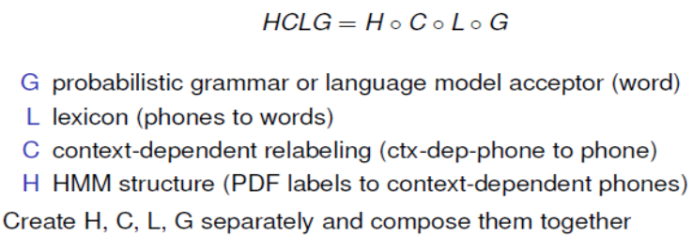
EESEN: CTC with WFST
CTC output의 경우 WFST가 간단해짐
다음의 세가지를 필요
Grammar
Lexicon
Token

Slide 37
Three components for WFST in EESEN
Grammar: permissible word sequences in language domain. Denoted as G

Slide 38
Lexicon: A lexicon WFST encodes the mapping from sequences of lexicon units (phonemes or characters) to words.
If the labels are phonemes, the lexicon is a standard dictionary. When the labels are characters, the lexicon simply contains the spellings of the words.
A key difference between these two cases is that the spelling lexicon can be easily expanded to include any out-of-vocabulary (OOV) words. In contrast, expansion of the phoneme lexicon is not so straightforward. For the spelling lexicon, there is another complication to deal with. With characters as CTC labels, we usually insert an additional space character between every pair of words.

Slide 39
Token: The third WFST component maps a sequence of frame-level CTC labels to a single lexicon unit (phoneme or character). For a lexicon unit, its token WFST is designed to subsume all of its possible label sequences at the frame level. Therefore, this WFST allows occurrences of the blank label ?, as well as repetitions of any non-blank lables.
The RNN model may generate 3 possible label sequences “AAAAA”, “? ? A A ?”, “? AA A ?”.

Slide 40
Search Graph
After compiling the three individual WFSTs, we compose them into a comprehensive search graph.
The lexicon and grammar WFSTs are firstly composed. Two special WFST operations, determinization and minimization, are performed over the composition of them, in order to compress the search space and thus speed up decoding. The resulting WFST LG is then composed with the token WFST, which finally generates the search graph. Overall the order of the FST operations is:

Slide 41
Phoneme-based EESEN

Slide 42
Character-based EESEN

