Slide 1








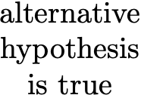

True Negative | False Positive Type I Error
False Negative Type II Error | True Positive Power

Slide 2

True Negative | False Negative Type II Error
False Positive Type I Error | True Positive Power

