Slide 1
BI – Overview

Slide 2
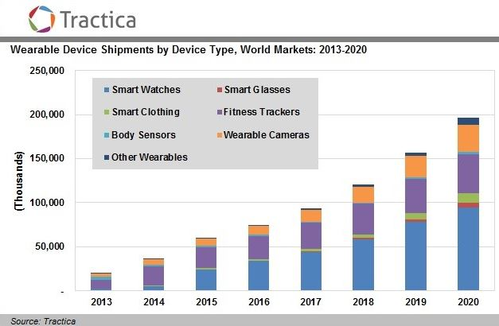
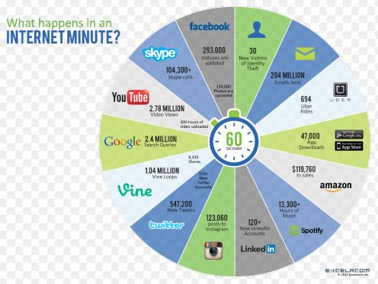
Growth in devices

Slide 3
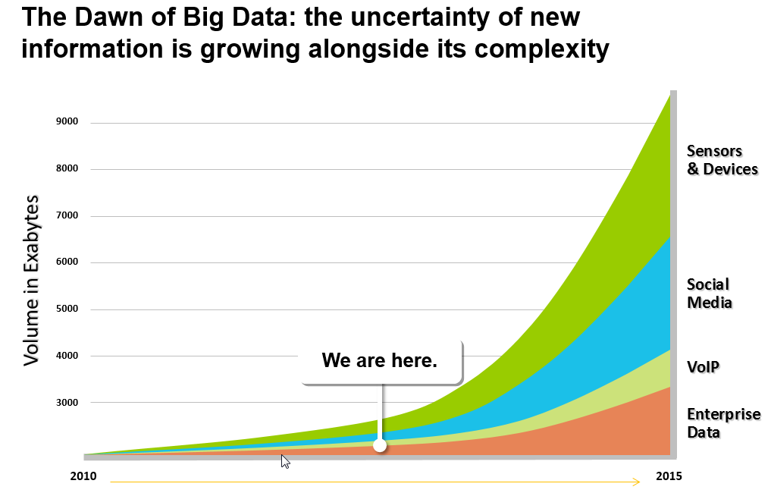
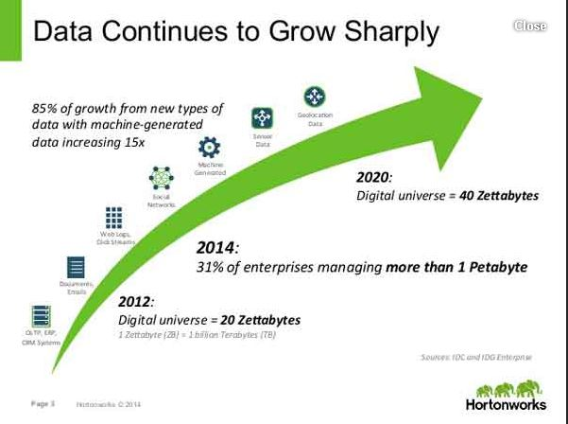
Growth rate of data
1 Exabytes = 10¹⁸ bytes / 1 Zettabytes = 10²¹ bytes

Slide 4
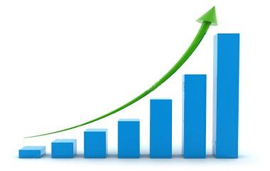
Growth of Data Volumes
The NYSE produces about 1TB/day of trading data
Facebook hosts approx. 10 billion photos = 1 PB
Ancestry.com: 2.5 PB
Large Hadron Collider: 15 PB/year
In 2010, Ericsson’s CEO predicted that by 2020, 50 billion devices would be connected to the internet
Wearables are around the corner (here)
Amount of data stored doubles every 18 months

Slide 5
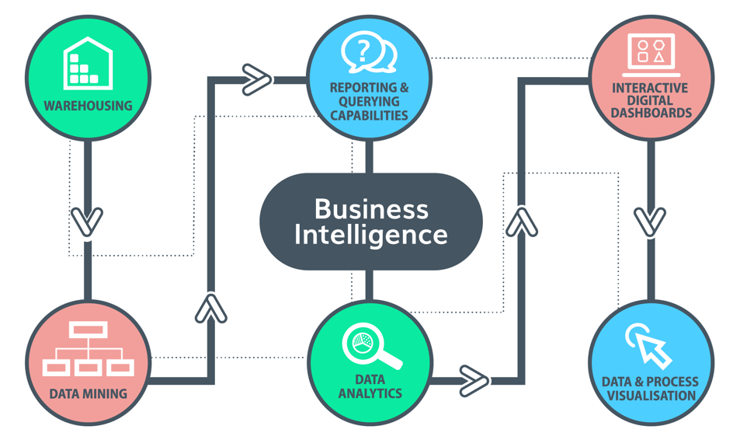
What is BI ?

Slide 6
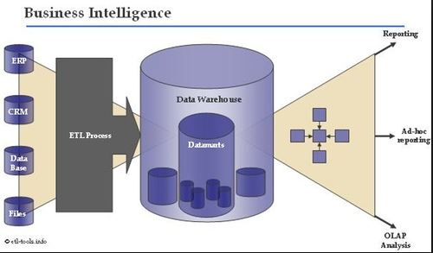
BI Aspects
1. Data Ingestion from multiple sources
2. Meta data information / Data quality
3. Analytics

Slide 7
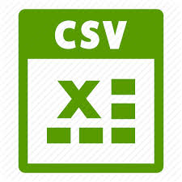
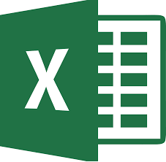
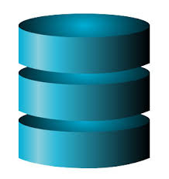
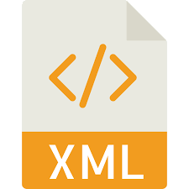



Data Source types
Files (Excel, csv)
Databases (Sql Server, Oracle, postgres)
Message Based (XML, JSON)
Hadoop ecosystem (HDFS / Hive / Cassandra)
RSS (Rich Site Summary) feeds - > Twitter / facebook feeds
Ex. https://marcobonzanini.com/2015/03/02/mining-twitter-data-with-python-part-1/

Slide 8
Files
Text files
Location : C:\dump\shared_cloud\CloudStation\s_learn\Lecture-1\customers-100.txt
CSV File
Location : C:\dump\shared_cloud\CloudStation\s_learn\Lecture-1\sales_data.csv
Excel files
Location : C:\dump\shared_cloud\CloudStation\s_learn\Lecture-1\sample-file.csv

Slide 9
Messages
XML messages
Location : C:\dump\shared_cloud\CloudStation\s_learn\Lecture-1\GetXMLData - test 1 - simple functionality test.xml
Sample Json Message
{ "id": 1, "name": "A green door", "price": 12.50, "tags": ["home", "green"] }

Slide 10
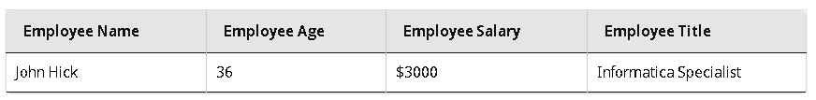
Metadata
First row containing employee name / age / salary / title are called as Metadata for above said data
Types :
Technical : Tables / Tablespace / datatypes / relationships / constraintss
Business : Entities definition / business rules /
Metadata repository:
Information about source / target / transformations / mapping / workflow / session is stored

Slide 11
Data Lineage Information
Data lineage Includes the data's origins, what happens to it and where it moves over time
Data lineage can be represented visually to discover the data flow/movement from its source to destination via various changes and hops on its way in the enterprise environment, how the data gets transformed along the way, how the representation and parameters change, and how the data splits or converges after each hop. A simple representation of the Data Lineage can be shown with dots and lines, where dot represents a data container for data point(s) and lines connecting them represents the transformation(s) the data point under goes, between the data containers
Data lineage information includes technical metadata involving data transformations. Enriched data lineage information may include data quality test results, reference data values, data models, business vocabulary, data stewards, program management information, and enterprise information systems linked to the data points and transformations. Masking feature in the data lineage visualization allows the tools to incorporate all the enrichments that matter for the specific use case. To represent disparate systems into one common view, "metadata normalization" or standardization may be necessary.

Slide 12
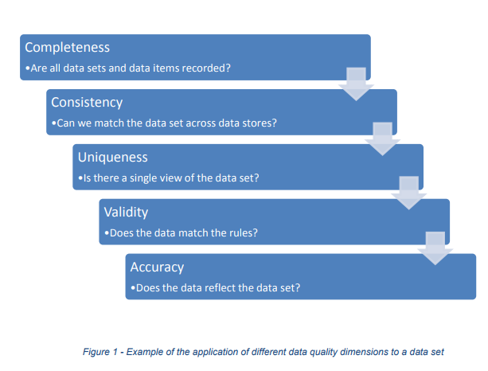
Define data quality dimension (according to business priority)
What is data quality ?

Slide 13
Data Quality
Data quality is a perception or an assessment of data's fitness to serve its purpose in a given context.
Aspects of data quality include:
Accuracy : The degree to which data correctly describes the "real world" object or event being described.
Completeness : The proportion of stored data against the potential of "100% complete"
Timeliness : The degree to which data represent reality from the required point in time.
Validity : Data are valid if it conforms to the syntax (format, type, range) of its definition.
Uniqueness: No thing will be recorded more than once based upon how that thing is identified.
Consistency : The absence of difference, when comparing two or more representations of a thing against a definition.

Slide 14
DLM Data Life Cycle Management
It’s a policy-based approach to managing the flow of an information system's data throughout its life cycle.
Policies are designed around:
Data creation
Data storage
Active Lifeperiod
Obsolete lifeperiod
Data deletion
As a rule, newer data, and data that must be accessed more frequently, is stored on faster, but more expensive storage media, while less critical data is stored on cheaper, but slower media.

Slide 15
DG Data Governance
Data governance (DG) is the overall management of the following aspects around dataset :
Availability
Usability
Integrity
Security of data used in an enterprise.
A sound data governance program includes a governing body or council, a defined set of procedures and a plan to execute those procedures.

Slide 16
DPM Data Protection Management
Data protection management (DPM) is the administration of backup processes to ensure that
1. tasks run on schedule
2. data is securely backed up
3. Data is recoverable.
Good data protection management means having effective processes and methodologies in place to maintain data integrity.

Slide 17
Database / SQL Queries
Deep dive into specific implementation for database:
Location : C:\dump\shared_cloud\CloudStation\s_learn\sql\sql-tutorial-master\sql-tutorial-master

