Slide 1
Data Operations

Slide 2
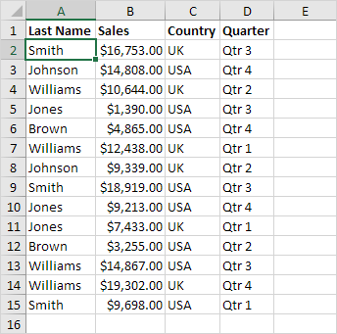
Sort
You can sort your Excel data on one column or multiple columns. You can sort in ascending or descending order.
One Column Sort / Multiple column sort

Slide 3
Filter
Filter your Excel data if you only want to display records that meet certain criteria.
Click any single cell inside a data set.
On the Data tab, in the Sort & Filter group, click Filter.
click the arrow next to Country.
Click on Select All to clear all the check boxes, and click the check box next to USA.
Click OK.
Result. Excel only displays the sales in the USA.

Slide 4
Tables
Tables allow you to analyze your data in Excel quickly and easily. Learn how to insert, sort and filter a table, and how to display a total row at the end of a table.
Insert a Table
To insert a table, execute the following steps.
Click any single cell inside the data set.
Excel automatically selects the data for you. Check 'My table has headers' and click on OK.
Result. Excel creates a nicely formatted table for you. This may still seem like a normal data range to you but many powerful features are now just a click of a button away.
Total Row
To display a total row at the end of the table, execute the following steps.
First, select a cell inside the table. Next, on the Design tab, in the Table Style Options group, check Total Row.
Click any cell in the last row to calculate the Total (Average, Count, Max, Min, Sum etc.) of a column. For example, calculate the sum of the Sales column.

