Slide 1
Map Reduce
An Parallel Processing Pattern
@BigDataJunkies

Slide 2
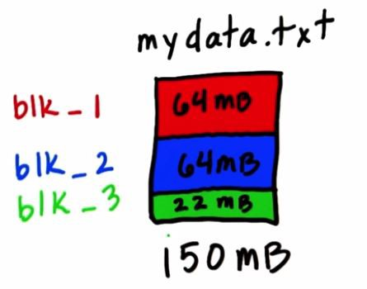
Block Size , Helpful ?
Block Size → the smallest unit of data that a HDFS can store.
Default is 64 MB .
For Example : a cluster of 1 peta bytes, 64 MB block size results into 15+ million blocks, which is difficult for Namenode to manage efficiently.
lot of blocks sometimes result in a lot of mappers during MapReduce execution.
Depending on your data requirement, you can fine tune dfs.blocksize

Slide 3
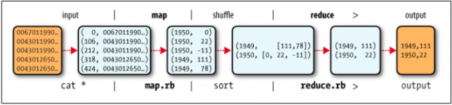
Motivations for MapReduce :
Data processing: > 1 TB .
Massively parallel (hundreds or thousands of CPUs).
Must be easy to use.
Map Reduce in Simple Diagram :

Slide 4
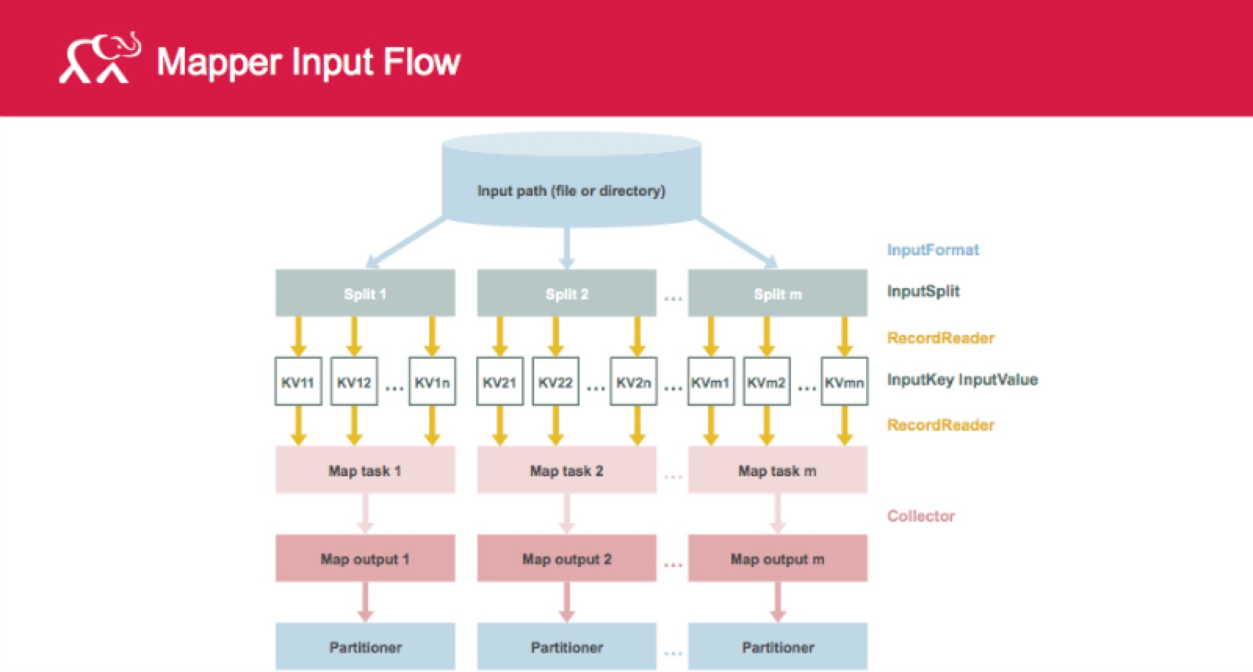
MR – Input Flow

Slide 5
Map →
Records from the data source (lines out of files, rows of a database, etc) are fed into the map function as key*value pairs: e.g., (filename, line).
map() produces one or more intermediate values along with an output key from the input.
Reduce →
After the map phase is over, all the intermediate values for a given output key are combined together into a list.
reduce() combines those intermediate values into one or more final values for that same output key (in practice, usually only one final value per key)

Slide 6
Programming Model
Borrows from functional programming
Users implement interface of two
functions:
map (in_key, in_value) -> (out_key, intermediate_value) list
reduce (out_key, intermediate_value list) -> out_value list

Slide 7
Pseudo code :
map(String input_key, String input_value):
// input_key: document name
// input_value: document contents
for each word w in input_value:
EmitIntermediate(w, "1");
…....................
.............
...................
reduce(String output_key, Iterator intermediate_values):
// output_key: a word
// output_values: a list of counts
int result = 0;
for each v in intermediate_values:
result += ParseInt(v);
Emit(AsString(result));

Slide 8
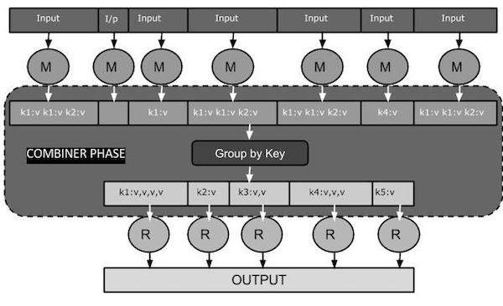
There is one more Phase . Combiner

Slide 9
What it does ???
A combiner does not have a predefined interface and it must implement the Reducer interface’s reduce() method.
A combiner operates on each map output key. It must have the same output key-value types as the Reducer class.
A combiner can produce summary information from a large dataset because it replaces the original Map output.

Slide 10
Inputs and Outputs (Java Perspective)
The key and the value classes should be in serialized manner.
Need to implement the Writable interface.
key classes have to implement the Writable-Comparable interface to facilitate sorting by the framework.

Slide 11
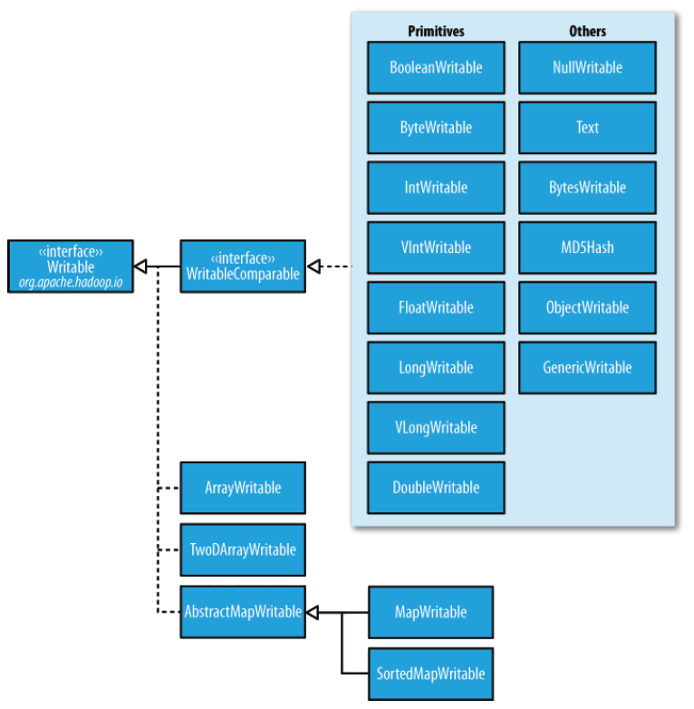
Class Hierarchy :

Slide 12
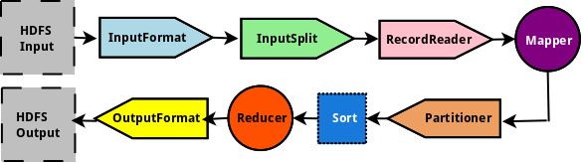
Map Reduce Job - Flow

Slide 13
InputFormat
Used by the JobTracker
Validates the specified HDFS input directory
Based on the input file(s) to be processed, returns a list of org.apache.hadoop.mapreduce.InputSplit objects
Is a factory for org.apache.hadoop.mapreduce.RecordReader
The default implementation for InputFormat is org.apache.hadoop.mapreduce.lib.input.TextInputFormat. TextInputFormat is used for processing text file(s)

Slide 14
InputSplit
Used by the JobTracker
Is typically a data block from the HDFS with a byte-oriented view of the data
Encapsulates the size of the input data block as well as the list of nodes in the cluster where the data block(s) reside
Used as the input for the Mapper task
The default implementation for InputSplit is org.apache.hadoop.mapreduce.lib.input.FileSplit

Slide 15
RecordReader
Used by the Mapper task in the TaskTracker
An InputSplit provides a raw byte-oriented view of the input data block, while the org.apache.hadoop.mapreduce.RecordReader provides a record-oriented view of the input data
Provides input value into the map() function of the Mapper
The default implementation for RecordReader is org.apache.hadoop.mapreduce.lib.input.LineRecordReader

Slide 16
Partitioner
Used in the TaskTracker after the Mapper task produces output
Helps in the distribution of output from the Mapper to the Reducer
The default implementation for Partitioner used is org.apache.hadoop.mapred.lib.HashPartitioner. It uses the hash code on KEY to distribute the output

Slide 17
OutputFormat
Used by the Reducer task in the TaskTracker
Used for writing output to HDFS from the Reducer task
The default implementation for OutputFormat is org.apache.hadoop.mapreduce.lib.input.TextOutputFormat
Is a factory for org.apache.hadoop.mapreduce.RecordWriter

Slide 18
RecordWriter
Used by the Reducer task in the TaskTracker
The default implementation for RecordWriter is org.apache.hadoop.mapreduce.lib.input.TextOutputFormat.LineRecordWriter
The TextOutputFormat.LineRecordWriter is what outputs each line of KEY-VALUE pairs (terminated by a newline) as a record from the Reducer

Slide 19
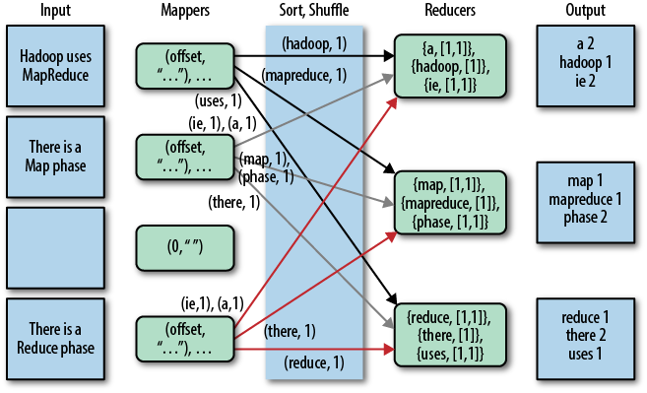
Shuffle And Sort

Slide 20
