Slide 1
Basics of Hadoop

Slide 2
What’s Up for Today !
HDFS Architecture
Replication & Rack Awareness
Daemons in Hadoop 1.x
Architecture of Hadoop 1.x
Why we need Hadoop 2.x ?
Daemons in Hadoop 2.x
Architecture of Hadoop 2.x

Slide 3


Slide 4
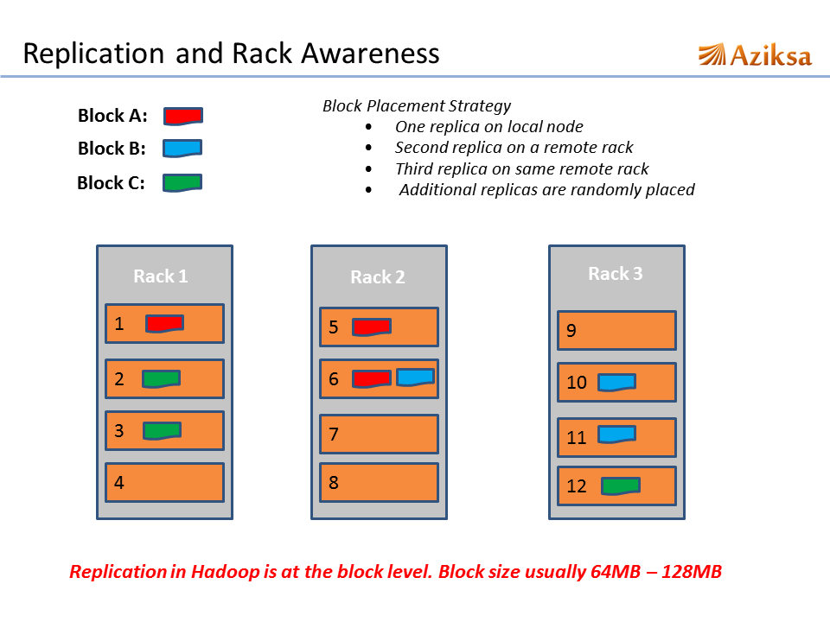
Replication & Rack Awareness :

Slide 5
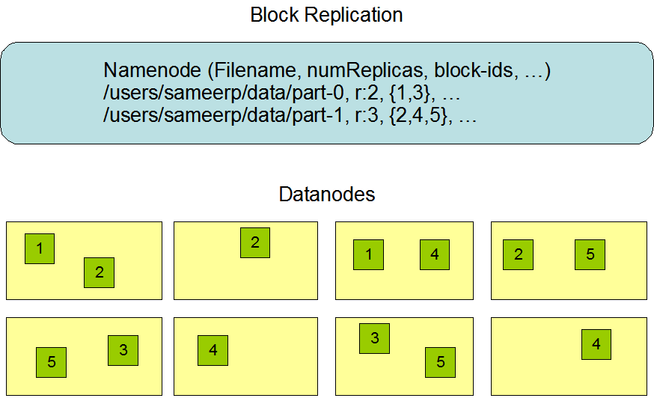
In Other ways ….
Advantages :
improves write performance without compromising data reliability or read performance.

Slide 6
Daemons in Hadoop 1.x
Mainly 3 Daemons :
Name Node
Secondary Name Node
Data Node
Map reduce Daemons :
Job Tracker
Task Tracker

Slide 7
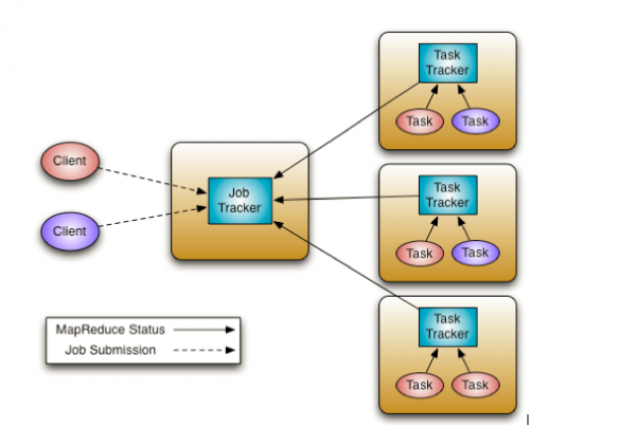
Architecure of Hadoop 1.x

Slide 8
Name Node :
Only single instance of this process runs on a cluster and that is on a master node
Manage metadata about files distributed across the cluster
Manages information like location of file blocks across cluster and it’s permission.
It periodically writes the changes in one file called edits as edit logs
This process is a heart of HDFS, if it is down HDFS is not accessible any more

Slide 9
Secondary Name Node :
Only single instance of this process runs on a cluster
This process can run on a master node (for smaller clusters) or can run on a separate node (in larger clusters) depends on the size of the cluster
“This is NOT a backup Name Node”
It manages the metadata for the Name Node. In the sense, it reads the information written in edit logs (by Name Node) and creates an updated file of current cluster metadata
Than it transfers that file back to Name Node so that fsimage file can be updated

Slide 10
Data Node :
Many instances of this process running on various slave nodes(referred as Data nodes)
It is responsible for storing the individual file blocks on the slave nodes in Hadoop cluster
Always Replication Factor > 1
Periodically sends heart bits to Name Node to make Name Node aware that slave process is running

Slide 11
Job Tracker :
Only one instance of this process runs on a master node same as Name Node.
Any MapReduce job is submitted to Job Tracker first.
Than it initiates the separate tasks on various Data Nodes(where blocks are present) by communicating with Task Tracker Daemons.
Task Tracker :
Multiple instances running on the slave nodes(typically runs on the slave nodes where Data Node process is running).
It receives the job information from Job Tracker daemon and initiates a task on that slave node.
In most of the cases, Task Tracker initiates the task on the same node where there physical data block is present.
Periodically sends HEART BEAT to JOB TRACKER .

Slide 12
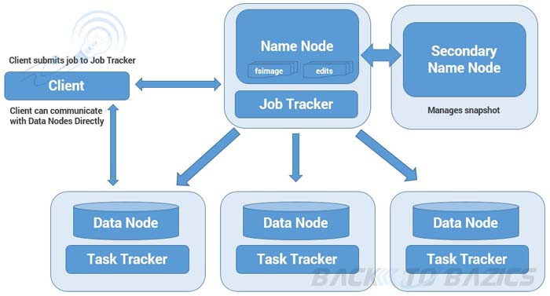
For Better Understanding !!!!!

Slide 13
When It Works ! Why Hadoop 2.x ???
Hadoop 1.x has a Single Point Of Failure.
Hadoop Cluster can be scaled upto ~4000 nodes.
OverLoad on JobTracker .
Only supports Map Reduce Computation .
No Streaming Components .

Slide 14
Daemons in Hadoop 2.x(YARN)
Mainly 2 Daemons :
Resource Manager
Node Manager

Slide 15
Resource Manager
This daemon process runs on master node (may run on the same machine as name node for smaller clusters)
It is responsible for getting job submitted from client and schedule it on cluster, monitoring running jobs on cluster and allocating proper resources on the slave node
It communicates with Node Manager daemon process on the slave node to track the resource utilization
It uses two other processes named Application Manager and Scheduler for MapReduce task and resource management

Slide 16
Node Manager
This daemon process runs on slave nodes (normally on HDFS Data node machines)
It is responsible for coordinating with Resource Manager for task scheduling and tracking the resource utilization on the slave node
It also reports the resource utilization back to the Resource Manager
It uses other daemon process like Application Master and Container for MapReduce task scheduling and execution on the slave node

Slide 17
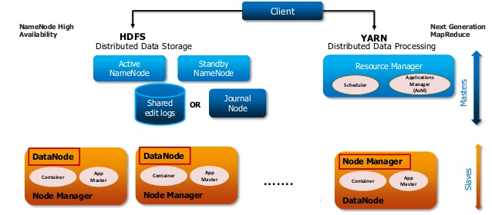
Hadoop 2 Architecture :

Slide 18
Really Highly Available ?? How ??
Hadoop 2.x supports two Name Nodes at a time one node is active and another is standby node
Active Name Node handles the client operations in the cluster
StandBy Name Node manages metadata same as Secondary Name Node in Hadoop 1.x
When Active Name Node is down, Standby Name Node takes over and will handle the client operations then after
HDFS HA can be configured by two ways
Using Shared NFS Directory
Using Quorum Journal Manager

Slide 19
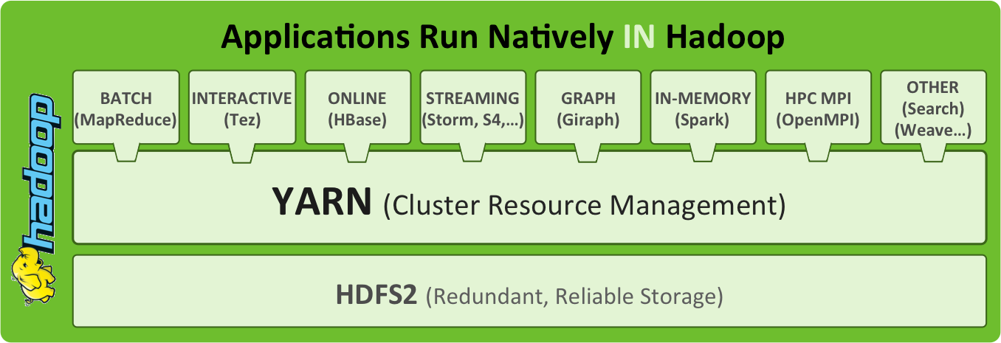
Components in Hadoop :

Slide 20
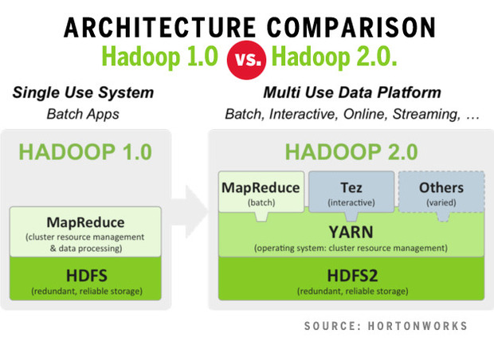

Slide 21

Hadoop Distributions in Market :

