Slide 1
SQOOP 2

Slide 2
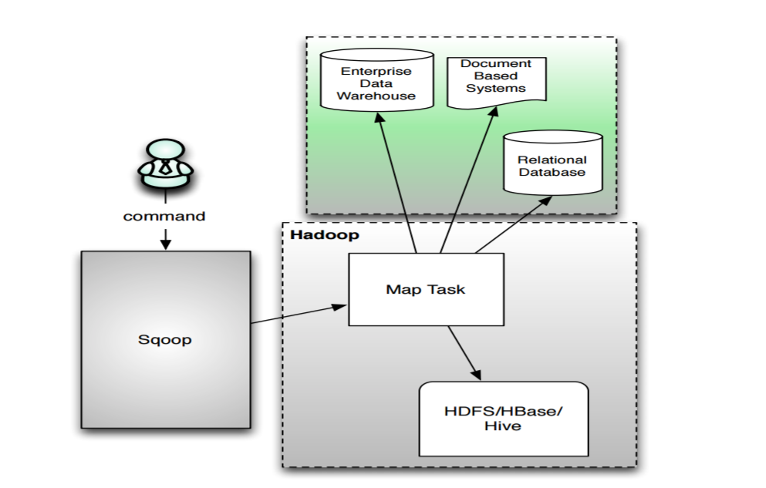
SQOOP 1

Slide 3
SQOOP 1 Challenges
Cryptic, contextual command line arguments
Security concerns
Type mapping is not clearly defined
Client needs access to Hadoop binaries/
configuration and database
JDBC model is enforced

Slide 4
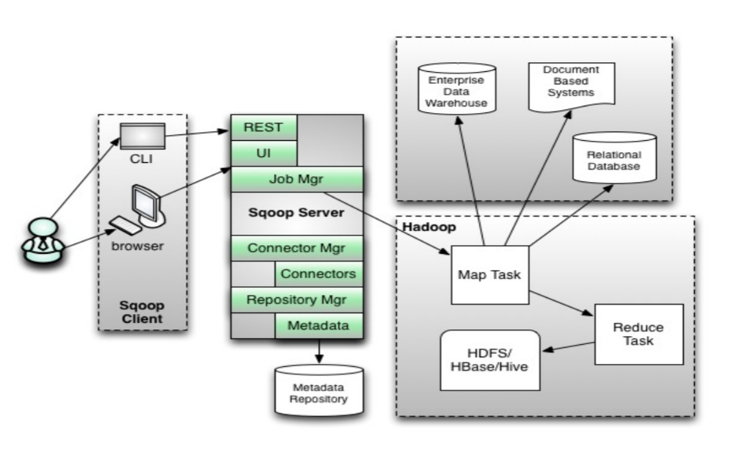
SQOOP 2

Slide 5
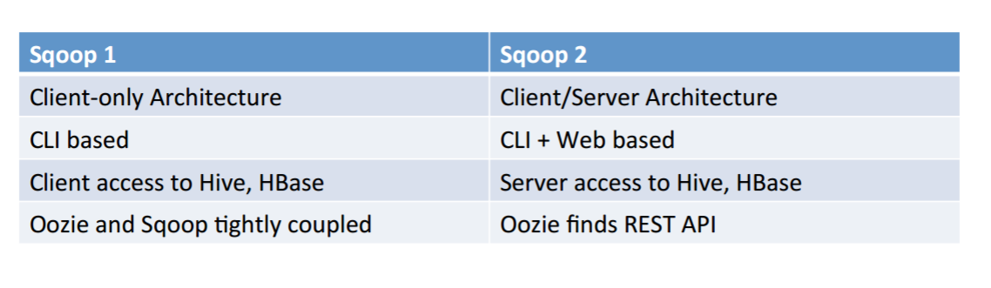
Ease Of Use

Slide 6
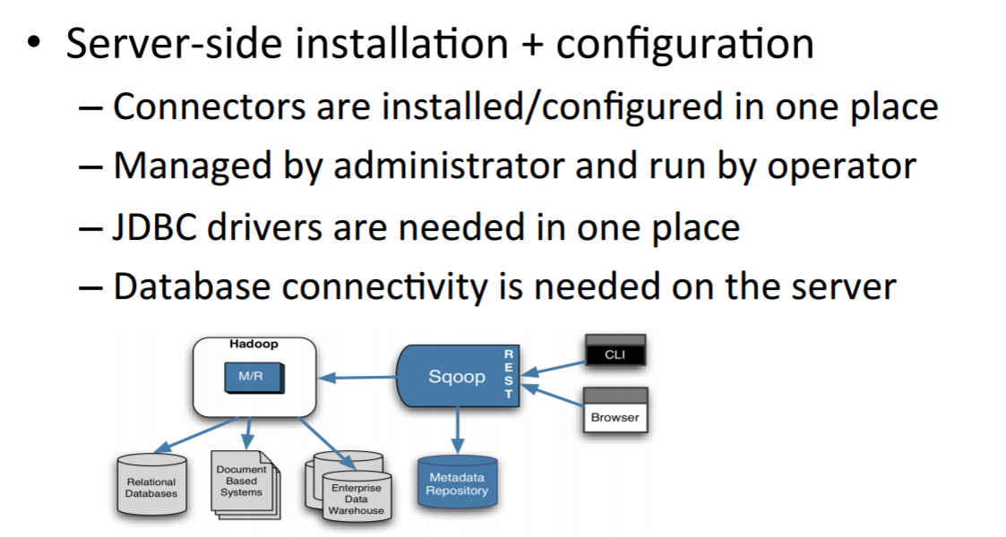
SQOOP as a Service

Slide 7
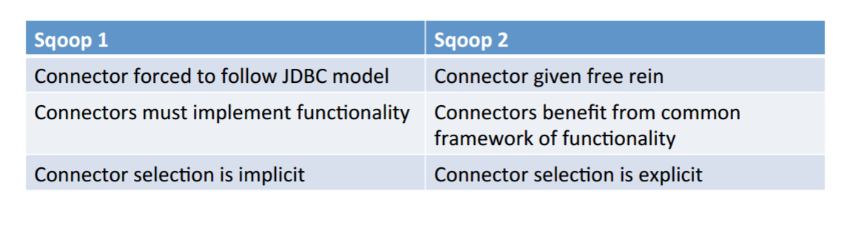
Ease of Extension

Slide 8
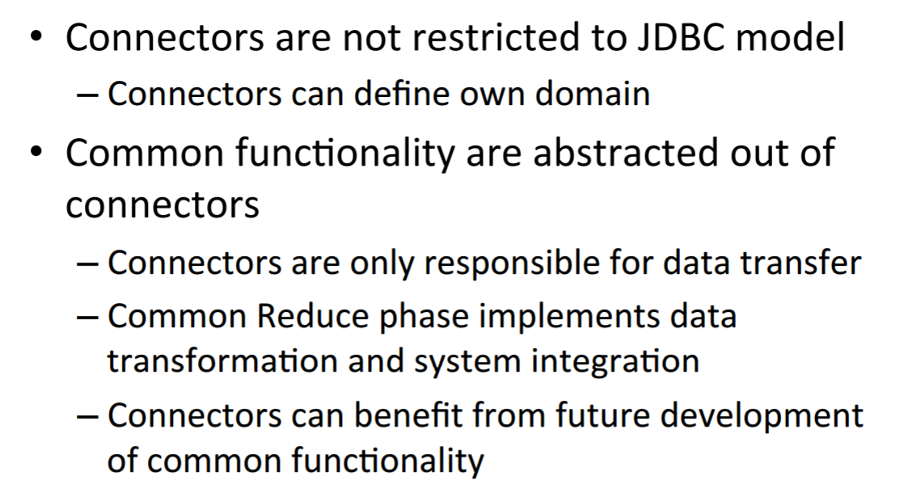
Implementing Connectors

Slide 9
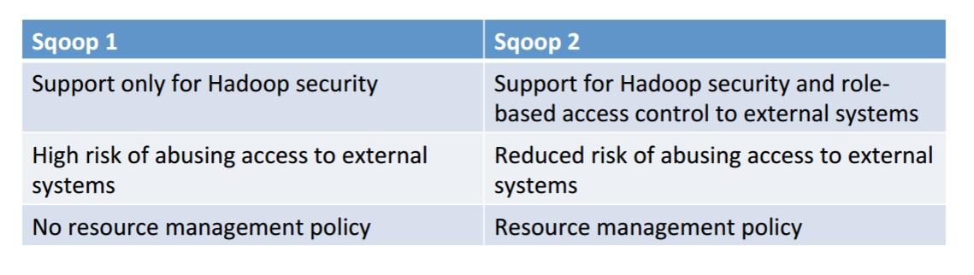
Security

Slide 10
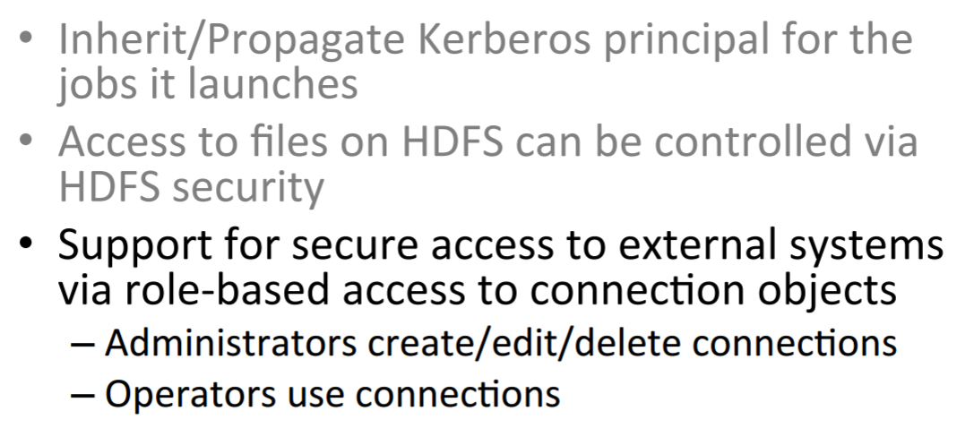
Security

Slide 11
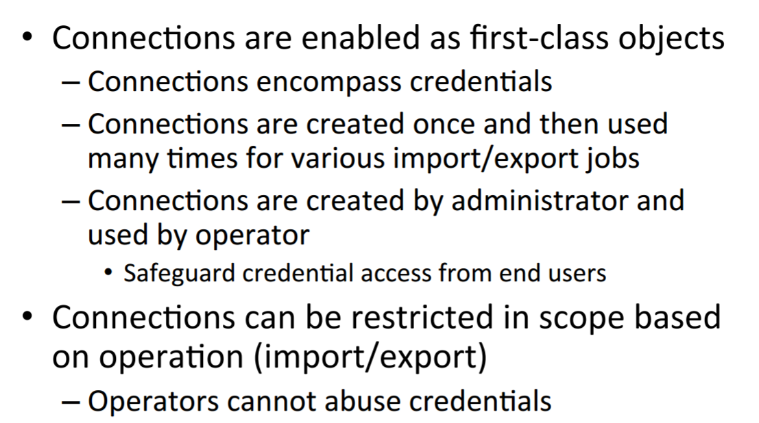
External System Access

Slide 12
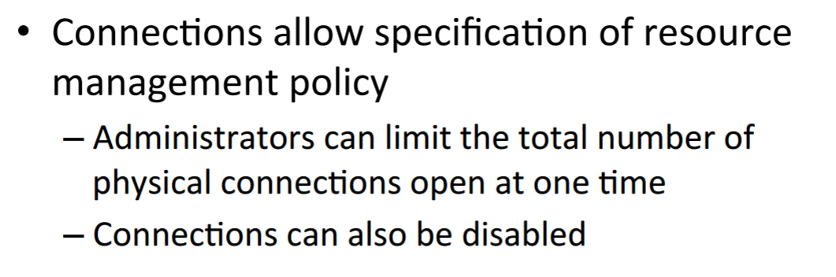
Resource Management

