Slide 1
Reducing Commercial Aviation Fatalities
Can you tell when a pilot is heading for trouble?

Slide 2
Experiment
The pilots experienced distractions intended to induce one of the following three cognitive states:
Channelized Attention (CA)
Diverted Attention (DA)
Startle/Surprise (SS)
Base (B) is the reference state

Slide 3
Data
id
crew
seat
experiment - CA, DA, SS
time
ecg - 3-point Electrocardiogram signal. The sensor had a resolution/bit of .012215 µV and a range of -100mV to +100mV. The data are provided in microvolts.
r - respiration
gsr - Galvanic Skin Response
event - The state of the pilot at the given time: one of 1 = baseline, 2 = SS, 3 = CA, 4 = DA
eeg_f7
eeg_f8
eeg_t4
eeg_t6
eeg_t5
eeg_t3
eeg_fp2
eeg_o1
eeg_p3
eeg_pz
eeg_f3
eeg_fz
eeg_f4
eeg_c4
eeg_p4
eeg_poz
eeg_c3
eeg_cz
eeg_o2

Slide 4
Model Ideas
Neural Network
Random Forest
SVM
Gradient Boosting

Slide 5
Model Ideas
Neural Network
Random Forest
SVM
Gradient Boosting

Slide 6
Paramater choice
Neural Network
Learning rate
No. layers
Learning rate decay
Exit condition:
no. iterations
Light GBM
Learning rate
num_leaves
max_bin
Exit conditions:
Tree depth
Early stopping rounds

Slide 7
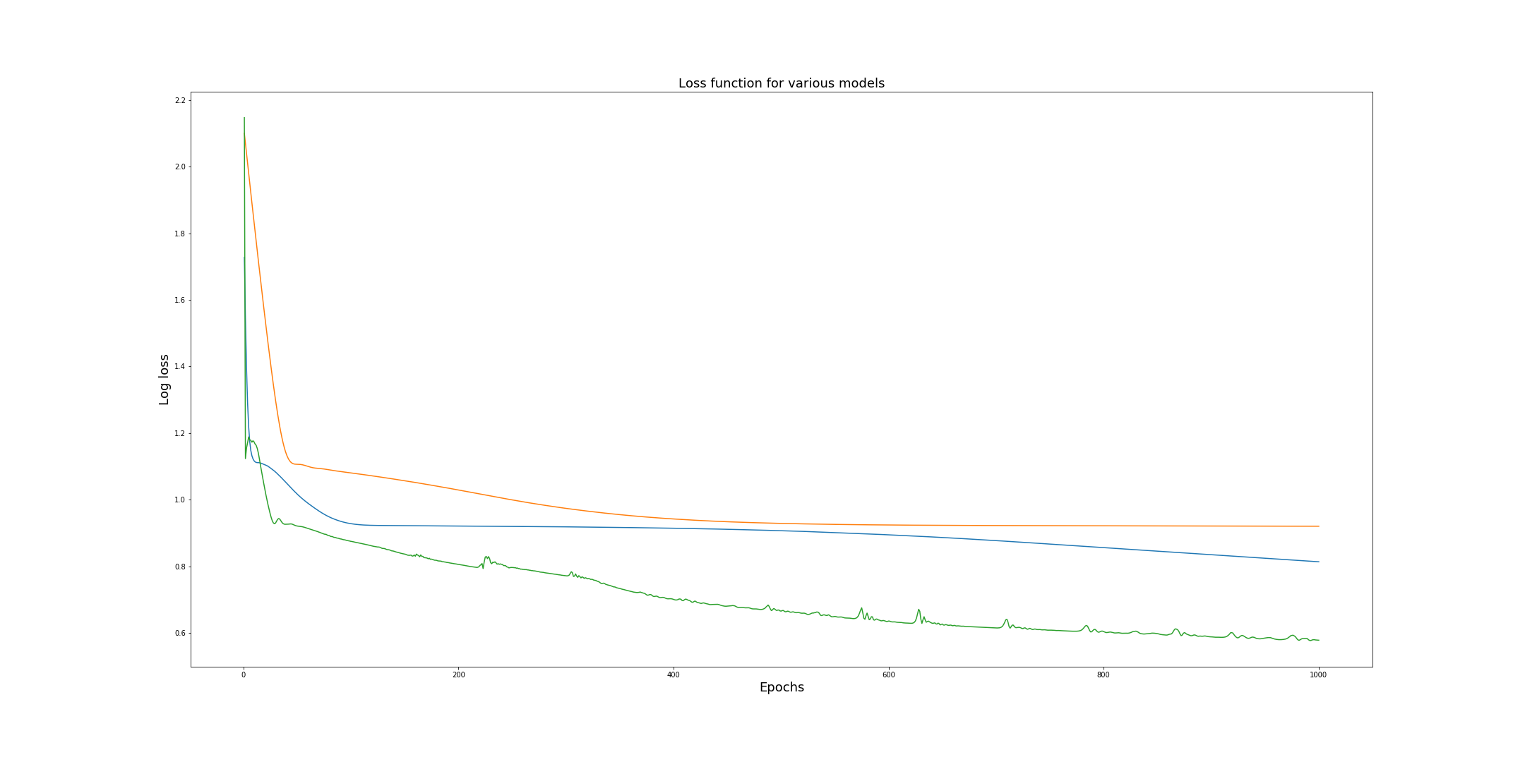
Neural Network – first results

Slide 8
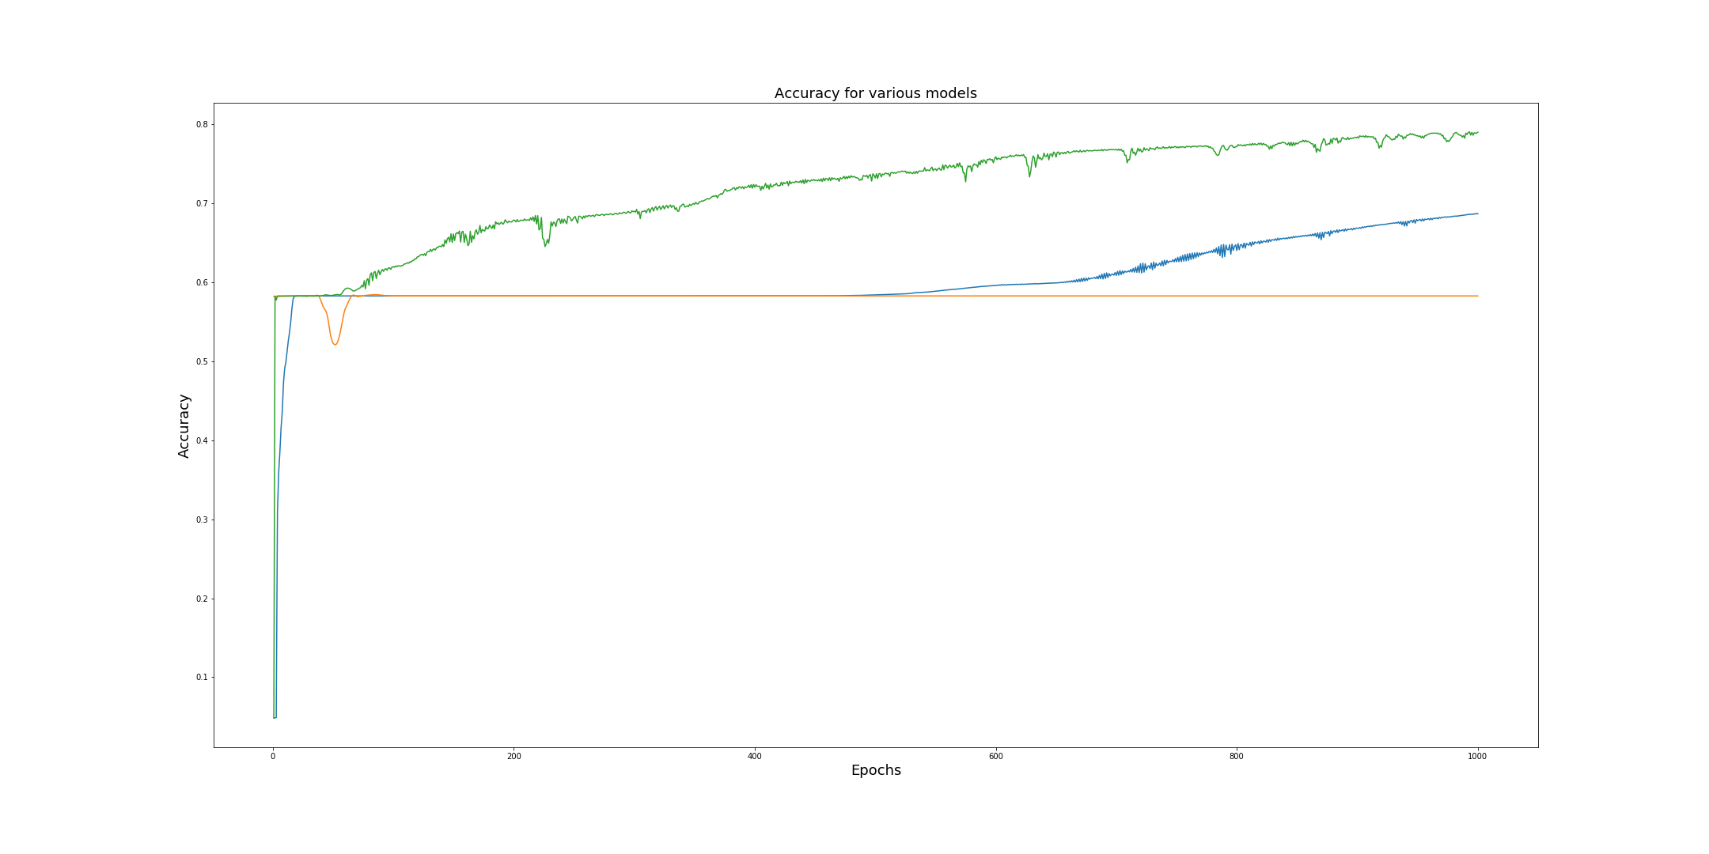
Neural Network – first results

Slide 9
Neural Network – first results
Accuracy
Parameters
training set: 79.32%
test set: 78.89%
Learning rate: 0.0038
No. layers: 371
Learning rate decay: 0

Slide 10
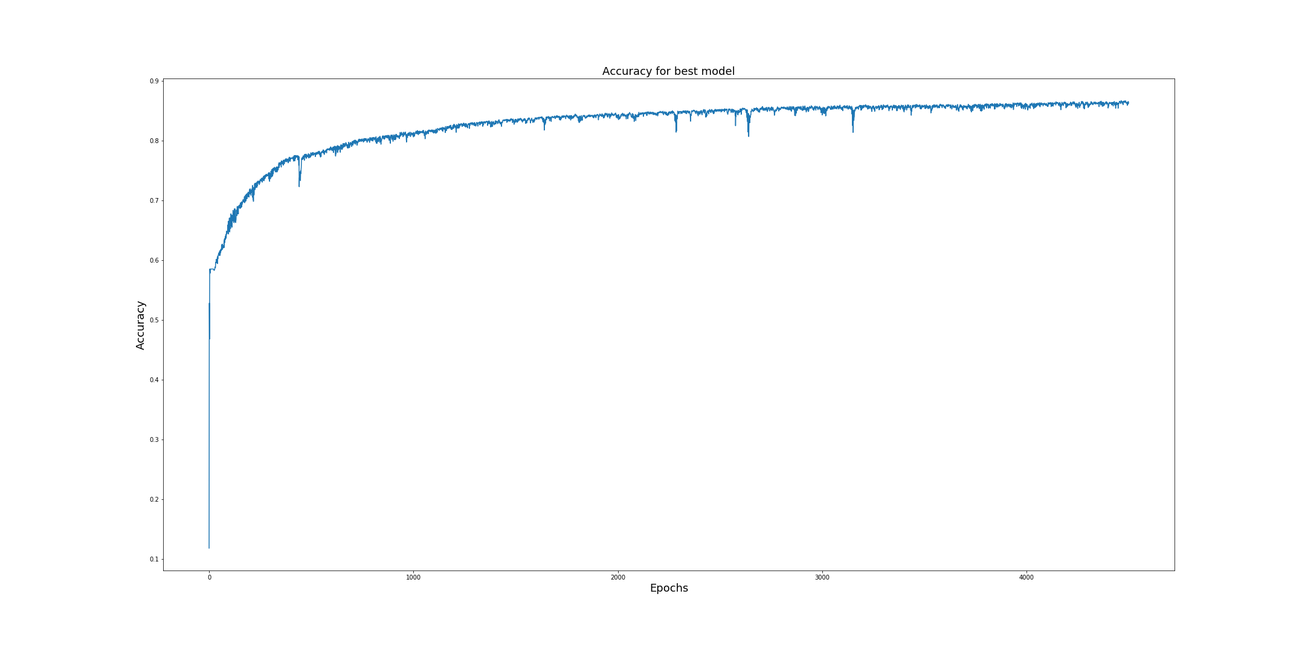
Neural Network - continued
Accuracy
Trainig set : 86.39%
Test set: 86.48%

Slide 11
LGBM – first results
Accuracy
Parameters
training set: 90.30 %
test set: 89.22 %
Learning rate: 0.014
num_leaves: 61
max_bin: 46

Slide 12
Understanding data
Respiration
Electrocardiogram (ECG)
Electroencephalogram (EEG)

Slide 13
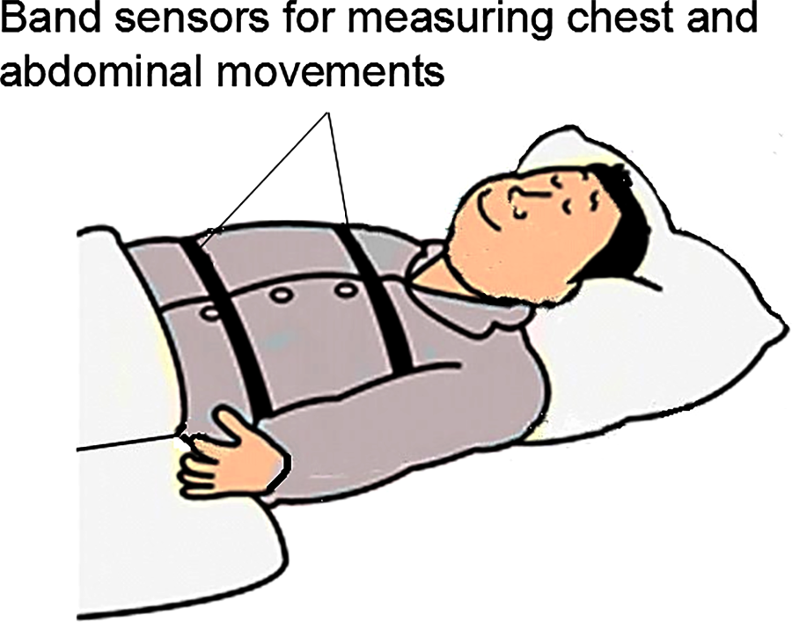
Respiration

Slide 14
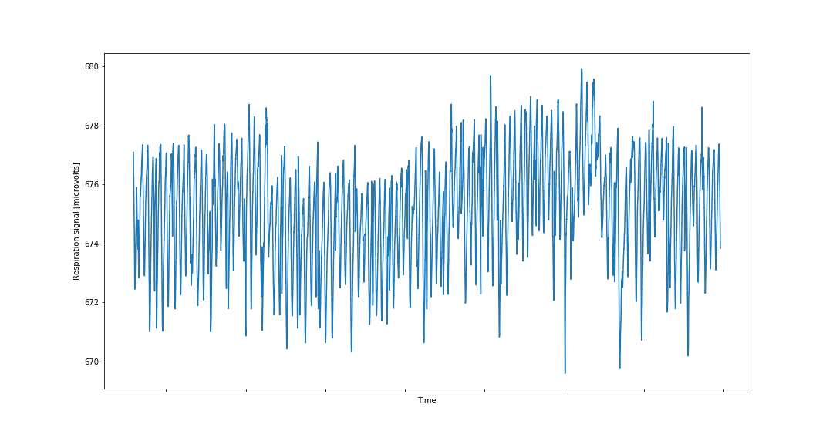
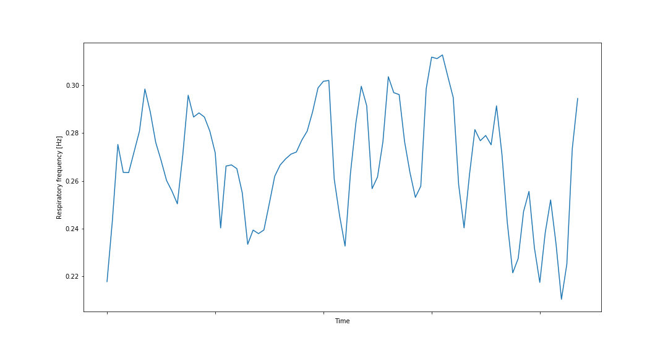
Respiration
Original signal
Respiration frequency

Slide 15
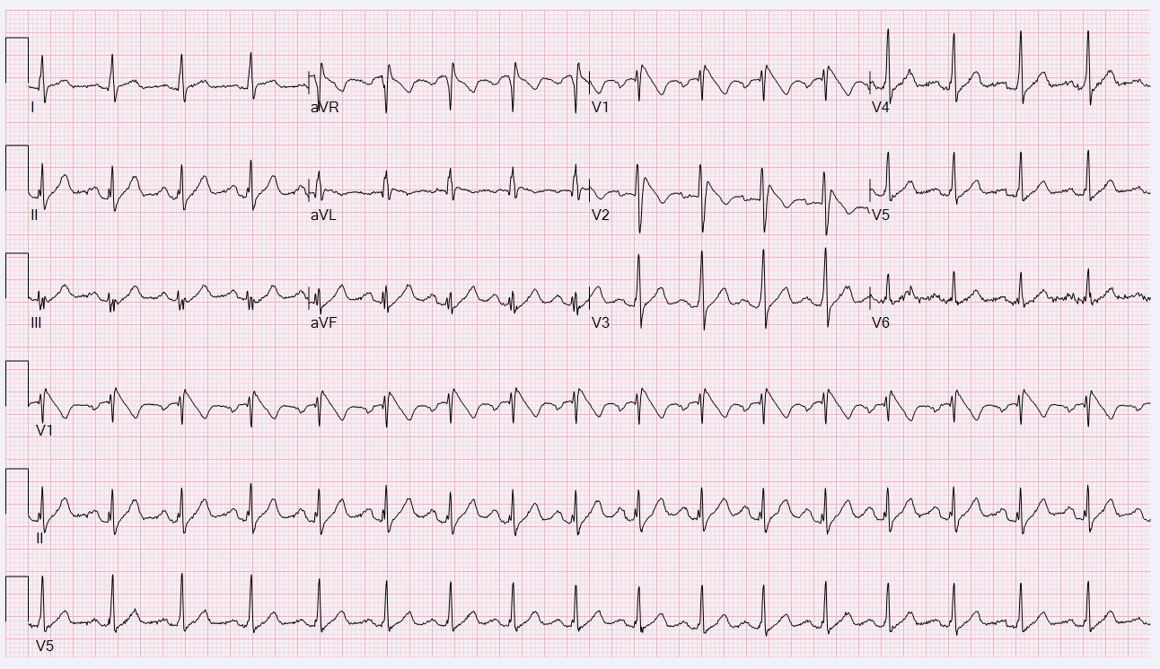
Electrocardiogram

Slide 16
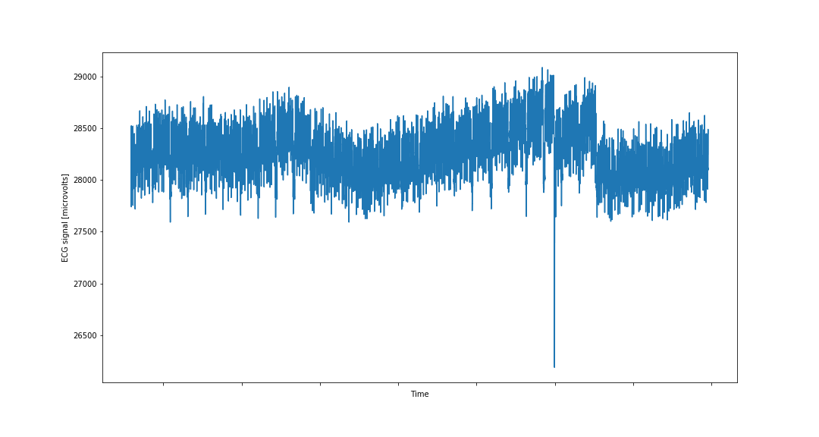
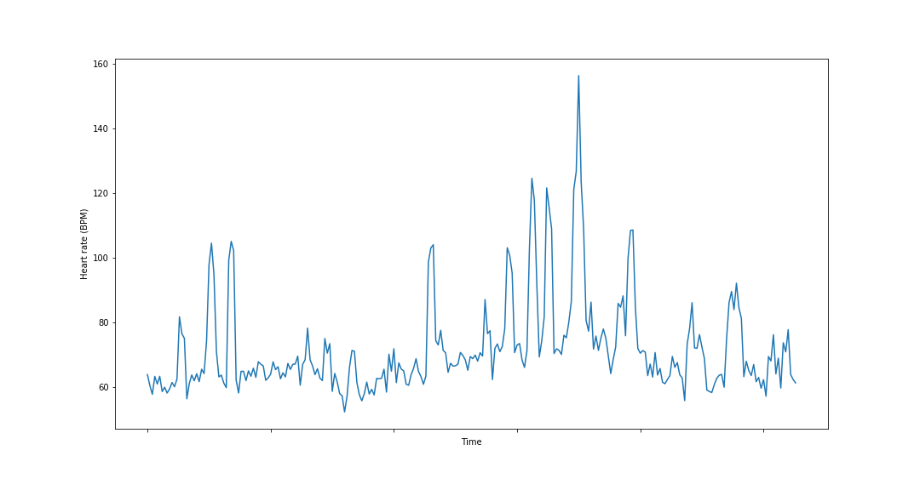
Electrocardiogram
Original signal
Heart rate

Slide 17
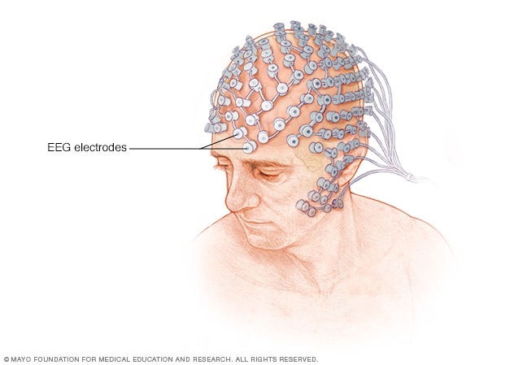
EEG

Slide 18
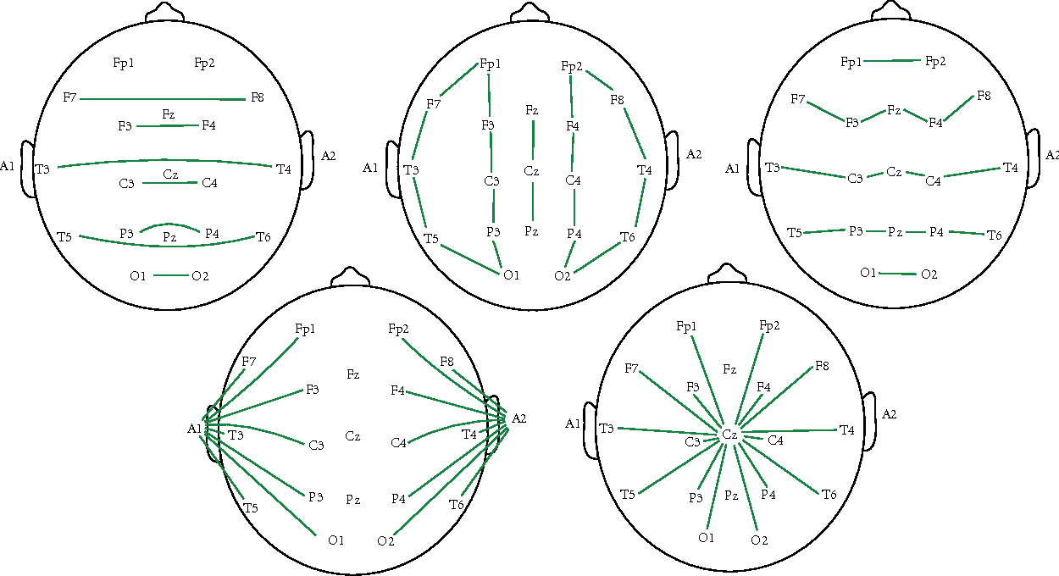
EEG

Slide 19
Impact of new features
Neural Network
Light GBM
Before:
Train accuracy: 86.39%
Test accuracy: 86.48%
After:
Train accuracy: 88.65%
Test accuracy: 88.28%
Before:
Train accuracy: 90.30 %
Test accuracy: 89.22 %
After:
Train accuracy: 94.93 %
Test accuracy: 92.69 %

Slide 20
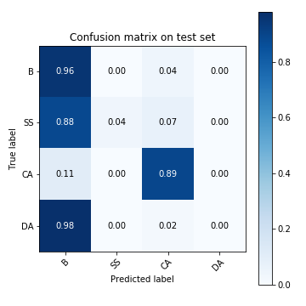
Neural Network – error decomposition

Slide 21
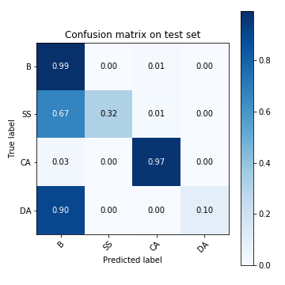
LGBM – error decomposition

Slide 22
Next steps
Redefine evaluation metric
Address imbalanced data
Incorporate character of data

