Slide 1
Reducing Commercial Aviation Fatalities
Can you tell when a pilot is heading for trouble?

Slide 2
Experiment
The pilots experienced distractions intended to induce one of the following three cognitive states:
Attention
Distraction
Surprise
Base is the reference state

Slide 3
Data
id
crew
seat
experiment - Attention, Distraction or Surprise
time
ecg - 3-point Electrocardiogram signal. The sensor had a resolution/bit of .012215 µV and a range of -100mV to +100mV. The data are provided in microvolts.
r - respiration
gsr - Galvanic Skin Response
event - The state of the pilot at the given time: one of Attention, Distraction, Surprise or Baseline
eeg_f7
eeg_f8
eeg_t4
eeg_t6
eeg_t5
eeg_t3
eeg_fp2
eeg_o1
eeg_p3
eeg_pz
eeg_f3
eeg_fz
eeg_f4
eeg_c4
eeg_p4
eeg_poz
eeg_c3
eeg_cz
eeg_o2

Slide 4
Can you predict pilot’s cognitive state?

Slide 5
Model Ideas
Neural Network
Random Forest
SVM
Gradient Boosting

Slide 6
Model Ideas
Neural Network
Random Forest
SVM
Gradient Boosting

Slide 7
Paramater choice
Neural Network
Learning rate
Number of layers
Learning rate decay
Exit condition:
Number of iterations
Light GBM
Learning rate
num_leaves
max_bin
Exit conditions:
Tree depth
Early stopping rounds

Slide 8
Paramater choice
Neural Network
Learning rate
Number of layers
Learning rate decay
Exit condition:
Number of iterations
Light GBM
Learning rate
num_leaves
max_bin
Exit conditions:
Tree depth
Early stopping rounds
optimize training time
optimize log loss

Slide 9
Neural Network – first results
Accuracy
Parameters
Best model
training set: 79.32%
test set: 78.89%
Best model
Learning rate: 0.0038
No. layers: 371
Learning rate decay: 0

Slide 10
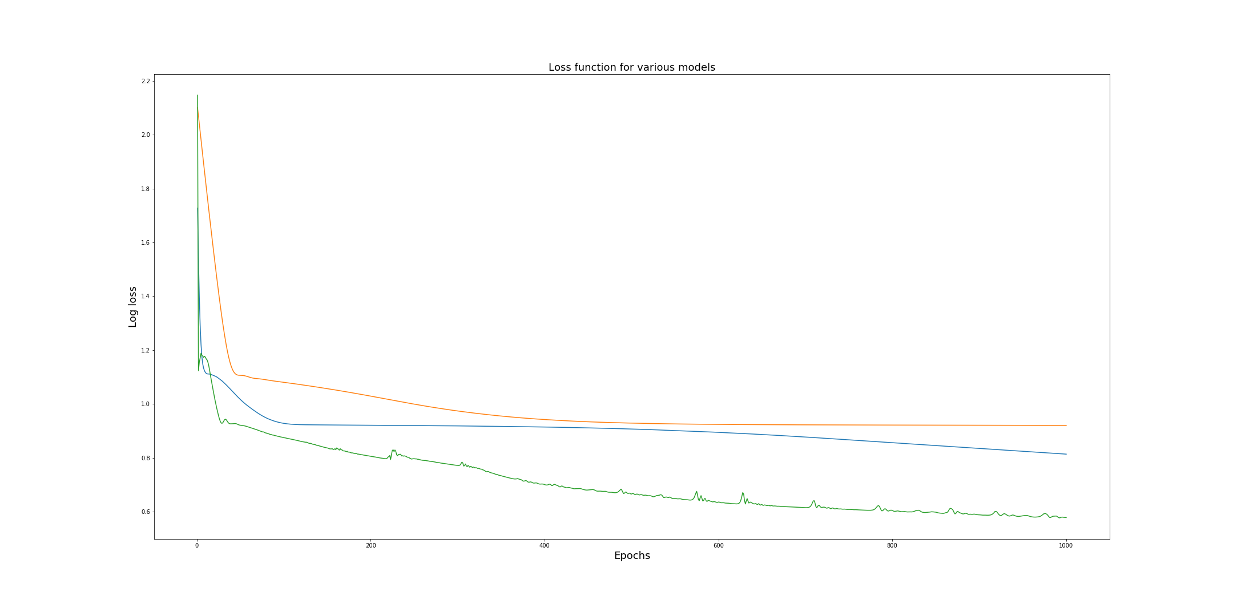
Neural Network – first results

Slide 11
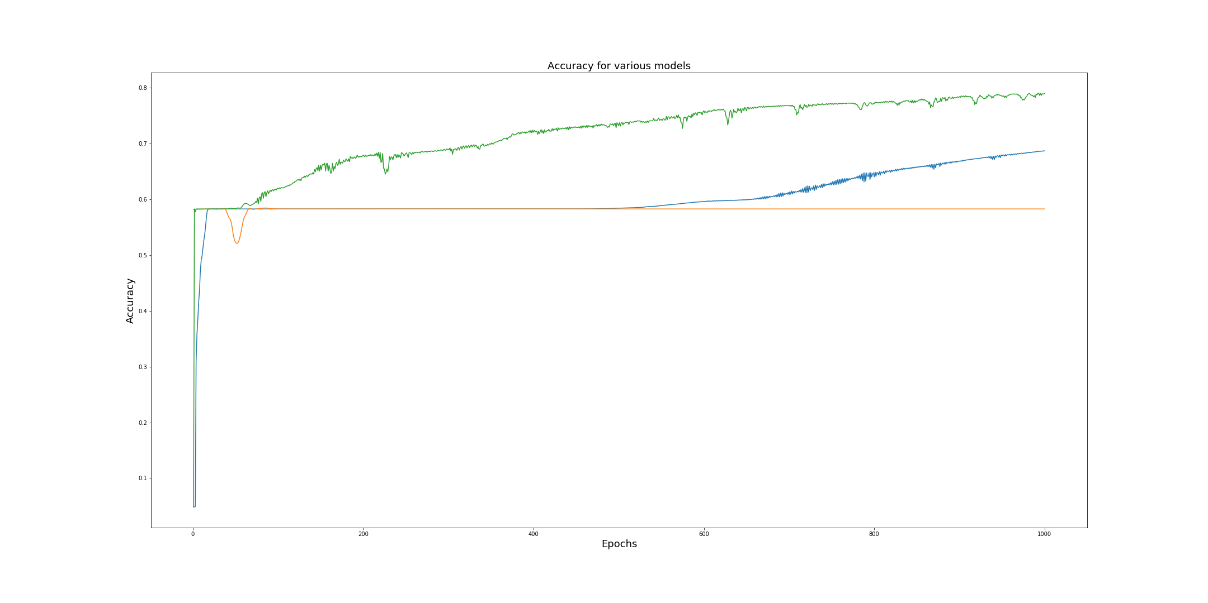
Neural Network – first results
Best Accuracy
Training set : 79.32%
Test set: 78.89%

Slide 12
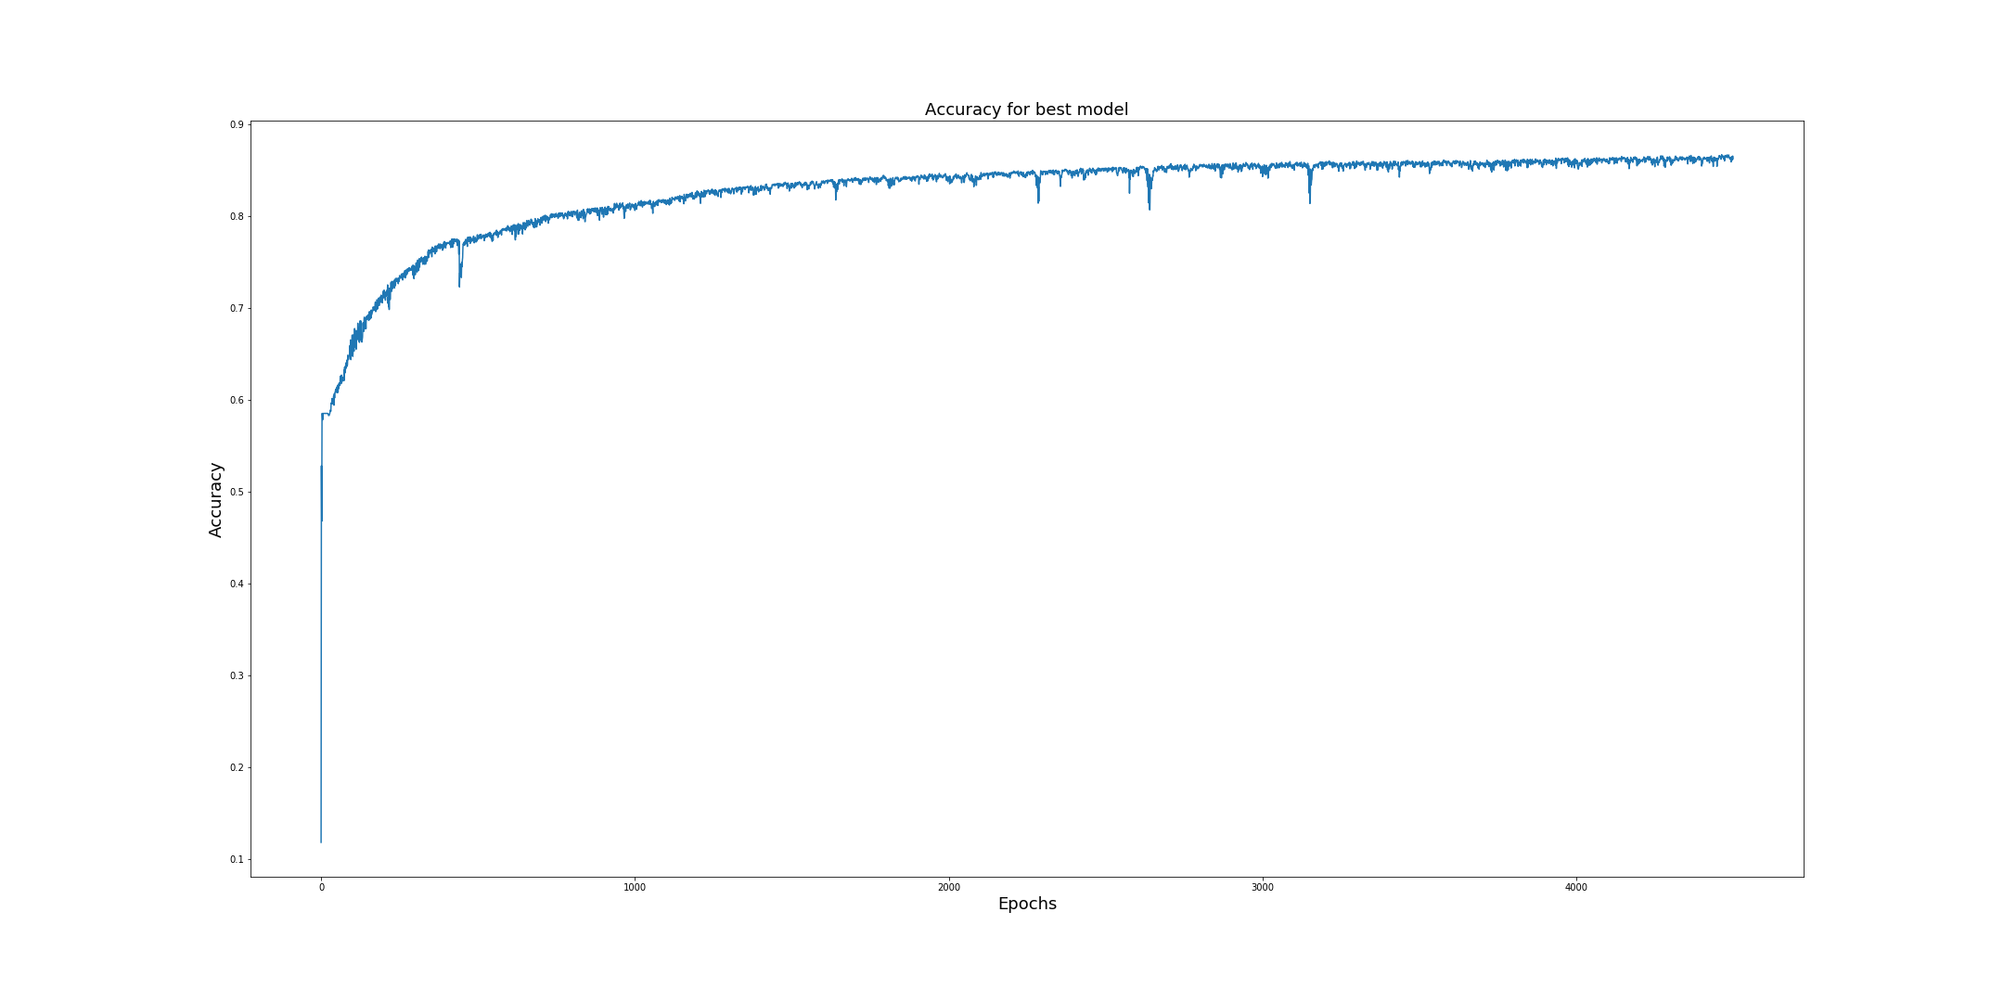
Neural Network - continued
Accuracy
Training set : 86.39%
Test set: 86.48%

Slide 13
LGBM – first results
Accuracy
Parameters
Best iteration
training set: 90.30 %
test set: 89.22 %
Fastest training
Learning rate: 0.014
num_leaves: 61
max_bin: 46

Slide 14
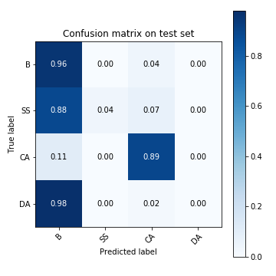
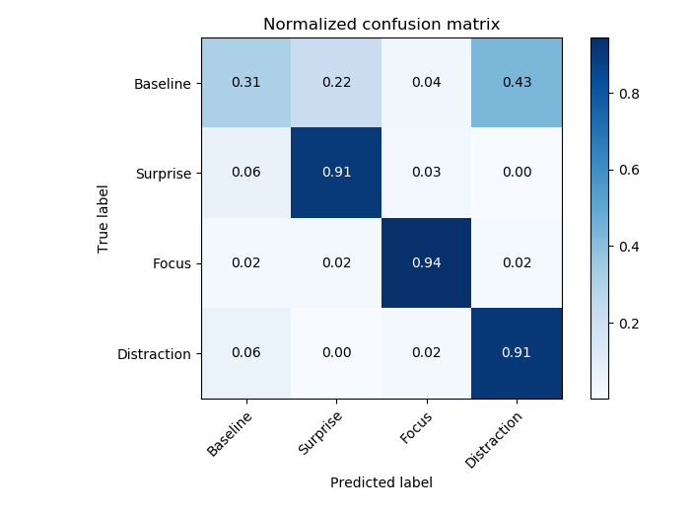
Neural Network – error decomposition

Slide 15
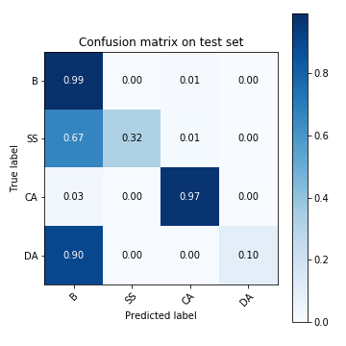
LGBM – error decomposition

Slide 16
Is the metric right for the problem?

Slide 17


Slide 18
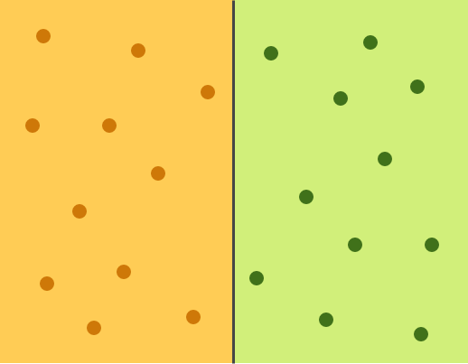

Slide 19
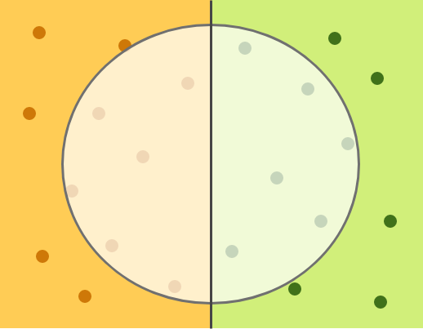
Relevant elements
Selected elements

Slide 20
Relevant elements
False negatives
True negatives
True positives
False positives
Selected elements

Slide 21



Relevant elements
False negatives
True negatives
How many items are marked correctly?
True positives
False positives
accuracy =
Selected elements

Slide 22

Relevant elements
False negatives
True negatives
How many items are marked correctly?
How many relevant items are marked?
True positives
False positives
accuracy =
recall =
Selected elements

Slide 23
Is the model right for the data?

Slide 24
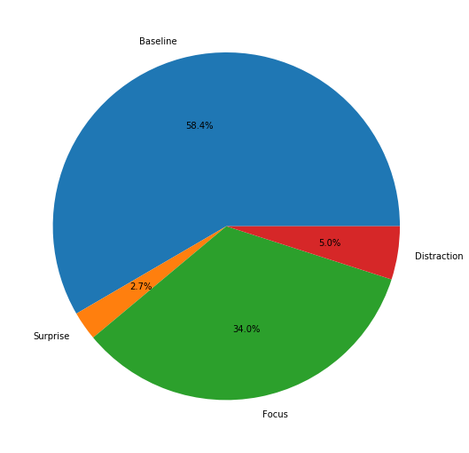
Class distribution

Slide 25
How to choose “best” model ?

Slide 26
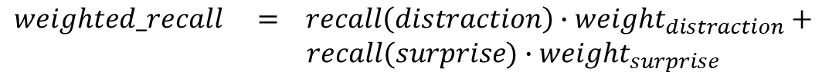
Single evaluation metric
$$weighted_recall = recall\left(distraction\right)∙{weight}_{distraction}+$$
$$recall(surprise){∙weight}_{surprise}$$

Slide 27
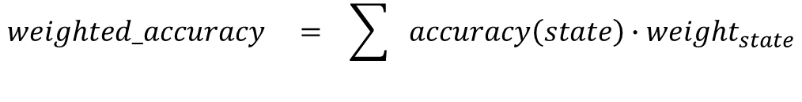
Single evaluation metric
$$weighted_recall = recall\left(distraction\right)∙{weight}_{distraction}+$$
$$recall(surprise){∙weight}_{surprise}$$
$$weighted_accuracy = \sum^{ }{accuracy\left(state\right)∙{weight}_{state}}$$

Slide 28
Single evaluation metric
$$weighted_recall = recall\left(distraction\right)∙{weight}_{distraction}+$$
$$recall(surprise){∙weight}_{surprise}$$
model choice
$$weighted_accuracy = \sum^{ }{accuracy\left(state\right)∙{weight}_{state}}$$
model supervision

Slide 29
Did it help?

Slide 30
Neural Network – results
Recall
Parameters
Best Model
training set: 4.03
test set: 3.95
Worst Model
training set: 0.5
test set: 0.44
Best Model
Learning rate: 0.0015
No. layers: 661
Learning rate decay: 0
Worst Model
Learning rate: 2.64e-06
No. layers: 996
Learning rate decay: 2.5e-06

Slide 31
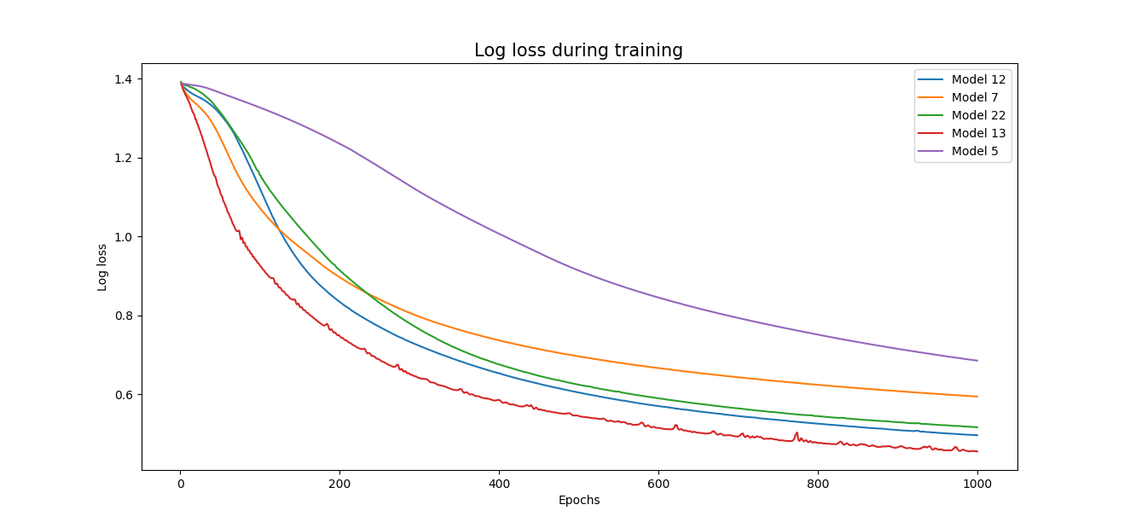
Neural Network – results

Slide 32
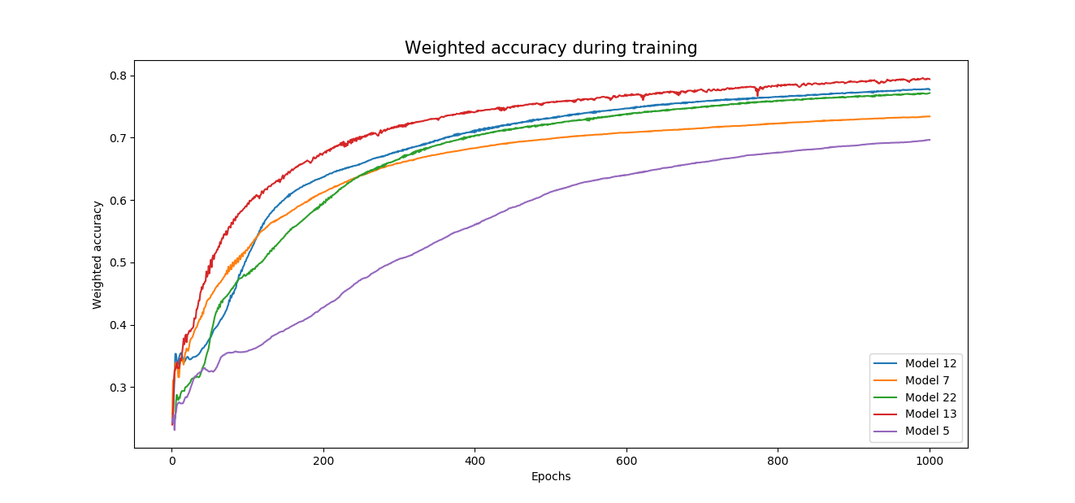
Neural Network – results

Slide 33
Neural Network

Slide 34
LBGM – results
Recall
Parameters
Best iteration
training set: 4.31
test set: 4.10
Fastest training
Learning rate: 0.014
num_leaves: 61
max_bin: 46

Slide 35
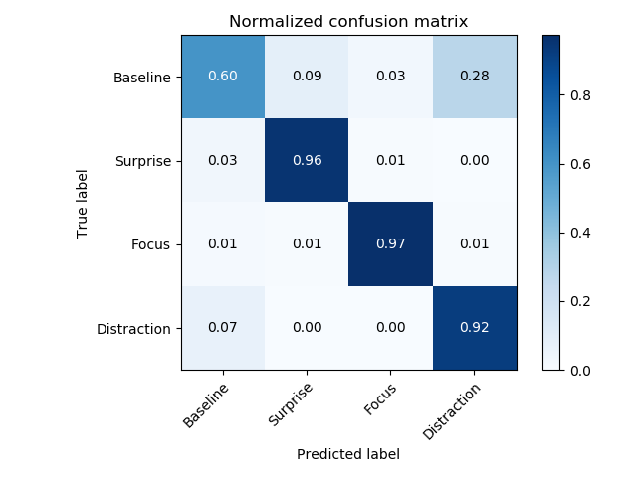
Light GBM

Slide 36
Appendix

Slide 37
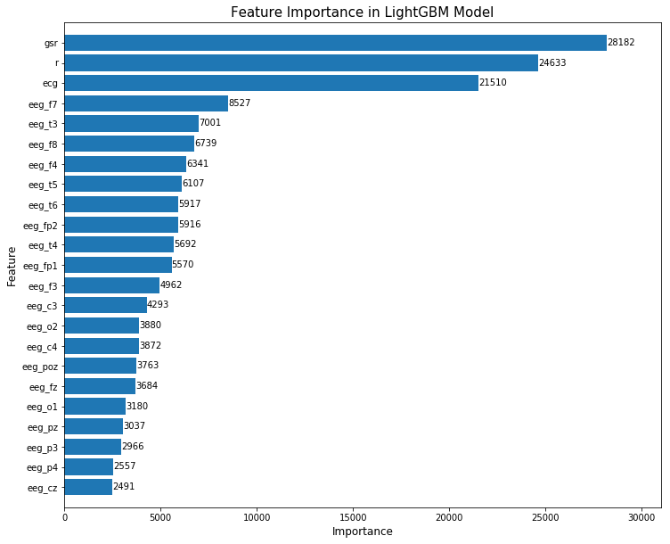
Understanding the data

Slide 38
Understanding the data
Respiration
Electrocardiogram (ECG)
Electroencephalogram (EEG)

Slide 39
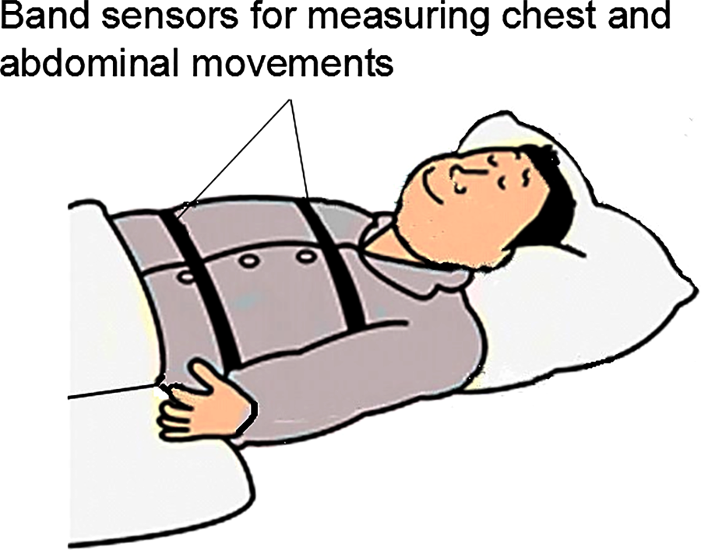
Respiration

Slide 40
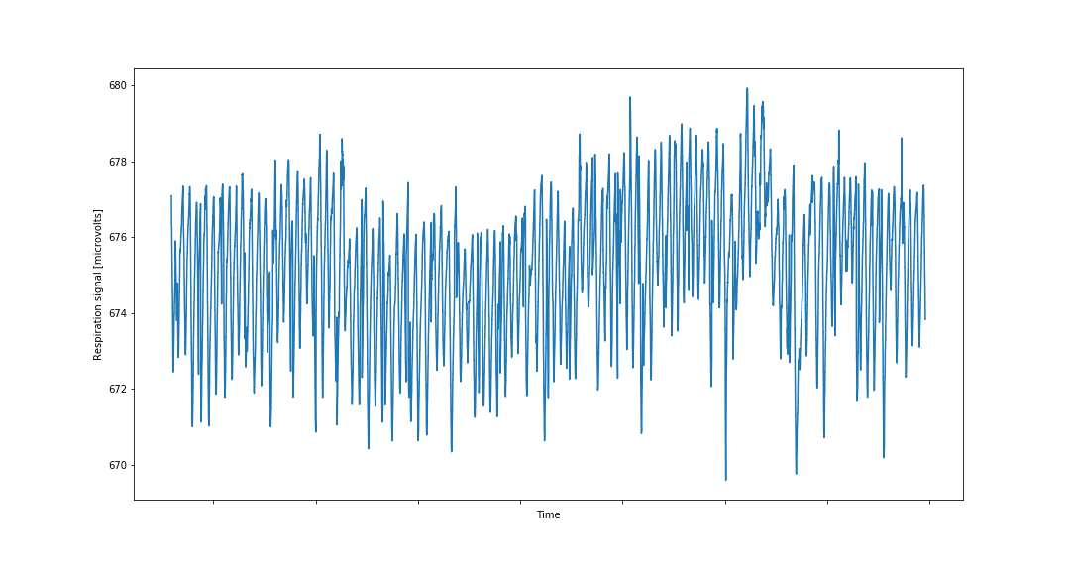
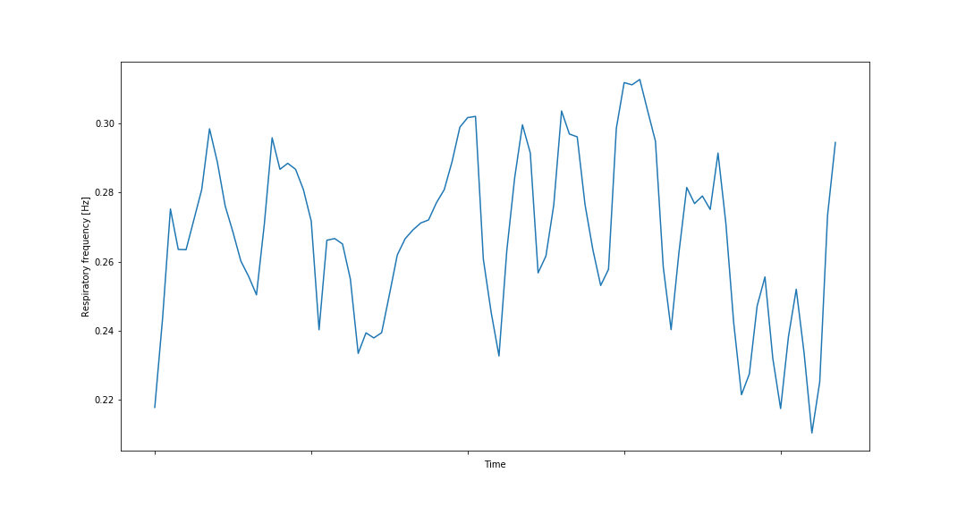
Respiration
Original signal
Respiration frequency

Slide 41
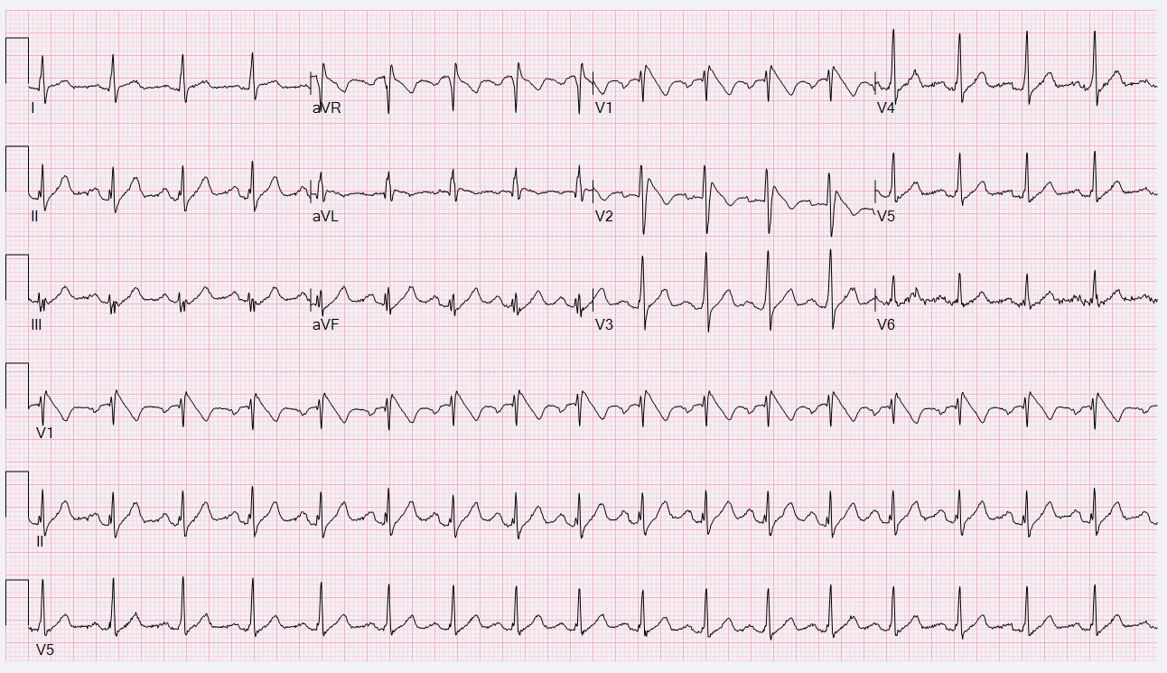
Electrocardiogram

Slide 42
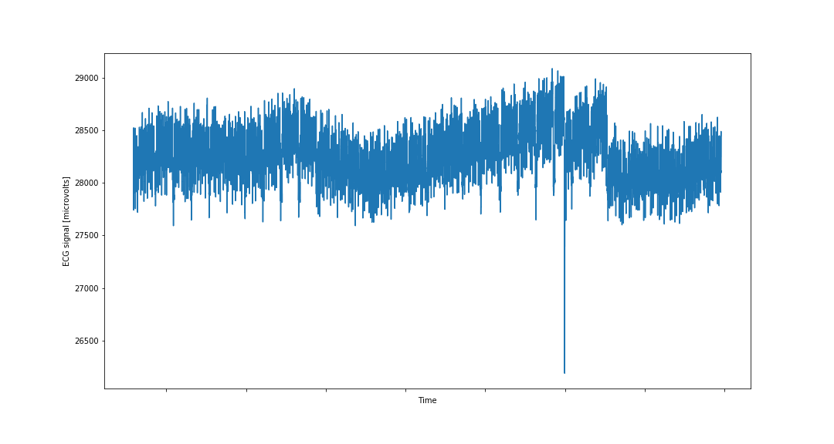
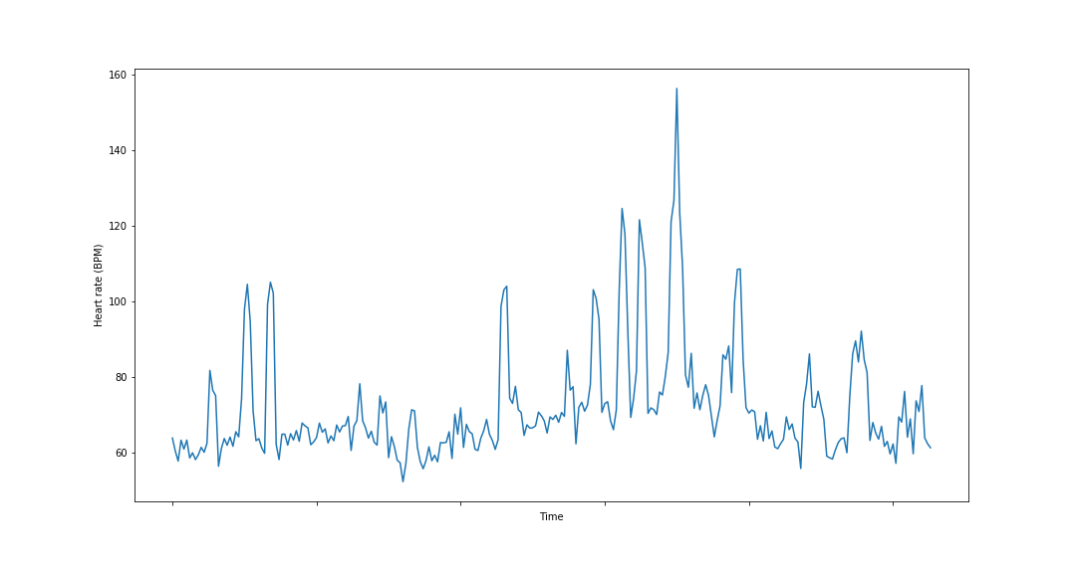
Electrocardiogram
Original signal
Heart rate

Slide 43
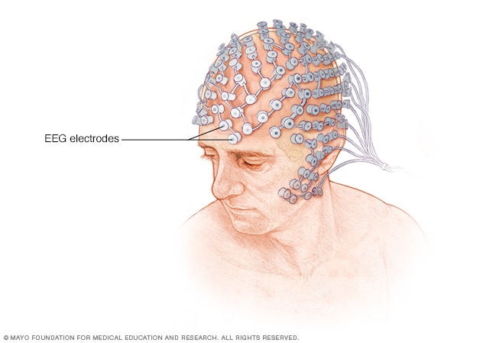
EEG

Slide 44
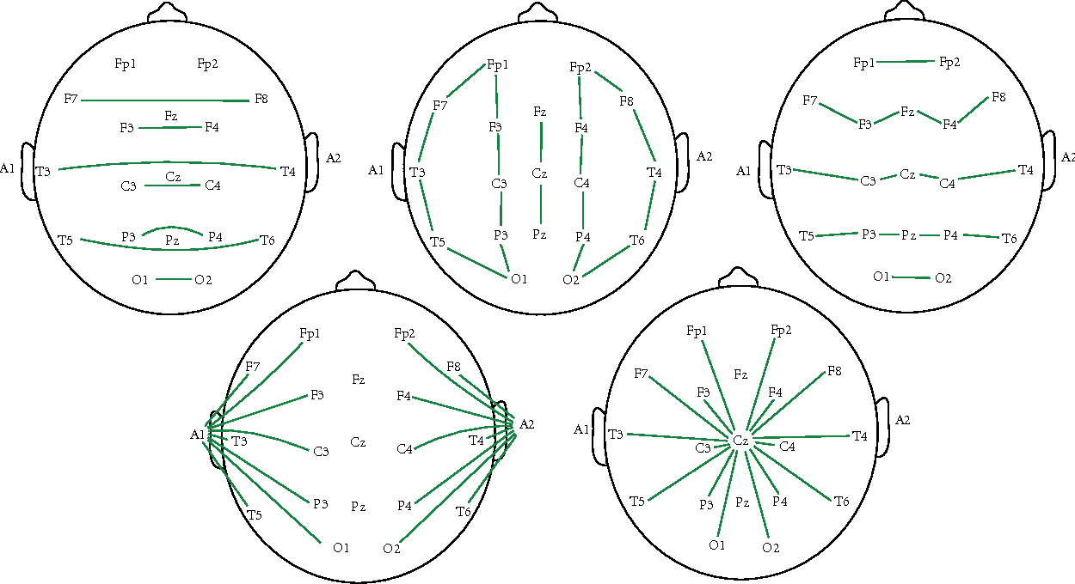
EEG

Slide 45
Impact of new features
Neural Network
Light GBM
Before:
Train accuracy: 86.39%
Test accuracy: 86.48%
After:
Train accuracy: 88.65%
Test accuracy: 88.28%
Before:
Train accuracy: 90.30 %
Test accuracy: 89.22 %
After:
Train accuracy: 94.93 %
Test accuracy: 92.69 %

