Slide 1
Aladdin SDS Daisy Chain Introduction
APril 2026,
Ho chi minh CiTY
Khai tran

Slide 2
Outline
How to see daisy chain devices on DL Connect website
How to update firmware/configuration for the HHS gun attached to FRS device

Slide 3
Caution
From Aladdin SDS version 1.2.1, to use the Daisy Chain feature, you must ensure that the HOST port of the FRS device is free (not used by any other software or POS system), as all daisy chain commands are currently supported only on the HOST port. If only the SERVICE port is available on the FRS device, this feature will not work.

Slide 4
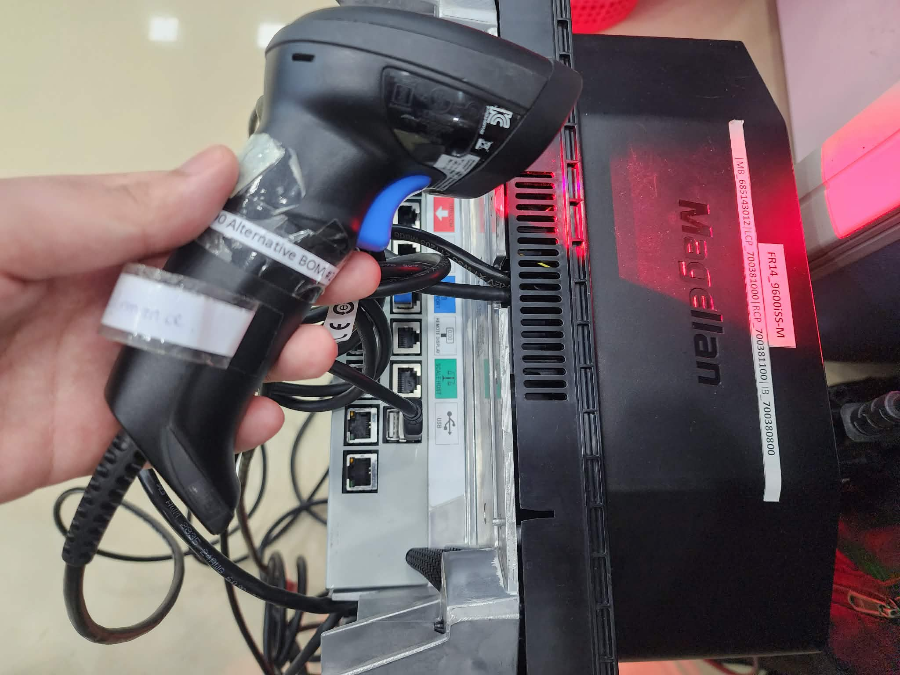
1. How to see daisy chain devices on DL Connect website
I have installed a QuickScan device plugin on a Fresco device.
 | FRS | HHS
Interface | COM/OEM | COM
Caution: The HHS device interface must be USB-COM. The FRS device interface must be USB-COM or OEM, and the host port of the FRS device must not be used by any other application.

Slide 5
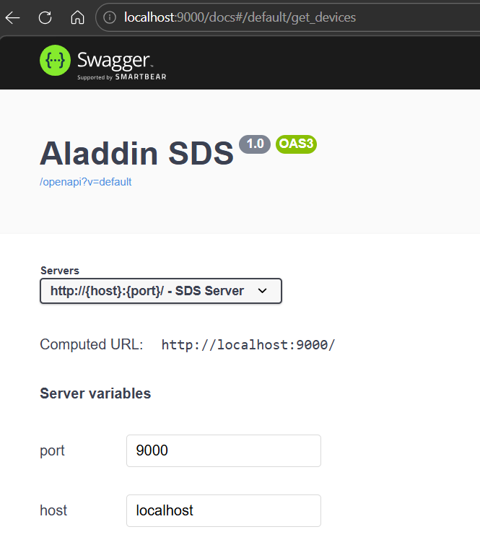
1. How to see daisy chain devices on DL Connect website
To check if Aladdin SDS is working, open your browser and go to http://localhost:9000/docs
Next, we need to ensure that Aladdin SDS is connected to IoT Edge. Please follow the steps below.

Slide 6
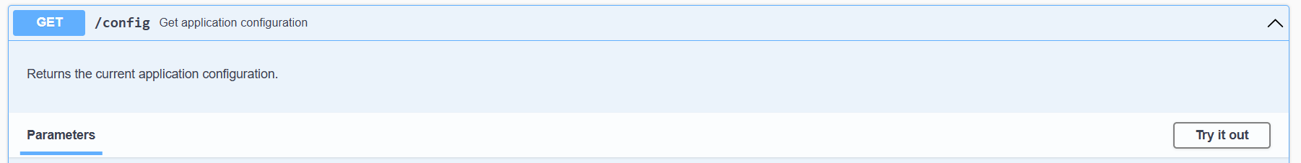
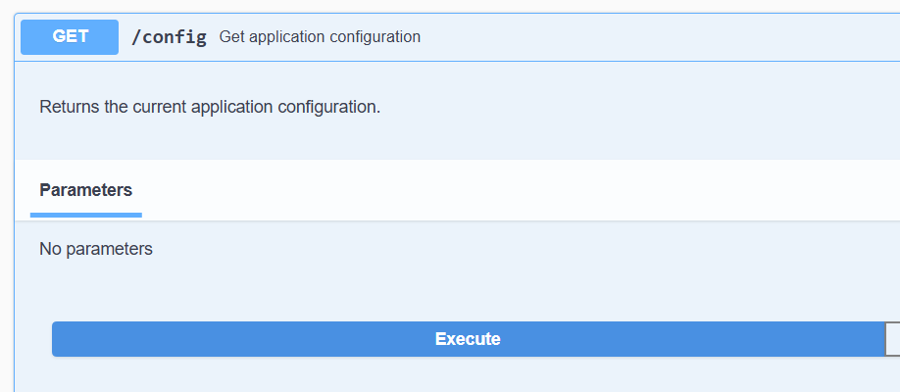
1. How to see daisy chain devices on DL Connect website
To connect to IoT Edge, SDS must be configured with the correct Edge IP. First, check the current Edge IP configured in SDS.
1
Under /config API click Try it out
Then click Execute
2

Slide 7
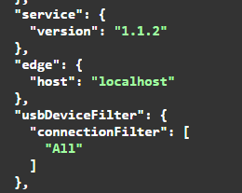
1. How to see daisy chain devices on DL Connect website
If the Edge IP is different from the one you want to connect to, follow the next steps to update it. If it is already correct, no changes are needed.

Slide 8
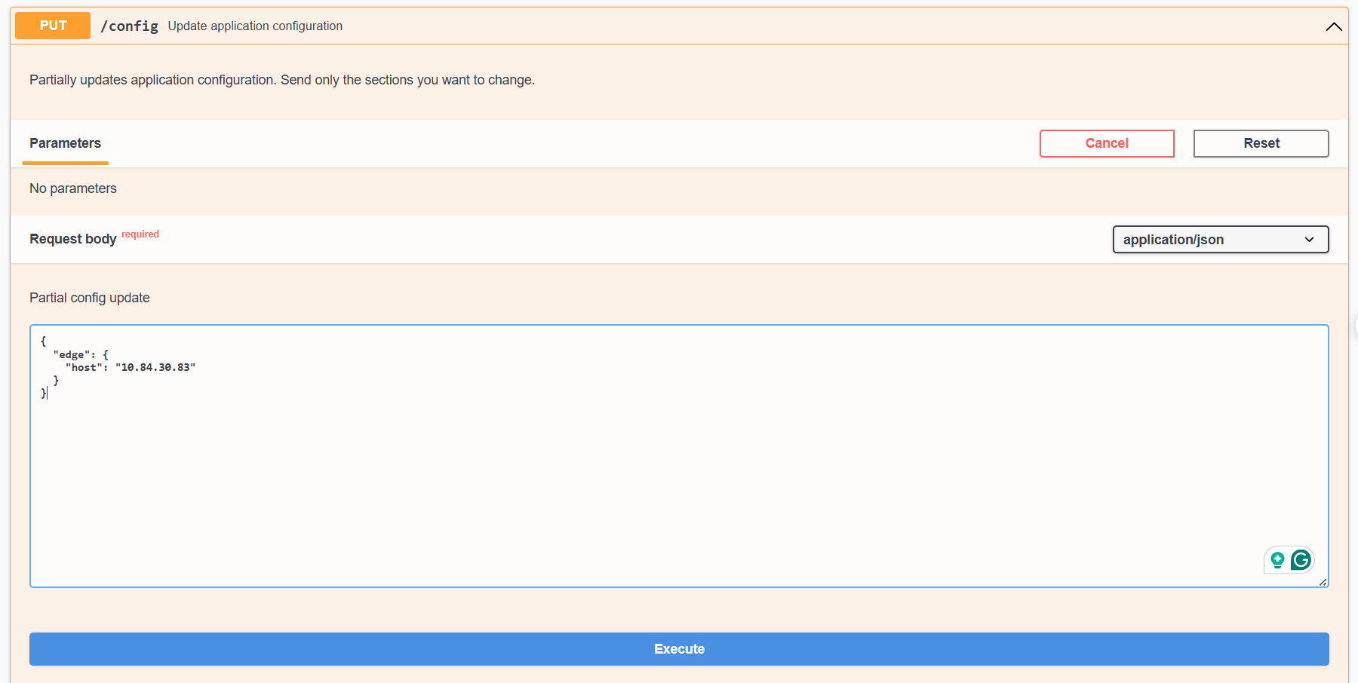
1. How to see daisy chain devices on DL Connect website
1
To update the Edge IP, go to the PUT /config API and click “Try it out.” Then enter the updated value in the text box. The format should remain the same—you only need to change the Edge IP. For example, in this case, my Edge IP is 10.84.30.83.
Then click Execute
2

Slide 9
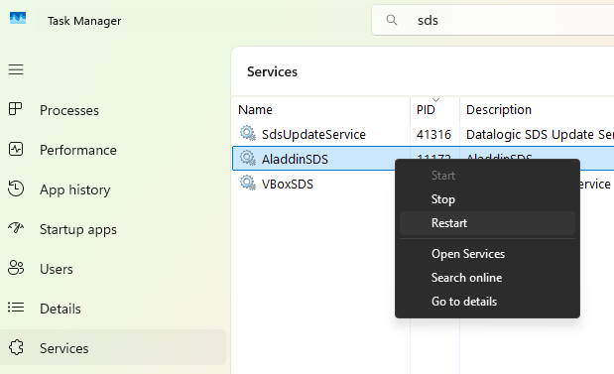
1. How to see daisy chain devices on DL Connect website
Then, restart Aladdin SDS by opening Task Manager → Services, finding AladdinSDS, right-clicking it, and selecting Restart.

Slide 10
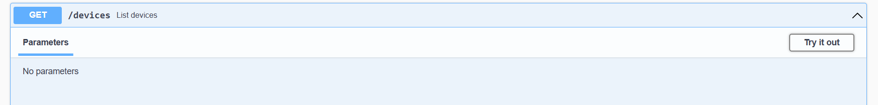
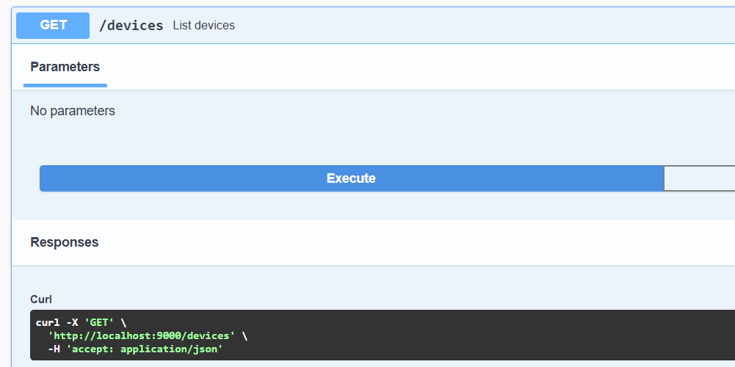
1. How to see daisy chain devices on DL Connect website
1
After restarting, check whether the daisy chain setup is detected by Aladdin SDS. Go to the GET /devices API and click “Try it out.”
2
Then Execute

Slide 11
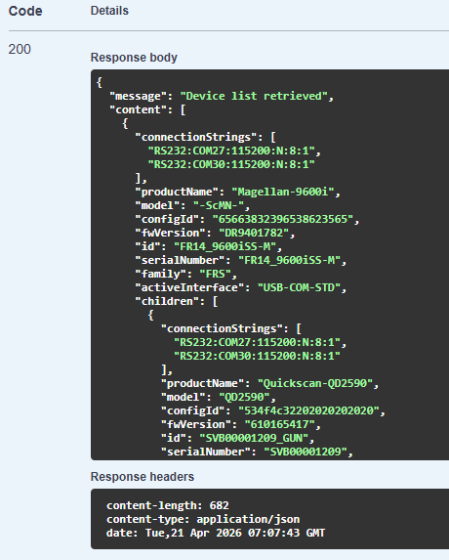
1. How to see daisy chain devices on DL Connect website
If you see something like this, your setup has been successfully detected.
This is Magellan 9600i device ID
This is Quickscan QD2590 device ID

Slide 12
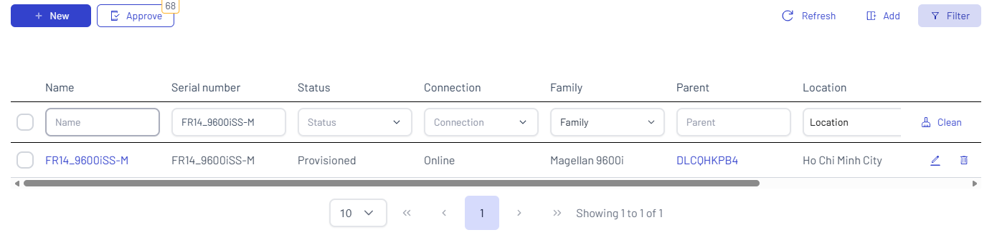
1. How to see daisy chain devices on DL Connect website
Search the FRS device by its serial number
1
2
Click to open device page

Slide 13
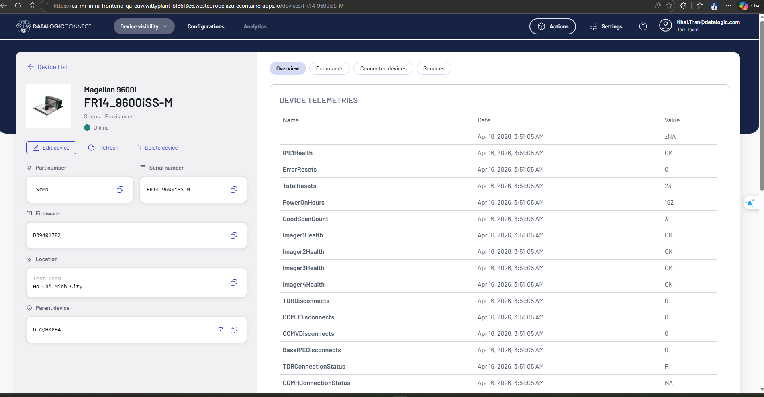
1. How to see daisy chain devices on DL Connect website

Slide 14
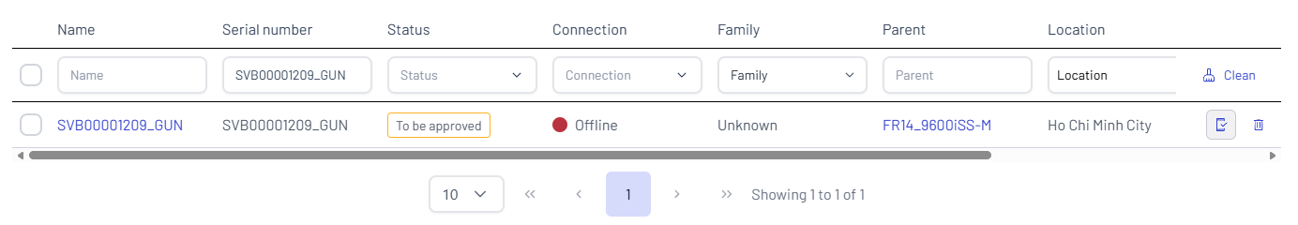
1. How to see daisy chain devices on DL Connect website
1
Search the gun by its serial number
2
Click to open device page

Slide 15
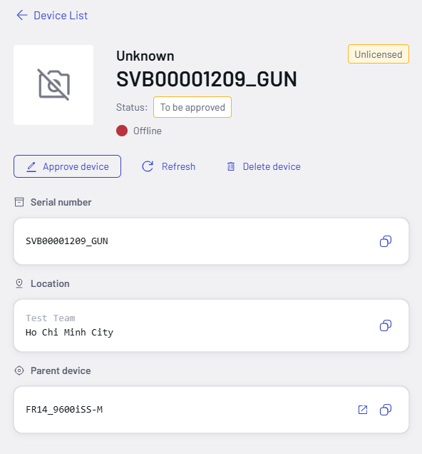
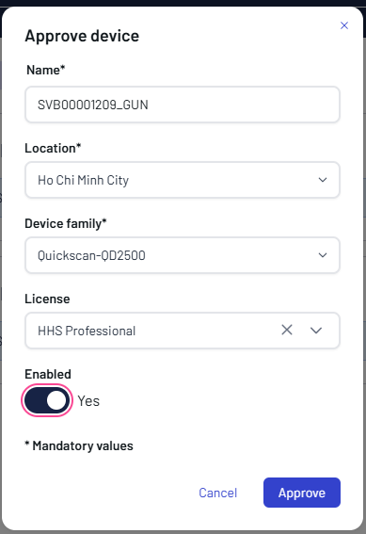
1. How to see daisy chain devices on DL Connect website
Device need to be verified
1
2
Click this
Complete the form, then approve
2

Slide 16
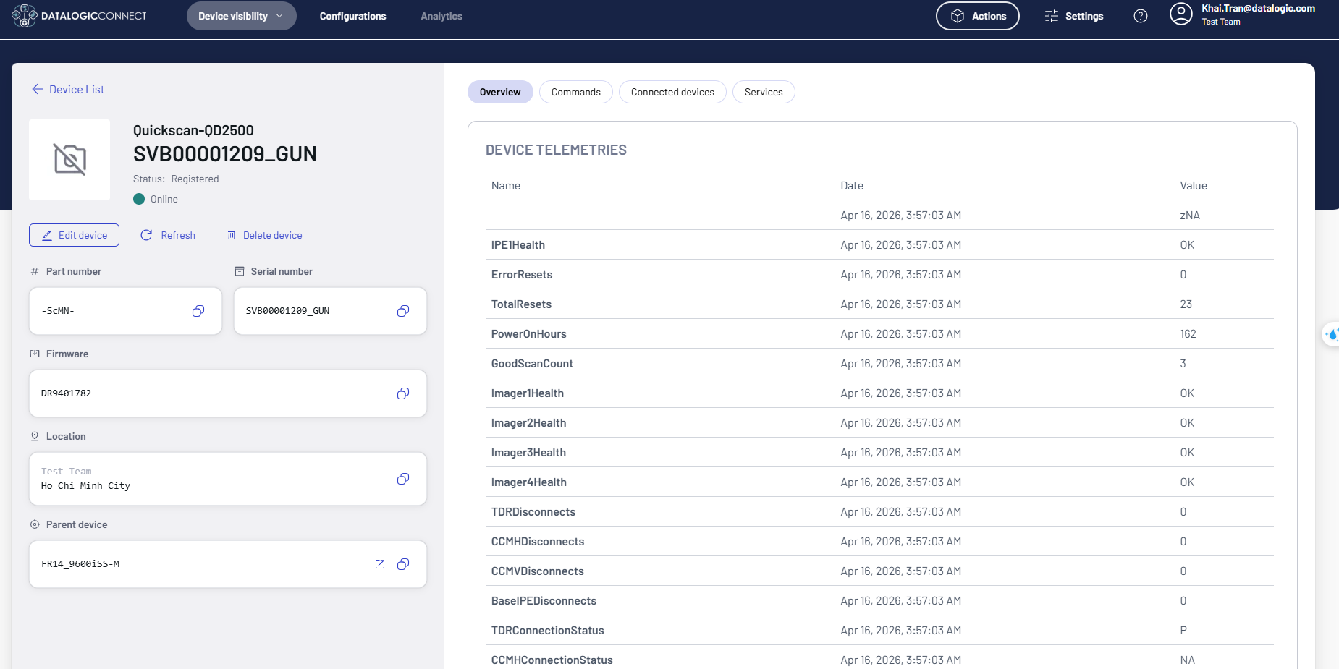
1. How to see daisy chain devices on DL Connect website
Device is verified and online

Slide 17
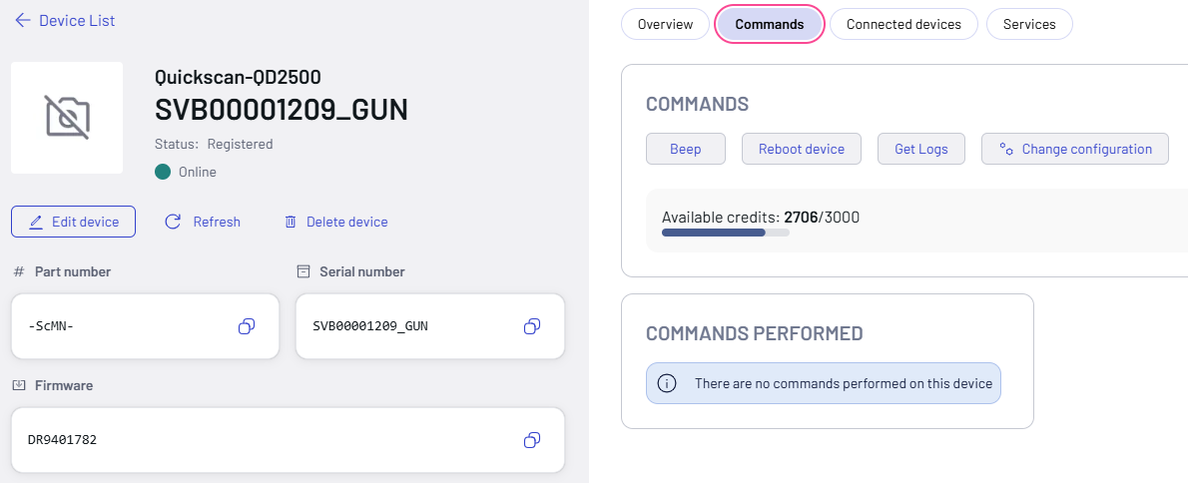
1. How to see daisy chain devices on DL Connect website
Now you can send commands to device

Slide 18
2. How to update firmware/configuration for the HHS gun attached to FRS device
To update the firmware or configuration for an HHS device (child of an FRS device), you need to create an SDS package for the child device.
There are two types of SDS packages, depending on the FRS interface:
If the FRS interface is USB-COM, use an S37 file.
If the FRS interface is USB-OEM, use a DAT file.

Slide 19
2. How to update firmware/configuration for the HHS gun attached to FRS device
OUTLINE
2.1. Create SDS package for the HHS gun with USB-COM FRS, USB-COM HHS
2.2. Create SDS package for the HHS gun with USB-OEM FRS, USB-COM HHS
2.3. Upload SDS package on DL Connect website and trigger the package from remote

Slide 20
2. How to update firmware/configuration for the HHS gun attached to FRS device
2.1. Create SDS package for the HHS gun with USB-COM FRS, USB-COM HHS
1
FRS (parent) | HHS(children) | HHS firmware/config file format required
USB-COM | USB-COM | .S37
First, you need to create a pass-through file for the HHS device using the HDFAT application.

Slide 21
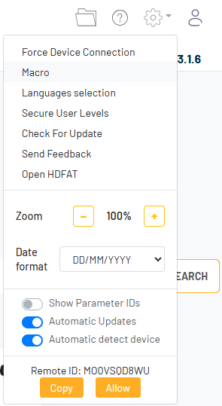
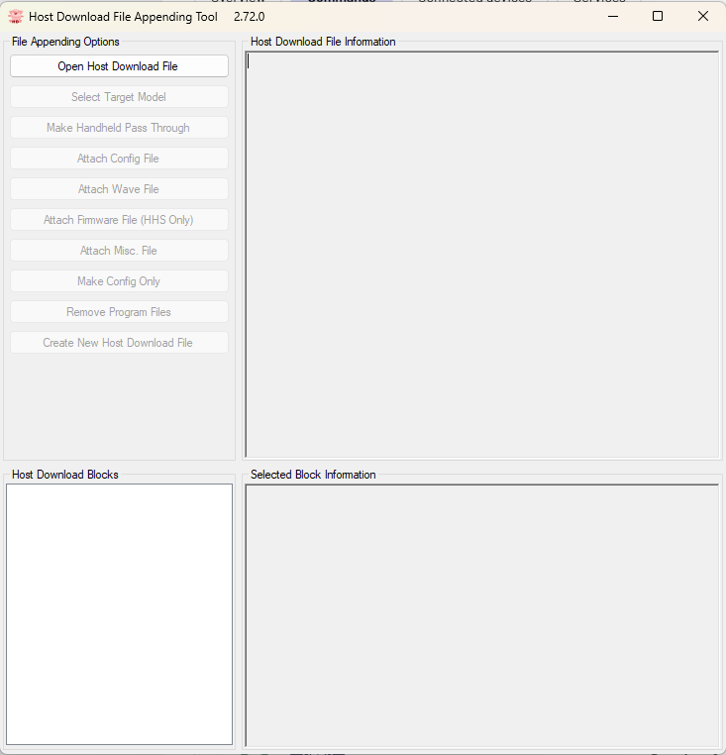

2. How to update firmware/configuration for the HHS gun attached to FRS device
2.1. Create SDS package for the HHS gun with USB-COM FRS, USB-COM HHS
1
Open Aladdin
2
Click Open HDFAT

Slide 22
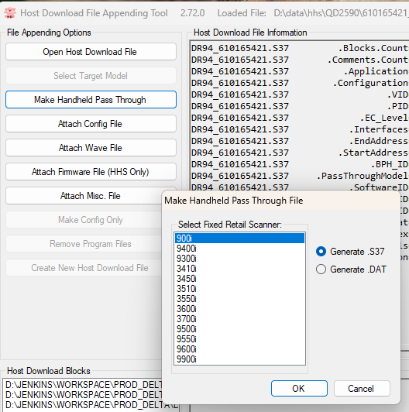

2. How to update firmware/configuration for the HHS gun attached to FRS device
Click here
2.1. Create SDS package for the HHS gun with USB-COM FRS, USB-COM HHS
Click here to load .S37 file of HHS device
3
1
2
Here, I select the .S37 firmware file (version 610165421) for the QuickScan QD2590 because I want to update the firmware. If you want to update the configuration of the HHS device, select the .S37 configuration file instead.

Slide 23
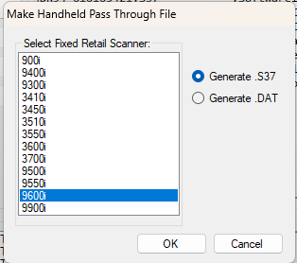
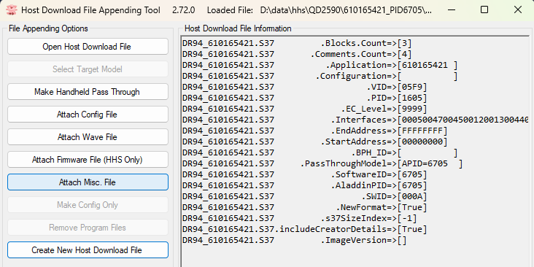
2. How to update firmware/configuration for the HHS gun attached to FRS device
2.1. Create SDS package for the HHS gun with USB-COM FRS, USB-COM HHS
1
Check this
2
Then, select the FRS parent device of the HHS gun. In my setup, I use a Magellan 9600i and a PD2590, so I select the 9600.
3
Then, click here to create pass through file.
Now we have .S37 passthrough file

Slide 24
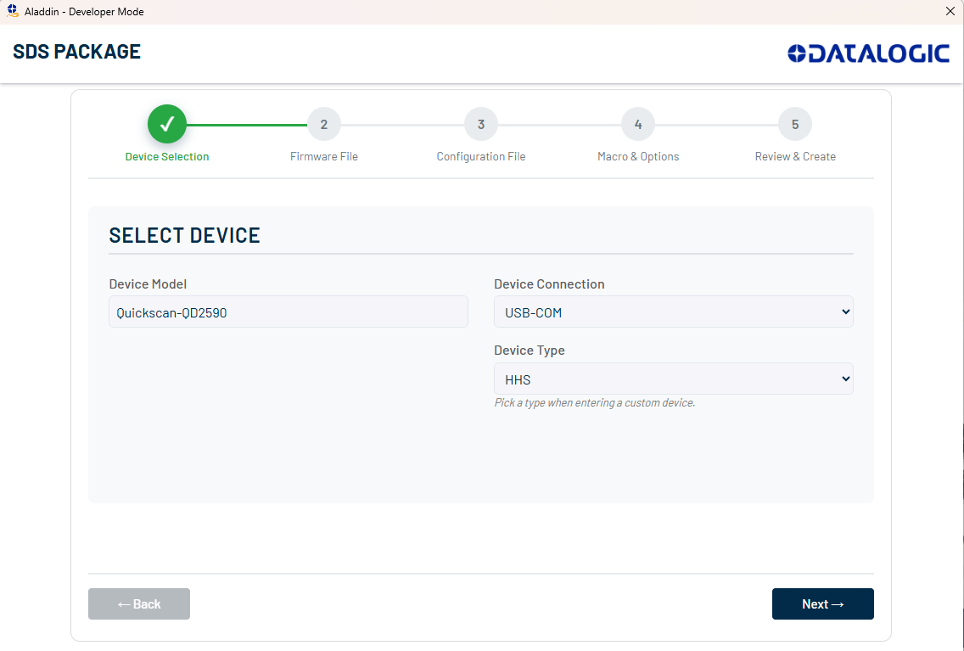
2. How to update firmware/configuration for the HHS gun attached to FRS device
2.1. Create SDS package for the HHS gun with USB-COM FRS, USB-COM HHS
In Aladdin, open “SDS Package” page
1
2
Choose USB-COM
3
Choose HHS
Fill HHS device model name

Slide 25
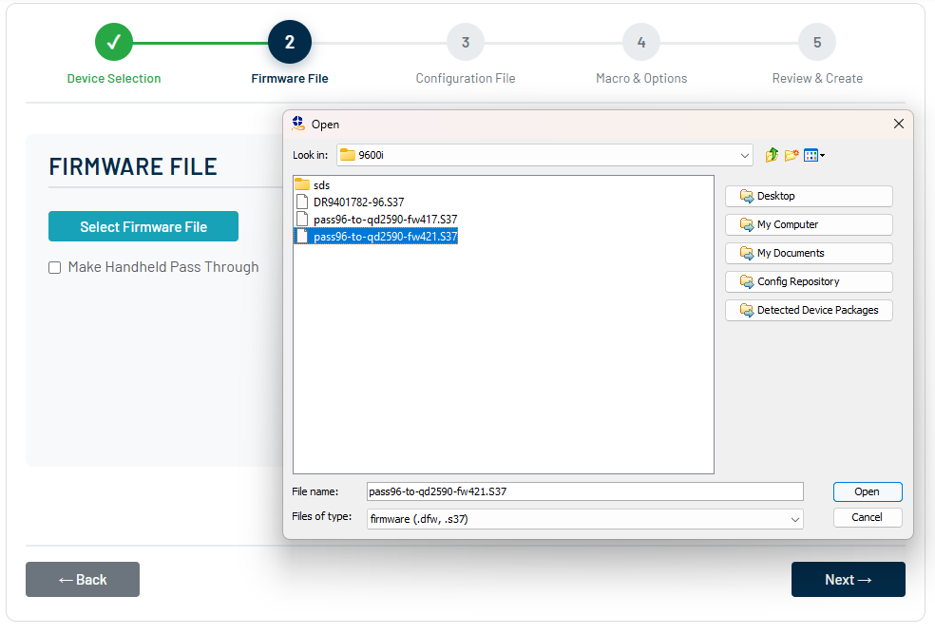
2. How to update firmware/configuration for the HHS gun attached to FRS device
2.1. Create SDS package for the HHS gun with USB-COM FRS, USB-COM HHS
1
Click to select firmware
2
Load the created pass-through file

Slide 26
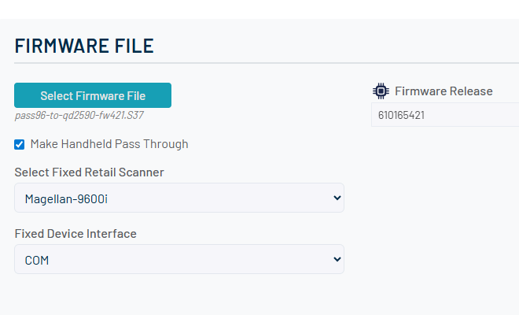
2. How to update firmware/configuration for the HHS gun attached to FRS device
2.1. Create SDS package for the HHS gun with USB-COM FRS, USB-COM HHS
1
Check this
Select FRS device
2
3
Select COM

Slide 27
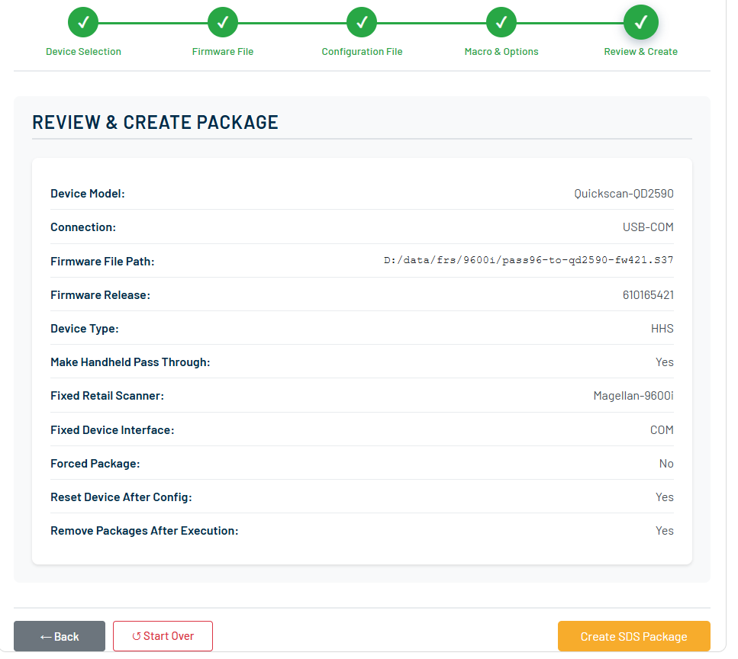

2. How to update firmware/configuration for the HHS gun attached to FRS device
2.1. Create SDS package for the HHS gun with USB-COM FRS, USB-COM HHS
2
Rename and save
Review the package info and click create
1

Slide 28
2. How to update firmware/configuration for the HHS gun attached to FRS device
2.2. Create SDS package for the HHS gun with USB-OEM FRS, USB-COM HHS
2
FRS (parent) | HHS(children) | Firmware/Config file format required
USB-OEM | USB-COM | .DAT
First, you need to create a pass-through file for the HHS device using the HDFAT application.

Slide 29
2. How to update firmware/configuration for the HHS gun attached to FRS device
2.2. Create SDS package for the HHS gun with USB-OEM FRS, USB-COM HHS
1
Open Aladdin
2
Click Open HDFAT

Slide 30
2. How to update firmware/configuration for the HHS gun attached to FRS device
Click here
2.2. Create SDS package for the HHS gun with USB-OEM FRS, USB-COM HHS
3
1
Click here to load .DAT file of HHS device
2
Here, I select the .DAT firmware file (version 610165421) for the QuickScan QD2590 because I want to update the firmware. If you want to update the configuration of the HHS device, select the .DAT configuration file instead.

Slide 31
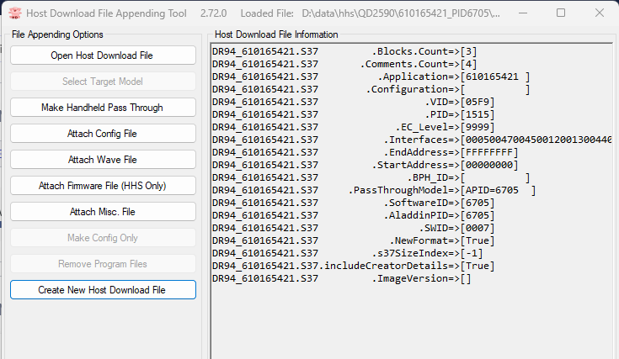
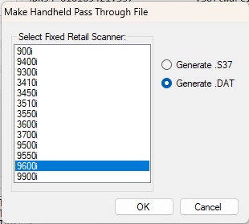
2. How to update firmware/configuration for the HHS gun attached to FRS device
2.2. Create SDS package for the HHS gun with USB-OEM FRS, USB-COM HHS
1
2
Check this
3
Then, select the FRS parent device of the HHS gun. In my setup, I use a Magellan 9600i and a PD2590, so I select the 9600.
Then, click here to create pass through file.
Now we have .DAT passthrough file

Slide 32
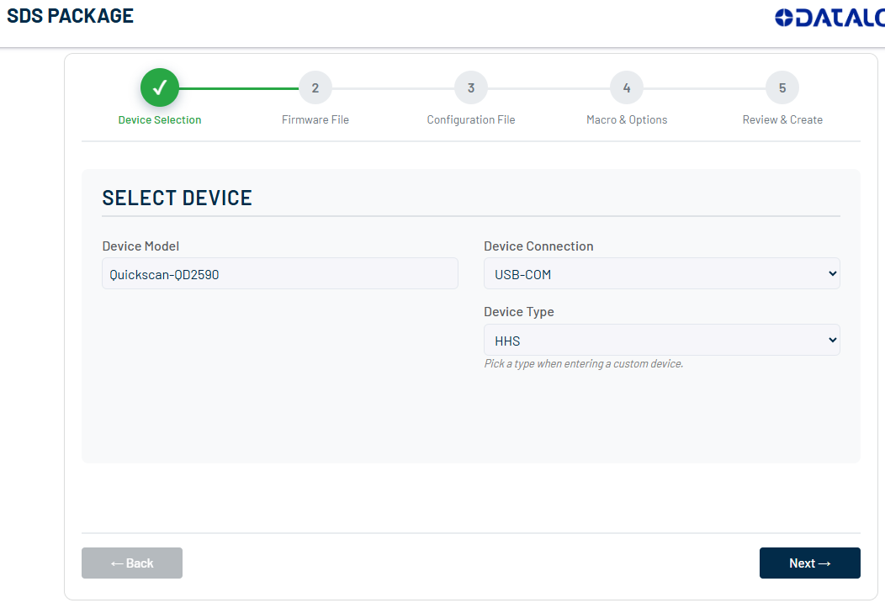
2. How to update firmware/configuration for the HHS gun attached to FRS device
2.2. Create SDS package for the HHS gun with USB-OEM FRS, USB-COM HHS
In Aladdin, open “SDS Package” page
1
2
Choose USB-COM
3
Choose HHS
Fill HHS device model name

Slide 33
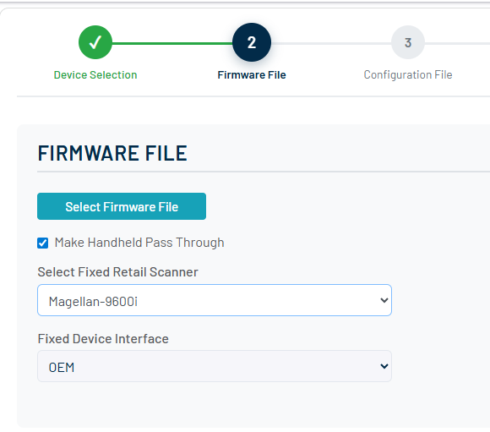
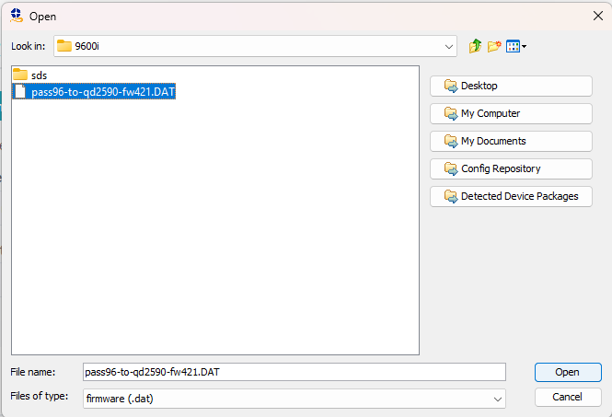
2. How to update firmware/configuration for the HHS gun attached to FRS device
2.2. Create SDS package for the HHS gun with USB-OEM FRS, USB-COM HHS
Load the created pass-through file
Click to select firmware
2
1
3
Check this
4
Select FRS device
5
Select OEM

Slide 34


2. How to update firmware/configuration for the HHS gun attached to FRS device
2.2. Create SDS package for the HHS gun with USB-OEM FRS, USB-COM HHS
2
Rename and save
Review the package info and click create
Now we have the SDS package
1

Slide 35
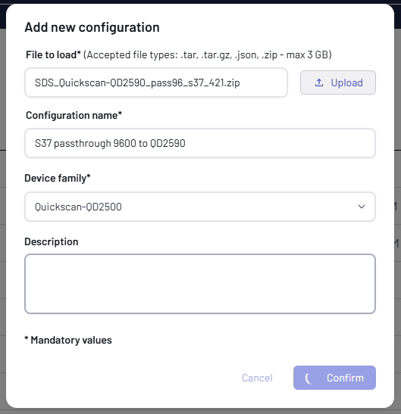
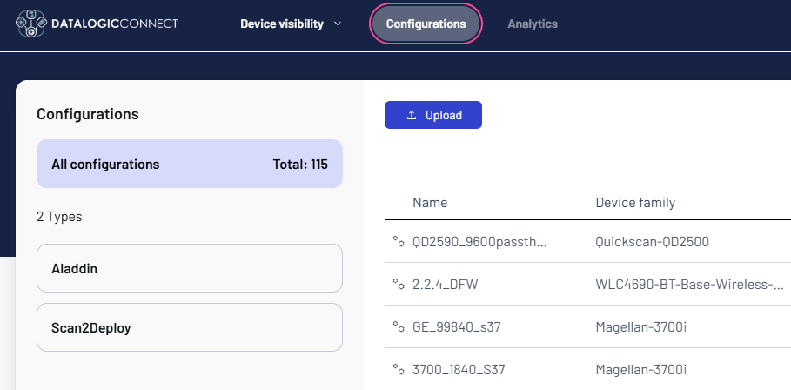
2. How to update firmware/configuration for the HHS gun attached to FRS device
2.3. Upload SDS package on DL Connect website and trigger the package from remote
Load SDS package created from 2.1 section
Section 2.3 provides an example of triggering an SDS execution remotely for the USB-COM FRS + USB-COM HHS scenario.
3
Open DL Connect web site, select Configurations tab
4
Rename here
1
5
Select device model
Click this
2
6
Create here

Slide 36
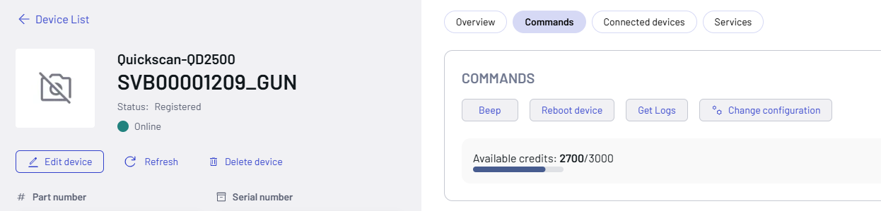
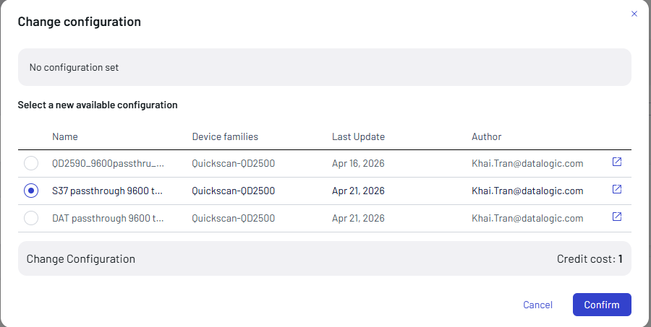
2. How to update firmware/configuration for the HHS gun attached to FRS device
2.3. Upload SDS package on DL Connect website and trigger the package from remote
1
2
Choose Commands
Go to the gun device page
3
Select SDS package to execute
4
Start the update

Slide 37
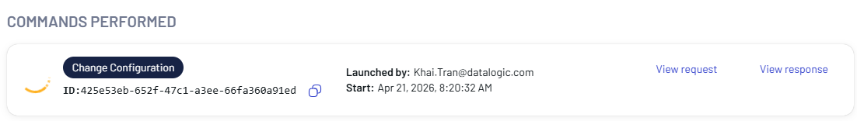
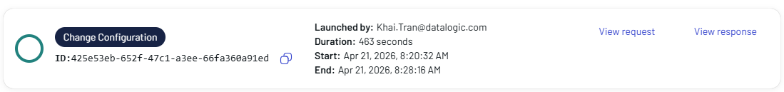
2. How to update firmware/configuration for the HHS gun attached to FRS device
2.3. Upload SDS package on DL Connect website and trigger the package from remote
1
The SDS package is applying…
2
The SDS package is applied successfully

