Slide 1
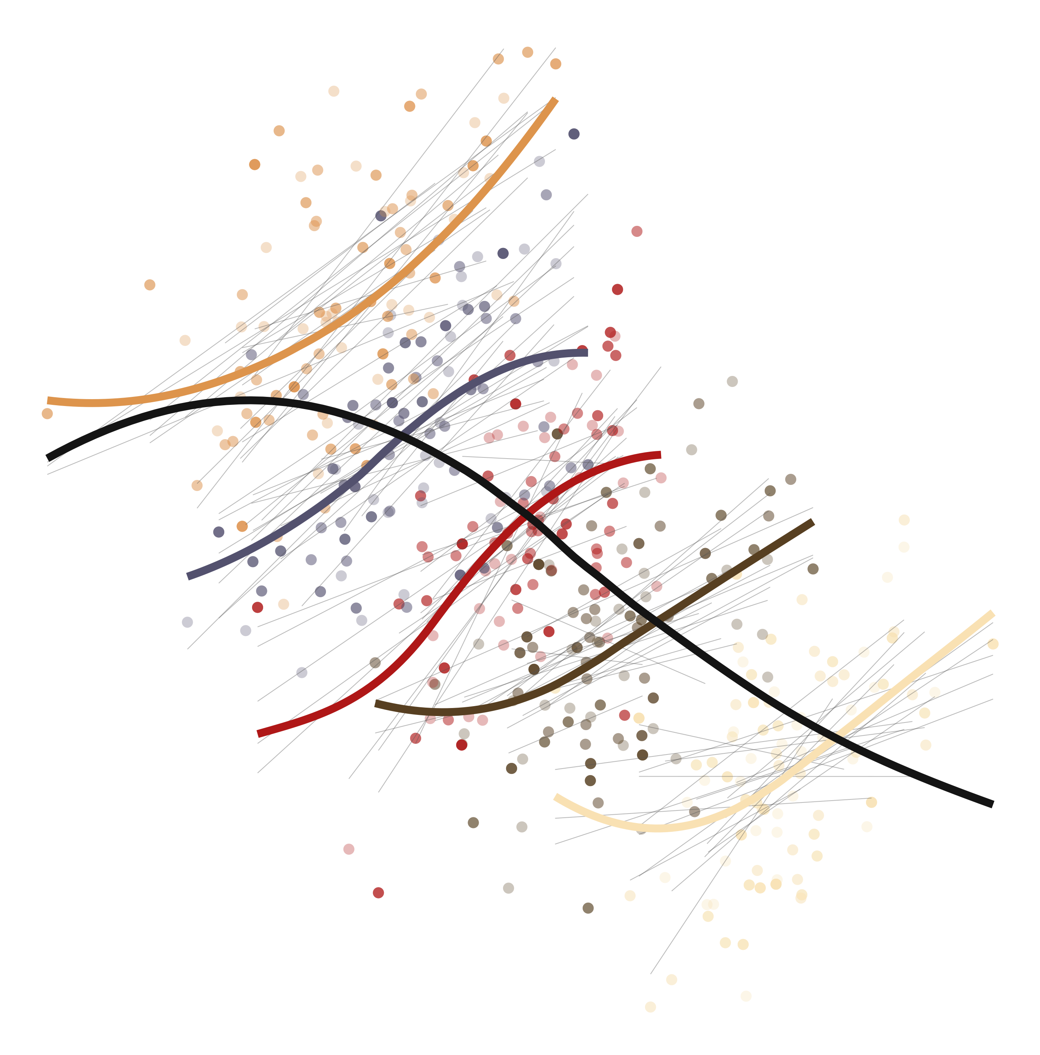
EDLD 629
Multilevel modeling II

