Slide 1


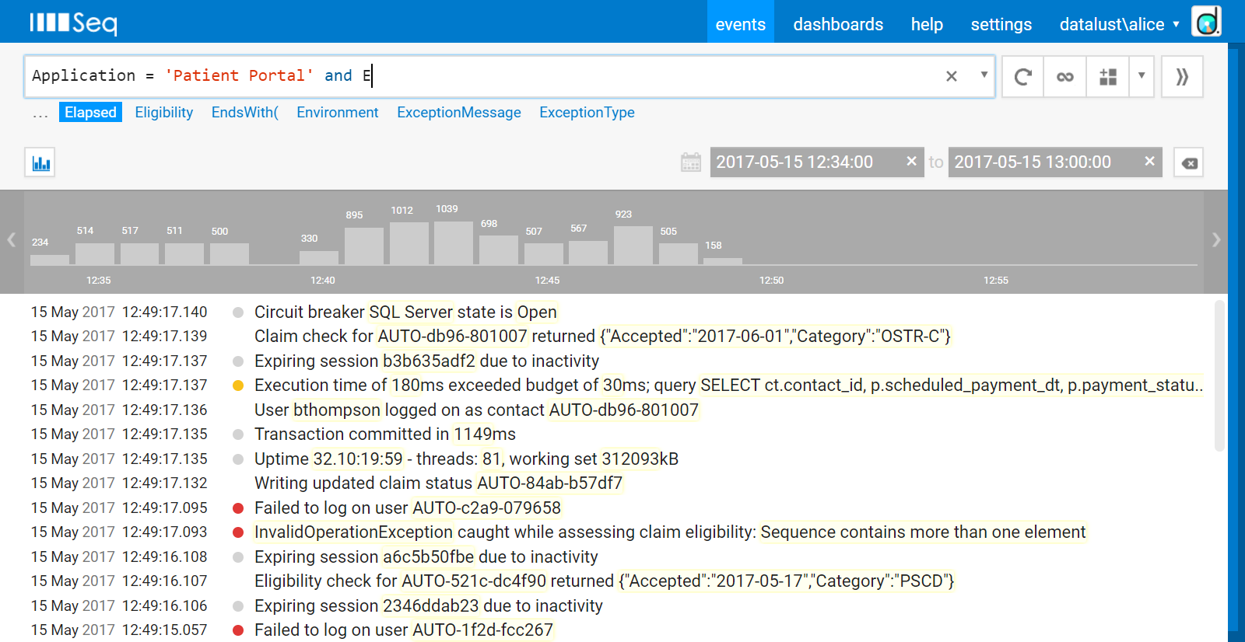


Expressions
Event Data
Check if a property exists
Check if a property is non-null
Access a sub-property
Access a collection element
Find any collection element (use * for all)
More Functions…
DateTime(value) – parse a date/time string
IndexOf(text, pattern) – index or -1
Length(text) – string length
ToIsoString(value) – convert ticks to ISO-8601
See also: Arrived(), Round(), TimeOfDay(), ToNumber(), TypeOf(), TotalMilliseconds()
Full-Text Search
Search for arbitrary text by entering it directly
If the text might be interpreted as an expression, double-quote it
To force exact case-sensitivity, prefix text with @
To search for a regular expression, use slashes
Has(Environment)
DateTime(Order.Placed) < DateTime("2016-03-31 14:00:00 -7")
Environment is not null
Checking out cart c-012834
IndexOf(CustomerName, "al") = 10
User.Email <> 'support@getseq.net'
Length(CustomerName) < 5
"apple or orange"
Tags[5] = 'promoted'
ToIsoString(@Timestamp)
@"Apple" or @"Orange"
Tags[?] = 'promoted'
/[Aa].*e/
Built-in Properties
@Arrived – order-of-arrival at Seq
@Document – a full JSON rendering of the event
@EventType – a hash of the event’s message template or an assigned event type
@Exception – error and stack trace, if any
@Id – unique identity assigned by Seq
@Level – logging level associated with the event
@Message – message associated with the event
@MessageTemplate – message template used to generate the event
@Properties – a dictionary of custom event properties
@Timestamp – UTC timestamp as ticks
Strings
Strings are written in SQL single-quoted syntax.
Substrings, prefixes and suffixes
Exact, case-sensitive equality
Full regular expression match
Regular expression partial match
Positional substring – zero-based index, length
Strings are 'single-quoted'
@Message like 'Checking out%'
Environment = 'Production'
Signals – use the >> button to save filters.
To SQL – click + next to queries in the right-hand panel to convert the current filter to SQL.
Recent Filters – use the drop-down in the right-hand side of the filter box to view recent filters.
Learn more at https://docs.getseq.net/
SourceContext = /System\.(Web|Net)/
Contains(SourceContext, /(Web|Net)/)
Substring(Path, 1, 3) = 'api'
Copyright © 2017 Datalust

Slide 2

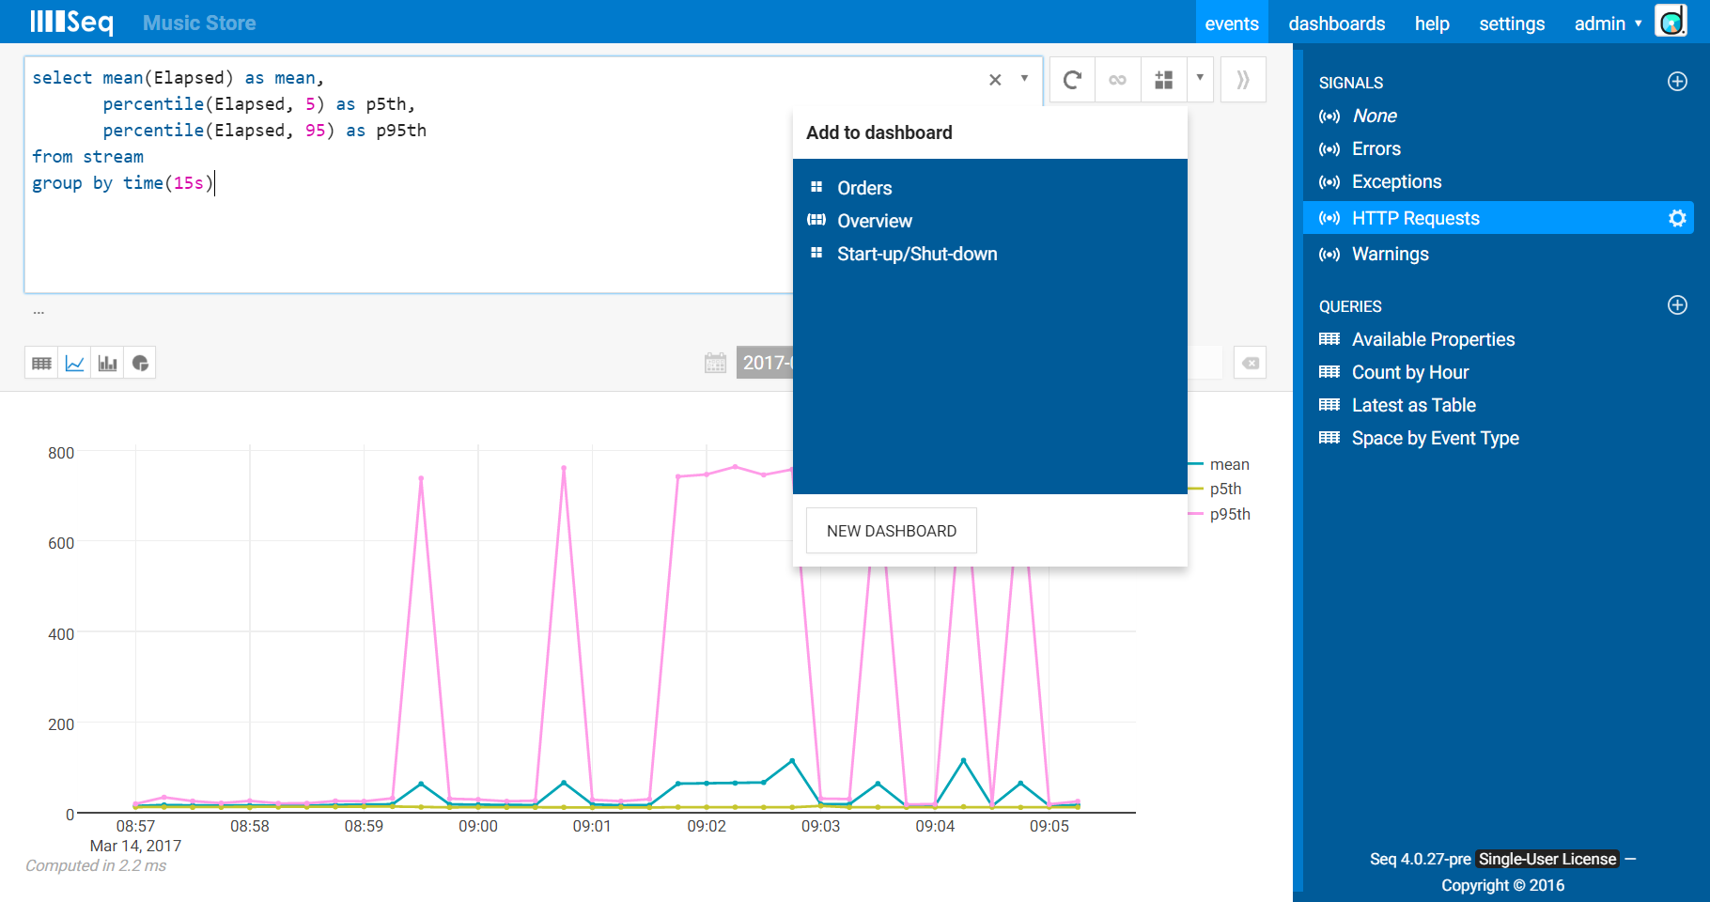

Query Syntax
Aggregate Functions
count() – number of events or non-null values
distinct() – unique values of an expression
first(), last() – first or last non-null value
min(), max() – smallest or largest value
mean() – the average of non-null values
names() – distinct available property names
percentile() – the value at or below which a certain percentage of values lie
sum() – sum of an expression
top(), bottom() – first or last n values
Clauses
limit – retrieve only the first n rows of a result
Grammar
Grouping columns are always included in the result set.
select count(*), count(SessionId)
select *
from stream
where Environment = 'Production'
limit 100
select [<expr> [as <label>],]
[from stream
[where <expr>]
[group by [time(<duration>)|<expr>,]]
[having <expr>]
[order by [time|<label>] [asc|desc]]
[limit <number>]
[for refresh]]
select distinct(StatusCode),
count(distinct(RequestPath))
select first(Elapsed), last(Elapsed)
select min(Elapsed), max(Elapsed)
Time Slicing
Count by time slice
Count by time slice, grouped by property
Time groupings accept durations in:
d – days, h – hours, m – minutes, s – seconds,
ms – milliseconds, us – microseconds.
select mean(CartSize)
Switch to chart views with the selector on the left below the query box.
Add a chart to a dashboard using the button to the right of the query box.
Save a query by clicking + next to the queries heading in the right-hand panel.
Learn more at https://docs.getseq.net/
select count(*)
from stream
group by time(15m)
select names()
select count(*)
from stream
group by MachineName, time(8h)
select percentile(ResponseTime, 99)
select sum(SaleTotal)
select top(Elapsed, 5), bottom(Item, 2)
Copyright © 2017 Datalust

