Slide 1
Sales_Project
Created By : MANISH SAHOO

Slide 2
Description:
In this project, we will dive into a large sales dataset to extract valuable insights. Exploring sales trends over time, identify the best-selling products, calculate revenue metrics such as total sales and profit margins, and create visualizations to present the findings effectively. This project showcases the ability to manipulate and derive insights from large datasets, enabling me to make data-driven recommendations for optimizing sales strategies.
Tools Used : Excel
Visualisation : Tableau

Slide 3
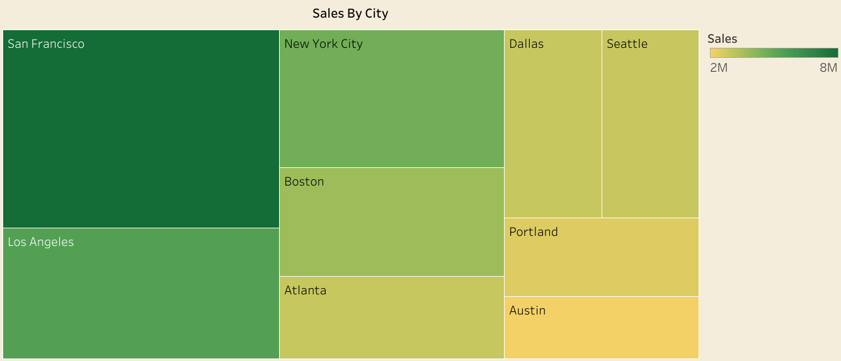
SALES BY CITY
The graph illustrates total sales by city, providing valuable insights for the owner to determine which areas to target and which are performing well. San Francisco leads with impressive sales of $8 million, while Austin struggles to make an impact. To optimize investments, it is recommended to reduce spending in Austin and focus on developing markets like Los Angeles, New York City, and Boston, where sales are stronger.

Slide 4
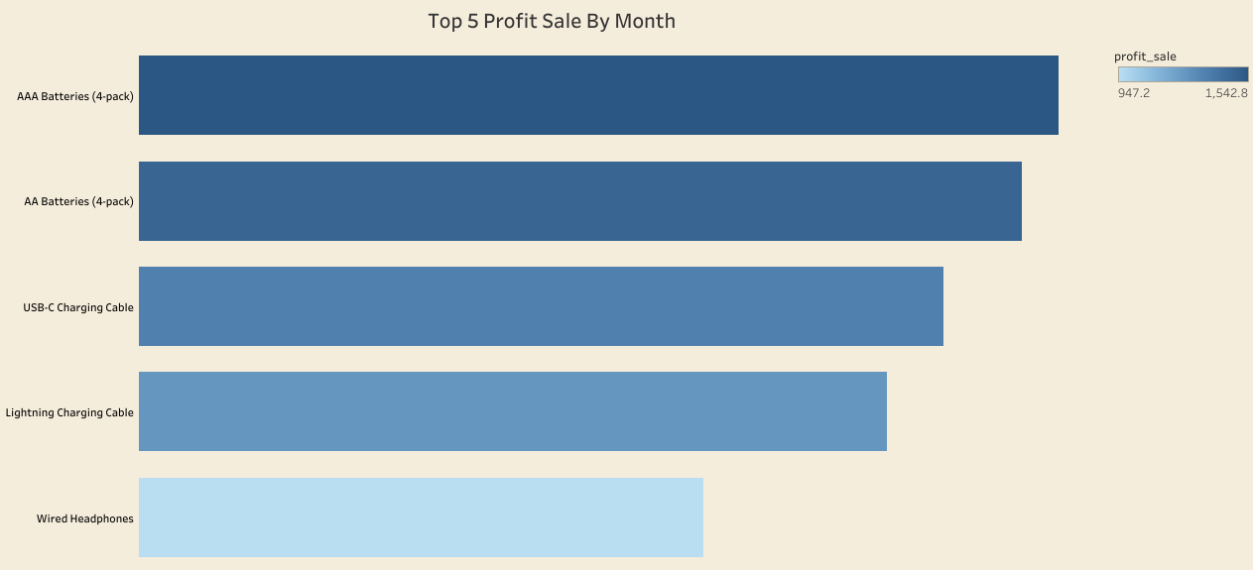
Profit Product Sale By Month
The graph displays the top 5 products of the month, providing the owner with essential insights into the best-selling items and their corresponding profits. This information is instrumental in monitoring monthly sales performance and assessing the overall progress of the business. By consistently tracking these top products, the owner can make informed decisions about inventory management and marketing strategies.
Understanding which products are driving sales enables the owner to consider potential add-ons or complementary items that could encourage customers to make additional purchases, thereby increasing revenue. Furthermore, by analyzing monthly sales trends, the owner can identify patterns and adjust their product offerings to align with customer preferences, ultimately fostering long-term growth and profitability. In essence, this data empowers the owner to make strategic decisions that enhance the business's competitiveness and success.

Slide 5
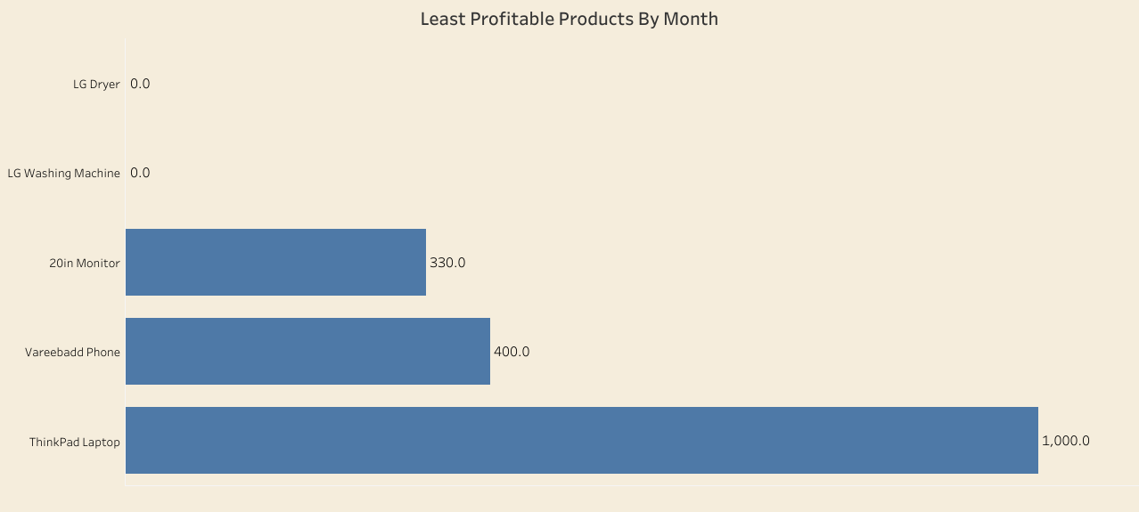
Least Sold Product By City
The analysis of the least profitable products is a crucial aspect for the owner to manage inventory effectively and minimize financial risks. The graph highlights products like "LG dryer" and "washing machine" that consistently have low or no sales throughout most of the month. This data signals a need for the owner to reconsider the inclusion of such items in their product lineup.
To maintain a thriving business, it's essential to prioritize products that customers consistently demand. The owner can use this information to make informed decisions, such as exploring new innovative products or services that have a higher likelihood of regular consumption. Additionally, offering special discounts on poorly performing products can help reduce losses and stimulate sales.
In essence, by closely monitoring and adjusting their product offerings based on least profitable items, the owner can optimize their inventory, reduce financial risks, and enhance the overall profitability of the business. This approach ensures that the products for sale align with customer needs and market trends.

Slide 6
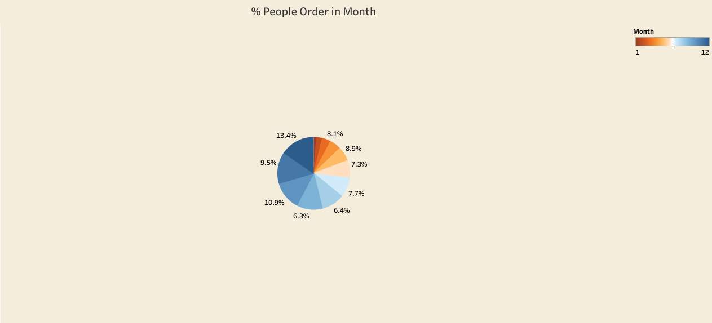
People’s Order by Month
The pie chart serves as a valuable tool for understanding customer preferences and behavior when it comes to purchasing products from the store. By analyzing the chart, the owner can gauge the level of interest customers have in buying products from the store. It provides insights into the number of customers visiting the store and their potential buying patterns.
This information is instrumental in making strategic decisions, such as determining when to offer discounts or special offers on specific products or within the store as a whole. It allows the owner to align promotions with customer traffic and preferences, optimizing the chances of increasing sales and customer satisfaction.
In essence, the pie chart empowers the owner to tailor their marketing and pricing strategies based on customer behavior, ultimately leading to more effective decision-making and improved business performance.

Slide 7
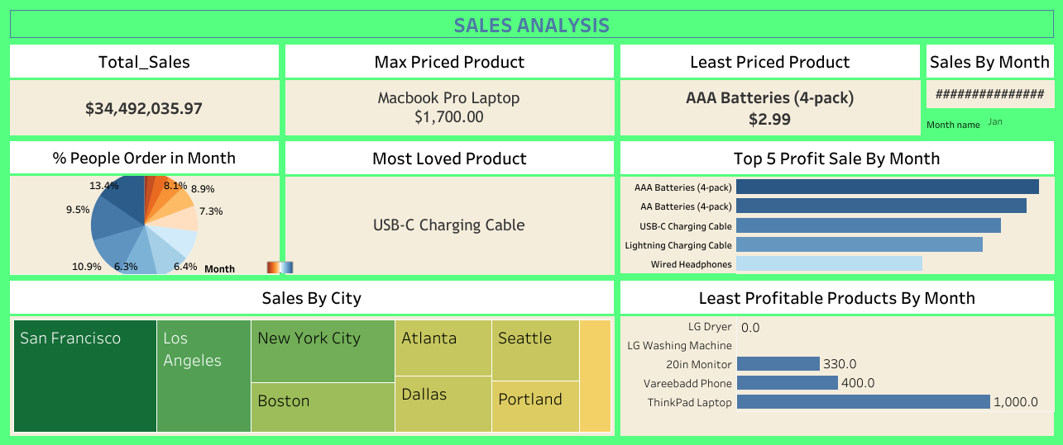
Visualization
The final visualization allows users to select a specific month, and the visualization dynamically adjusts to display sales data for that chosen month. This interactive feature enhances the usability and flexibility of the visualization, enabling users to explore sales trends and patterns on a month-to-month basis. This functionality provides valuable insights into how sales performance fluctuates throughout the year, empowering users to make informed decisions and strategic adjustments based on real-time data. It fosters a deeper understanding of sales dynamics and enables businesses to adapt to changing market conditions effectively.

Slide 8
Thank You
Any Questions

