Slide 1
Diabetes Analysis
By :- MANISH SAHOO

Slide 2
Contents
About the Project
% Having Diabetes and No_diabetes
Pregnancy Insights
Glucose & Insulin Analysis
Glucose & Insulin Analysis
Blood Pressure Analysis
BMI VS Diabetes
Diabetes Pedigree
Skin Thickness by Diabetes
Thnak You

Slide 3
About
This dataset is originally from the National Institute of Diabetes and Digestive and Kidney Diseases. The objective of the dataset is to diagnostically predict whether a patient has diabetes based on certain diagnostic measurements included in the dataset. Several constraints were placed on the selection of these instances from a larger database.
In particular, all patients here are females at least 21 years old of Pima Indian heritage.
From the data set in the (.csv) File We can find several variables, some of them are independent (several medical predictor variables) and only one target dependent variable (Outcome).
Tools Used : Tableau, Excel

Slide 4
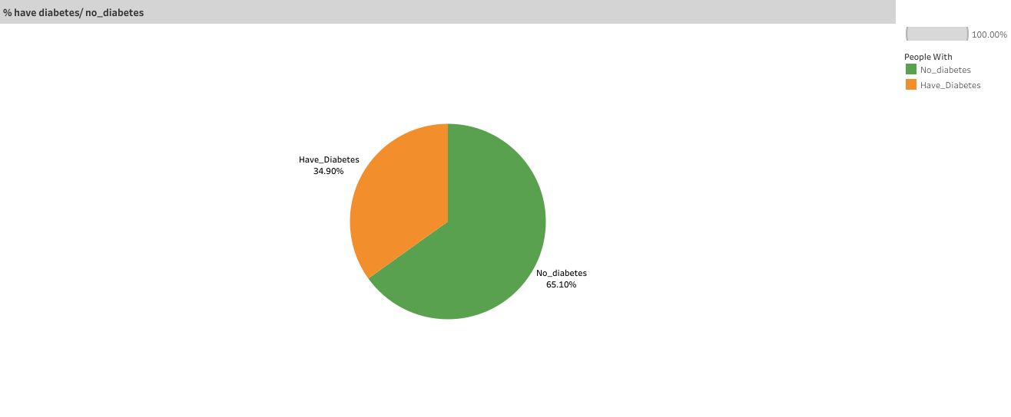
% Having Diabetes and No_diabetes
From the provided dataset, a segmentation has been made between individuals who have been diagnosed with diabetes and those who do not have diabetes. This segregation is essential for the company to evaluate the percentage of individuals registered with them falling into each category.
This data segmentation provides valuable insights into the behavior and health outcomes of the treated patients. By analyzing the percentage of patients with and without diabetes, the company can assess the effectiveness of their treatments, interventions, or preventive measures. It allows for a quantitative evaluation of the impact of the company's services on diabetes management and prevention.
Understanding the distribution of patients within these categories enables the company to tailor its strategies, interventions, and educational initiatives to better serve the specific needs of each group. This data-driven approach can lead to more targeted and effective healthcare interventions, ultimately improving patient outcomes and the overall success of the company's healthcare programs.

Slide 5
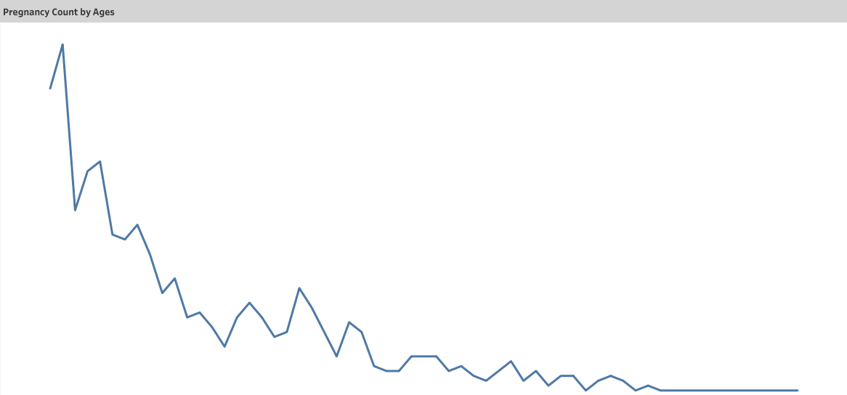
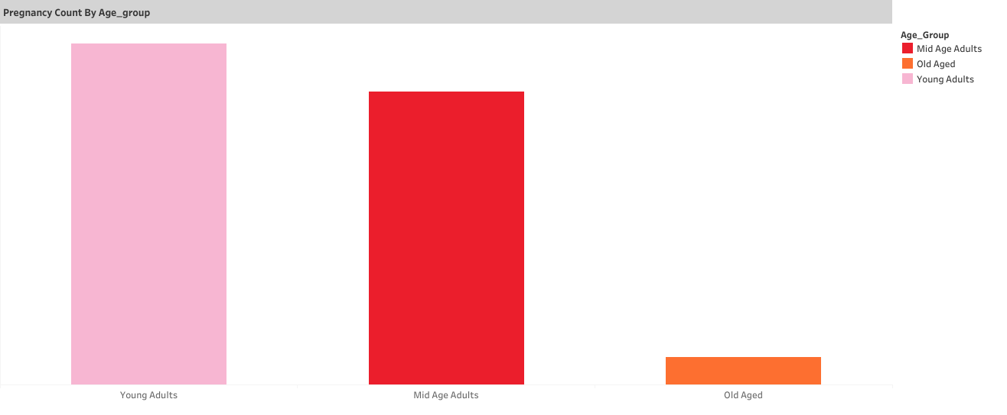
Pregnancy Insights
The two provided graphs offer insights into the distribution of pregnancies across different age groups, shedding light on the age demographics of patients and their pregnancies.
In the first graph, the count of pregnancies at each age point highlights a clear trend, with a peak in pregnancies occurring in a specific age group, followed by a gradual decrease. This information allows for the identification of the age group with the highest pregnancy rate, which can be valuable for healthcare planning and resource allocation.
The second graph, which categorizes patients into three age groups—Young Adults, Mid-Aged Adults, and Old Aged Adults—reveals that the majority of pregnancies are among Young Adults. This categorization simplifies the understanding of patient demographics and provides a clear picture of which age group contributes the most to pregnancies.
By combining the insights from both graphs, healthcare providers and policymakers can better tailor their services, education, and healthcare resources to address the specific needs of each age group. This data-driven approach can lead to more effective healthcare interventions and strategies for promoting reproductive health and family planning.

Slide 6
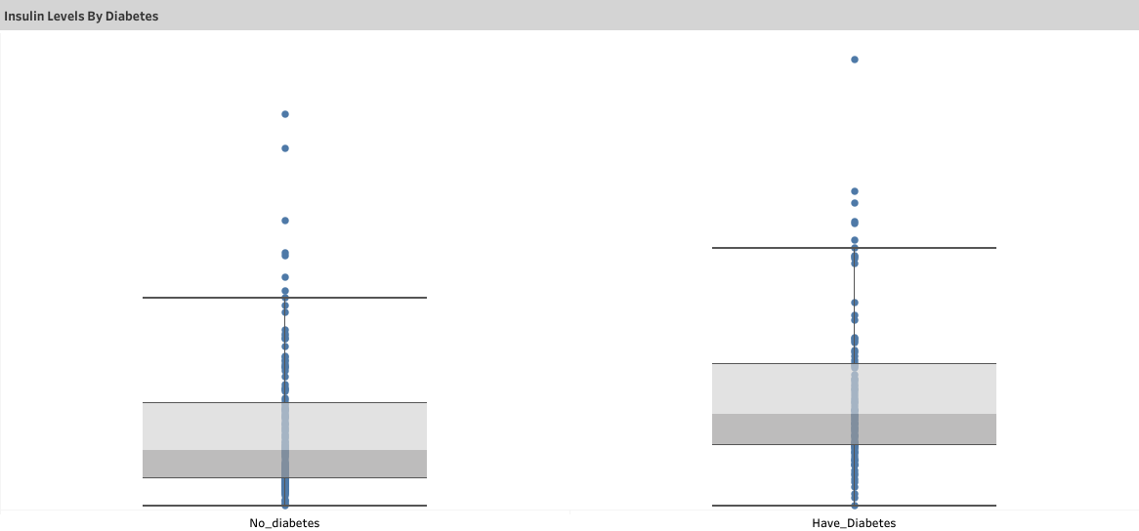
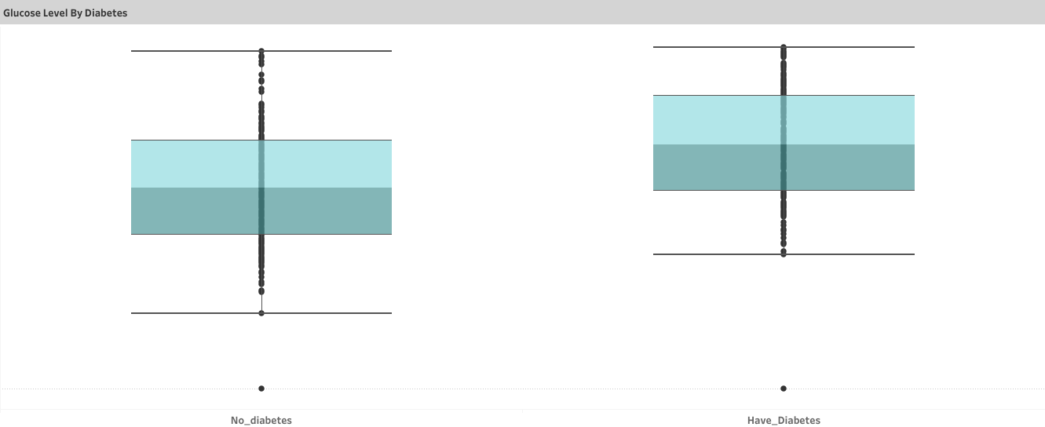
Glucose & Insulin Analysis
Analyzing these box-and-whisker plots for insulin and glucose levels in diabetes and non-diabetes patients allows you to compare the central tendency, variability, and potential outliers in the data for both groups. This information can be crucial for understanding the distribution of these essential health parameters and can inform clinical decisions, treatment strategies, and further investigations into diabetes management.

Slide 7
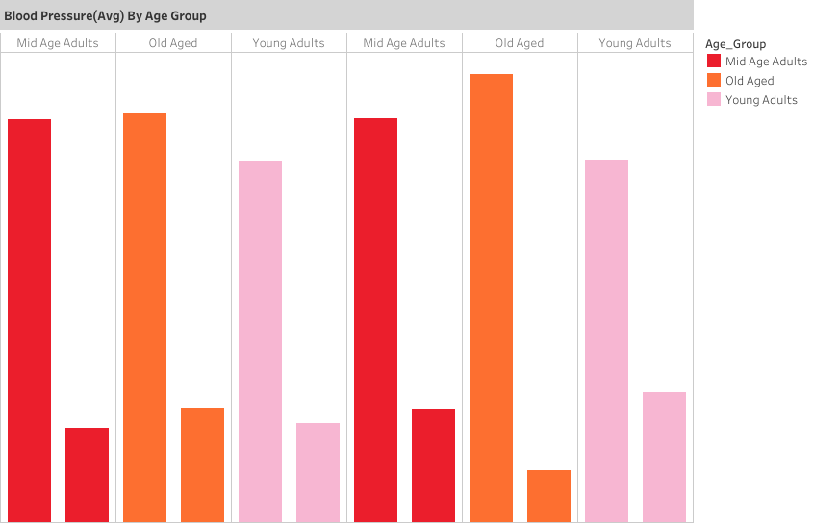
Blood Pressure Analysis
The analysis of blood pressure data among different age groups in diabetes patients provides valuable insights into the relationship between age and blood pressure levels. This information aids in risk assessment, personalized care, and early intervention strategies, ultimately improving the management and outcomes of diabetes patients.

Slide 8
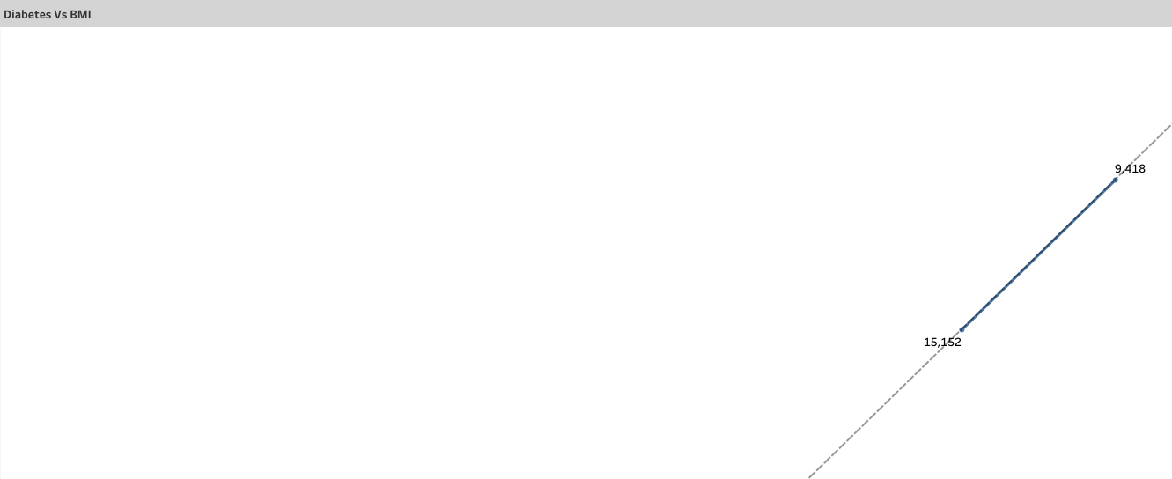
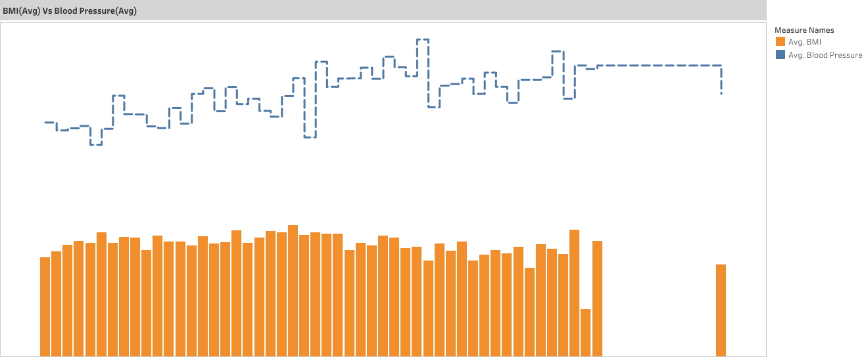
BMI VS Diabetes
BMI VS BLOOD PRESSURE

Slide 9
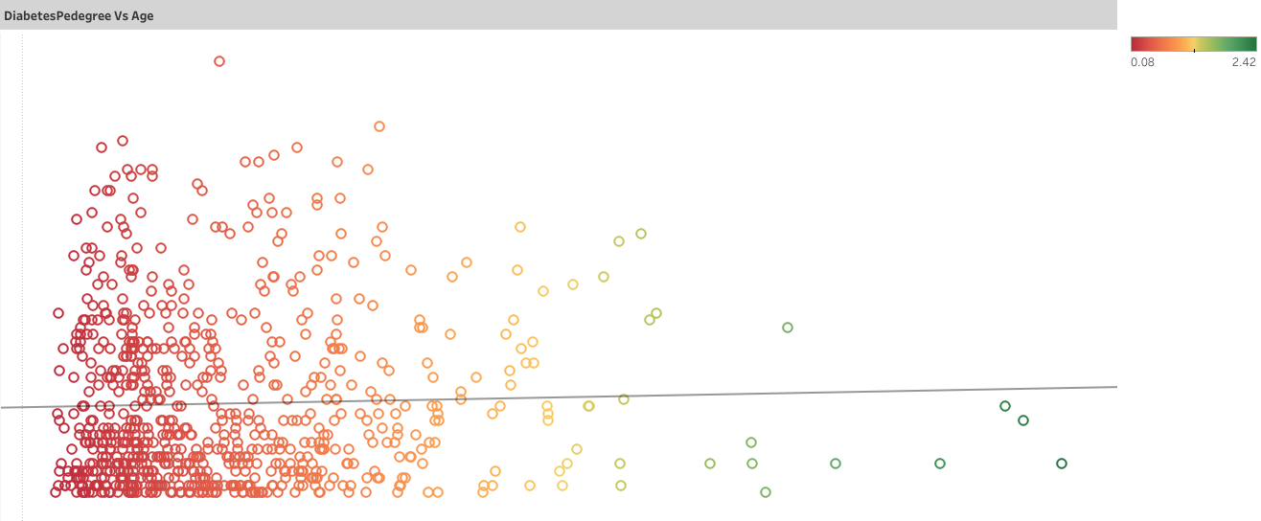
Diabetes Pedigree
A diabetes pedigree helps healthcare professionals and genetic counselors assess the risk of diabetes within a family, identify potential genetic patterns or predispositions, and make recommendations for genetic testing or lifestyle modifications. It can be a valuable tool for understanding the hereditary factors contributing to diabetes and guiding preventive measures or early interventions for family members at higher risk.
Here we can see the concentration of points left side of the graph i.e. between 20 to 30 years of age.

Slide 10
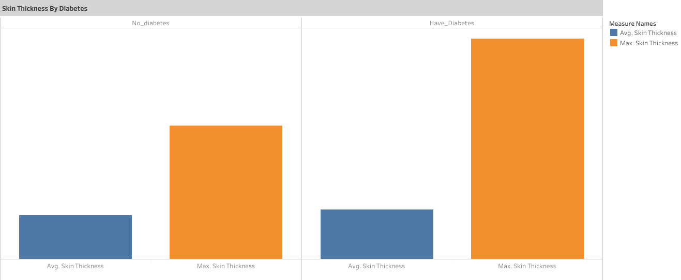
Skin Thickness by Diabetes

Slide 11
Thank You

