Slide 1
Statistics Overview – Part 3
Hypothesis Development and Testing
Hardik Shah
Epitome IT Coaching

Slide 2
Statistical inference
One of the major roles of statisticians is to draw conclusions from data
This is referred to as statistical inference
We can put a probability on whether a conclusion is correct within reasonable doubt
Statistical inference plays a major role in decision making

Slide 3
Statistical inference
Decision-making process:
1. Collect the data
2. Summarize the data (using either visual displays or descriptive statistics)
3. Set up an hypothesis (i.e. claim or theory) to be tested
4. Calculate the probability of obtaining a sample such as the one we have if the hypothesis is true
5. Either accept or reject the hypothesis
Inferences will be made based on samples taken from the population

Slide 4
Significance level
This level represents the borderline probability between whether an event has occurred by chance or whether an unusual event has taken place
Most common significance level used is 0.05, commonly written as = 0.05
5% significance level says in effect that an event that occurs less than 5% of the time is considered unusual

Slide 5
Assumptions
Simple random Sampling
Sample size n is reasonably large
Good rule of thumb is at least 30.
Beware of strong skewness if your sample size is smaller than 30.
Remember that and s are strongly influenced by outliers.

Slide 6
Confidence Interval Steps
1. Define problem. Select level of confidence.
2. Collect data (SRS).
3. Calculate as an estimate of µ and s as an estimate of σ.
4. Check assumptions:
Sample size n is reasonably large (n ≥ 30) so can use normal distribution and estimate σ with s.
Check for strong skewness or outliers
5. Calculate confidence interval.
6. Make conclusions in context of the problem.

Slide 7
What is a Hypothesis?
A hypothesis is a claim (assumption) about the population parameter
Examples of parameters are population mean or proportion
The parameter must be identified before analysis
I claim the mean CGPA of this class is 7.5!

Slide 8
Types of Hypotheses
Research Hypothesis
a statement of what the researcher believes will be the outcome of an experiment or a study.
Statistical Hypotheses
a more formal structure derived from the research hypothesis.

Slide 9
Example Research Hypotheses
Older workers are more loyal to a company
Companies with more than Rs 1000 Crores of assets spend a higher percentage of their annual budget on advertising than do companies with less than Rs 1000 Crores of assets.
The price of scrap metal is a good indicator of the industrial production index some x months later.

Slide 10
Statistical Hypotheses
Two Parts
a null hypothesis
an alternative hypothesis
Null Hypothesis – nothing new is happening
Alternative Hypothesis – something new is happening
Notation
null: H₀
alternative: H_{a}

Slide 11
Null and Alternative Hypotheses
The Null and Alternative Hypotheses are mutually exclusive. Only one of them can be true.
The Null and Alternative Hypotheses are collectively exhaustive. They are stated to include all possibilities. (An abbreviated form of the null hypothesis is often used.)
The Null Hypothesis is assumed to be true.
The burden of proof falls on the Alternative Hypothesis.
Notes:
5

Slide 13
The null hypothesis
Null hypothesis is a statement that nothing unusual has occurred. The notation is H_{o}.
Alternative hypothesis states that something unusual has occurred. The notation is H₁ or H_{A}
Together they may be written in the form:
H_{o}:(statement) v H₁(alternative statement)
Where: ‘v’ stands for versus

Slide 14
The Null Hypothesis, H₀
States the assumption (numerical) to be tested
e.g.: The average number of Children in Shillong Households is three
Is always about a population parameter , not about a sample statistic

Slide 15
The Null Hypothesis, H₀
Begins with the assumption that the null hypothesis is true
Similar to the notion of innocent until proven guilty
Refers to the status quo
May or may not be rejected

Slide 16
Alternative hypothesis
May be classified as two-tailed test or one-tailed test
Two-tailed test (two sided alternative)
Test with no preconceived notion that the true value of µ is either above or below the hypothesised value of µ
H₁: µ ≠ µ_{o}

Slide 17
The Alternative Hypothesis, H₁
Is the opposite of the null hypothesis
e.g.: The average number of Children is less than 3 ( )
Challenges the status quo
May or may not be accepted
Is generally the hypothesis that is believed (or needed to be proven) to be true by the researcher

Slide 18
Null and Alternative Hypotheses: Example
A manufacturer is filling 40 Kg. packages with flour.
The company wants the package contents to average 40 Kgs.
Notes:
6

Slide 19
Application
The Meghalaya Electricity Department installed energy efficient lights, heaters and air conditioners last year. Now they want to determine whether the average monthly energy usage has decreased. Should they perform a one- or two-tail test? If their previous average monthly usage was 3124 Kwh, what are the null and alternative hypotheses?
Notes:
They should use one tail test.
Here the researcher is 3rd party. So he wants to falsify the claim of State Electricity Board that it is less than 3124 and therefore:-
Null Hypothesis :
H0: u<3124
H1: u>=3124

Slide 20
Application
Dr. Ross believes that nicotine in cigarettes causes cigarette smokers to have higher daytime heart rates on average than do nonsmokers. He also believes that smokers crave the nicotine in cigarette rather than just smoking for physical satisfaction of the act, accordingly that the average smoker will smoke more cigarettes per day if he or she switches from a brand with high nicotine content to one with a low level of nicotine.
Suppose Ross knows that nonsmokers have an average daytime heart rate of 78 beats per minute. What are the appropriate null and alternative hypotheses for testing his belief?
For the past 3 months, he has been observing a sample of 48 individual who smoke an average of 15 high-nicotine cigarettes per day. He has just switch them to a brand with a low nicotine content. State Null and alternative hypotheses for testing second belief.

Slide 21
Hypothesis Testing Process
Assume the
population
mean age is 50.
( )
Identify the Population
Take a Sample
No, not likely!
REJECT
Null Hypothesis

Slide 22
Reason for Rejecting H₀
Sampling Distribution of
It is unlikely that we would get a sample mean of this value ...
... Therefore, we reject the null hypothesis that m = 50.
... if in fact this were the population mean.
μ
20
= 50
If H₀ is true

Slide 23
Null and Alternative Hypotheses: Example
A manufacturer is filling 40 Kg. packages with flour.
The company wants the package contents to average 40 Kgs.
Notes:
6

Slide 24
Rejection and Non Rejection Regions
Rejection Region
Rejection Region
Non Rejection Region
μ=40 Kg
Critical Value
Critical Value
Notes:
7

Slide 25
One-tailed and Two-tailed Tests
One-tailed Tests
Two-tailed Test
Notes:
10

Slide 26
Level of Significance,
Defines unlikely values of sample statistic if null hypothesis is true
Called rejection region of the sampling distribution
Is designated by , (level of significance)
Typical values are .01, .05, .10
Is selected by the researcher at the beginning
Provides the critical value(s) of the test

Slide 27
Level of Significance and the Rejection Region
α
H₀: μ = 3 H₁: μ < 3
Critical Value(s)
Rejection Regions
0
α
H₀: μ = 3 H₁: μ > 3
0
α/2
H₀: μ = 3 H₁: μ ≠ 3
0

Slide 28
One-tailed Tests
Rejection Region
Rejection Region
Non Rejection Region
Non Rejection Region
μ=40 oz
μ=40 oz
Critical Value
Critical Value
Notes:
11

Slide 29
Two-tailed Tests
Rejection
Region
Rejection
Region
Non Rejection Region
μ=40
Critical Values
Notes:
12

Slide 30
An Example: Net Income Two-tailed Test
Rejection
Region
Rejection
Region
Non Rejection Region
Ζ=0
Notes:
13

Slide 31
Income Example: Two-tailed Test
Notes:
13

Slide 32
Net Income Example: Critical Value Method
Rejection
Region
Rejection
Region
Non Rejection Region
72,223
77,605
Ζ=0
Notes:
15

Slide 33
Net Income Example: Critical Value Method
Rejection
Region
Rejection
Region
Non Rejection Region
72,223
77,605
Ζ=0
Notes:
16

Slide 34
Demonstration Problem using Excel

Slide 35
Demonstration Problem using Excel
H₀: μ = | 4.3
H_{a}: μ < | 4.3
3 | 4 | 5 | 5 | 4 | 5 | 5 | 4
4 | 4 | 4 | 4 | 4 | 4 | 4 | 5
4 | 4 | 4 | 3 | 4 | 4 | 4 | 3
5 | 4 | 4 | 5 | 4 | 4 | 4 | 5
n = | =COUNT(A4:H7)
α = | 0.05
Mean = | =AVERAGE(A4:H7)
S = | =STDEV(A4:H7)
Std Error = | =B12/SQRT(B9)
Z = | =(B11-B1)/B13
p-Value | =NORMSDIST(B14)

Slide 36
An exercise
SAT score distribution for India:
Population mean = 500,
Population st.dev. = 100
Sample mean of 35 students = 541
Develop and test Hypothesis

Slide 37
Application
Each day, the Indian Custom Service (ICS) has historically intercepted about Rs. 28 Lacs in the contraband goods being smuggled into the country, with the standard deviation of Rs. 16 Lacs per day. On 64 randomly chosen days in 2010, the ICS intercepted an average of Rs. 30.3 Lacs in the contraband goods. What would you suggest the Commissioner about the smuggling as compared to historic level.

Slide 38
Two-tailed Test: Small Sample, σ Unknown, α = .05
Weights in Kgs of a Sample of 20 Plates
22.6 22.2 23.2 27.4 24.5
27.0 26.6 28.1 26.9 24.9
26.2 25.3 23.1 24.2 26.1
25.8 30.4 28.6 23.5 23.6
Notes:
21

Slide 39
Two-tailed Test: Small Sample, σ Unknown, α = .05
Rejection Regions
Non Rejection Region
Critical Values
Notes:
22

Slide 40
Two-tailed Test: Small Sample, σ Unknown, α = .05
Rejection Regions
Non Rejection Region
Critical Values
Notes:
23

Slide 41
Example
Size in Acres of 23 Farms
445 489 474 505 553 477 545
463 466 557 502 449 438 500
466 477 557 433 545 511 590
561 560
Notes:
25

Slide 42
Example
Rejection Region
Non Rejection Region
Critical Value
Notes:
26

Slide 43
Rejection Region
Non Rejection Region
Critical Value
Notes:
27

Slide 44
Z Test of Population Proportion
Notes:
28

Slide 45
A case
Audio Sounds runs a chain of stores selling stereo systems and components. It has been very successful in many university towns but it has had some failures. Analysis of its failures has led it to adopt a policy of not opening a store unless it can be reasonably certain that more than 15% of the students in the town own stereo system costing at least $1,000 or more. A survey of 300 of 2400 students at a small art college in the Midwest has discovered that 57 of them own stereo system costing at least $1000. If Audio Sounds is willing to run a 5% risk of failure, should it open a store in the town?

Slide 46
Application
XCO, a multinational manufacturer, uses a batch process to produce widgets. Each batch of widgets takes 8 hrs to produce and has material and labor cost of $ 8,476. Because of variation in machine efficiency and raw material purity, the number of widgets per batch is random. All widgets made can be sold @ $2.50 each, and widget production is profitable so long as the batches sell for more than $ 12,500 on average. XCO sampled 16 batches and found 5040 widgets per batch on average, with a standard deviation of 41.3 widgets. At α = 0.025, can XCO conclude that its widget operation is profitable?

Slide 47
Errors
There are two possible errors in making a conclusion about a null hypothesis
1. Type I errors occur when you reject H_{o} as being false when H_{o} is really true
2. Type II errors occur when you accept H_{o} as being true when H_{o} is really false

Slide 48
Errors (Risk) in Making Decisions
Type I Error
Rejects a true null hypothesis
Has serious consequences
The probability of Type I Error is
Called level of significance
Set by researcher
Type II Error
Fails to reject a false null hypothesis
The probability of Type II Error is
The power of the test is

Slide 49
Result Probabilities
H₀: Innocent
Jury Trial
Hypothesis
Test
The Truth
The Truth
Verdict
Innocent
Guilty
Decision
H
True
H
False
0
0
Do Not
Type II
Innocent
Correct
Error
Reject
1 -
α
β
)
Error (
H
0
Type I
Error
Reject
Power
Correct
Error
H
(1 -
)
Guilty
0
β
(
)
α

Slide 50
Errors in Making Decisions
(continued)
Probability of not making Type I Error
Called the confidence coefficient

Slide 51
smaller alpha values are more conservative from the point of view of Type I errors
compare a alpha-level of .01 and .05:
we accept the null hypothesis unless the sample is so unusual that we would only expect to observe it 1 in 100 and 5 in 100 times (respectively) due to random chance
the larger value (.05) means we will accept less unusual sample data as evidence that H₀ is false
the probability of falsely rejecting it (i.e., a Type I error) is higher
the more conservative (smaller) alpha is set to, the greater the probability associated with another kind of error—Type II error

Slide 52
Type II error
P(accepting H₀|H₀ is false)
failing to reject the null hypothesis when it actually is false
the probability of a Type II error (β) is generally unknown

Slide 53
the relative costs of Type I vs. Type II errors vary according to context
in general, Type I errors are more of a problem
e.g., claiming a significant pattern where none exists
 | H₀ is correct | H₀ is incorrect
H₀ is accepted | correct decision | Type II error (β)
H₀ is rejected | Type I error (α) | correct decision

Slide 54
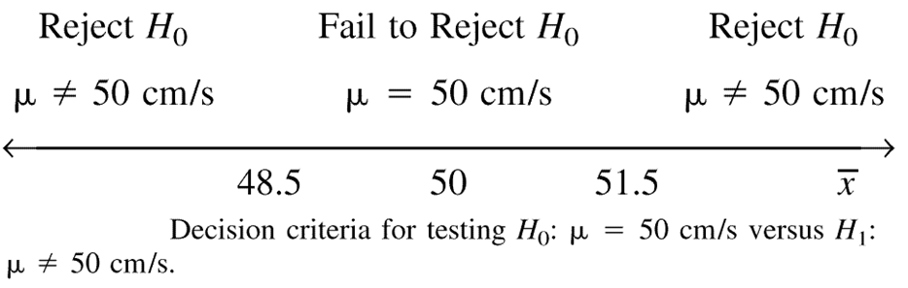
Note: for this example n=10
Note: for this example we will assume σ = 2.5

Slide 55
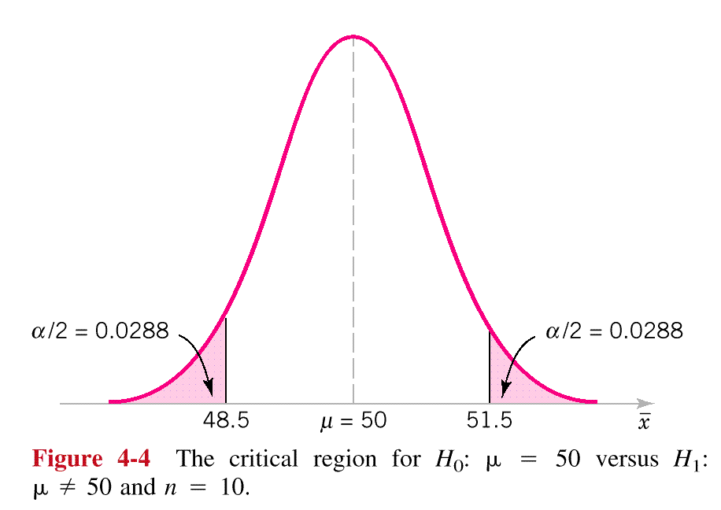
Where does this number come from?
We will reject the null hypothesis (μ = 50) if our sample mean is either of these two regions
Notes:
Be sure to have students calculate this.

Slide 56
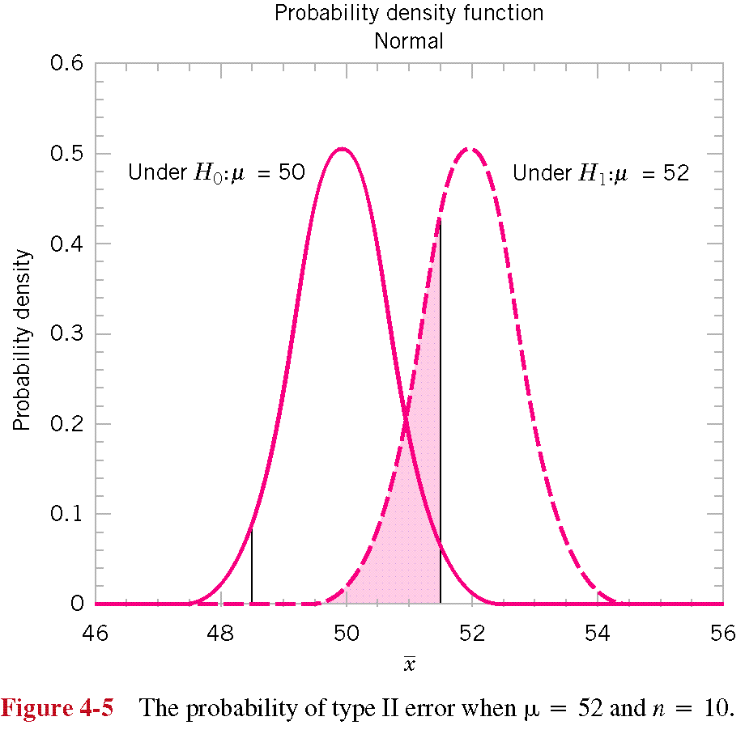
The pink area is the probability
of a Type II error if the actual mean is 52.
Notes:
Students calculate this again.

Slide 57
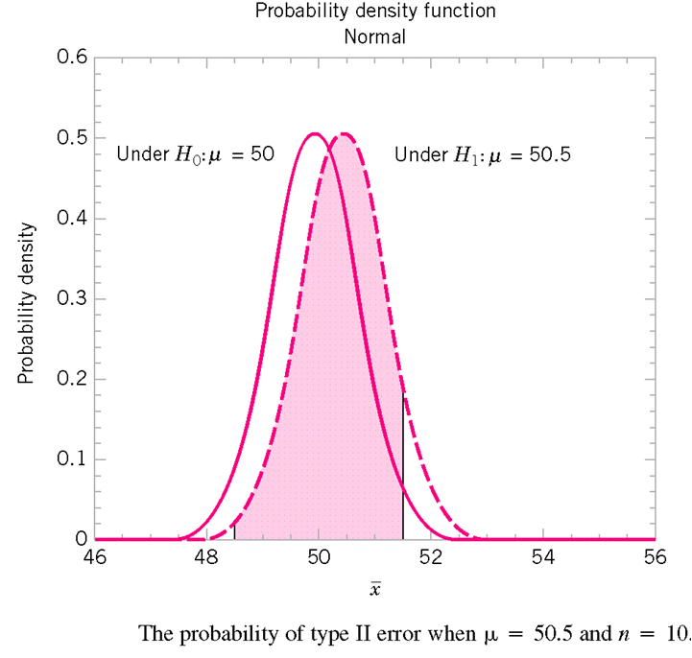
Notes:
Students calculate this and ask WHAT IS THE MORAL?

Slide 58
Type II error
There is a different type II error for each μ different than 50
The probability of a Type II error is designated by β

Slide 59
The Power of a Test
The power of a statistical hypothesis test is the probability of rejecting the null hypothesis when the null hypothesis is false.
Power = (1 - β)

Slide 60
The Power Function
The probability of a type II error, and the power of a test, depends on the actual value of the unknown population parameter. The relationship between the population mean and the power of the test is called the power function.
Value of μ β Power = (1 - β)
61 0.8739 0.1261
62 0.7405 0.2695
63 0.5577 0.4423
64 0.3613 0.6387
65 0.1963 0.8037
66 0.0877 0.9123
67 0.0318 0.9682
68 0.0092 0.9908
69 0.0021 0.9972
P
o
w
e
r
o
f
a
O
n
e
-
T
a
i
l
e
d
T
e
s
t
:
μ
=
6
0
,
α
=
0
.
0
5
1
.
0
0
.
9
0
.
8
0
.
7
Power
0
.
6
0
.
5
0
.
4
0
.
3
0
.
2
0
.
1
α=0.05
0
.
0
μ
6
7
0
6
1
6
2
6
3
6
4
6
5
6
6
6
7
6
8
6
9
0

Slide 61
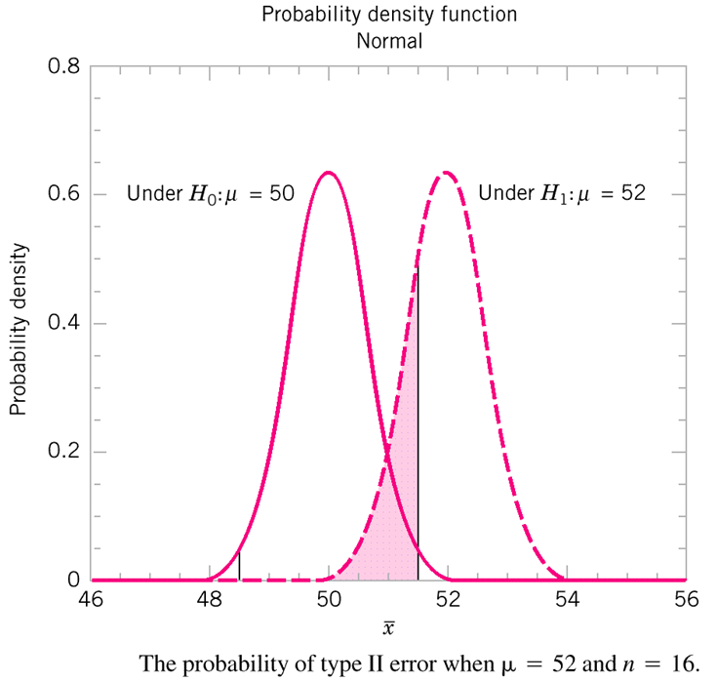
Computing the probability of a type II error may be the most difficult concept

Slide 62
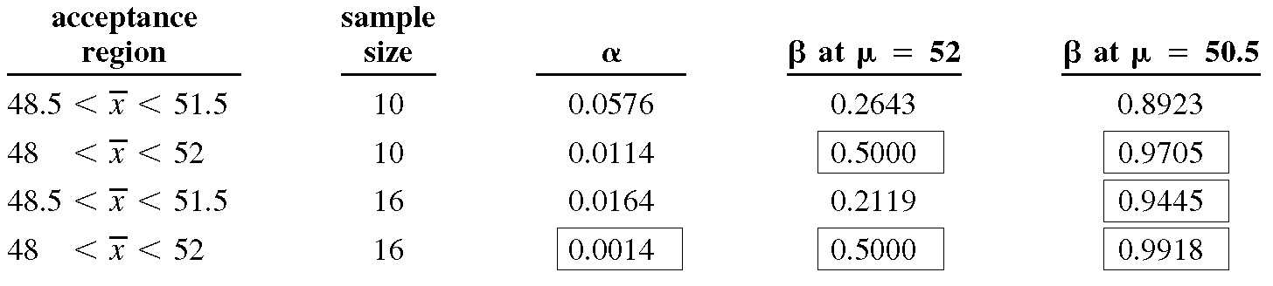
For constant n, increasing the acceptance region (hence decreasing α) increases β.
Increasing n, can decrease both types of errors.

Slide 63
Type I & II Errors Have an Inverse Relationship
If you reduce the probability of one error, the other one increases so that everything else is unchanged.
β
α

Slide 64
Factors Affecting Type II Error
True value of population parameter
Increases when the difference between hypothesized parameter and its true value decrease
Significance level
Increases when decreases
Population standard deviation
Increases when increases
Sample size
Increases when n decreases
n

Slide 65
How to Choose between Type I and Type II Errors
Choice depends on the cost of the errors
Choose smaller Type I Error when the cost of rejecting the maintained hypothesis is high
A criminal trial: convicting an innocent person
The Exxon Valdez: causing an oil tanker to sink
Choose larger Type I Error when you have an interest in changing the status quo
A decision in a startup company about a new piece of software
A decision about unequal pay for a covered group

Slide 66
Solving for Type II Errors: Example
Rejection
Region
α=.05
Non Rejection Region
Ζ=0
Notes:
35

Slide 67
Type II Error for Example with μ =11.99 Kg
Reject H_{o}
Do Not Reject H_{o}
Type I
Error
Correct
Decision
95%
α=.05
H_{o} is True
−1.645
0
Z₀
H_{o} is False
Correct
Decision
β=.8023
Type II
Error
19.77%
Z₁
−0.85
0
11.979
11.99
12
Notes:
36

Slide 68
Type II Error for Demonstration with μ=11.96 Kg
Reject H_{o}
Do Not Reject H_{o}
Type I
Error
Correct
Decision
95%
α=.05
H_{o} is True
−1.645
Z₀
0
H_{o} is False
Correct
Decision
β=.0708
Type II
Error
92.92%
Z₁
0
11.96
11.979
12
Notes:
37

Slide 69
Critical Values Approach to Testing
Convert sample statistic (e.g.: ) to test statistic (e.g.: Z, t or F –statistic)
Obtain critical value(s) for a specified from a table or computer
If the test statistic falls in the critical region, reject H₀
Otherwise do not reject H₀

Slide 70
p-Value Approach to Testing
Convert Sample Statistic (e.g. ) to Test Statistic (e.g. Z, t or F –statistic)
Obtain the p-value from a table or computer
p-value: Probability of obtaining a test statistic more extreme ( or ) than the observed sample value given H₀ is true
Called observed level of significance
Smallest value of that an H₀ can be rejected
Compare the p-value with
If p-value , do not reject H₀
If p-value , reject H₀

Slide 71
General Steps in Hypothesis Testing
e.g.: Test the assumption that the true mean number of of TV sets in U.S. homes is three ( Known)
State the H₀
State the H₁
Choose
Choose n
Choose Test

Slide 72
General Steps in Hypothesis Testing
(continued)
Set up critical value(s)
7. Collect data
8. Compute test statistic and p-value
9. Make statistical decision
10. Express conclusion
100 households surveyed
Computed test stat =-2, p-value = .0228
Reject null hypothesis
The true mean number of TV sets is less than 3
Reject H₀
α
Z
-1.645

Slide 73
One-tail Z Test for Mean ( Known)
Assumptions
Population is normally distributed
If not normal, requires large samples
Null hypothesis has or sign only
Z test statistic

Slide 74
Rejection Region
H₀: μ ≥ μ₀ H₁: μ < μ₀
H₀: μ ≤ μ₀ H₁: μ > μ₀
Reject H₀
Reject H₀
0
Z
0
Z
Z Must Be Significantly Below 0 to reject H₀
Small values of Z don’t contradict H₀ Don’t Reject H₀ !

Slide 75
Example: One Tail Test
Q. Does an average box of cereal contain more than 368 grams of cereal? A random sample of 25 boxes showed = 372.5. The company has specified σ to be 15 grams. Test at the α = 0.05 level.
368 gm.

Slide 76
Finding Critical Value: One Tail
Standardized Cumulative Normal Distribution Table (Portion)
What is Z given α = 0.05?
.05
Z
.04
.06
.95
1.6
.9495
.9505
.9515
α = .05
1.7
.9591
.9599
.9608
0
1.645
Z
1.8
.9671
.9678
.9686
Critical Value = 1.645
.9738
.9750
1.9
.9744

Slide 77
Example Solution: One Tail Test
H₀: μ ≤ 368 H₁: μ > 368
Test Statistic:
Decision:
Conclusion:
α = 0.5
n = 25
Critical Value: 1.645
Reject
.05
Do Not Reject at α = .05
0
1.645
Z
No evidence that true mean is more than 368
1.50

Slide 78
Confidence Intervals for µ
We can find confidence intervals for µ using the same reasoning as confidence intervals for p.
The big idea is to cover the middle 95% (or whatever our confidence level is) of the area of the normal curve (sampling distribution of x-bar), we must go out a distance of z* standard deviations on either side of the mean.
The standard deviation of the sampling distribution of x-bar (σ/√n) depends on the sample size n and the population standard deviation σ.
z* is the critical value for our confidence level from Table
The confidence interval will give us a reasonable range of values for our unknown population mean µ.

Slide 79
p -Value Solution
p-Value is P(Z ≥ 1.50) = 0.0668
Use the alternative hypothesis to find the direction of the rejection region.
P-Value =.0668
1.0000 - .9332 .0668
0
1.50
Z
From Z Table: Lookup 1.50 to Obtain .9332
Z Value of Sample Statistic

Slide 80
p -Value Solution
(continued)
(p-Value = 0.0668) ≥ (α = 0.05) Do Not Reject.
p Value = 0.0668
Reject
α = 0.05
0
Z
1.645
1.50
Test Statistic 1.50 is in the Do Not Reject Region

Slide 81
Example: Two-Tail Test
Q. Does an average box of cereal contain 368 grams of cereal? A random sample of 25 boxes showed = 372.5. The company has specified σ to be 15 grams. Test at the α = 0.05 level.
368 gm.

Slide 82
Example Solution: Two-Tail Test
H₀: μ = 368 H₁: μ ≠ 368
Test Statistic:
Decision:
Conclusion:
α = 0.05
n = 25
Critical Value: ±1.96
Reject
Do Not Reject at α = .05
.025
.025
No Evidence that True Mean is Not 368
-1.96
0
1.96
Z
1.50

Slide 83
p-Value Solution
(p Value = 0.1336) ≥ (α = 0.05) Do Not Reject.
p Value = 2 x 0.0668
Reject
Reject
α = 0.05
0
Z
1.50
1.96
Test Statistic 1.50 is in the Do Not Reject Region

Slide 84
Connection to Confidence Intervals

Slide 85
t Test: Unknown
Assumption
Population is normally distributed
If not normal, requires a large sample
T test statistic with n-1 degrees of freedom

Slide 86
Example: One-Tail t Test
Does an average box of cereal contain more than 368 grams of cereal? A random sample of 36 boxes showed X = 372.5, and s = 15. Test at the α = 0.01 level.
368 gm.
σ is not given

Slide 87
Example Solution: One-Tail
H₀: μ ≤ 368 H₁: μ > 368
Test Statistic:
Decision:
Conclusion:
α = 0.01
n = 36, df = 35
Critical Value: 2.4377
Reject
Do Not Reject at α = .01
.01
No evidence that true mean is more than 368
0
2.437
t₃₅
1.80

Slide 88
p -Value Solution
(p Value is between .025 and .05) ≥ (α = 0.01). Do Not Reject.
p Value = [.025, .05]
Reject
α = 0.01
0
t₃₅
1.80
2.4377
Test Statistic 1.80 is in the Do Not Reject Region

Slide 89
Proportion
Involves categorical values
Two possible outcomes
“Success” (possesses a certain characteristic) and “Failure” (does not possesses a certain characteristic)
Fraction or proportion of population in the “success” category is denoted by p

Slide 90
Proportion
(continued)
Sample proportion in the success category is denoted by p_{S}
When both np and n(1-p) are at least 5, p_{S} can be approximated by a normal distribution with mean and standard deviation

Slide 91
Example: Z Test for Proportion
Q. A marketing company claims that it receives 4% responses from its mailing. To test this claim, a random sample of 500 were surveyed with 25 responses. Test at the α = .05 significance level.

Slide 92
Z Test for Proportion: Solution
H₀: p = .04 H₁: p ≠ .04
Test Statistic:
α = .05
n = 500
Decision:
Critical Values: ± 1.96
Do not reject at α = .05
Reject
Reject
Conclusion:
.025
.025
We do not have sufficient evidence to reject the company’s claim of 4% response rate.
Z
-1.96
0
1.96
1.14

Slide 93
p -Value Solution
(p Value = 0.2542) ≥ (α = 0.05). Do Not Reject.
p Value = 2 x .1271
Reject
Reject
α = 0.05
0
Z
1.14
1.96
Test Statistic 1.14 is in the Do Not Reject Region

