Slide 1
Fans vs. Haters:
A Brief Text Analysis on tweets about Apple
Shuheng Li
Xinyi Liu

Slide 2


Shut up and give me your $$$

Slide 3




SuperSteveJobsFan@luoyonghao · 3m
I have to say, Apple has by far the best customer care service I have ever received! @Apple @AppStore"
CNDotaBestDota @xiaomiboy · 2d
you guys are cheep little freaks and I hope u get testicular cancer and loose a nut @apple

Slide 4
Sentiment Scoring
And Data Cleaning

Slide 5

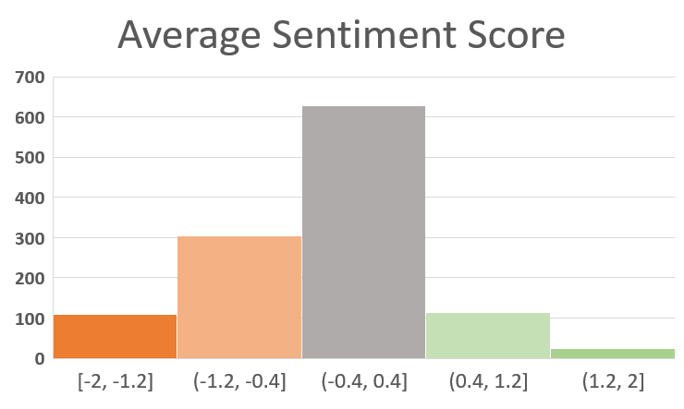
Human-labeled Sentiment score
Strongly Negative
Negative
Neutral
Positive
Strongly Positive

Slide 6
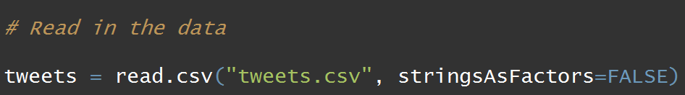
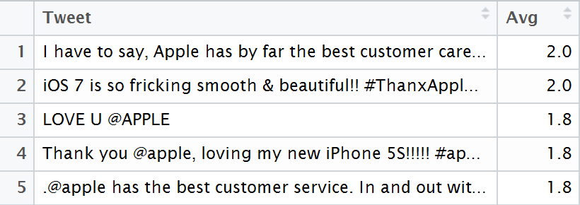
Read data

Slide 7
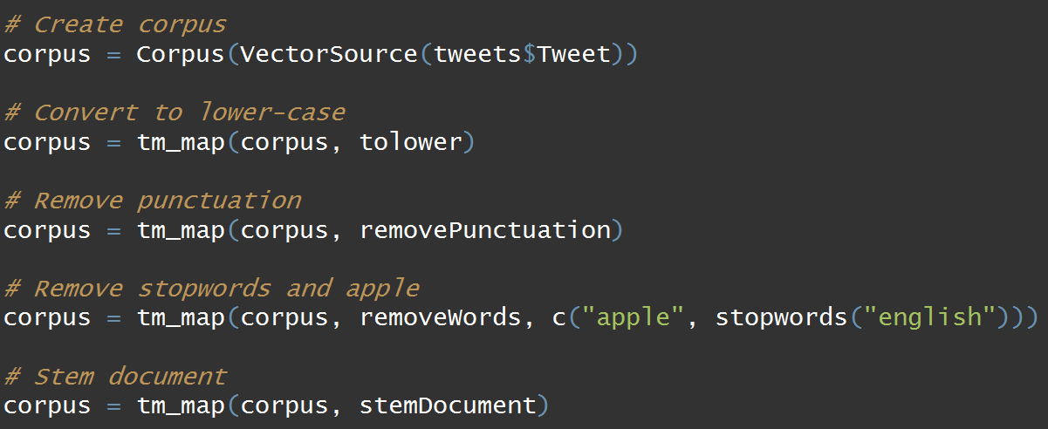
I have to say, Apple has by far the best customer care service I have ever received! @Apple @AppStore
i have to say, apple has by far the best customer care service i have ever received! @apple @appstore
i have to say apple has by far the best customer care service i have ever received apple appstore
say far best customer care service ever received appstore
say far best custom care servic ever receiv appstor

Slide 8
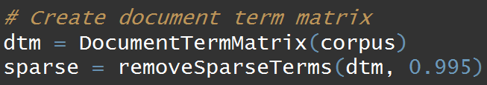

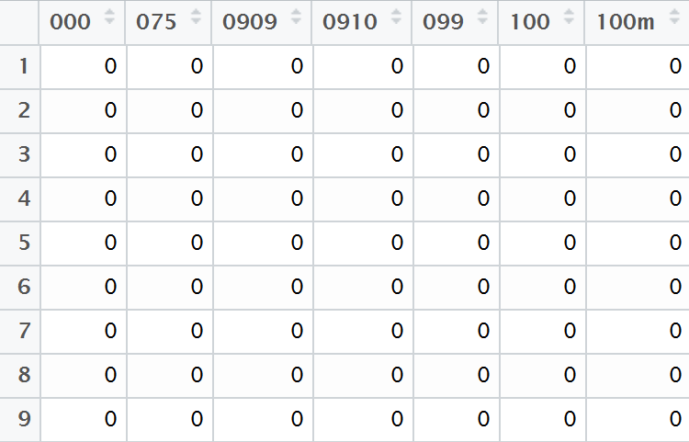
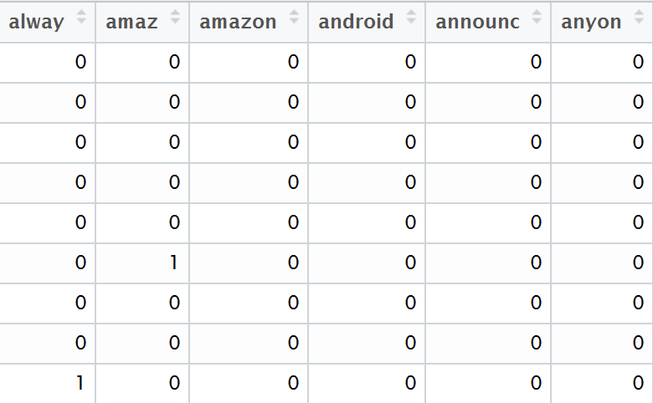
Document Term Matrix Using Bag-of-Words

Slide 9
Visualization

Slide 10
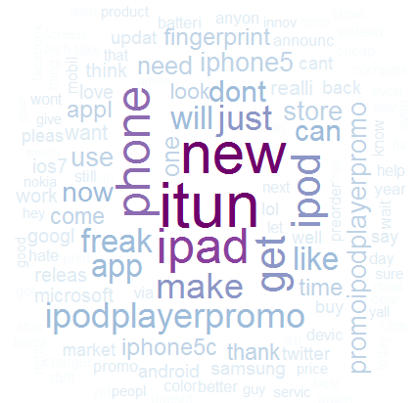
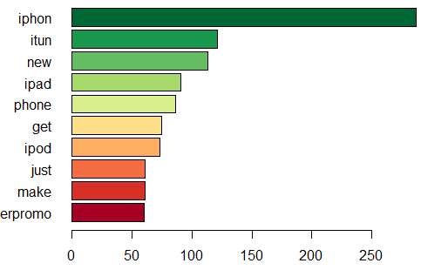
Most Frequent words

Slide 11
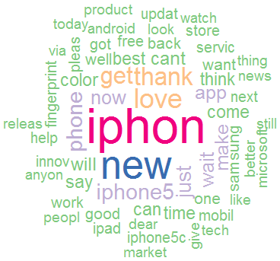
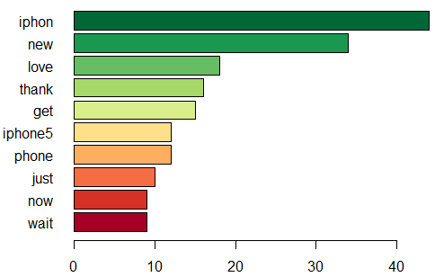
Most Frequent words by sentiment - Positive

Slide 12
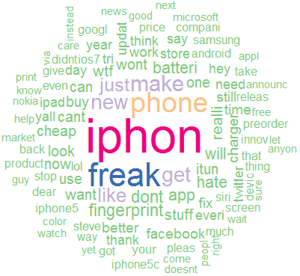
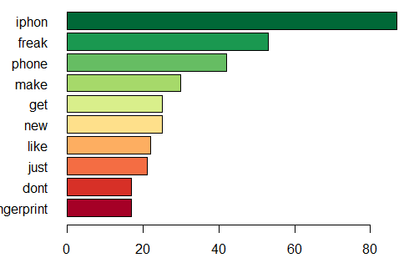
Most Frequent words by sentiment - Negative

Slide 13
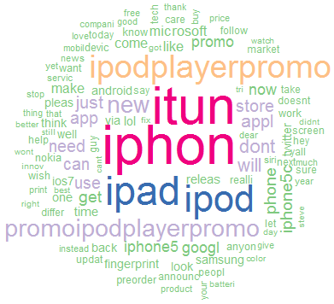
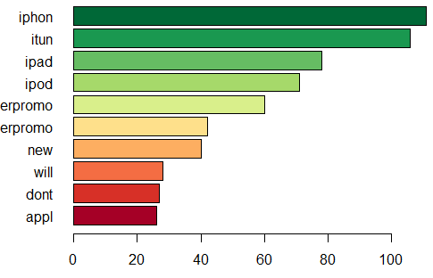
Most Frequent words by sentiment - Neutral

Slide 14
There’s more we can do…

Slide 15
THANK YOU
Reference: MITx: 15.071x The Analytics Edge
Project URL:
https://github.com/lxy11282/Simple-Tweet-Text-Analysis

